Slide 1
Sensors and Transducers
E80 Spring 2015
Erik Spjut

Slide 2
What Motors Will You Fly?
Motor Lottery/Draft at 9:35 AM on Tuesday, 10 MAR 2015.
List on http://www.eng.hmc.edu/NewE80/RocketLaunchLab.html#Motors
Those with * require an extra-long motor mount and MUST be reinforced with a layer of fiberglass.

Slide 3
Scientific & Engineering Measurements
Scientific Measurements
  What you measure with a rocket.
  What are examples?
Engineering Measurements
  What you measure about a rocket.
  What are examples?

Slide 4
Experimental Measurements
Mass
Force
Acceleration
Velocity
Position
Displacement
Orientation
Vibration
EM Intensity
  Radio
  Microwave
  IR
  Visible
  UV
  X-ray
  Gamma

Slide 5
Experimental Measurements II
Temperature
Pressure
Flow Rate
Composition
  Partial Pressure
  Humidity
  Mass fraction
  Mole fraction
  pH
Phases
  Aerosols
  Suspensions
  Microstructure
Sound
Images
Video

Slide 6
Experimental Measurements III
Electrical
  Voltage
  Charge
  Current
  Resistance
  Inductance
  Capacitance
  Power
Time
Frequency
Phase
Angular
  Position
  Velocity
  Acceleration

Slide 7
Digikey’s List of Sensors
Accelerometers (1069 items)
Accessories (3933 items)
Amplifiers (312 items)
Capacitive Touch Sensors, Proximity Sensor ICs (569 items)
Color Sensors (126 items)
Current Transducers (1555 items)
Dust Sensors (17 items)
Encoders (4286 items)
Flex Sensors (3 items)
Float, Level Sensors (533 items)
Flow Sensors (177 items)
Force Sensors (76 items)
Gas Sensors (69 items)
Gyroscopes (246 items)
Image Sensors, Camera (354 items)
Inclinometers (44 items)
IrDA Transceiver Modules (294 items)
LVDT Transducers (Linear Variable Differential Transformer) (153 items)
Magnetic Sensors - Compass, Magnetic Field (Modules) (23 items)
Magnetic Sensors - Hall Effect, Digital Switch, Linear, Compass (ICs) (3023 items)
Magnetic Sensors - Position, Proximity, Speed (Modules) (3641 items)
Magnets (101 items)
Moisture Sensors, Humidity (354 items)
Motion Sensors, Detectors (282 items)
Multifunction (80 items)
Optical Sensors - Ambient Light, IR, UV Sensors (639 items)
Optical Sensors - Distance Measuring (45 items)
Optical Sensors - Mouse (117 items)
Optical Sensors - Photo Detectors - CdS Cells (48 items)
Optical Sensors - Photo Detectors - Logic Output (131 items)
Optical Sensors - Photo Detectors - Remote Receiver (1139 items)
Optical Sensors - Photodiodes (990 items)
Optical Sensors - Photoelectric, Industrial (11099 items)
Optical Sensors - Photointerrupters - Slot Type - Logic Output (1078 items)
Optical Sensors - Photointerrupters - Slot Type - Transistor Output (1164 items)
Optical Sensors - Phototransistors (781 items)
Optical Sensors - Reflective - Analog Output (325 items)
Optical Sensors - Reflective - Logic Output (130 items)
Position Sensors - Angle, Linear Position Measuring (1213 items)
Pressure Sensors, Transducers (26694 items)
Proximity Sensors (3759 items)
Proximity/Occupancy Sensors - Finished Units (236 items)
RTD (Resistance Temperature Detector) (60 items)
Shock Sensors (18 items)
Solar Cells (85 items)
Specialized Sensors (359 items)
Strain Gages (21 items)
Temperature Regulators (3803 items)
Temperature Sensors, Transducers (1031 items)
Temperature Switches (719 items)
Thermistors - NTC (4972 items)
Thermistors - PTC (1253 items)
Thermocouple, Temperature Probe (399 items)
Tilt Sensors (54 items)
Ultrasonic Receivers, Transmitters (77 items)
Vibration Sensors (35 items)

Slide 8
What Spec’s Do We Care About?
Quantity Measured
Range or Span
Accuracy
Precision
Noise
Linearity
Speed of Response
Voltage Requirements
Current Requirements
Output Impedance
Mounting Requirements

Slide 9
Example – Altimeter
Measure Absolute Pressure and Calculate Altitude
  What range of pressures do we need?
  What accuracy do we expect?

Slide 10
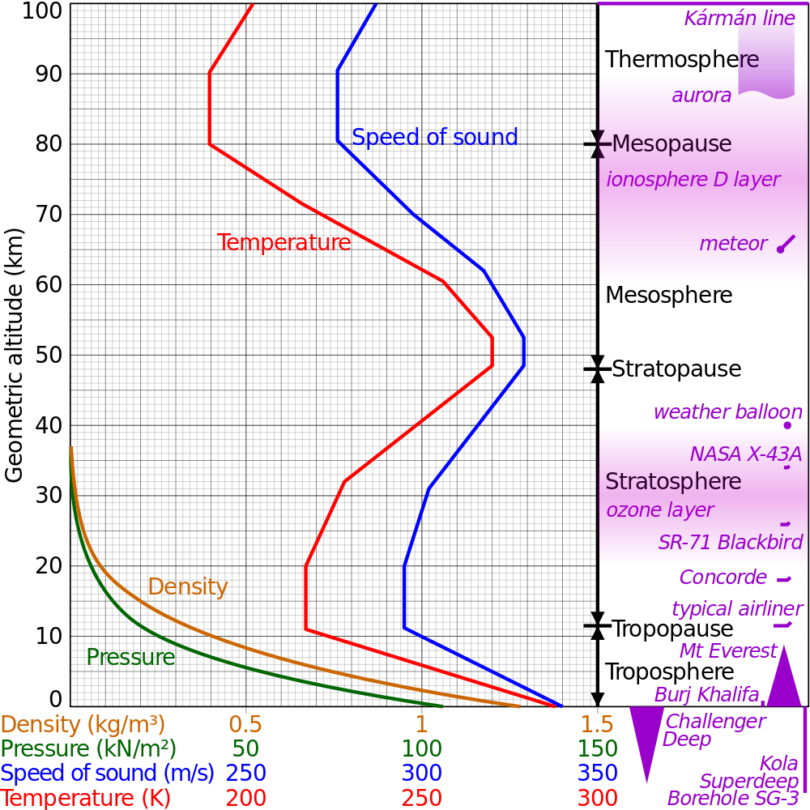
Calculate Altitude from Pressure
US Standard Atmosphere
http://en.wikipedia.org/wiki/File:Comparison_US_standard_atmosphere_1962.svg

Slide 11
For the Troposphere
where
  h = geopotential altitude (above sea level) (in meters)
  P₀ = standard atmosphere pressure = 101325Pa
  T₀ = 288.15K (+15°C)
  dT/dh = –0.0065 K/m: thermal gradient or standard temperature lapse rate
  R = 8.31432 Nm/mol K (Current NIST value 8.3144621)
  g = 9.80665 m/s²
  M = 0.0289644 kg/mol
From 1976 US Standard Atmosphere

Slide 12
How Does Pressure Vary With Height?
Alt. (m) | Alt. (ft) | Alt. (mi) | P (Pa) | dP/dh (Pa/m)
0 | 0 | 0.000 | 101325 | -12.01
200 | 656 | 0.124 | 98945 | -11.78
400 | 1312 | 0.249 | 96610 | -11.56
600 | 1969 | 0.373 | 94321 | -11.34
800 | 2625 | 0.497 | 92076 | -11.12
1000 | 3281 | 0.621 | 89874 | -10.90
1200 | 3937 | 0.746 | 87715 | -10.69
1400 | 4593 | 0.870 | 85598 | -10.48
1600 | 5249 | 0.994 | 83522 | -10.27
1800 | 5906 | 1.118 | 81488 | -10.07
2000 | 6562 | 1.243 | 79494 | -9.87
2200 | 7218 | 1.367 | 77540 | -9.67
2400 | 7874 | 1.491 | 75624 | -9.48
2600 | 8530 | 1.616 | 73747 | -9.29

Slide 13
Calculate Flight Height

Slide 14
Assume 1 Mile AGL Max Alt
Lucerne Valley at 3000 ft MSL, Claremont 1200 ft
P_{ground} = 90 kPa
P_{apogee} = 74 kPa
Span = ∆P = 16 kPa
Need to allow for Barometric Pressure Changes +7% to –13%
P_{max} = MAX(104 kPa, 97 kPa)
P_{min} = 64 kPa

Slide 15
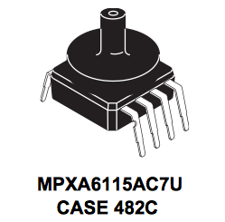
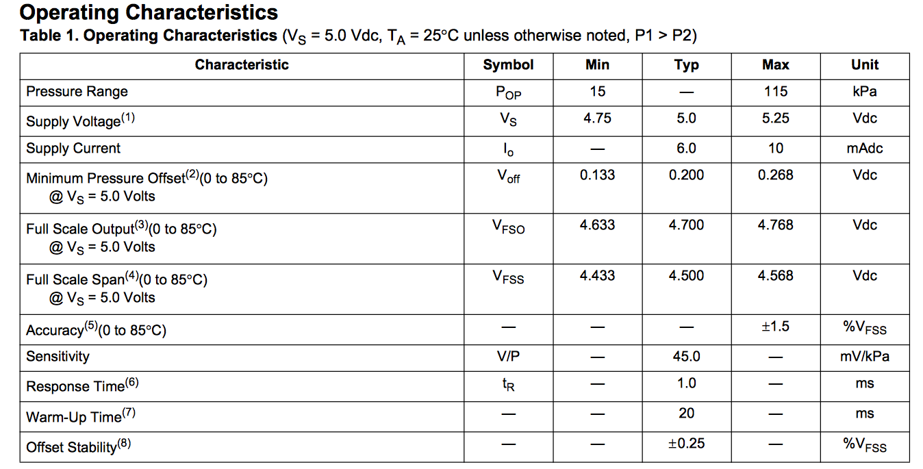
MPXA6115AC7U
From Freescale Data Sheet

Slide 16
Nominal Values
V @ P_{min}= 0.200 V + (64 kPa – 15 kPa)•0.045 V/kPa = 2.41 V
V @ P_{max} = 0.200 + (104 kPa – 15 kPa)•0.045 V/kPa = 4.21 V
Accuracy (Uncalibrated) ±1.5% V_{FS} = ±1.5%•4.7 V = ±0.071 V = ±1.57 kPa = ±157 m
t_{R10%-90%} = 1.0 ms, τ = t_{R10%-90%}/ln(9) = 0.46 ms

Slide 17
Output Impedance
Can drive circuit with 0.5 mA at 4.7 V
Impedance of driven circuit = V/I = 4.7 V/0.0005 A = 9400 Ω.
Actual output impedance determined empirically. How?

Slide 18
Choices on Conditioning
Data Logger
  0 V to 3.3 V
  Input Impedance ~2200 Ω
  16 bit, 1 LSB = 3.3 V/2¹⁶ = 50 µV
Change gain so V_{max} = 3.3 V
  1 LSB = 50 µV = 0.16 m = 6 in
Change gain and offset so V_{min} = 0 V & V_{max} = 3.3 V
  1 LSB = 50 µV = 0.06 m = 2.4 in

Slide 19
Signal Conditioning
Does it need a buffer amp? How would you know?
How do you change the gain?
How do you change the gain and offset?
What about aliasing?

Slide 20
Single-Sided Circuits
(Will visit again under Flight Hardware)
Data logger expects 0 V to 3.3 V signals
Classical op-amp circuit power ±15 V
Low-voltage op-amp circuit power
  ±1.4 V to ±3 V
  0-to-2.8 V to 0-to-6 V
Signal offset
Reference offset
Virtual ground

Slide 21
Inverting Amps

Slide 22
Non-Inverting Amps

Slide 23
Can You do Single Sided for:
Differential Amplifier?
Integrator?
Transimpedance Amplifier?
Sallen-Key Filter?
Bipolar sensor like piezoelectric vibration?

Slide 24
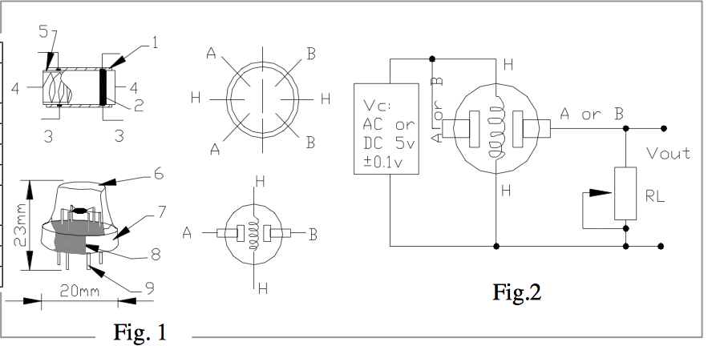
Example – Gas Sensor
MQ-2 CH₄ Gas Sensor (Digikey, Parallax, or Pololu)

Slide 25
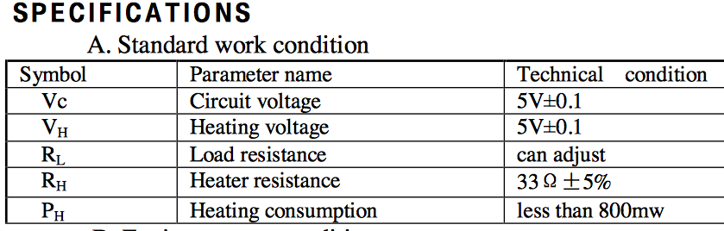
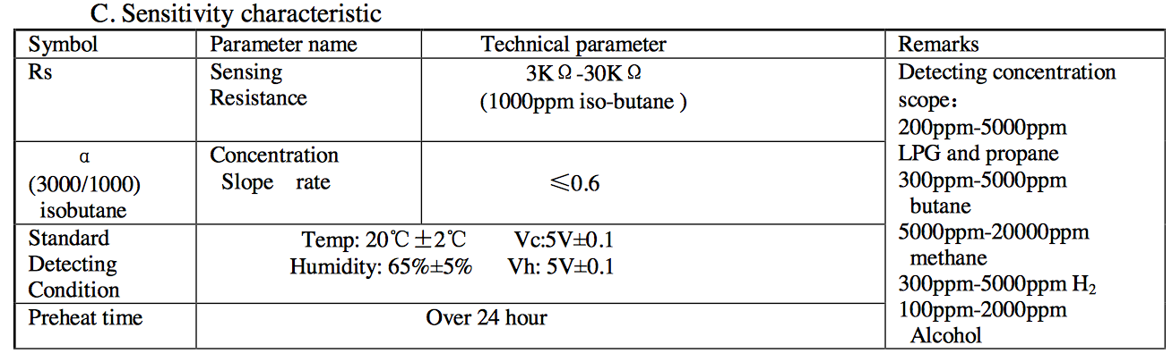
Other Specs

Slide 26
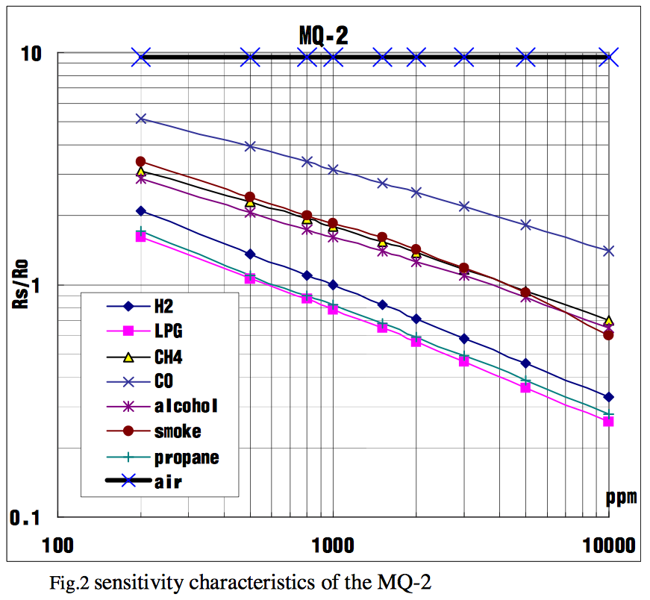
Sensitivity

Slide 27
Power Calculations
5 V @ 800 mW = 160 mA.
5 V @ 33 Ω = 150 mA.
Standard 9 V battery is ~250 mAh
  Would last about 1 ½ hours
  Separate battery for sensor and system.

Slide 28
Signal Conditioning
Must get air to sensor.
Resistance changes with gas concentration.
Designed to work in voltage divider.
Need R in range of approx. 3 kΩ to 30 kΩ.
Need buffer amp.
What is time constant?
http://www.parallax.com/catalog/sensors/gas for more info

Slide 29

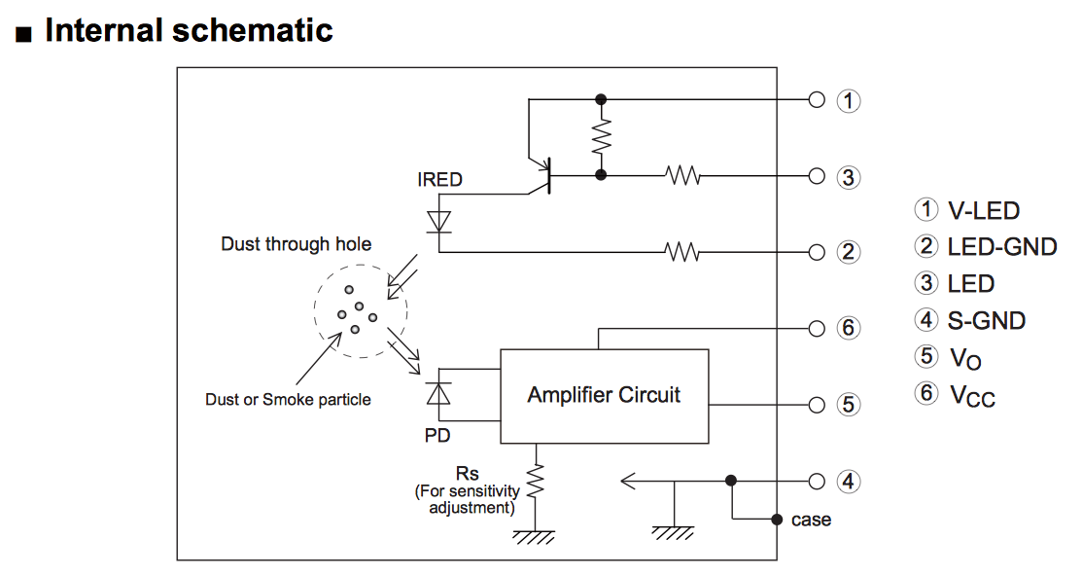
Example – Particle Sensor

Slide 30
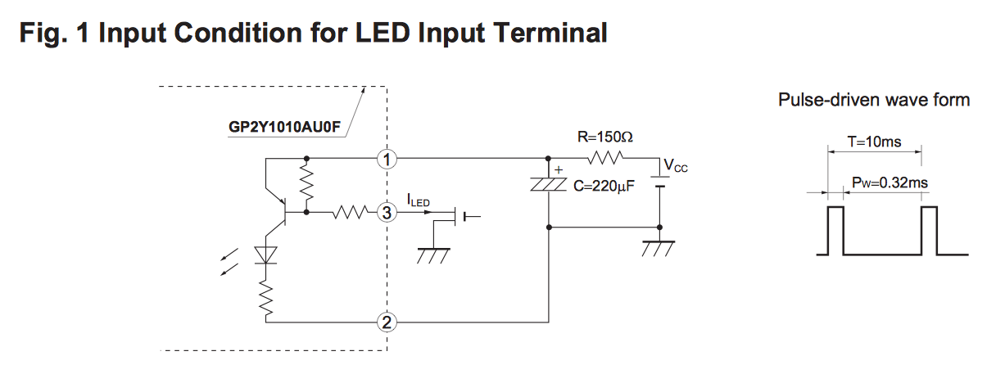
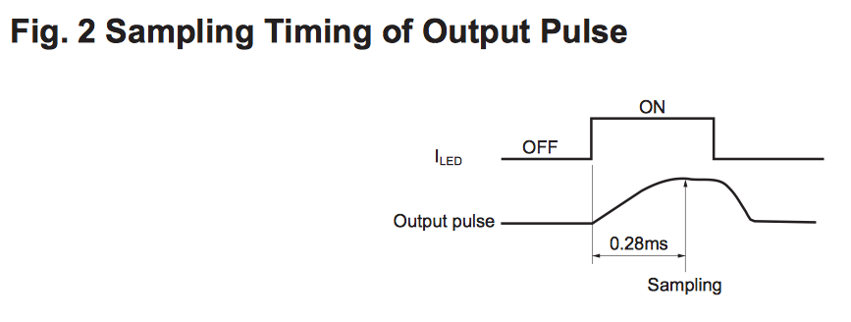
Driving & Reading Circuits

Slide 31
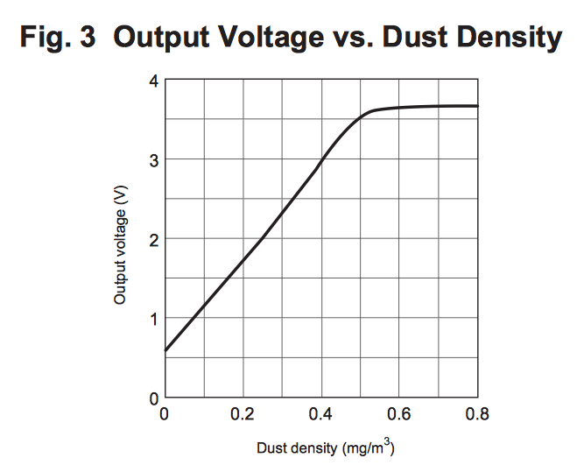
Output & Caution

Slide 32


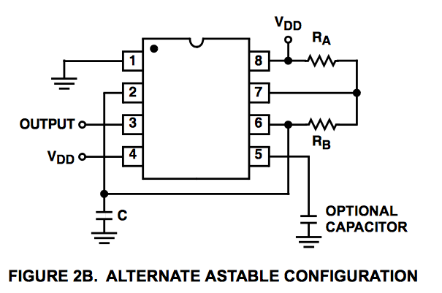
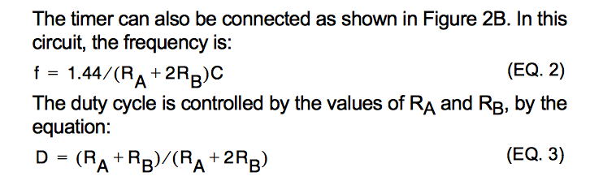
Driving Circuit
D must be ≥ 0.5
See http://www.physics.udel.edu/~nowak/phys645/555%20timer%20lab_files/555%20timer%20lab.pdf
for alternate duty cycle control

Slide 33
Reading Circuit
Pulse Width 0.32 ms
Minimum 1 point
Best 10 points
Sample rate = 10/0.32 ms = 31.25 kSPS

Slide 34
Could You Do Better?
IRED and Driver
Photodiode & Reading Circuit
Mechanical & Optical Chamber
Start at http://en.wikipedia.org/wiki/Particle_counter for more information

Slide 35
Example – Humidity Sensor
Check out Digikey
  http://www.digikey.com/product-search/en?FV=fff4001e%2Cfff80274&mnonly=0&newproducts=0&ColumnSort=1000011&page=1&stock=0&pbfree=0&rohs=0&quantity=1&ptm=0&fid=0&pageSize=25
Digital, I²C – 18 s response time
Capacitive – 15 s, 5 s response time
Linear Voltage – 5 s response time

Slide 36
Digital, I²C
Need microcontroller, e.g., Arduino Pro Mini 328 - 3.3V/8MHz <Sparkfun>
Power separately from data logger
Must synchronize
Must program

Slide 37
Capacitive
How do you measure capacitance?
  Put in a timer circuit
  Put in an integrator
  Put in a voltage divider

Slide 38
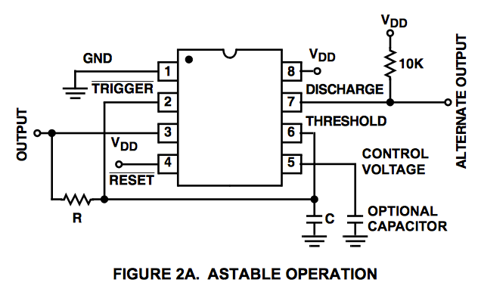

In a Timer Circuit

Slide 39
HS1101LF (Capacitive)

Slide 40
HS1101LF continued

Slide 41
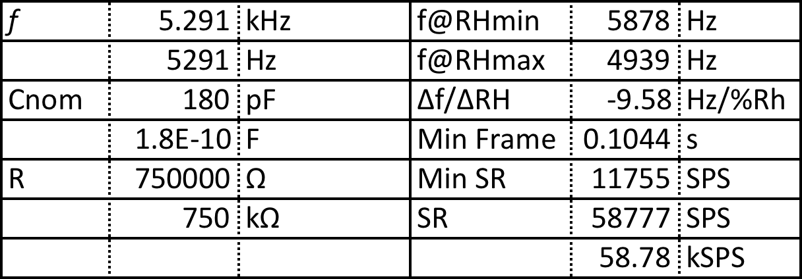
Timer Calc’s
The sample rate will need to be twice the frequency and preferably 10X. The frame size needs to be the reciprocal of the frequency resolution

Slide 42
Integrator

Slide 43
Issues
Easiest input is constant voltage
  Output is then a ramp
  Calculate C from ramp slope or time to V_{set}.
  Ramp up or down? Single-sided supply?
How control reset switch?
  Solid state switch
  Signal generator
  Comparator
Are you just making an oscillator?

Slide 44
Voltage Divider
Need sinusoidal input

Slide 45
Voltage Divider Performance

Slide 46
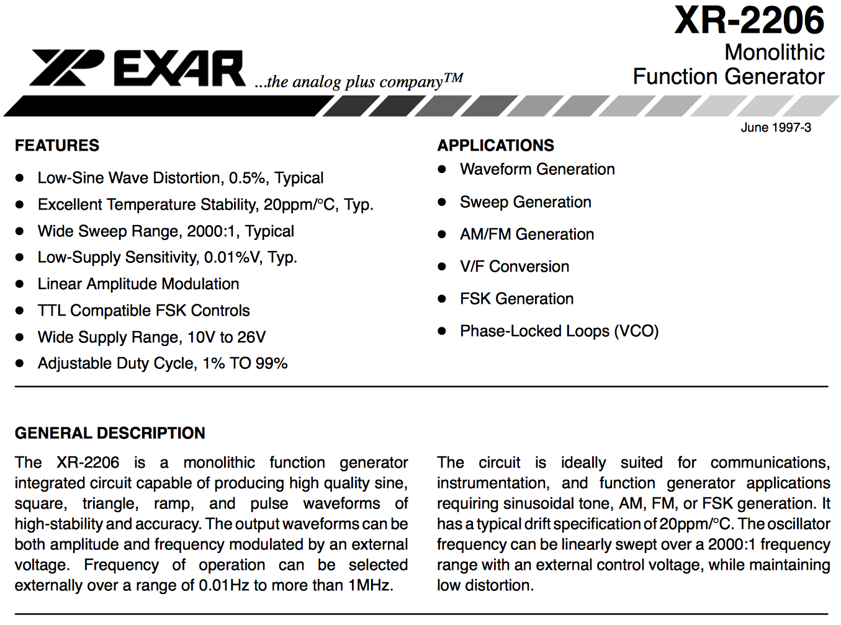
How Do You Generate a Sine Wave?
Available on eBay
What killed it?

Slide 47
How Do You Generate a Sine Wave?
http://www.valvewizard.co.uk/signalgenerator.pdf
http://arduino.cc/en/Tutorial/DueSimpleWaveformGenerator
http://www.analog.com/media/en/technical-documentation/data-sheets/AD9833.pdf

Slide 48
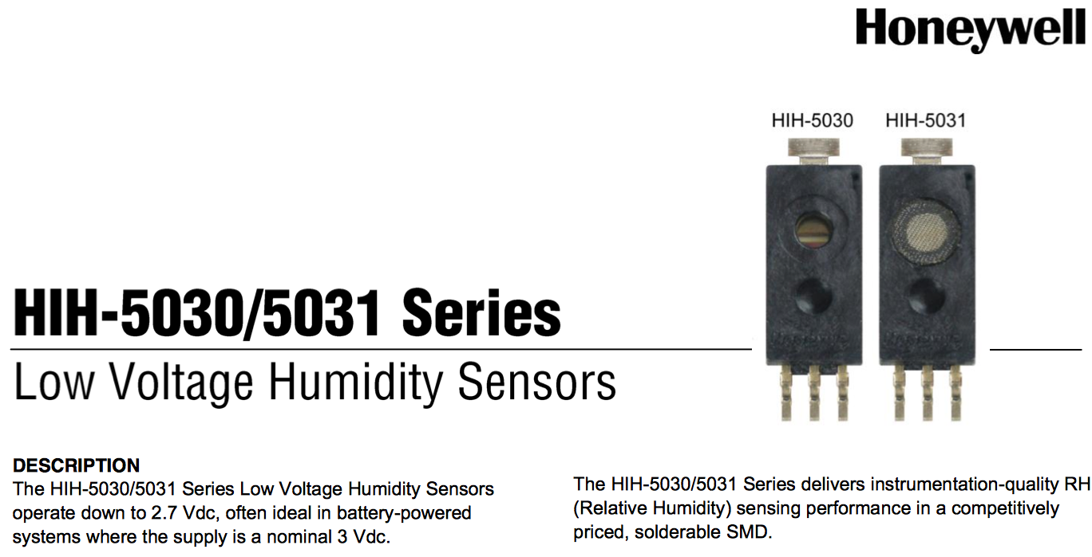
Linear Voltage

Slide 49
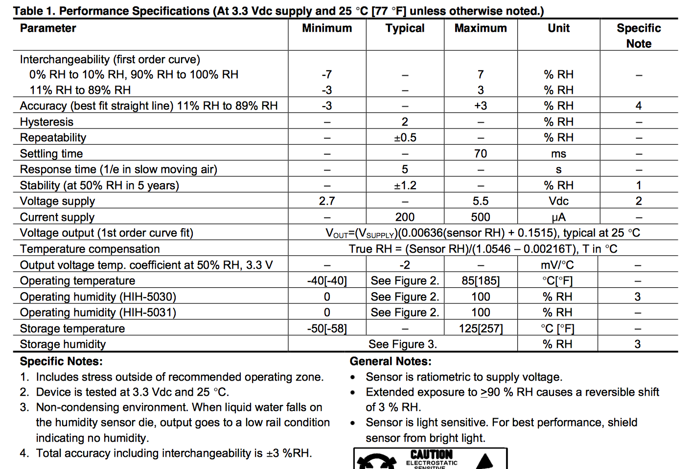

Slide 50
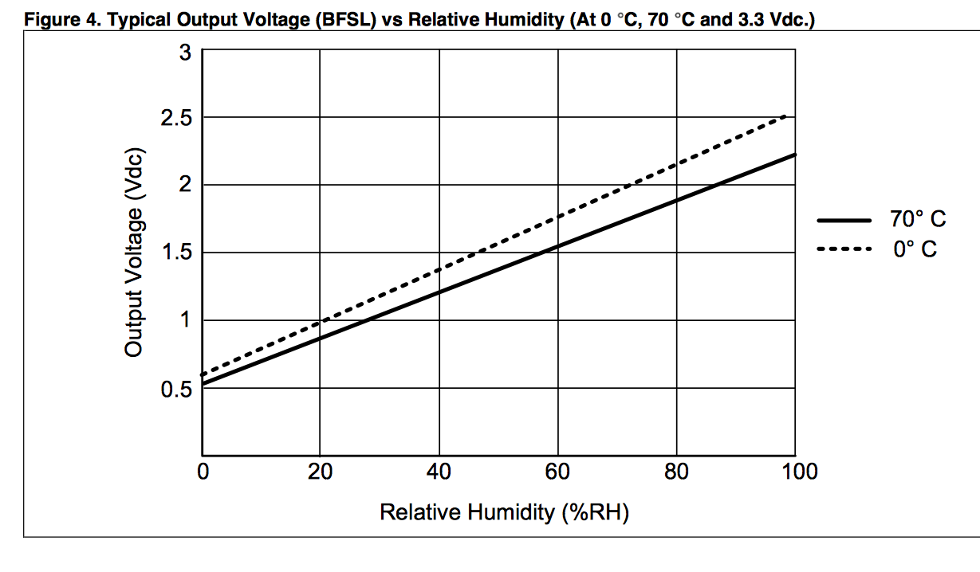

Slide 51
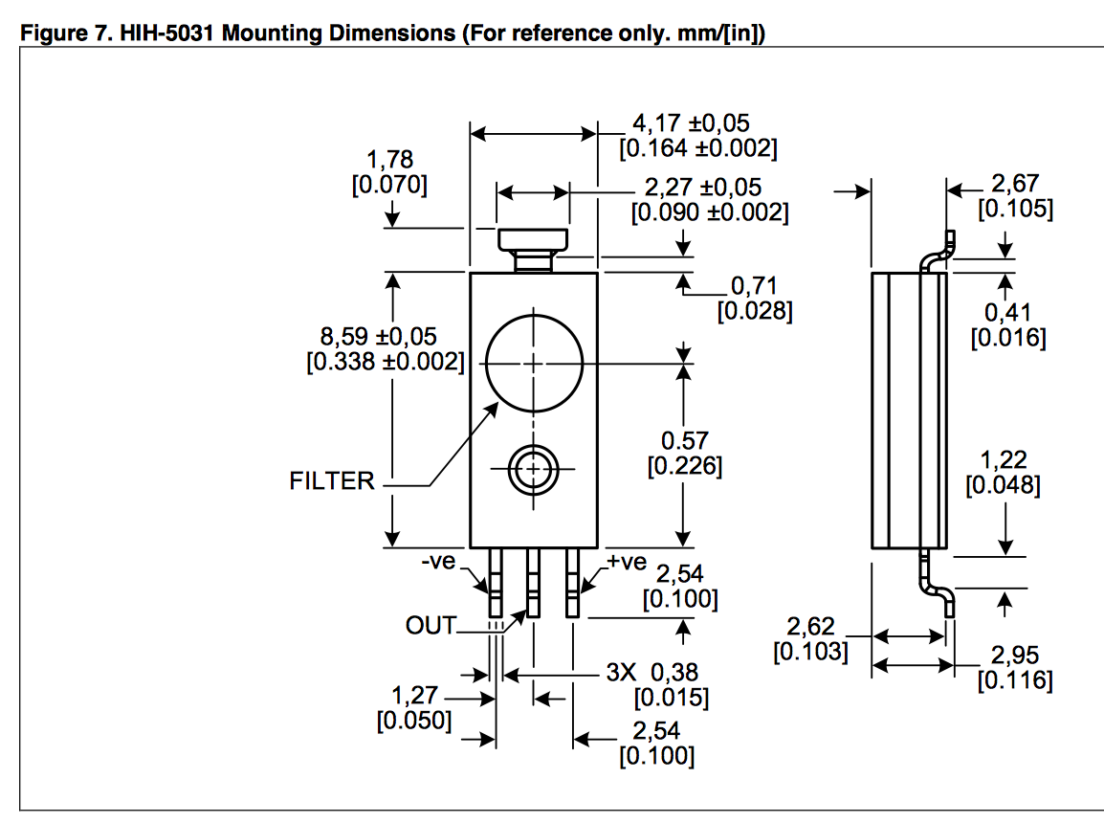
The challenges are how and where to connect it, how and where to mount it, and how to get airflow over it.

Slide 52
Where to look for sensors
Digikey: http://www.digikey.com
Mouser: http://www.mouser.com
Arrow: http://www.arrow.com
Sparkfun: https://www.sparkfun.com
Pololu: https://www.pololu.com
Parallax: http://www.parallax.com
SGX Sensortech: http://sgx.cdistore.com

