Slide 1
Measuring Things
E80 Spring 2015

Slide 2
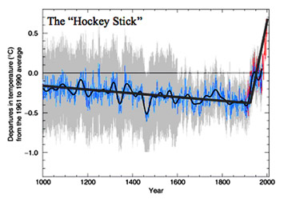
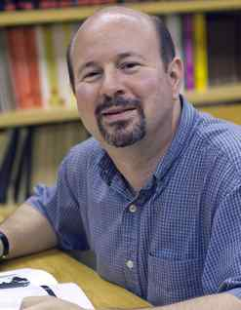
Why do we care?
Who is this man?
Notes:
Michael Mann, the director of Pennsylvania State University's Earth System Science Center

Slide 3
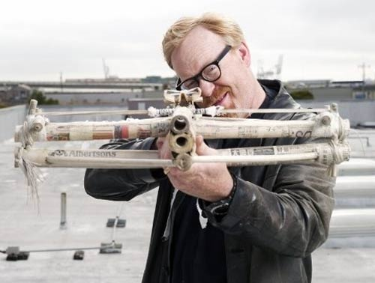
Your Mission
Mythbuster Tech Advisor
Testing Arrows for a crossbow

Slide 4
Brand 1 Arrows

Slide 5
Brand 2 Arrows

Slide 6
Brand 3 Arrows

Slide 7
Brand 4 Arrows

Slide 8
Crossbow Questions
Where is the center of the distribution, i.e., what is the aiming point?
How certain are you?
If we aim the crossbow at the apple, how likely is BusterTM to get an arrow in the head?

Slide 9
Measured Value
Where is the center of the distribution, i.e., where should we put the target?
Use the sample mean.

Slide 10
Error Estimate
How certain are you?
Use Estimated Standard Error and Student’s t-test

Slide 11
Students t-test
SIGNIFICANCE LEVEL FOR TWO-TAILED TEST
df | .20 | .10 | .05 | .02 | .01 | .001
1 | 3.078 | 6.314 | 12.706 | 31.821 | 63.657 | 636.619
2 | 1.886 | 2.920 | 4.303 | 6.965 | 9.925 | 31.598
3 | 1.638 | 2.353 | 3.182 | 4.541 | 5.841 | 12.941
4 | 1.533 | 2.132 | 2.776 | 3.747 | 4.604 | 8.610
5 | 1.476 | 2.015 | 2.571 | 3.365 | 4.032 | 6.859
10 | 1.372 | 1.812 | 2.228 | 2.764 | 3.169 | 4.587
20 | 1.325 | 1.725 | 2.086 | 2.528 | 2.845 | 3.850
30 | 1.310 | 1.697 | 2.042 | 2.457 | 2.750 | 3.646
40 | 1.303 | 1.684 | 2.021 | 2.423 | 2.704 | 3.551
60 | 1.296 | 1.671 | 2.000 | 2.390 | 2.660 | 3.460
120 | 1.289 | 1.658 | 1.980 | 2.358 | 2.617 | 3.373
∞ | 1.282 | 1.645 | 1.960 | 2.326 | 2.576 | 3.291

Slide 12
Spread of Data
If we aim the crossbow at the apple, how likely is BusterTM to get an arrow in the head?
Use sample standard deviation

Slide 13
Linear Fits
How about fitting lines to sets of data?
Use linear least squares fit.

Slide 14
How Certain Are We?
How good are the betas?

Slide 15
Why? Because!
How certain is the calculated value of y for a chosen x?
If we experimentally set x, how will the experimental y’s spread (The arrow in the head question)?
Use S_{e} like you previously used S.

Slide 16
What About Functions?
What if you want T?
and you measure β and R?

Slide 17
How error in x affects F(x)

Slide 18
Error Propagation
For
Let

Slide 19
Thermistor Example

Slide 20
Results
 | Nom. Value | error% | error | error term
β | 4261 | 1% | 42.61 | 0.23
R (Ω) | 3,700,000 | 10% | 370000 | 1.75
T (K) | 273.14 |  |  | 1.77
T₀ (K) | 298.15
R₀ (Ω) | 1000000

Slide 21
What if you hate calculus?
You can do the whole thing on a spreadsheet with no calculus.
Value | Nominal | β + 1% | β – 1% | R + 10% | R – 10%
T₀ (K) | 298.15 | 298.15 | 298.15 | 298.15 | 298.15
R₀ (Ω) | 1,000,000 | 1,000,000 | 1,000,000 | 1,000,000 | 1,000,000
β | 4261 | 4303.61 | 4218.39 | 4261 | 4261
R (Ω) | 3,700,000 | 3,700,000 | 3,700,000 | 4,070,000 | 3,330,000
T (K) | 273.14 | 273.37 | 272.91 | 271.49 | 275.00
∆T (K) |  | 0.46 |  | -3.52
error (K) | 3.55
±error (K) | 1.77

Slide 22
Steinhart-Hart Example

Slide 23
 | Nom. Value | error% | error | error term
A₁ | 3.354016E-03 | 0.1% | 3.35402E-06 | 0.318
B₁ | 2.460382E-04 | 1% | 2.46038E-06 | -0.104
C₁ | 3.405377E-06 | 1% | 3.40538E-08 | 0.001
D₁ | 1.034240E-07 | 1% | 1.03424E-09 | 0.000
R (Ω) | 64080 | 3% | 1922.4 | 0.692
T (K) | 308.15 |  |  | 0.769
R_{ref} | 100,000

Slide 24
Calculus free style
Value | Nominal | A₁ +0.1% | A₁ –0.1% | B₁ +1% | B₁ –1% | C₁ +1% | C1 –1% | D₁ +1% | D₁ –1% | R +3% | R –%
A₁ | 0.003354016 | 0.00335737 | 0.003350662 | 0.003354016 | 0.003354016 | 0.003354016 | 0.003354016 | 0.003354016 | 0.003354016 | 0.003354016 | 0.003354016
B₁ | 0.000246038 | 0.000246038 | 0.000246038 | 0.000248499 | 0.000243578 | 0.000246038 | 0.000246038 | 0.000246038 | 0.000246038 | 0.000246038 | 0.000246038
C₁ | 3.40538E-06 | 3.40538E-06 | 3.40538E-06 | 3.40538E-06 | 3.40538E-06 | 3.43943E-06 | 3.37132E-06 | 3.40538E-06 | 3.40538E-06 | 3.40538E-06 | 3.40538E-06
D₁ | 1.03424E-07 | 1.03424E-07 | 1.03424E-07 | 1.03424E-07 | 1.03424E-07 | 1.03424E-07 | 1.03424E-07 | 1.04458E-07 | 1.0239E-07 | 1.03424E-07 | 1.03424E-07
R_{ref} | 100,000 | 100,000 | 100,000 | 100,000 | 100,000 | 100,000 | 100,000 | 100,000 | 100,000 | 100,000 | 100,000
R | 64,080 | 64,080 | 64,080 | 64,080 | 64,080 | 64,080 | 64,080 | 64,080 | 64,080 | 66,002 | 62,158
T_{calc} | 308.15 | 307.83 | 308.47 | 308.25 | 308.04 | 308.15 | 308.15 | 308.15 | 308.15 | 307.47 | 308.85
∆T |  | -0.64 |  | 0.21 |  | 0.00 |  | 0.00 |  | -1.39
error | 1.539
error ± | 0.769

Slide 25
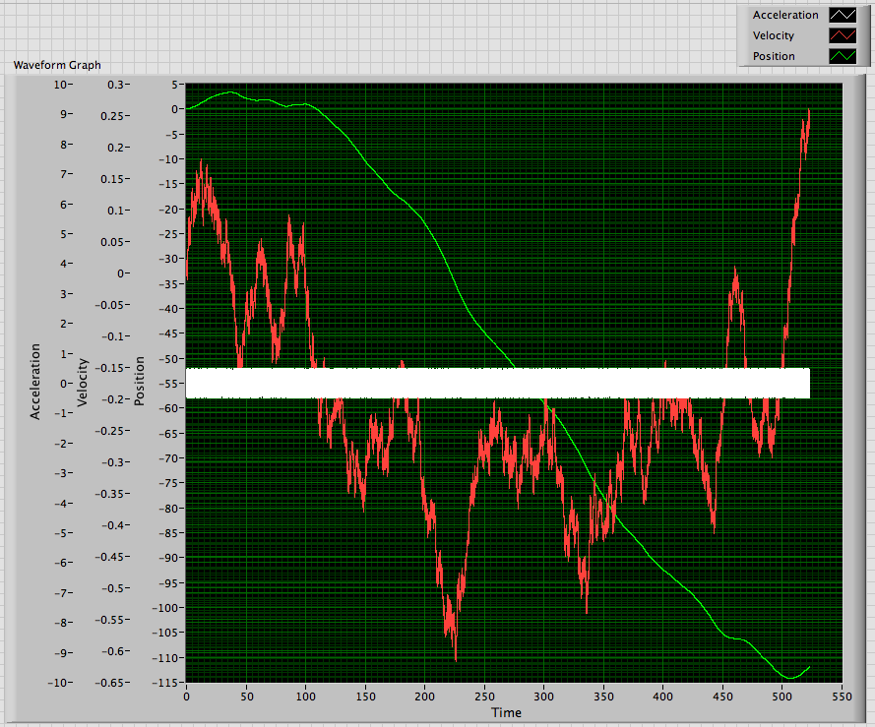
What happens to Integrals?

Slide 26
Finite Precision?
Calculate or determine the quantization range, q, e.g., for a ±5V, 12-bit DAQ:
If ignore quantization
If include as
If confidence interval is

Slide 27
Resources
Data Analysis Lecture Notes
http://www.eng.hmc.edu/NewE80/PDFs/DataAnalysisLecNotes2015.pdf
NIST Engineering Statistics Handbook
http://www.itl.nist.gov/div898/handbook/
ISO Guide to the Expression of Uncertainty in Measurement
http://www.iso.org/sites/JCGM/GUM/JCGM100/C045315e-html/C045315e.html?csnumber=50461

