Slide 1
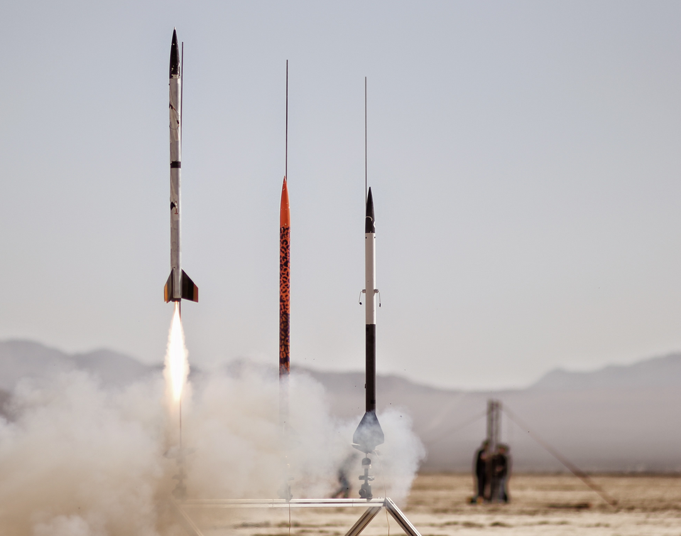
Engineering 80 – Spring 2015 Flight Hardware

Slide 2
Three Words You Should Know!
MAKE IT HAPPEN

Slide 3
MAKING IT HAPPEN

Slide 4
Three Words You Should Know!
“MAKE IT HAPPEN”?
How does one

Slide 5
What’s Your Problem Statement?
SOURCE: http://www.clker.com/cliparts/6/5/b/f/11949864691020941855smiley114.svg.med.png

Slide 6
A “ONE-PAGER”…
Problem Statement (or Purpose, or Goal)
The final E80 project needs to be completed to pass the course
Success Criteria (envision successfully crossing the finish line)
Design, build, and test a rocket that meets E80 requirements, and submit a final report and give a final presentation
Strategies (how are you going to get to that finish line?)
Work as a team to meet all weekly project deliverables
Timeline (detailed plan for implementing the strategies)
TASK | Start | End | Status
Meet Week 1 Deliverables | 3/12/2015 | 3/25/2015 | In Progress
Meet Week 2 Deliverables | 3/25/2015 | 4/1/2015 | Not Started
Meet Week 3 Deliverables | 4/1/2015 | 4/8/2015 | Not Started
Meet Week 4 Deliverables | 4/8/2015 | 4/15/2015 | Not Started
Meet Week 5 Deliverables | 4/15/2015 | 4/22/2015 | Not Started
Meet Week 6 Deliverables | 4/22/2015 | 5/4/2015 | Not Started
Give Final Presentation | 5/4/2015 | 5/4/2015 | Not Started
Sample Timeline for Section 2

Slide 7
Today We Will Discuss…
E80 Rocket Requirements
Surviving Launch and Recovery
Rocket Construction
Deliverables

Slide 8
E80 Engineering Rocket Requirements
Payload Dimensions
Sensor Requirements
Speed of Response
Power Requirements
Acceleration, Shock, and Vibration
Temperature Profile
Construction Standards

Slide 9
Payload Dimensions
Length = 12” -or- 22.75”
You will be assigned either an…
Aerotech Arreaux <.rkt> <.ork> <.zip>
Payload Section ID: 1.80 inches
Payload Section Length: 12.00 inches
Aerotech Barracuda <.rkt> <.ork> <.zip>
Payload Section ID: 1.80 inches
Payload Section Length: 22.75 inches
ID = 1.80”
If you feel you need a rocket different from the assigned, write a proposal explaining the technical reasons and give it to your section Prof.
Teams
1, 3, & 5
Teams
2 & 4

Slide 10
Your Precious Payload – The PC Board
Top laid out like your protoboard
4 exterior buses slightly closer
1 extra power bus
Bottom has connectors for a data logger
4 Holes for mounting
2 holes for mounting battery holder
If it works on your protoboard, then it will work on the PC Board Chip for Chip
Wire for Wire

Slide 11
Payload Sections
PC board matches Aerotech body tubing diameter
Arreaux payload section too short
Barracuda payload section too long
An Aerotech body tube that fits the PC board will be provided
Length = 10.10”
ID = 1.80”

Slide 12
Data Logging
How do you acquire and log data in the rocket?
Length = 10.10”
ID = 1.80”

Slide 13
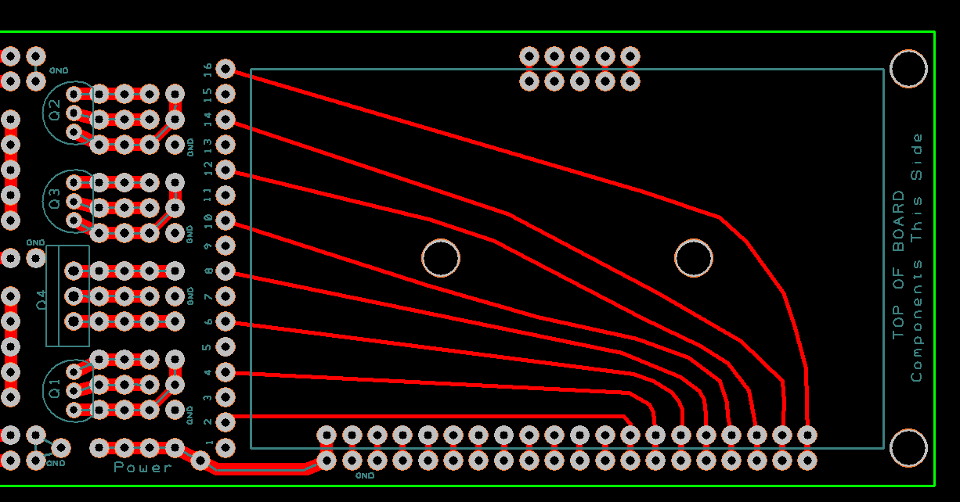
Your Precious Payload – The PC Board
Center has place for 5 V regulator + three more
Regulators can tie common to ground or not
Bottom has connectors for data logger

Slide 14
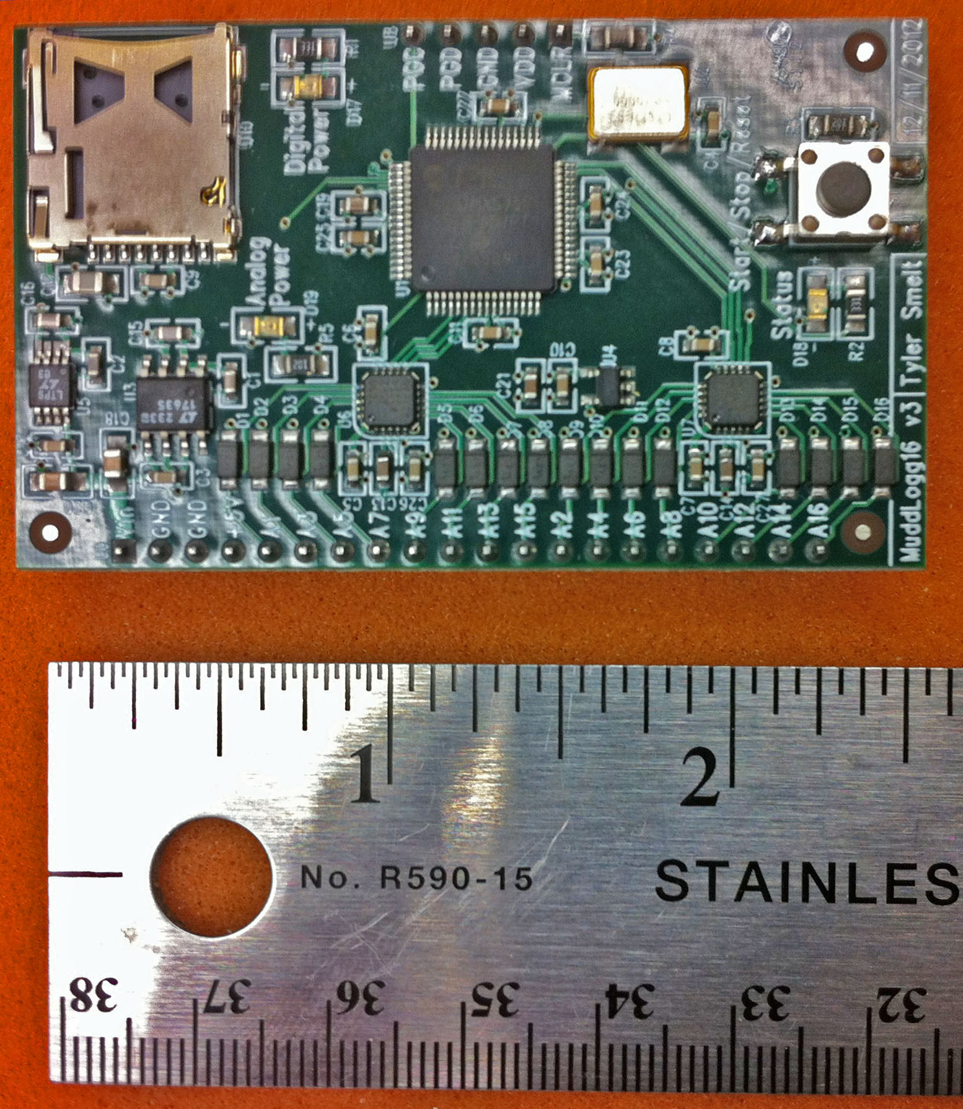
Your Precious Payload – The Data Logger
Created and programmed by Tyler Smelt
16 channels (Can measure up to 16 sensors)
16-bit resolution
Max 400 kSPS composite rate (25 kSPS/chan)
Max 200 kSPS on single channel (read in pairs)
Power with 6 V to 20 V (9 V recommended)
Uses microSD for storage (have 16 GB cards)
Need to tape/secure the SD card in the reader!
Input range 0 to 3.3 V
Input Impedance ≈2.2kΩ (MyDAQ is 10 GΩ)
Low impedance, may need to buffer your input signals
Set parameters with Config File (Initialize on PC)
Have VI and .m file to read binary data files
PIC-32 microcontroller; Two AD7689 A/D Chips
MORE INFO ON THE E80 WEBSITE!

Slide 15
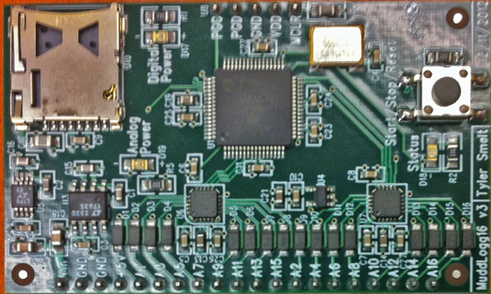
Single–Sided Circuits
Data logger expects 0 V to 3.3 V signals
Classical op-amp circuit power ±15 V
Low-voltage op-amp circuit power
±1.4 V to ±3 V
0-to-2.8 V to 0-to-6 V
Signal offset
Normal signal that goes above and below zero will need DC offset
Reference offset
Virtual ground
This is where we want all signals referenced
WHAT IS A VIRTUAL GROUND?

Slide 16
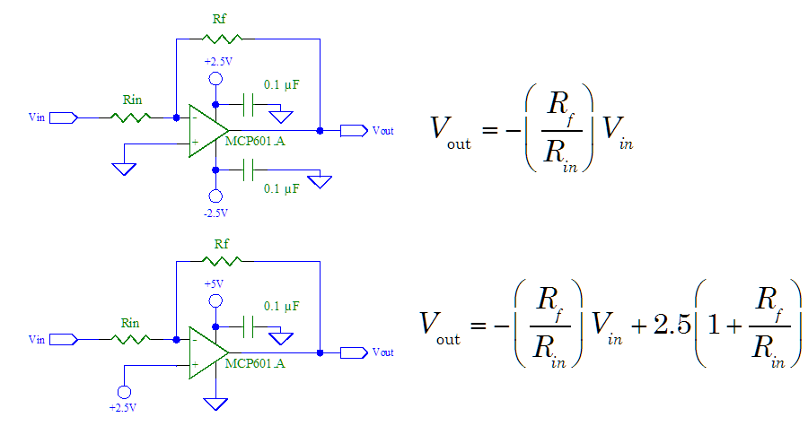
Inverting Amps
LOW POWER OP-AMP

Slide 17
Inverting Amps
LOW POWER OP-AMP
What are these for?

Slide 18
Inverting Amps
LOW POWER OP-AMP
These filter out noise in the power lines; Use them!

Slide 19
Inverting Amps
LOW POWER OP-AMP

Slide 20
Inverting Amps
LOW POWER OP-AMP
Virtual Ground
This offsets the op-amp so that the signal is centered between 0 and 5 V
High side of battery
Low side of battery

Slide 21
Inverting Amps
LOW POWER OP-AMP
If you are powering your circuit by battery and you have a single sided supply, you need to think of creating a virtual ground halfway between your low and high on your op amp; then offset your signal so that you have your average value in the middle instead of zero
Virtual Ground
This offsets the op-amp so that the signal is centered between 0 and 5 V
Data logger needs 0 to 3.3 V;
You could go from 0 to 3.3 V with 1.8 V as center
High side of battery
Low side of battery

Slide 22
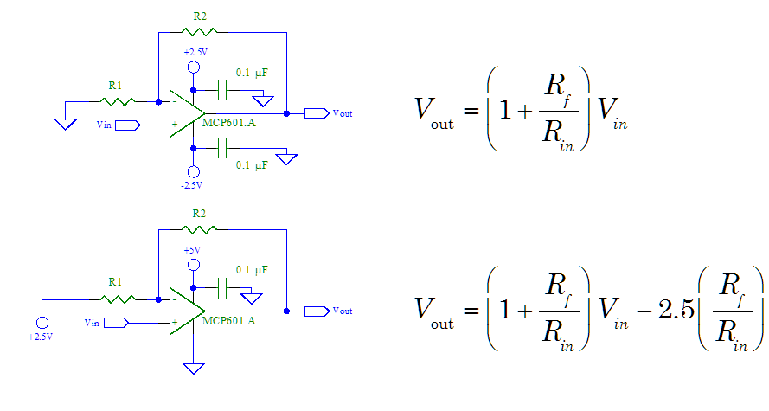
Non-Inverting Amps

Slide 23
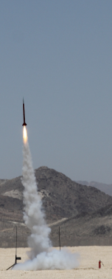
Scientific vs. Engineering Measurements
WHAT’S THE DIFFERENCE?

Slide 24
Scientific vs. Engineering Measurements
Engineering Measurements
“What you measure about a rocket.”
Scientific Measurements
“What you measure with a rocket.”

Slide 25
Sensor Requirement
You are required to have a MINIMUM of 2 types of sensors
One thermocouple and one thermistor would count
Two thermocouples would NOT count

Slide 26
What Does a PC Board with Sensors Look Like?
WHERE WOULD I FIND THIS?

Slide 27
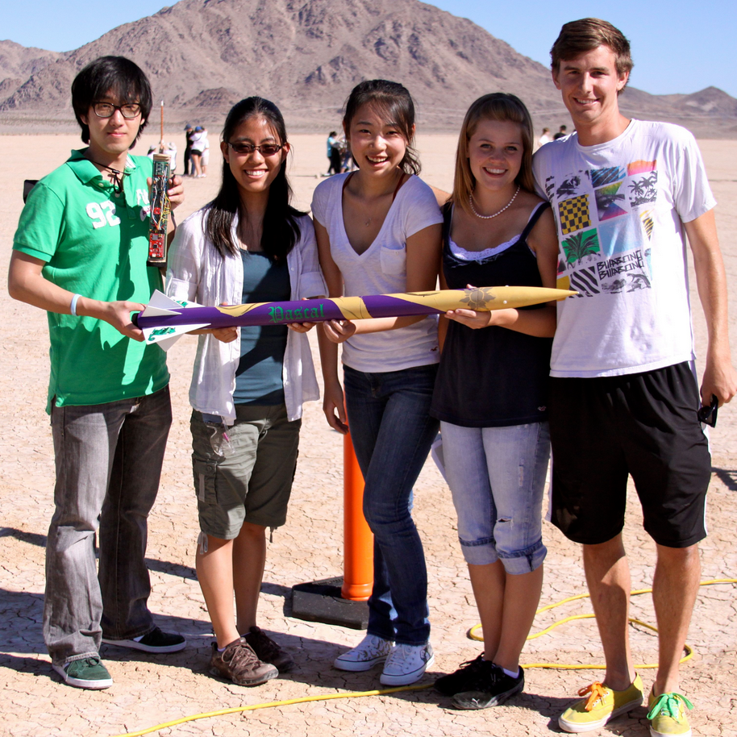
What Does a PC Board with Sensors Look Like?
SOURCE: http://www.eng.hmc.edu/NewE80/LargePhotos/KC20120421_IMG_1658.jpg

Slide 28
Sensor Requirement
You are required to have a MINIMUM of 2 types of sensors
One thermocouple and one thermistor would count
Two thermocouples would NOT count
SOURCE: http://www.eng.hmc.edu/NewE80/LargePhotos/KC20120421_IMG_1658.jpg

Slide 29
Speed of Sensor Response
We recommend using…
At least one sensor with a time constant faster than 1 ms
Bandwidth ≥ 1 kHz
Sensor adequate:
The bandwidth of the sensor is 10 times higher than the phenomenon that you want to measure
Sensor Needs deconvolution:
Sensor is “Hopeless”:

Slide 30
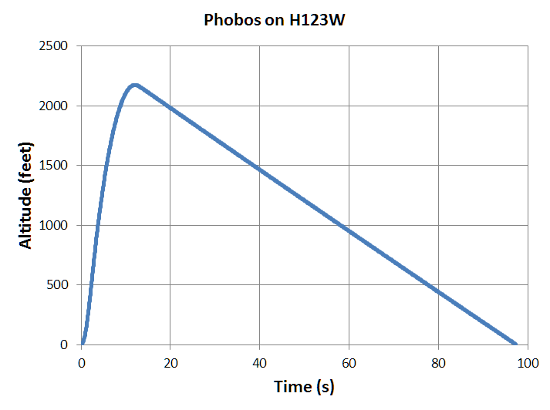
Effect of Temperature Sensor Time Constant

Slide 31
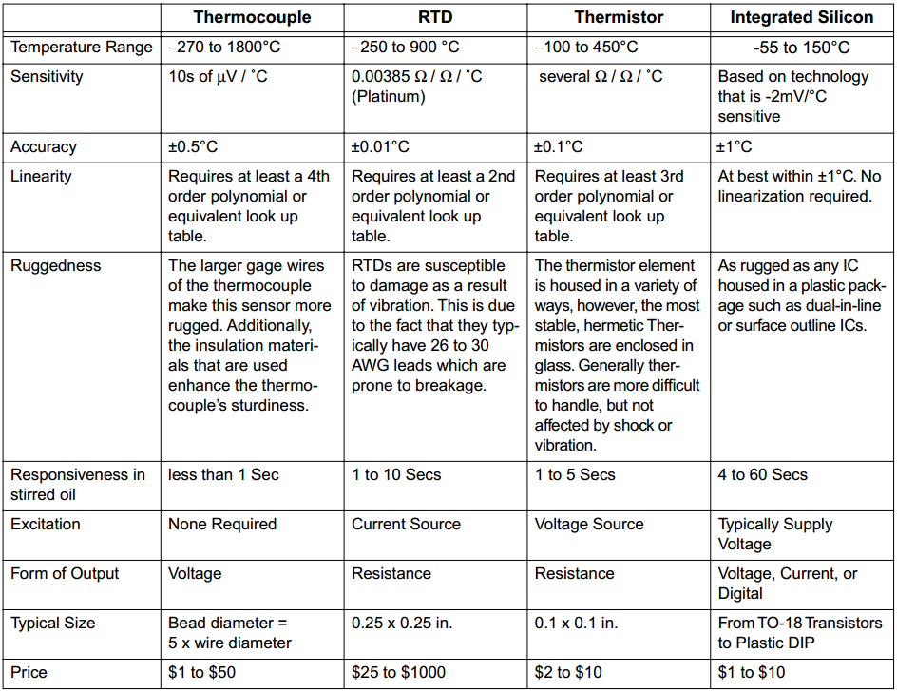
Temperature Measurement Devices in Lab
>

Slide 32
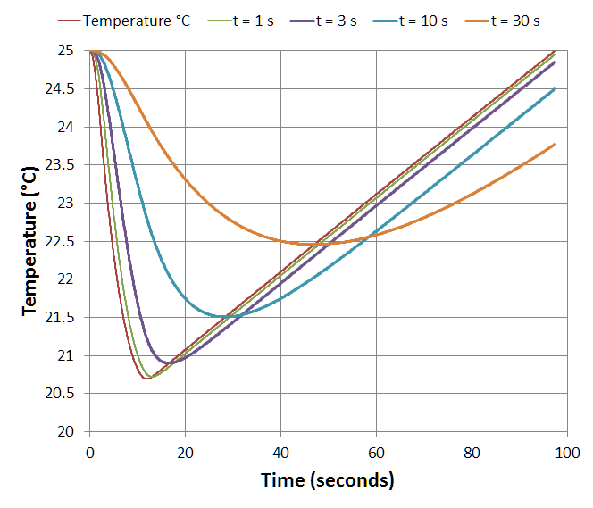
Effect of Temperature Sensor Time Constant
PML Phobos on H123W-M
Effect of Temp. Sensor Time Constant
At standard lapse rate
∆T = –7.8°C @ 1200 m AGL
Temperature drops by 0.0065ºC for every meter going up

Slide 33
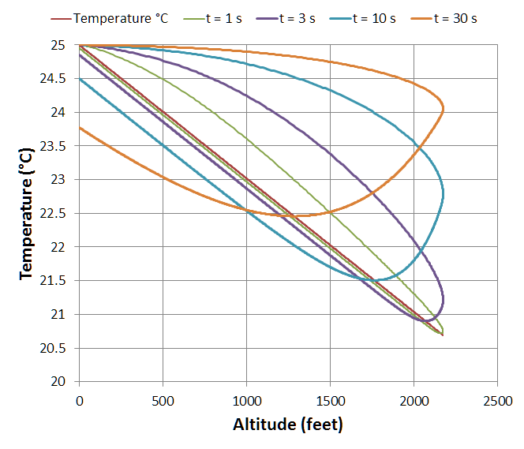
Effect of Temperature Sensor Time Constant
PML Phobos on H123W-M
Effect of Temp. Sensor Time Constant
PML Phobos on H123W-M
Hysteresis of Temp. sensor

Slide 34
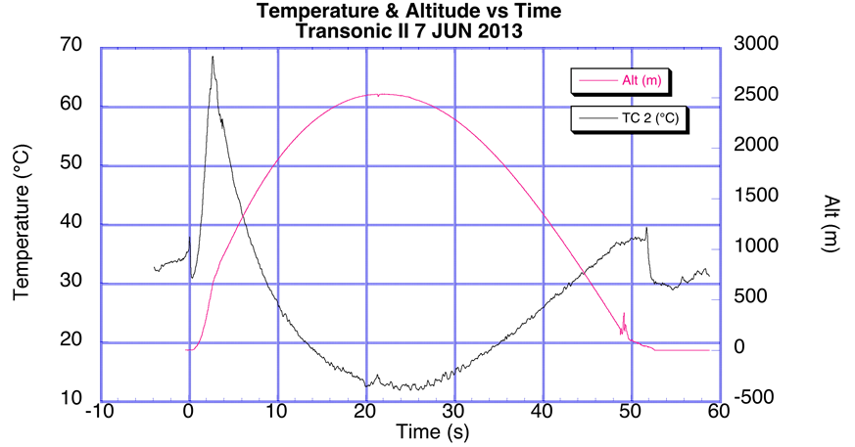
Actual Data from Sensors

Slide 35
Actual Data from Sensors
Speed of Sound = 343 m/s

Slide 36
Actual Data from Sensors

Slide 37
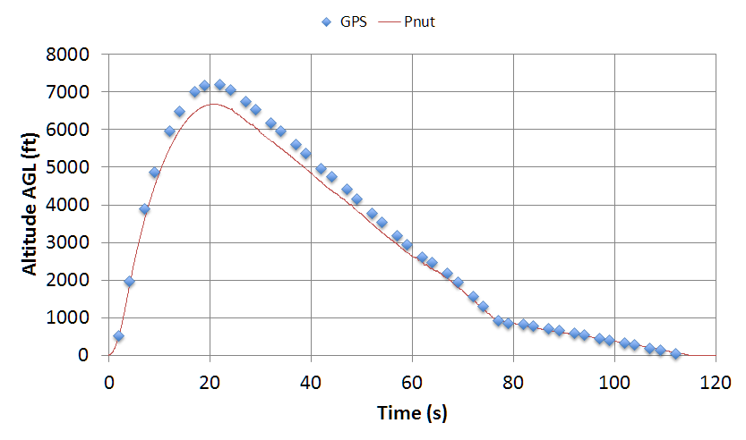
Actual Data from Sensors
WHY THE DISCREPANCY?

Slide 38
Actual Data from Sensors
Pnut assumes Standard Atmospheric Model
Dry Air
Temperature Varies Linearly

Slide 39
Sensor Requirement
You are required to have a MINIMUM of 2 types of sensors
One thermocouple and one thermistor would count
Two thermocouples would NOT count
WHAT OTHER TYPES OF SENSORS COULD WE USE?
Pressure Altimeter
Pitot-Static Tube
Gas/Humidity Sensor
Vibration Sensor; Light Sensor

Slide 40
Sensor Requirement
You are required to have a MINIMUM of 2 types of sensors
One thermocouple and one thermistor would count
Two thermocouples would NOT count
WHAT OTHER TYPES OF SENSORS COULD WE USE?
Pressure Altimeter
Pitot-Static Tube
Accelerometer/Rate Gyroscope
Gas/Humidity Sensor; Vibration Sensor; Light Sensor

Slide 41
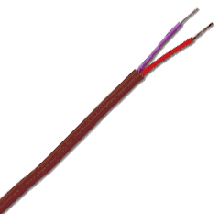
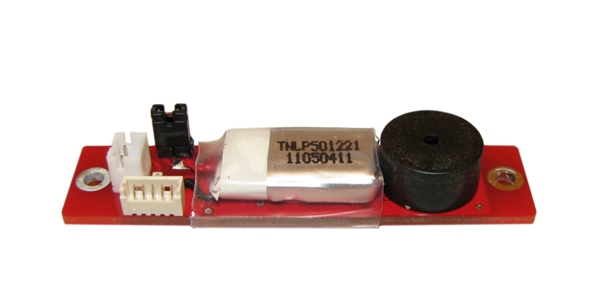
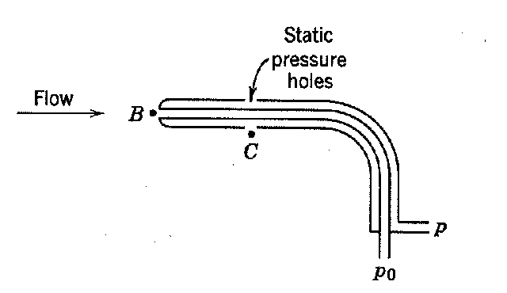
Sensor Requirements
Your Team has a Budget of $50
Air Temperature Sensor
Sensor in the free stream
Pressure Altimeter
No flow; 3 or 4 symmetric pressure taps
Accelerometer/Rate Gyroscope
Known fixed orientation
Means to deal with baseline and drift
Pitot-Static Tube
Pitot tube in free stream and direction of motion
Static Tap should be normal to the flow
Preferable 4+ “calibers” (rocket tube diameters) from the nose cone
Multiple in symmetric pattern is best
SOURCE: http://cdn2.bigcommerce.com/server2900/730e2/products/56/images/248/PnutTop__64333.1405342120.1280.640.png?c=2
SOURCE: http://www.ipscustom.com/ProdImages/Wire_E_tt_pp_m.gif
SOURCE: http://web.stanford.edu/class/me220/data/lectures/lect05/static_probe.gif

Slide 42
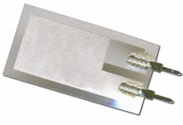
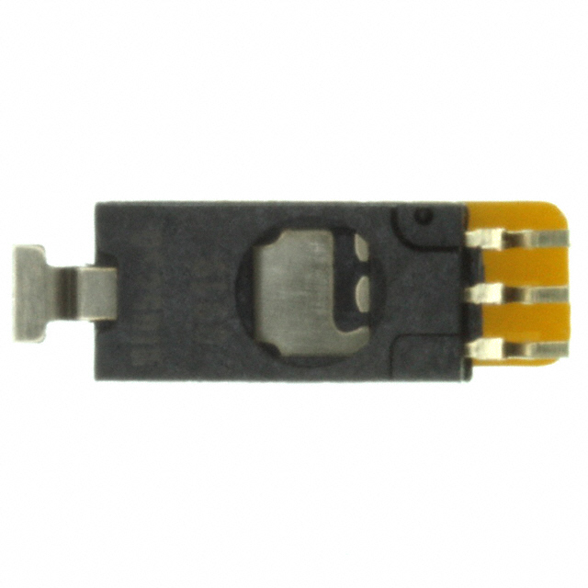
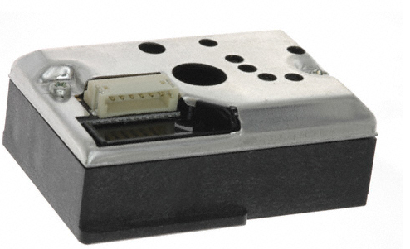
Sensor Requirements
Light Sensor
Proper orientation and view field
Vibration Sensor
Best on anti-node; avoid node
Nor for DC strain
Gas Humidity Sensor
Gas flow to sensor is desired
Particle/Dust Sensor
Gas flow through sensor
If optical, reduce or eliminate background light
Often needs pulse train
SOURCE: http://www.digikey.com/product-search/en?vendor=0&keywords=605-00004-ND
SOURCE: http://www.digikey.com/product-detail/en/HIH-5030-001/480-3294-1-ND/2061078
SOURCE: http://www.digikey.com/product-detail/en/GP2Y1010AU0F/425-2068-ND/720164

Slide 43
Sensor Placement
Sensors need to be placed in locations where a measurement is desired
Easiest in Payload Section
Next easiest in Nosecone
Ports/Channels to rout to exterior
Don’t forget separation for recovery
Can run (very long) wires through shock cord
Can make connector that separates at recovery
Can have separate sections

Slide 44
What Does a Rocket with Sensors Look Like?
WHERE WOULD I FIND THIS?

Slide 45
What Does a Rocket with Sensors Look Like?
SOURCE: http://www.eng.hmc.edu/NewE80/LargePhotos/20140419_E80-FirstLaunch_SMM_341.jpg

Slide 46
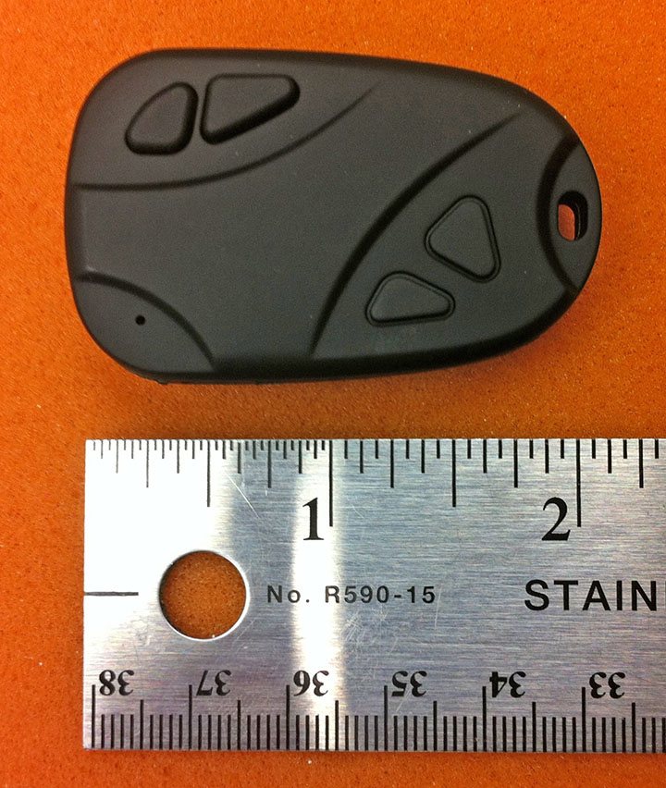
Video Camera
Battery charged by USB
40 minute battery time on full charge
Creates 720P .mov file on microSD
10 minutes per 1 GB
On 16 GB card will run out of battery before storage
Physical Mounting
Method
Duct tape? Electrical tape?
Location
Center of pressure?
Field of View

Slide 47
Power Requirements
Power Inputs
Data Logger: 6 V to 20 V
IMU: 5 V (regulated) & 3 V to 3.3 V (regulated)
AD623AN: 3 V to 12 V or ±1.5 V to ±6 V
MPC 60XX: 2.7 V to 6 V
Other sensors – TBD
Must measure current draw of final circuit
Batteries must power for 1 hour minimum
Battery capacity (in mAh) / Average current consumption (in mA) = Hours of expected runtime
Turn on before launch, stay on during flight, turn off after recovery.

Slide 48
Power Sources
Your Team has a Budget of $50
Power sources
9 V lithium, 750 mAh
1.5 V
AAA Alkaline, 1000 mAh; Lithium, 1200 mAh
AA Alkaline, 2700 mAh; Lithium, 3000 mAh
12 V (NEDEA- 1811A), 55 mAh
LiPo (Rechargable, High Power Density, Special Charger, HazMat)
3.7 V, up to 5000 mAh
7.4 V, up to 5000 mAh
11.1 V, up to 5000 mAh
NiMH (Rechargable)
NiCd (Rechargable)
Your team will decide on which power source to use

Slide 49
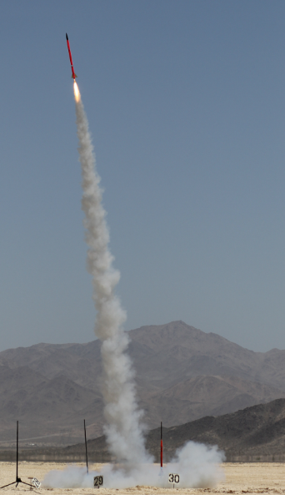
Surviving
What does your rocket have to survive during launch?
BE THE ROCKET

Slide 50
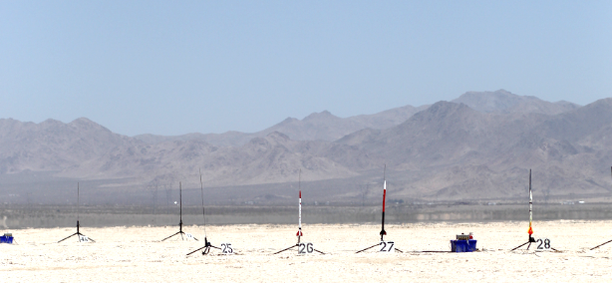
Temperature
1) Temperature at Launch
Often –2°C at 6 AM
Solar heating of payload section to 50°C+
At standard lapse rate ∆T = –7.8°C @ 1200 m AGL
Temperature drops by 0.0065ºC for every meter going up
Standards for Parts
Commercial Grade: 0°C to 70°C
Industrial Grade: –40°C to 85°C
Military Grade: –55°C to 125°C

Slide 51
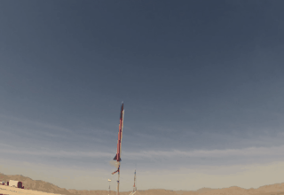
Acceleration
2) Acceleration
From motor, 6g to (50+)g
Use RockSim or OpenRocket to estimate

Slide 52
Vibration
3) Vibration (What causes vibration?)
BE THE ROCKET

Slide 53
Vibration
3) Vibration (What causes vibration?)
From motor
From aerodynamics
From shock impulse
Amplified at resonant frequencies
Use viscoelastic damping materials
SOURCE: http://www.sorbothane.com/blog/wp-content/uploads/2010/07/engine-vibrations.jpg

Slide 54
Shock
4) Shock (What causes shock?)
BE THE ROCKET

Slide 55
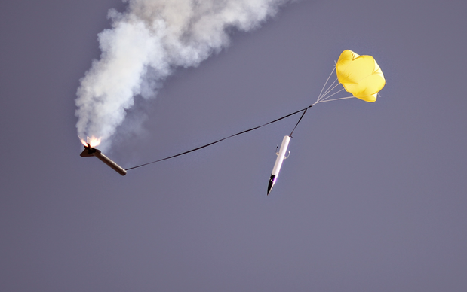
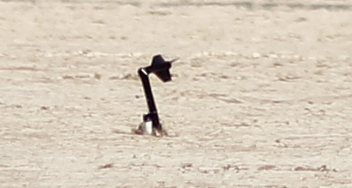
Shock
4) Shock (What causes shock?)
Deployment charge, 2 g to 20+ g
From parachute, 1 g to 50+ g
From ballistic landing, 200+ g

Slide 56
Surviving
What does your rocket have to survive during launch?
Temperature
Acceleration
Vibration
Shock

Slide 57
Constructing Your Rocket
NAR or TRA safety Code is mandatory.
Materials: I will use only lightweight materials such as paper, wood, rubber, plastic, fiberglass, or when necessary ductile metal, for the construction of my rocket.
Motors: I will use only certified, commercially made rocket motors, and will not tamper with these motors or use them for any purposes except those recommended by the manufacturer. I will not allow smoking, open flames, nor heat sources within 25 feet of these motors.

Slide 58
Constructing Your Rocket
Adhesives must be used under fume hood, in spray-paint booth, or outdoors.
Neoprene gloves required. Eye protection required
G10 Fiberglass (PML fins) must be wet sanded or with full respiratory protection. Neoprene gloves strongly recommended.
No sharp implements permitted when removing plastic rivets.
Spray painting only permitted in paint booth or outdoors (not by Libra Complex). Skin & eye protection required.
If you follow the unmodified instructions for the rockets, you will NOT be able to fly them.
Aerotech requires motor retainer, longer motor mount, modified placement, and removal of motor hook, thrust ring, and thrust ring flange

Slide 59
Rocket Construction
Motor retainers attached with JB Weld ONLY!
Cyanoacrylic/Super-Glue (Aerotech)
Make SURE you have adequate ventilation
ALWAYS use skin protection (neoprene gloves)
Usually sets in 30 s to 20 min
Can use accelerator (we have limited supplies)
Accelerator on one surface + Super-Glue on other surface = instant bond when joined.
Will have to dribble on some internal joints
Epoxy clay
Not quite as strong as epoxy
Very useful for fillets and custom mounts
You always need less than you think

Slide 60
Rocket Hints
For Aerotech kits…
There is no need for the 24 mm motor adaptor.
Make sure the fins snap easily into the Fink Locks BEFORE putting the Motor Tube Assembly into the Body Tube.
It’s very difficult to reconnect the shock cord to the nose cone. An extension from the screw eye to the end of the coupler makes the process much easier.

Slide 61
Deliverables
NO RESTRICTIONS ON WHEN YOU DO YOUR WORK.
However, priority for resources goes to groups that were assigned to that lab section.
Need to show up to your lab section for the check-off.
Week 1
Scientific and/or Engineering objectives
Select sensors (min: 2, MAX: 16)
Parts list (especially to order)
Complete schematic
Show all calculations; bypass capacitors; power
Check off by Section Prof & Prof Spjut
Week 2
Complete protoboard
Measured current draw
Demonstrate functionality
Check off by Section Prof & Prof Spjut

Slide 62
Deliverables
Week 3
Fully populated PC board
Demonstrate functionality
Data acquisition works and is demonstrated
Check off by Section Prof & Prof Spjut
Week 4
Completed Rocket
Complete ground and analysis procedures
Completed launch checklist (you have to DO steps)
Loaded launch motors
NO RESTRICTIONS ON WHEN YOU DO YOUR WORK.
However, priority for resources goes to groups that were assigned to that lab section.
Need to show up to your lab section for the check-off.

Slide 63
Deliverables
NO RESTRICTIONS ON WHEN YOU DO YOUR WORK.
However, priority for resources goes to groups that were assigned to that lab section.
Need to show up to your lab section for the check-off.
Week 5
List lessons learned
Fix & correct things
Load launch motors
Week 6
Analyze data
Write Final Report
Prepare Final Presentation

Slide 64
A “ONE-PAGER”…
Problem Statement (or Purpose, or Goal)
The final E80 project needs to be completed to pass the course
Success Criteria (envision successfully crossing the finish line)
Design, build, and test a rocket that meets E80 requirements, and submit a final report and give a final presentation
Strategies (how are you going to get to that finish line?)
Work as a team to meet all weekly project deliverables
Timeline (detailed plan for implementing the strategies)
TASK | Start | End | Status
Meet Week 1 Deliverables | 3/12/2015 | 3/25/2015 | In Progress
Meet Week 2 Deliverables | 3/25/2015 | 4/1/2015 | Not Started
Meet Week 3 Deliverables | 4/1/2015 | 4/8/2015 | Not Started
Meet Week 4 Deliverables | 4/8/2015 | 4/15/2015 | Not Started
Meet Week 5 Deliverables | 4/15/2015 | 4/22/2015 | Not Started
Meet Week 6 Deliverables | 4/22/2015 | 5/4/2015 | Not Started
Give Final Presentation | 5/4/2015 | 5/4/2015 | Not Started
Sample Timeline for Section 2

Slide 65
Good Luck Over the Next 7 Weeks!
MAKE IT HAPPEN!

