Slide 1
Flight Hardware
E80 Spring 2013
Erik Spjut

Slide 2
NASA Standards
Mechanical tests
Strength
Sinusoidal sweep vibration (5 to 50 hertz [Hz]) ELV and STS payloads
Random vibration and acoustics
Shock (mechanical and pyro)
Modal survey
Pressure profile
Appendage deployment
Thermal tests
Thermal/vacuum and ambient pressure thermal cycling
Thermal balance
Bakeout
Leak test for sealed components
EMI tests
Functional tests
Electrical interface
Comprehensive performance
Failure-free performance
End-to-end compatibility tests and mission simulations
Life test program
Mass properties verification

Slide 3
E80 Engineering Requirements
Payload Dimensions
Power Requirements
Acceleration, Shock, & Vibration
Temperature Profile
Speed of Response
Sensor Requirements
Construction Standards

Slide 4
Payload Dimensions
PC Board & Envelope
1.80” by 10.10” (height depends on components)
Aerotech
ID 1.800”
Length Arreaux 12”, Barracuda 22.75”

Slide 5
Payload Dimensions
PC Board & Envelope
1.80” by 10.10” (height depends on components)
PML – 12´´Payload Bay
Length 11.75” to 11.88”
ID Tube 2.152”
ID Coupler 2.02”

Slide 6
Power Requirements
Power Inputs
Data Logger: 6 V to 20 V
IMU: 5 V (regulated) & 3 V to 3.3 V (regulated)
AD623AN: 3 V to 12 V or ±1.5 V to ±6 V
MPC 60XX: 2.7 V to 6 V
Other sensors – TBD
Must measure current draw of final circuit.
Batteries must power for 1 hour minimum.
Turn on before launch, stay on during flight, turn off after recovery.

Slide 7
Power (cont)
Power sources
9 V lithium, 750 mAh
1.5 V
AAA Alkaline, 1000 mAh; Lithium, 1200 mAh
AA Alkaline, 2700 mAh; Lithium, 3000 mAh
12 V (NEDEA- 1811A), 55 mAh
References
Duracell Tech Specs
Energizer Tech Specs

Slide 8
Power (cont)
Rechargable Batteries
LiPo (High Power Density, Special Charger, HazMat)
3.7 V, up to 5000 mAh
7.4 V, up to 5000 mAh
11.1 V, up to 5000 mAh
NiMH
NiCd

Slide 9
Acceleration, Vibration, & Shock
Acceleration
From motor, 6 G to 50 G
Use RockSim or OpenRocket to estimate
Shock
From deployment charge, 2 G to 20 G
From parachute, 1 G to 50 G
From ballistic landing, 200 G +

Slide 10
Vibration
From motor
From aerodynamics
From shock impulse
Amplified at resonant frequencies
Viscoelastic damping materials

Slide 11
Temperature Profile
Standards
Commercial Grade: 0°C to 70°C
Industrial Grade: –40°C to 85°C
Military Grade: –55°C to 125°C
Launch
Often –2°C at 6 AM
Solar heating of payload section to 50°C+
At standard lapse rate ∆T = –7.8°C @ 1200 m AGL

Slide 12
Sensor Requirement
Minimum 2 types of sensors
2 Thermocouples wouldn’t count
1 Thermocouple, 1 thermistor would (but see next)
Minimum 1 sensor with BW ≥ 1 kHz
Necessary speed of response
Mechanical Integrity (launch, flight, recovery)
Functional Placement

Slide 13
Speed of Response
Sensor adequate:
Needs deconvolution:
Hopeless:

Slide 14
PML Phobos on H123W-M, Effect of T-sensor Time Constant

Slide 15
PML Phobos on H123W-M, Hysteresis of T-sensor

Slide 16
Sensor Requirement (cont.)
Air Temperature
Sensor in free stream
Pressure Altimeter
No Flow
Pressure taps, 3 or 4 symmetric
Gas/Humidity Sensor
Gas flow to sensor

Slide 17
Pitot- Static Tube
Pitot Tube
In free stream
In direction of motion
Static Tap
Normal to flow
Preferable 4+ calibers from nose cone
Multiple in symmetric pattern best

Slide 18
Pitot Tube Designs
http://naca.central.cranfield.ac.uk/reports/arc/rm/3365.pdf

Slide 19
Sensor Requirements (cont)
Light Sensor
Proper orientation
Proper view field
Vibration Sensor
Best on anti-node
Avoid node
Not for DC strain

Slide 20
Sensor Requirements (cont)
Particle/Dust Sensor
Gas flow through sensor
If optical, reduce or eliminate background reflections/light.
Often needs pulse train
Accelerometer/ Rate Gyroscope
Known fixed orientation
Means to deal with baseline and drift

Slide 21
Sensor Placement
Easiest in Payload Section
Next easiest in Nosecone
Ports/Channels to rout to exterior
Don’t forget separation for recovery
Can run (very long) wires through shock cord
Can make connector that separates at recovery
Can have separate sections

Slide 22
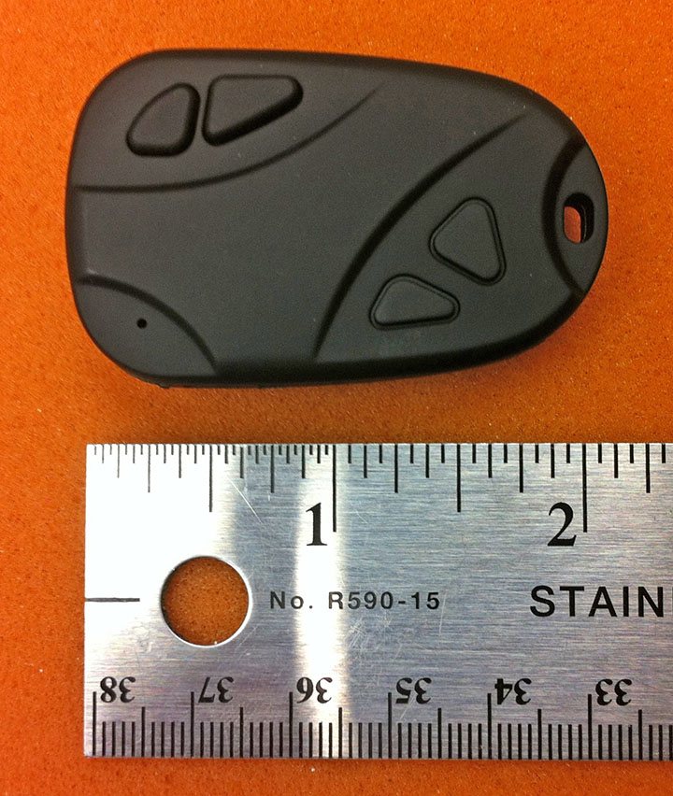
Video Camera
Battery charged by USB
40 minute battery time on full charge
Creates 720P .mov file on microSD
10 minutes per 1 GB. On 16 GB card will run out of battery before storage
Physical Mounting
Method
Location
Field of View

Slide 23
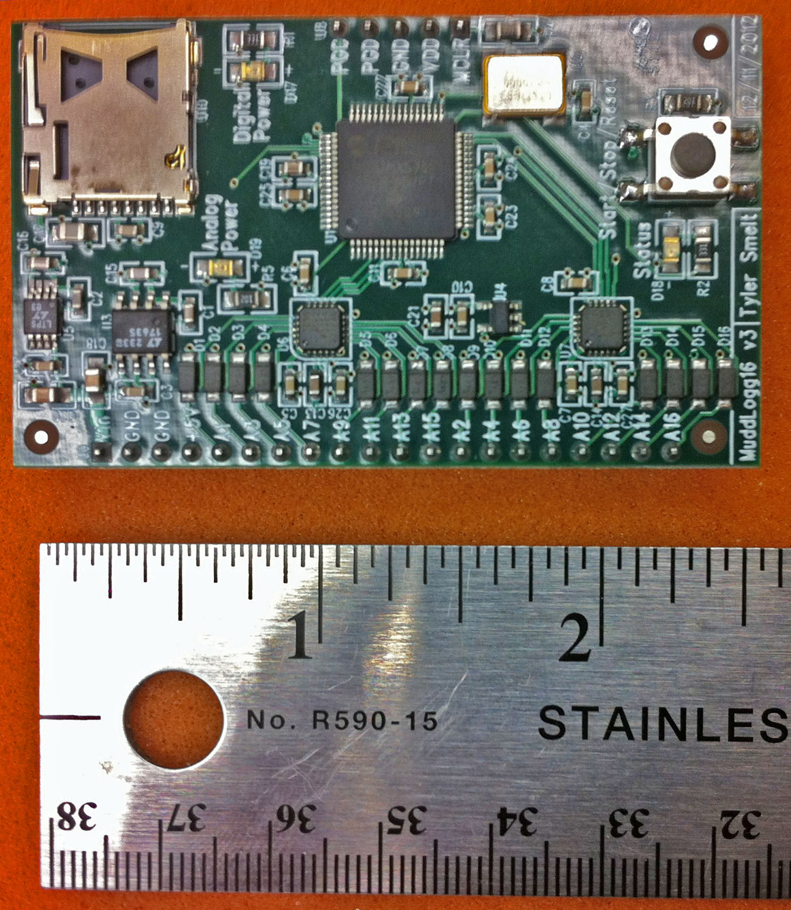
Data Logger
Created and programmed by Tyler Smelt
16 channels
16-bit resolution
Max 400 kSPS composite rate (25 kSPS/chan)
Max 200 kSPS on single channel

Slide 24
Data Logger
Power with 6 V to 20 V (9 V recommended)
Uses microSD for storage (have 16 GB cards)
Input range 0 to 3.3 V
Input Impedance ≈2.2kΩ
Set parameters with Config File
Have VI and .m file to read binary data files
PIC-32 microcontroller
2 – AD7689 A/D

Slide 25
Single-Sided Circuits
Data logger expects 0 V to 3.3 V signals
Classical op-amp circuit power ±15 V
Low-voltage op-amp circuit power
±1.4 V to ±3 V
0-to-2.8 V to 0-to-6 V
Signal offset
Reference offset
Virtual ground

Slide 26
Inverting Amps

Slide 27
Non-Inverting Amps

Slide 28
PC Board
Top laid out like your protoboard
4 exterior buses slightly closer
1 extra power bus
Bottom has connectors for data logger
4 Holes for mounting
2 holes for mounting battery holder

Slide 29
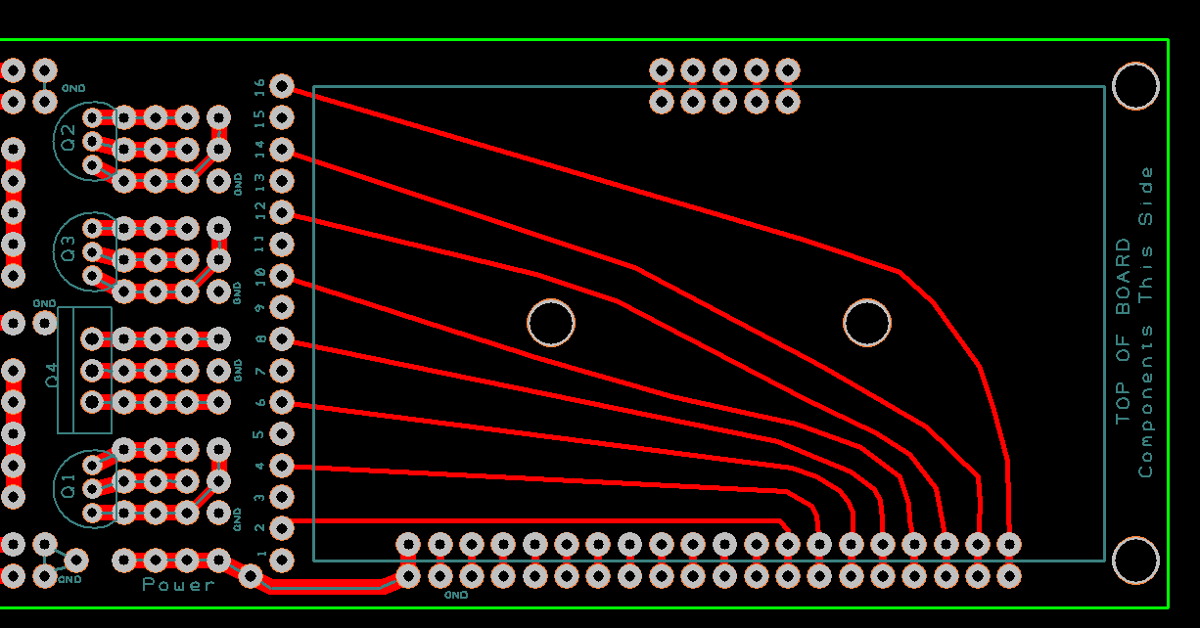
PC Board
Center has place for 5 V regulator + three more
Regulators can tie common to ground or not.
Bottom has connectors for data logger

Slide 30
Rocket Assignments
Team 1 – PML Phobos <.rkt> <.ork>
Team 2 – Aerotech Arreaux <.rkt> <.ork>
Team 3 – PML X-Calibur <.rkt> <.ork>
Team 4 – Aerotech Barracuda <.rkt> <.ork>
Team 5 – PML Phobos <.rkt> <.ork>
If you feel you need a rocket different from the assigned, write a proposal explaining the technical reasons and give it to your section prof.

Slide 31
Rocket Construction
NAR or TRA safety Code is mandatory.
Materials: I will use only lightweight materials such as paper, wood, rubber, plastic, fiberglass, or when necessary ductile metal, for the construction of my rocket.
Motors: I will use only certified, commercially made rocket motors, and will not tamper with these motors or use them for any purposes except those recommended by the manufacturer. I will not allow smoking, open flames, nor heat sources within 25 feet of these motors.

Slide 32
Rocket Construction (cont.)
Adhesives must be used under fume hood, in spray-paint booth, or outdoors.
Neoprene gloves required. Eye protection recommended
G10 Fiberglass (PML fins) must be wet sanded or with full respiratory protection. Neoprene gloves strongly recommended.
No sharp implements permitted when removing plastic rivets.

Slide 33
Rocket Construction (cont.)
Spray painting only permitted in paint booth or outdoors. Skin & eye protection recommended.
If you follow the unmodified instructions for the rockets, you will not be able to fly them.
PML requires motor retainer, modified motor mount placement, and launch rail guides.
Aerotech requires motor retainer, longer motor mount, modified placement, and removal of motor hook, thrust ring, and thrust ring flange

Slide 34
Rocket Construction (cont.)
Motor retainers attached with JB Weld ONLY!
Epoxy (PML kits)
Surfaces to be joined must be pre-sanded with 80-to-120 grit sandpaper (and then de-dusted).
Mix small quantities at a time (exothermic reaction)
Epoxy flows until fully set
Epoxy clay
Not quite as strong as epoxy
Very useful for fillets and custom mounts
You always need less than you think

Slide 35
Rocket Construction (cont.)
Cyanoacrylic/Super-Glue (Aerotech)
Make SURE you have adequate ventilation
ALWAYS use skin protection (neoprene gloves)
Usually sets in 30 s to 20 min
Can use accelerator (we have limited supplies)
Accelerator on one surface + Super-Glue on other surface = instant bond when joined.
Will have to dribble on some internal joints

Slide 36
Rocket Hints
The PML Piston Strap is in the Piston parts..
For PML kits, make sure fins are straight.
Use masking tape.
Use patience.

Slide 37
Rocket Hints (cont.)
For Aerotech kits, there is no need for the 24 mm motor adaptor.
For Aerotech kits, make sure the fins snap easily into the Fink Locks BEFORE putting the Motor Tube Assembly into the Body Tube.
For Aerotech kits, it’s very difficult to reconnect the shock cord to the nose cone. An extension from the screw eye to the end of the coupler makes the process much easier.

Slide 38
Payload Sections
PC board designed to fit in PML payload bay.
PC board matches Aerotech body tubing diameter.
A 14.75´´ long Aerotech body tube fits the PC board.
Arreaux payload section too short.
Barracuda payload section too long.
We have extras of both PML and Aerotech to allow for mistakes.

Slide 39
Deliverables
Week 1
Scientific and/or Engineering objectives
Complete schematic
Parts list (especially to order)
Check off by Section Prof & Prof Spjut
Week 2
Complete protoboard
Measured current draw
Demonstrate functionality
Check off by Section Prof & Prof Spjut

Slide 40
Deliverables (cont.)
Week 3
Fully populated PC board
Demonstrate functionality
Check off by Section Prof & Prof Spjut
Week 4
Completed Rocket
Complete ground and analysis procedures
Completed launch checklist (you have to DO steps)
Loaded launch motors

Slide 41
Deliverables (cont.)
Week 5
List lessons learned
Fix & correct things
Load launch motors
Week 6
Analyze data
Write Final Report
Prepare Final Presentation

