Slide 1
E80 – The Impossible Class
Intro & Flight Basics
Engineering 80 S 2015
Erik Spjut

Slide 2
Important Dates
22 JAN 2015 – Labs Begin (Section 4)
30 JAN 2015 – 1st LabVIEW Assignment Due
12 MAR 2015 – Final Project Begins
18 APR 2015 – Final Project Launch 1
25 APR 2015 – Final Project Launch 2
4 MAY 2015 – Final Presentation, Final Project Due

Slide 3
Course Objectives
By the end of the course students will:
  Demonstrate hardware and equipment skills
  Demonstrate experimental and analytical skills
  Demonstrate the beginnings of professional practice

Slide 4
Course Structure
Informational Lectures
  T Th from today through 26 FEB + 2
Pre-lab
  Modeling and Data Manipulation Prep
  VIs & Code, Equipment Manuals, Ask Professors
6-hour Lab Sessions
LabVIEW assignments
Tech Memo
Final Project
  Launches
  Final Report
  Final Presentation

Slide 5
The E80 Website
Fount of almost all knowledge (sort of like Wikipedia but harder to search)
Sakai used for submission of LabVIEW assignments and labs, but almost nothing else
http://www.eng.hmc.edu/NewE80/index.html

Slide 6

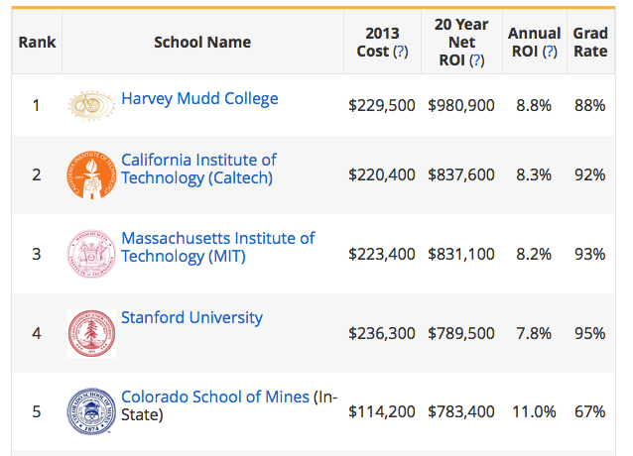
What is the HMC Value Added?

Slide 7


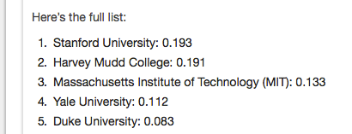
What is the HMC Value Added?

Slide 8
HMC Engineering Value Added
Technical Excellence
Grasps essence of problem quickly
Self educates quickly to needed expertise
Not stuck in narrow expertise
Delivers top-notch results quickly
Communicates needs and solutions professionally

Slide 9
<http://youtu.be/oRBchZLkQR0>

Slide 10
When could you be stuck on the escalator?
Unfamiliar equation in lecture
Unfamiliar term in data sheet
Not enough detail in lab instructions
Didn’t quite get E59 and you’re expected to use it, e.g., impedance
Staring at a LabVIEW VI
Expected to do an error analysis

Slide 11
E80 Expectations
Professional Practice
  Be prepared (do pre-lab).
  Don’t expect to be hand fed.
  Ask for help when you’re not making progress.
  Budget your time, e.g., Section 3 completed by 8:30 PM.
  Make efficient use of your team.

Slide 12
Experimental Engineering
Determine Experimental Objectives.
Model experiment to determine expected ranges of measured variables, and useful range of specified parameters.
Use model to develop error models.
Perform initial experiments and compare results with expectations and error estimates.
Adjust input parameters to account for lessons learned.

Slide 13
Experimental Engineering (cont.)
Perform remaining experiments.
Plot experimental results with error bars on same graph with modeled results.
Quantitatively explain similarities and differences.
Quantitatively determine degree of attainment of Experimental Objectives.
Make quantitative recommendations for future work.

Slide 14
Pre-Lab
Read through the entire lab
Create outline of lab report
  Determine relative importance of different sections
  Allocate time to different sections, e.g., if Section 1 is worth 10%, allocate 10% of 6 hours = 36 minutes. Plan to have it done by 7:06 PM.
Allocate prep for different sections to team members

Slide 15
Pre-Lab (cont.)
Determine which lecture(s) apply to this specific lab.
Use lecture material to start writing report.
Open and learn software and/or VIs that are specific to this lab.
Set up models or spreadsheets for processing data.
Test process example or synthetic data.

Slide 16
Pre-Lab (cont.)
Use model and/or other info to determine input parameter ranges and output variable ranges.
Read manuals for any unfamiliar equipment.
Prepare list of questions for proctors and/or professors. Visit prof’s as needed.
Develop process router, task assignment for lab.

Slide 17
Example Connections
Temperature Lecture (Principal)
Temperature Lab
Basic Electrical Lecture
Op Amps Lecture
Data Fitting Lecture
LabVIEW Lecture

Slide 18
Pre- & Intra-Lab Don’ts
You may NOT collect data (for you experiment).
You may NOT manipulate or test hardware (except for your personally-owned myDAQ).
You may NOT populate a protoboard.
You may NOT use the laboratory equipment outside of lab.
You may NOT process data collected during the lab.
When in doubt, ask.

Slide 19
The E80 Website
Fount of almost all knowledge (sort of like Wikipedia but harder to search)
http://www.eng.hmc.edu/NewE80/index.html

Slide 20
Rocketry Basics
Modeling and Measurement of Rocket Performance
FAA
Rocketry Certification

Slide 21
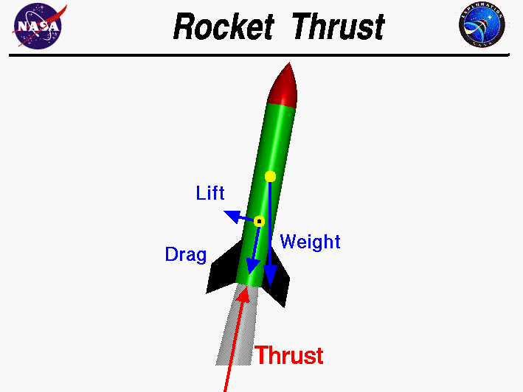
Forces on a Rocket
http://exploration.grc.nasa.gov/education/rocket/bgmr.html

Slide 22
Modeling and Measurement of Rocket Performance
Full Full Model

Slide 23
Modeling and Measurement of Rocket Performance
Full Model
Rocksim

Slide 24
Altimeter Data Analysis

Slide 25
Numerical Derivatives
For a set of points
taken at times
Forward Difference
Backward Difference

Slide 26
Noise Reduction
Lowpass filter signal, derivative, or both
Fit a smooth analytical function, e.g., cubic spline
  Take analytical derivative

Slide 27
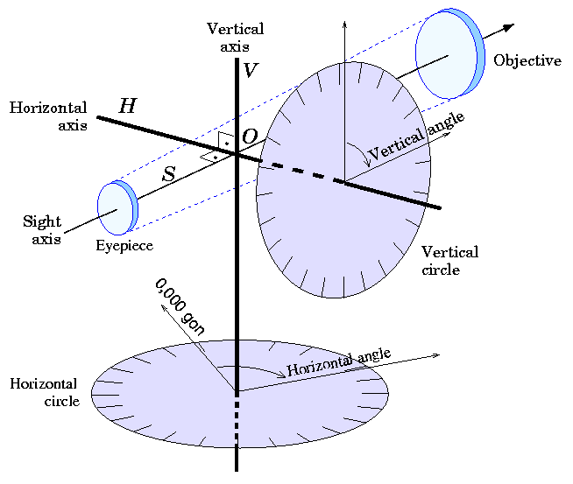
Inclinometer or Theodolite
http://en.wikipedia.org/wiki/File:Theodolite_vermeer.png

Slide 28
Inclinometer
http://www.apogeerockets.com/education/downloads/newsletter92.pdf

Slide 29
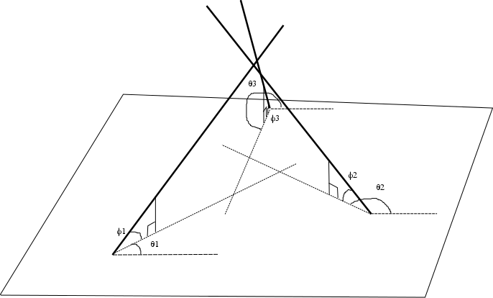
Three Theodolites

Slide 30
Lines in 3 Space
Rarely intersect
Use points of closest approach
Details of calculation and VI to do calculation are on website

Slide 31
FAA Regulations
Class 1 - a model rocket that uses no more than 125 grams (4.4 ounces) of propellant; uses a slow-burning propellant; is made of paper, wood, or breakable plastic; contains no substantial metal parts; and weighs no more than 1,500 grams (53 ounces) including the propellant – Requires permission of the Fire Department and the property owner.
Class 2 – a high power rocket, other than a model rocket, that is propelled by a motor or motors having a combined total impulse of 40,960 Newton-seconds (9,208 pound-seconds) or less – Requires permission of FAA, Fire Department, and property owner. Operator must also be TRA or NAR certified.
Class 3 – an advanced high power rocket, other than a model rocket or high-power rocket – Has lots of regulatory restrictions.
Rockets flown in California require either State Fire Marshall certified motors or a bunch of permits.

Slide 32
NAR or Tripoli Certification
Level 1
  Can fly H and I impulse motors
Level 2
  Can fly J, K, and L impulse motors
Level 3
  Can fly M and above

Slide 33
11 APR 2015 ROC Launch
1 week before our first launch
One team member can certify Level 1 .
  Have to construct the Final Project rocket yourself.
  Have to prep and load the motor yourself.
  NAR best for general rocketeers
  Tripoli best for BIG rockets
Can test out rocket if desired.

