Slide 1
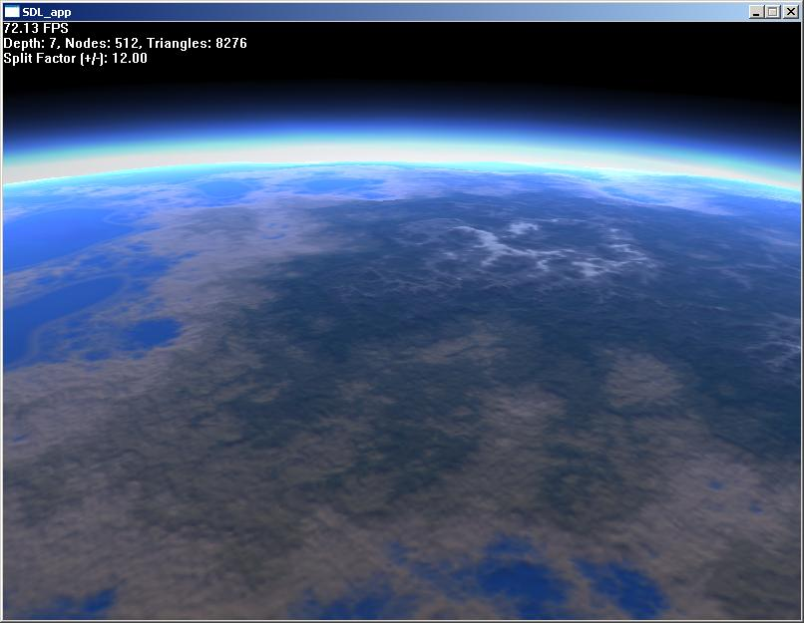
The air up there
Measurements in Atmospheric Science
E80 Spring 2014
Image credit: http://vterrain.org/Atmosphere/

Slide 2
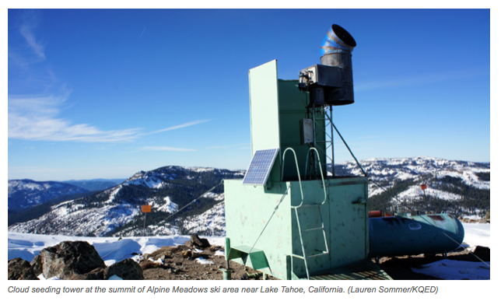
California’s dry winter – silver bullet?

Slide 3
Concepts in Atmospheric Science
Atmospheric science across the disciplines
Why and how to make atmospheric measurements
What you might consider for your rocket
Where did the air come from? HYSPLIT back trajectory models

Slide 4
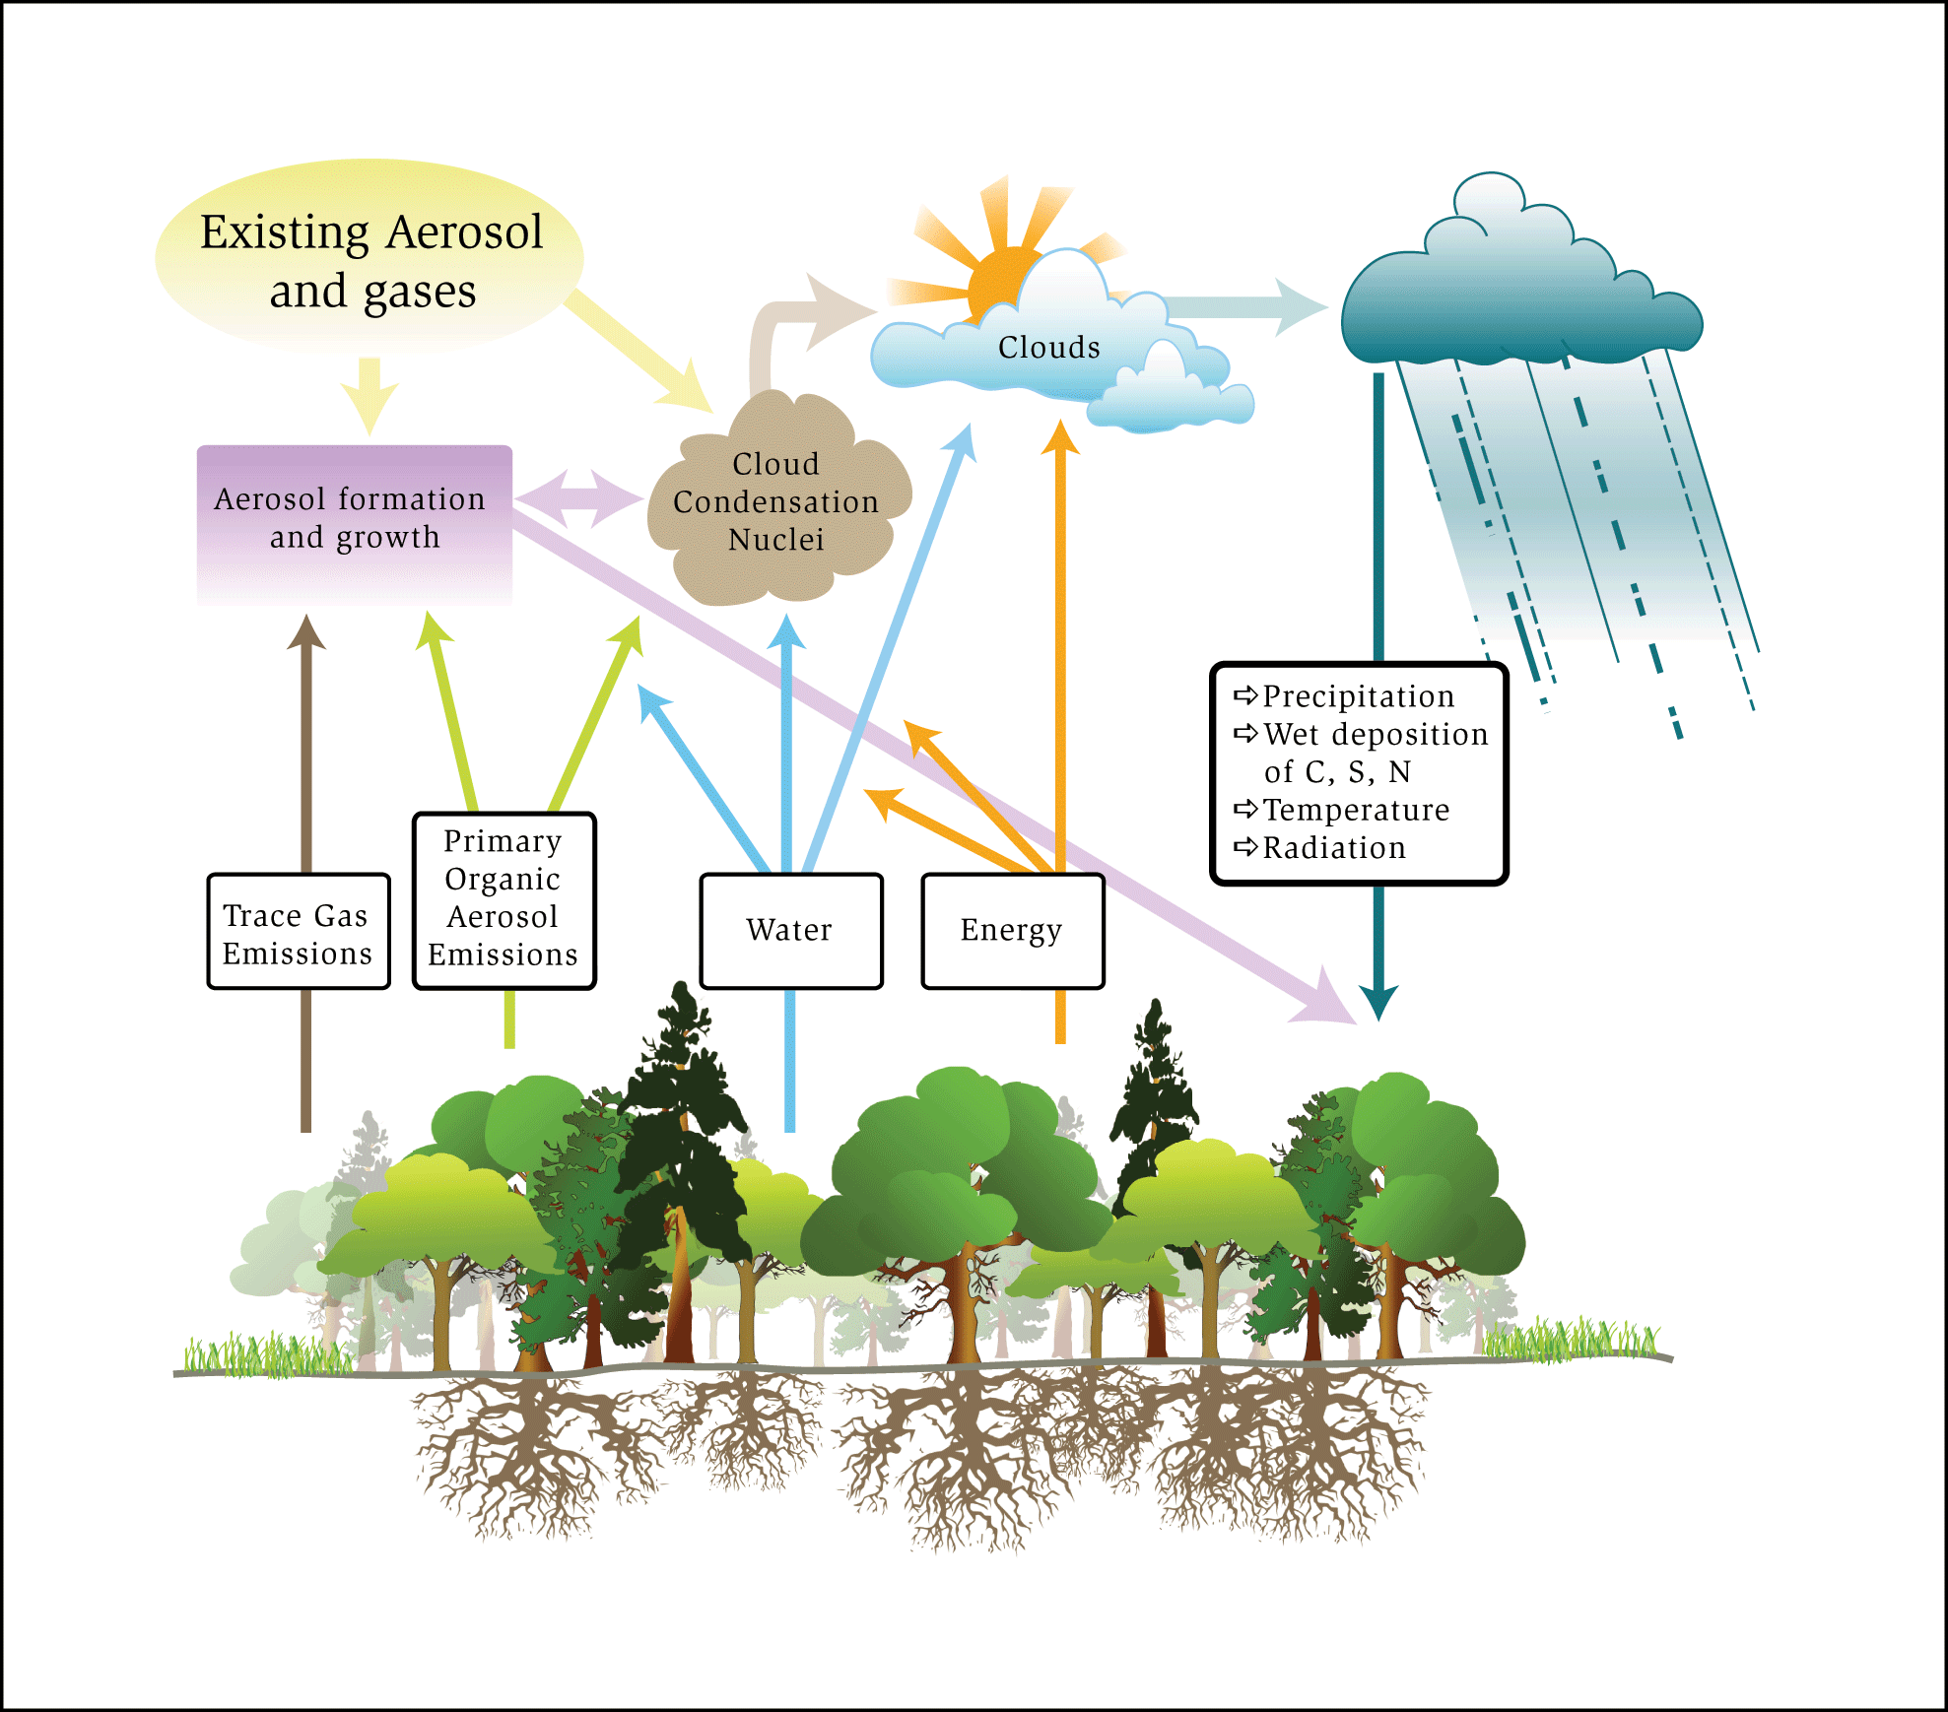
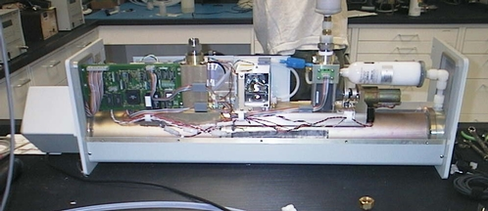
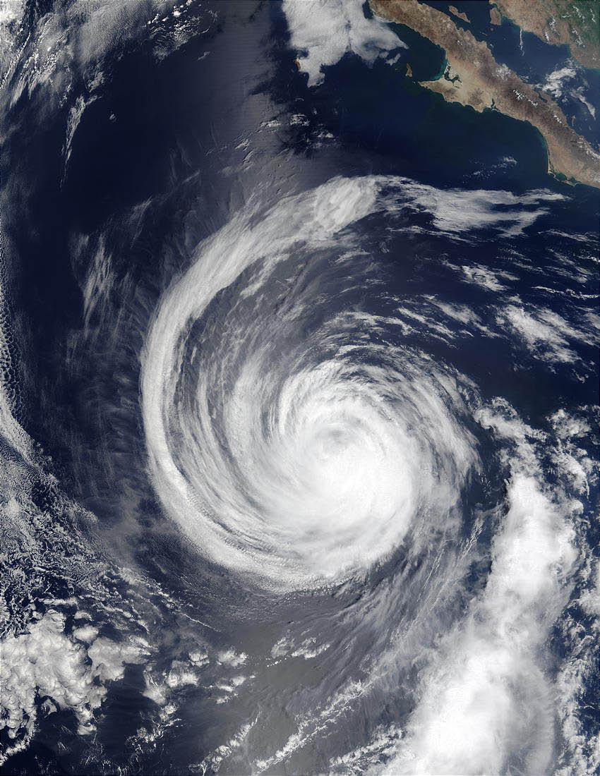
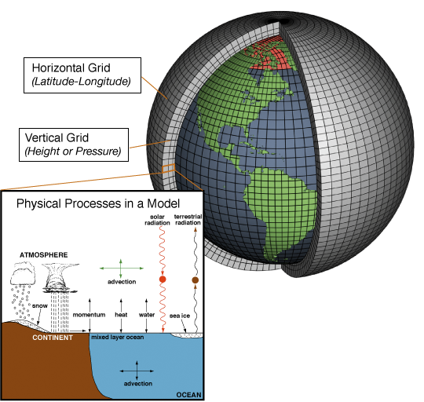
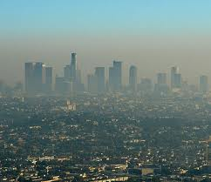
Atmospheric Science across the disciplines
BIOLOGY
Physics
Engineering
Chemistry
Mathematics
Computer
Science
Image credits: atmos.washington.edu, acd.ucar.edu, caice.ucsd.edu, oar.noaa.gov, chemwiki.ucdavis.edu

Slide 5
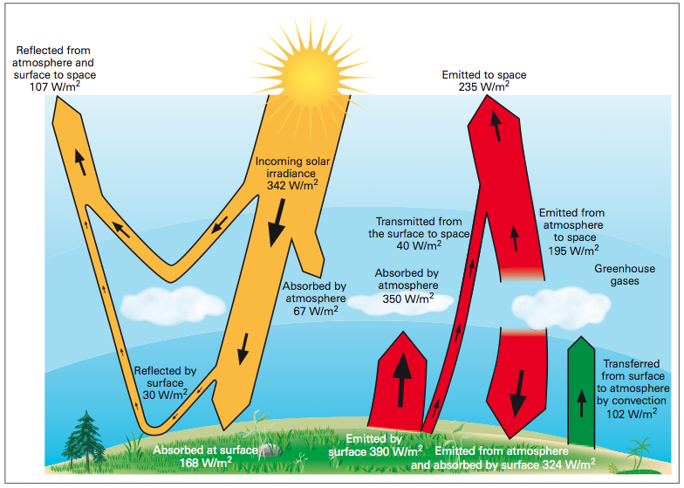
Geoengineering requires understanding atmospheric composition and it’s changes
Geoengineering: Intentional, large scale intervention in Earth’s climate system designed to counteract climate change

Slide 6
Geoengineering: you want to do what??
Remove CO₂ on LARGE scale
Slow to take effect, but SAFE
Reduce incoming sunlight
Acts quickly, but with what side effects?
Scatter light back to space
Use mirrors, sulfate aerosols, pieces of the moon...
CO₂
Sequester greenhouse gases
Ocean, land, and biosphere sinks

Slide 7
Image credit: agci.org

Slide 8
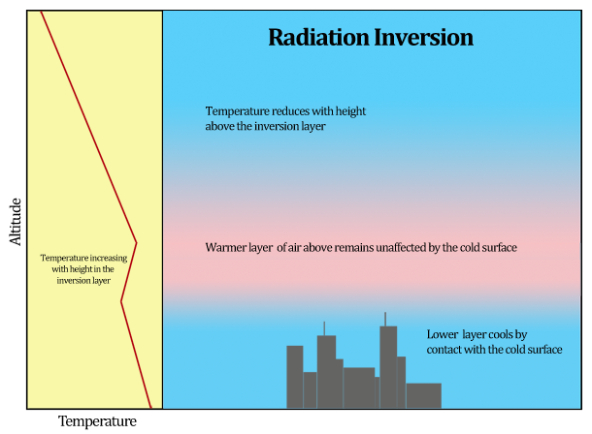
Inversion layer

Slide 9
What’s going on in the troposphere?
Nearly all
weather (clouds, rain, tornados, hurricanes, snow)
anthropogenic (human-caused) pollution
transport of anthropogenic and natural chemicals (think dust storms, wildfires)
warfare related emissions (weaponized aerosols)
molecules relevant to climate change (because most of the mass is here).
What’s not?

Slide 10
Visualized
Video Credit: NASA/Goddard Space Flight Center Scientific Visualization Studio
Pay attention to southern hemisphere spring!

Slide 11
Outliers: How NASA “missed” the ozone hole
“Our software had flags for ozone that was lower than 180 DU, a value lower than had ever been reliably reported prior to 1983.
In 1984, before publication of the Farman paper, we noticed a sudden increase in ‘low value’ from October of 1983. [...]
As the first one in print, he gets full credit for discovery of the ozone hole. It makes a great story to talk about how NASA "missed" the ozone hole, but it isn't quite true.”

Slide 12
Practical uses for atmospheric measurements
Air quality control and monitoring (including airborne pathogens)
Better prediction of tornadoes and hurricanes (improve early warning)
Changes in patterns (rain, storm tracks) due to changing climate
Monitoring greenhouse gases and short-lived climate forcers (like soot).
Cross-border pollution issues

Slide 13
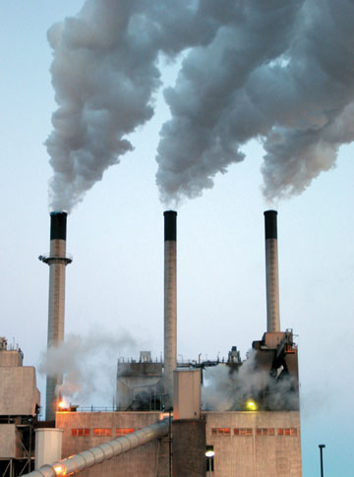
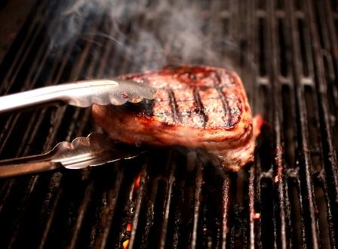
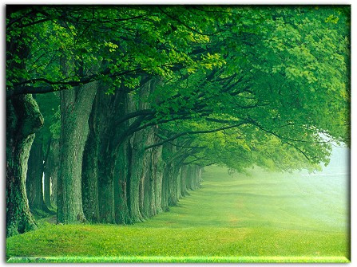
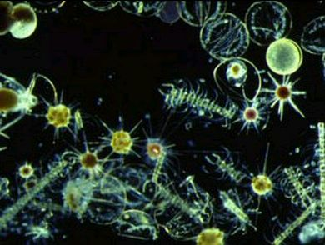
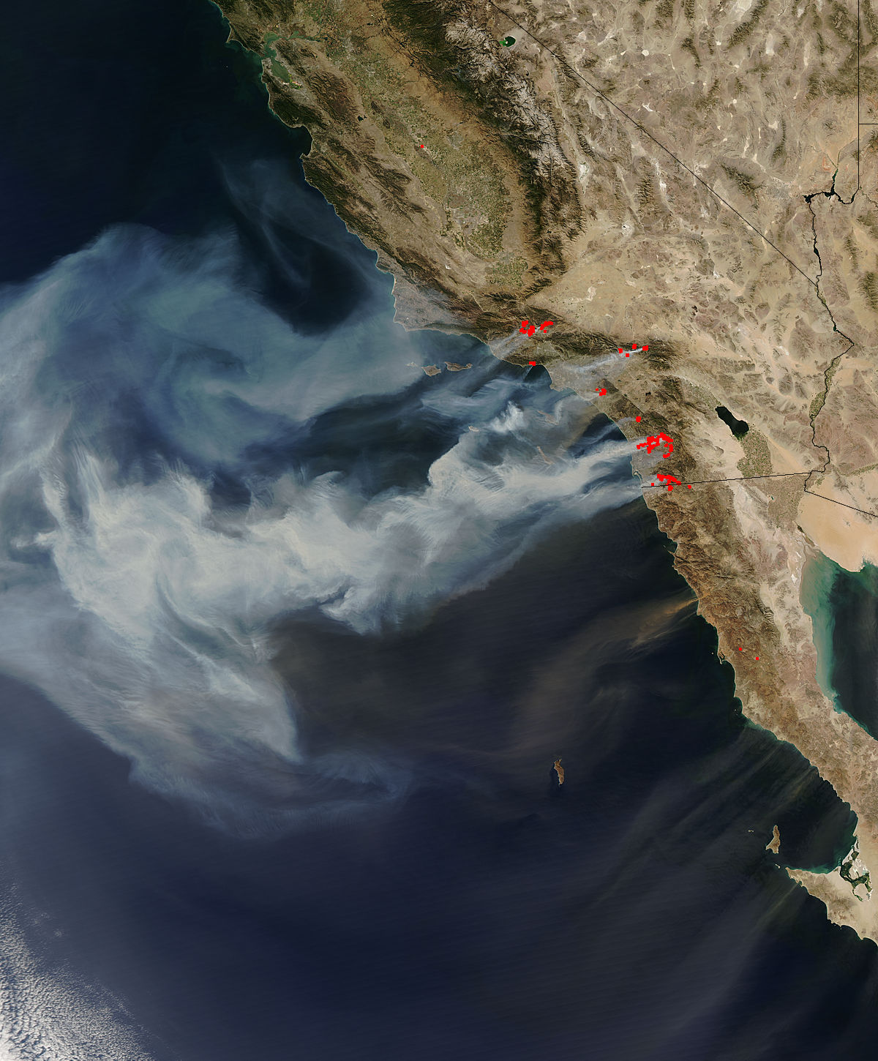
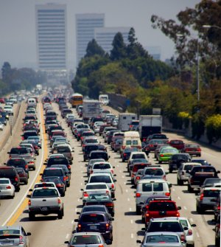
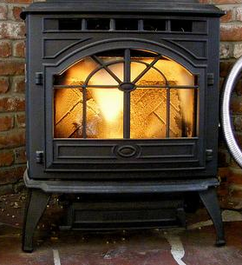
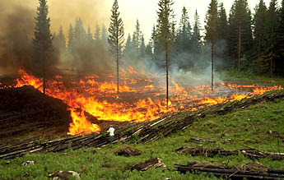
Introduction to Atmospheric Aerosols: Particle Sources
Coal burning
Dust
Sea spray
Bubble bursting
Primary particles are emitted as liquids or solids to the atmosphere.
Secondary particles are emitted as gas phase components and later condense to form particles.
Primary particles that are transported in the atmosphere can accumulate mass from secondary components.
Meat cooking
Plants
Phytoplankton
Automobiles
Wildfires
Heating
Agricultural fires
Notes:
many sources …variety of mechanisms.
fossil fuel combustion (coal and gasoline) and large forest fires.
However, the relative contribution of particle sources VARIES IN BOTH TIME AND SPACE
****next***
….emit BOTH primary particles AND gas-phase precursors to particles,
1.2.3.
meaning that the total particle mass or number produced by each source cannot be measured simply at the source itself…

Slide 14
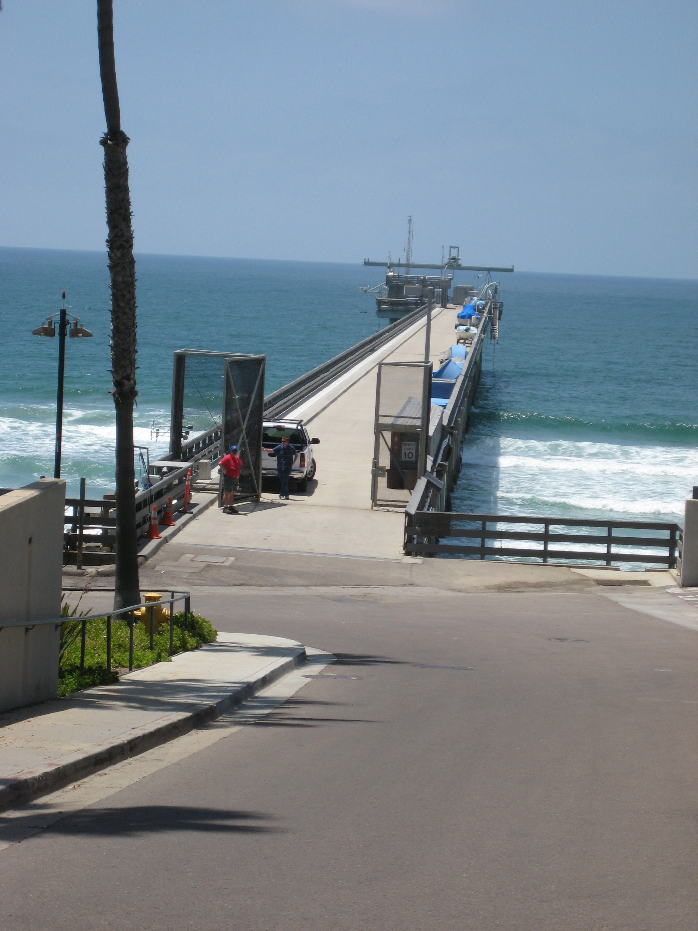
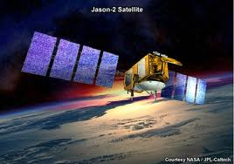
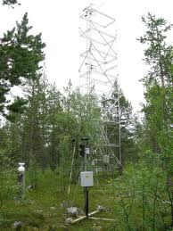
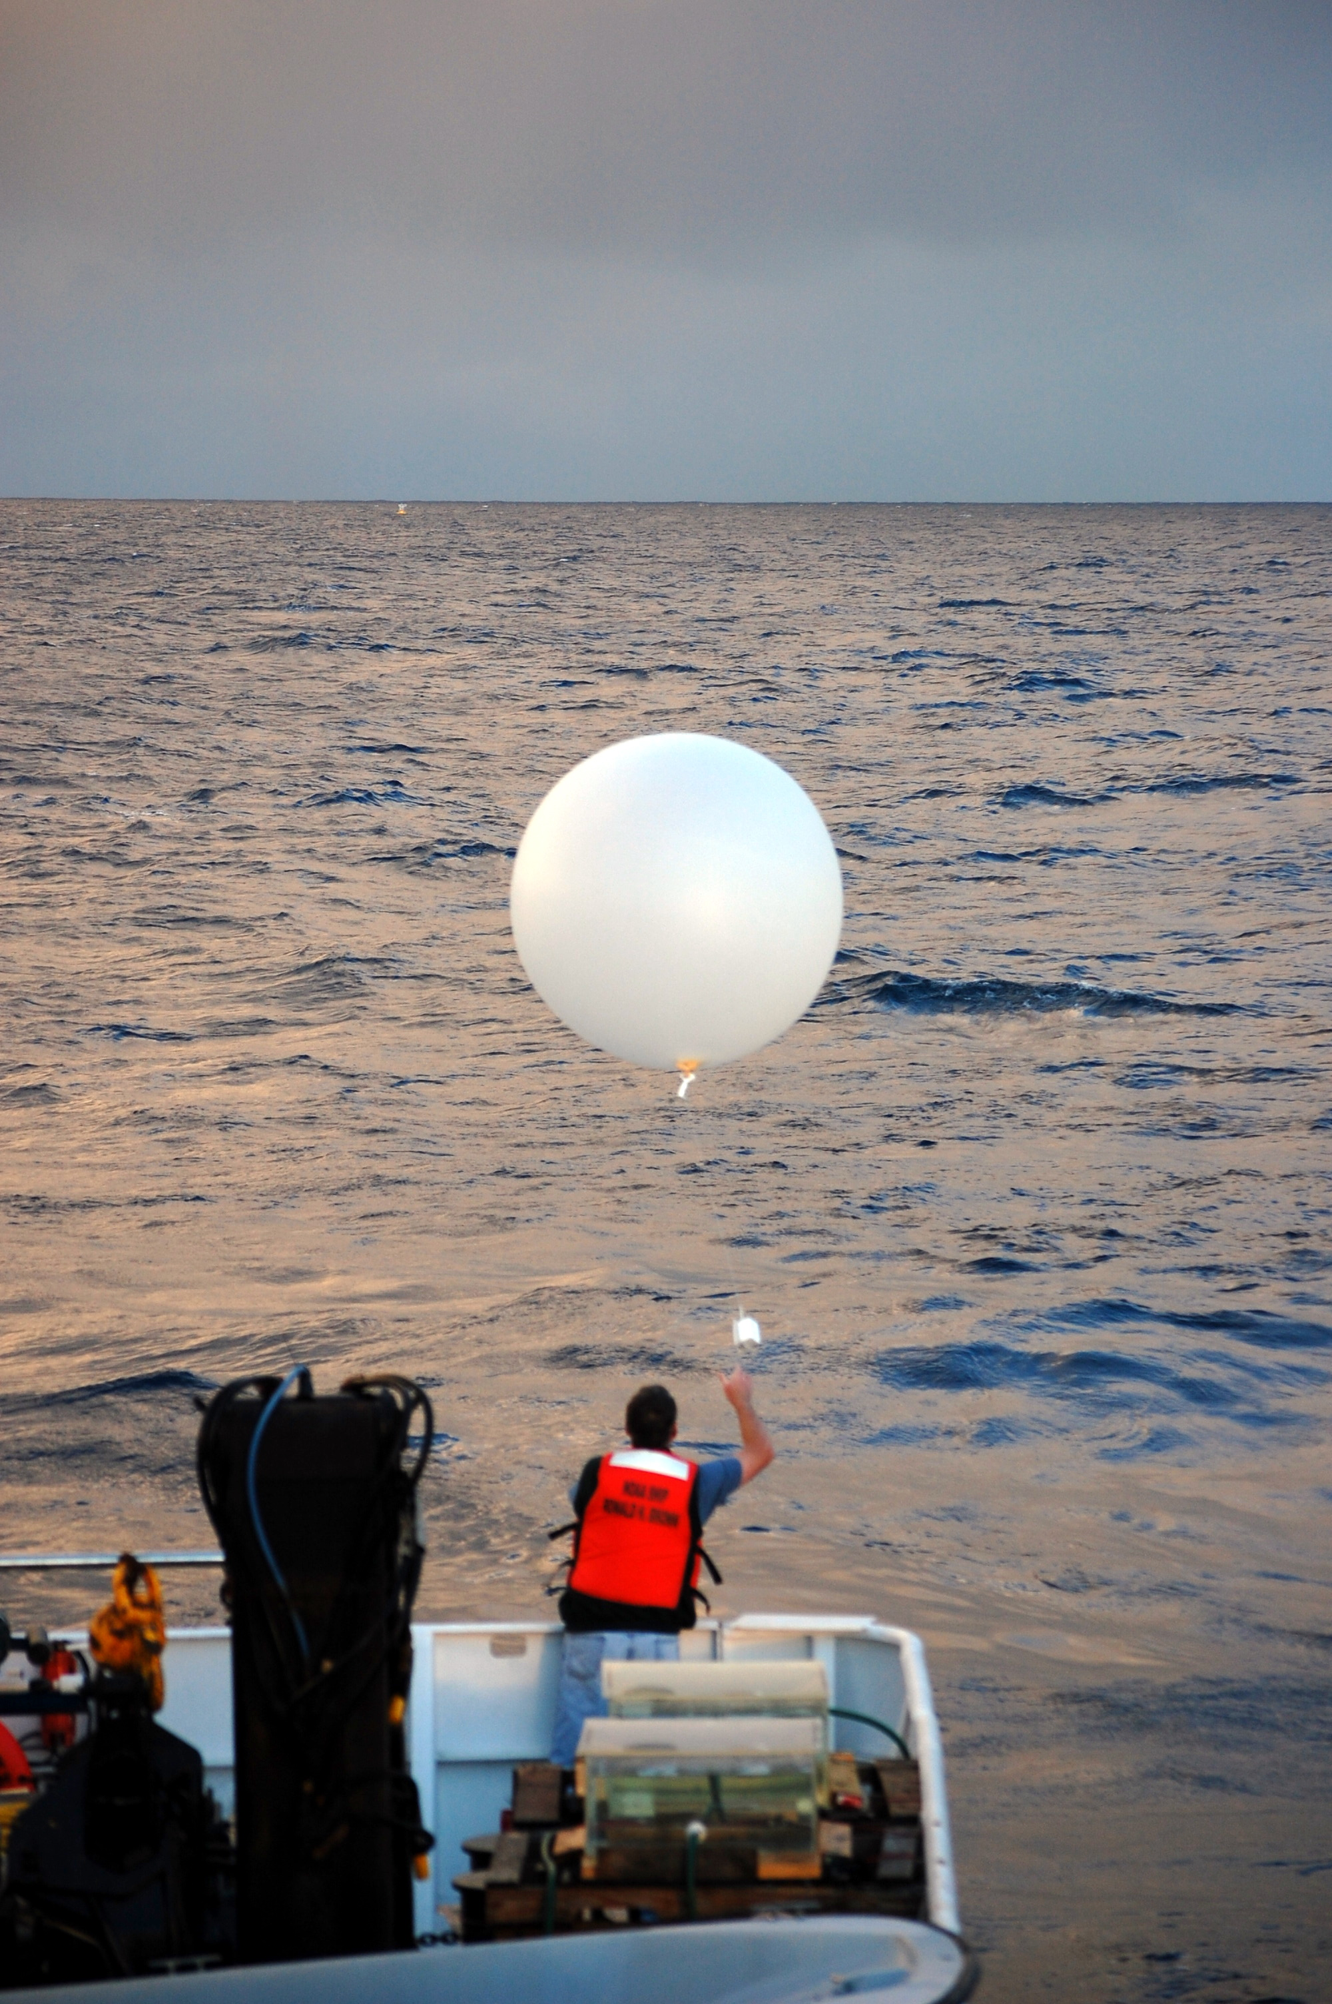
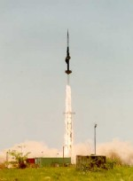
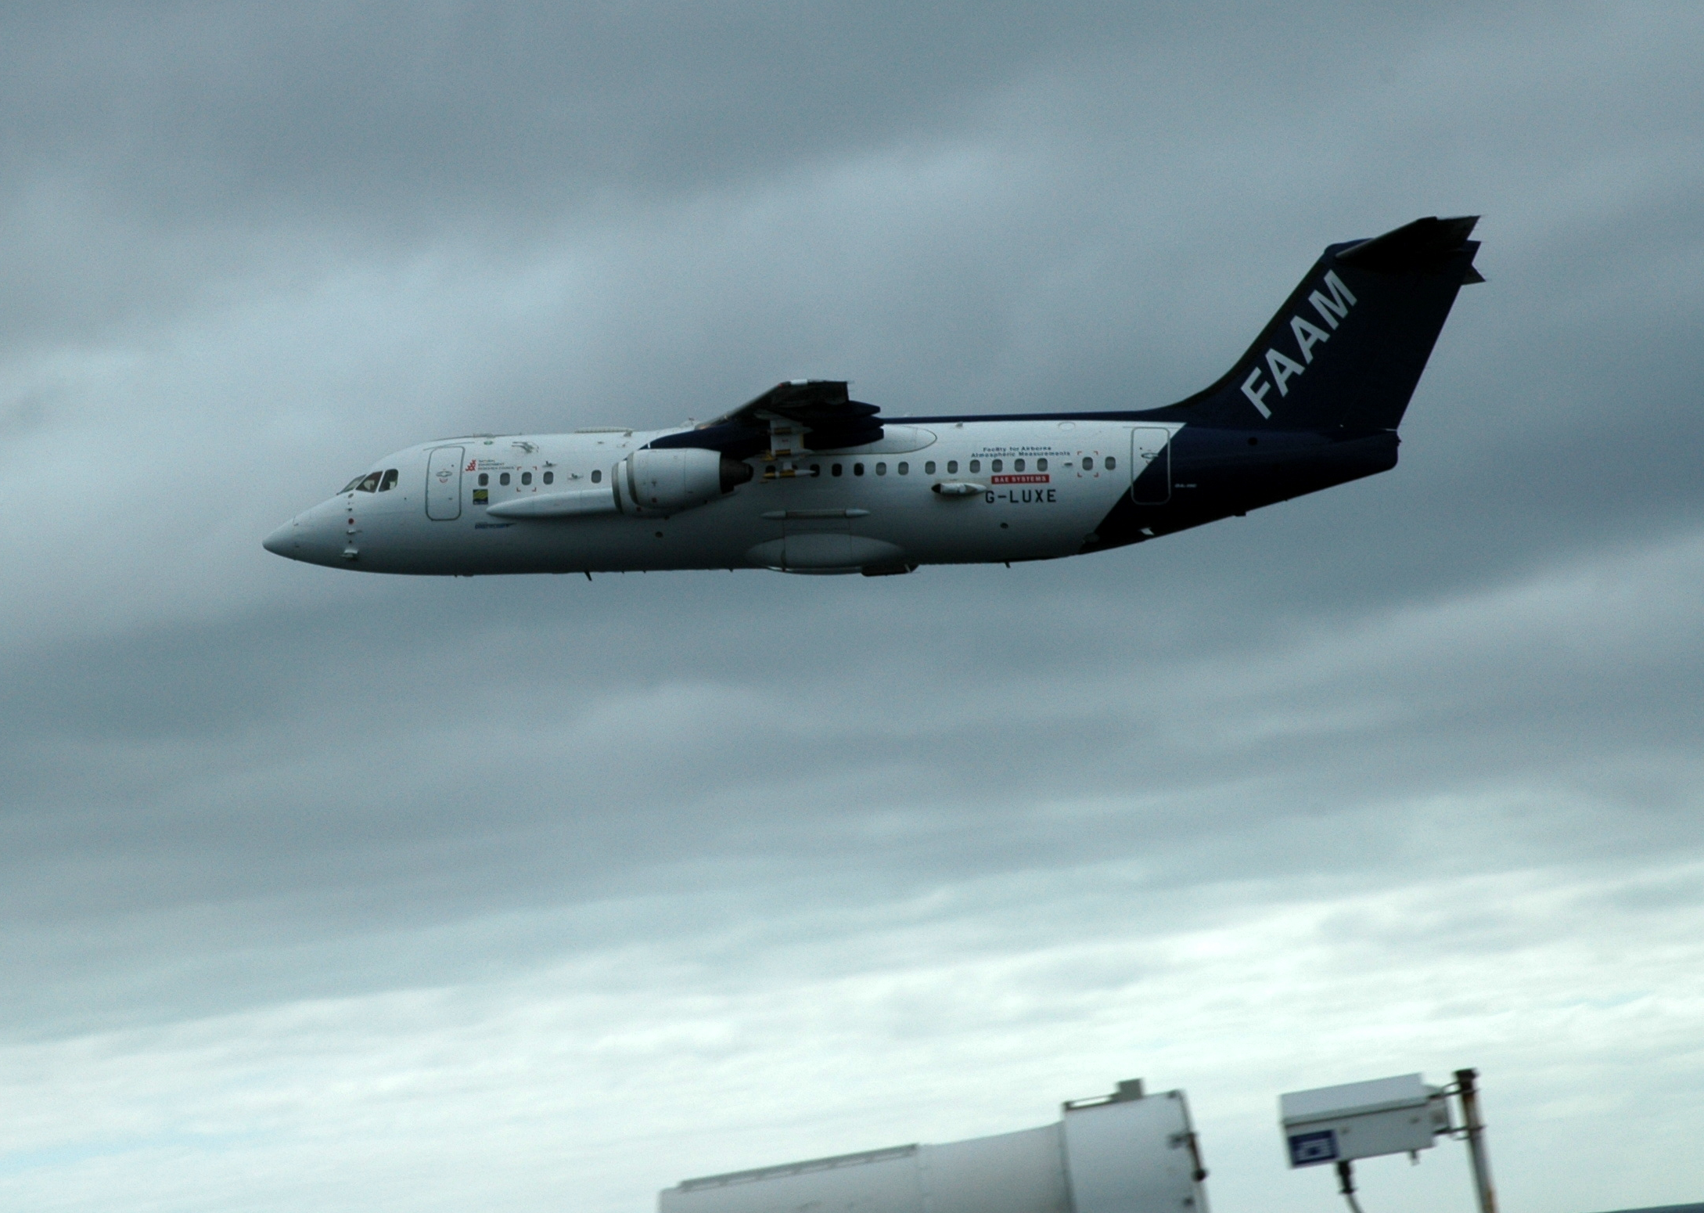
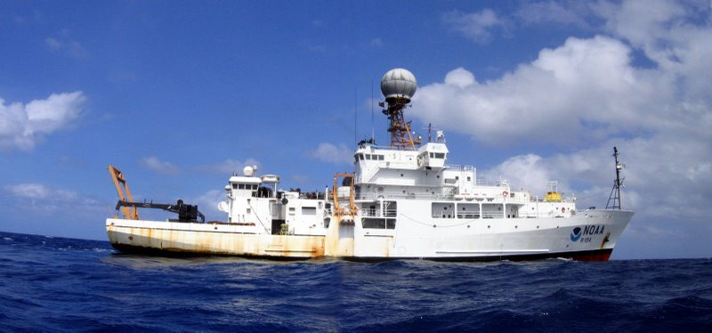
Where are measurements made? And how?

Slide 15
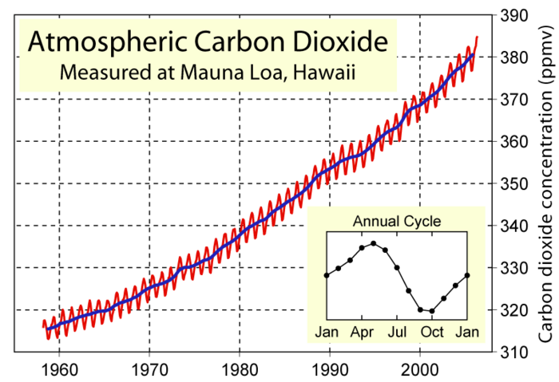
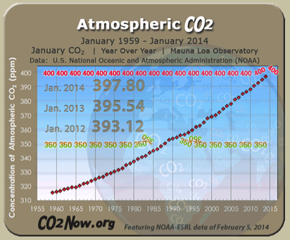
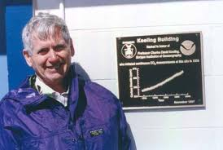
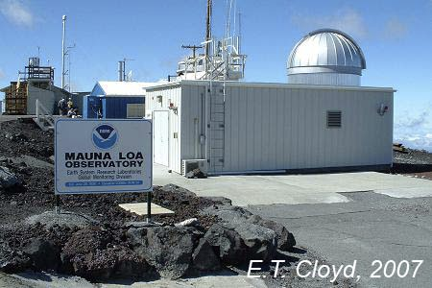
One of the most important atmospheric measurements of our time
Charles David Keeling

Slide 16
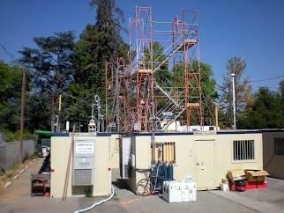
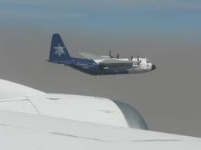
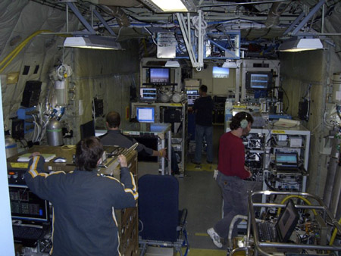
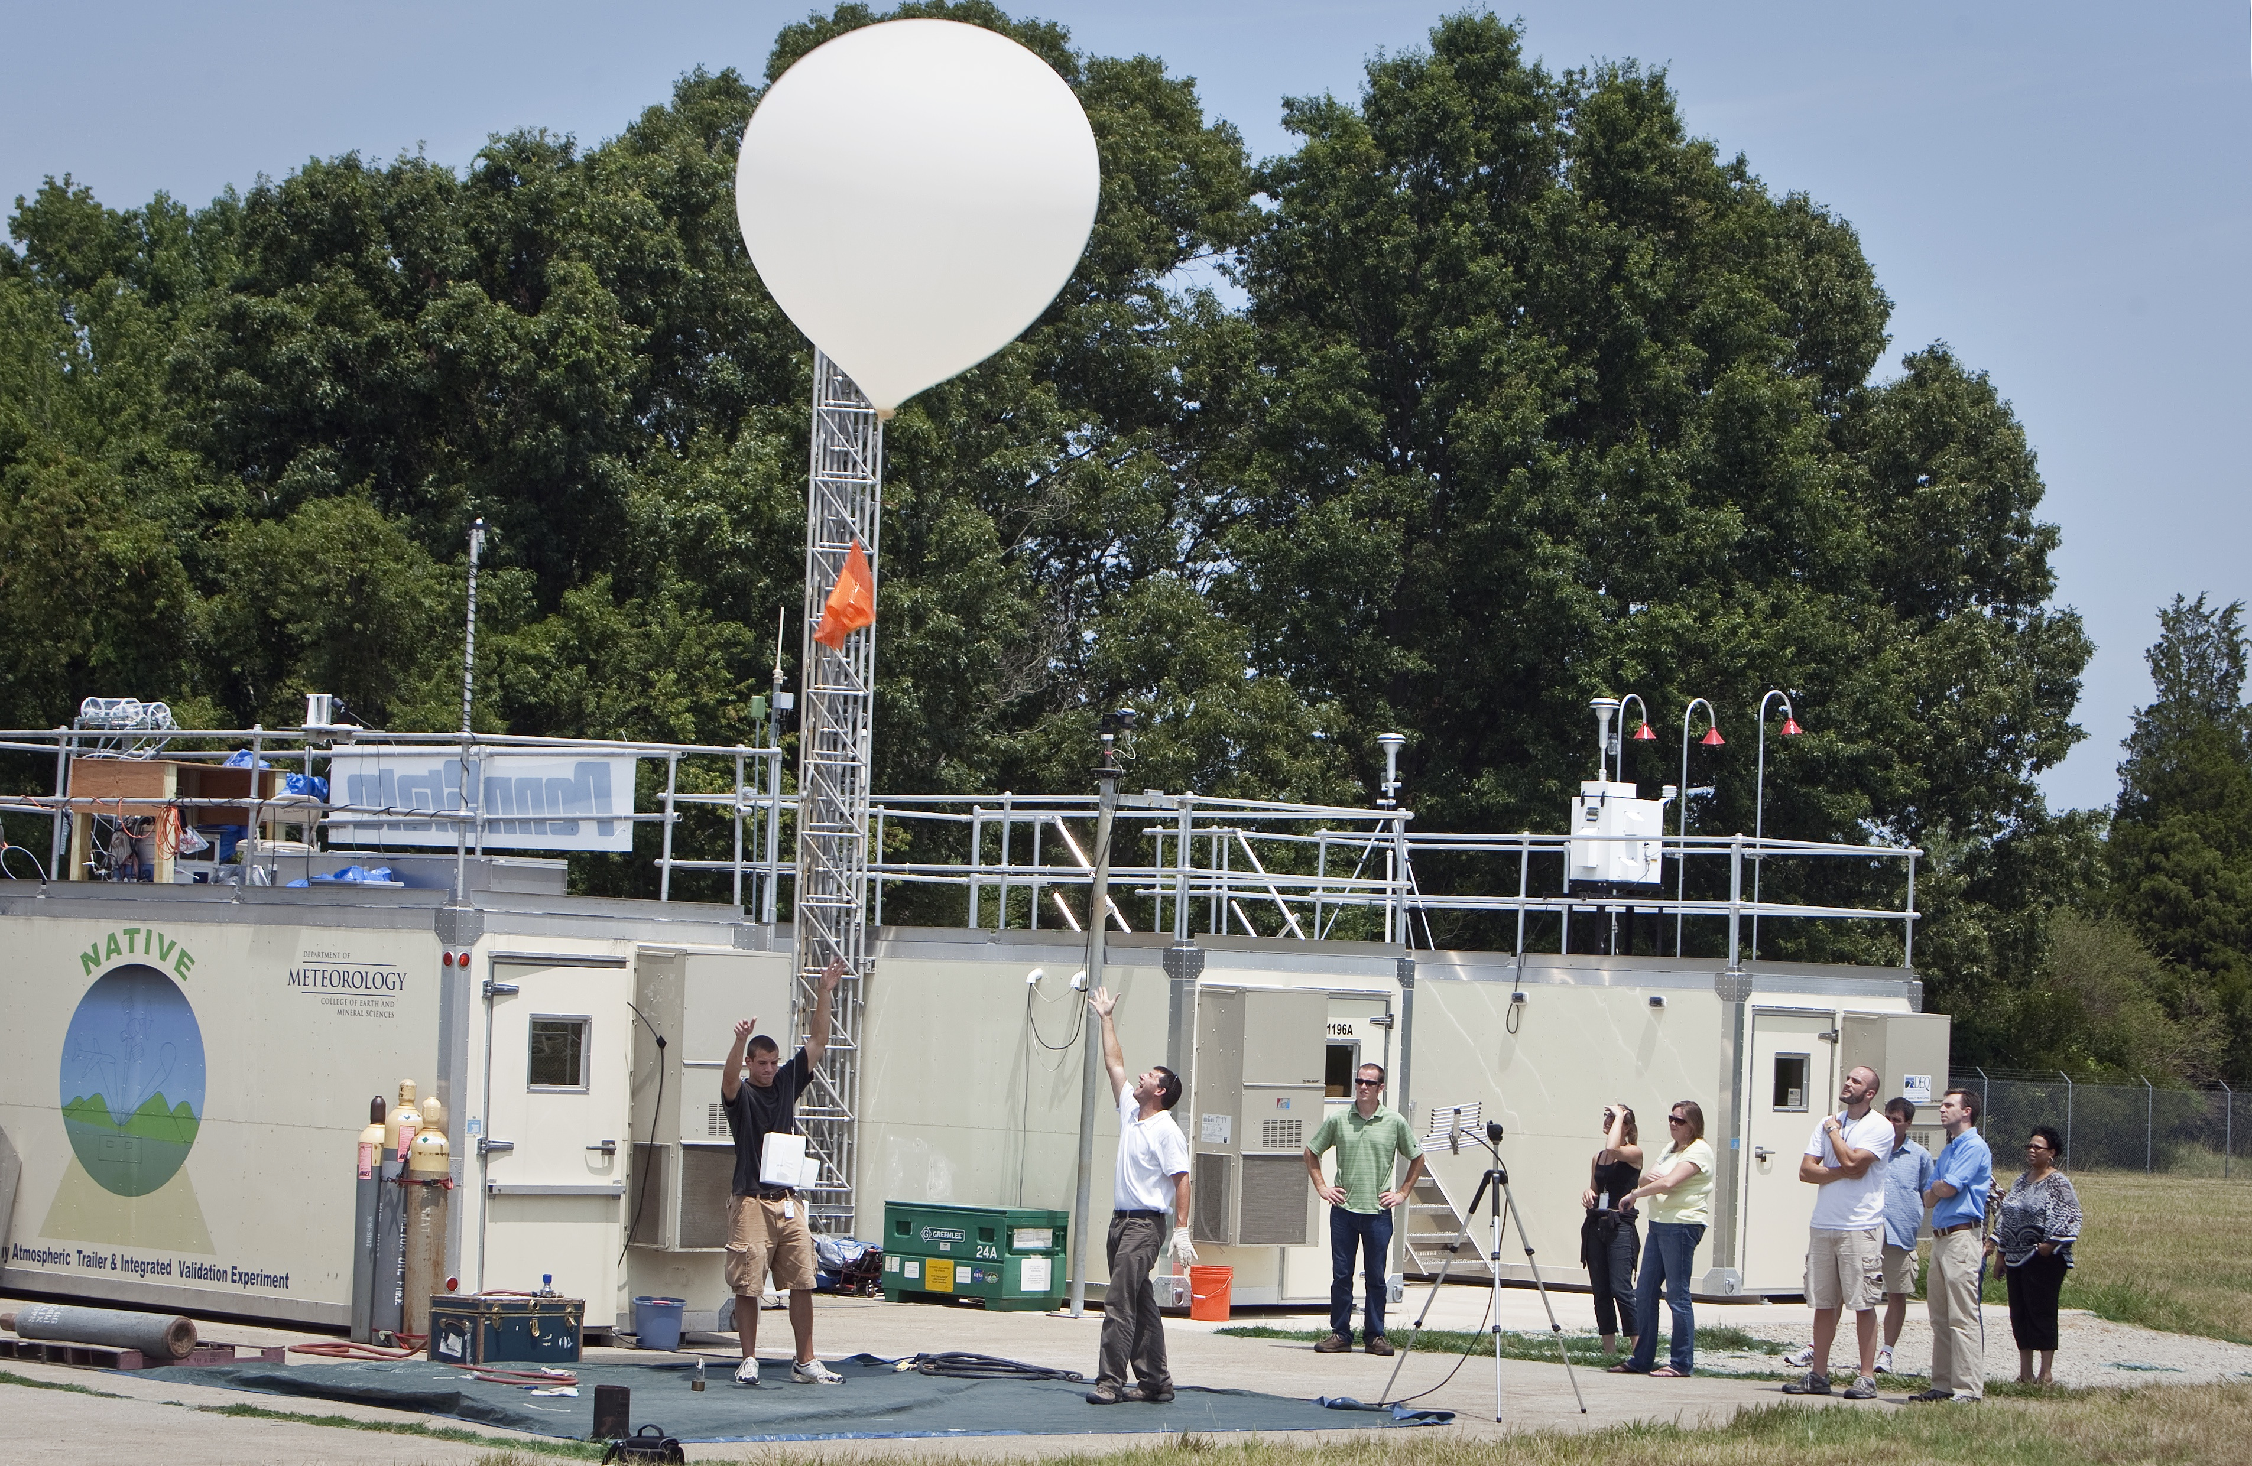
Importance of collaboration
Calnex Field Study
MILAGRO, Mexico City
Inside a C-130 airplane during MILAGRO

Slide 17
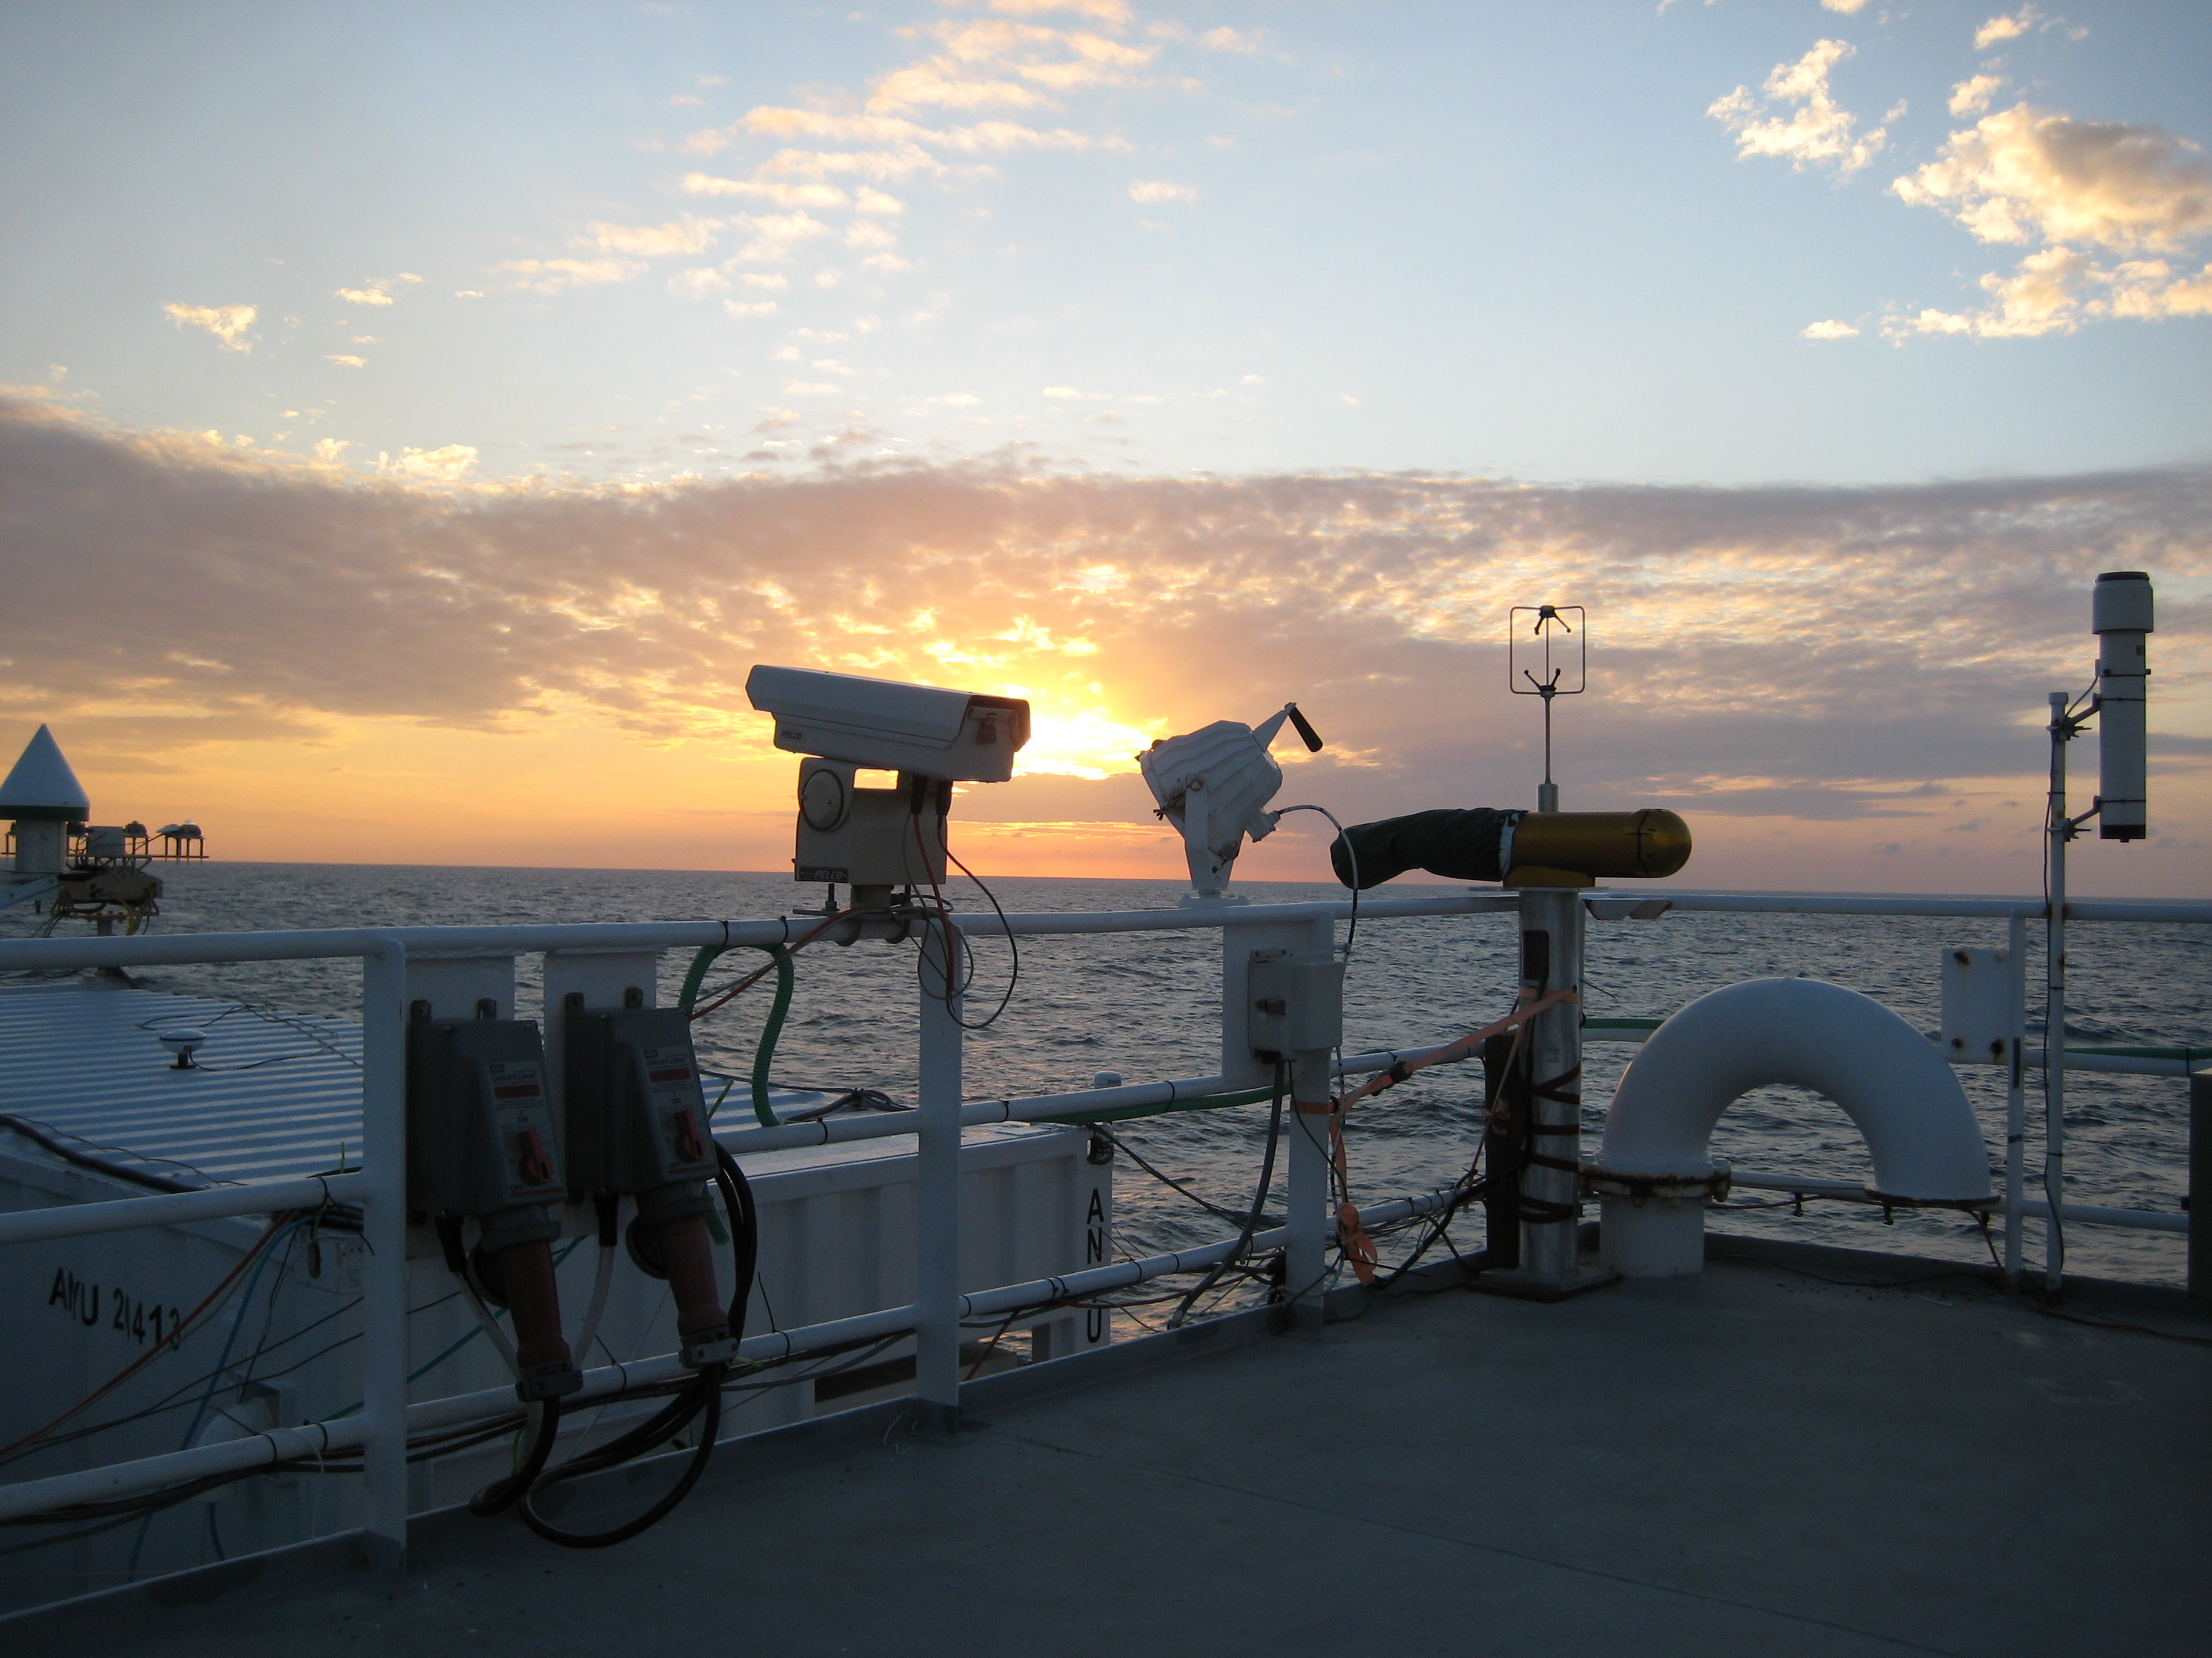
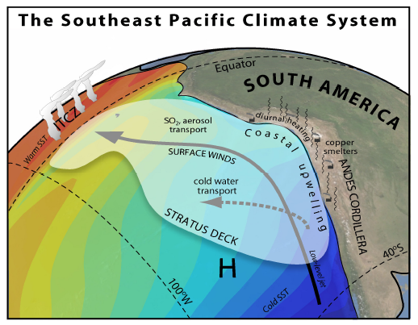
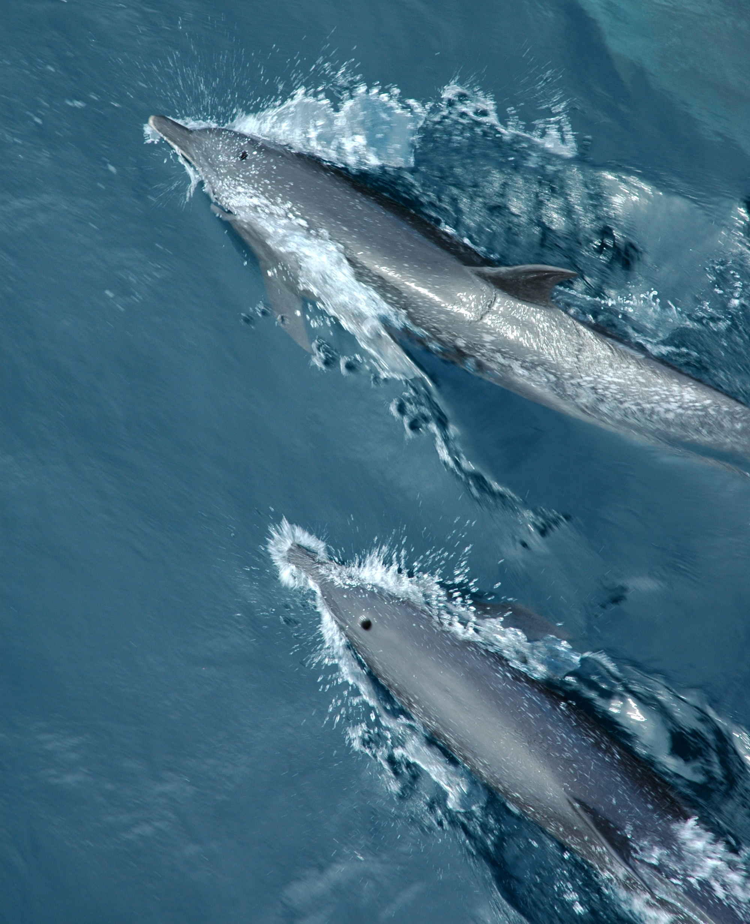
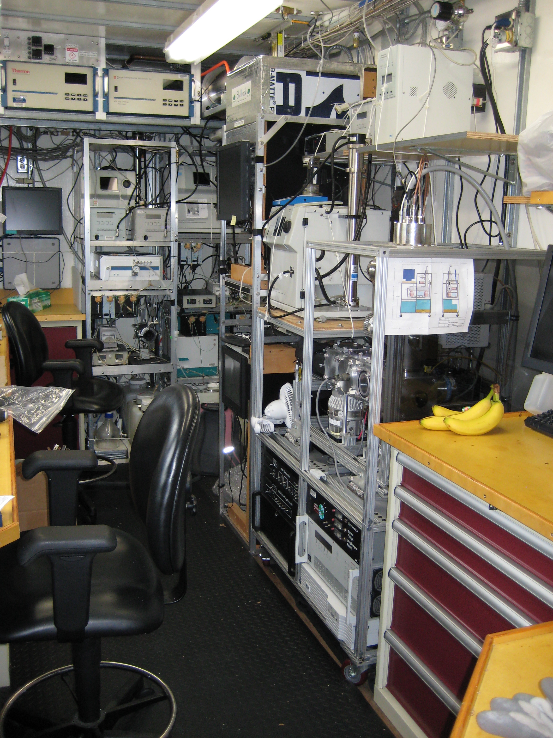
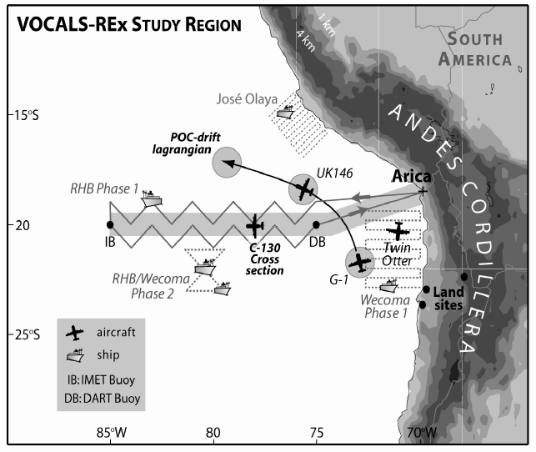
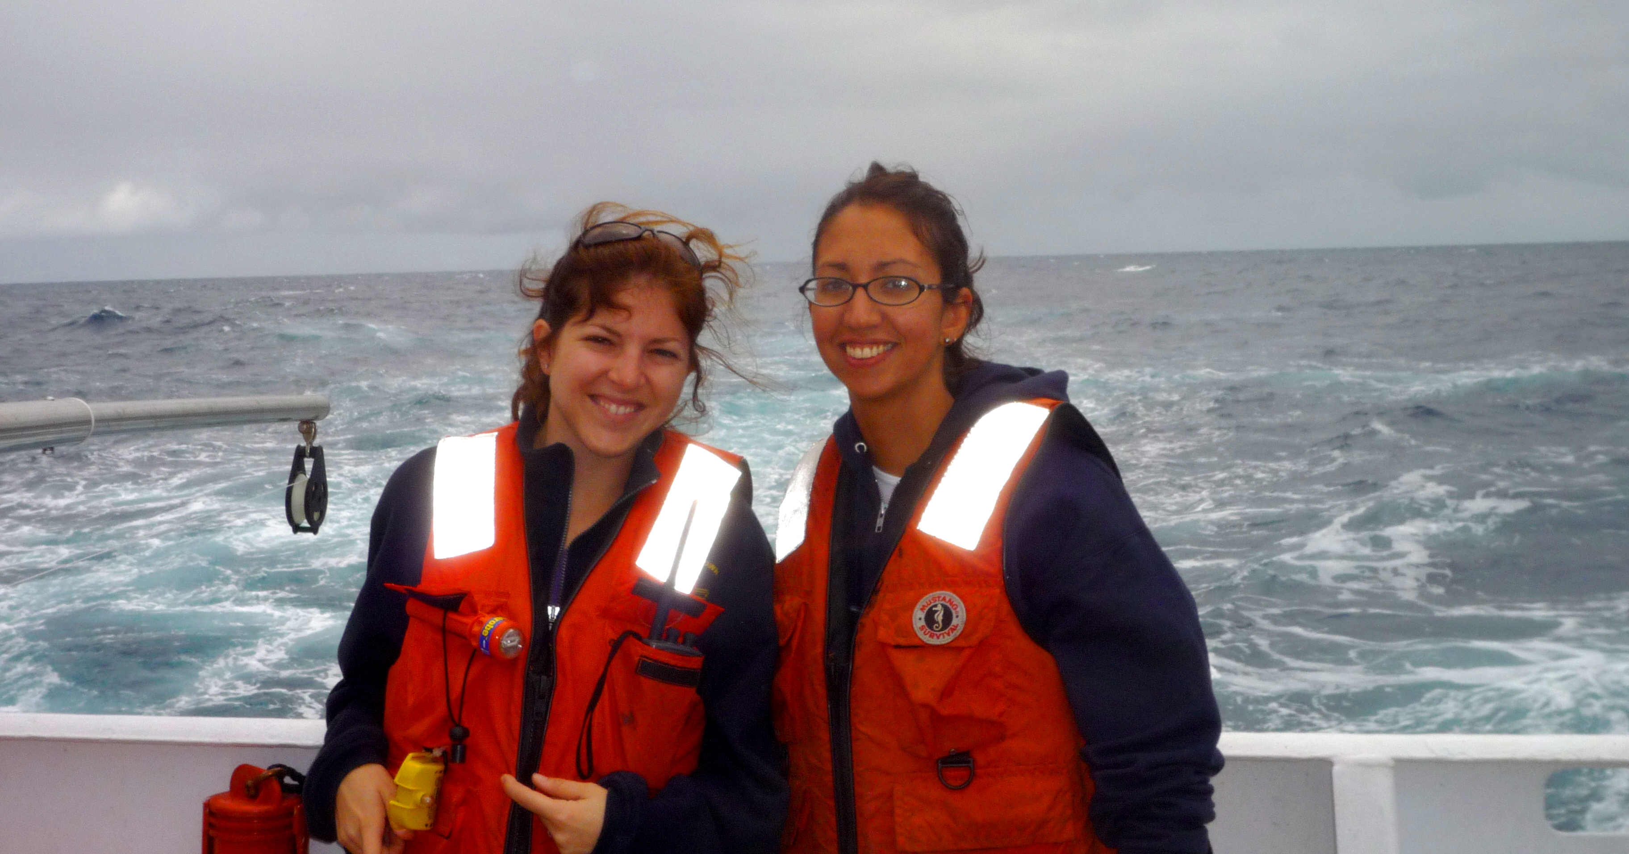
VAMOS Ocean-Cloud-Atmosphere Land-Study Regional Experiment (VOCALS-REx)
Wood et al., 2007 Program Summary
Notes:
This region was the site of the …..
A multiplatform campaign..
…aimed at improving our ability to model air-sea fluxes and aerosol-cloud interactions in this region
This figure shows the decrease in cloud droplet size near the continent, thought to be caused by the outflow of particles from the coasts many copper smelters, emitted sulfate aerosol
This lower figure shows the planned track of the ship (ron brown) to investigate the east-west trend in particle concentration and composition.
I should point out, though..

Slide 18
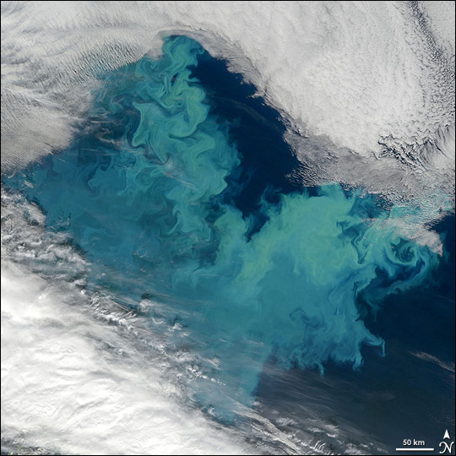
Calcareous Phytoplankton Fragments: Phytoplankton in the air?
Barents Sea on 1 August 2007: bloom covering approximately 150,000 km².
Particles enriched in Ca (relative to sea water) have been attributed to coccolithophores [Sievering et al., 2004].
Other types of phytoplankton (diatoms) have been observed in aerosol samples [Leck and Bigg, 1999;2005].
Coccolithophores produce long-chain hydrocarbons called alkenones, containing many repeating units of -CH₂.
Previously unknown to exist in the atmosphere at 200 nm (thought to be confined to sizes larger than 1 micrometer.
Emiliania huxleyi
Alkenones
Image courtesy of NASA Earth Observatory from the Moderate Resolution Imaging Spectrometer (MODIS) on NASA's Terra satellite
Hawkins and Russell, 2010b
Notes:
Calcareous phytoplankton were most interesting because of their extremely strong signal/noise even in small particles
We attributed these particles to phytoplankton on the basis of…
These phytoplankton are very common in many of the world’s oceans and responsible for about 50% of the calcite production in the oceans.
Their blooms are so large… potentially important part of the primary marine aerosol budget.

Slide 19
MAGIC: Using cargo ships for atmospheric research
Gathering cloud data from Long Beach to Hawaii, marine stratocumulus to

Slide 20
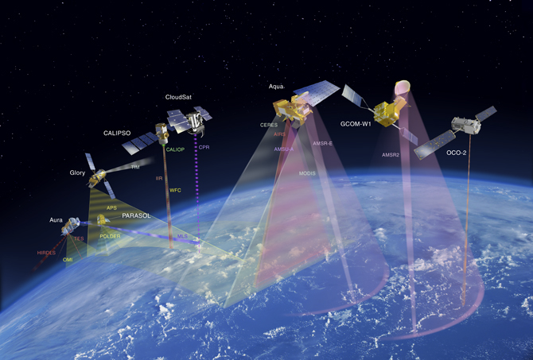
Satellite measurements: NASA’s A-Train
Crosses the equator around 1:30 pm daily.
Measures water vapor, temperature, rainfall, clouds, aerosols, greenhouse gases and more.
Questions only satellites can answer
What is the overall affect of aerosols and clouds on climate?
How much carbon is absorbed by forests?
How will the monsoon cycle react to a warming world?
To what extent will a changing climate change the size and strength of hurricanes?
And what feedback cycles will encourage or discourage climate change?

Slide 21
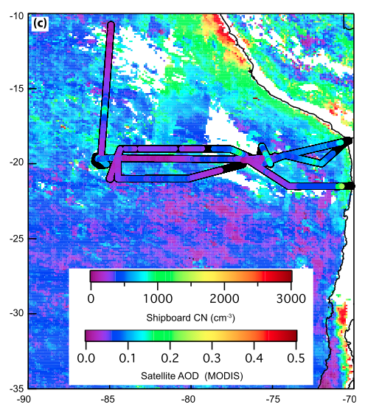
Particle concentration by satellite
AOD is aerosol optical depth
Parameterized by ground measurements
Clouds interfere

Slide 22
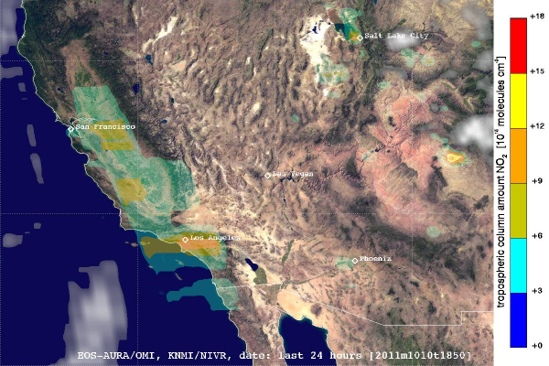
What can satellite spectrophotometry do?
NO₂ is a tracer of fossil fuel combustion-related pollution.
HMC

Slide 23
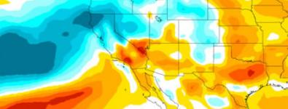
A great place to know about: NCAR
Models
Measurements
Black carbon and sea ice

Slide 24
What might rockets add?
Climate model “ground-truthing”
Repeatable, local measurements
Very high altitude studies (not yours), most useful above altitude for balloons (40 km) and below satellites (recall collaboration!).
Lower cost than a fully instrumented aircraft
Can be launched from remote locations (ships etc).
Vertical profiles help meteorologists understand weather
Complement ground-based measurements
Can be launched at short notice of phenomena

Slide 25
What you might find interesting to measure by rocket
Temperature, pressure, light intensity, relative humidity, and average wind speed.
Trace gas (e.g. CO) concentration and particulate concentration.
CO₂, which should be elevated below the inversion layer

Slide 26
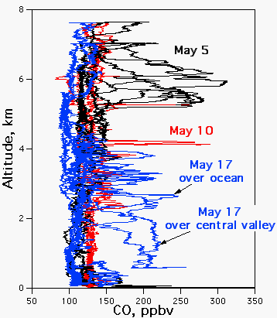
What’s cool about CO?
Major sources are anthropogenic (combustion) and photochemical processing of other pollutants
60 day life time
About 1000 Tg C per year from human sources (compare to 150 Tg C per year natural)
It makes a great tracer for anthropogenic activity (people normalize their measurements to CO to account for dilution)
http://www.esrl.noaa.gov/csd/projects/itct/2k2/data/images/altco.png

Slide 27
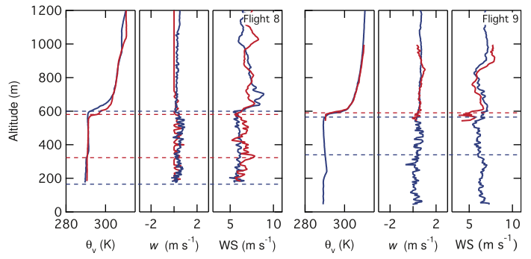
Vertical Profiles are telling
Potential temperature, vertical velocity, and wind speed

Slide 28
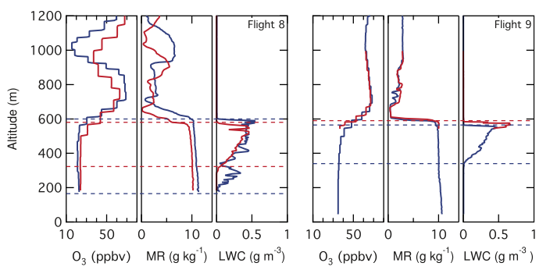
Cloud layers in vertical profiles
Ozone, water vapor mixing ratio, and liquid water content

Slide 29
Coupling rockets with models

Slide 30
NOAA’s HYSPLIT Model

Slide 31
NOAA’s HYSPLIT Model
Instructions:
Go to http://ready.arl.noaa.gov/HYSPLIT_traj.php
Select Compute archive trajectories
Leave “Number of locations” at 1, and use the normal type
Select the EDAS 40km 2004-present meteorological data set
Select your location one of three ways (today I picked Lat/Lon for Claremont, 34.0967°N and 117.7189°W, use negative for west))
Depending on how far back you want your trajectory to start, pick the date (I’m using ‘current15days’ here).
Select “backward” as the direction
Pick the time your rocket was sampling, in UTC time.
Select the run time (how far back in time you want to model).
Pick your desired altitude
Pick your plot style and features and output data type (Google Earth is possible)
Request trajectory, and wait!

Slide 32
Beijing smog problem – exacerbated by stagnant air and shallow boundary layer
http://www.cnn.com/2013/01/14/world/asia/china-smog-blanket

Slide 33
Want to do atmospheric research at Mudd?
Engineers make EXCELLENT atmospheric scientists
Jonpaul Littleton – built a fog chamber to simulate fog in the Hawkins lab
Automate instruments (Labview), set up reaction chambers, and design collection devices.

Slide 34
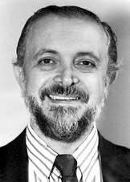
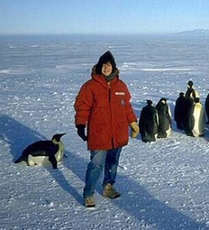
The Ozone Hole Story
1973: Molina is a
Postdoc with Roland, hypothesized that CFCs could destroy O₃
1983-1984: The Total Ozone Monitoring group at NASA notices an increase in “Low Value” flags in October data
1986: Mission to Antarctica in local spring (August) organized by S. Solomon (NOAA)
1984: Joseph Farmer and colleagues at British Antarctic Survey measure O₃ with a Dobson Spectrophotometer and discovered that it was 35% lower than 1960 levels
1985: Farmer and NASA publicize results and the term “ozone hole” enters existence after satellite measurements reveal the shape and extent of the depletion.
1978: Bans on aerosol CFCs but use increased in general, due to skeptics/industry

Slide 35
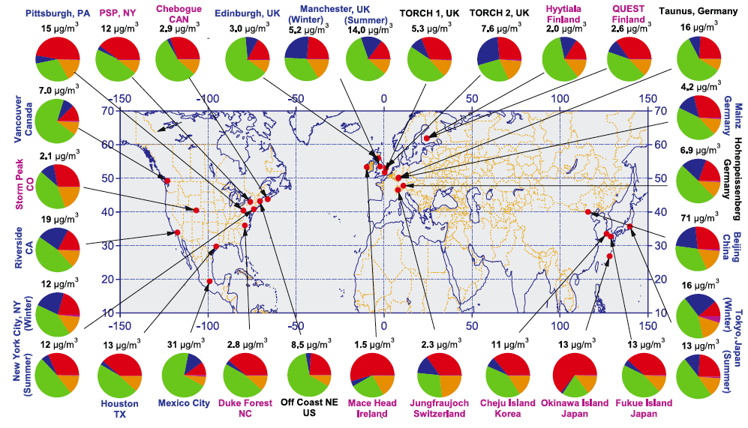
Introduction to Atmospheric Aerosols: Organic Components are Substantial
Submicron particle composition from an aerosol mass spectrometer:
organic and inorganic (sulfate, nitrate, and ammonium) components
Figure from Zhang et al., 2007 GRL

