Slide 1
Basic Electrical Measurements
Matthew Spencer
E80 Lecture 4
2016-01-27
Many thanks to Prof. Lee for her excellent work on the lecture figures

Slide 2
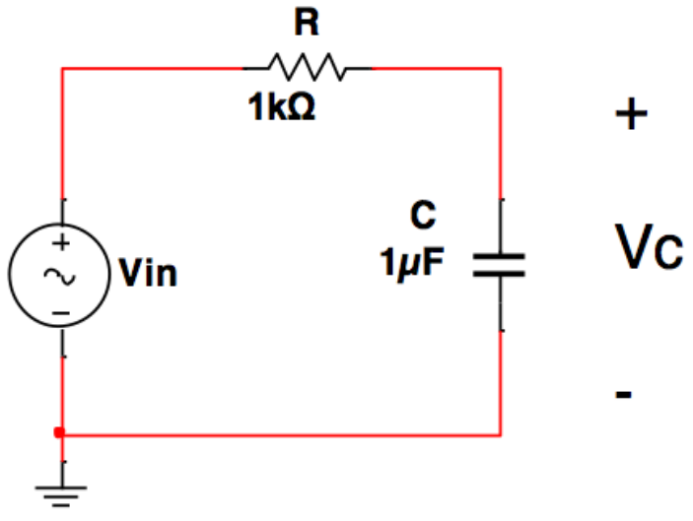
Why are We Talking?
GIVEN: Schematics
DESIRE: Experiments
http://positron.hep.upenn.edu/wja/p364/2012/detkin_lab_bench_2012.jpg

Slide 3
The Three Parts of a Schematic
Output:
Multimeter
Oscilloscope
Input:
Signal Generator
Power Supply
Circuit Under Test (CUT):
Breadboard, PCB
Notes:
Our goal for today is to talk about how to turn each of these parts into a physical item on a bench.
I don’t have them with me, but I’ll show you lots of pictures so that you are familiar with them in lab.
Weird order – CUT, OUT, IN

Slide 4
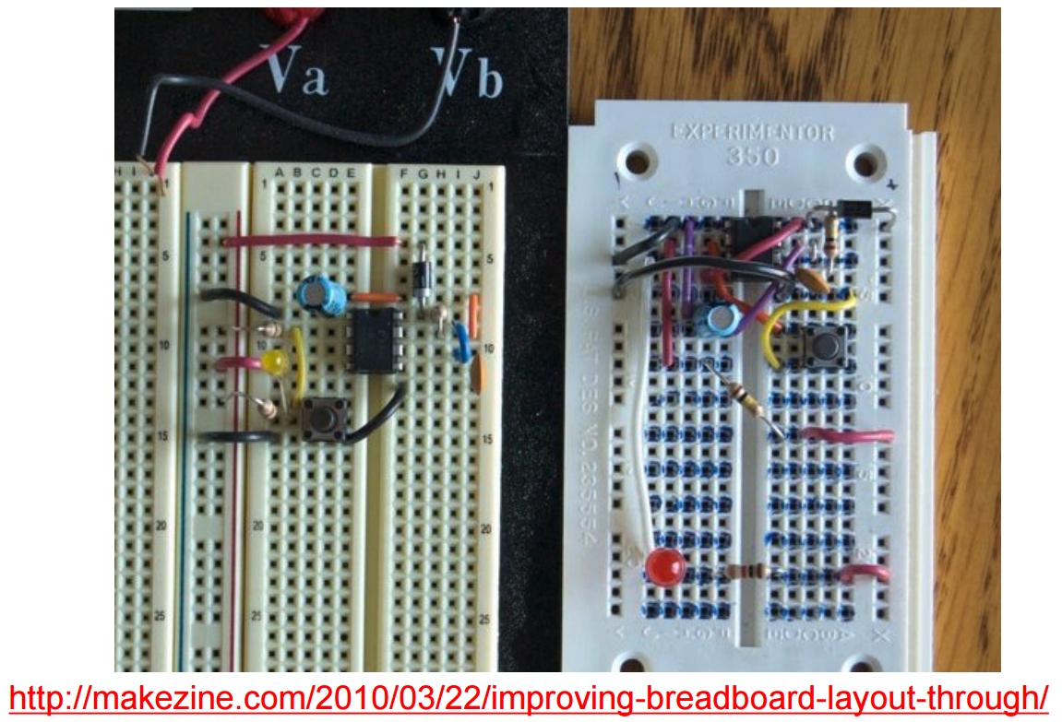
A Circuit Under Test
Stuff to notice:
Breadboard Routing
Layout Sins
Parasitic Elements
Color Coding
Connected
Connected
For Power
Notes:
Wire over chip, sky wires, flying components, weird power busses

Slide 5
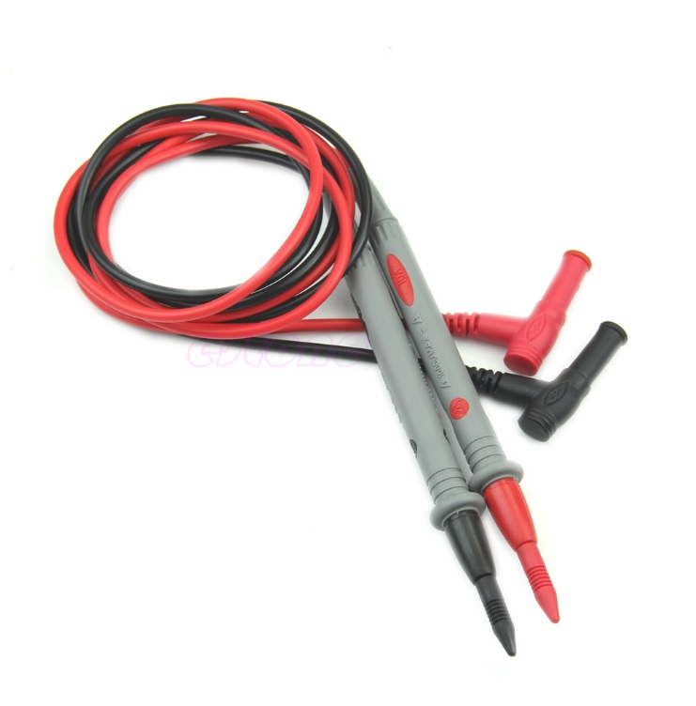
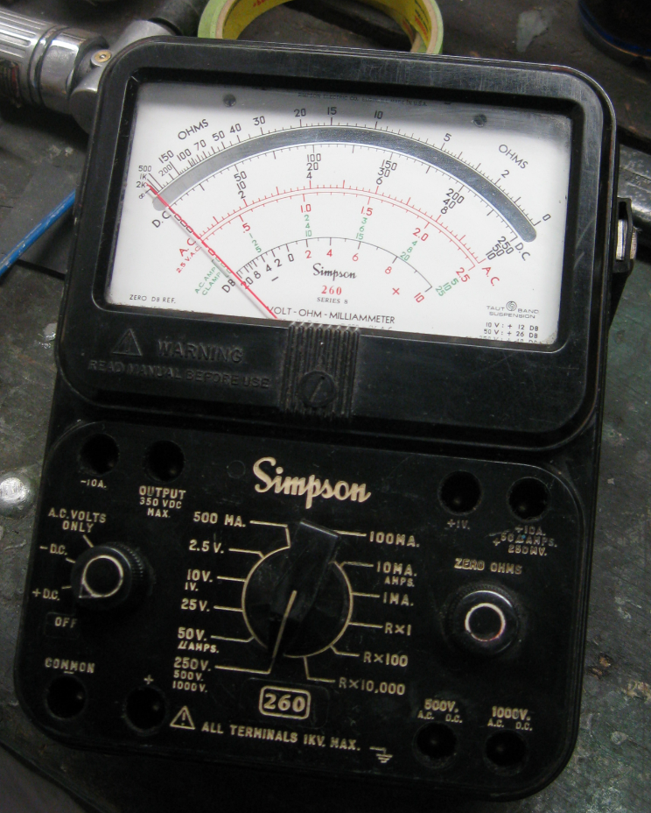
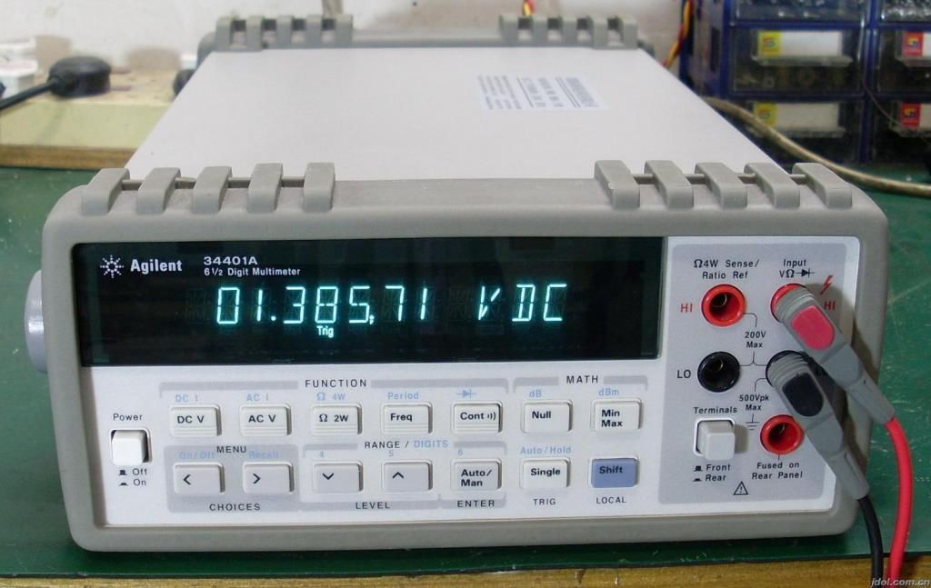
Multimeter
Don’t forget this
Notes:
Names of each device, introduce probes, we’re almost exclusively using the Elenco, multimeter can measure multiple things as a guessing game …
DC voltage, at multiple scales, Resistance (continuity), capacitance, AC Voltage _in RMS V_
NOTE THE AC/DC button
Tricky ideas: why multiple plugs, what the heck is RMS voltage

Slide 6
Two Tricky Things
What the heck does AC RMS Mean?
To the board!
It is one number that describes the amplitude of a sine wave*
Specifically, it is the DC voltage which dissipates the same power in a resistor as a sine wave of amplitude $V_{ZeroPeak}$
$V_{RMS}=V_{ZeroPeak}/√2$ in a sinusoidal wave
Why are there so many plug holes?
Next few slides
Notes:
Do prepare board notes for this → A picture showing all values, and a quick derivation

Slide 7
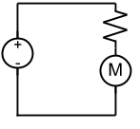
Let’s Do a Current Measurement
Put multimeter in series
Current flows through it
Multimeter must look like a wire to be non-invasive
R

Slide 8
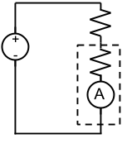
The Multimeter has Impedance
R_ma is needed to take a measurement.
Most of the time, this won’t matter. It could for small R.
Do analysis with equivalent circuit model if necessary.
R
R_ma

Slide 9
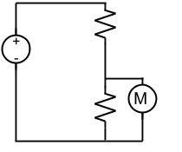
Let’s do a Voltage Measurement
Schematic
Schematic w/ Eq. Ckt Model
R1
R1
R_mv
R2
R2
Notes:
Here’s how to hook it up for a voltage measurement. Do we want R_mv to be big or small if we don’t want to disturb the circuit? Big.
Because we have these two wildly different input impedance modes, we put the plugs into dif

Slide 10
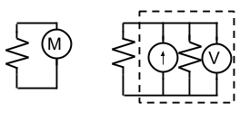
Let’s do a Resistance Measurement
Current source will do weird stuff if it interacts with chips

Slide 11
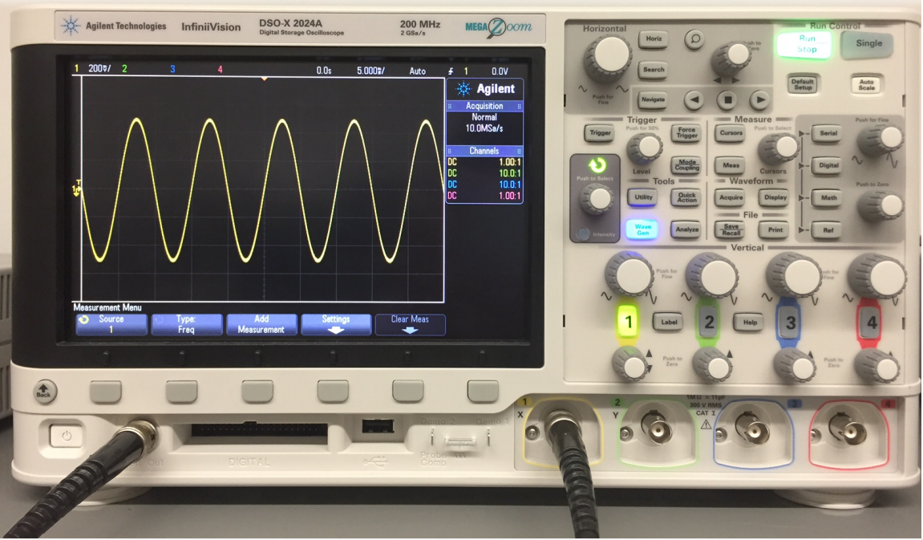
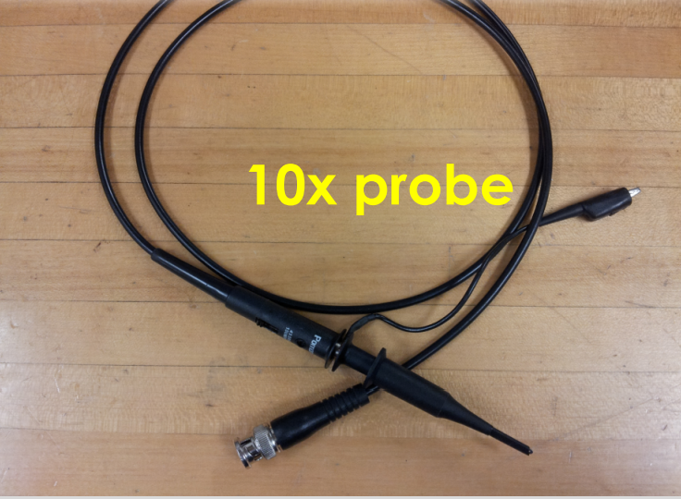
Oscilloscopes
Ground, not like multimeter
Voltage
Time
1x / 10x switch
Leave wires in your board, don’t wrap around probes
Don’t lose probe hats!
Signal
Notes:
Talk about buttons briefly.
Mention that there is an equivalent circuit for this, in fact two depending on probe configuration, but it’s part of lab,
Voltage measurement, so hook up in parallel,
Don’t use BNC connectors on a scope

Slide 12
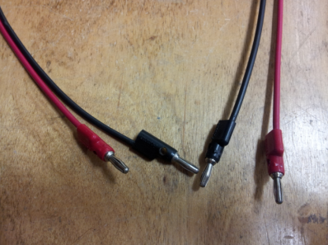
Power Supplies Make DC Voltage
Use this to make negative V
Sets${−1∗V}_{−20}/V_{+20}$
Circuit Ground
“Common” Node
Earth Ground
Connects to wire in wall

Slide 13
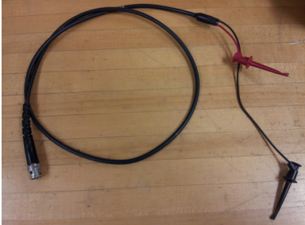
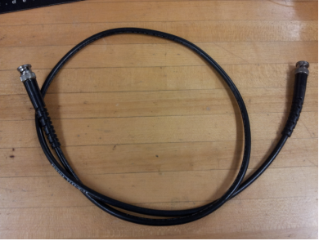
Old Signal Generators
Bad Habit to use these for oscilloscopes
Notes:
Play the capability game,
mention offset, point out the output, point out adjustment arrows and knob, point out shift key

Slide 14
New Signal Generators
Notes:
Works more or less the same way

Slide 15
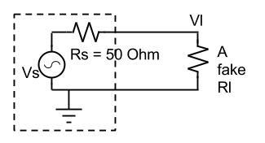
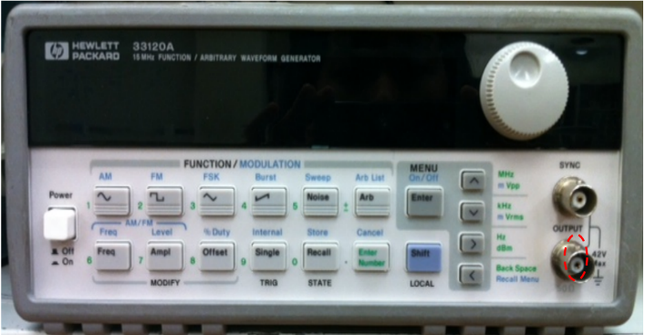
Model of Signal Generators and 50 Ohm/Hi Z
Output term set to 50 Ohm
Vl if fake Rl=50 ohm
Output term set to Hi Z
Vl if fake Rl=infinity
Output term has NO PHYSICAL EFFECT
This confuses _lots_ of people. Use Hi-Z.
I hate the 50 Ohm setting, but it has some historical significance related to high speed measurements.

