Slide 1
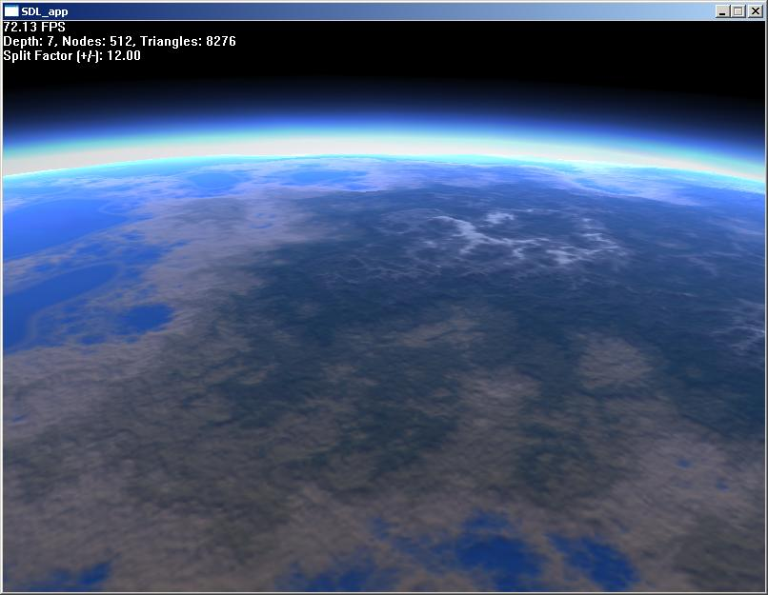
The air up there
Measurements in Atmospheric Science
E80 Spring 2012
Image credit: http://vterrain.org/Atmosphere/

Slide 2
Concepts in Atmospheric Science
Atmospheric science across the disciplines
The basics
Why atmospheric measurements?
Platforms for atmospheric measurements
What you might consider for your rocket

Slide 3
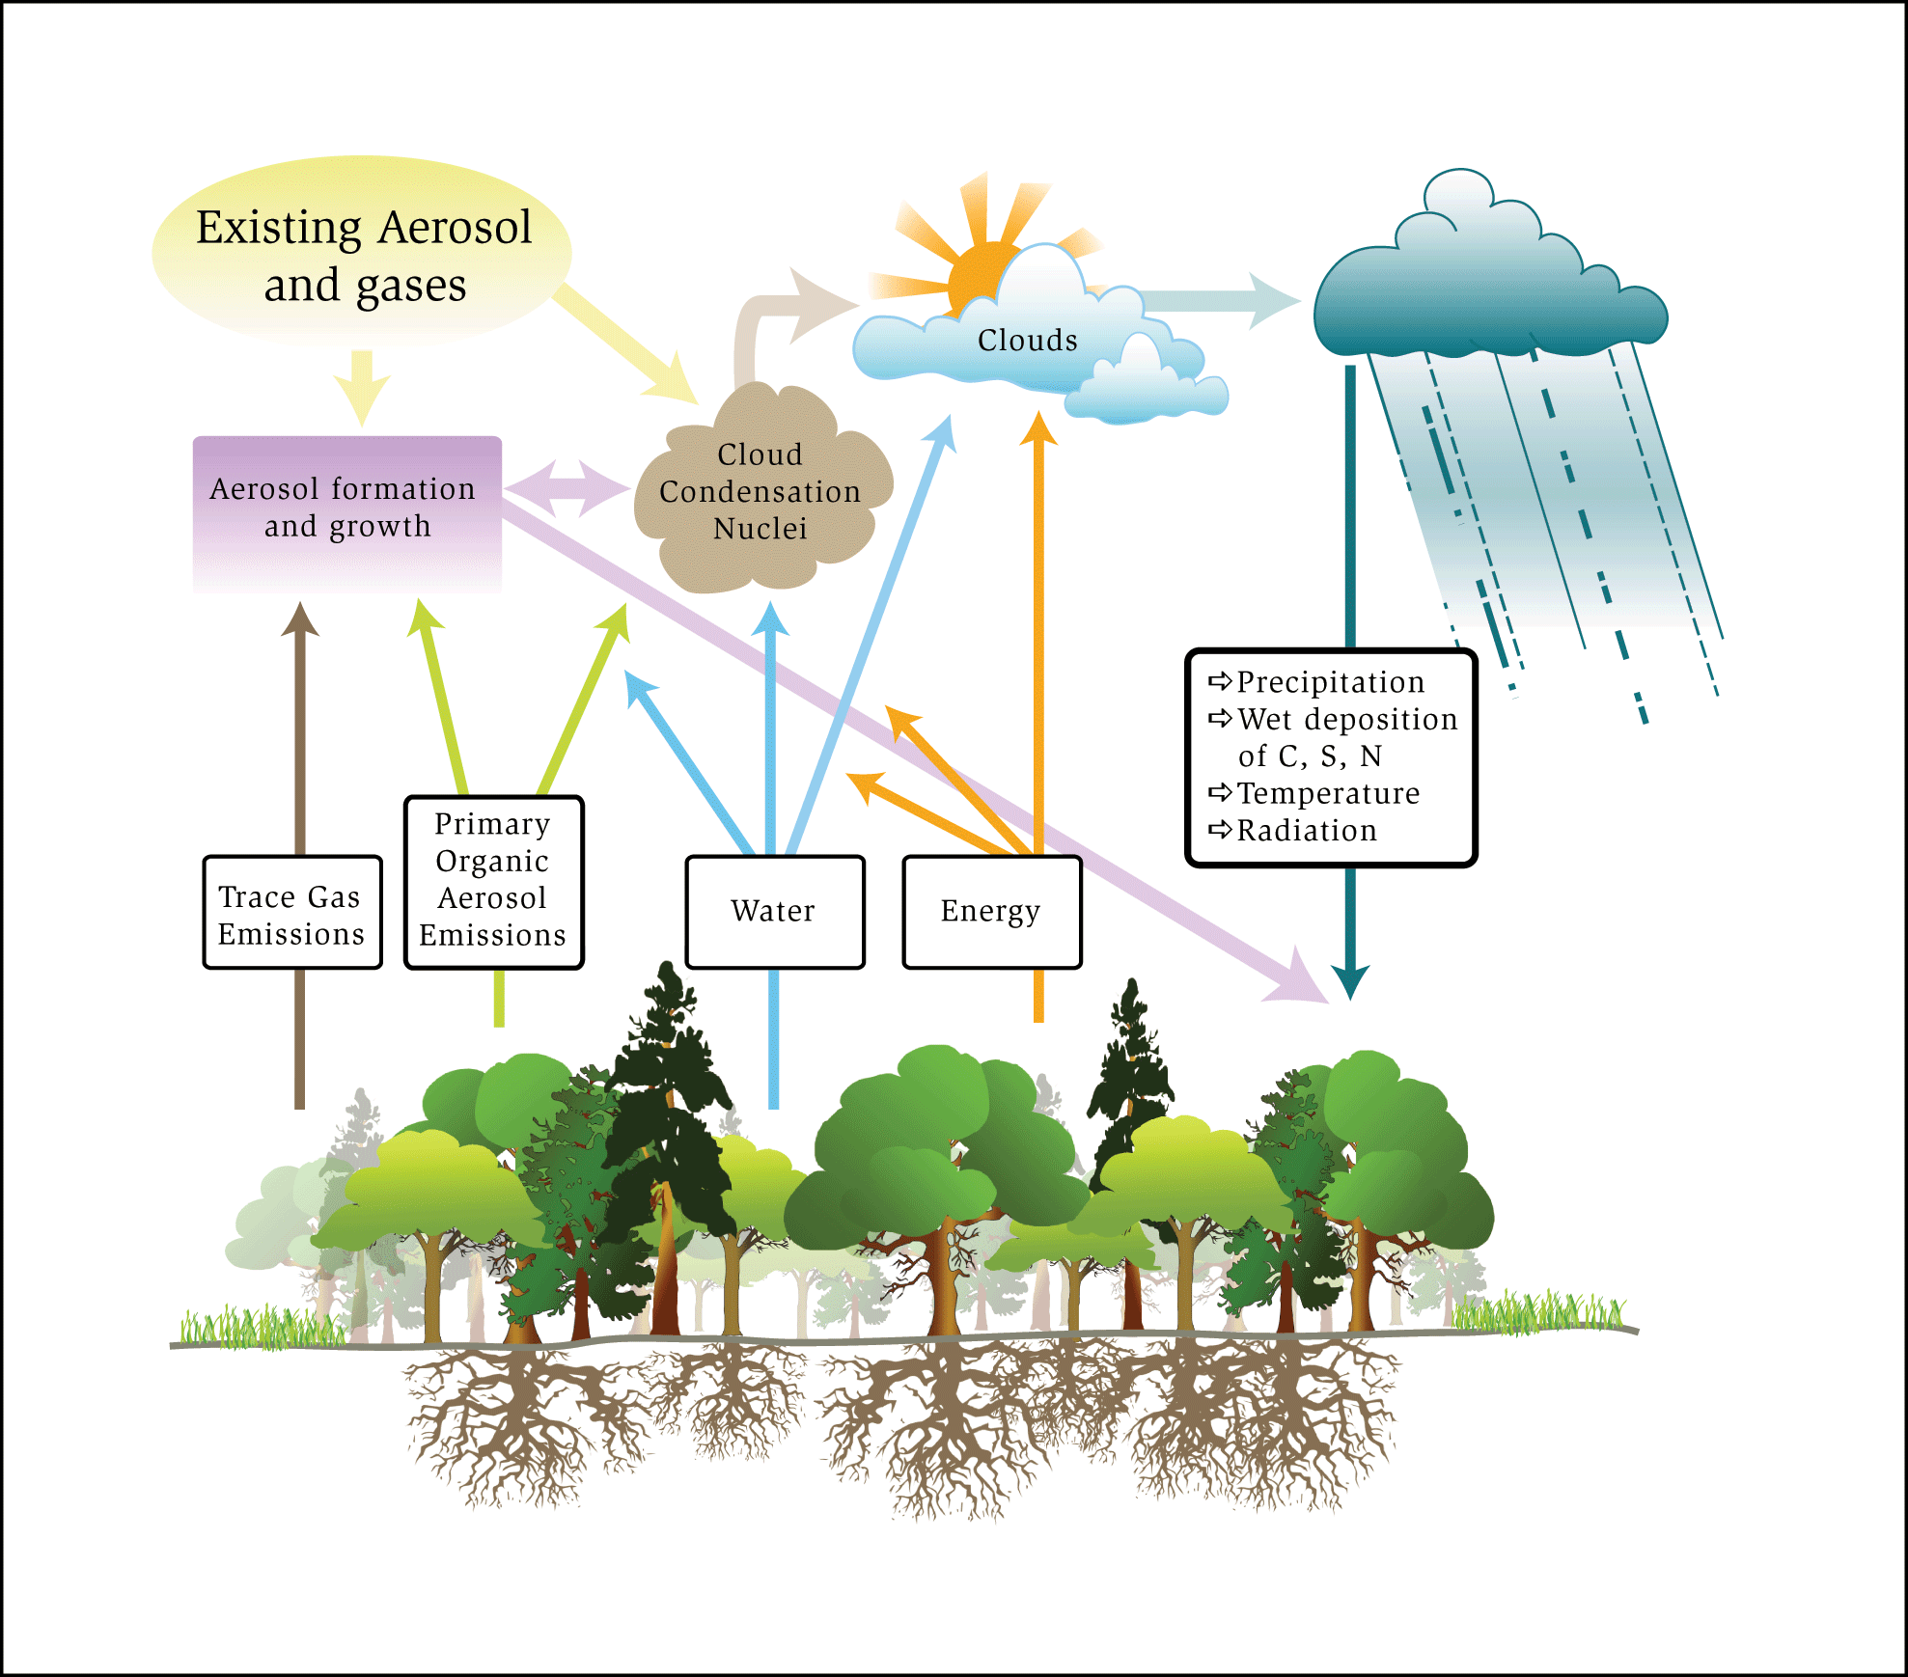
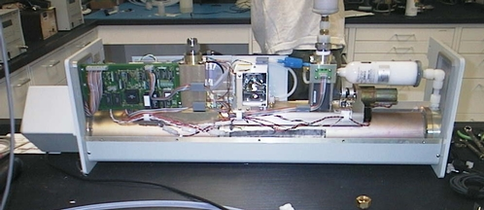
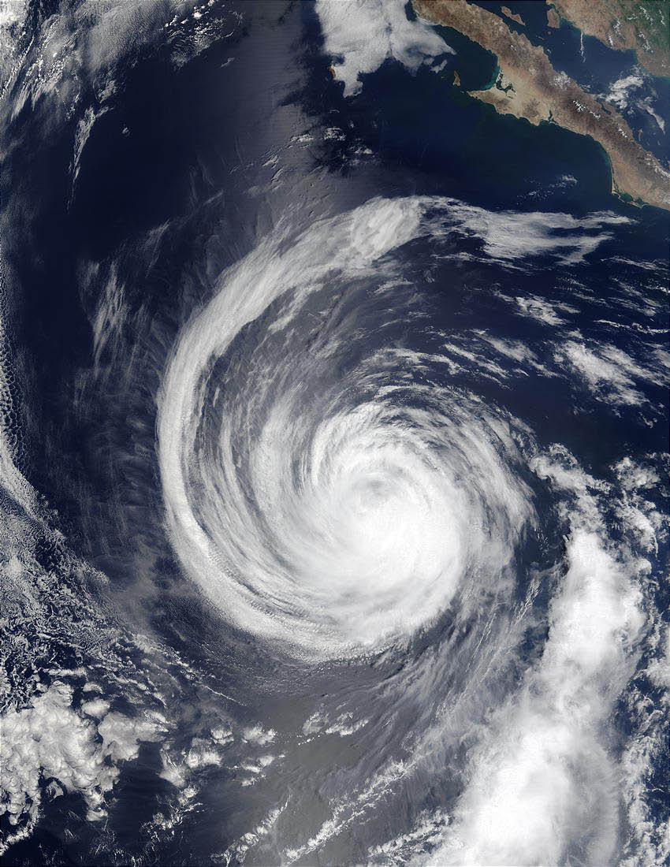
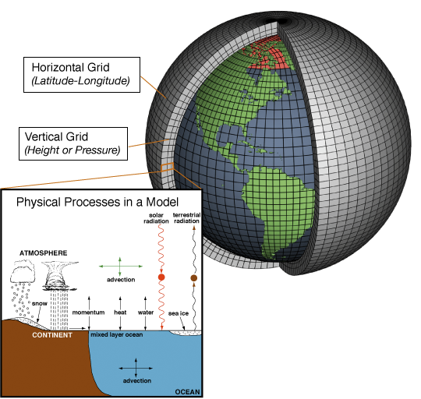
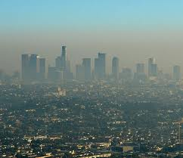
Atmospheric Science across the disciplines
BIOLOGY
Physics
Engineering
Chemistry
Mathematics
Computer
Science
Image credits: atmos.washington.edu, acd.ucar.edu, caice.ucsd.edu, oar.noaa.gov, chemwiki.ucdavis.edu

Slide 4
Image credit: agci.org

Slide 5
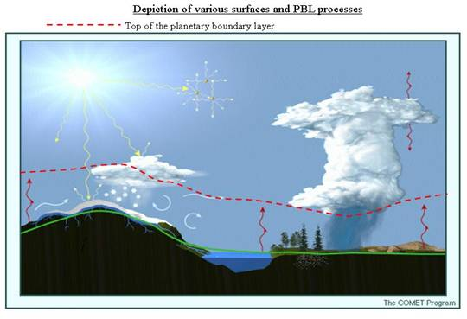
PBL vs the free troposphere
Image credit: esrl.noaa.gov

Slide 6
What’s going on in the troposphere?
Nearly all weather (clouds, rain, tornados, hurricanes, snow)
Nearly all anthropogenic (human-caused) pollution
Nearly all transport of anthropogenic and natural chemicals (think dust storms, wildfires)
Warfare related emissions (weaponized aerosols)
Most of the molecules relevant to climate change (because most of the mass is here).

Slide 7
However....

Slide 8
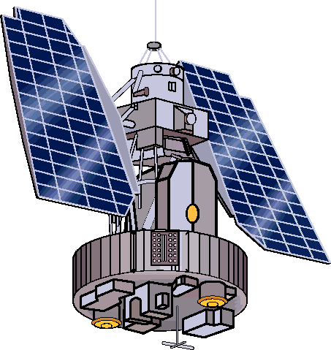
Outliers: How NASA “missed” the ozone hole
“Our software had flags for ozone that was lower than 180 DU, a value lower than had ever been reliably reported prior to 1983. In 1984, before publication of the Farman paper, we noticed a sudden increase in ‘low value’ from October of 1983. We had decided that the values were real and submitted a paper to the conference the following summer when Joe's paper came out, showing the same thing. As the first one in print, he gets full credit for discovery of the ozone hole. It makes a great story to talk about how NASA "missed" the ozone hole, but it isn't quite true.”
The Nimbus-7 has 3 ways to measure O₃

Slide 9
Practical uses for atmospheric measurements
Air quality control and monitoring (including airborne pathogens)
Better prediction of tornadoes and hurricanes (improve early warning)
Changes in patterns (rain, storm tracks) due to changing climate
Monitoring greenhouse gases and short-lived climate forcers.
Cross border pollution issues

Slide 10
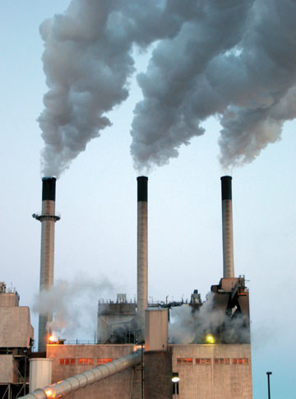
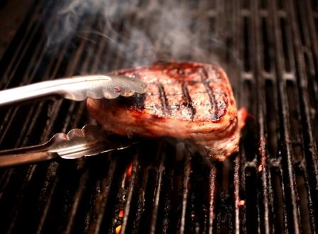
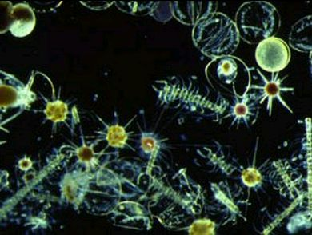
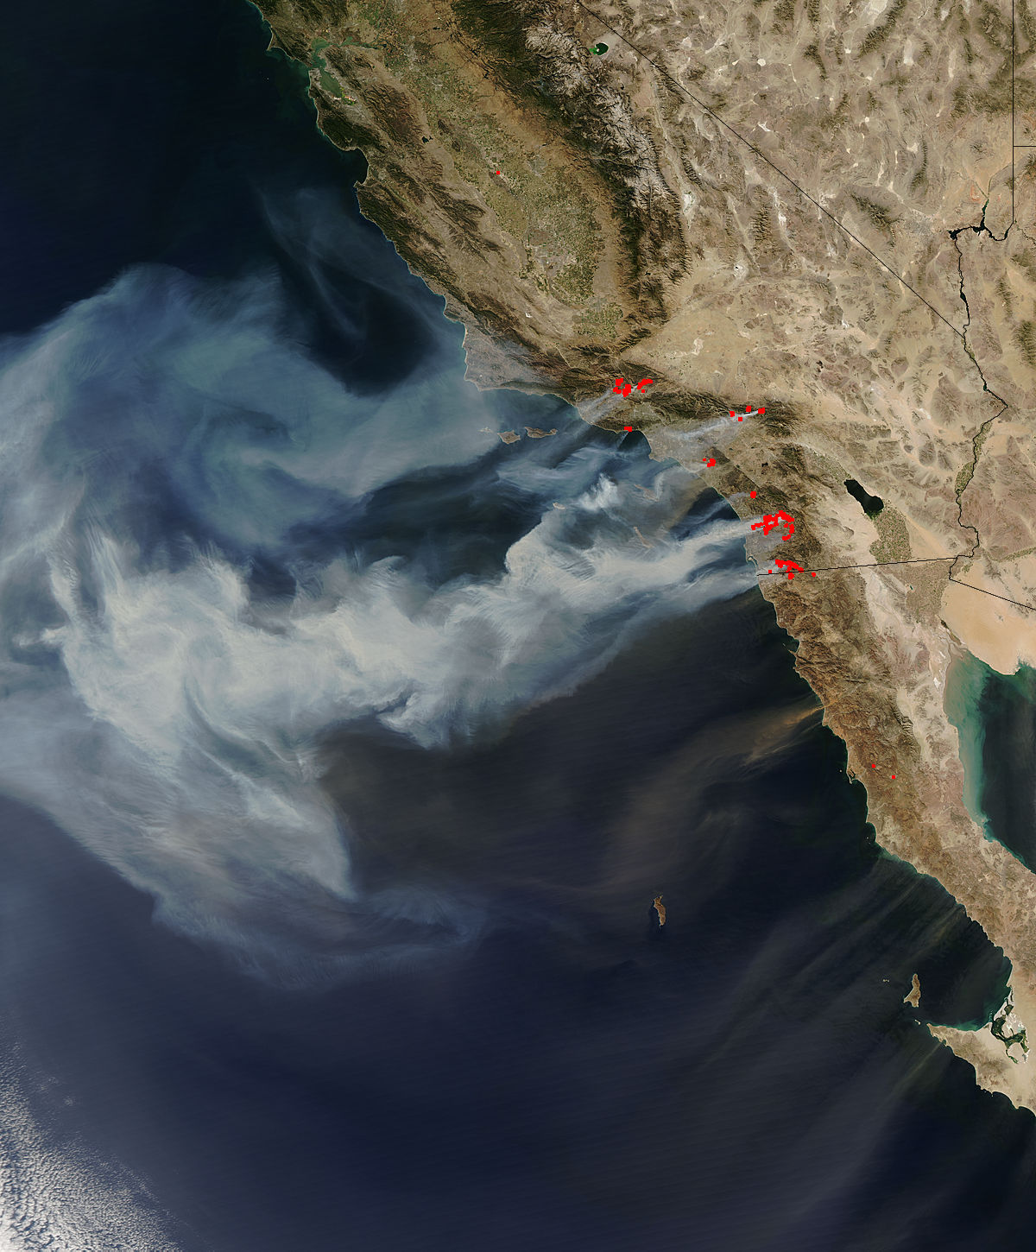
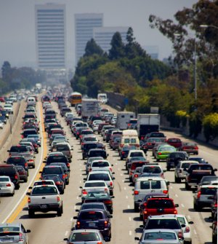
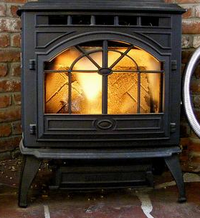
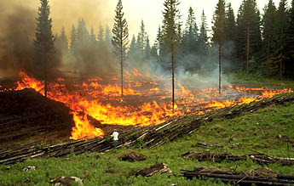
Introduction to Atmospheric Aerosols: Particle Sources
Coal burning
Dust
Sea spray
Bubble bursting
Primary particles are emitted as liquids or solids to the atmosphere.
Secondary particles are emitted as gas phase components and later condense to form particles.
Primary particles that are transported in the atmosphere can accumulate mass from secondary components.
Meat cooking
Plants
Phytoplankton
Automobiles
Wildfires
Heating
Agricultural fires
Notes:
many sources …variety of mechanisms.
fossil fuel combustion (coal and gasoline) and large forest fires.
However, the relative contribution of particle sources VARIES IN BOTH TIME AND SPACE
****next***
….emit BOTH primary particles AND gas-phase precursors to particles,
1.2.3.
meaning that the total particle mass or number produced by each source cannot be measured simply at the source itself…

Slide 11
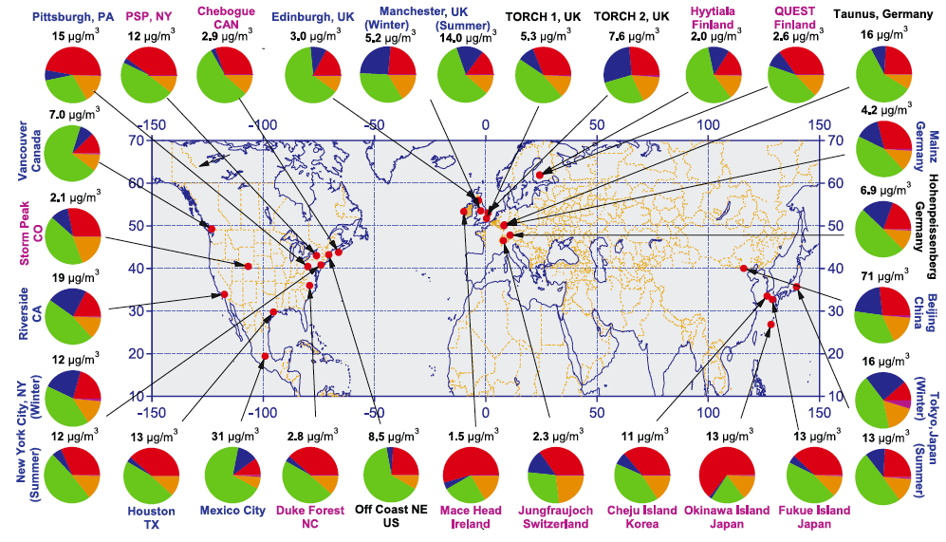
Introduction to Atmospheric Aerosols: Organic Components are Substantial
Submicron particle composition from an aerosol mass spectrometer:
organic and inorganic (sulfate, nitrate, and ammonium) components
Figure from Zhang et al., 2007 GRL

Slide 12
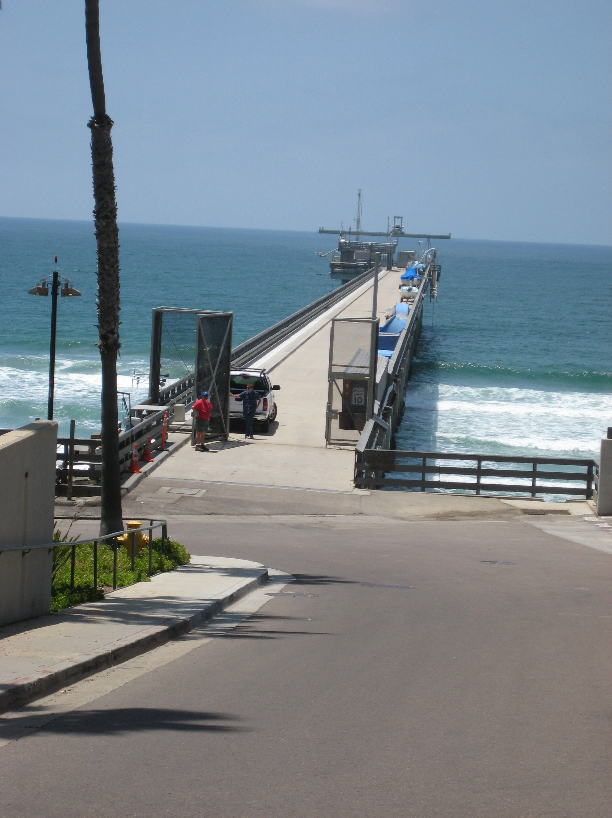
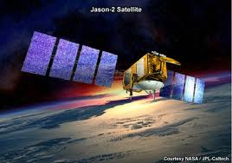
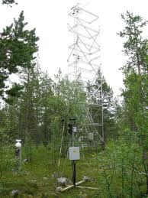
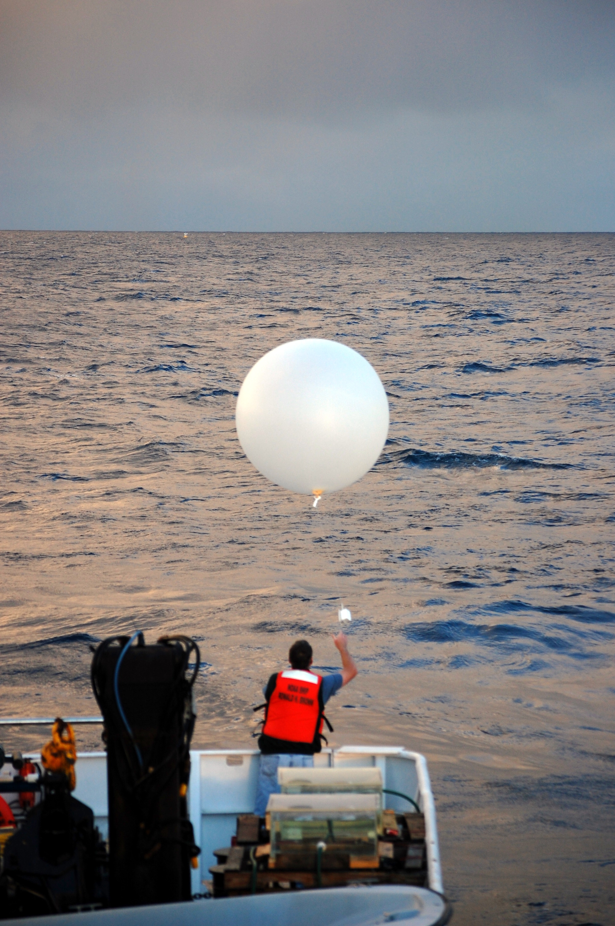
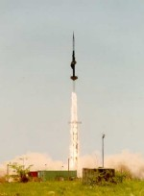
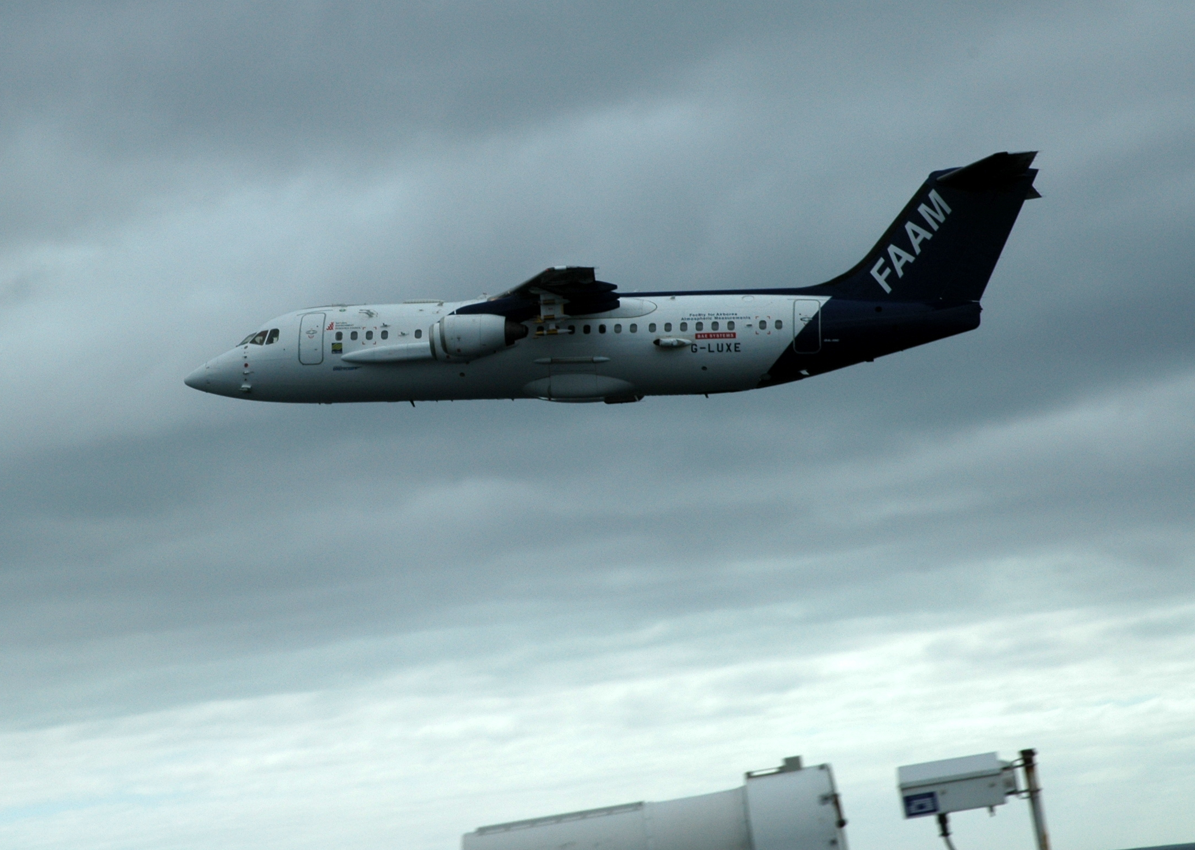
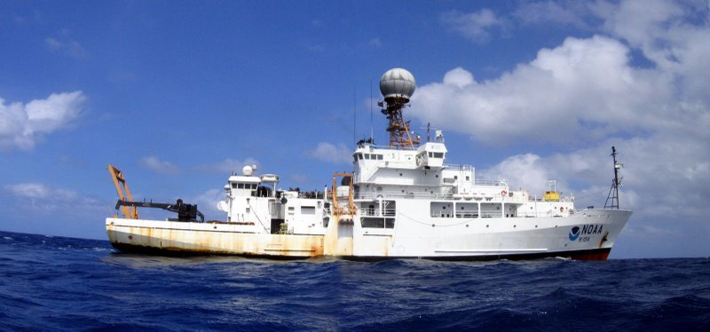
Where are measurements made? And how?

Slide 13
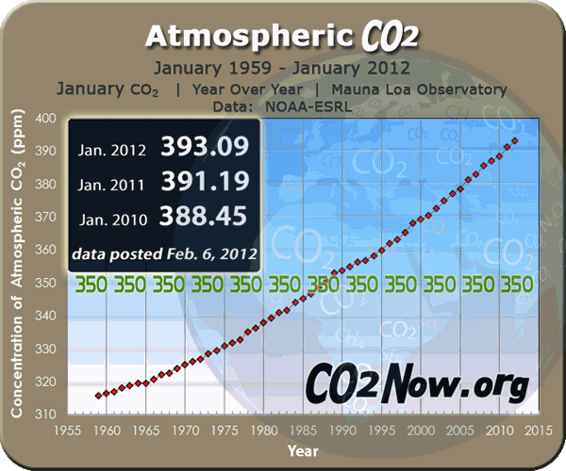
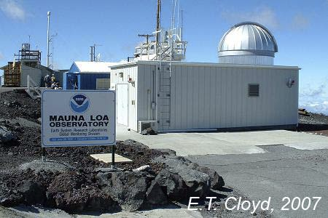
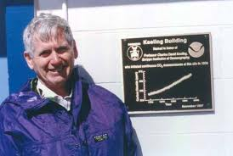
One of the most important atmospheric measurements of our time
Charles David Keeling

Slide 14
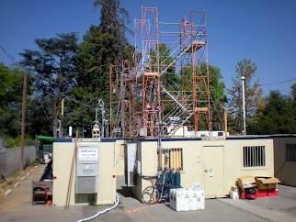
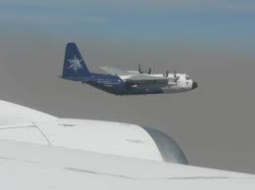
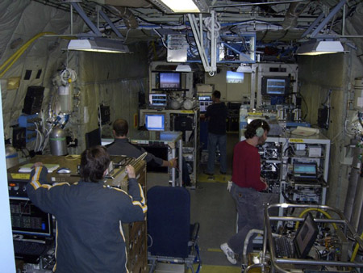
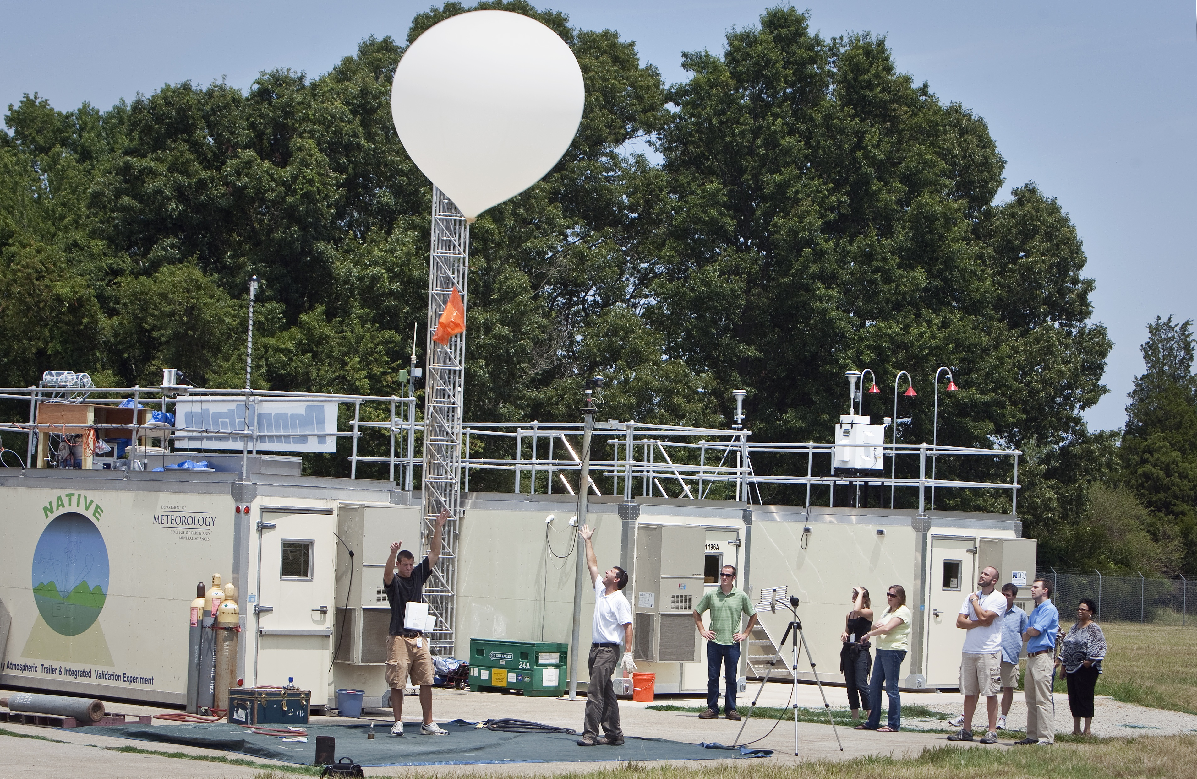
Importance of collaboration
Calnex Field Study
MILAGRO, Mexico City
Inside a C-130 airplane during MILAGRO

Slide 15
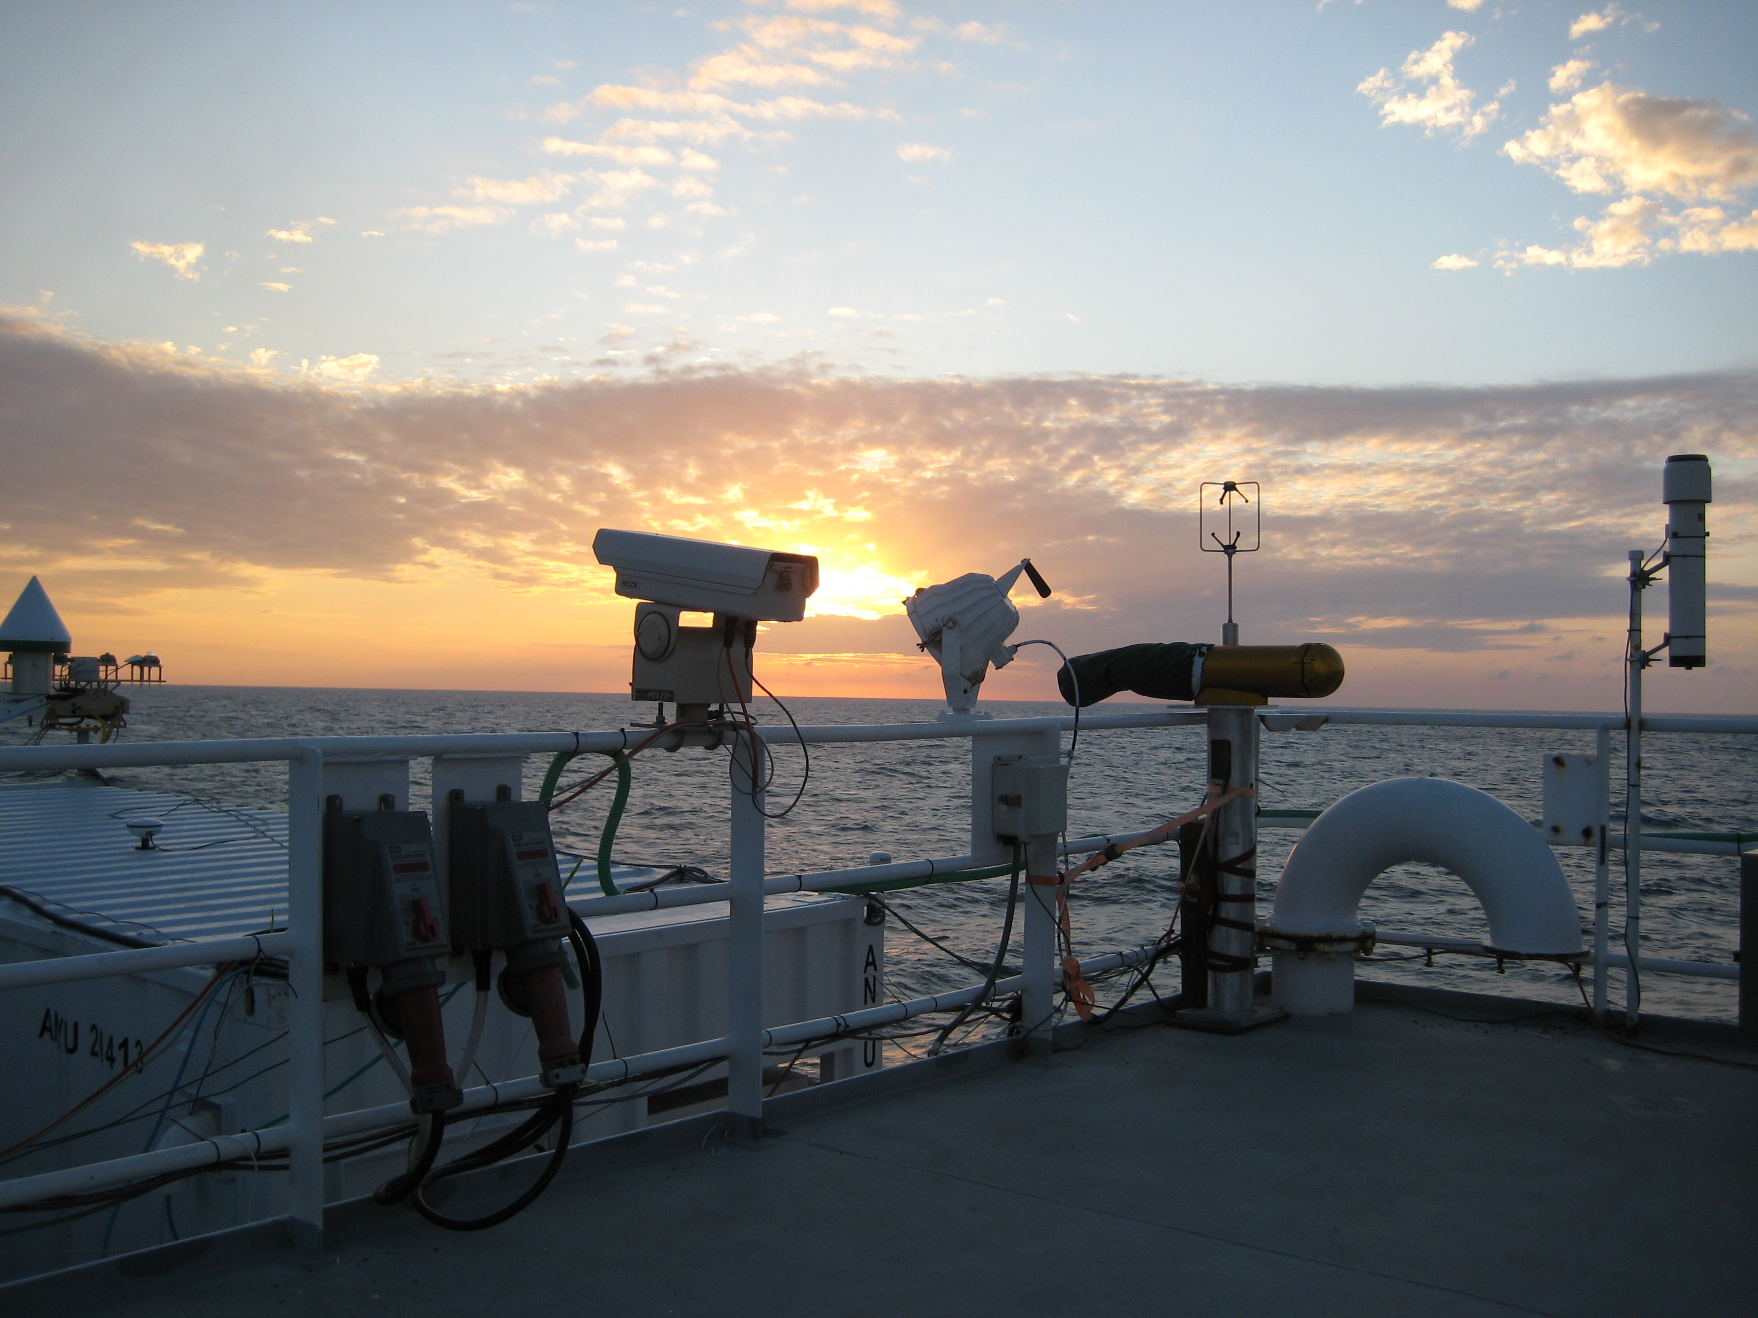
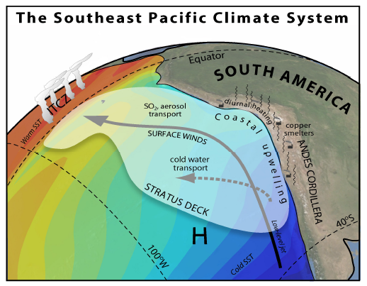
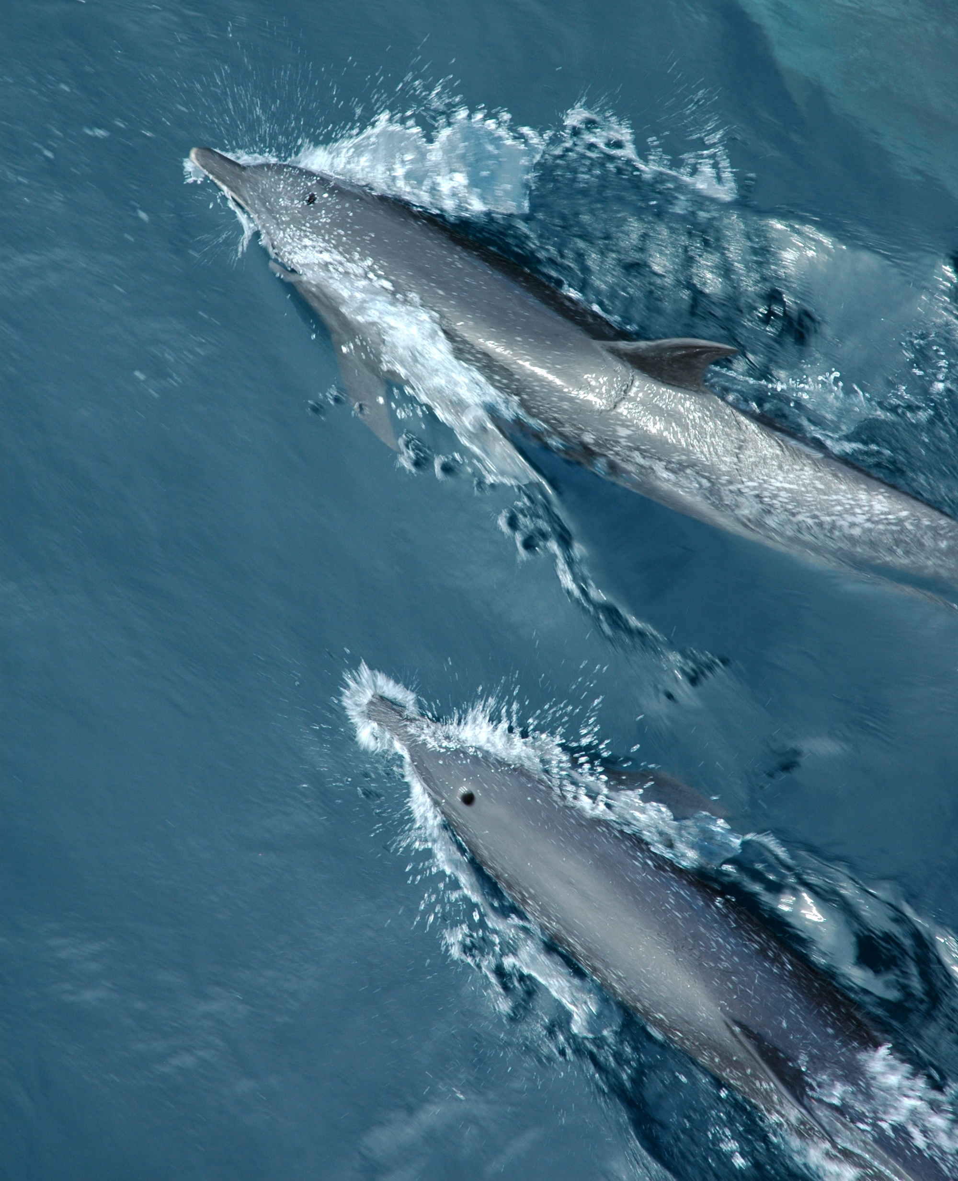
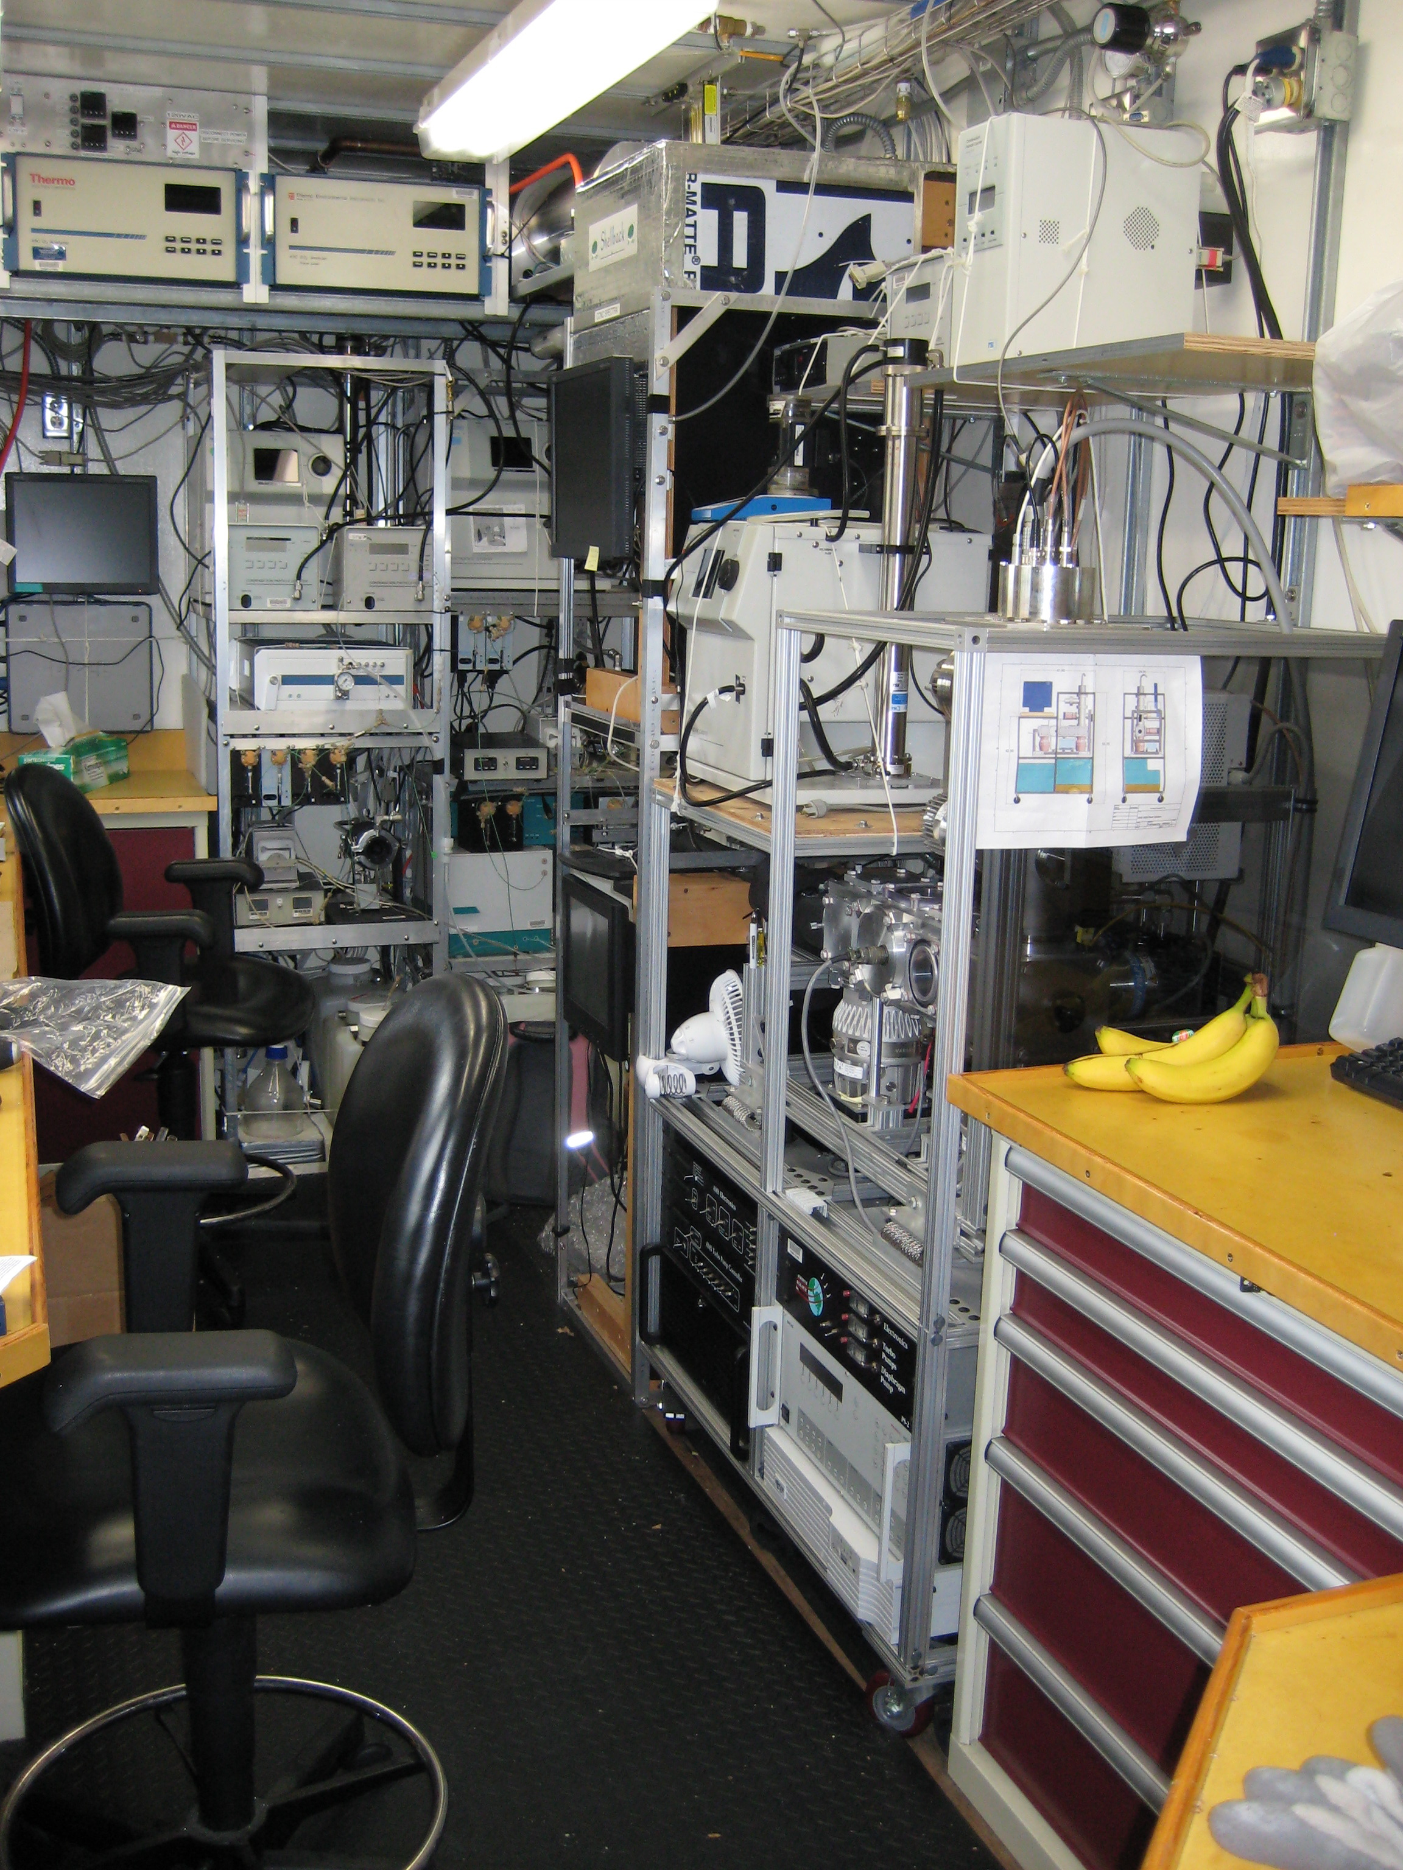
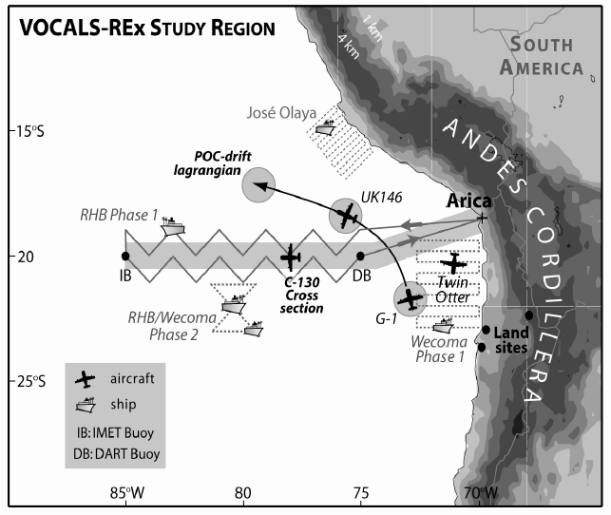
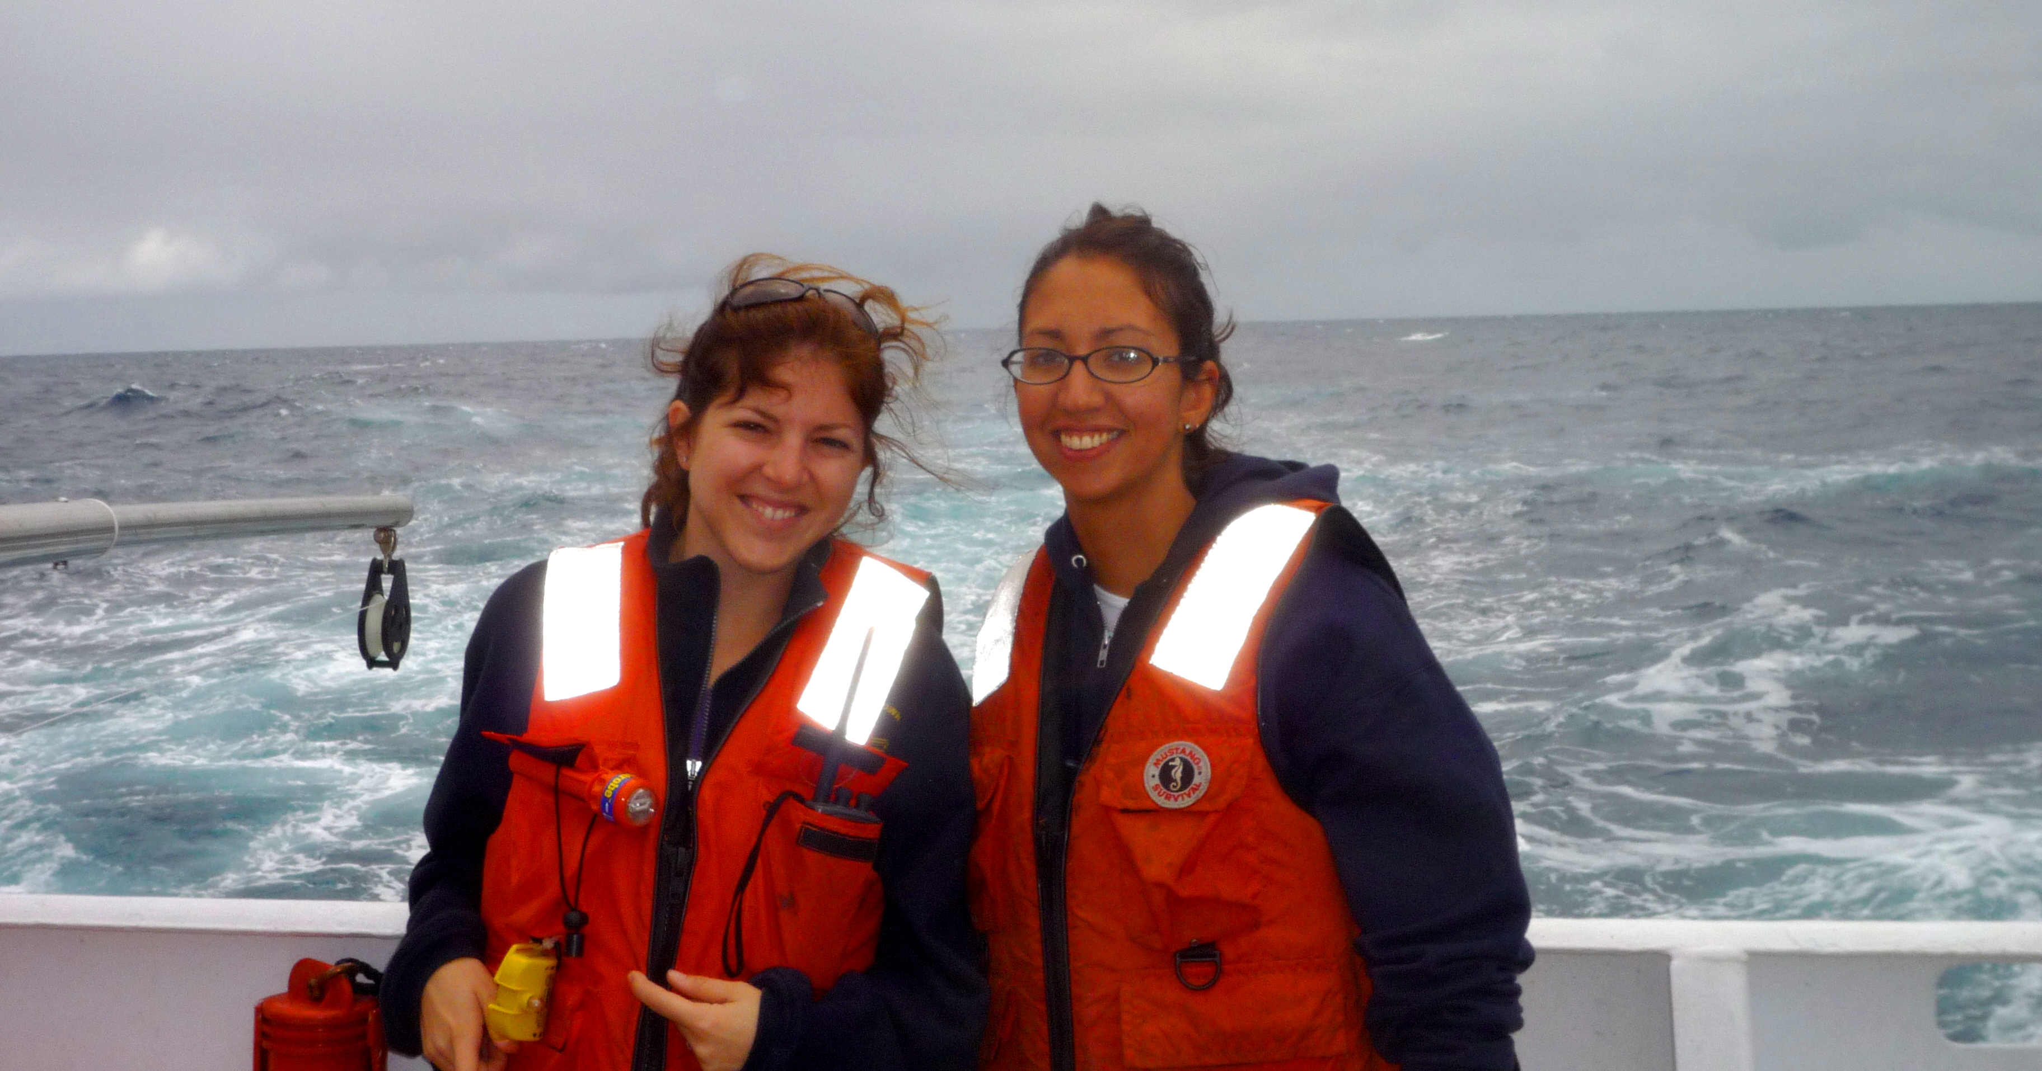
VAMOS Ocean-Cloud-Atmosphere Land-Study Regional Experiment (VOCALS-REx)
Wood et al., 2007 Program Summary
Notes:
This region was the site of the …..
A multiplatform campaign..
…aimed at improving our ability to model air-sea fluxes and aerosol-cloud interactions in this region
This figure shows the decrease in cloud droplet size near the continent, thought to be caused by the outflow of particles from the coasts many copper smelters, emitted sulfate aerosol
This lower figure shows the planned track of the ship (ron brown) to investigate the east-west trend in particle concentration and composition.
I should point out, though..

Slide 16
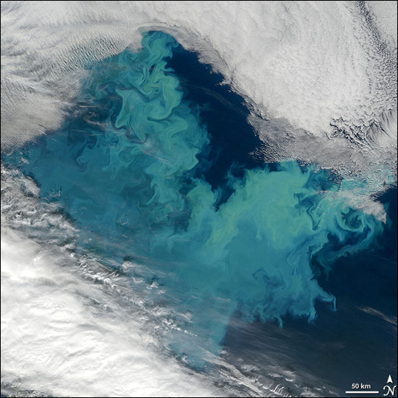
Calcareous Phytoplankton Fragments: Phytoplankton in the air?
Barents Sea on 1 August 2007: bloom covering approximately 150,000 km².
Particles enriched in Ca (relative to sea water) have been attributed to coccolithophores [Sievering et al., 2004].
Other types of phytoplankton (diatoms) have been observed in aerosol samples [Leck and Bigg, 1999;2005].
Coccolithophores produce long-chain hydrocarbons called alkenones, containing many repeating units of -CH₂.
Previously unknown to exist in the atmosphere at 200 nm (thought to be confined to sizes larger than 1 micrometer.
Harris, 8th ed.
Coccolithophores produce 1/3 of all oceanic CaCO₃ and the average mass of E. huxleyi is increasing in response to ocean acidification.
Can these phytoplankton keep up with our changing planet?
Emiliania huxleyi
Alkenones
Image courtesy of NASA Earth Observatory from the Moderate Resolution Imaging Spectrometer (MODIS) on NASA's Terra satellite
Hawkins and Russell, 2010b
Notes:
Calcareous phytoplankton were most interesting because of their extremely strong signal/noise even in small particles
We attributed these particles to phytoplankton on the basis of…
These phytoplankton are very common in many of the world’s oceans and responsible for about 50% of the calcite production in the oceans.
Their blooms are so large… potentially important part of the primary marine aerosol budget.

Slide 17
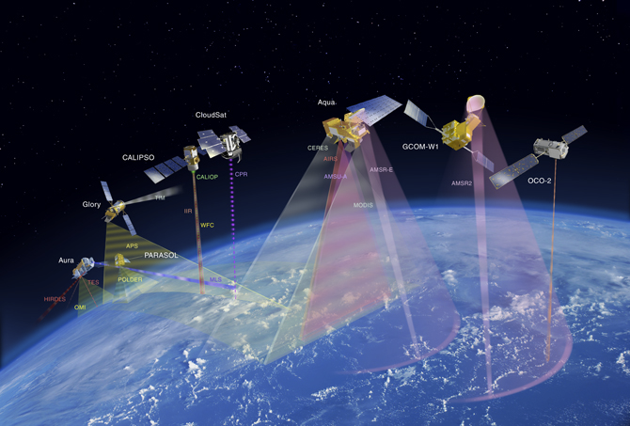
NASA’s A-Train
Crosses the equator around 1:30 pm daily.
Together they measure water vapor, temperature, rainfall, clouds, aerosols, greenhouse gases and more.
What is the overall affect of aerosols and clouds on climate? How much carbon is absorbed by forests? How will the monsoon cycle react to a warming world? To what extent will a changing climate change the size and strength of hurricanes? And what feedback cycles will encourage or discourage climate change?

Slide 18
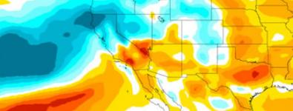
A great place to know about: NCAR
Models
Measurements
Black carbon and sea ice

Slide 19
What might rockets add?
Climate model “ground truthing”
Repeatable, local measurements
Very high altitude studies (not yours!), most useful above altitude for balloons (40 km) and below satellites (recall collaboration!).
Lower cost than a fully instrumented aircraft
Can be launched from remote locations (ships etc).
Vertical profiles help meteorologists understand weather
Complement ground based measurements
Can be launched at short notice of phenomena

Slide 20
What I’d find interesting to measure by rocket
Temperature, pressure, light intensity, relative humidity, and average wind speed.
Trace gas concentration and particulate concentration.
Could you collect a sample of particulates?
Can you think of anything to add?

