Slide 1
Vibration & System ID
E80 Spring 2014
Erik Spjut

Slide 2
Lecture Outline
Why
How
  Model
  SMD Model
  Vibration Sensors
  Accelerometers
  Tap Test
  PSD

Slide 3
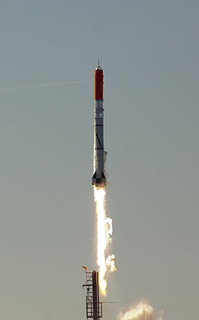
Rocket Vibration
http://www.youtube.com/watch?v=-rASHRBo9Rg&feature=player_embedded
HEAT1X-Tycho Brahe inaugural flight / Pilot's POV – 9Hz oscillation

Slide 4
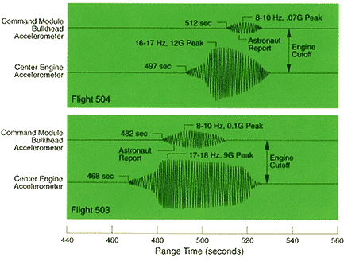
Saturn Rocket Vibration
“Pain was directly associated with motion of the eyeballs and testicles, as well as from internal heating that resulted from sloshing of the brain and viscera. The vibration frequency was also in the range of normal brain waves, adding confusion to decision making, hand and arm movement, and even speech.” –Jim Fenwick on Pogo oscillations

Slide 5
Space Shuttle Main Engine Turbopumps
“The high-pressure pumps rotated at speeds reaching 36,000 rpm on the fuel side and 24,000 rpm on the oxidizer side. At these speeds, minor faults were exacerbated and could rapidly propagate to catastrophic engine failure.”
“…the vibration spectral data contained potential failure indicators in the form of discrete rotordynamic spectral signatures. These signatures were prime indicators of turbomachinery health…”

Slide 6
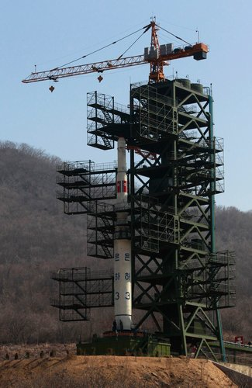
March 2012
“While the lower stages of the North Korean rocket continued to function for several minutes, resonance at the top of the launch vehicle resulted in ‘catastrophic disassembly of the third stage at Max Q,’ said Charles Vick, senior technical and space policy analyst at GlobalSecurity.org. ‘The vibrations just tore it apart.’”
http://www.nytimes.com/2012/04/13/world/asia/north-korea-launches-rocket-defying-world-warnings.html?pagewanted=all&_r=0

Slide 7
Model
Continuum Model
  Analytical <http://iitg.vlab.co.in/?sub=62&brch=175&sim=1080&cnt=1>
  Finite Element (SolidWorks Simulation)
SMD Model
  Stiffness
  Equivalent mass
  Damping

Slide 8
Finite Element Model
SolidWorks Simulation

Slide 9
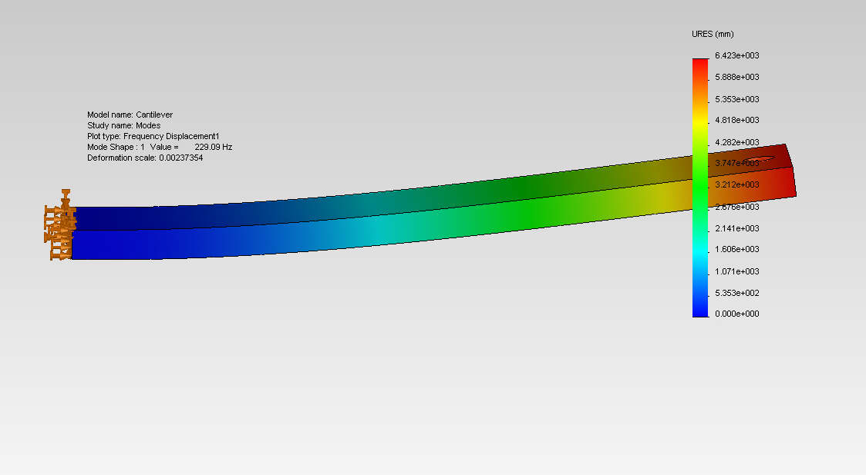
Mode 1 – 229.09 Hz

Slide 10
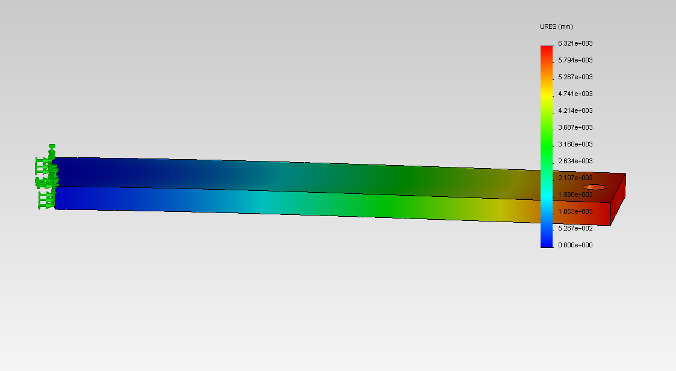
Mode 2 – 1297.9 Hz

Slide 11
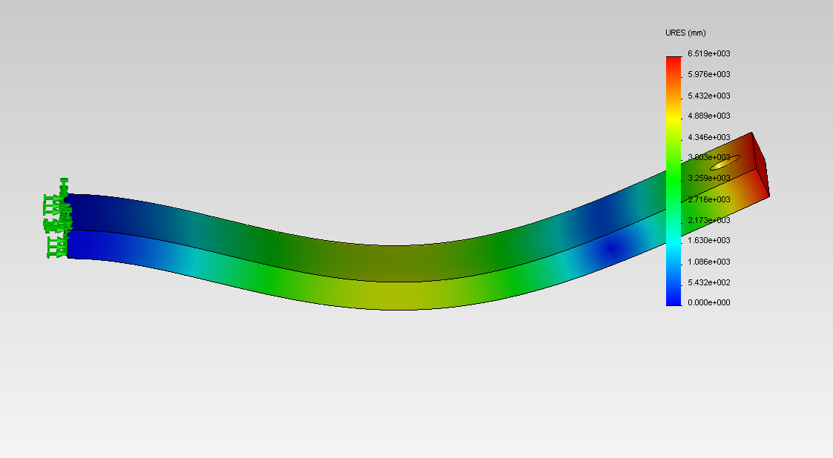
Mode 3 1417.6 Hz

Slide 12
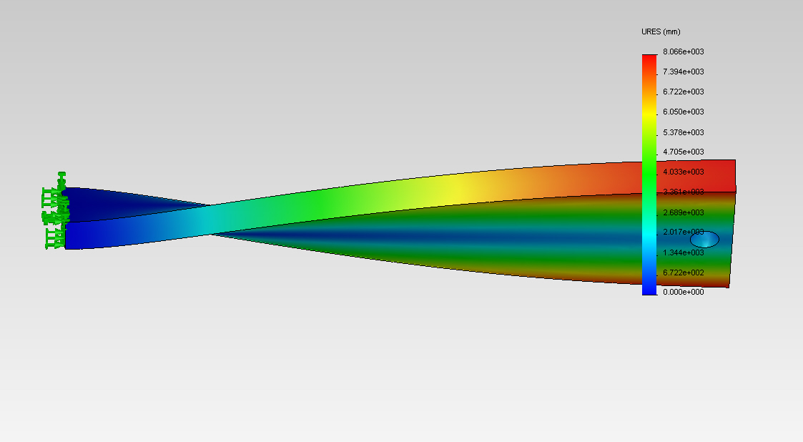
Mode 4 – 1679.3 Hz

Slide 13
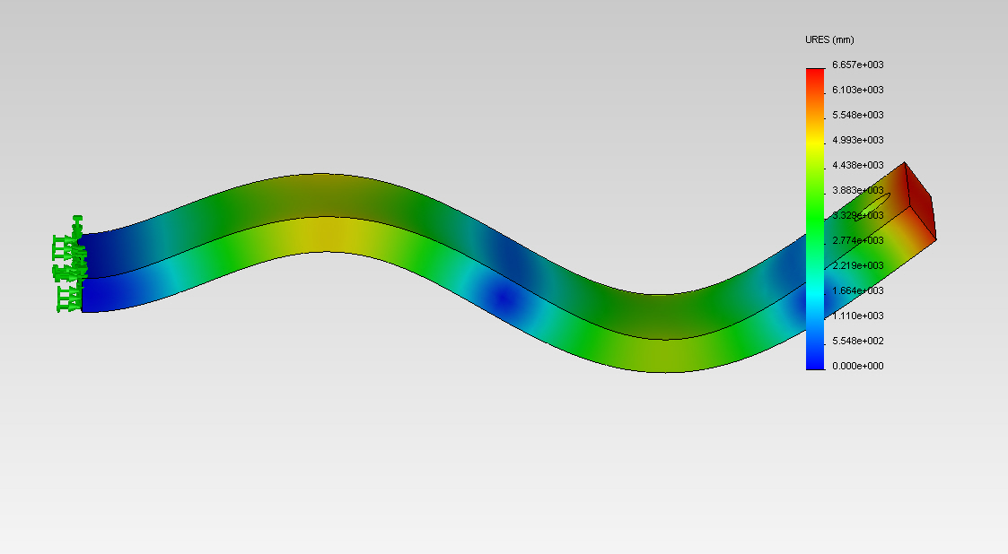
Mode 5 – 3917.6 Hz

Slide 14
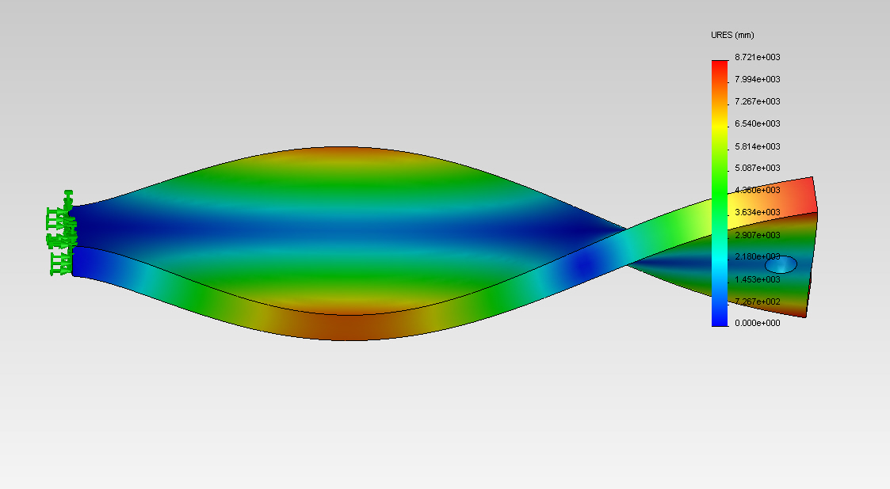
Mode 6 – 5149.6 Hz

Slide 15
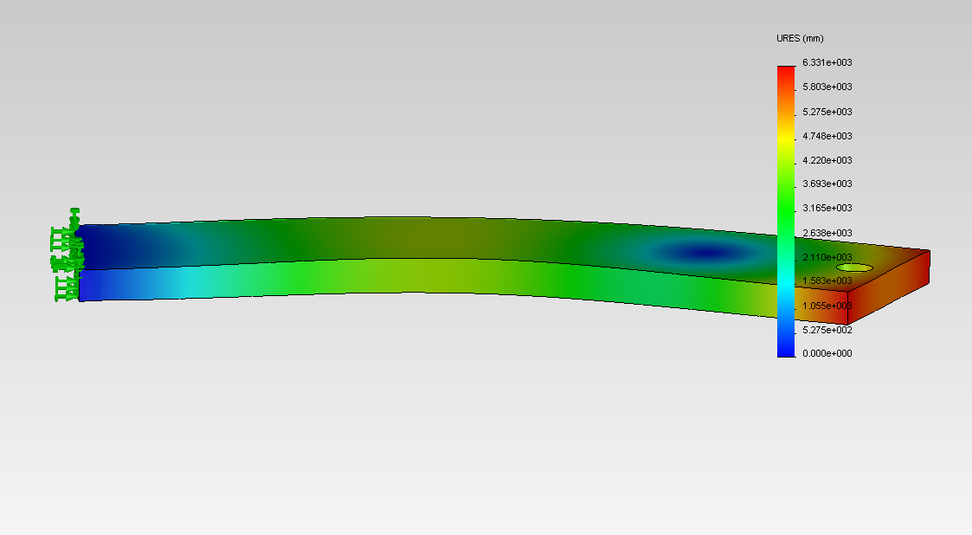
Mode 7 – 6538.1 Hz

Slide 16
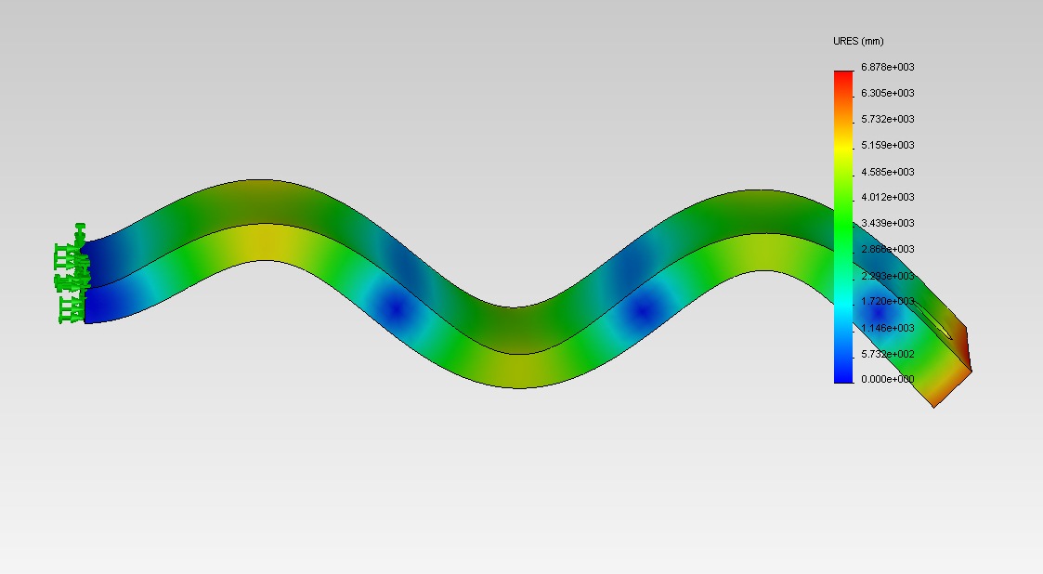
Mode 8 – 7545.1 Hz

Slide 17
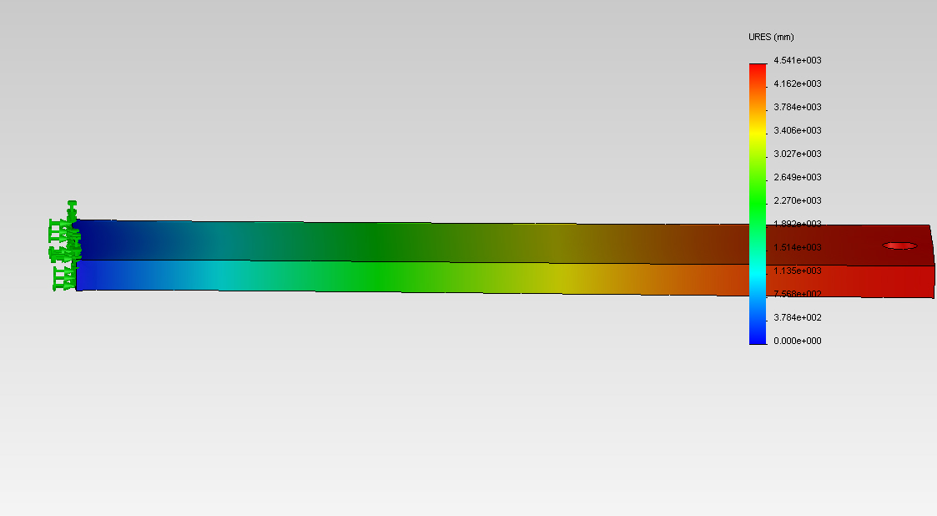
Mode 9 – 8377.9 Hz

Slide 18
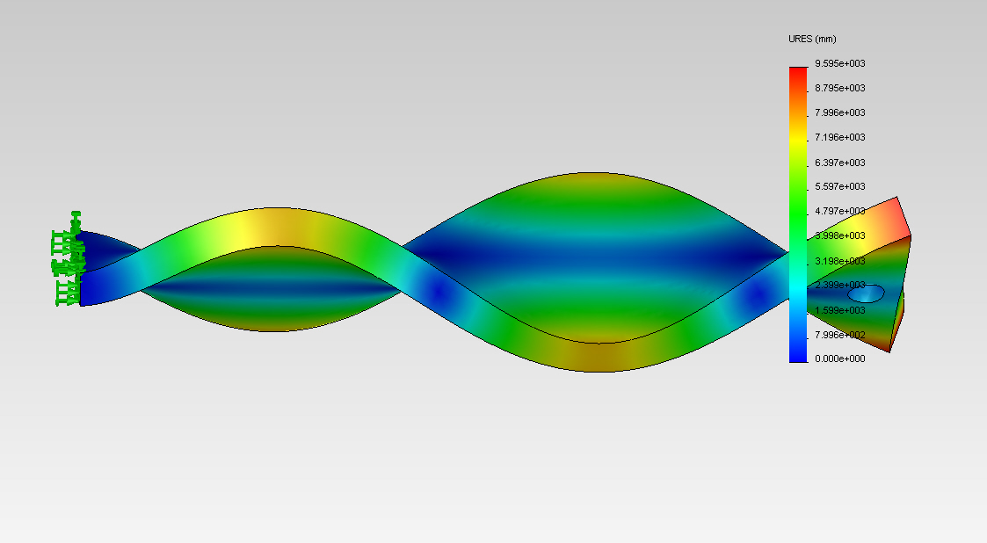
Mode 10 – 8933.4 Hz

Slide 19
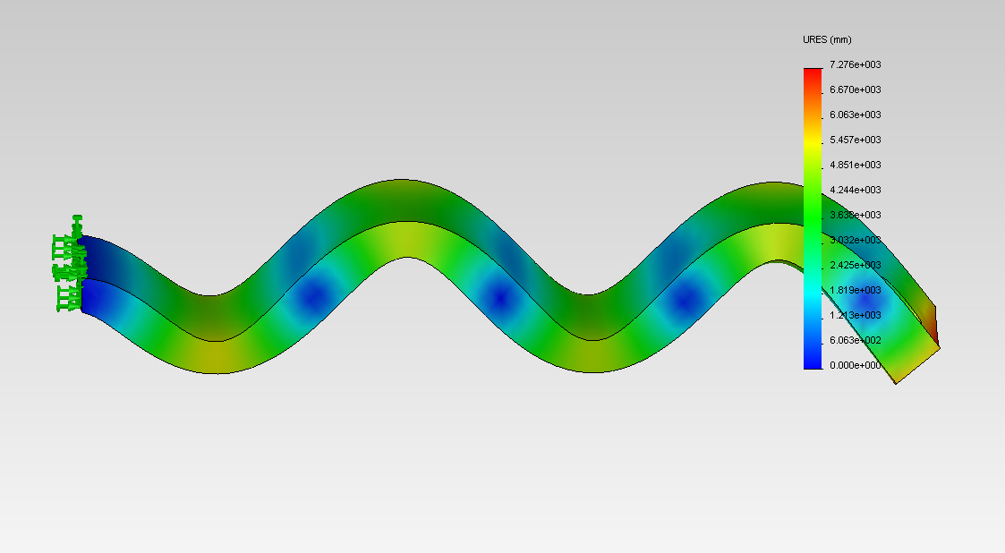
Mode 11 – 12199 Hz

Slide 20
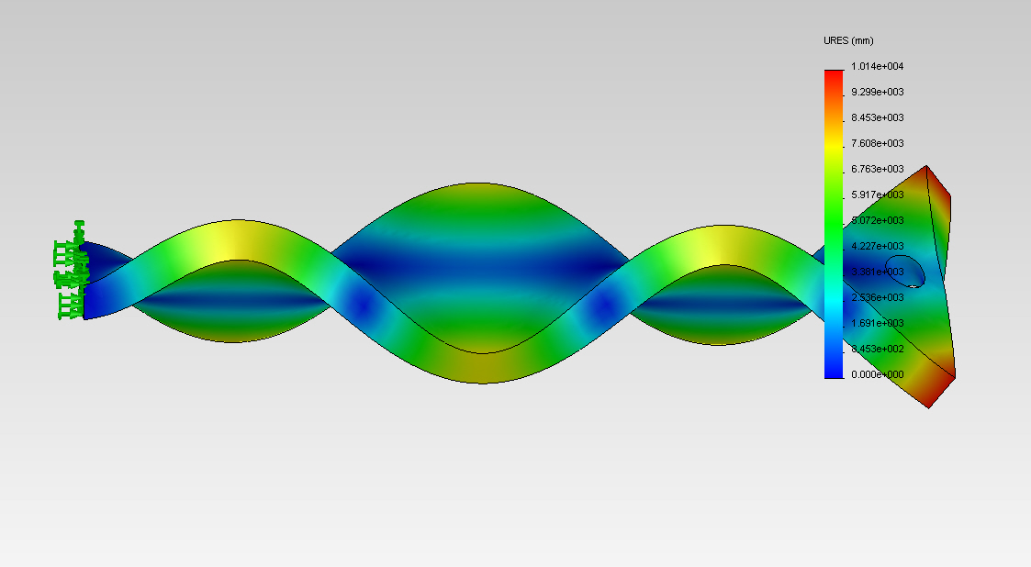
Mode 12 – 13198 Hz

Slide 21
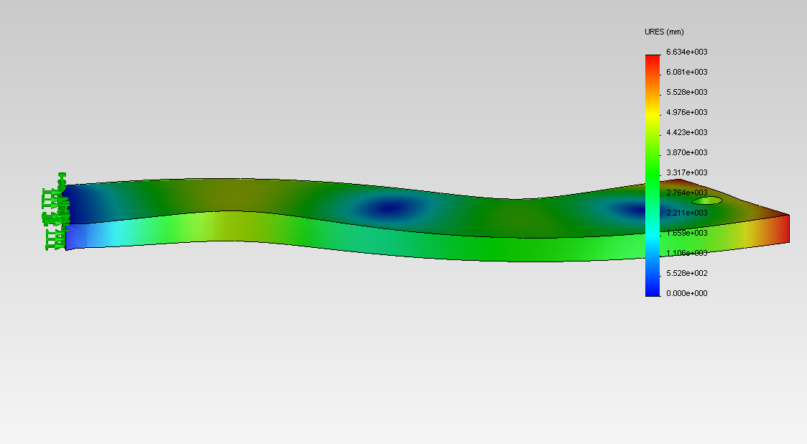
Mode 13 – 14941 Hz

Slide 22
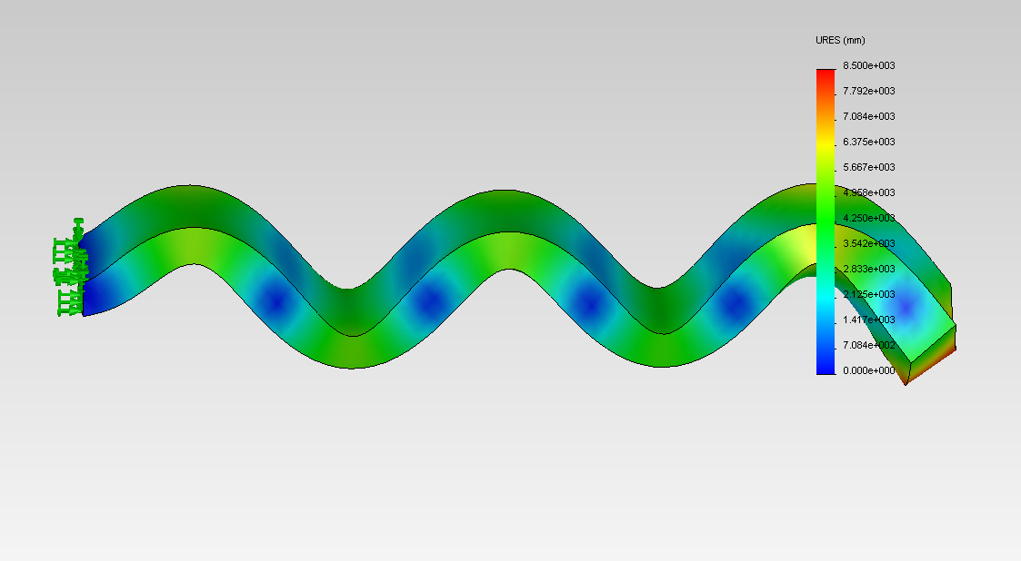
Mode 14 – 17714 Hz

Slide 23
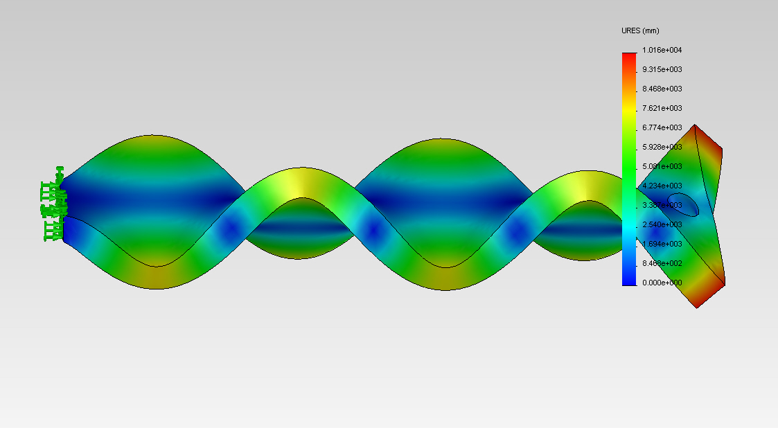
Mode 15 – 18072 Hz

Slide 24
SMD Model
Around a resonance you can model as

Slide 25
FRF
Position
Velocity

Slide 26
FRF
Acceleration

Slide 27
From your data
From the peak
From the ½ power bandwidth
You can also use log decrement.

Slide 28


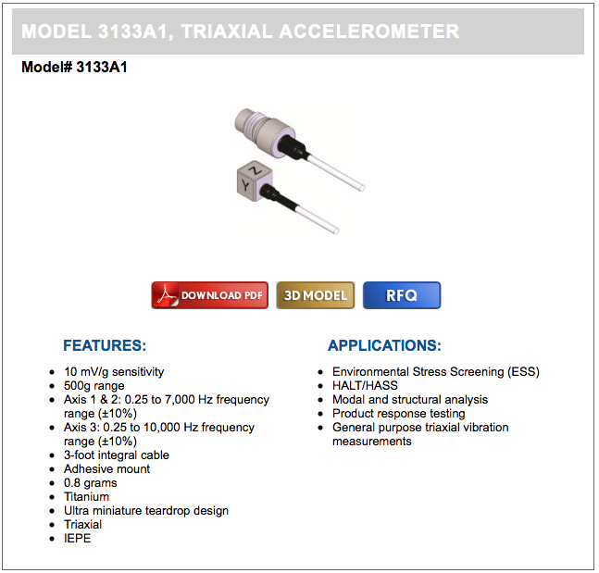
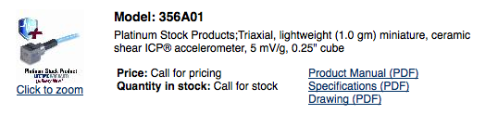

How Do We Measure?
Expensive Accelerometers

Slide 29
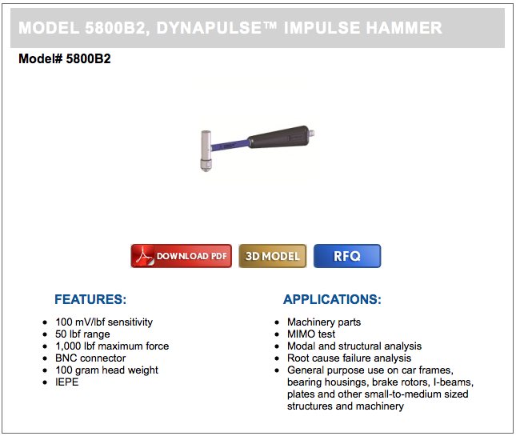
Measure (cont.)
Expensive Impulse Hammers

Slide 30


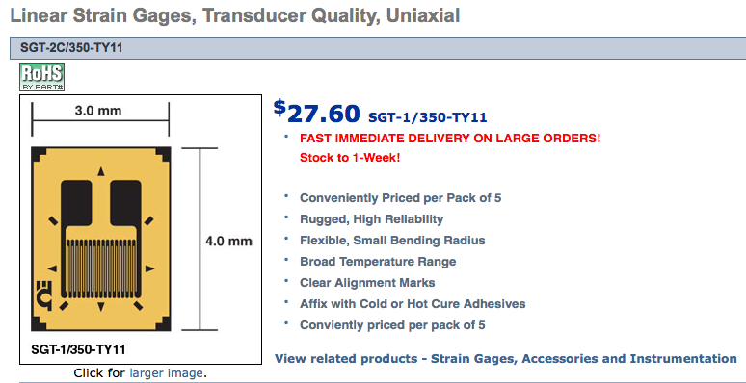
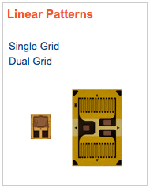
Measure (cont.)
Moderately Priced Strain Gauges

Slide 31
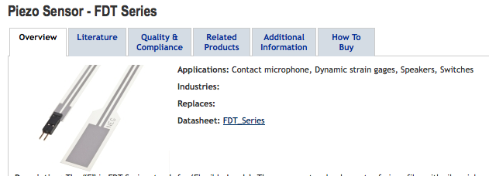

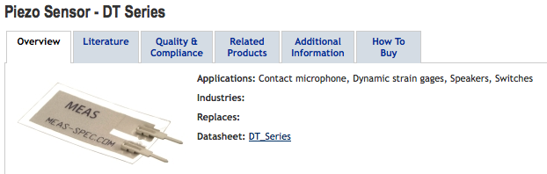
Measure (cont.)
Low Priced Dynamic Strain Gauges

Slide 32
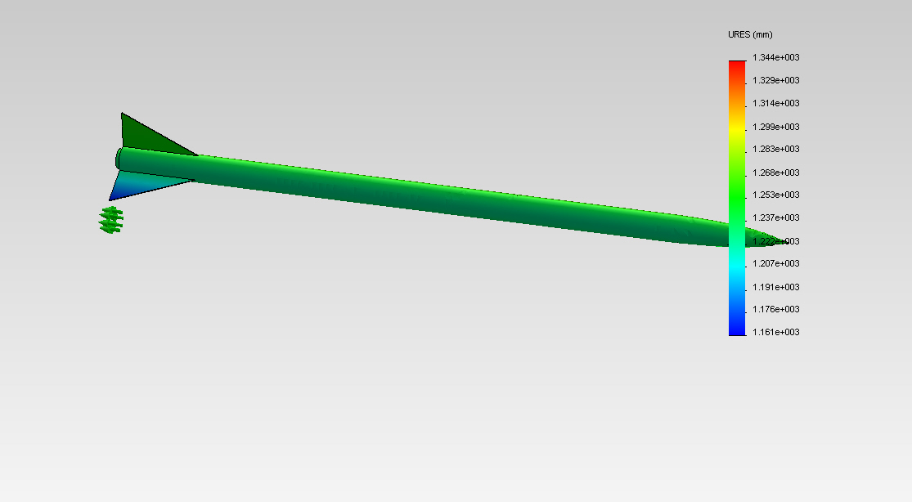
Mode 1 – 0 Hz

Slide 33
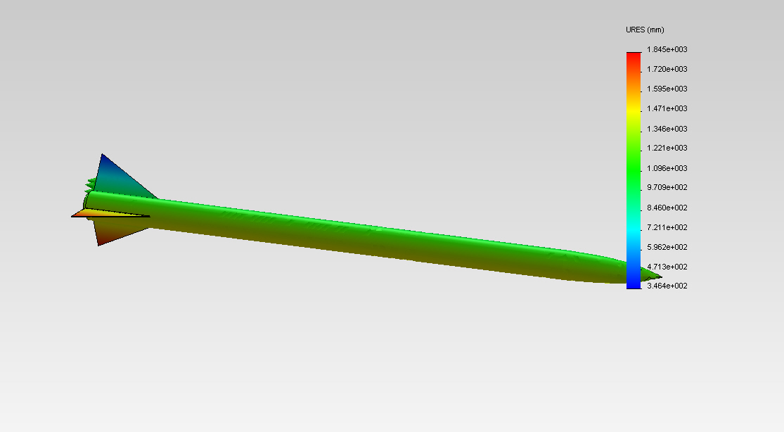
Mode 2 – 7.0439E–4 Hz

Slide 34
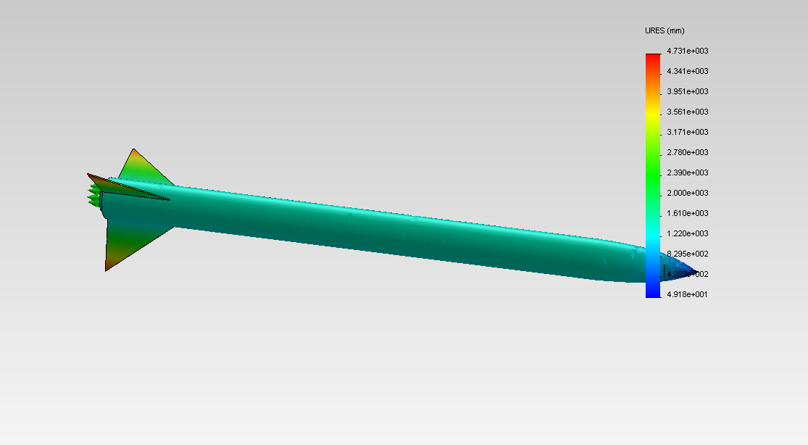
Mode 3 – 1.7816E–3 Hz

Slide 35
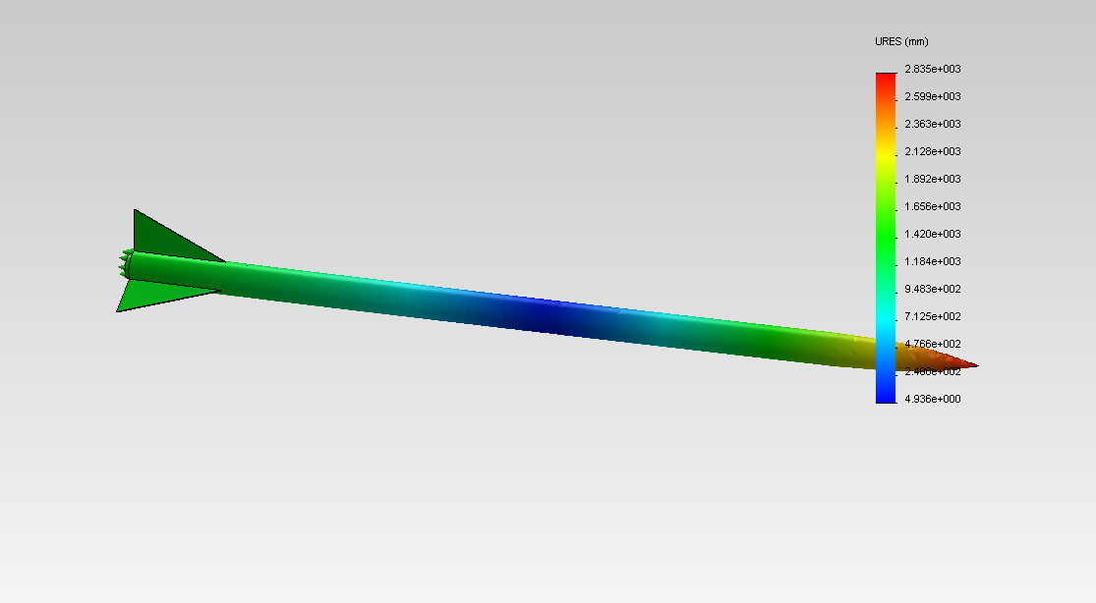
Mode 4 – 11.752 Hz

Slide 36
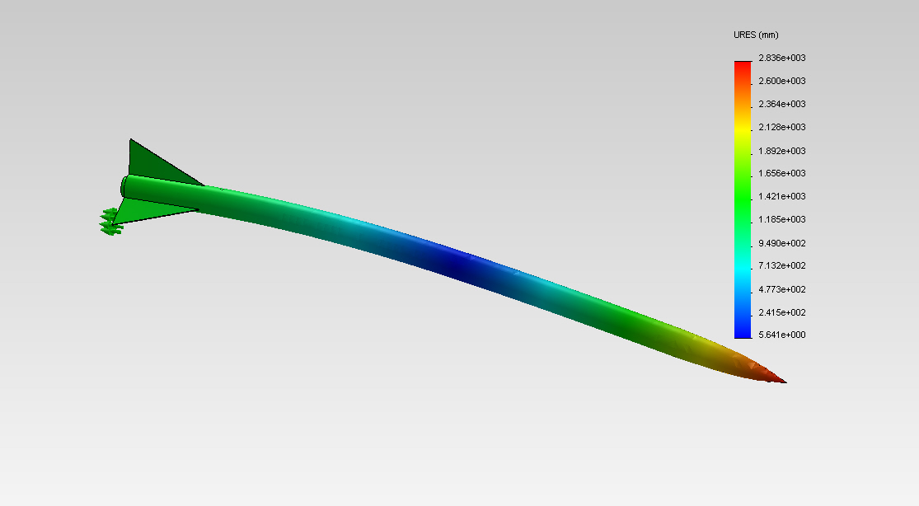
Mode 5 – 11.802 Hz

Slide 37
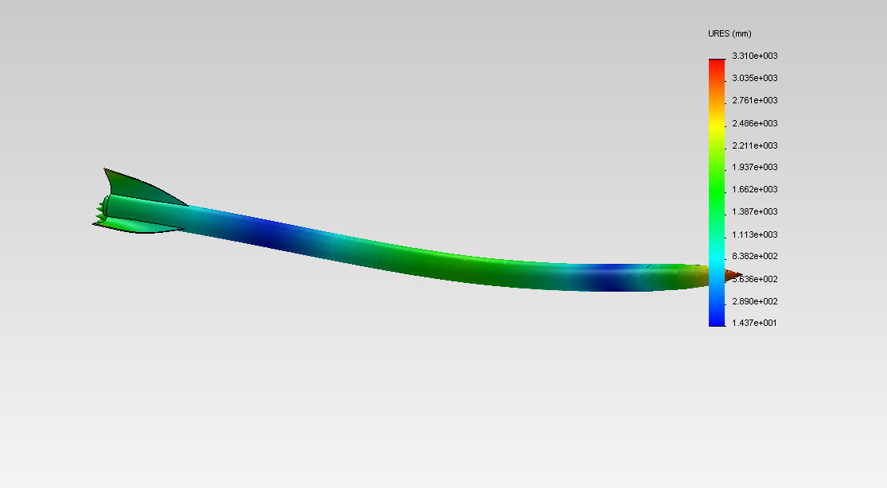
Mode 6 – 62.133 Hz

Slide 38
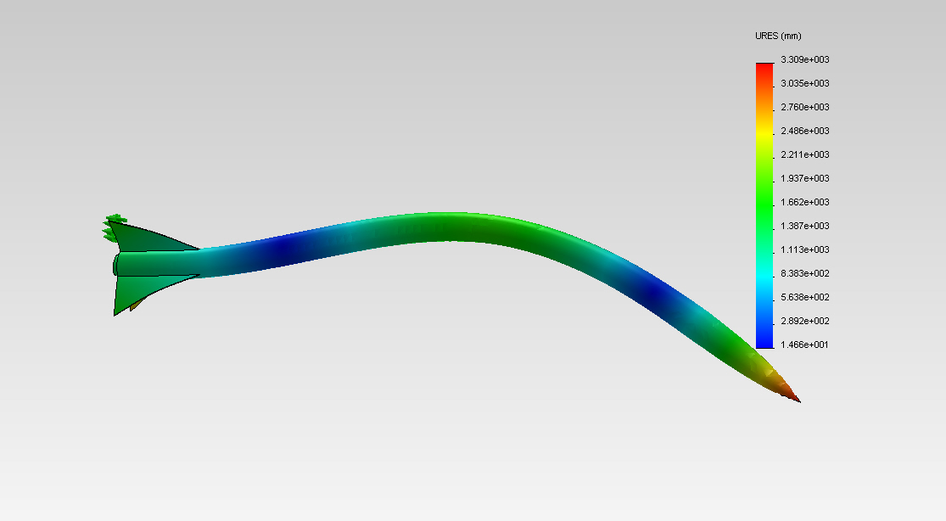
Mode 7 – 62.287 Hz

Slide 39
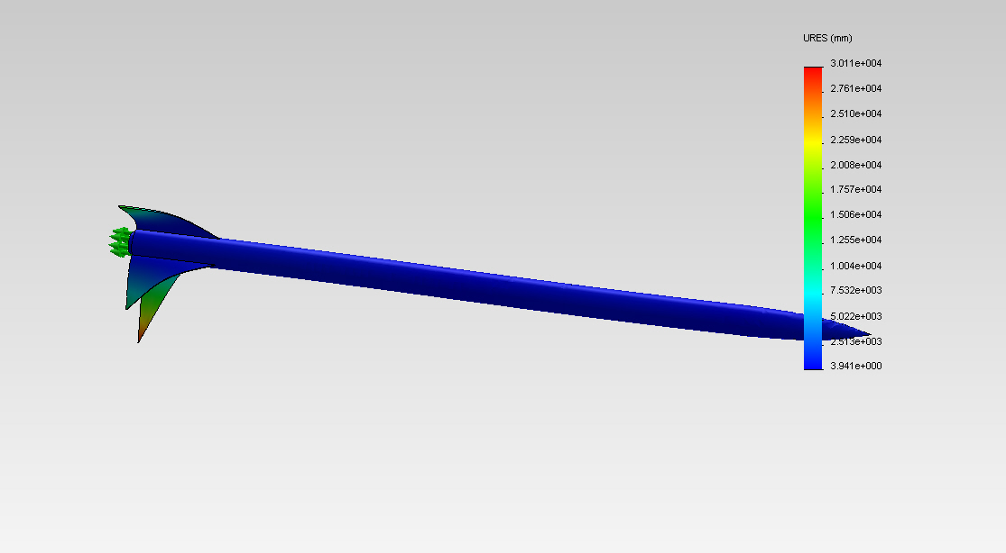
Mode 8 – 111.02 Hz

Slide 40
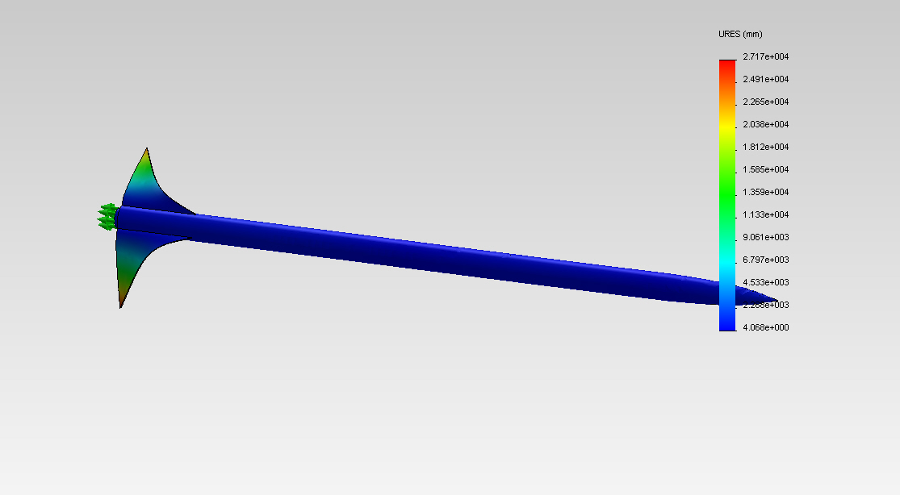
Mode 9 – 111.06 Hz

Slide 41

Mode 10 – 114.37 Hz

Slide 42
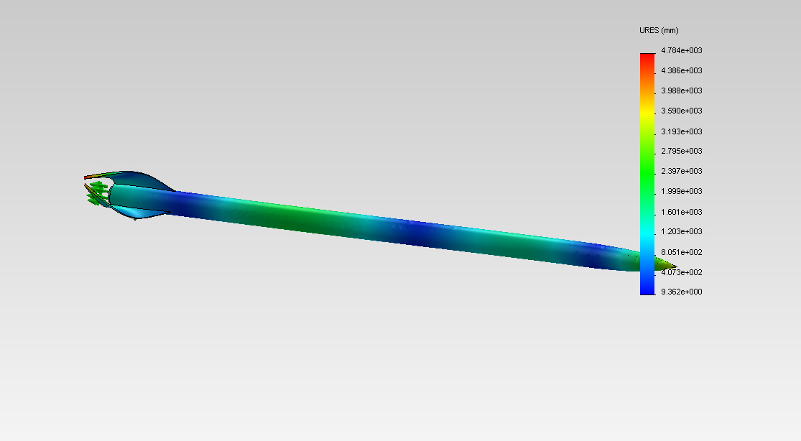
Mode 11 – 154.73 Hz

Slide 43
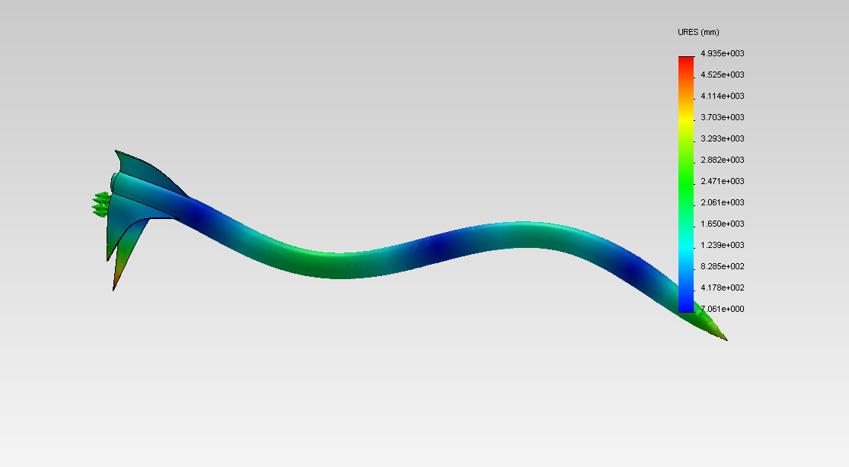
Mode 12 – 155.32 Hz

Slide 44
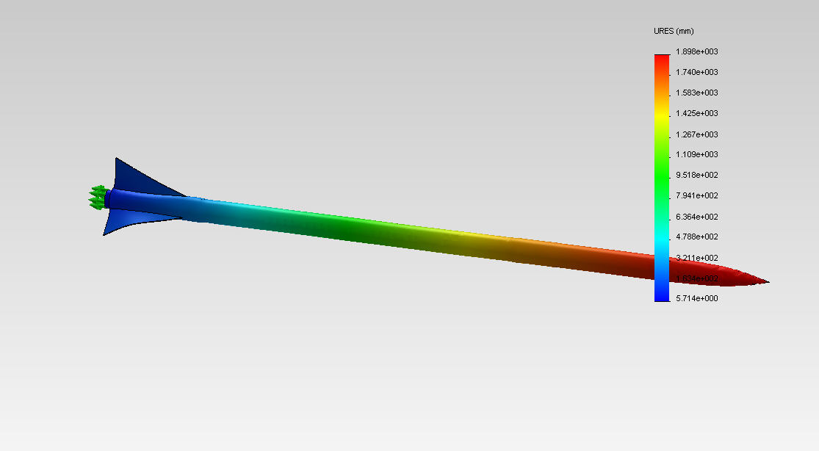
Mode 13 – 257.09 Hz

Slide 45
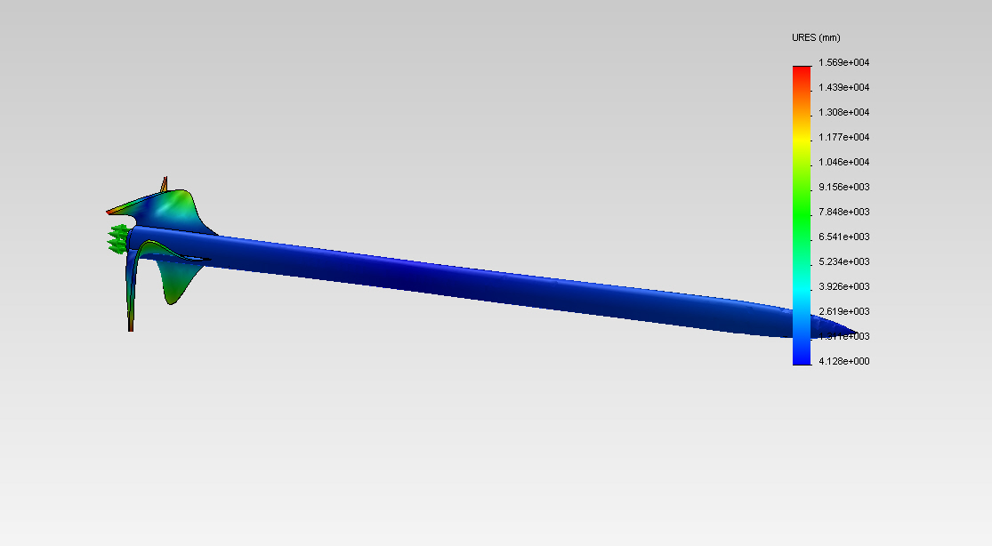
Mode 14 – 266.75 Hz

Slide 46
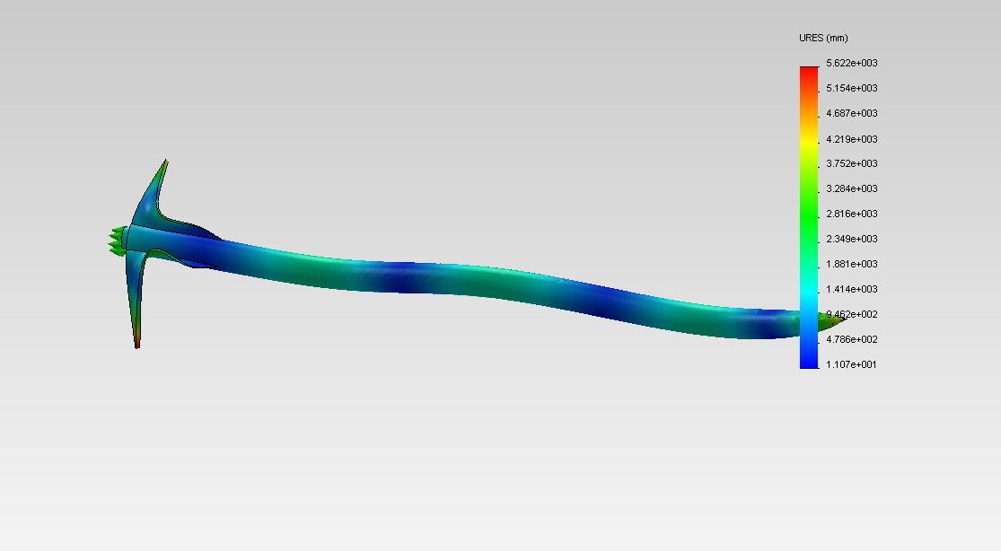
Mode 15 – 273.79 Hz

