Slide 1
Sensors and Transducers
E80 Spring 2014
Erik Spjut

Slide 2
Scientific & Engineering Measurements
Scientific Measurements
  What you measure with a rocket.
  What are examples?
Engineering Measurements
  What you measure about a rocket.
  What are examples?

Slide 3
Experimental Measurements
Mass
Force
Acceleration
Velocity
Position
Displacement
Orientation
Vibration
EM Intensity
  Radio
  Microwave
  IR
  Visible
  UV
  X-ray
  Gamma

Slide 4
Experimental Measurements II
Temperature
Pressure
Flow Rate
Composition
  Partial Pressure
  Humidity
  Mass fraction
  Mole fraction
  pH
Phases
  Aerosols
  Suspensions
  Microstructure
Sound
Images
Video

Slide 5
Experimental Measurements III
Electrical
  Voltage
  Charge
  Current
  Resistance
  Inductance
  Capacitance
  Power
Time
Frequency
Phase
Angular
  Position
  Velocity
  Acceleration

Slide 6
Digikey’s List of Sensors
Accelerometers (1022 items)
Accessories (3085 items)
Amplifiers (277 items)
Capacitive Touch Sensors, Proximity Sensor ICs (508 items)
Color Sensors (111 items)
Current Transducers (1440 items)
Dust Sensors (11 items)
Encoders (4042 items)
Flex Sensors (3 items)
Float, Level Sensors (313 items)
Flow Sensors (162 items)
Force Sensors (50 items)
Gas Sensors (66 items)
Gyroscopes (205 items)
Image Sensors, Camera (313 items)
Inclinometers (44 items)
IrDA Transceiver Modules (291 items)
LVDT Transducers (Linear Variable Differential Transformer) (47 items)
Magnetic Sensors - Compass, Magnetic Field (Modules) (26 items)
Magnetic Sensors - Hall Effect, Digital Switch, Linear, Compass (ICs) (2324 items)
Magnetic Sensors - Position, Proximity, Speed (Modules) (879 items)
Magnets (95 items)
Moisture Sensors, Humidity (257 items)
Motion Sensors, Detectors (PIR) (168 items)
Multifunction (101 items)
Obsolete/Discontinued Part Numbers (16 items)
Optical Sensors - Ambient Light, IR, UV Sensors (561 items)
Optical Sensors - Distance Measuring (36 items)
Optical Sensors - Mouse (117 items)
Optical Sensors - Photo Detectors - CdS Cells (38 items)
Optical Sensors - Photo Detectors - Logic Output (128 items)
Optical Sensors - Photo Detectors - Remote Receiver (1104 items)
Optical Sensors - Photodiodes (925 items)
Optical Sensors - Photoelectric, Industrial (2861 items)
Optical Sensors - Photointerrupters - Slot Type - Logic Output (1126 items)
Optical Sensors - Photointerrupters - Slot Type - Transistor Output (1115 items)
Optical Sensors - Phototransistors (738 items)
Optical Sensors - Reflective - Analog Output (323 items)
Optical Sensors - Reflective - Logic Output (123 items)
Position Sensors - Angle, Linear Position Measuring (937 items)
Pressure Sensors, Transducers (25455 items)
Proximity Sensors (3521 items)
RTD (Resistance Temperature Detector) (60 items)
Shock Sensors (11 items)
Solar Cells (82 items)
Specialized Sensors (311 items)
Strain Gages (24 items)
Temperature Regulators (3285 items)
Temperature Sensors, Transducers (1374 items)
Thermistors - NTC (4928 items)
Thermistors - PTC (1257 items)
Thermocouple, Temperature Probe (396 items)
Tilt Sensors (50 items)
Ultrasonic Receivers, Transmitters (78 items)
Vibration Sensors (30 items)

Slide 7
What Spec’s Do We Care About?
Quantity Measured
Range or Span
Accuracy
Precision
Noise
Linearity
Speed of Response
Voltage Requirements
Current Requirements
Output Impedance
Mounting Requirements

Slide 8
Example – Altimeter
Measure Absolute Pressure and Calculate Altitude
  What range of pressures do we need?
  What accuracy do we expect?

Slide 9
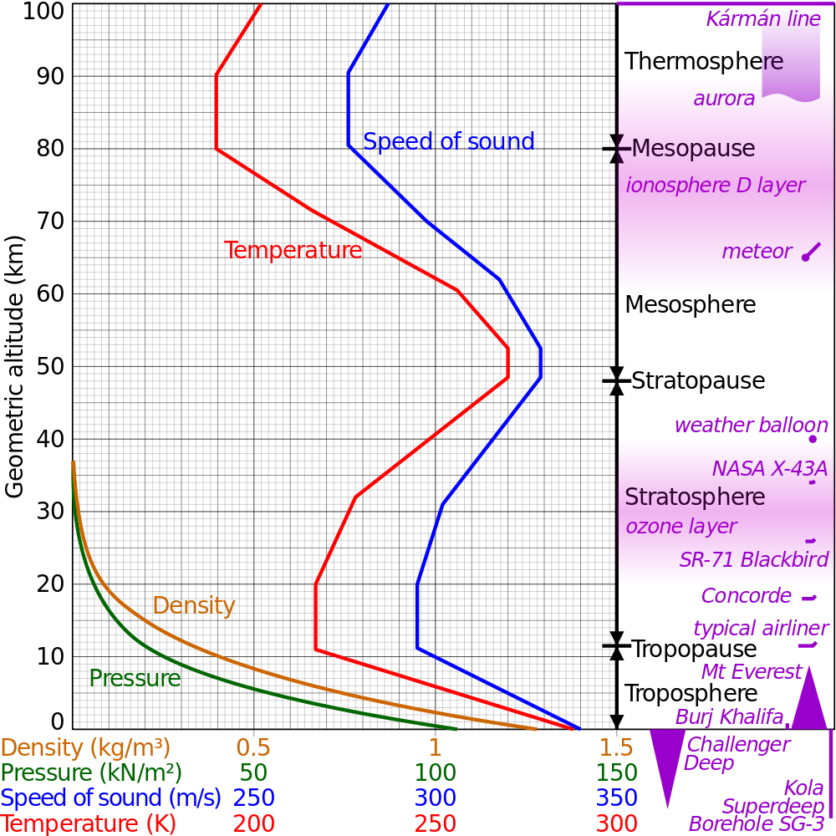
Calculate Altitude from Pressure
US Standard Atmosphere
http://en.wikipedia.org/wiki/File:Comparison_US_standard_atmosphere_1962.svg

Slide 10
For the Troposphere
where
  h = geopotential altitude (above sea level) (in meters)
  P₀ = standard atmosphere pressure = 101325Pa
  T₀ = 288.15K (+15°C)
  dT/dh = –0.0065 K/m: thermal gradient or standard temperature lapse rate
  R = 8.31432 Nm/mol K (Current NIST value 8.3144621)
  g = 9.80665 m/s²
  M = 0.0289644 kg/mol
From 1976 US Standard Atmosphere

Slide 11
How Does Pressure Vary With Height?
Alt. (m) | Alt. (ft) | Alt. (mi) | P (Pa) | dP/dh (Pa/m)
0 | 0 | 0.000 | 101325 | -12.01
200 | 656 | 0.124 | 98945 | -11.78
400 | 1312 | 0.249 | 96610 | -11.56
600 | 1969 | 0.373 | 94321 | -11.34
800 | 2625 | 0.497 | 92076 | -11.12
1000 | 3281 | 0.621 | 89874 | -10.90
1200 | 3937 | 0.746 | 87715 | -10.69
1400 | 4593 | 0.870 | 85598 | -10.48
1600 | 5249 | 0.994 | 83522 | -10.27
1800 | 5906 | 1.118 | 81488 | -10.07
2000 | 6562 | 1.243 | 79494 | -9.87
2200 | 7218 | 1.367 | 77540 | -9.67
2400 | 7874 | 1.491 | 75624 | -9.48
2600 | 8530 | 1.616 | 73747 | -9.29

Slide 12
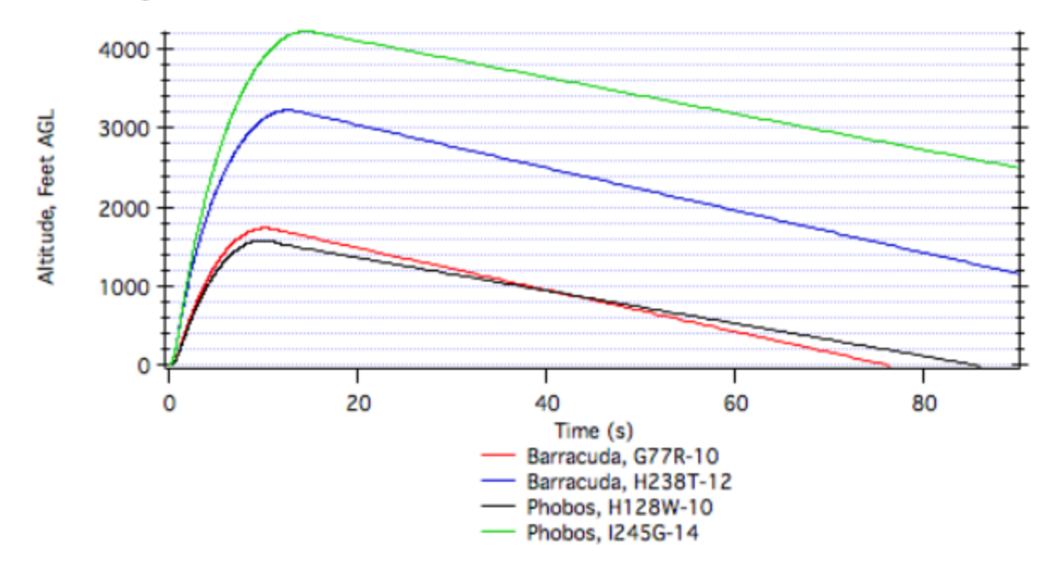
Calculate Flight Height

Slide 13
Assume 1 Mile AGL Max Alt
Lucerne Valley at 3000 ft MSL, Claremont 1200 ft
P_{ground} = 90 kPa
P_{apogee} = 74 kPa
Span = ∆P = 16 kPa
Need to allow for Barometric Pressure Changes +7% to –13%
P_{max} = MAX(104 kPa, 97 kPa)
P_{min} = 64 kPa

Slide 14
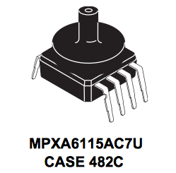
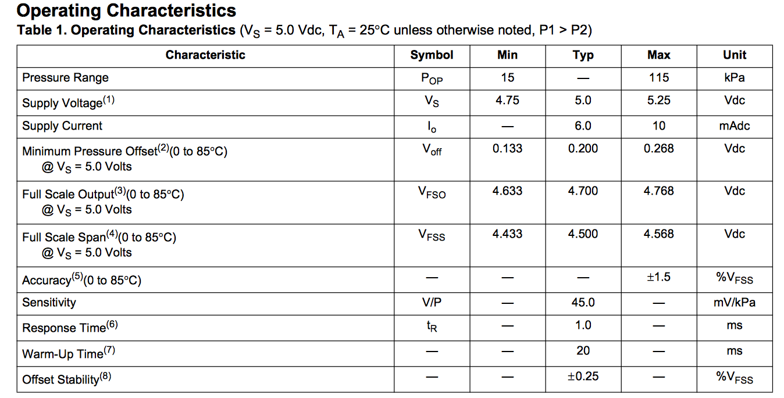
MPXA6115AC7U
From Freescale Data Sheet

Slide 15
Nominal Values
V @ P_{min}= 0.200 V + (64 kPa – 15 kPa)•0.045 V/kPa = 2.41 V
V @ P_{max} = 0.200 + (104 kPa – 15 kPa)•0.045 V/kPa = 4.21 V
Accuracy (Uncalibrated) ±1.5% V_{FS} = ±1.5%•4.7 V = ±0.071 V = ±1.57 kPa = ±157 m
t_{R10%-90%} = 1.0 ms, τ = t_{R10%-90%}/ln(9) = 0.46 ms

Slide 16
Output Impedance
Can drive circuit with 0.5 mA at 4.7 V
Impedance of driven circuit = V/I = 4.7 V/0.0005 A = 9400 Ω.
Actual output impedance determined empirically. How?

Slide 17
Choices on Conditioning
Data Logger
  0 V to 3.3 V
  Input Impedance ~2200 Ω
  16 bit, 1 LSB = 3.3 V/2¹⁶ = 50 µV
Change gain so V_{max} = 3.3 V
  1 LSB = 50 µV = 0.16 m = 6 in
Change gain and offset so V_{min} = 0 V & V_{max} = 3.3 V
  1 LSB = 50 µV = 0.06 m = 2.4 in

Slide 18
Signal Conditioning
Does it need a buffer amp? How would you know?
How do you change the gain?
How do you change the gain and offset?
What about aliasing?

Slide 19
Single-Sided Circuits
(Will visit again under Flight Hardware)
Data logger expects 0 V to 3.3 V signals
Classical op-amp circuit power ±15 V
Low-voltage op-amp circuit power
  ±1.4 V to ±3 V
  0-to-2.8 V to 0-to-6 V
Signal offset
Reference offset
Virtual ground

Slide 20
Inverting Amps

Slide 21
Non-Inverting Amps

Slide 22
Can You do Single Sided for:
Differential Amplifier?
Integrator?
Transimpedance Amplifier?
Sallen-Key Filter?
Bipolar sensor like piezoelectric vibration?

Slide 23
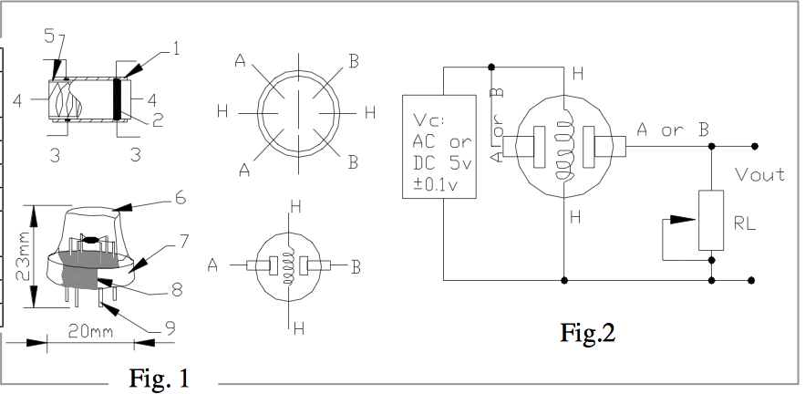
Example – Gas Sensor
MQ-2 CH₄ Gas Sensor (Digikey, Parallax, or Pololu)

Slide 24
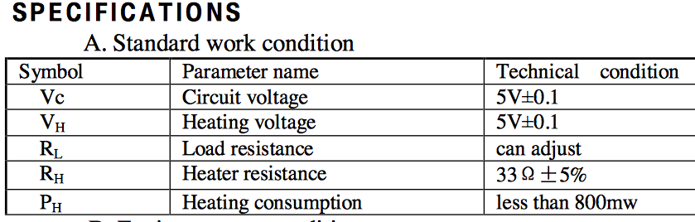
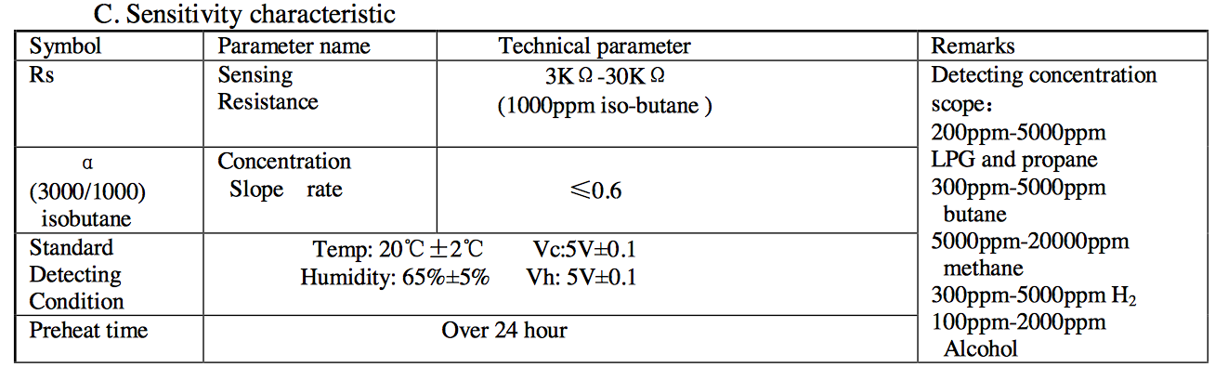
Other Specs

Slide 25
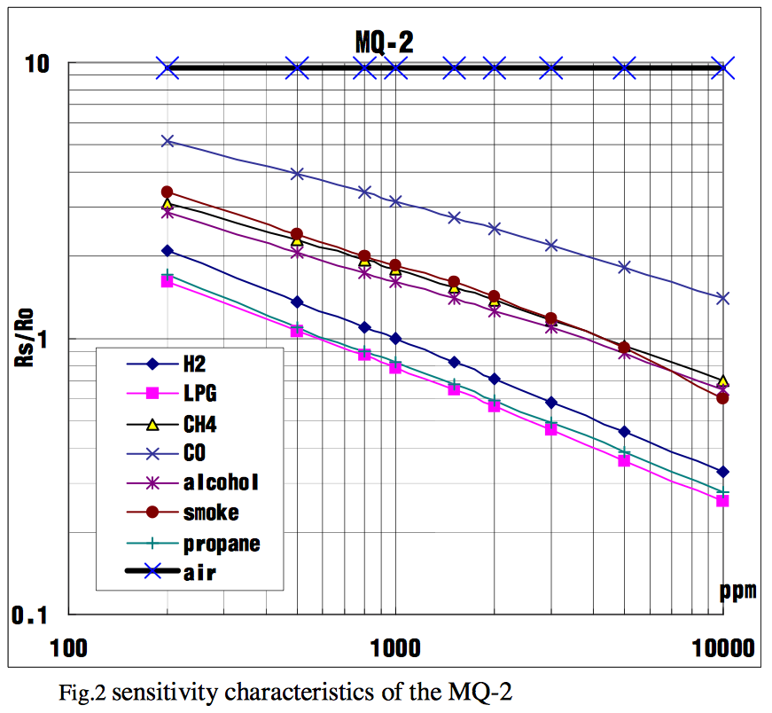
Sensitivity

Slide 26
Power Calculations
5 V @ 800 mW = 160 mA.
5 V @ 33 Ω = 150 mA.
Standard 9 V battery is ~250 mAh
  Would last about 1 ½ hours
  Separate battery for sensor and system.

Slide 27
Signal Conditioning
Must get air to sensor.
Resistance changes with gas concentration.
Designed to work in voltage divider.
Need R in range of approx. 3 kΩ to 30 kΩ.
Need buffer amp.
What is time constant?
http://www.parallax.com/catalog/sensors/gas for more info

Slide 28

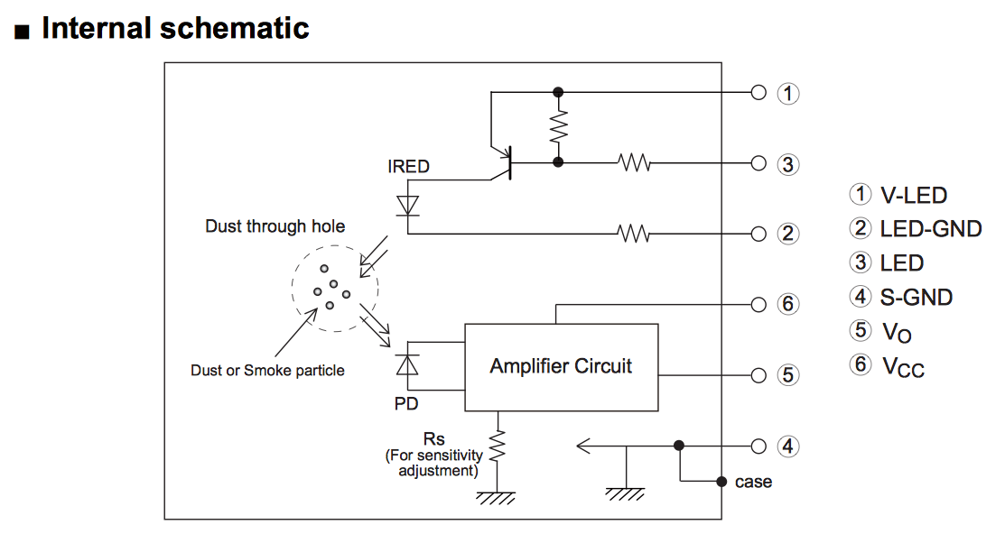
Example – Particle Sensor

Slide 29
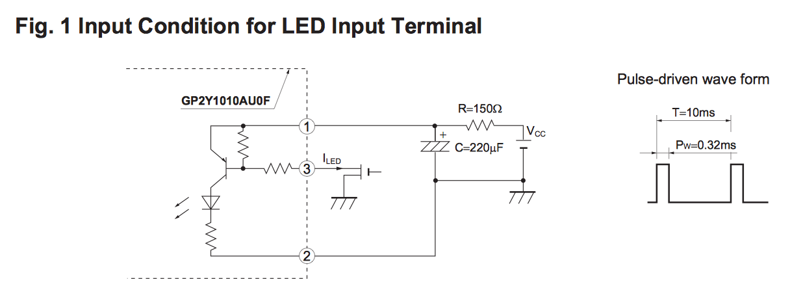
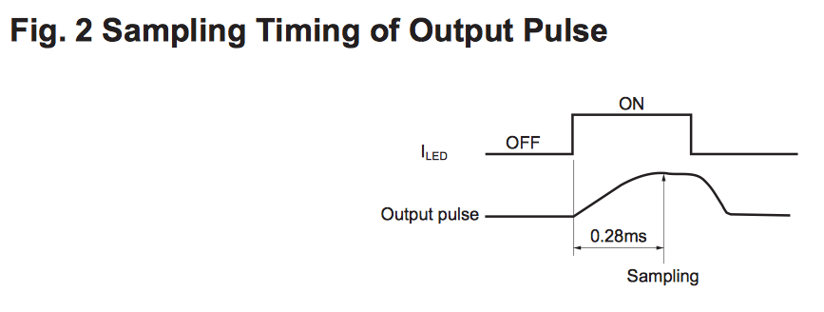
Driving & Reading Circuits

Slide 30
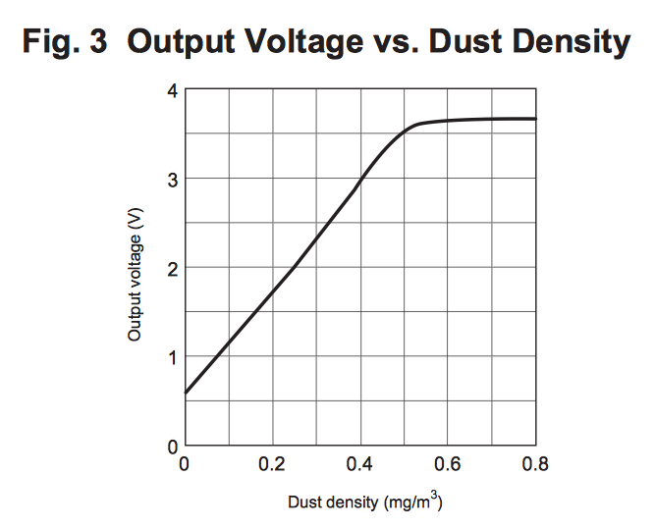
Output & Caution

Slide 31


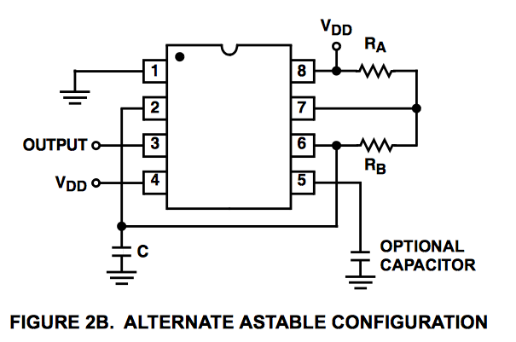
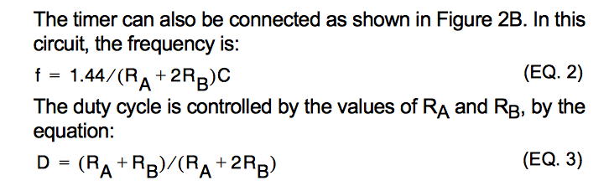
Driving Circuit

Slide 32
Reading Circuit
Pulse Width 0.32 ms
Minimum 1 point
Best 10 points
Sample rate = 10/0.32 ms = 31.25 kSPS

Slide 33
Could You Do Better?
IRED and Driver
Photodiode & Reading Circuit
Mechanical & Optical Chamber
Start at http://en.wikipedia.org/wiki/Particle_counter for more information

Slide 34
Example – Humidity Sensor
Check out Digikey
  http://www.digikey.com/product-search/en?FV=fff4001e%2Cfff80274&mnonly=0&newproducts=0&ColumnSort=1000011&page=1&stock=0&pbfree=0&rohs=0&quantity=1&ptm=0&fid=0&pageSize=25
Digital, I²C – 18 s response time
Capacitive – 15 s, 5 s response time
Linear Voltage – 5 s response time

Slide 35
Digital, I²C
Need microcontroller, e.g., Arduino Pro Mini 328 - 3.3V/8MHz <Sparkfun>
Power separately from data logger
Must synchronize
Must program

Slide 36
Capacitive
How do you measure capacitance?
  Put in a timer circuit
  Put in an integrator
  Put in a voltage divider

Slide 37
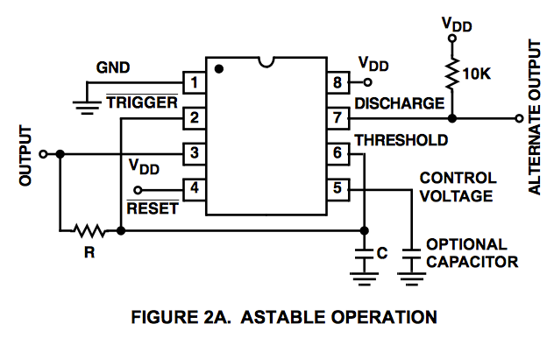

In a Timer Circuit

Slide 38
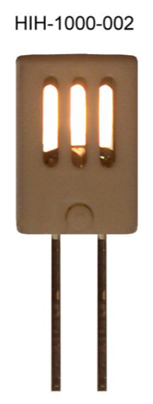
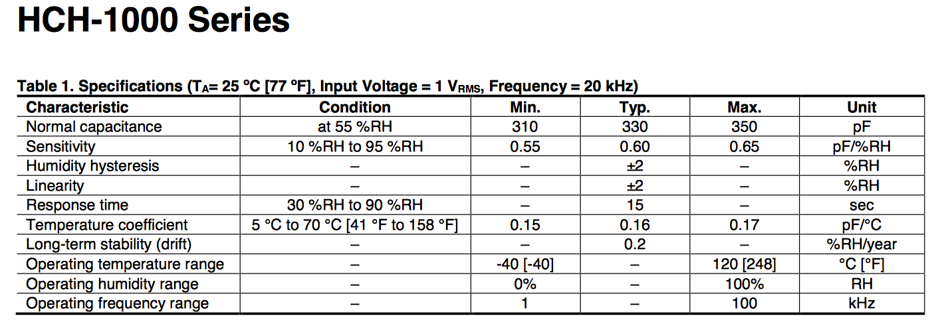
Honeywell HIH-1000-002

Slide 39
Measurement Calc’s
R | 200,000 | Ω
C | 330 | pF
 | 3.3E-10 | F
RC | 0.000066 | s
 | 66 | µs
Angular Freq | 15152 | s^{–1}
Freq | 2411 | Hz
Sensitivity | 0.6 | pF/%RH
0% RH | 297 | pF
 | 2679 | Hz
100% RH | 357 | pF
 | 2229 | Hz
∆F | 450 | Hz
∆F/F | 18.67% | Hz/Hz
The sample rate will need to be high enough to discriminate the frequency changes.

Slide 40
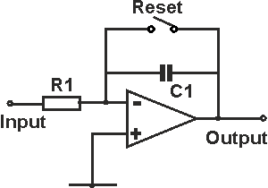
Integrator
From: http://www.radio-electronics.com/info/circuits/opamp-circuits/operational-amplifier-integrator.php

Slide 41
Issues
Easiest input is constant voltage
  Output is then a ramp
  Calculate C from ramp slope or time to V_{set}.
How control reset switch?
  Solid State Relay
  Signal Generator
  Comparator

Slide 42
Voltage Divider
Need sinusoidal input

Slide 43
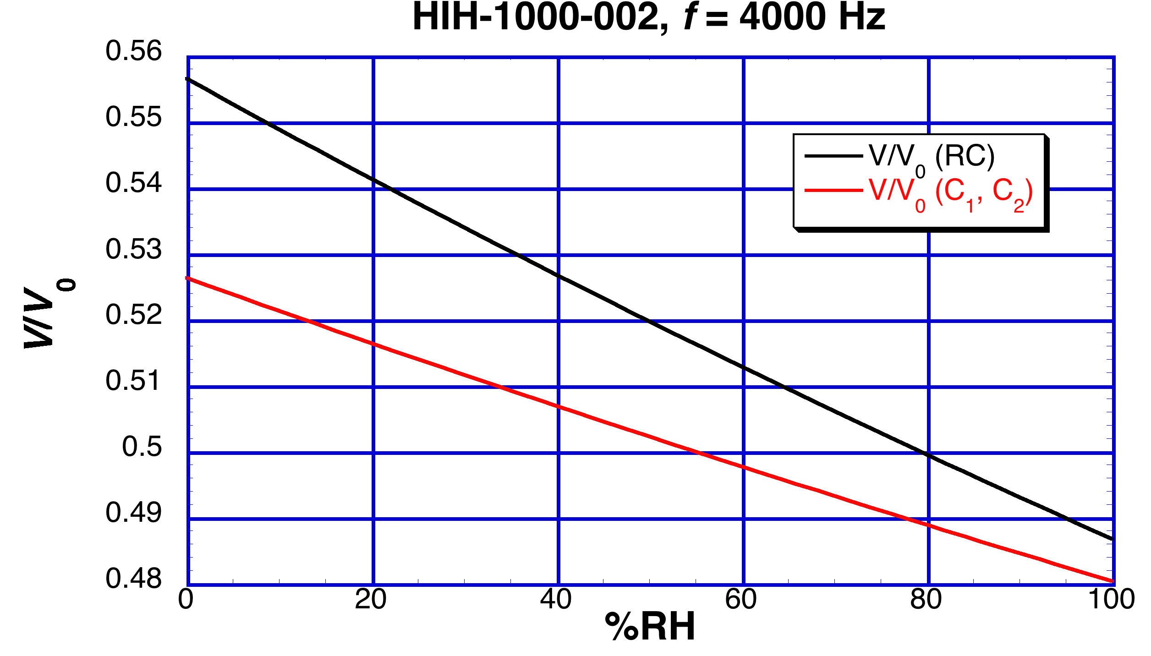
Voltage Divider Performance

Slide 44
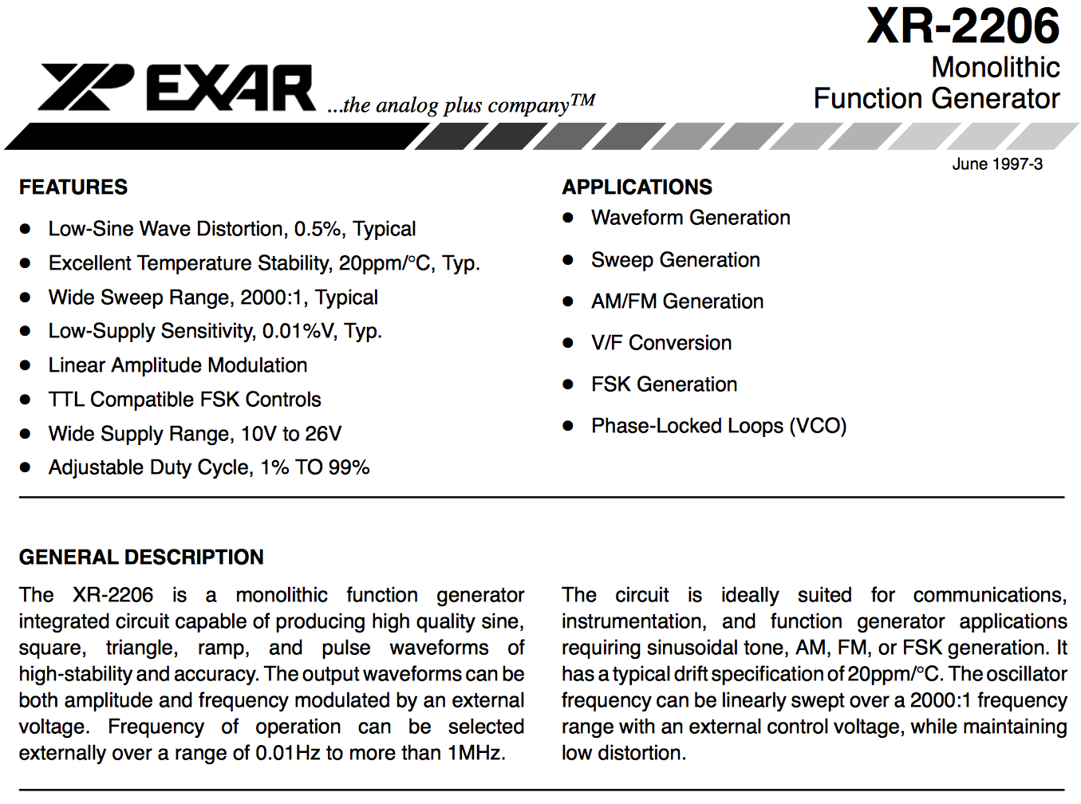
How Do You Generate a Sine Wave?

Slide 45
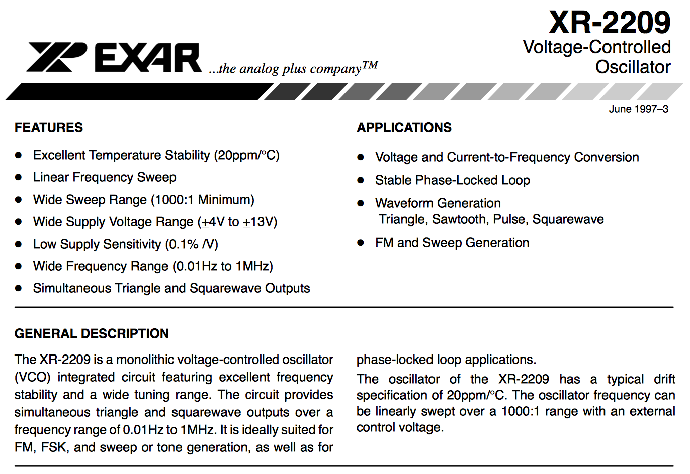
How Do You Generate a Sine Wave?

Slide 46
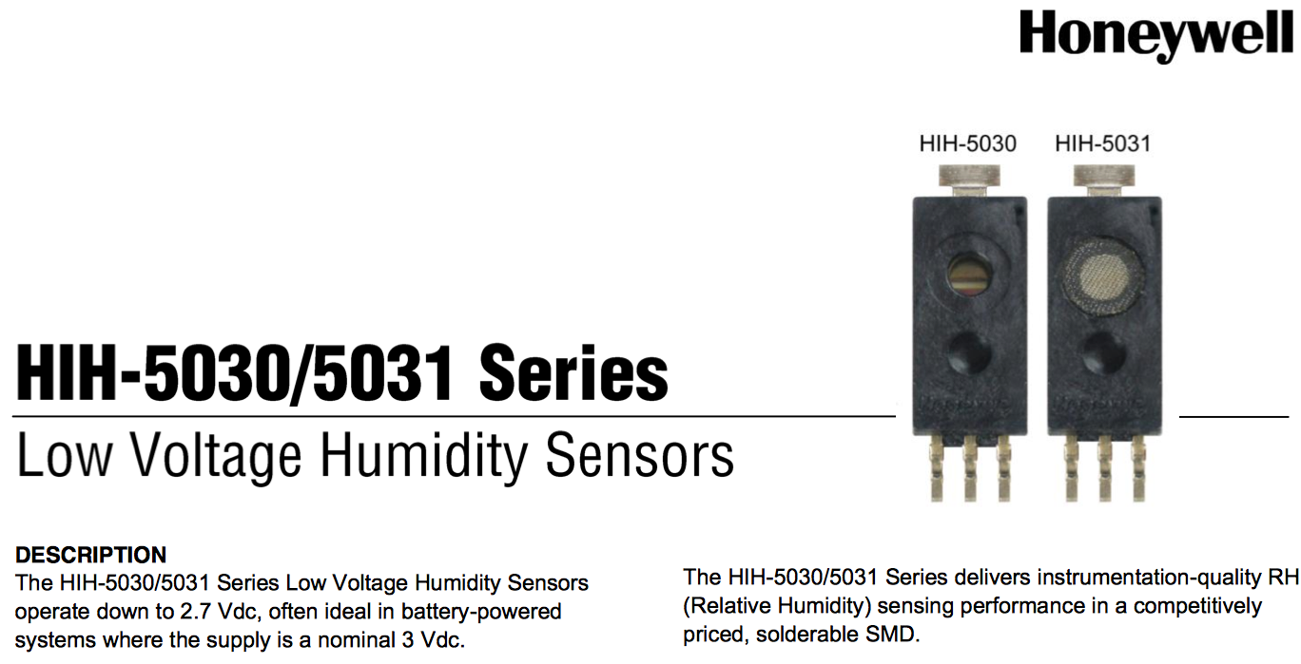
Linear Voltage

Slide 47
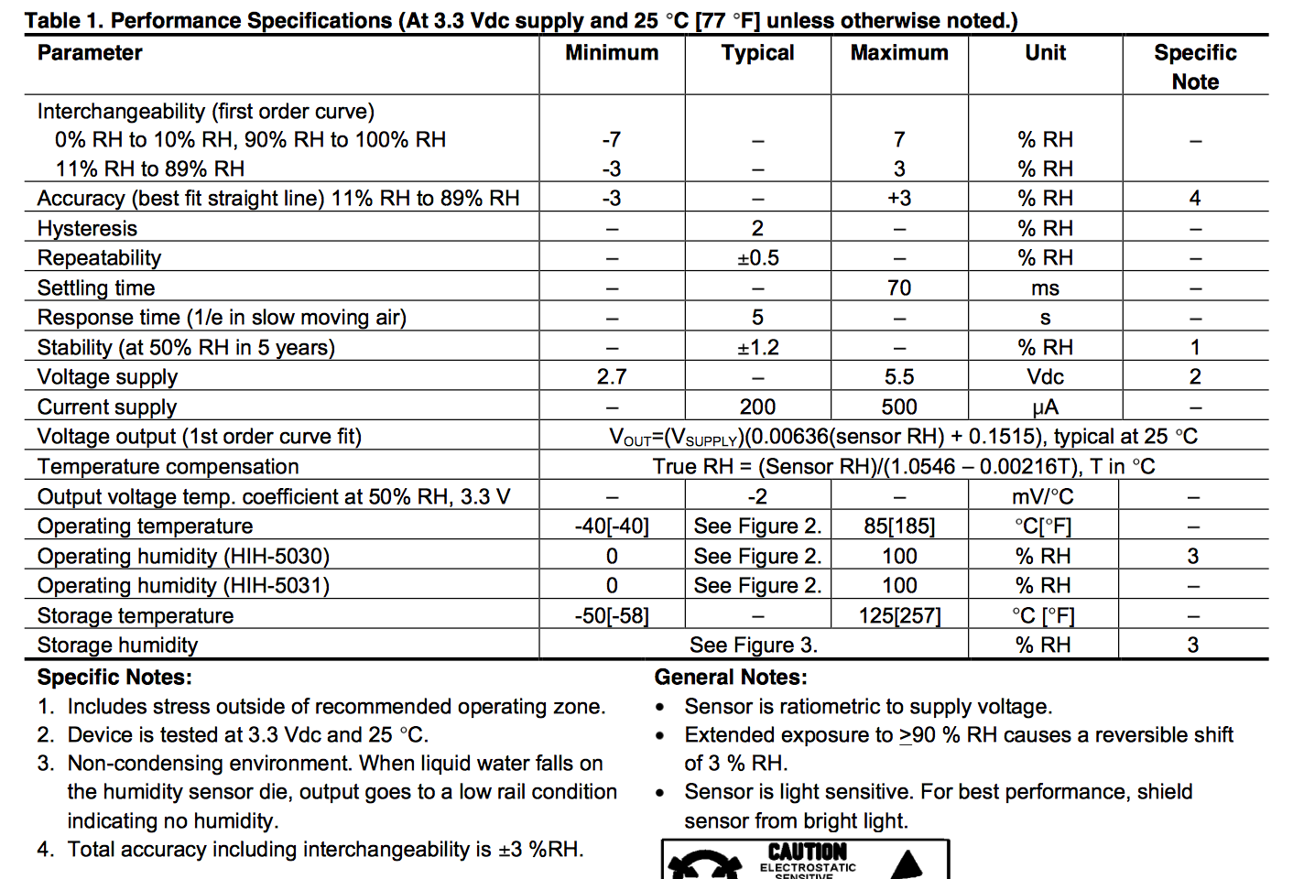

Slide 48
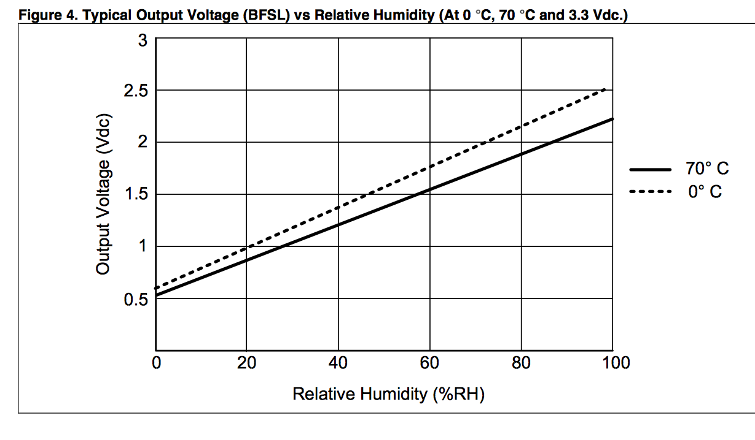

Slide 49
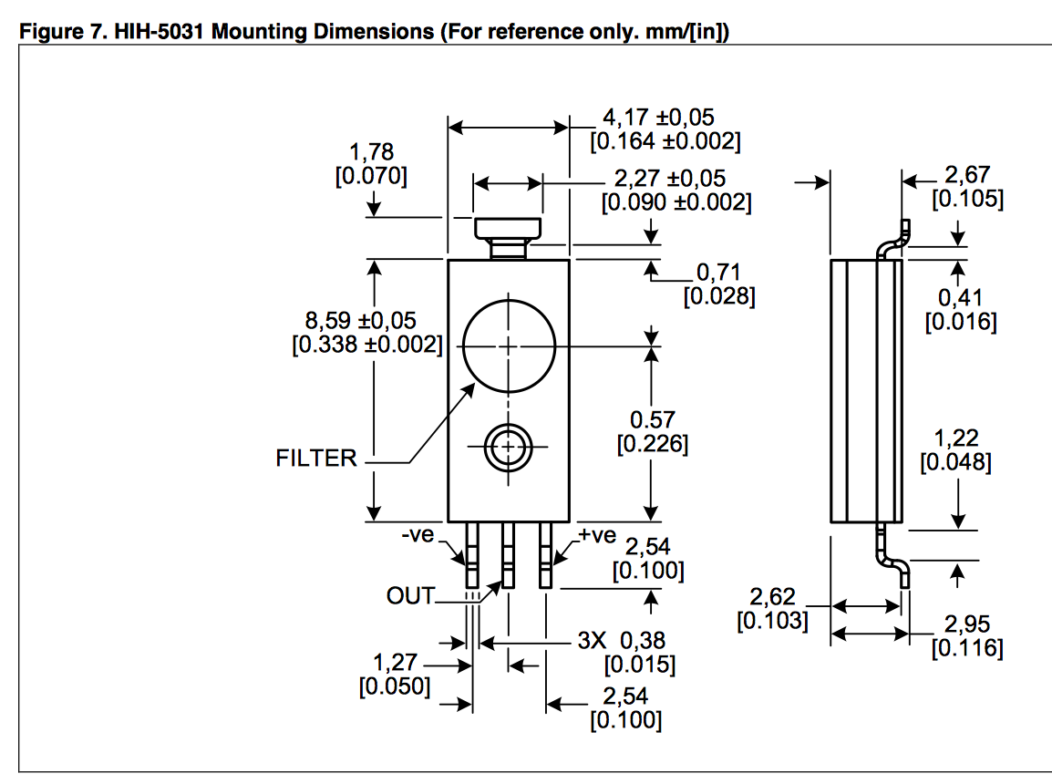
The challenges are how and where to connect it, how and where to mount it, and how to get airflow over it.

Slide 50
Where to look for sensors
Digikey: http://www.digikey.com
Mouser: http://www.mouser.com
Arrow: http://www.arrow.com
Sparkfun: https://www.sparkfun.com
Pololu: https://www.pololu.com
Parallax: http://www.parallax.com

