Slide 1
Op Amps and Signal Conditioning
E80 Spring 2015
Erik Spjut

Slide 2
5 wire diagram
Positive supply
Non-inverting input
Output
Inverting input
Negative supply
Inverting and non-inverting inputs
are often flipped in the schematic.
Be sure you check.

Slide 3
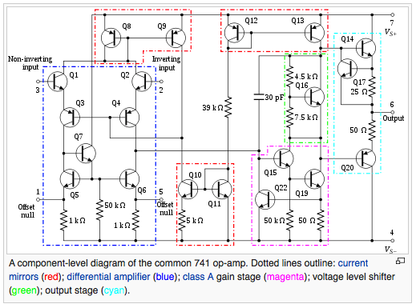
Sample Op Amp Internals
For the curious.
Not needed
for E80
"OpAmpTransistorLevel Colored Labeled" by Daniel Braun - redrawn png file (from User:Omegatron), datasheet. Licensed under CC BY 2.5 via Wikimedia Commons - http://commons.wikimedia.org/wiki/File:OpAmpTransistorLevel_Colored_Labeled.svg#mediaviewer/File:OpAmpTransistorLevel_Colored_Labeled.svg

Slide 4
Simulink Op Amp Model
For the curious.
Not needed
for E80
Rate limited integrator followed by a range limit block.
Ask Prof. Spjut if you ever need it.

Slide 5
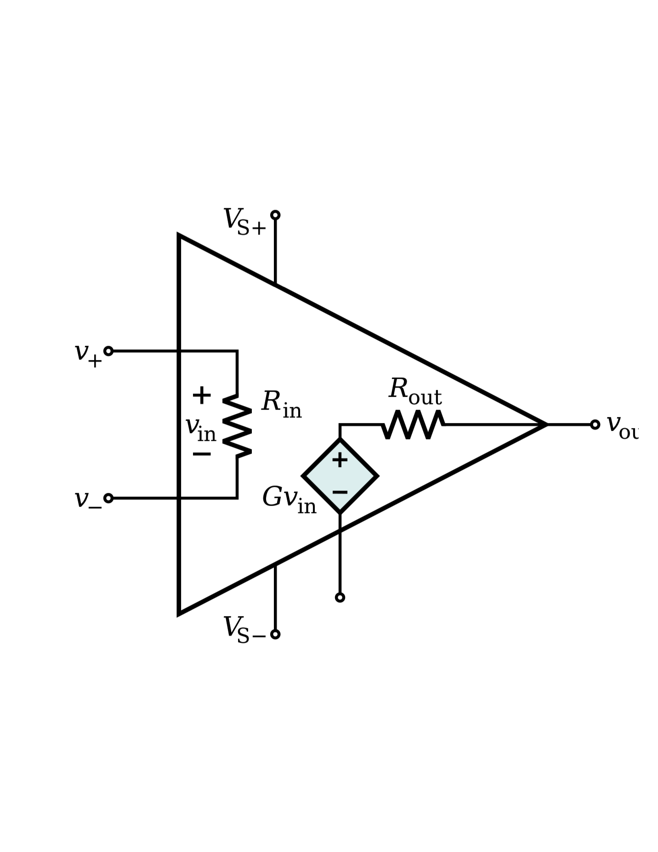
Simplified Real Op Amp Model
For the curious.
Not needed
for E80
The internally generated voltage is the gain times the difference of the input voltages.
The input impedance is very large.
The output impedance is very small.
The ideal op amp is derived by assuming the gain approaches ∞, the output impedance approaches 0, and the input impedance approaches ∞.

Slide 6
TL081 Datasheet

Slide 7
Ideal Op Amp Model
Input impedance: ∞Ω
Output impedance: 0Ω
With negative feedback, gain so high that V₊ = V–

Slide 8
Operational Amplifier
Can be configured to perform mathematical operations on a signal.
  Multiply by a constant (change gain)
  Change sign
  Add two or more signals
  Subtract one signal from another
  Integrate a signal
  Differentiate a signal
  Many others

Slide 9
Unity Gain Buffer
Your go-to circuit. It solves many problems.
Analyze circuit.
Draws no current at input (ideal model).
Provides needed current at output (ideal model).
Transfers voltage with no circuit loading.

Slide 10
Non-Inverting
High impedance input, great for measuring voltages
Gains ≥1
Do you see the voltage divider?
Analyze circuit.

Slide 11
Inverting
Input impedance is R₁ (ideal model).
Flips sign (or phase) of input.
Full gain range
Analyze circuit.

Slide 12
Inverting Summing Amp
How would you sum three signals?
How would you average three signals?
What is the input impedance?
Analyze circuit.
Non-inverting summer exists.

Slide 13
General Impedance Model
Analyze circuit.
Do you see the voltage divider?
What is the input impedance?

Slide 14
Integrator
What is the time-domain version?
How do you set initial condition?
How do you reset?

Slide 15
Differentiator

Slide 16
Filters – LP, HP

Slide 17
Filters – BP

Slide 18
A Step Up – Sallen & Key

Slide 19
Difference Amplifier
If and then

Slide 20
Instrumentation Amplifier
Set gain with R_{gain}.
V_{ref} must be a low-impedance source.
Never make one. Use a commercial one.

Slide 21
Transimpedance Amp
If V_{out} has the wrong sign, flip the diode.
The far side of the photodiode can be tied to V_{bias} instead of ground.

Slide 22
Logarithmic Amp
V_{T} and i_{s} are diode properties.
Thermal voltage
Saturation current

Slide 23
Exponential Amp
V_{T} and i_{s} are diode properties.
Thermal voltage
Saturation current

Slide 24
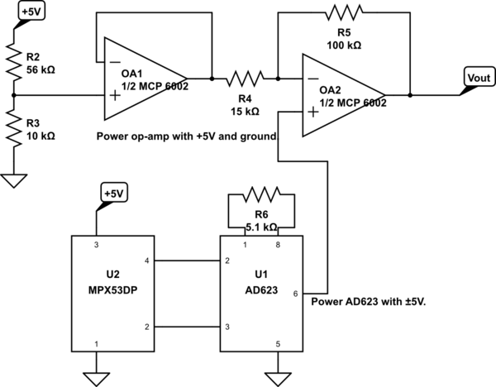
What Does It Do?
What does the first voltage divider do?
Can you find the unity gain buffer?
Where is the instrumentation amp?
Can you find the modified difference amp?
What are G and K?
Don’t use a circuit you don’t understand.

Slide 25
LabVIEW File Naming Convention:
  Your file name should be (Last Name)_(First Initial)_A(Assignment Number)_S(Section Number).(vi or llb). For example, if I were Greg Lake in Section 4 and I was turning in Assignment 3, my file would be named Lake_G_A3_S4.llb. If your file does not have the correct naming convention, it will not be graded.
Professors have asked that you submit lab reports as PDF files. There are too many Mac/Win formatting battles to submit Word files.

