Slide 1
Flight Hardware
-Making Sure it Works!
E80
Fall 2011

Slide 2
Surviving Flight
http://www.youtube.com/watch?v=EXQKl-28zn0&NR=1

Slide 3
Practice and Benefit
Acoustic and random vibration testing supplemented with additional sine vibration testing is performed to qualify payload hardware to the vibroacoustic environments of the mission, and to demonstrate acceptable workmanship.
Testing alleviates vibroacoustic-induced failures of structural stress and fatigue, unacceptable workmanship, and performance degradation of sensitive subsystems including instruments and components.
Implementation of this practice assures that minimal degradation of "design reliability" has occurred during prior fabrication, integration and test activities

Slide 4
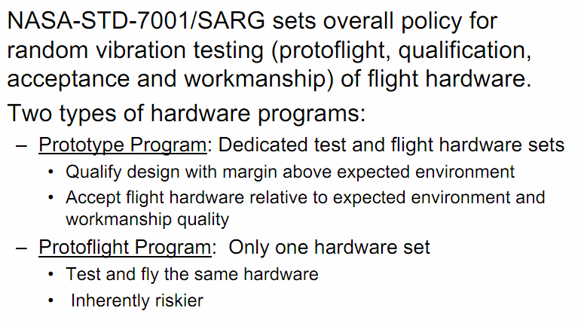
NASA Standards
Ref: Hughes, McNelis, “Random Vibration Testing Tutorial,”
Glenn Research Center, 071204

Slide 5
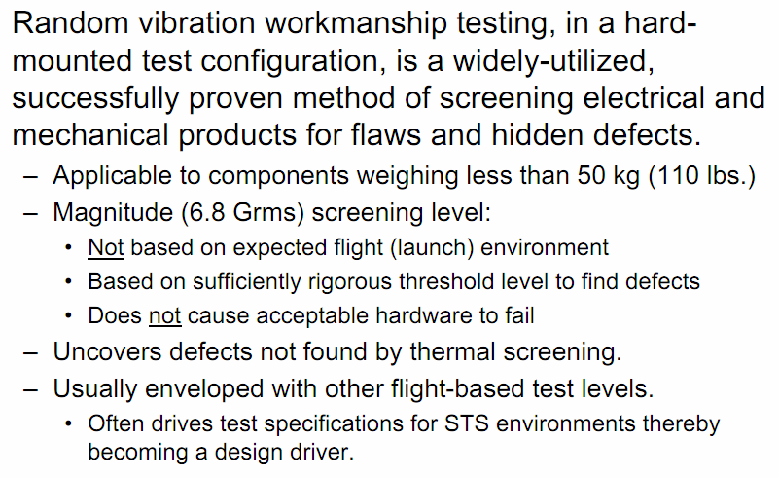
NASA Standards

Slide 6
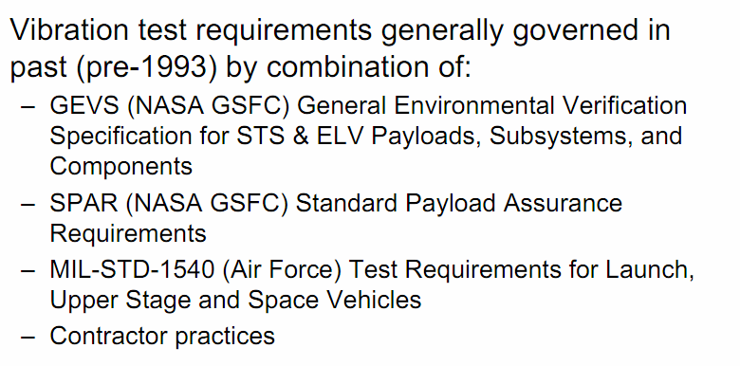
Other Test Standards

Slide 7
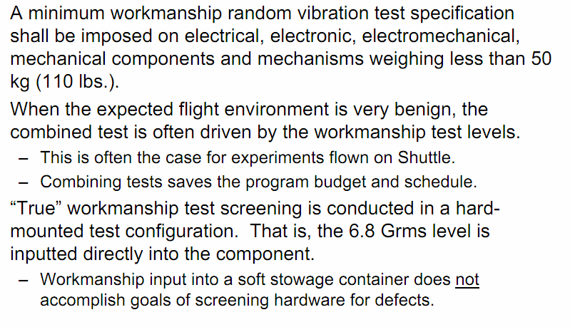
Workmanship Testing

Slide 8
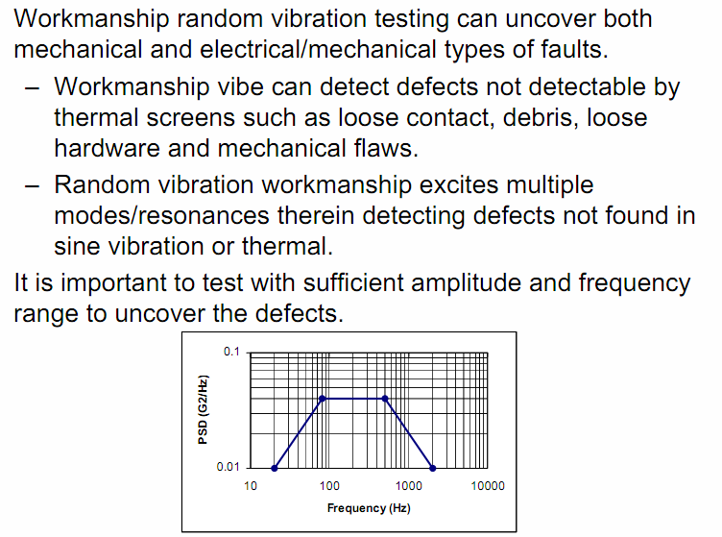
Random Vib Testing http://www.youtube.com/watch?v=MH0okmOnfVo

Slide 9
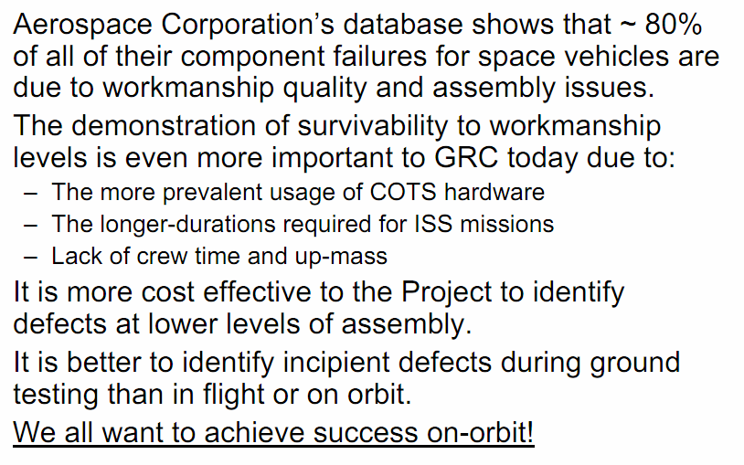
Value Based Testing

Slide 10
Flight Readiness - Sensors
Define your engineering or science objectives.
  What measurements do you need?
Requirement
  At least two different sensors must be used
  You are limited to 8 channels of data acquisition

Slide 11
Flight Readiness - Ranging
Determine proper ranging for your data acquisition channels.
Requirement
  Your dynamic range for all channels must fit within
  0-3.3V ADC.
  Response times must be sufficient for each measurement.
  Sample rates must also be considered.
  You must document the design of your flight hardware circuitry.

Slide 12
Flight Readiness - Power
You are required to power your instrumentation (circuitry and sensors) according to their specifications.
You may use any supply source you wish.
  9V batteries with regulators (#7805) are available.
Caution
  Certain components can be damaged if not properly powered (e.g. Data Logger – 3.6-7.5V @$60/unit)
  Connecting 8V directly to the DL will blow it.

Slide 13
Flight Readiness - Docs
You are required to enter documentation into your lab notebook regarding the steps you took leading to your design. Include instrumentation objectives, specifications, parts lists, and schematics of your designs.
Requirement
  Your documentation must be approved by your section instructor and Prof. Spjut by the end of your Lab 1.

Slide 14
Breadboard (ing)
You are required to breadboard your circuitry on your personal breadboards.
Power and data loggers can be left off your breadboards, but everything else in your design should fit onto your breadboards .
Requirement
  You must demonstrate operation to your section instructor and Prof. Spjut by the end of Lab 2 or 3 at the latest.

Slide 15
PC Board (ing)
Transfer your working breadboard circuitry to your PC boards.
Considerations
  Be careful when soldering components onto your PC boards.
  Calibrate your sensors at some point before flight.
Requirement
  You must demonstrate operation to your section instructor and Prof. Spjut by the end of Lab 3 or 4 at the latest.

Slide 16
Assembly
Assemble your rocket
  Make sure you know how to “introduce” or mount your instrumentation into your rocket.
Develop an experimental plan with objectives for each flight. Enter these into your notebooks and have them reviewed by your section instructor.
Be flight ready by the end of Lab 4.

Slide 17
Labs 5 and 6 and more…
Lab 5
  For fixing and getting ready to re-fly.
Lab 6
  Write-up and Technical Presentation preparation.
Team Access
  $50 budget
  Your regular lab time is prioritized, other times as available.
  Equipment lists will be posted.

