Slide 1

Lecture 18:
Function Calls &
Machine Language
E85 Digital Design & Computer Engineering

Slide 2
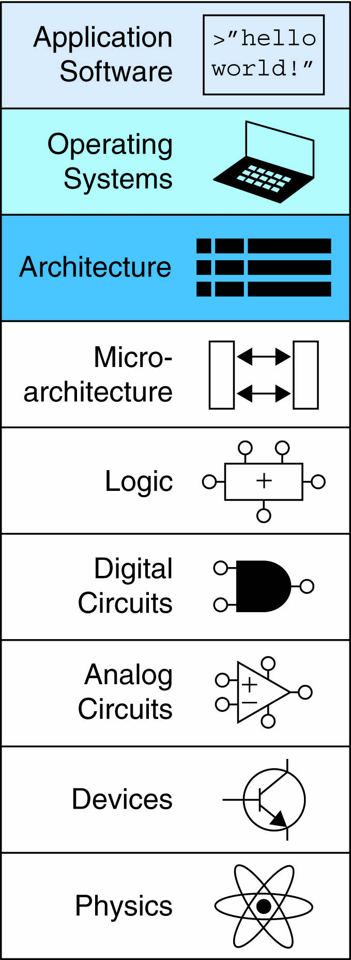
Lecture 18
Function Calls
Machine Language

Slide 3
Programming Building Blocks
Data-processing Instructions
Conditional Execution
Branches
High-level Constructs:
  if/else statements
  for loops
  while loops
  arrays
  function calls

Slide 4
Function Calls
Caller: calling function (in this case, main)
Callee: called function (in this case, sum)
C Code
void main()
{
int y;
y = sum(42, 7);
...
}
int sum(int a, int b)
{
return (a + b);
}

Slide 5
Function Conventions
Caller:
  passes arguments to callee
  jumps to callee

Slide 6
Function Conventions
Caller:
  passes arguments to callee
  jumps to callee
Callee:
  performs the function
  returns result to caller
  returns to point of call
  must not overwrite registers or memory needed by caller

Slide 7
ARM Function Conventions
Call Function: branch and link
BL
Return from function: move the link register to PC: MOV PC, LR
Arguments: R0-R3
Return value: R0

Slide 8
Function Calls
C Code
int main() {
simple();
a = b + c;
}
void simple() {
return;
}
ARM Assembly Code
0x00000200 MAIN BL SIMPLE
0x00000204 ADD R4, R5, R6
...
0x00401020 SIMPLE MOV PC, LR
void means that simple doesn’t return a value

Slide 9
Function Calls
C Code
int main() {
simple();
a = b + c;
}
void simple() {
return;
}
ARM Assembly Code
0x00000200 MAIN BL SIMPLE
0x00000204 ADD R4, R5, R6
...
0x00401020 SIMPLE MOV PC, LR
BL branches to SIMPLE
LR = PC + 4 = 0x00000204
MOV PC, LR makes PC = LR
(the next instruction executed is at 0x00000200)

Slide 10
Input Arguments and Return Value
ARM conventions:
Argument values: R0 - R3
Return value: R0

Slide 11
Input Arguments and Return Value
C Code
int main()
{
int y;
...
y = diffofsums(2, 3, 4, 5); // 4 arguments
...
}
int diffofsums(int f, int g, int h, int i)
{
int result;
result = (f + g) - (h + i);
return result; // return value
}

Slide 12
Input Arguments and Return Value
ARM Assembly Code
; R4 = y
MAIN
...
MOV R0, #2 ; argument 0 = 2
MOV R1, #3 ; argument 1 = 3
MOV R2, #4 ; argument 2 = 4
MOV R3, #5 ; argument 3 = 5
BL DIFFOFSUMS ; call function
MOV R4, R0 ; y = returned value
...
; R4 = result
DIFFOFSUMS
ADD R8, R0, R1 ; R8 = f + g
ADD R9, R2, R3 ; R9 = h + i
SUB R4, R8, R9 ; result = (f + g) - (h + i)
MOV R0, R4 ; put return value in R0
MOV PC, LR ; return to caller

Slide 13
Input Arguments and Return Value
ARM Assembly Code
; R4 = result
DIFFOFSUMS
ADD R8, R0, R1 ; R8 = f + g
ADD R9, R2, R3 ; R9 = h + i
SUB R4, R8, R9 ; result = (f + g) - (h + i)
MOV R0, R4 ; put return value in R0
MOV PC, LR ; return to caller
diffofsums overwrote 3 registers: R4, R8, R9
diffofsums can use stack to temporarily store registers

Slide 14

The Stack
Memory used to temporarily save variables
Like stack of dishes, last-in-first-out (LIFO) queue
Expands: uses more memory when more space needed
Contracts: uses less memory when the space no longer needed

Slide 15
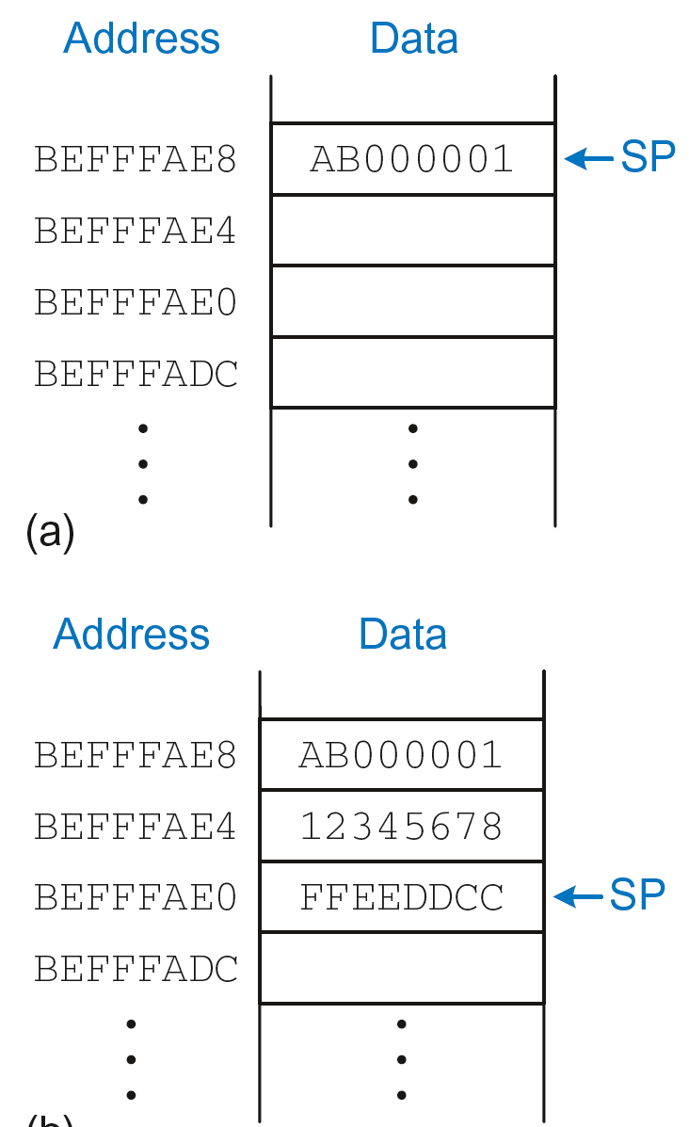
The Stack
Grows down (from higher to lower memory addresses)
Stack pointer: SP points to top of the stack
Stack expands by 2 words

Slide 16
How Functions use the Stack
Called functions must have no unintended side effects
But diffofsums overwrites 3 registers: R4, R8, R9
ARM Assembly Code
; R4 = result
DIFFOFSUMS
ADD R8, R0, R1 ; R8 = f + g
ADD R9, R2, R3 ; R9 = h + i
SUB R4, R8, R9 ; result = (f + g) - (h + i)
MOV R0, R4 ; put return value in R0
MOV PC, LR ; return to caller

Slide 17
Storing Register Values on the Stack
ARM Assembly Code
; R2 = result
DIFFOFSUMS
SUB SP, SP, #12 ; make space on stack for 3 registers
STR R4, [SP, 8] ; save R4 on stack
STR R8, [SP, #4] ; save R8 on stack
STR R9, [SP] ; save R9 on stack
ADD R8, R0, R1 ; R8 = f + g
ADD R9, R2, R3 ; R9 = h + i
SUB R4, R8, R9 ; result = (f + g) - (h + i)
MOV R0, R4 ; put return value in R0
LDR R9, [SP] ; restore R9 from stack
LDR R8, [SP, #4] ; restore R8 from stack
LDR R4, [SP, #8] ; restore R4 from stack
ADD SP, SP, #12 ; deallocate stack space
MOV PC, LR ; return to caller

Slide 18
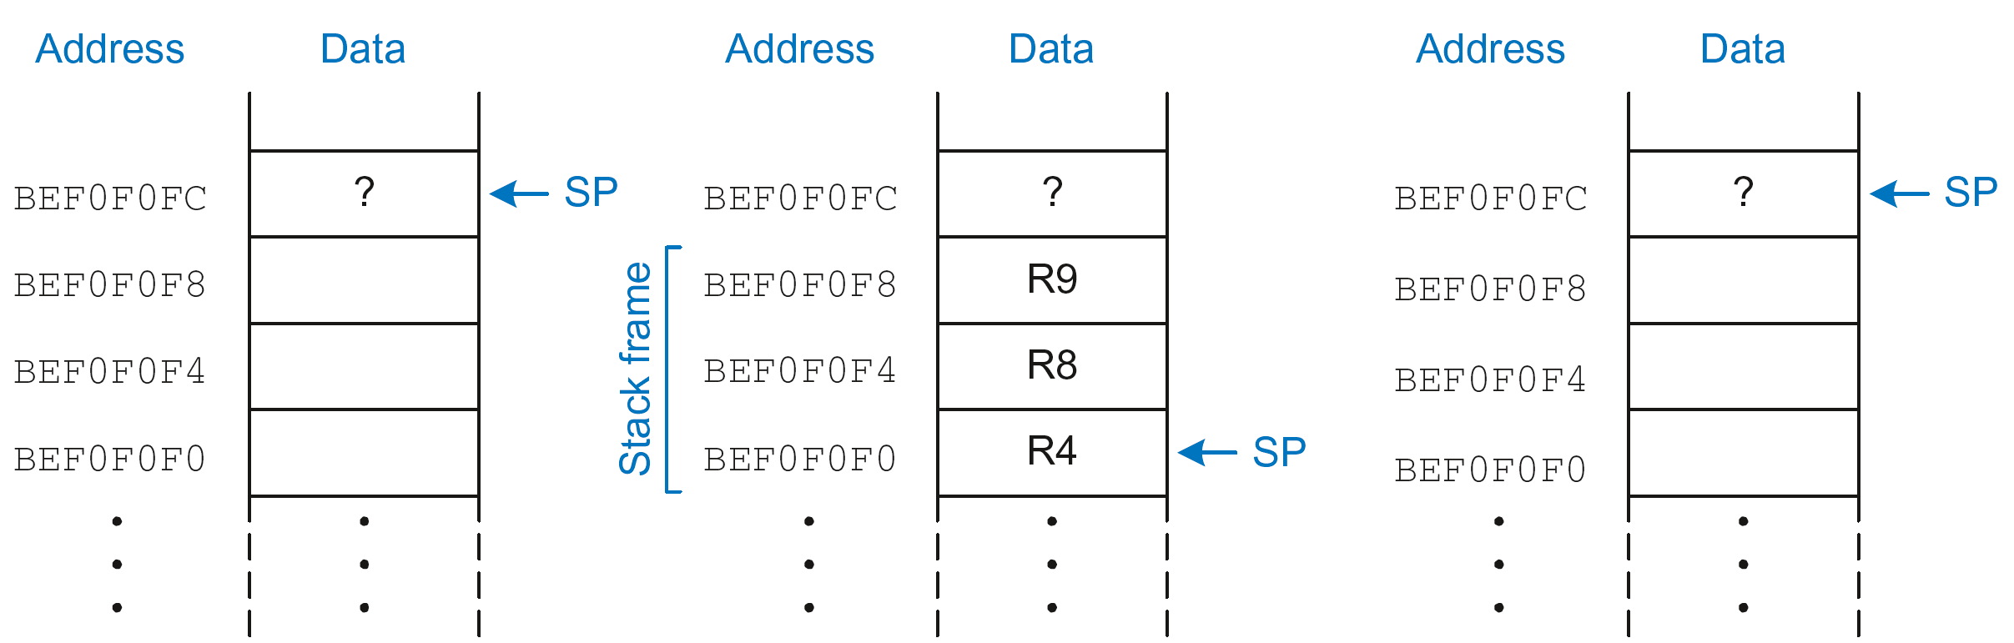
The Stack during diffofsums Call
Before call
During call
After call

Slide 19
Registers
Preserved Callee-Saved | Nonpreserved Caller-Saved
R4-R11 | R12
R14 (LR) | R0-R3
R13 (SP) | CPSR
stack above SP | stack below SP

Slide 20
Storing Saved Registers only on Stack
ARM Assembly Code
; R2 = result
DIFFOFSUMS
STR R4, [SP, #-4]! ; save R4 on stack
ADD R8, R0, R1 ; R8 = f + g
ADD R9, R2, R3 ; R9 = h + i
SUB R4, R8, R9 ; result = (f + g) - (h + i)
MOV R0, R4 ; put return value in R0
LDR R4, [SP], #4 ; restore R4 from stack
MOV PC, LR ; return to caller

Slide 21
Storing Saved Registers only on Stack
ARM Assembly Code
; R2 = result
DIFFOFSUMS
STR R4, [SP, #-4]! ; save R4 on stack
ADD R8, R0, R1 ; R8 = f + g
ADD R9, R2, R3 ; R9 = h + i
SUB R4, R8, R9 ; result = (f + g) - (h + i)
MOV R0, R4 ; put return value in R0
LDR R4, [SP], #4 ; restore R4 from stack
MOV PC, LR ; return to caller
Notice code optimization for expanding/contracting stack

Slide 22
Nonleaf Function
ARM Assembly Code
STR LR, [SP, #-4]! ; store LR on stack
BL PROC2 ; call another function
...
LDR LR, [SP], #4 ; restore LR from stack
MOV PC, LR ; return to caller

Slide 23
Nonleaf Function Example
C Code
int f1(int a, int b) {
int i, x;
x = (a + b)*(a − b);
for (i=0; i<a; i++)
x = x + f2(b+i);
return x;
}
int f2(int p) {
int r;
r = p + 5;
return r + p;
}

Slide 24
Nonleaf Function Example
C Code
int f1(int a, int b) {
int i, x;
x = (a + b)*(a − b);
for (i=0; i<a; i++)
x = x + f2(b+i);
return x;
}
int f2(int p) {
int r;
r = p + 5;
return r + p;
}
ARM Assembly Code
; R0=a, R1=b, R4=i, R5=x
F1
PUSH {R4, R5, LR}
ADD R5, R0, R1
SUB R12, R0, R1
MUL R5, R5, R12
MOV R4, #0
FOR
CMP R4, R0
BGE RETURN
PUSH {R0, R1}
ADD R0, R1, R4
BL F2
ADD R5, R5, R0
POP {R0, R1}
ADD R4, R4, #1
B FOR
RETURN
MOV R0, R5
POP {R4, R5, LR}
MOV PC, LR
; R0=p, R4=r
F2
PUSH {R4}
ADD R4, R0, 5
ADD R0, R4, R0
POP {R4}
MOV PC, LR

Slide 25
Nonleaf Function Example
ARM Assembly Code
; R0=a, R1=b, R4=i, R5=x
F1
PUSH {R4, R5, LR} ; save regs
ADD R5, R0, R1 ; x = (a+b)
SUB R12, R0, R1 ; temp = (a-b)
MUL R5, R5, R12 ; x = x*temp
MOV R4, #0 ; i = 0
FOR
CMP R4, R0 ; i < a?
BGE RETURN ; no: exit loop
PUSH {R0, R1} ; save regs
ADD R0, R1, R4 ; arg is b+i
BL F2 ; call f2(b+i)
ADD R5, R5, R0 ; x = x+f2(b+i)
POP {R0, R1} ; restore regs
ADD R4, R4, #1 ; i++
B FOR ; repeat loop
RETURN
MOV R0, R5 ; return x
POP {R4, R5, LR} ; restore regs
MOV PC, LR ; return
; R0=p, R4=r
F2
PUSH {R4} ; save regs
ADD R4, R0, 5 ; r = p+5
ADD R0, R4, R0 ; return r+p
POP {R4} ; restore regs
MOV PC, LR ; return

Slide 26
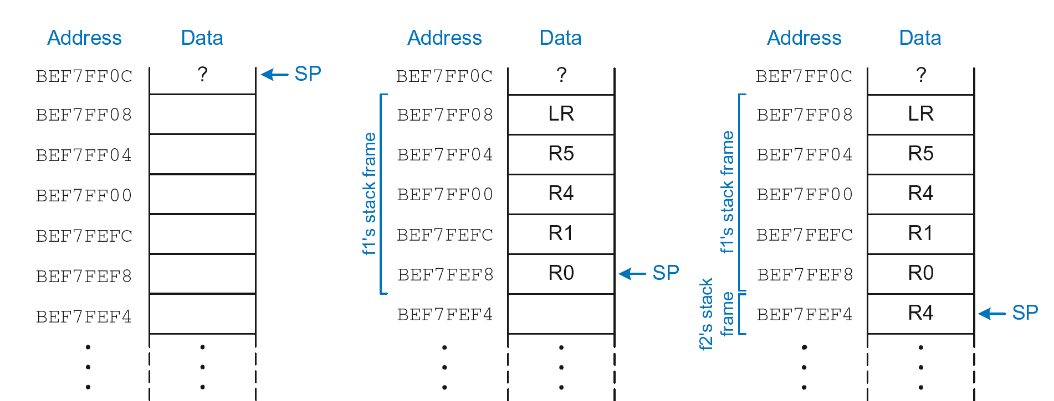
Stack during Nonleaf Function
At beginning of f1
Just before calling f2
After calling f2

Slide 27
Recursive Function Call
C Code
int factorial(int n) {
if (n <= 1)
return 1;
else
return (n * factorial(n-1));
}

Slide 28
Recursive Function Call
ARM Assembly Code
0x94 FACTORIAL STR R0, [SP, #-4]! ;store R0 on stack
0x98 STR LR, [SP, #-4]! ;store LR on stack
0x9C CMP R0, #2 ;set flags with R0-2
0xA0 BHS ELSE ;if (r0>=2) branch to else
0xA4 MOV R0, #1 ; otherwise return 1
0xA8 ADD SP, SP, #8 ; restore SP 1
0xAC MOV PC, LR ; return
0xB0 ELSE SUB R0, R0, #1 ; n = n - 1
0xB4 BL FACTORIAL ; recursive call
0xB8 LDR LR, [SP], #4 ; restore LR
0xBC LDR R1, [SP], #4 ; restore R0 (n) into R1
0xC0 MUL R0, R1, R0 ; R0 = n*factorial(n-1)
0xC4 MOV PC, LR ; return

Slide 29
Recursive Function Call
C Code
int factorial(int n) {
if (n <= 1)
return 1;
else
return (n * factorial(n-1));
}
ARM Assembly Code
0x94 FACTORIAL STR R0, [SP, #-4]!
0x98 STR LR, [SP, #-4]!
0x9C CMP R0, #2
0xA0 BHS ELSE
0xA4 MOV R0, #1
0xA8 ADD SP, SP, #8
0xAC MOV PC, LR
0xB0 ELSE SUB R0, R0, #1
0xB4 BL FACTORIAL
0xB8 LDR LR, [SP], #4
0xBC LDR R1, [SP], #4
0xC0 MUL R0, R1, R0
0xC4 MOV PC, LR

Slide 30
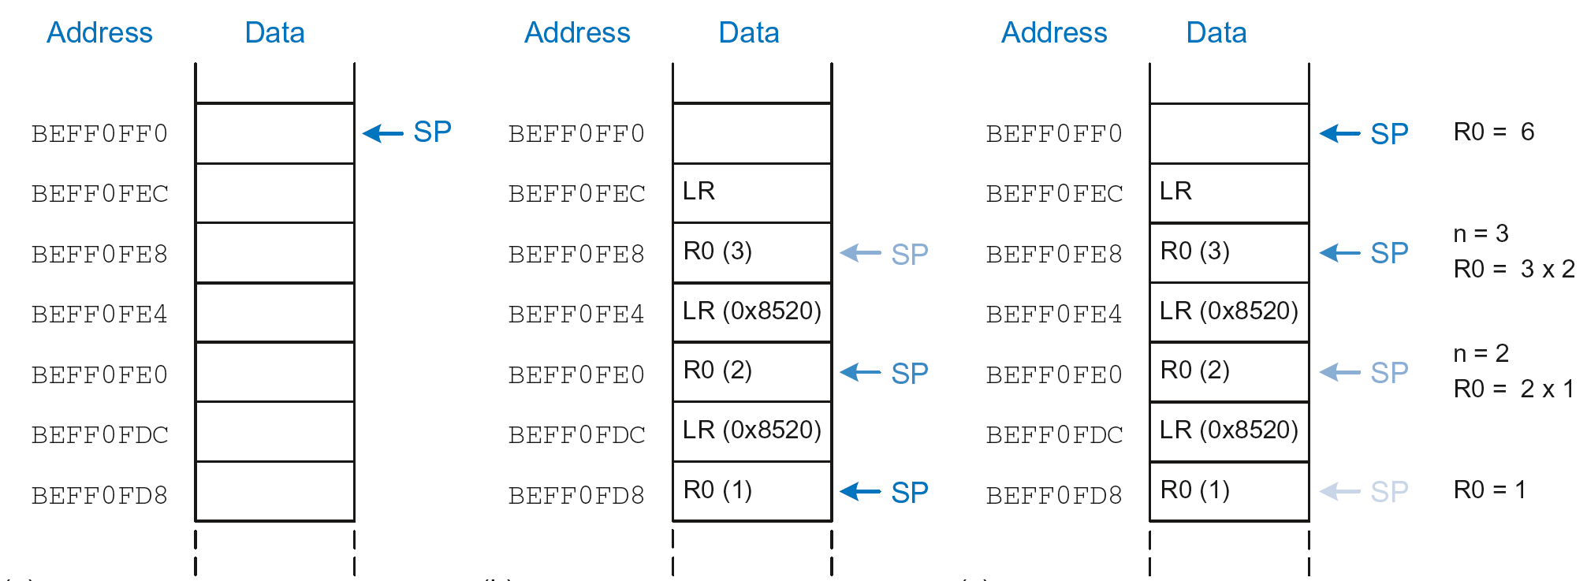
Stack during Recursive Call
Before call
During call
After call

Slide 31
Function Call Summary
Caller
  Puts arguments in R0-R3
  Saves any needed registers (LR, maybe R0-R3, R8-R12)
  Calls function: BL CALLEE
  Restores registers
  Looks for result in R0
Callee
  Saves registers that might be disturbed (R4-R7)
  Performs function
  Puts result in R0
  Restores registers
  Returns: MOV PC, LR

Slide 32
How to Encode Instructions?

Slide 33
How to Encode Instructions?
Design Principle 1: Regularity supports design simplicity
  32-bit data, 32-bit instructions
  For design simplicity, would prefer a single instruction format but…

Slide 34
How to Encode Instructions?
Design Principle 1: Regularity supports design simplicity
  32-bit data, 32-bit instructions
  For design simplicity, would prefer a single instruction format but…
  Instructions have different needs

Slide 35
Design Principle 4
Good design demands good compromises
Multiple instruction formats allow flexibility
  ADD, SUB: use 3 register operands
  LDR, STR: use 2 register operands and a constant
Number of instruction formats kept small
  to adhere to design principles 1 and 3 (regularity supports design simplicity and smaller is faster)

Slide 36
Machine Language
Binary representation of instructions
Computers only understand 1’s and 0’s
32-bit instructions
  Simplicity favors regularity: 32-bit data & instructions
3 instruction formats:
  Data-processing
  Memory
  Branch

Slide 37
Instruction Formats
Data-processing
Memory
Branch

Slide 38
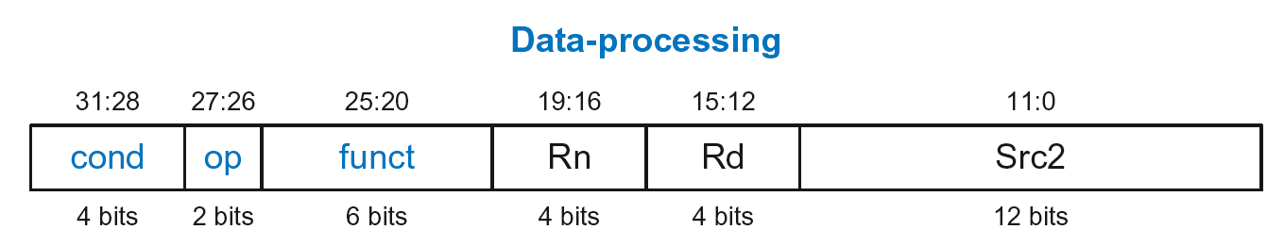
Data-processing Instruction Format
Operands:
  Rn: first source register
  Src2: second source – register or immediate
  Rd: destination register
Control fields:
  cond: specifies conditional execution
  op: the operation code or opcode
  funct: the function/operation to perform

Slide 39
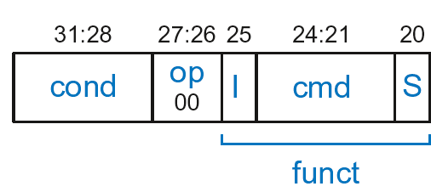
Data-processing Control Fields
op = 00₂ for data-processing (DP) instructions
funct is composed of cmd, I-bit, and S-bit

Slide 40
Data-processing Control Fields
op = 00₂ for data-processing (DP) instructions
funct is composed of cmd, I-bit, and S-bit
  cmd: specifies the specific data-processing instruction. For example,
    cmd = 0100₂ for ADD
    cmd = 0010₂ for SUB
  I-bit
    I = 0: Src2 is a register
    I = 1: Src2 is an immediate
  S-bit: 1 if sets condition flags
    S = 0: SUB R0, R5, R7
    S = 1: ADDS R8, R2, R4 or CMP R3, #10

Slide 41
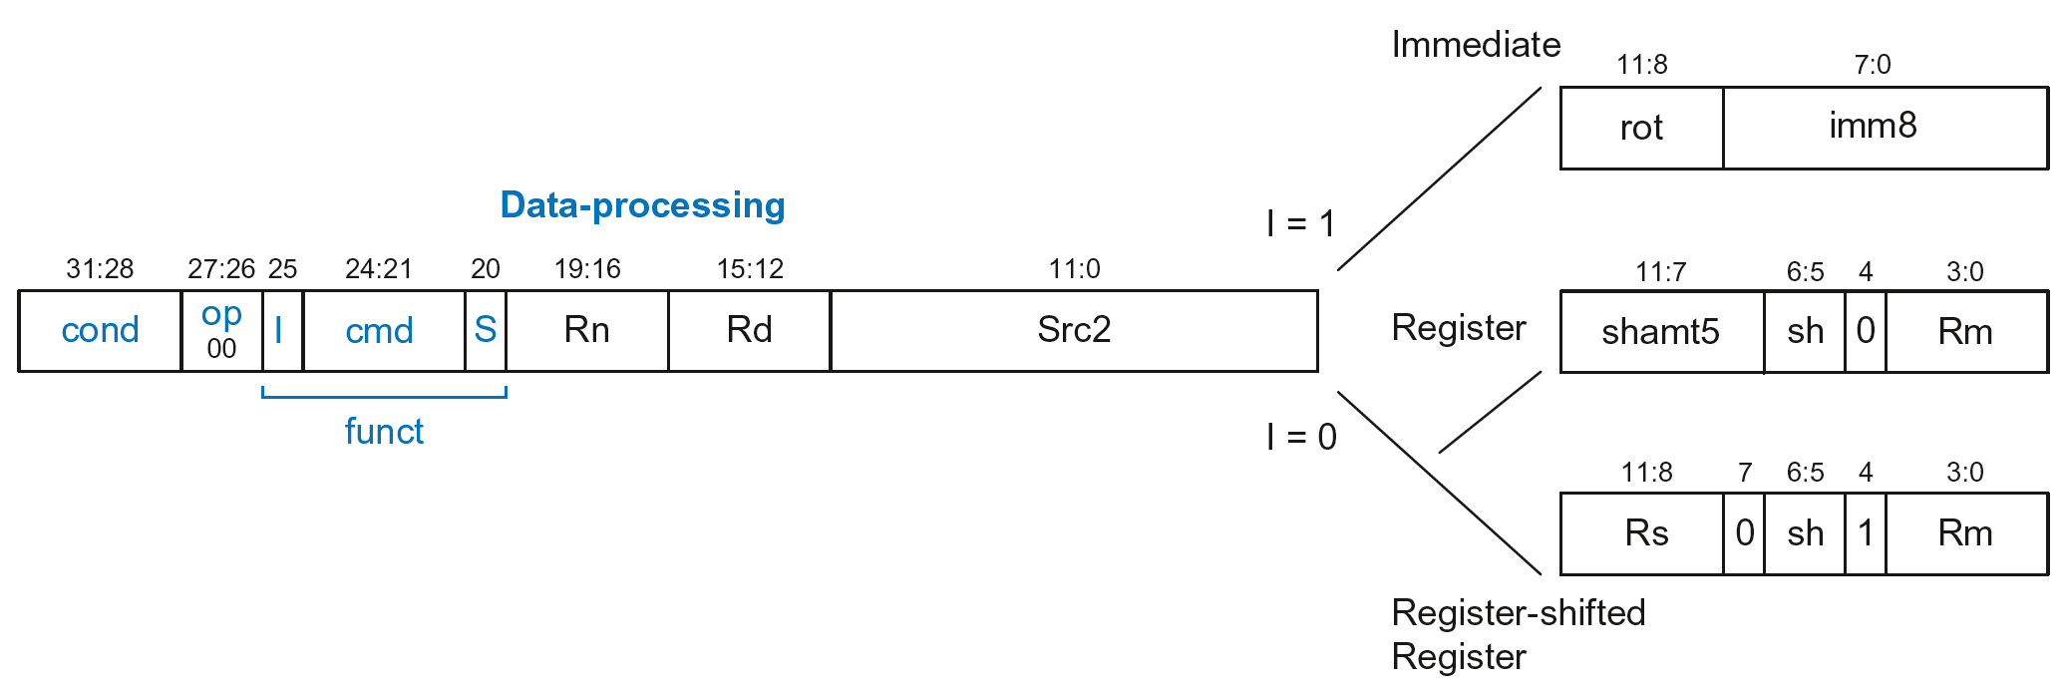
Data-processing Src2 Variations
Src2 can be:
  Immediate
  Register
  Register-shifted register

Slide 42
Data-processing Src2 Variations
Src2 can be:
  Immediate
  Register
  Register-shifted register

Slide 43
Immediate Src2
Immediate encoded as:
  imm8: 8-bit unsigned immediate
  rot: 4-bit rotation value
32-bit constant is: imm8 ROR (rot × 2)

Slide 44
Immediate Src2
Immediate encoded as:
  imm8: 8-bit unsigned immediate
  rot: 4-bit rotation value
32-bit constant is: imm8 ROR (rot × 2)
Example: imm8 = abcdefgh
rot | 32-bit constant
0000 | 0000 0000 0000 0000 0000 0000 abcd efgh
0001 | gh00 0000 0000 0000 0000 0000 00ab cdef
… | …
1111 | 0000 0000 0000 0000 0000 00ab cdef gh00

Slide 45
Immediate Src2
Immediate encoded as:
  imm8: 8-bit unsigned immediate
  rot: 4-bit rotation value
32-bit constant is: imm8 ROR (rot × 2)
Example: imm8 = abcdefgh
ROR by X = ROL by (32-X)
Ex: ROR by 30 = ROL by 2
rot | 32-bit constant
0000 | 0000 0000 0000 0000 0000 0000 abcd efgh
0001 | gh00 0000 0000 0000 0000 0000 00ab cdef
… | …
1111 | 0000 0000 0000 0000 0000 00ab cdef gh00

Slide 46
DP Instruction with Immediate Src2
  ADD R0, R1, #42
        cond = 1110₂ (14) for unconditional execution
        op = 00₂ (0) for data-processing instructions
        cmd = 0100₂ (4) for ADD
        Src2 is an immediate so I = 1
        Rd = 0, Rn = 1
        imm8 = 42, rot = 0

Slide 47
DP Instruction with Immediate Src2
  ADD R0, R1, #42
        cond = 1110₂ (14) for unconditional execution
        op = 00₂ (0) for data-processing instructions
        cmd = 0100₂ (4) for ADD
        Src2 is an immediate so I = 1
        Rd = 0, Rn = 1
        imm8 = 42, rot = 0
0xE281002A

Slide 48
DP Instruction with Immediate Src2
  SUB R2, R3, #0xFF0
  cond = 1110₂ (14) for unconditional execution
  op = 00₂ (0) for data-processing instructions
  cmd = 0010₂ (2) for SUB
  Src2 is an immediate so I=1
  Rd = 2, Rn = 3
  imm8 = 0xFF
  imm8 must be rotated right by 28 to produce 0xFF0, so rot = 14
ROR by 28 =
ROL by (32-28) = 4
0xE2432EFF

Slide 49
DP Instruction with Register Src2
Src2 can be:
  Immediate
  Register
  Register-shifted register

Slide 50
DP Instruction with Register Src2
Rm: the second source operand
shamt5: the amount Rm is shifted
sh: the type of shift (i.e., >>, <<, >>>, ROR)

Slide 51
DP Instruction with Register Src2
Rm: the second source operand
shamt5: the amount Rm is shifted
sh: the type of shift (i.e., >>, <<, >>>, ROR)
  First, consider unshifted versions of Rm (shamt5=0, sh=0)

Slide 52
DP Instruction with Register Src2
  ADD R5, R6, R7
  cond = 1110₂ (14) for unconditional execution
  op = 00₂ (0) for data-processing instructions
  cmd = 0100₂ (4) for ADD
  Src2 is a register so I=0
  Rd = 5, Rn = 6, Rm = 7
  shamt = 0, sh = 0
0xE0865007

Slide 53
DP Instruction with Register Src2
Rm: the second source operand
shamt5: the amount Rm is shifted
sh: the type of shift
Shift Type | sh
LSL | 00₂
LSR | 01₂
ASR | 10₂
ROR | 11₂
  Now, consider shifted versions.

Slide 54
DP Instruction with Register Src2
  ORR R9, R5, R3, LSR #2
  Operation: R9 = R5 OR (R3 >> 2)
  cond = 1110₂ (14) for unconditional execution
  op = 00₂ (0) for data-processing instructions
  cmd = 1100₂ (12) for ORR
  Src2 is a register so I=0
  Rd = 9, Rn = 5, Rm = 3
  shamt5 = 2, sh = 01₂ (LSR)
  1110 00 0 1100 0 0101 1001 00010 01 0 0011
  0xE1859123

Slide 55
DP with Register-shifted Reg. Src2
Src2 can be:
  Immediate
  Register
  Register-shifted register

Slide 56
DP with Register-shifted Reg. Src2
  EOR R8, R9, R10, ROR R12
  Operation: R8 = R9 XOR (R10 ROR R12)
  cond = 1110₂ (14) for unconditional execution
  op = 00₂ (0) for data-processing instructions
  cmd = 0001₂ (1) for EOR
  Src2 is a register so I=0
  Rd = 8, Rn = 9, Rm = 10, Rs = 12
  sh = 11₂ (ROR)
  1110 00 0 0001 0 1001 1000 1100 0 11 1 1010
  0xE0298C7A

Slide 57
Shift Instructions Encoding
Shift Type | sh
LSL | 00₂
LSR | 01₂
ASR | 10₂
ROR | 11₂

Slide 58
Shift Instructions: Immediate shamt
  ROR R1, R2, #23
  Operation: R1 = R2 ROR 23
  cond = 1110₂ (14) for unconditional execution
  op = 00₂ (0) for data-processing instructions
  cmd = 1101₂ (13) for all shifts (LSL, LSR, ASR, and ROR)
  Src2 is an immediate-shifted register so I=0
  Rd = 1, Rn = 0, Rm = 2
  shamt5 = 23, sh = 11₂ (ROR)
  1110 00 0 1101 0 0000 0001 10111 11 0 0010
  0xE1A01BE2

Slide 59
Shift Instructions: Immediate shamt
  ROR R1, R2, #23
  Operation: R1 = R2 ROR 23
  cond = 1110₂ (14) for unconditional execution
  op = 00₂ (0) for data-processing instructions
  cmd = 1101₂ (13) for all shifts (LSL, LSR, ASR, and ROR)
  Src2 is an immediate-shifted register so I=0
  Rd = 1, Rn = 0, Rm = 2
  shamt5 = 23, sh = 11₂ (ROR)
Uses (immediate-shifted) register Src2 encoding
  1110 00 0 1101 0 0000 0001 10111 11 0 0010
  0xE1A01BE2

Slide 60
Shift Instructions: Register shamt
  ASR R5, R6, R10
  Operation: R5 = R6 >>> R10_{7:0}
  cond = 1110₂ (14) for unconditional execution
  op = 00₂ (0) for data-processing instructions
  cmd = 1101₂ (13) for all shifts (LSL, LSR, ASR, and ROR)
  Src2 is a register so I=0
  Rd = 5, Rn = 0, Rm = 6, Rs = 10
  sh = 10₂ (ASR)
  1110 00 0 1101 0 0000 0101 1010 0 10 1 0110
  0xE1A05A56

Slide 61
Shift Instructions: Register shamt
  ASR R5, R6, R10
  Operation: R5 = R6 >>> R10_{7:0}
  cond = 1110₂ (14) for unconditional execution
  op = 00₂ (0) for data-processing instructions
  cmd = 1101₂ (13) for all shifts (LSL, LSR, ASR, and ROR)
  Src2 is a register so I=0
  Rd = 5, Rn = 0, Rm = 6, Rs = 10
  sh = 10₂ (ASR)
Uses register-shifted register Src2 encoding
  1110 00 0 1101 0 0000 0101 1010 0 10 1 0110
  0xE1A05A56

Slide 62
Review: Data-processing Format
Src2 can be:
  Immediate
  Register
  Register-shifted register

Slide 63
Instruction Formats
Data-processing
Memory
Branch

Slide 64
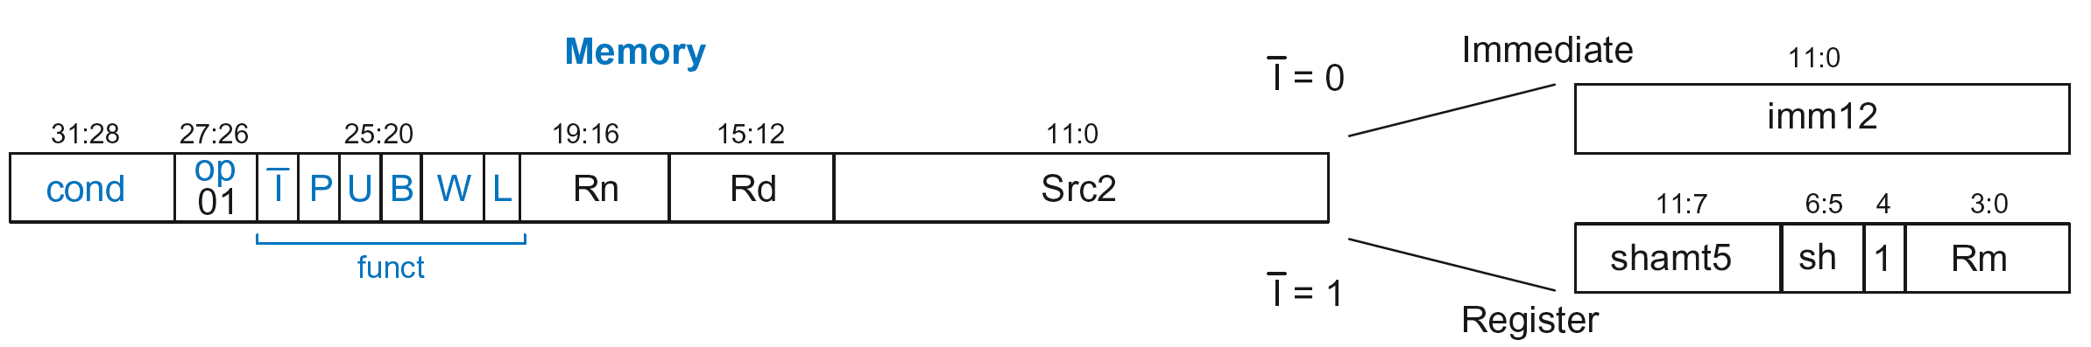
Memory Instruction Format
Encodes: LDR, STR, LDRB, STRB
op = 01₂
Rn = base register
Rd = destination (load), source (store)
Src2 = offset
funct = 6 control bits

Slide 65
Offset Options
Recall: Address = Base Address + Offset
  Example: LDR R1, [R2, #4]
  Base Address = R2, Offset = 4
  Address = (R2 + 4)
Base address always in a register
The offset can be:
  an immediate
  a register
  or a scaled (shifted) register

Slide 66
Offset Examples
ARM Assembly | Memory Address
LDR R0, [R3, #4] | R3 + 4
LDR R0, [R5, #-16] | R5 – 16
LDR R1, [R6, R7] | R6 + R7
LDR R2, [R8, -R9] | R8 – R9
LDR R3, [R10, R11, LSL #2] | R10 + (R11 << 2)
LDR R4, [R1, -R12, ASR #4] | R1 – (R12 >>> 4)
LDR R0, [R9] | R9

Slide 67
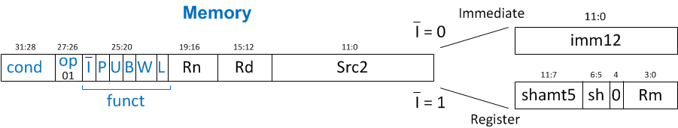
Memory Instruction Format
Encodes: LDR, STR, LDRB, STRB
op = 01₂
Rn = base register
Rd = destination (load), source (store)
Src2 = offset: register (optionally shifted) or immediate
funct = 6 control bits

Slide 68
Indexing Modes
Mode | Address | Base Reg. Update
Offset | Base register ± Offset | No change
Preindex | Base register ± Offset | Base register ± Offset
Postindex | Base register | Base register ± Offset
Examples
Offset: LDR R1, [R2, #4] ; R1 = mem[R2+4]
Preindex: LDR R3, [R5, #16]! ; R3 = mem[R5+16]
; R5 = R5 + 16
Postindex: LDR R8, [R1], #8 ; R8 = mem[R1]
    ; R1 = R1 + 8

Slide 69
Memory Instruction Format
funct:
  I: Immediate bar
  P: Preindex
  U: Add
  B: Byte
  W: Writeback
  L: Load

Slide 70
Memory Format funct Encodings
Type of Operation
L | B | Instruction
0 | 0 | STR
0 | 1 | STRB
1 | 0 | LDR
1 | 1 | LDRB

Slide 71
Memory Format funct Encodings
Type of Operation
Indexing Mode
L | B | Instruction
0 | 0 | STR
0 | 1 | STRB
1 | 0 | LDR
1 | 1 | LDRB
P | W | Indexing Mode
0 | 1 | Not supported
0 | 0 | Postindex
1 | 0 | Offset
1 | 1 | Preindex

Slide 72
Memory Format funct Encodings
Type of Operation
Indexing Mode
L | B | Instruction
0 | 0 | STR
0 | 1 | STRB
1 | 0 | LDR
1 | 1 | LDRB
P | W | Indexing Mode
0 | 1 | Not supported
0 | 0 | Postindex
1 | 0 | Offset
1 | 1 | Preindex
Add/Subtract Immediate/Register Offset
Value | I | U
0 | Immediate offset in Src2 | Subtract offset from base
1 | Register offset in Src2 | Add offset to base

Slide 73
Memory Instruction Format
Encodes: LDR, STR, LDRB, STRB
op = 01₂
Rn = base register
Rd = destination (load), source (store)
Src2 = offset: immediate or register (optionally shifted)
funct = I (immediate bar), P (preindex), U (add),
B (byte), W (writeback), L (load)

Slide 74
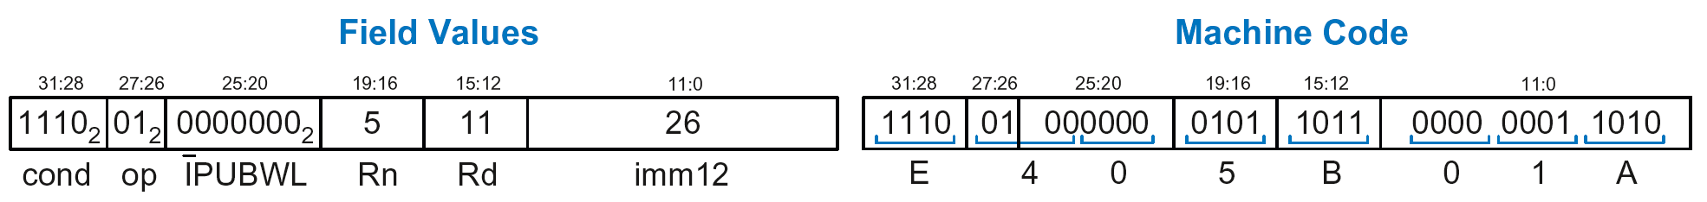
Memory Instr. with Immediate Src2
  STR R11, [R5], #-26
  Operation: mem[R5] <= R11; R5 = R5 - 26
  cond = 1110₂ (14) for unconditional execution
  op = 01₂ (1) for memory instruction
  funct = 0000000₂ (0)
  I = 0 (immediate offset), P = 0 (postindex),
  U = 0 (subtract), B = 0 (store word), W = 0 (postindex),
  L = 0 (store)
  Rd = 11, Rn = 5, imm12 = 26

Slide 75
Memory Instr. with Register Src2
  LDR R3, [R4, R5]
  Operation: R3 <= mem[R4 + R5]
  cond = 1110₂ (14) for unconditional execution
  op = 01₂ (1) for memory instruction
  funct = 111001₂ (57)
  I = 1 (register offset), P = 1 (offset indexing),
  U = 1 (add), B = 0 (load word), W = 0 (offset indexing),
  L = 1 (load)
  Rd = 3, Rn = 4, Rm = 5 (shamt5 = 0, sh = 0)
  1110 01 111001 0100 0011 00000 00 0 0101 = 0xE7943005

Slide 76
Memory Instr. with Scaled Reg. Src2
  STR R9, [R1, R3, LSL #2]
  Operation: mem[R1 + (R3 << 2)] <= R9
  cond = 1110₂ (14) for unconditional execution
  op = 01₂ (1) for memory instruction
  funct = 111000₂ (0)
  I = 1 (register offset), P = 1 (offset indexing),
  U = 1 (add), B = 0 (store word), W = 0 (offset indexing),
  L = 0 (store)
  Rd = 9, Rn = 1, Rm = 3, shamt = 2, sh = 00₂ (LSL)
  1110 01 111000 0001 1001 00010 00 0 0011 = 0xE7819103

Slide 77
Review: Memory Instruction Format
Encodes: LDR, STR, LDRB, STRB
op = 01₂
Rn = base register
Rd = destination (load), source (store)
Src2 = offset: register (optionally shifted) or immediate
funct = I (immediate bar), P (preindex), U (add),
B (byte), W (writeback), L (load)

Slide 78
Instruction Formats
Data-processing
Memory
Branch

Slide 79
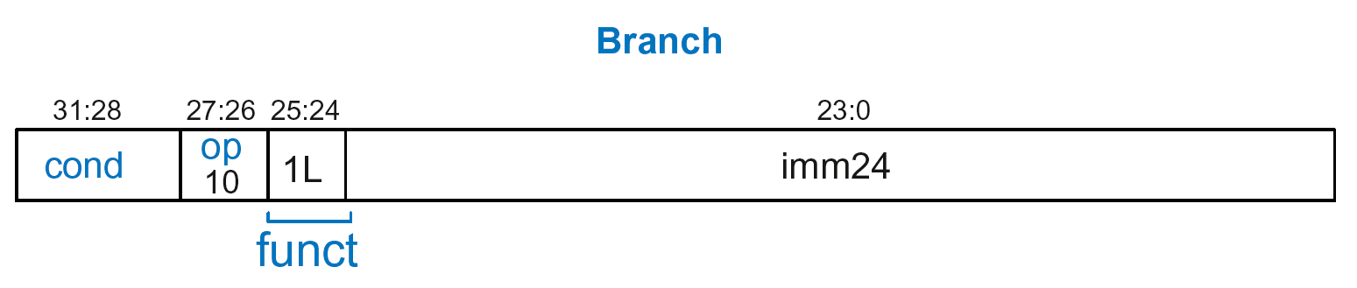
Branch Instruction Format
Encodes B and BL
op = 10₂
imm24: 24-bit immediate
funct = 1L₂: L = 1 for BL, L = 0 for B

Slide 80
Encoding Branch Target Address
Branch Target Address (BTA): Next PC when branch taken
BTA is relative to current PC + 8
imm24 encodes BTA
imm24 = # of words BTA is away from PC+8

Slide 81
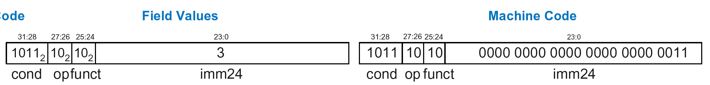
Branch Instruction: Example 1
ARM assembly code
0xA0 BLT THERE
0xA4 ADD R0, R1, R2
0xA8 SUB R0, R0, R9
0xAC ADD SP, SP, #8
0xB0 MOV PC, LR
0xB4 THERE SUB R0, R0, #1
0xB8 BL TEST
PC
PC = 0xA0
PC + 8 = 0xA8
THERE label is 3 instructions past PC+8
So, imm24 = 3
PC+8
BTA
0xBA000003

Slide 82
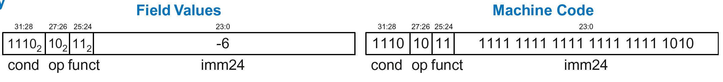
Branch Instruction: Example 2
ARM assembly code
0x8040 TEST LDRB R5, [R0, R3]
0x8044 STRB R5, [R1, R3]
0x8048 ADD R3, R3, #1
0x8044 MOV PC, LR
0x8050 BL TEST
0x8054 LDR R3, [R1], #4
0x8058 SUB R4, R3, #9
BTA
PC = 0x8050
PC + 8 = 0x8058
TEST label is 6 instructions before PC+8
So, imm24 = -6
PC
PC+8
0xEBFFFFFA

Slide 83
Review: Instruction Formats

Slide 84
Conditional Execution
Encode in cond bits of machine instruction
  For example,
  ANDEQ R1, R2, R3 (cond = 0000)
  ORRMI R4, R5, #0xF (cond = 0100)
  SUBLT R9, R3, R8 (cond = 1011)

Slide 85
Review: Condition Mnemonics

Slide 86
Conditional Execution: Machine Code

Slide 87
Interpreting Machine Code
Start with op: tells how to parse rest
    op = 00 (Data-processing)
    op = 01 (Memory)
    op = 10 (Branch)
I-bit: tells how to parse Src2
Data-processing instructions:
    If I-bit is 0, bit 4 determines if Src2 is a register (bit 4 = 0) or a register-shifted register (bit 4 = 1)
Memory instructions:
    Examine funct bits for indexing mode, instruction, and add or subtract offset

Slide 88
Interpreting Machine Code: Example 1
0xE0475001

Slide 89
Interpreting Machine Code: Example 1
0xE0475001
  Start with op: 00₂, so data-processing instruction

Slide 90
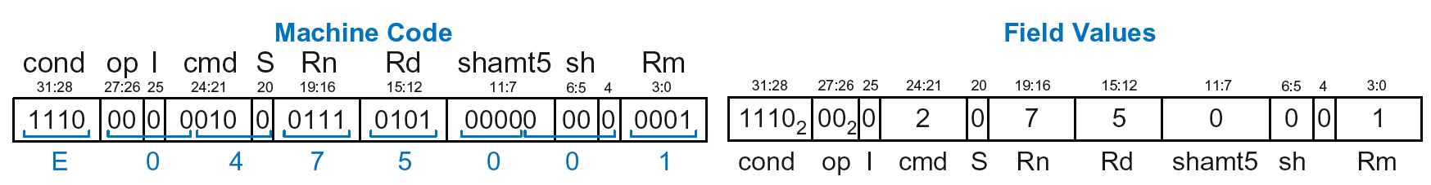
Interpreting Machine Code: Example 1
0xE0475001
  Start with op: 00₂, so data-processing instruction
  I-bit: 0, so Src2 is a register
  bit 4: 0, so Src2 is a register (optionally shifted by shamt5)

Slide 91
Interpreting Machine Code: Example 1
0xE0475001
  Start with op: 00₂, so data-processing instruction
  I-bit: 0, so Src2 is a register
  bit 4: 0, so Src2 is a register (optionally shifted by shamt5)
  cmd: 0010₂ (2), so SUB
  Rn=7, Rd=5, Rm=1, shamt5 = 0, sh = 0
  So, instruction is: SUB R5,R7,R1

Slide 92
Interpreting Machine Code: Example 2
0xE5949010

Slide 93
Interpreting Machine Code: Example 2
0xE5949010
  Start with op: 01₂, so memory instruction
  funct: B=0, L=1, so LDR; P=1, W=0, so offset indexing;
  I=0, so immediate offset, U=1, so add offset
  Rn=4, Rd=9, imm12 = 16
  So, instruction is: LDR R9,[R4,#16]

Slide 94
Addressing Modes
How do we address operands?
Register
Immediate
Base
PC-Relative

Slide 95
Addressing Modes
How do we address operands?
Register Only
Immediate
Base
PC-Relative

Slide 96
Register Addressing
Source and destination operands found in registers
Used by data-processing instructions
Three submodes:
  Register-only
  Immediate-shifted register
  Register-shifted register

Slide 97
Register Addressing Examples
Register-only
  Example: ADD R0, R2, R7
Immediate-shifted register
  Example: ORR R5, R1, R3, LSL #1
Register-shifted register
  Example: SUB R12, R9, R0, ASR R1

Slide 98
Addressing Modes
How do we address operands?
Register Only
Immediate
Base
PC-Relative

Slide 99
Immediate Addressing
Operands found in registers and immediates
  Example: ADD R9, R1, #14
Uses data-processing format with I=1
  Immediate is encoded as
    8-bit immediate (imm8)
    4-bit rotation (rot)
  32-bit immediate = imm8 ROR (rot x 2)

Slide 100
Addressing Modes
How do we address operands?
Register Only
Immediate
Base
PC-Relative

Slide 101
Base Addressing
Address of operand is:
base register + offset
Offset can be a:
  12-bit Immediate
  Register
  Immediate-shifted Register

Slide 102
Base Addressing Examples
Immediate offset
  Example: LDR R0, [R8, #-11]
  (R0 = mem[R8 - 11] )
Register offset
  Example: LDR R1, [R7, R9]
  (R1 = mem[R7 + R9] )
Immediate-shifted register offset
  Example: STR R5, [R3, R2, LSL #4]
  (R5 = mem[R3 + (R2 << 4)] )

Slide 103
Addressing Modes
How do we address operands?
Register Only
Immediate
Base
PC-Relative

Slide 104
PC-Relative Addressing
Used for branches
Branch instruction format:
  Operands are PC and a signed 24-bit immediate (imm24)
  Changes the PC
  New PC is relative to the old PC
  imm24 indicates the number of words away from PC+8
PC = (PC+8) + (SignExtended(imm24) x 4)

Slide 105
Power of the Stored Program
32-bit instructions & data stored in memory
Sequence of instructions: only difference between two applications
To run a new program:
  No rewiring required
  Simply store new program in memory
Program Execution:
  Processor fetches (reads) instructions from memory in sequence
  Processor performs the specified operation

Slide 106
The Stored Program
Program Counter (PC): keeps track of current instruction

Slide 107
Up Next
How to implement the ARM Instruction Set
Architecture in Hardware
  Microarchitecture

