Slide 1
Logic Analyzer
“Because I had to”
Ivan Wong

Slide 2
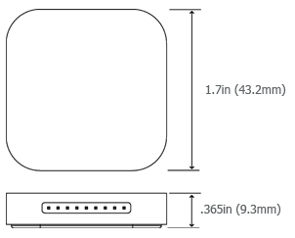
My own logic analyzer:
Saleae
17 protocol analyzers (I2C, SPI, Async Serial) etc
24 MHz, 8 channels, 10B sampleas max.
Voltages from -0.5V to 5.25V and CMS thresholds for 0.8V for low and 2.0V for high.
75mA sampling power requirement
Aluminium Enclosure
Software: Saleae Logic

Slide 3
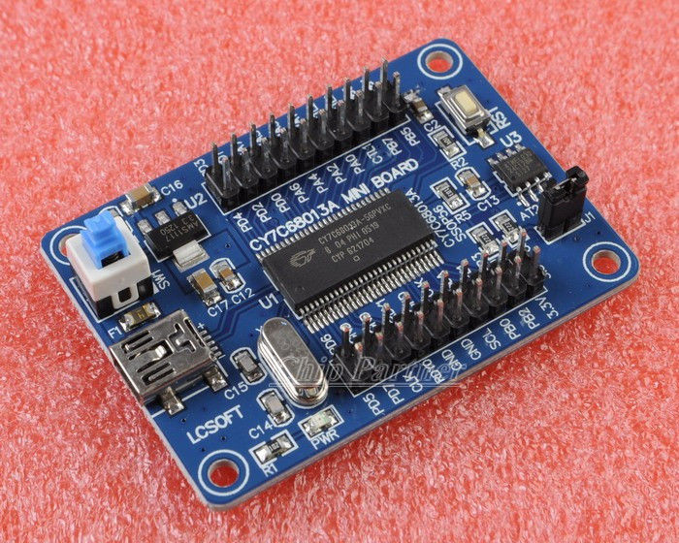
Now… lets go to this link.
http://www.ebay.com/itm/CY7C68013A-56-EZ-USB-FX2LP-USB-2-0-Develope-Board-Module-Logic-Analyzer-EEPROM-/400330480196?pt=LH_DefaultDomain_0&hash=item5d358e5a44
Some others have changed to faster EEPROM for better performance
http://sunbizhosting.co.uk/~spiral/blog/?p=117

Slide 4
CPUs
For the mobile platform
Ivan Wong

Slide 5
ARM
Reduced Instruction Set Computing (RISC) architecture.
Low power
Most are 32-bit processors (address space and arithmetic)
License chip designs and ARM instruction set to SoC builders

Slide 6
Example of ARM Assembly
while(i!=j){
if(i>j)
i-=j;
else
j-=i;
}

Slide 7
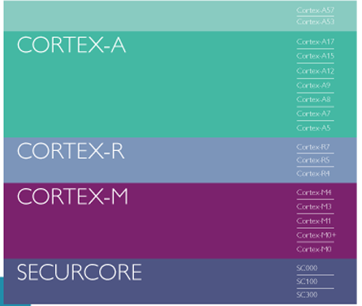
ARM Cortex-M
Intended for Microcontroller use
Thumb instruction set
16 bit instruction that is a shorthand for 32 bit instruction
Different set of registers as normal ARM mode.
Reduce memory requirements
Low power with pre-loaded apps

Slide 8
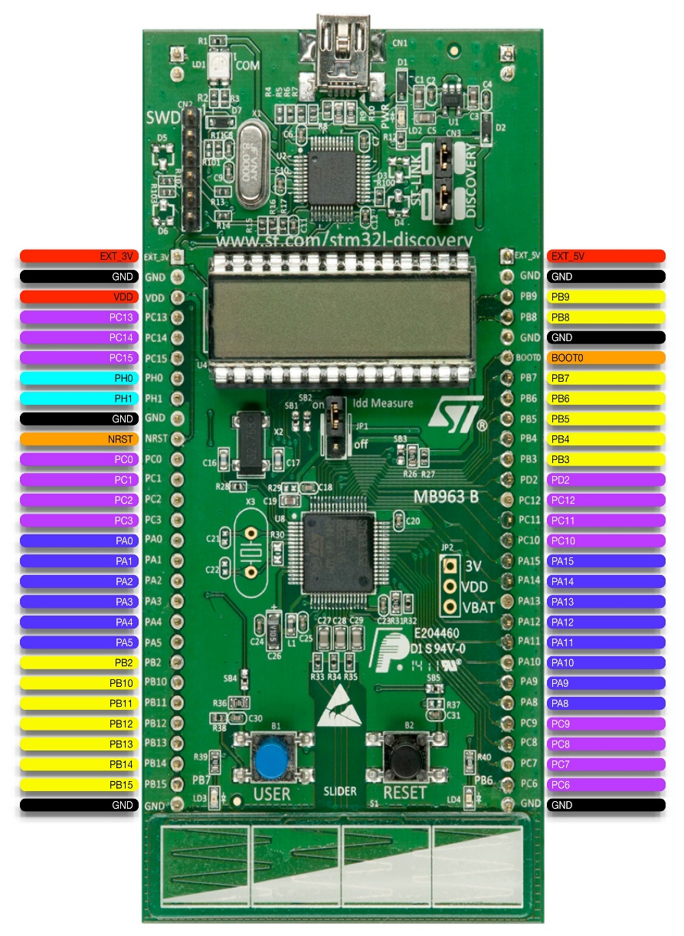
Application
STM32L-Discovery
128KB flash
LCD
4 LEDs
2 Pushbuttons
Touch sensor
http://rusticengineering.files.wordpress.com/2012/01/stm32l-discovery-pinnout_web.jpg

Slide 9
ARM Cortex A Series
Ability to execute complex instructions and operating systems
Integrates a memory management Unit (MMU)
Big.LITTLE technology
Pairing: Cortex-A7 with Cortex A15
Most widely used mobile architecture.

Slide 10
Application of ARM A-Series
Nvidia Tegra 3: Quad Core ARM Cortex A9-CPU with 5th A9 LP Core.
ARMv7 (32bit) Instruction set
40nm LPG semiconductor technology (TSMC)
CPU Cache: L1: 32KB Instruction, 32KB Data, L2: 1MB
Up to 2Ghz
Used in Tesla Model S
Altera FPGA + Processor for SoC
Apple A7

Slide 11
ARM Cortex A53/A57
AMD Announce Opteron A1100 for servers
4 or 8 Cortex A-57 cores
Compare to x86 architecture server parts:
 | CPU Core Configuration | CPU Frequency | SPECint_rate Estimate | SPECint per Core | Estimated TDP
AMD Opteron A1100 | 8 x ARM Cortex A57 | >= 2GHz | 80 | 10 | 25W
AMD Opteron X2150 | 4 x AMD Jaguar | 1.9GHz | 28.1 | 7 | 22W

Slide 12
Comparison to x86
RISC vs CISC wars in 190s when Processor Design complexity was primary constraint → Power consumption
 | ARM | x86
Format | Fixed Length Instructions THUMB | Allows for special instructions, slower decoder
Operations | Simple, Single Cycle, single function operations | Multi-cycle instructions, string manipulation, encryption
Operands | Registers, Immediates 16 GP registers in ARM | Memory, registers, immediates
Source: [1] http://research.cs.wisc.edu/vertical/papers/2013/isa-power-struggles-tr.pdf

Slide 13
Comparison to x86 (continued) [1]
 | Sandy Bridge Core i7 2720QM | Atom N450 | Cortex A9 | Cortex A8
Where? | Lenovo W520 | Netbook | Galaxy S3 | Iphone 4
Cores | 4 | 1 | 2 | 1
Frequency | 3.3/3.2/3.0 Ghz | 1.66Ghz | 1Ghz | 0.6Ghz
Width | 4 way | 2 way | 2 way | 2way
Issue | OOO | In Order | OOO | In Order
Supported Memory | 16GB | 1GB | 1GB | 256MB
Total Cache (L1+L2+L3) | ~10MB | ~600kB | 1MB | ~300kB
Die Area | 216mm2 | 66mm2 | 70mm2 | 60mm2
Tech Node | 32nm HKMG | 45nm | 45nm | 65nm
Avg Power | 45W TDP | 5.5W TDP | 2.5W TDP | 2.5W TDP

Slide 14
Thanks :)
Questions?

