Slide 1
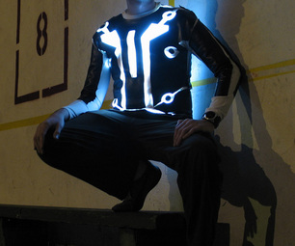
Wearable Electronics
Jackie Ong
E190P: Spring 2014

Slide 2
Overview of Products
Relevant Boards
LilyPad Arduino Board
FLORA Board
Potentially useful depending on project goals:
Bare Conductive Pen
Velostat Sheet

Slide 3
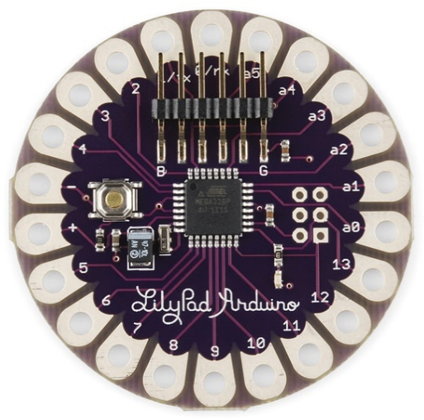
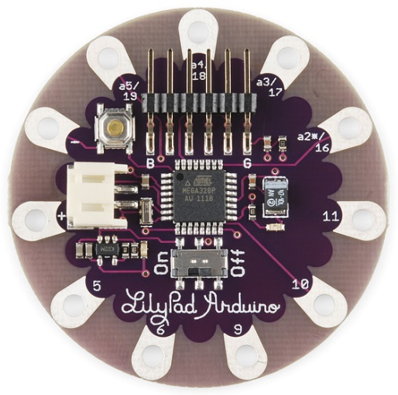
LilyPad Arduino
Came out in 2007
Different models on the market
Board Dimensions: 2” by 2”
Atmega 168/328 Board
Simple Board

Slide 4
LilyPad Arduino Atmega 168/328
Microcontroller | ATmega168V or ATmega328V
Operating Voltage | 2.7-5.5 V
Input Voltage | 2.7-5.5 V
Digital I/O Pins | 14 (6 provide PWM output)
Analog Input Pins | 6
DC Current per I/O Pin | 40 mA
Flash Memory | 16 KB (2 KB used by bootloader)
SRAM | 1 KB
EEPROM | 512 bytes
Clock Speed | 8 MHz

Slide 5
FLORA
$24
Came out in 2012
1.75” Diameter
USB-compatible and Arduino-Compatible(?)
Input Voltage: 3.5V – 16V DC
14 sewing tap pads for attachment and electrical connections
Modules: Bluetooth, GPS, 3-axis accelerometer, compass module, flex sensor, piezo, IR LED, push button, embroidered + capacitive keypad, OLED
4 indicator LEDs: power good, digital signal LED for bootloader feedback, data RX/TX

Slide 6
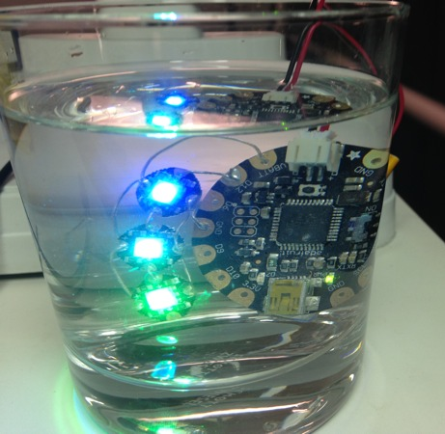
FLORA
Built-in USB support (via mini B connector)
USB HID support → can act like a mouse, keyboard, MIDI, etc.
Twice as much flash memory and SRAM than the LilyPad Arduino
Easy control and power of a large quantity of digital RGB LED pixels
*Difficult to destroy the FLORA…

Slide 7
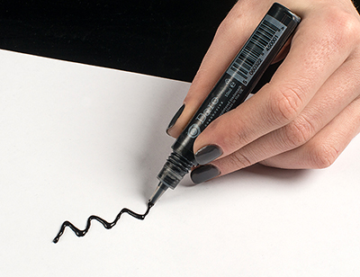
Bare Conductive Pen
Electrically conductive paint
Non-toxic, water-soluble and dries at room temperature
Applicable Materials: Almost any surface
Great Electronics prototyping tool
Replaces conventional acid etching
*Disclaimer: Pen is not meant for use on “bare” skin.

Slide 8
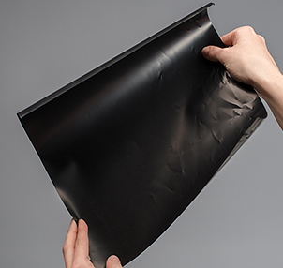
Velostat Sheet
Pressure-sensitive conductive sheet
Squeezing it will reduce the resistance
Useful for making flexible sensors
Easy to remove hard creases if any.
Price: $3.95 per one 11”x11” sheet
Parameter | Tech Spec
Thickness | 0.2mm (~0.8in)
Weight | 18.66g
Temperature Range | -50°F to 150°F (-45°C to 65°C)
Heat Sealable | Yes
Volume Resistivity | <500 ohm-cm
Surface Resistivity | <31,000 ohms/sq.cm

Slide 9
Helpful Links
Datasheets:
Bare Conductive Pen http://www.adafruit.com/datasheets/TechnicalDataSheet_BareConductivePaint.pdf
FLORA http://www.farnell.com/datasheets/1701054.pdf
LilyPad Arduino Atmega168/328 http://www.atmel.com/Images/doc8025.pdf
Extra Information on FLORA and LilyPad:
http://www.adafruit.com/products/659
http://hackaday.com/2012/01/21/flora-a-better-arduino-lilypad/

