Slide 1
Servo Motors
Precise angular motion

Slide 2
Servo Motors Raspberry Pi Webcam Interfaces
Keeping track of things

Slide 3
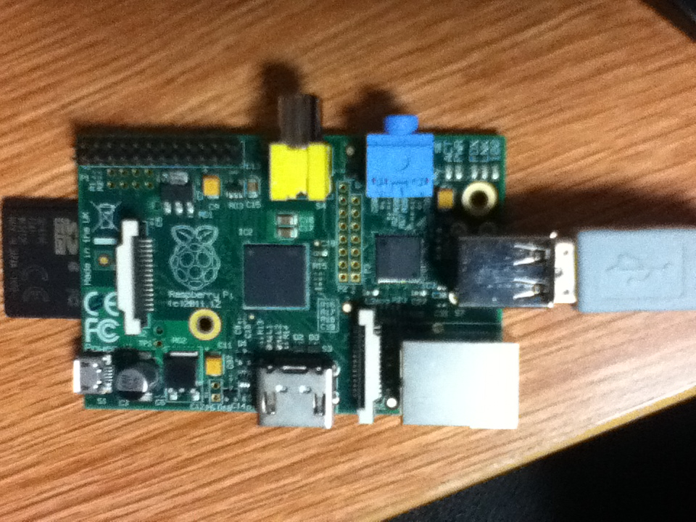
Setting Up the Webcam
Drivers are generally automatic (USB)
Need a program to actually do something with it
May want a powered USB hub

Slide 4
Viewing Options
Motion
MJPEG-Streamer
Many others

Slide 5
Motion
Installable as a package
sudo apt-get install motion
Run from command line
motion [ -hns ] [ -c config file path ] [ -d level ] [ -p process_id_file ]

Slide 6
Using Motion
Requires a “motion.conf” file to operate correctly
Many different configuration options
Alternative: use Setup Mode
Package may include a basic GUI mode
Many built-in motion tracking options
http://www.lavrsen.dk/foswiki/bin/view/Motion/MotionGuideBasicFeatures

Slide 7
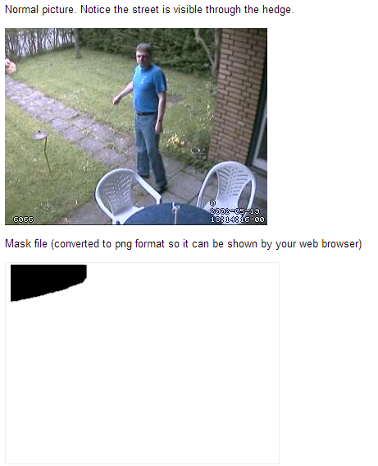
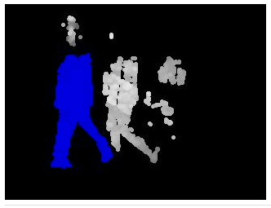
Examples

Slide 8
Motion as a Server
Motion is easy to use as a webcam server
Daemon on
Set webcam_localhost off
Set webcam_motion depending on your needs
Activate with sudo service motion start

Slide 9
Using the Stream
View your webcam stream at yourIP:8080 by default
Port can be changed
Stream is a mjpg (motion jpg).
Many browsers don’t work well with it.
Motion documentation suggests wrapping stream in a Cambozola applet

Slide 10
MJPG-Streamer
Faster than motion (in my experience)
Less resource-intensive
Fewer features

Slide 11
Installing MJPG-Streamer
Somewhat more complicated than motion
Guide here: http://blog.miguelgrinberg.com/post/how-to-build-and-run-mjpg-streamer-on-the-raspberry-pi
In short, install several packages, then download and build mjpg-streamer

Slide 12
Using MJPG-Streamer
Designed for streaming to web server
Includes default web server with detailed instructions
mjpg_streamer -i | input "<inputplugin.so> [parameters]" -o | output "<outputplugin.so> [parameters]" [-h | help ]........: display this help [-v | version ].....: display version information [-b | background]...: fork to the background, daemon mode

Slide 13
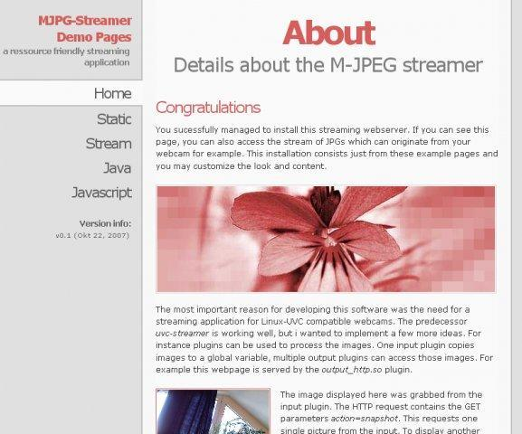
Default Configuration
Small web server
Explanation of how to embed stream elsewhere
/home/pi/mjpg-streamer/mjpg_streamer -b -i "/home/pi/mjpg-streamer/input_uvc.so -n -f 8 -r 320x240" -o "/home/pi/mjpg-streamer/output_http.so -p 8080 -n -w /home/pi/mjpg-streamer/www"

Slide 14
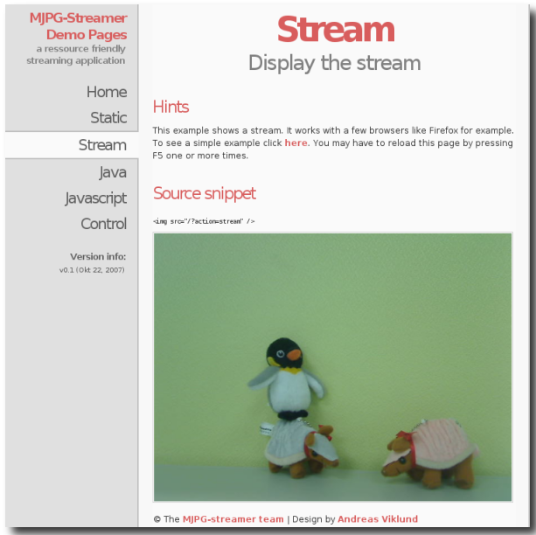
Stream

Slide 15
Embedding the Stream
HTML:
<img src="http://134.173.199.133:8080/?action=stream" /><br>
Works reasonably well in all browsers.

Slide 16
Questions

