Slide 1
Embedded Audio: WTV020SD
A Technical Presentation by:
Gourav Khadge

Slide 2
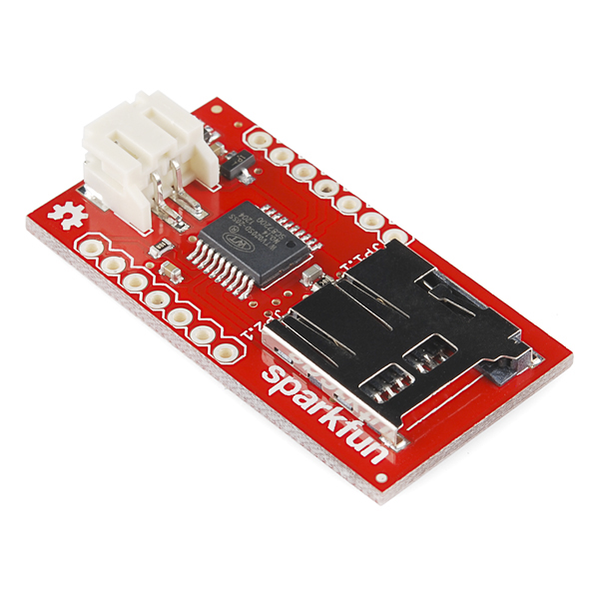
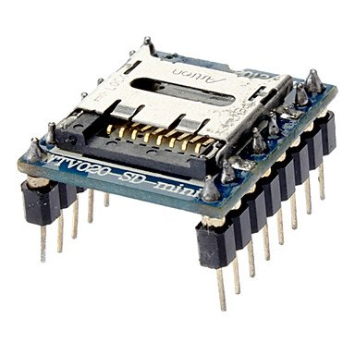
“The WTV020SD is a small, simple IC for embedding audio-playback into your next project. These devices are commonly used in children's toys and ‘talking’ retail displays.”
-Sparkfun

Slide 4
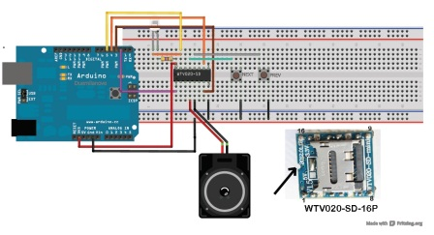
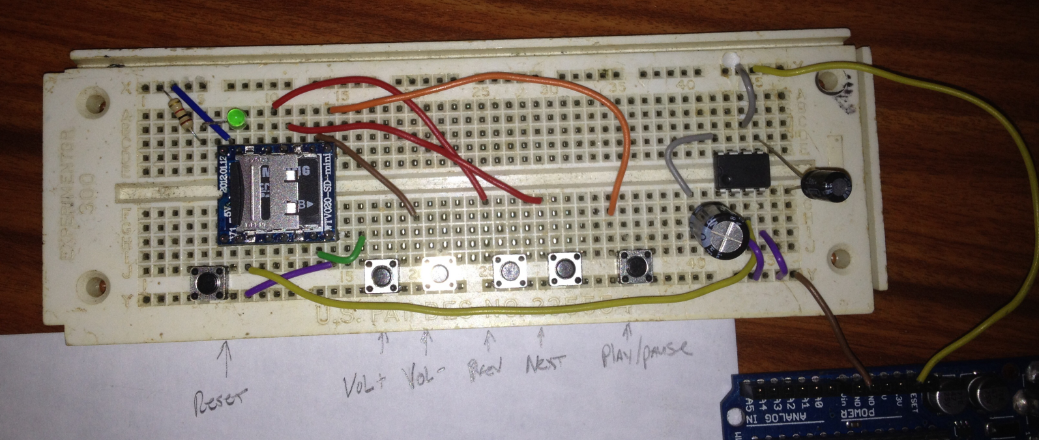

Slide 5
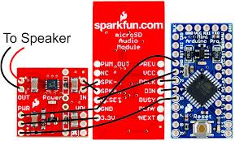

Slide 6
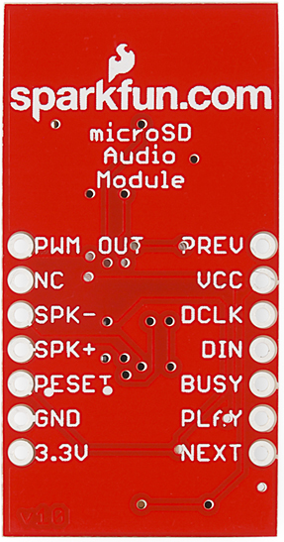
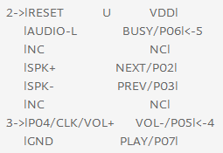
Control Modes
MP3 mode
Play, pause, prev, next, volume control through tactile interface
2 wire serial mode (DATA, CLK)
control through serial commands

Slide 7
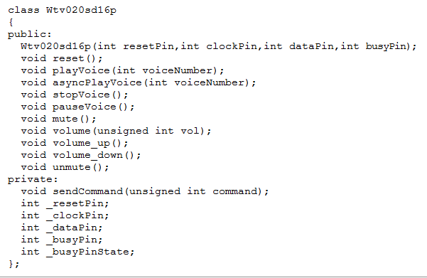
Libraries!
http://forum.arduino.cc/index.php?PHPSESSID=8pf2jlv3aj0ofejpn82vvn5up5&topic=117009.120

Slide 8
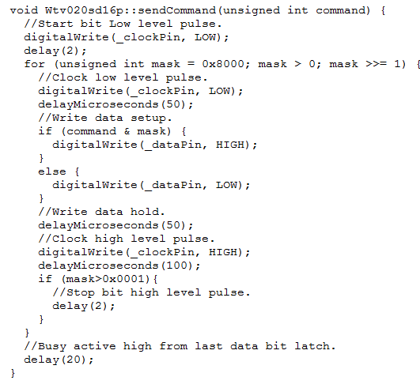

Slide 9
Music!
64 MB to 2 GB microSD card
Requires music to be in 4 bit ADPCM (.ad4 files)
Stores up to 512 files.
Files must be named 0000.ad4, 0001.ad4, 0002.ad4, … 0512.ad4

Slide 10
Questions?

