Slide 1
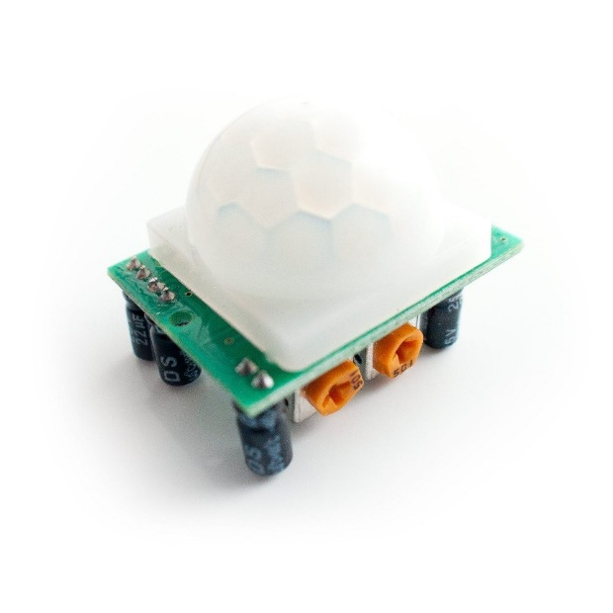
PIR Motion Sensor

Slide 2

What is it?
PIR -- Passive Infrared
Can buy online for $≈\$7$
Easy to use

Slide 3
How does it work
PIR Sensing Element
Fresnel Lens
Decoder Chip

Slide 4
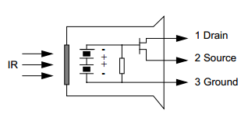
PIR Sensing Element
IR Sensing
$8−15 μm$ wavelength used for thermal imaging
$3−8 μ$m wavelength used for heat seeking missiles
Window designed for $7−14 μ$m wavelength
^ http://www.ladyada.net/media/sensors/RE200B.pdf

Slide 5
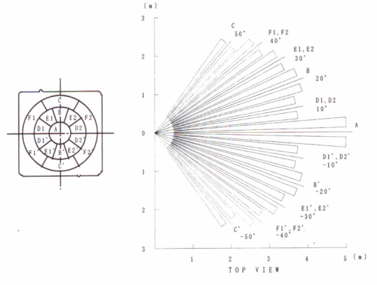
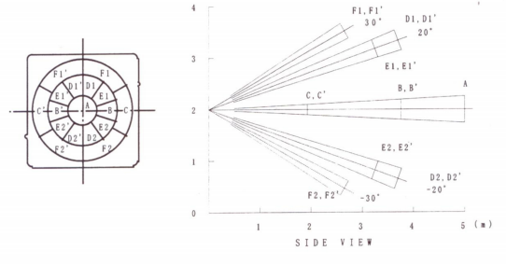
Fresnel Lens

Slide 6
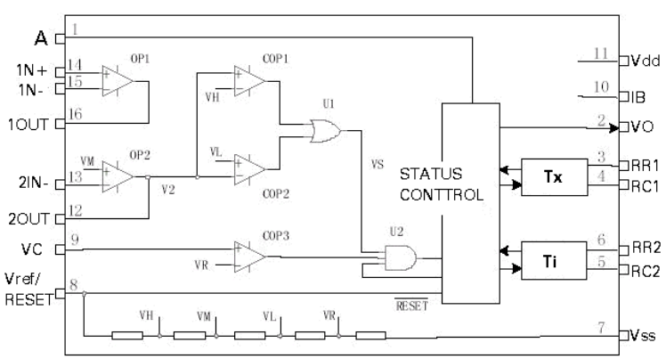
Decoder Chip
^ http://www.ladyada.net/media/sensors/BISS0001.pdf

Slide 7
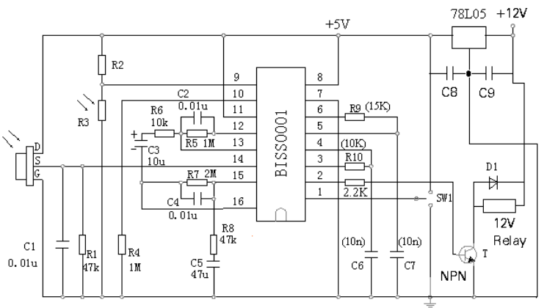
Example Circuit

Slide 8
Applications
Motion sensing
Human Detection
Not ballistic heat-seeking missiles

