Slide 1
Digital System Design
Digital Design and Computer Architecture: ARM® Edition
Sarah L. Harris and David Money Harris

Slide 2
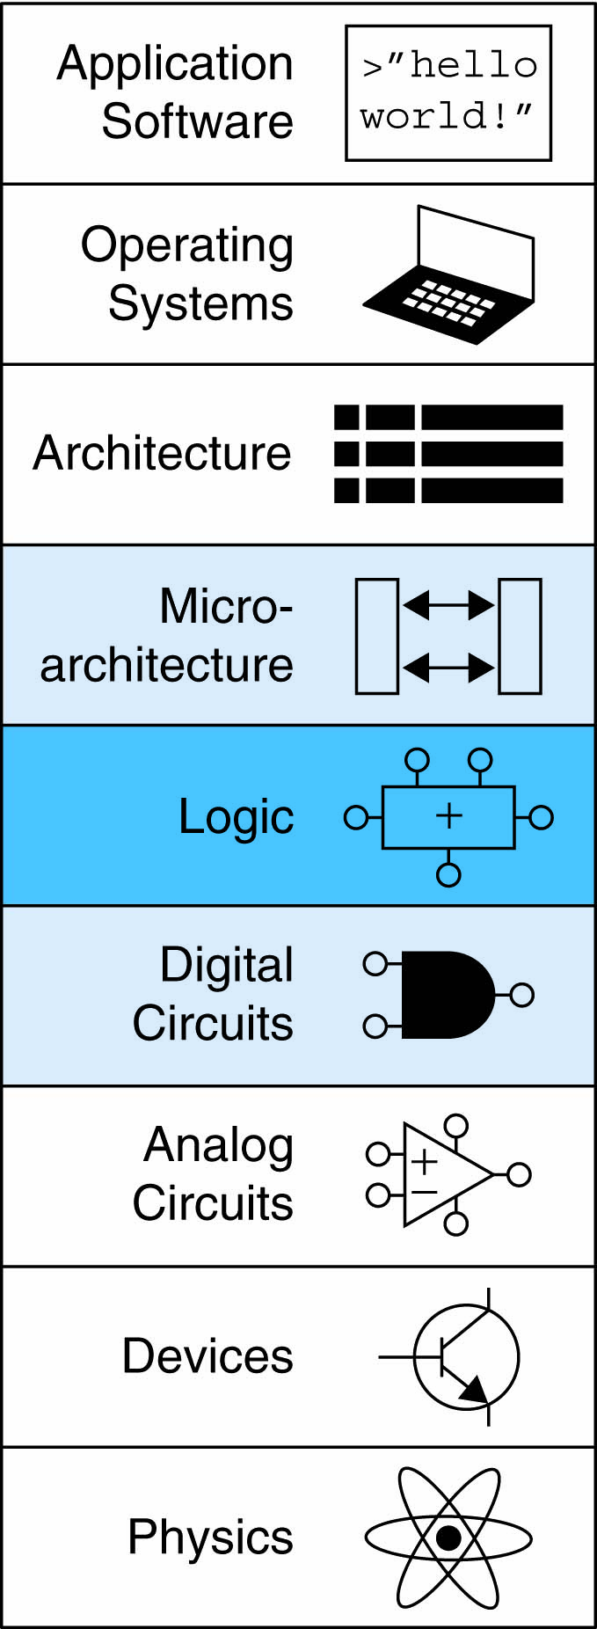
Digital System Design :: Topics
Introduction
Component Selection
  Bill of Materials (BoM)
Circuit Implementation
  Breadboarding
  Printed Circuit Board (PCB)
Interpreting Datasheets

Slide 3
Introduction
How to build a digital system?
  Requirements
  Component selection
  Implementation
  Debug

Slide 4
Context Matters
What is your purpose?
  Rapid prototyping / hackathon?
    Ease of design – breadboarding is great if possible
  Low volume prototype / production?
    PCB, focus on features & schedule over cost
  Mass production?
    PCB, spend more time to drive down cost

Slide 5
Requirements
Function
Power Consumption
Form Factor
Cost
Schedule

Slide 6
Component Selection
Find parts to meet function
  Capabilities / performance
  Supply voltage
  Package
  Interfaces
  Power consumption
  Environmental qualification
    Temperature / vibration / radiation / etc.
Geek out and follow components you like
  Art of Electronics
  electronicdesign.com

Slide 7
Supply Voltage
Pick parts with compatible logic levels
  5 V will cook most parts today
  Many have 3.3 V interfaces
  Some only run at 1.8 V or lower
If not possible, use level shifters
Core voltage may be lower than I/O
  Multiple power supplies required

Slide 8
Package
Through-hole
  Convenient for breadboarding
  Consumes lots of board area
  Unavailable for modern parts
Surface mount with pins on edges
  Good choice for low volume PCBs
Surface mount with pads underneath
  Only option for some advanced components
  Difficult and costly to assemble

Slide 9
Integrated Circuit Packages
digikey.com

Slide 10
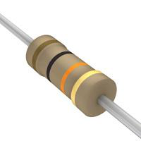
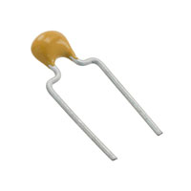
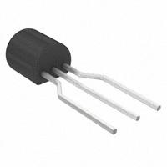
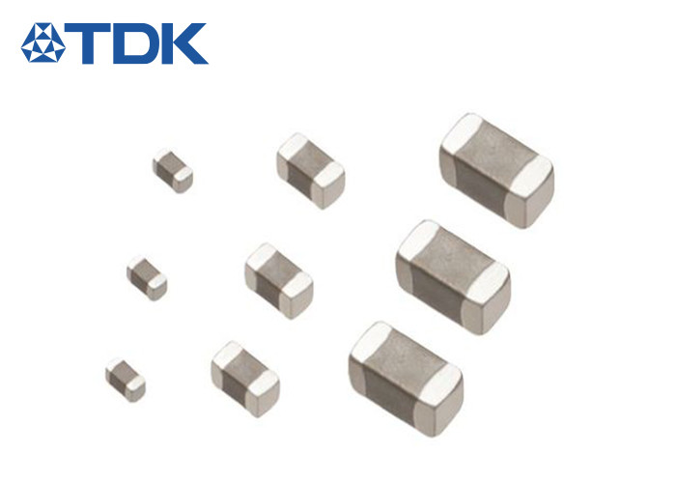
Other packages
Through-hole components
SMT Passive Components
  Package dimensions in mils
  0805 easiest for soldering
  0603 doable with skill
  0402 doable with much skill
  0201 for robots only

Slide 11
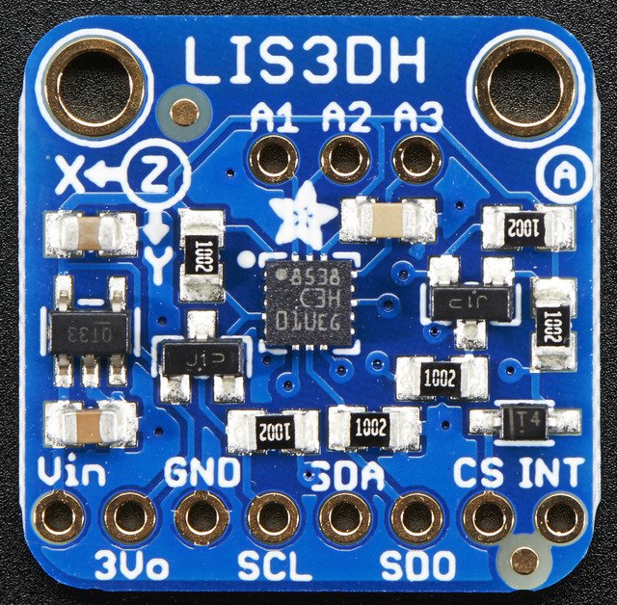
Breakout Boards
Some popular SMT components available on breakout boards.
  E.g. adafruit.com, sparkfun.com

Slide 12
Power Budget
  Internet of Things device
  3.7 V 300 mA-h Li-ion rechargeable battery
  20 mA in active mode (1% of the time)
  0.1 mA in idle mode (99% of the time)
  Average power: 20 * 1% + 0.1 % 99% = 0.3 mA
  Battery life: 300 mA-h / 0.3 mA = 100 hrs
  (6 weeks)

Slide 13
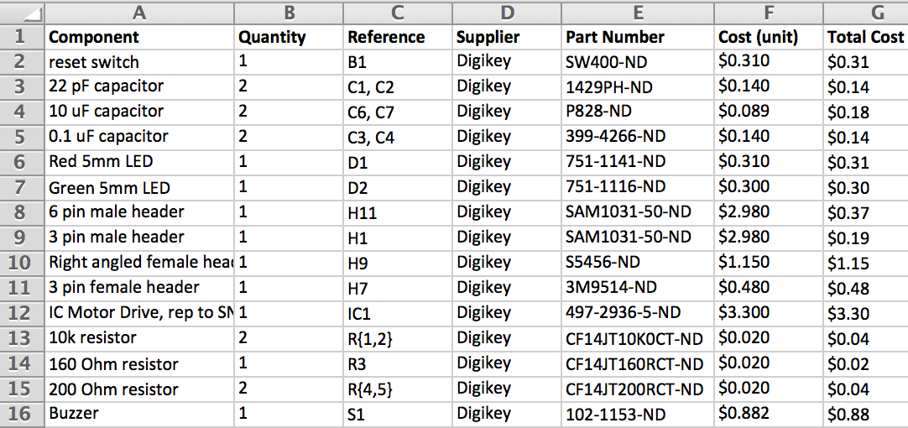
Bill of Materials Example

Slide 14
PCB Design
Software
BoM
Layer Stack & Trace Widths
Symbols & Footprints
Schematic
Layout
Routing
Design Rule Checks
Fabrication
Assembly

Slide 15
PCB Design at HMC
Software: Mentor Graphics PADS
BoM: Components from DigiKey if possible
Layer Stack & Trace Widths
  2 layers for quick hacks
  4 layers for most Clinic prototypes
  6 mil minimum trace width + spacing
Fabrication: Advanced Circuits
  $33 / $66 student 2/4 layer specials
  Beyond 5 units, standard pricing is better
Assembly: You or Action Assembly

Slide 16
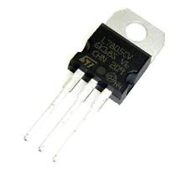
Voltage Regulators
Convert battery or wall wart to stable lower voltage
Regulator types
  DC regulators
    7805 drops >8 to exactly 5
    Low Dropout Regulators need less headroom
  Switching regulators
    Greater efficiency (often > 80%)
    Require external inductor

Slide 17
Power Supply Integrity
All physical systems have inductance between the voltage regulator and circuits being powered
Changing current draw causes voltage drop across inductor, malfunctions
Use bypass capacitors to stabilize power supply
  10 μF near voltage regulator
  0.1 μF near each component
  High-performance components need more
    See datasheet for guidance

Slide 18
Interpreting Datasheets
Learn standard terms for specs
Fully understand the datasheet before you use a component
Skimming is better than searching

Slide 19
Datasheet Examples: 74HC08
What is the power supply voltage
  How much supply current does it draw?
What are the logic levels?
  Can it read an input from 3.3V logic?
How much output current could it drive?
  How to hook up an LED?
How much input current does it draw?
  How to hook up to a switch?
What packages are available?
What temperature range can it operate over?

Slide 20
Datasheet Examples: Cyclone II
Cyclone II EP2C35F672
  From DE2 board
  Representative FPGA

Slide 21
Datasheet Examples: LIS3DH Accel
LIS3DH
  Representative peripheral
  SPI communication

Slide 22
Datasheet Examples: STM32F042
Microcontroller
  Challenge of big datasheet

