Slide 1
Lecture 7: Verilog Part II
E85 Digital Design & Computer Engineering

Slide 2
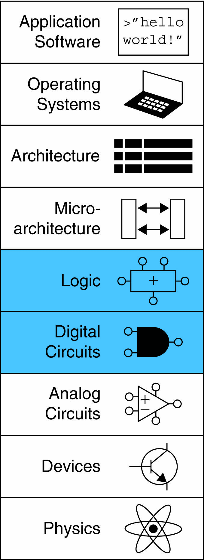
Lecture 7
More Combinational Logic
Finite State Machines
Parameterized Modules
Testbenches

Slide 3
Other Behavioral Statements
Statements that must be inside always statements:
if / else
case, casez

Slide 4
Combinational Logic using always
// combinational logic using an always statement
module gates(input logic [3:0] a, b,
output logic [3:0] y1, y2, y3, y4, y5);
always_comb // need begin/end because there is
begin // more than one statement in always
y1 = a & b; // AND
y2 = a | b; // OR
y3 = a ^ b; // XOR
y4 = ~(a & b); // NAND
y5 = ~(a | b); // NOR
end
endmodule
This hardware could be described with assign statements using fewer lines of code, so it’s better to use assign statements in this case.

Slide 5
Combinational Logic using case
module sevenseg(input logic [3:0] data,
output logic [6:0] segments);
always_comb
case (data)
// abc_defg
0: segments = 7'b111_1110;
1: segments = 7'b011_0000;
2: segments = 7'b110_1101;
3: segments = 7'b111_1001;
4: segments = 7'b011_0011;
5: segments = 7'b101_1011;
6: segments = 7'b101_1111;
7: segments = 7'b111_0000;
8: segments = 7'b111_1111;
9: segments = 7'b111_0011;
default: segments = 7'b000_0000; // required
endcase
endmodule

Slide 6
Combinational Logic using case
case statement implies combinational logic only if all possible input combinations described
Remember to use default statement

Slide 7
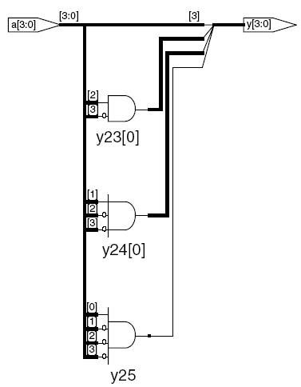
Combinational Logic using casez
module priority_casez(input logic [3:0] a,
output logic [3:0] y);
always_comb
casez(a)
4'b1???: y = 4'b1000; // ?=don’t care
4'b01??: y = 4'b0100;
4'b001?: y = 4'b0010;
4'b0001: y = 4'b0001;
default: y = 4'b0000;
endcase
endmodule
Synthesis:

Slide 8
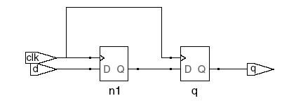
Blocking vs. Nonblocking Assignment
<= is nonblocking assignment
Occurs simultaneously with others
= is blocking assignment
Occurs in order it appears in file
// Good synchronizer using
// nonblocking assignments
module syncgood(input logic clk,
input logic d,
output logic q);
logic n1;
always_ff @(posedge clk)
begin
n1 <= d; // nonblocking
q <= n1; // nonblocking
end
endmodule
// Bad synchronizer using
// blocking assignments
module syncbad(input logic clk,
input logic d,
output logic q);
logic n1;
always_ff @(posedge clk)
begin
n1 = d; // blocking
q = n1; // blocking
end
endmodule

Slide 9
Rules for Signal Assignment
Synchronous sequential logic: use always_ff @(posedge clk)and nonblocking assignments (<=)
always_ff @(posedge clk)
q <= d; // nonblocking
Simple combinational logic: use continuous assignments (assign…)
assign y = a & b;
More complicated combinational logic: use always_comb and blocking assignments (=)
Assign a signal in only one always statement or continuous assignment statement.

Slide 10
Finite State Machines (FSMs)
Three blocks:
next state logic
state register
output logic

Slide 11
FSM Example: Divide by 3
The double circle indicates the reset state

Slide 12
FSM in SystemVerilog
module divideby3FSM(input logic clk,
input logic reset,
output logic q);
typedef enum logic [1:0] {S0, S1, S2} statetype;
statetype state, nextstate;
// state register
always_ff @(posedge clk, posedge reset)
if (reset) state <= S0;
else state <= nextstate;
// next state logic
always_comb
case (state)
S0: nextstate = S1;
S1: nextstate = S2;
S2: nextstate = S0;
default: nextstate = S0;
endcase
// output logic
assign q = (state == S0);
endmodule

Slide 13
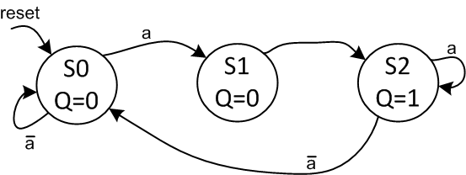
FSM with Inputs
module fsmWithInputs(input logic clk,
input logic reset,
input logic a,
output logic q);
typedef enum logic [1:0] {S0, S1, S2} statetype;
statetype state, nextstate;
// state register
always_ff @(posedge clk, posedge reset)
if (reset) state <= S0;
else state <= nextstate;
// next state logic
always_comb
case (state)
S0: if (a) nextstate = S1;
else nextstate = S0;
S1: nextstate = S2;
S2: if (a) nextstate = S2;
else nextstate = S0;
default: nextstate = S0;
endcase
// output logic
assign q = (state == S2);
endmodule

Slide 14
Parameterized Modules
2:1 mux:
module mux2
#(parameter width = 8) // name and default value
(input logic [width-1:0] d0, d1,
input logic s,
output logic [width-1:0] y);
assign y = s ? d1 : d0;
endmodule
Instance with 8-bit bus width (uses default):
mux2 myMux(d0, d1, s, out);
Instance with 12-bit bus width:
mux2 #(12) lowmux(d0, d1, s, out);

Slide 15
Testbenches
HDL that tests another module: device under test (dut)
Not synthesizeable
Uses different features of SystemVerilog
Types:
Simple
Self-checking
Self-checking with testvectors

Slide 16
Testbench Example
Write SystemVerilog code to implement the following function in hardware:
y = bc + ab
Name the module sillyfunction

Slide 17
Testbench Example
Write SystemVerilog code to implement the following function in hardware:
y = bc + ab
module sillyfunction(input logic a, b, c,
output logic y);
assign y = ~b & ~c | a & ~b;
endmodule

Slide 18
Simple Testbench
module testbench1();
logic a, b, c;
logic y;
// instantiate device under test
sillyfunction dut(a, b, c, y);
// apply inputs one at a time
initial begin
a = 0; b = 0; c = 0; #10;
c = 1; #10;
b = 1; c = 0; #10;
c = 1; #10;
a = 1; b = 0; c = 0; #10;
c = 1; #10;
b = 1; c = 0; #10;
c = 1; #10;
end
endmodule

Slide 19
Self-checking Testbench
module testbench2();
logic a, b, c;
logic y;
sillyfunction dut(a, b, c, y); // instantiate dut
initial begin // apply inputs, check results one at a time
a = 0; b = 0; c = 0; #10;
if (y !== 1) $display("000 failed.");
c = 1; #10;
if (y !== 0) $display("001 failed.");
b = 1; c = 0; #10;
if (y !== 0) $display("010 failed.");
c = 1; #10;
if (y !== 0) $display("011 failed.");
a = 1; b = 0; c = 0; #10;
if (y !== 1) $display("100 failed.");
c = 1; #10;
if (y !== 1) $display("101 failed.");
b = 1; c = 0; #10;
if (y !== 0) $display("110 failed.");
c = 1; #10;
if (y !== 0) $display("111 failed.");
end
endmodule

Slide 20
Testbench with Testvectors
Testvector file: inputs and expected outputs
Testbench:
Generate clock for assigning inputs, reading outputs
Read testvectors file into array
Assign inputs, expected outputs
Compare outputs with expected outputs and report errors

Slide 21
Testbench with Testvectors
Testbench clock:
assign inputs (on rising edge)
compare outputs with expected outputs (on falling edge).
Testbench clock also used as clock for synchronous sequential circuits

Slide 22
Testvectors File
File: example.tv
contains vectors of abc_yexpected
000_1
001_0
010_0
011_0
100_1
101_1
110_0
111_0

Slide 23
1. Generate Clock
module testbench3();
logic clk, reset;
logic a, b, c, yexpected;
logic y;
logic [31:0] vectornum, errors; // bookkeeping variables
logic [3:0] testvectors[10000:0]; // array of testvectors
// instantiate device under test
sillyfunction dut(a, b, c, y);
// generate clock
always // no sensitivity list, so it always executes
begin
clk = 1; #5; clk = 0; #5;
end

Slide 24
2. Read Testvectors into Array
// at start of test, load vectors and pulse reset
initial
begin
$readmemb("example.tv", testvectors);
vectornum = 0; errors = 0;
reset = 1; #27; reset = 0;
end
// Note: $readmemh reads testvector files written in
// hexadecimal

Slide 25
3. Assign Inputs & Expected Outputs
// apply test vectors on rising edge of clk
always @(posedge clk)
begin
#1; {a, b, c, yexpected} = testvectors[vectornum];
end

Slide 26
4. Compare with Expected Outputs
// check results on falling edge of clk
always @(negedge clk)
if (~reset) begin // skip during reset
if (y !== yexpected) begin
$display("Error: inputs = %b", {a, b, c});
$display(" outputs = %b (%b expected)",y,yexpected);
errors = errors + 1;
end
// Note: to print in hexadecimal, use %h. For example,
// $display(“Error: inputs = %h”, {a, b, c});

Slide 27
4. Compare with Expected Outputs
// increment array index and read next testvector
vectornum = vectornum + 1;
if (testvectors[vectornum] === 4'bx) begin
$display("%d tests completed with %d errors",
vectornum, errors);
$stop;
end
end
endmodule
// === and !== can compare values that are 1, 0, x, or z.

