Slide 1

Lecture 6:
Hardware Description
Languages: Verilog
E85 Digital Design & Computer Engineering

Slide 2
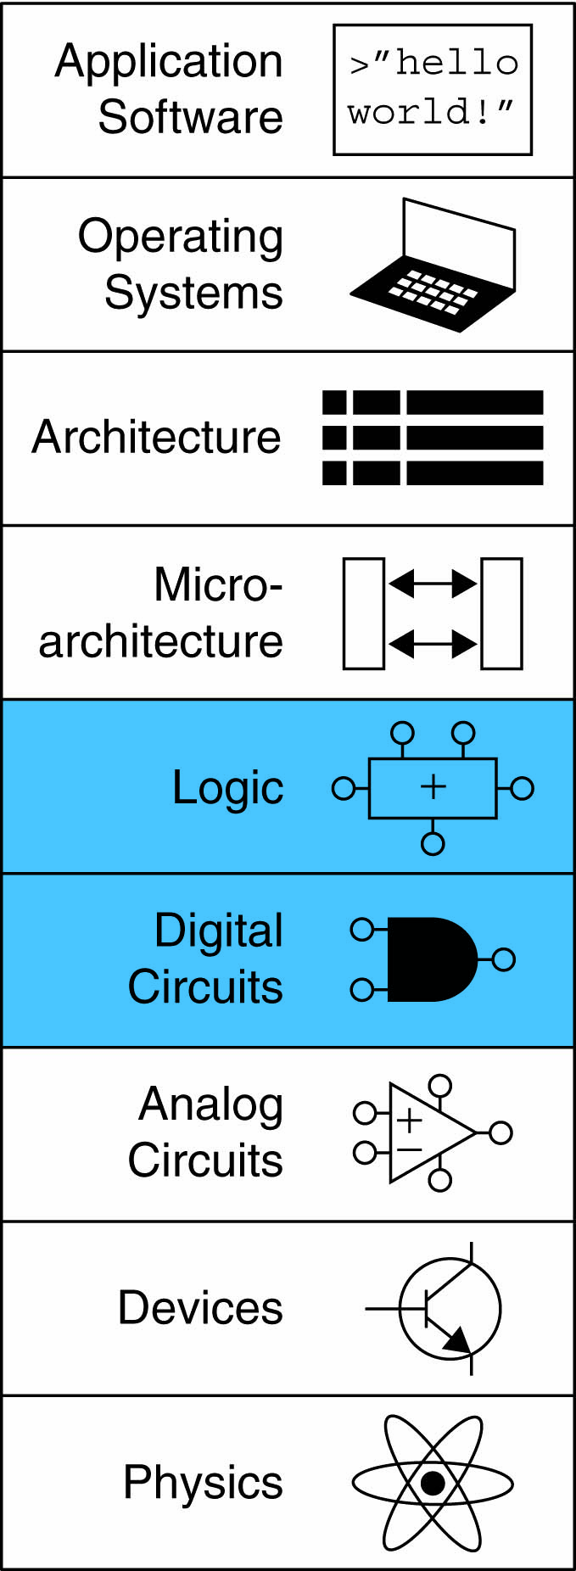
Lecture 6
Introduction
Combinational Logic
Structural Modeling
Sequential Logic

Slide 3
Introduction
Hardware description language (HDL):
  specifies logic function only
  Computer-aided design (CAD) tool produces or synthesizes the optimized gates
Most commercial designs built using HDLs
Two leading HDLs:
  SystemVerilog
    developed in 1984 by Gateway Design Automation
    IEEE standard (1364) in 1995
    Extended in 2005 (IEEE STD 1800-2009)
  VHDL 2008
    Developed in 1981 by the Department of Defense
    IEEE standard (1076) in 1987
    Updated in 2008 (IEEE STD 1076-2008)

Slide 4
HDL to Gates
Simulation
  Inputs applied to circuit
  Outputs checked for correctness
  Millions of dollars saved by debugging in simulation instead of hardware
Synthesis
  Transforms HDL code into a netlist describing the hardware (i.e., a list of gates and the wires connecting them)

Slide 5
HDL to Gates
Simulation
  Inputs applied to circuit
  Outputs checked for correctness
  Millions of dollars saved by debugging in simulation instead of hardware
Synthesis
  Transforms HDL code into a netlist describing the hardware (i.e., a list of gates and the wires connecting them)
IMPORTANT: When using an HDL, think of the hardware the HDL should implies

Slide 6
SystemVerilog Modules
SystemVerilog
Module
Two types of Modules:
  Behavioral: describe what a module does
  Structural: describe how it is built from simpler modules

Slide 7
Behavioral SystemVerilog
SystemVerilog:
module example(input logic a, b, c,
output logic y);
assign y = ~a & ~b & ~c | a & ~b & ~c | a & ~b & c;
endmodule

Slide 8
Behavioral SystemVerilog
SystemVerilog:
module example(input logic a, b, c,
output logic y);
assign y = ~a & ~b & ~c | a & ~b & ~c | a & ~b & c;
endmodule
module/endmodule: required to begin/end module
example: name of the module
Operators:
  ~: NOT
  &: AND
  |: OR

Slide 9
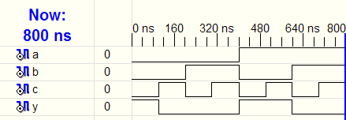
HDL Simulation
SystemVerilog:
module example(input logic a, b, c,
output logic y);
assign y = ~a & ~b & ~c | a & ~b & ~c | a & ~b & c;
endmodule

Slide 10
HDL Synthesis
SystemVerilog:
module example(input logic a, b, c,
output logic y);
assign y = ~a & ~b & ~c | a & ~b & ~c | a & ~b & c;
endmodule
Synthesis:

Slide 11
SystemVerilog Syntax
Case sensitive
  Example: reset and Reset are not the same signal.
No names that start with numbers
  Example: 2mux is an invalid name
Whitespace ignored
Comments:
  // single line comment
  /* multiline
  comment */

Slide 12
Structural Modeling - Hierarchy
module and3(input logic a, b, c,
output logic y);
assign y = a & b & c;
endmodule
module inv(input logic a,
output logic y);
assign y = ~a;
endmodule
module nand3(input logic a, b, c
output logic y);
logic n1; // internal signal
and3 andgate(a, b, c, n1); // instance of and3
inv inverter(n1, y); // instance of inv
endmodule

Slide 13
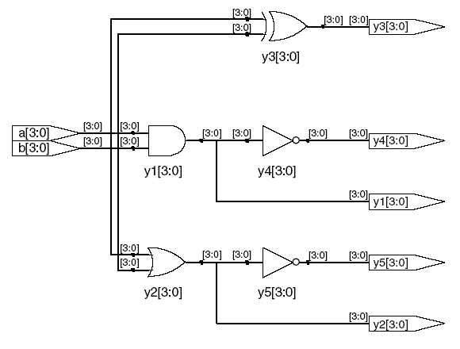
Bitwise Operators
module gates(input logic [3:0] a, b,
output logic [3:0] y1, y2, y3, y4, y5);
/* Five different two-input logic
gates acting on 4 bit busses */
assign y1 = a & b; // AND
assign y2 = a | b; // OR
assign y3 = a ^ b; // XOR
assign y4 = ~(a & b); // NAND
assign y5 = ~(a | b); // NOR
endmodule
// single line comment
/*…*/ multiline comment
Synthesis:

Slide 14
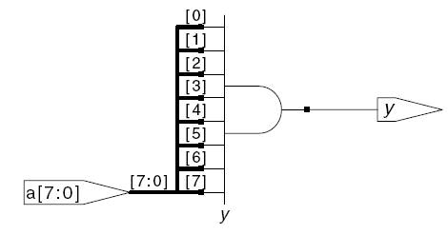
Reduction Operators
SystemVerilog:
module and8(input logic [7:0] a,
output logic y);
assign y = &a;
// &a is much easier to write than
// assign y = a[7] & a[6] & a[5] & a[4] &
// a[3] & a[2] & a[1] & a[0];
endmodule
Synthesis:

Slide 15
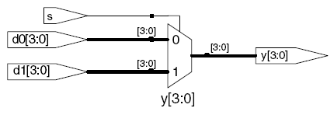
Conditional Assignment
SystemVerilog:
module mux2(input logic [3:0] d0, d1,
input logic s,
output logic [3:0] y);
assign y = s ? d1 : d0;
endmodule
? : is also called a ternary operator because it
operates on 3 inputs: s, d1, and d0.
Synthesis:

Slide 16
Internal Variables
SystemVerilog:
module fulladder(input logic a, b, cin,
output logic s, cout);
logic p, g; // internal nodes
assign p = a ^ b;
assign g = a & b;
assign s = p ^ cin;
assign cout = g | (p & cin);
endmodule
Synthesis:

Slide 17
Precedence
Highest
~ | NOT
*, /, % | mult, div, mod
+, - | add,sub
<<, >> | shift
<<<, >>> | arithmetic shift
<, <=, >, >= | comparison
==, != | equal, not equal
&, ~& | AND, NAND
^, ~^ | XOR, XNOR
|, ~| | OR, NOR
?: | ternary operator
Lowest

Slide 18
Numbers
Format: N'Bvalue
N = number of bits, B = base
N'B is optional but recommended (default is decimal)
Number | # Bits | Base | Decimal Equivalent | Stored
3'b101 | 3 | binary | 5 | 101
'b11 | unsized | binary | 3 | 00…0011
8'b11 | 8 | binary | 3 | 00000011
8'b1010_1011 | 8 | binary | 171 | 10101011
3'd6 | 3 | decimal | 6 | 110
6'o42 | 6 | octal | 34 | 100010
8'hAB | 8 | hexadecimal | 171 | 10101011
42 | Unsized | decimal | 42 | 00…0101010

Slide 19
Bit Manipulations: Example 1
assign y = {a[2:1], {3{b[0]}}, a[0], 6'b100_010};
// if y is a 12-bit signal, the above statement produces:
y = a[2] a[1] b[0] b[0] b[0] a[0] 1 0 0 0 1 0
// underscores (_) are used for formatting only to make
// it easier to read. SystemVerilog ignores them.

Slide 20
Bit Manipulations: Example 2
SystemVerilog:
module mux2_8(input logic [7:0] d0, d1,
input logic s,
output logic [7:0] y);
mux2 lsbmux(d0[3:0], d1[3:0], s, y[3:0]);
mux2 msbmux(d0[7:4], d1[7:4], s, y[7:4]);
endmodule
Synthesis:

Slide 21
Z: Floating Output
SystemVerilog:
module tristate(input logic [3:0] a,
input logic en,
output tri [3:0] y);
assign y = en ? a : 4'bz;
endmodule
Synthesis:

Slide 22
Delays
module example(input logic a, b, c,
output logic y);
logic ab, bb, cb, n1, n2, n3;
assign #1 {ab, bb, cb} = ~{a, b, c};
assign #2 n1 = ab & bb & cb;
assign #2 n2 = a & bb & cb;
assign #2 n3 = a & bb & c;
assign #4 y = n1 | n2 | n3;
endmodule

Slide 23
Delays
module example(input logic a, b, c,
output logic y);
logic ab, bb, cb, n1, n2, n3;
assign #1 {ab, bb, cb} =
~{a, b, c};
assign #2 n1 = ab & bb & cb;
assign #2 n2 = a & bb & cb;
assign #2 n3 = a & bb & c;
assign #4 y = n1 | n2 | n3;
endmodule

Slide 24
Delays
1
module example(input logic a, b, c,
output logic y);
logic ab, bb, cb, n1, n2, n3;
assign #1 {ab, bb, cb} =
~{a, b, c};
assign #2 n1 = ab & bb & cb;
assign #2 n2 = a & bb & cb;
assign #2 n3 = a & bb & c;
assign #4 y = n1 | n2 | n3;
endmodule

Slide 25
Delays
2
module example(input logic a, b, c,
output logic y);
logic ab, bb, cb, n1, n2, n3;
assign #1 {ab, bb, cb} =
~{a, b, c};
assign #2 n1 = ab & bb & cb;
assign #2 n2 = a & bb & cb;
assign #2 n3 = a & bb & c;
assign #4 y = n1 | n2 | n3;
endmodule

Slide 26
Delays
module example(input logic a, b, c,
output logic y);
logic ab, bb, cb, n1, n2, n3;
assign #1 {ab, bb, cb} =
~{a, b, c};
assign #2 n1 = ab & bb & cb;
assign #2 n2 = a & bb & cb;
assign #2 n3 = a & bb & c;
assign #4 y = n1 | n2 | n3;
endmodule
2

Slide 27
Delays
module example(input logic a, b, c,
output logic y);
logic ab, bb, cb, n1, n2, n3;
assign #1 {ab, bb, cb} =
~{a, b, c};
assign #2 n1 = ab & bb & cb;
assign #2 n2 = a & bb & cb;
assign #2 n3 = a & bb & c;
assign #4 y = n1 | n2 | n3;
endmodule
4

Slide 28
Sequential Logic
SystemVerilog uses idioms to describe latches, flip-flops and FSMs
Other coding styles may simulate correctly but produce incorrect hardware

Slide 29
always Statement
General Structure:
always @(sensitivity list)
statement;
Whenever the event in sensitivity list occurs, statement is executed

Slide 30
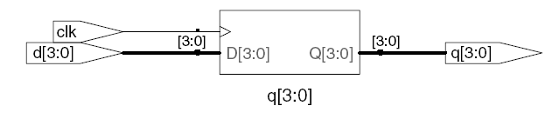
D Flip-Flop
module flop(input logic clk,
input logic [3:0] d,
output logic [3:0] q);
always_ff @(posedge clk)
q <= d; // pronounced “q gets d”
endmodule
Synthesis:

Slide 31
Resettable D Flip-Flop
module flopr(input logic clk,
input logic reset,
input logic [3:0] d,
output logic [3:0] q);
// synchronous reset
always_ff @(posedge clk)
if (reset) q <= 4'b0;
else q <= d;
endmodule
Synthesis:

Slide 32
Resettable D Flip-Flop
module flopr(input logic clk,
input logic reset,
input logic [3:0] d,
output logic [3:0] q);
// asynchronous reset
always_ff @(posedge clk, posedge reset)
if (reset) q <= 4'b0;
else q <= d;
endmodule
Synthesis:

Slide 33
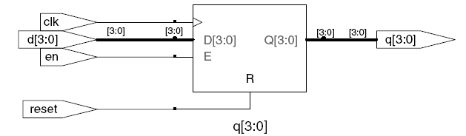
D Flip-Flop with Enable
module flopren(input logic clk,
input logic reset,
input logic en,
input logic [3:0] d,
output logic [3:0] q);
// enable and asynchronous reset
always_ff @(posedge clk, posedge reset)
if (reset) q <= 4'b0;
else if (en) q <= d;
endmodule
Synthesis:

Slide 34
Latch
module latch(input logic clk,
input logic [3:0] d,
output logic [3:0] q);
always_latch
if (clk) q <= d;
endmodule
Warning: We don’t use latches in this text. But you might write code that inadvertently implies a latch. Check synthesized hardware – if it has latches
in it, there’s an error.
Synthesis:

Slide 35
Review
General Structure:
always @(sensitivity list)
statement;
Flip-flop: always_ff
Latch: always_latch (don’t use)

