Slide 1
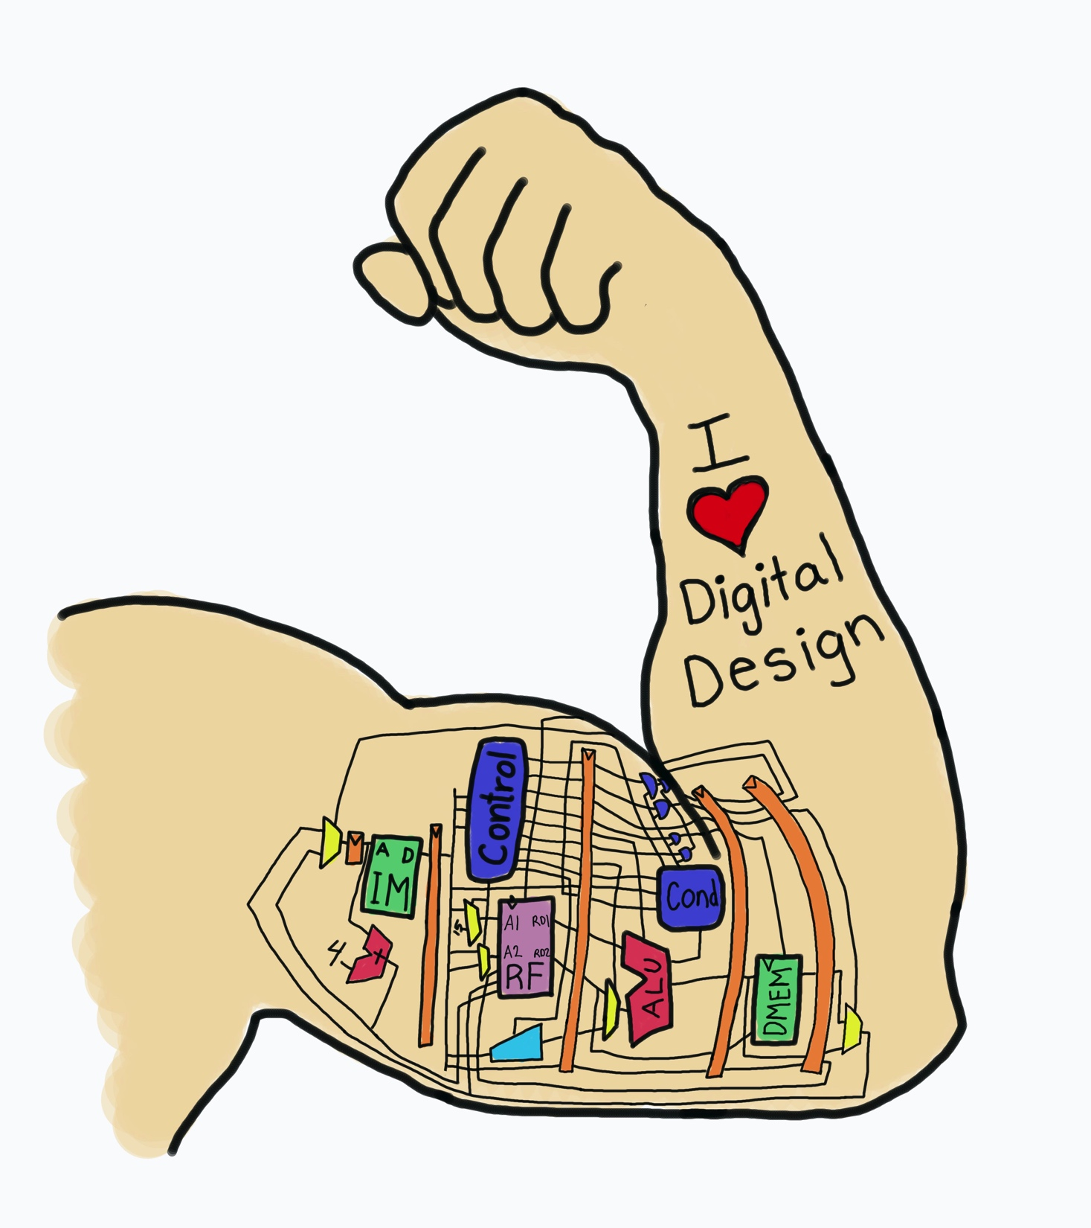
Lecture 5:
Sequential Timing
E85 Digital Design & Computer Engineering

Slide 2
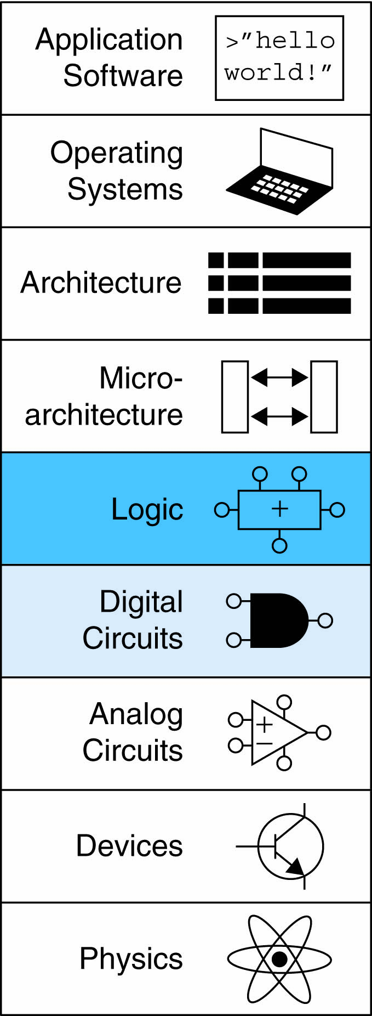
Lecture 5
Timing of Sequential Logic
Metastability
Parallelism

Slide 3
Timing
Flip-flop samples D at clock edge
D must be stable when sampled
Similar to a photograph, D must be stable around clock edge
If not, metastability can occur

Slide 4
Input Timing Constraints
Setup time: t_{setup} = time before clock edge data must be stable (i.e. not changing)
Hold time: t_{hold} = time after clock edge data must be stable
Aperture time: t_{a} = time around clock edge data must be stable (t_{a} = t_{setup} + t_{hold})

Slide 5
Output Timing Parameters
Propagation delay: t_{pcq} = time after clock edge that the output Q is guaranteed to be stable (i.e., to stop changing)
Contamination delay: t_{ccq} = time after clock edge that Q might be unstable (i.e., start changing)

Slide 6
Dynamic Discipline
Synchronous sequential circuit inputs must be stable during aperture (setup and hold) time around clock edge
Specifically, inputs must be stable
  at least t_{setup} before the clock edge
  at least until t_{hold} after the clock edge

Slide 7
Dynamic Discipline
The delay between registers has a minimum and maximum delay, dependent on the delays of the circuit elements

Slide 8
Setup Time Constraint
Depends on the maximum delay from register R1 through combinational logic to R2
The input to register R2 must be stable at least t_{setup} before clock edge
T_{c} ≥ t_{pcq} + t_{pd} + t_{setup}
t_{pd} ≤ T_{c} – (t_{pcq} + t_{setup})
(t_{pcq} + t_{setup}): sequencing overhead

Slide 9
Hold Time Constraint
Depends on the minimum delay from register R1 through the combinational logic to R2
The input to register R2 must be stable for at least t_{hold} after the clock edge
t_{hold} < t_{ccq} + t_{cd}
t_{cd} > t_{hold} - t_{ccq}

Slide 10
Timing Analysis
Timing Characteristics
t_{ccq} = 30 ps
t_{pcq} = 50 ps
t_{setup} = 60 ps
t_{hold} = 70 ps
t_{pd} = 35 ps
t_{cd} = 25 ps
t_{pd} = 3 x 35 ps = 105 ps
t_{cd} = 25 ps
Setup time constraint:
T_{c} ≥ (50 + 105 + 60) ps = 215 ps
f_{c} = 1/T_{c} = 4.65 GHz
Hold time constraint:
t_{ccq} + t_{cd} > t_{hold} ?
(30 + 25) ps > 70 ps ? No!

Slide 11
Timing Analysis
Add buffers to the short paths:
Timing Characteristics
t_{ccq} = 30 ps
t_{pcq} = 50 ps
t_{setup} = 60 ps
t_{hold} = 70 ps
t_{pd} = 35 ps
t_{cd} = 25 ps
t_{pd} = 3 x 35 ps = 105 ps
t_{cd} = 2 x 25 ps = 50 ps
Setup time constraint:
T_{c} ≥ (50 + 105 + 60) ps = 215 ps
f_{c} = 1/T_{c} = 4.65 GHz
Hold time constraint:
t_{ccq} + t_{cd} > t_{hold} ?
(30 + 50) ps > 70 ps ? Yes!

Slide 12
Clock Skew
The clock doesn’t arrive at all registers at same time
Skew: difference between two clock edges
Perform worst case analysis to guarantee dynamic discipline is not violated for any register – many registers in a system!

Slide 13
Setup Time Constraint with Skew
In the worst case, CLK2 is earlier than CLK1
T_{c} ≥ t_{pcq} + t_{pd} + t_{setup} + t_{skew}
t_{pd} ≤ T_{c} – (t_{pcq} + t_{setup} + t_{skew})

Slide 14
Hold Time Constraint with Skew
In the worst case, CLK2 is later than CLK1
t_{ccq} + t_{cd} > t_{hold} + t_{skew}
t_{cd} > t_{hold} + t_{skew} – t_{ccq}

Slide 15
Violating the Dynamic Discipline
Asynchronous (for example, user) inputs might violate the dynamic discipline

Slide 16
Metastability
Bistable devices: two stable states, and a metastable state between them
Flip-flop: two stable states (1 and 0) and one metastable state
If flip-flop lands in metastable state, could stay there for an undetermined amount of time

Slide 17
Flip-Flop Internals
Flip-flop has feedback: if Q is somewhere between 1 and 0, cross-coupled gates drive output to either rail (1 or 0)
Metastable signal: if it hasn’t resolved to 1 or 0
If flip-flop input changes at random time, probability that output Q is metastable after waiting some time, t:
P(t_{res} > t) = (T₀/T_{c} ) e^{-t/τ}
t_{res} : time to resolve to 1 or 0
T₀, τ : properties of the circuit

Slide 18
Metastability
Intuitively:
  T₀/T_{c}: probability input changes at a bad time (during aperture)
P(t_{res} > t) = (T₀/T_{c} ) e^{-t/τ}
  τ: time constant for how fast flip-flop moves away from metastability
P(t_{res} > t) = (T₀/T_{c} ) e^{-t/τ}
If flip-flop samples metastable input, if you wait long enough (t), the output will have resolved to 1 or 0 with high probability.

Slide 19
Synchronizers
Asynchronous inputs are inevitable (user interfaces, systems with different clocks interacting, etc.)
Synchronizer goal: make the probability of failure (the output Q still being metastable) low
Synchronizer cannot make the probability of failure 0

Slide 20
Synchronizer Internals
Synchronizer: built with two back-to-back flip-flops
Suppose D is transitioning when sampled by F1
Internal signal D2 has (T_{c} - t_{setup}) time to resolve to 1 or 0

Slide 21
Synchronizer Probability of Failure
For each sample, probability of failure is:
P(failure) = (T₀/T_{c} ) e^{-(Tc} ^{- tsetup)/τ}

Slide 22
Synchronizer Mean Time Between Failures
If asynchronous input changes once per second, probability of failure per second is P(failure).
If input changes N times per second, probability of failure per second is:
P(failure)/second = (NT₀/T_{c}) e^{-(Tc} ^{- tsetup)/τ}
Synchronizer fails, on average, 1/[P(failure)/second]
Called mean time between failures, MTBF:
MTBF = 1/[P(failure)/second] = (T_{c}/NT₀) e^{(Tc} ^{- tsetup)/τ}

Slide 23
Example Synchronizer
Suppose: T_{c} = 1/500 MHz = 2 ns τ = 200 ps
T₀ = 150 ps t_{setup} = 100 ps
N = 10 events per second
What is the probability of failure? MTBF?
P(failure) = (150 ps/2 ns) e^{-(1.9 ns)/200 ps}
= 5.6 × 10⁻⁶
P(failure)/second = 10 × (5.6 × 10⁻⁶ )
= 5.6 × 10⁻⁵ / second
MTBF = 1/[P(failure)/second] ≈ 5 hours

Slide 24
Parallelism
Two types of parallelism:
  Spatial parallelism
    duplicate hardware performs multiple tasks at once
  Temporal parallelism
    task is broken into multiple stages
    also called pipelining
    for example, an assembly line

Slide 25
Parallelism Definitions
Token: Group of inputs processed to produce group of outputs
Latency: Time for one token to pass from start to end
Throughput: Number of tokens produced per unit time
Parallelism increases throughput

Slide 26
Parallelism Example
Ben Bitdiddle bakes cookies to celebrate traffic light controller installation
5 minutes to roll cookies
15 minutes to bake
What is the latency and throughput without parallelism?
Latency = 5 + 15 = 20 minutes = 1/3 hour
Throughput = 1 tray/ 1/3 hour = 3 trays/hour

Slide 27
Parallelism Example
What is the latency and throughput if Ben uses parallelism?
  Spatial parallelism: Ben asks Allysa P. Hacker to help, using her own oven
  Temporal parallelism:
    two stages: rolling and baking
    He uses two trays
    While first batch is baking, he rolls the second batch, etc.

Slide 28
Spatial Parallelism
Latency = 5 + 15 = 20 minutes = 1/3 hour
Throughput = 2 trays/ 1/3 hour = 6 trays/hour

Slide 29
Temporal Parallelism
Latency = 5 + 15 = 20 minutes = 1/3 hour
Throughput = 1 trays/ 1/4 hour = 4 trays/hour
Using both techniques, the throughput would be 8 trays/hour

