Slide 1

Lecture 4:
Finite State Machines
E85 Digital Design & Computer Engineering

Slide 2
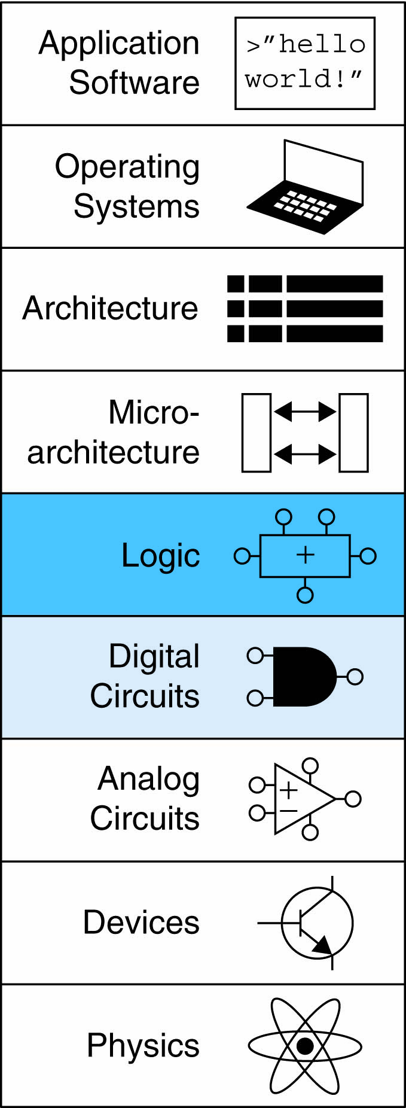
Lecture 4
Finite State Machines

Slide 3
Synchronous Sequential Logic Design
Breaks cyclic paths by inserting registers
Registers contain state of the system
State changes at clock edge: system synchronized to the clock
Rules of synchronous sequential circuit composition:
  Every circuit element is either a register or a combinational circuit
  At least one circuit element is a register
  All registers receive the same clock signal
  Every cyclic path contains at least one register
Two common synchronous sequential circuits
  Finite State Machines (FSMs)
  Pipelines

Slide 4
Finite State Machine (FSM)
Consists of:
  State register
    Stores current state
    Loads next state at clock edge
  Combinational logic
    Computes the next state
    Computes the outputs

Slide 5
Finite State Machines (FSMs)
Next state determined by current state and inputs
Two types of finite state machines differ in output logic:
  Moore FSM: outputs depend only on current state
  Mealy FSM: outputs depend on current state and inputs

Slide 6
FSM Example
Traffic light controller
  Traffic sensors: T_{A}, T_{B} (TRUE when there’s traffic)
  Lights: L_{A}, L_{B}

Slide 7
FSM Black Box
Inputs: CLK, Reset, T_{A}, T_{B}
Outputs: L_{A}, L_{B}

Slide 8
FSM State Transition Diagram
Moore FSM: outputs labeled in each state
States: Circles
Transitions: Arcs

Slide 9
FSM State Transition Diagram
Moore FSM: outputs labeled in each state
States: Circles
Transitions: Arcs

Slide 10
FSM State Transition Table
Current State | Inputs |  | Next State
S | T_{A} | T_{B} | S'
S0 | 0 | X | S1
S0 | 1 | X | S0
S1 | X | X | S2
S2 | X | 0 | S3
S2 | X | 1 | S2
S3 | X | X | S0

Slide 11
FSM Encoded State Transition Table
Current State |  | Inputs |  | Next State
S₁ | S₀ | T_{A} | T_{B} | S'₁ | S'₀
0 | 0 | 0 | X | 0 | 1
0 | 0 | 1 | X | 0 | 0
0 | 1 | X | X | 1 | 0
1 | 0 | X | 0 | 1 | 1
1 | 0 | X | 1 | 1 | 0
1 | 1 | X | X | 0 | 0
State | Encoding
S0 | 00
S1 | 01
S2 | 10
S3 | 11
S'₁ = S₁ xor S₀
S'₀ = S₁S₀T_{A} + S₁S₀T_{B}

Slide 12
FSM Output Table
Current State |  | Outputs
S₁ | S₀ | L_{A1} | L_{A0} | L_{B1} | L_{B0}
0 | 0 | 0 | 0 | 1 | 0
0 | 1 | 0 | 1 | 1 | 0
1 | 0 | 1 | 0 | 0 | 0
1 | 1 | 1 | 0 | 0 | 1
Output | Encoding
green | 00
yellow | 01
red | 10
L_{A1} = S₁
L_{A0} = S₁S₀
L_{B1} = S₁
L_{B0} = S₁S₀

Slide 13
FSM Schematic: State Register

Slide 14
FSM Schematic: Next State Logic

Slide 15
FSM Schematic: Output Logic

Slide 16
SystemVerilog Description
module trafficFSM(input logic clk, reset,
input logic ta, tb,
output logic [1:0] la, lb);
logic [1:0] state, nextstate, sb;
logic tab, tbb, p1, p2;
// state register
flopr #(2) statereg(clk, reset, nextstate, state);
// next state logic
not n0(sb[0], s[0]);
not n1(sb[1], s[1]);
not n2(tab, ta);
not n3(tbb, tb);
xor x1(nextstate[1], state[0], state[1]);
and a1(p1, sb[0], sb[1], tab);
and a2(p2, sb[0], s[1], tbb);
or o1(nextstate[0], p1, p2);
// output logic
buf b1(la[1], s[1]);
and a3(la[0], s[0], sb[1]);
inv n4(lb[1], s[1]);
and a4(lb[0], s[0], s[1]);
endmodule
Multi-input XOR: Odd parity

Slide 17
FSM Timing Diagram

Slide 18
FSM State Encoding
Binary encoding:
  i.e., for four states, 00, 01, 10, 11
One-hot encoding
  One state bit per state
  Only one state bit HIGH at once
  i.e., for 4 states, 0001, 0010, 0100, 1000
  Requires more flip-flops
  Often next state and output logic is simpler

Slide 19
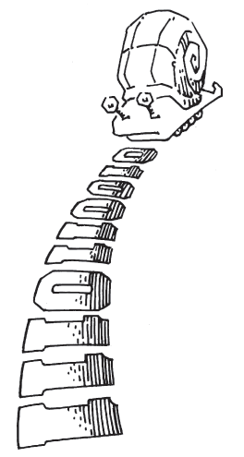
Moore vs. Mealy FSM
Alyssa P. Hacker has a snail that crawls down a paper tape with 1’s and 0’s on it. The snail smiles whenever the last two digits it has crawled over are 01. Design Moore and Mealy FSMs of the snail’s brain.

Slide 20
State Transition Diagrams
Mealy FSM: arcs indicate input/output

Slide 21
Moore FSM State Transition Table
State | Encoding
S0 | 00
S1 | 01
S2 | 10
Current State |  | Inputs | Next State
S₁ | S₀ | A | S'₁ | S'₀
0 | 0 | 0 | 0 | 1
0 | 0 | 1 | 0 | 0
0 | 1 | 0 | 0 | 1
0 | 1 | 1 | 1 | 0
1 | 0 | 0 | 0 | 1
1 | 0 | 1 | 0 | 0
S₁’ = S₀A
S₀’ = A

Slide 22
Moore FSM Output Table
Current State |  | Output
S₁ | S₀ | Y
0 | 0 | 0
0 | 1 | 0
1 | 0 | 1
Y = S₁

Slide 23
Mealy FSM State Transition & Output Table
Current State | Input | Next State | Output
S₀ | A | S'₀ | Y
0 | 0 | 1 | 0
0 | 1 | 0 | 0
1 | 0 | 1 | 0
1 | 1 | 0 | 1
State | Encoding
S0 | 0
S1 | 1
S₀’ = A
Y = S₀ A

Slide 24
Moore Mealy

Slide 25
Moore & Mealy Timing Diagram

Slide 26
Factoring State Machines
Break complex FSMs into smaller interacting FSMs
Example: Modify traffic light controller to have Parade Mode.
  Two more inputs: P, R
  When P = 1, enter Parade Mode & Bravado Blvd light stays green
  When R = 1, leave Parade Mode

Slide 27
Parade FSM
Unfactored FSM
Factored FSM

Slide 28
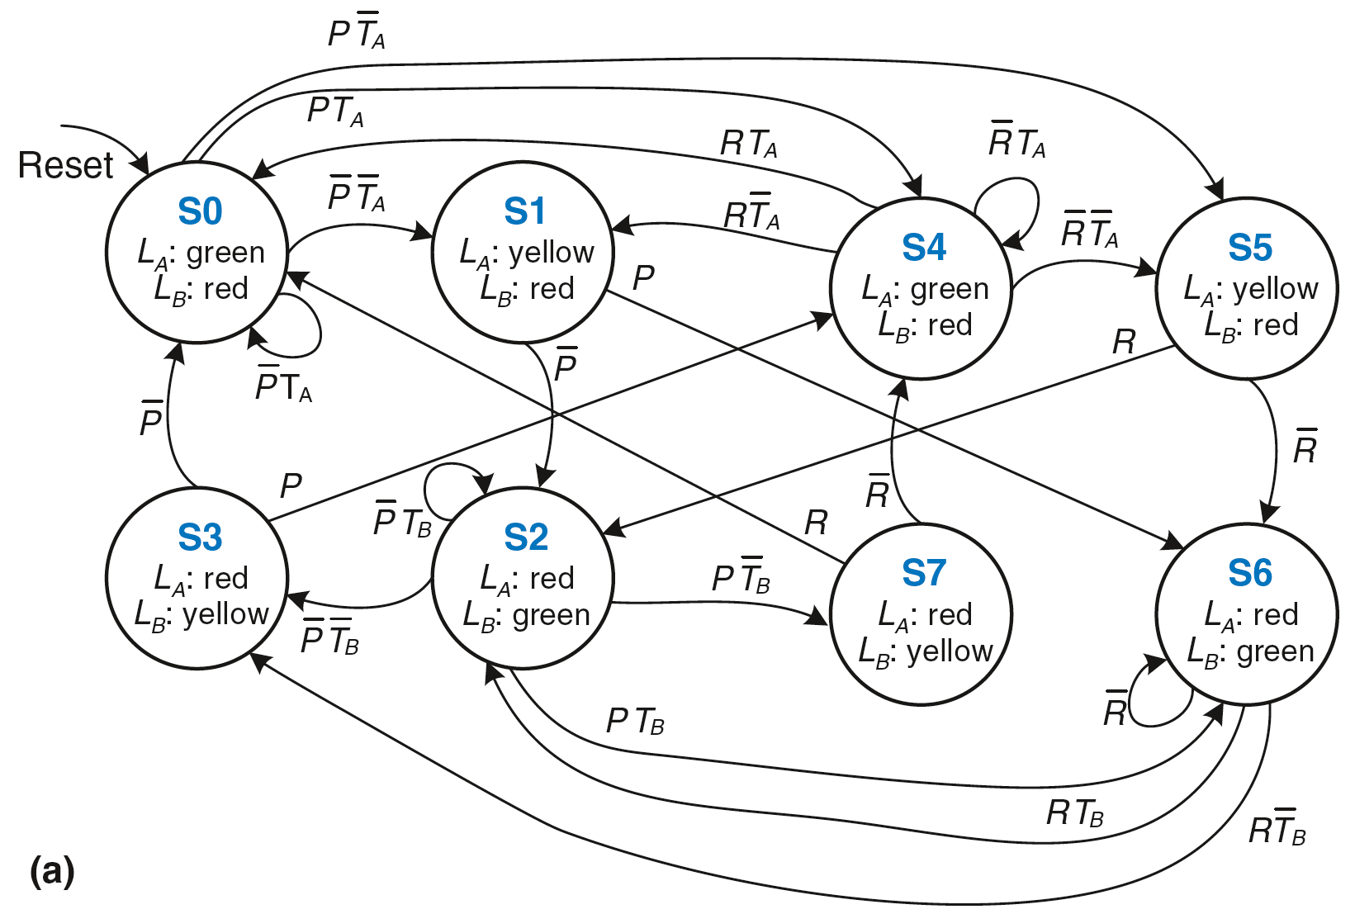
Unfactored FSM

Slide 29
Factored FSM

Slide 30
FSM Design Procedure
Identify inputs and outputs
Sketch state transition diagram
Write state transition table
Select state encodings
For Moore machine:
  Rewrite state transition table with state encodings
  Write output table
5. For a Mealy machine:
  Rewrite combined state transition and output table with state encodings
6. Write Boolean equations for next state and output logic
7. Sketch the circuit schematic

