Slide 1
Lecture 23: Advanced Microarchitecture
E85 Digital Design & Computer Engineering

Slide 2
Advanced Microarchitecture
Deep Pipelining
Micro-operations
Branch Prediction
Superscalar Processors
Out of Order Processors
Register Renaming
SIMD
Multithreading
Multiprocessors

Slide 3
Deep Pipelining
10-20 stages typical
Number of stages limited by:
Pipeline hazards
Sequencing overhead
Power
Cost

Slide 4
Micro-operations
Decompose more complex instructions into a series of simple instructions called micro-operations (micro-ops or µ-ops)
At run-time, complex instructions are decoded into one or more micro-ops
Used heavily in CISC (complex instruction set computer) architectures (e.g., x86)
Used for some ARM instructions, for example:
Complex Op Micro-op Sequence
LDR R1, [R2], #4 LDR R1, [R2]
ADD R2, R2, #4
Without u-ops, would need 2nd write port on the register file

Slide 5
Micro-operations
Allow for dense code (fewer memory accesses)
Yet preserve simplicity of RISC hardware
ARM strikes balance by choosing instructions that:
Give better code density than pure RISC instruction sets (such as MIPS)
Enable more efficient decoding than CISC instruction sets (such as x86)

Slide 6
Branch Prediction
Guess whether branch will be taken
Backward branches are usually taken (loops)
Consider history to improve guess
Good prediction reduces fraction of branches requiring a flush

Slide 7
Branch Prediction
Ideal pipelined processor: CPI = 1
Branch misprediction increases CPI
Static branch prediction:
Check direction of branch (forward or backward)
If backward, predict taken
Else, predict not taken
Dynamic branch prediction:
Keep history of last several hundred (or thousand) branches in branch target buffer, record:
Branch destination
Whether branch was taken

Slide 8
Branch Prediction Example
MOV R1, #0 ; R1 = sum
MOV R0, #0 ; R0 = i
FOR ; for (i=0; i<10; i=i+1)
CMP R0, #10
BGE DONE
ADD R1, R1, R0 ; sum = sum + i
ADD R0, R0, #1
B FOR
DONE

Slide 9
1-Bit Branch Predictor
Remembers whether branch was taken the last time and does the same thing
Mispredicts first and last branch of loop

Slide 10
2-Bit Branch Predictor
Only mispredicts last branch of loop

Slide 11
Superscalar
Multiple copies of datapath execute multiple instructions at once
Dependencies make it tricky to issue multiple instructions at once

Slide 12
Superscalar Example
Ideal IPC: 2
Actual IPC: 2

Slide 13
Superscalar with Dependencies
Ideal IPC: 2
Actual IPC: 6/5 = 1.2

Slide 14
Out of Order Processor
Looks ahead across multiple instructions
Issues as many instructions as possible at once
Issues instructions out of order (as long as no dependencies)
Dependencies:
RAW (read after write): one instruction writes, later instruction reads a register
WAR (write after read): one instruction reads, later instruction writes a register
WAW (write after write): one instruction writes, later instruction writes a register

Slide 15
Out of Order Processor
Instruction level parallelism (ILP): number of instruction that can be issued simultaneously (average < 3)
Scoreboard: table that keeps track of:
Instructions waiting to issue
Available functional units
Dependencies

Slide 16
Out of Order Processor Example
LDR R8, [R0, #40]
ADD R9, R8, R1
SUB R8, R2, R3 Ideal IPC: 2
AND R10, R4, R8 Actual IPC: 6/4 = 1.5
ORR R11, R5, R6
STR R7, [R11, #80]

Slide 17
Register Renaming
LDR R8, [R0, #40]
ADD R9, R8, R1
SUB R8, R2, R3 Ideal IPC: 2
AND R10, R4, R8 Actual IPC: 6/3 = 2
ORR R11, R5, R6
STR R7, [R11, #80]

Slide 18
SIMD
Single Instruction Multiple Data (SIMD)
Single instruction acts on multiple pieces of data at once
Common application: graphics
Perform short arithmetic operations (also called packed arithmetic)
For example, add eight 8-bit elements

Slide 19
Advanced Architecture Techniques
Multithreading
Word processor: thread for typing, spell checking, printing
Multiprocessors
Multiple processors (cores) on a single chip

Slide 20
Threading: Definitions
Process: program running on a computer
Multiple processes can run at once: e.g., surfing Web, playing music, writing a paper
Thread: part of a program
Each process has multiple threads: e.g., a word processor may have threads for typing, spell checking, printing

Slide 21
Threads in Conventional Processor
One thread runs at at at a time
When one thread stalls (for example, waiting for memory):
Architectural state of that thread stored
Architectural state of waiting thread loaded into processor and it runs
Called context switching
Appears to user like all threads running simultaneously

Slide 22
Multithreading
Multiple copies of architectural state
Multiple threads active at once:
When one thread stalls, another runs immediately
If one thread can’t keep all execution units busy, another thread can use them
Does not increase instruction-level parallelism (ILP) of single thread, but increases throughput
Intel calls this “hyperthreading”

Slide 23
Multiprocessors
Multiple processors (cores) with a method of communication between them
Types:
Homogeneous: multiple cores with shared main memory
Heterogeneous: separate cores for different tasks (for example, DSP and CPU in cell phone)
Clusters: each core has own memory system

Slide 24
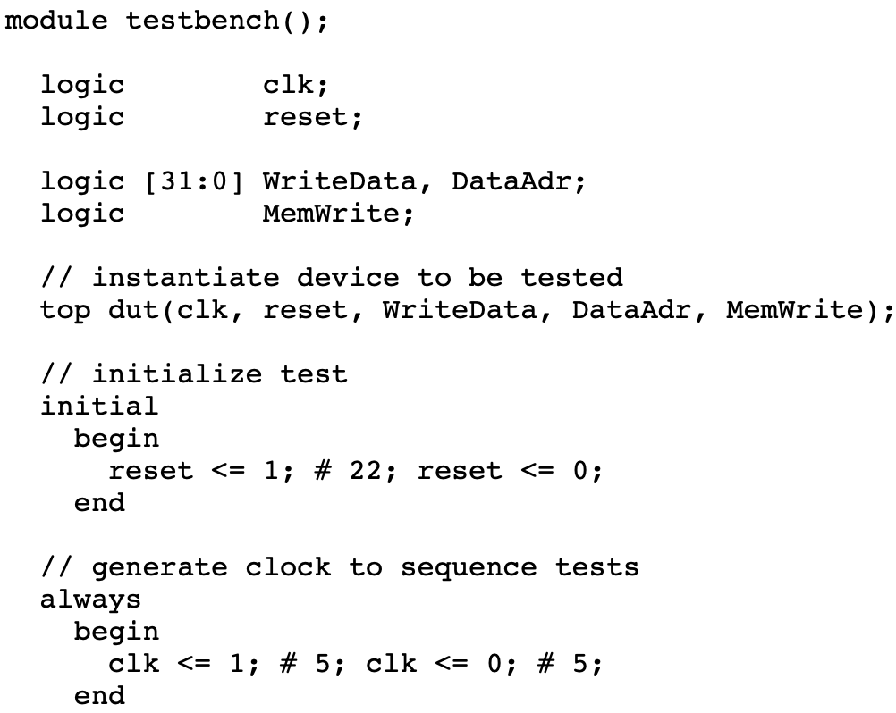
Multicycle Processor Test Bench

Slide 25
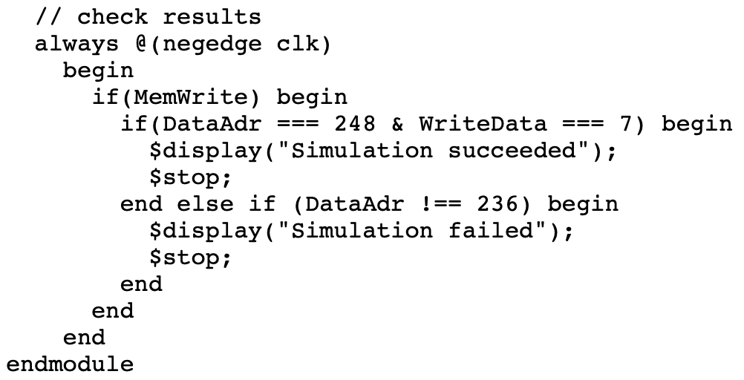
Multicycle Processor Test Bench

Slide 26
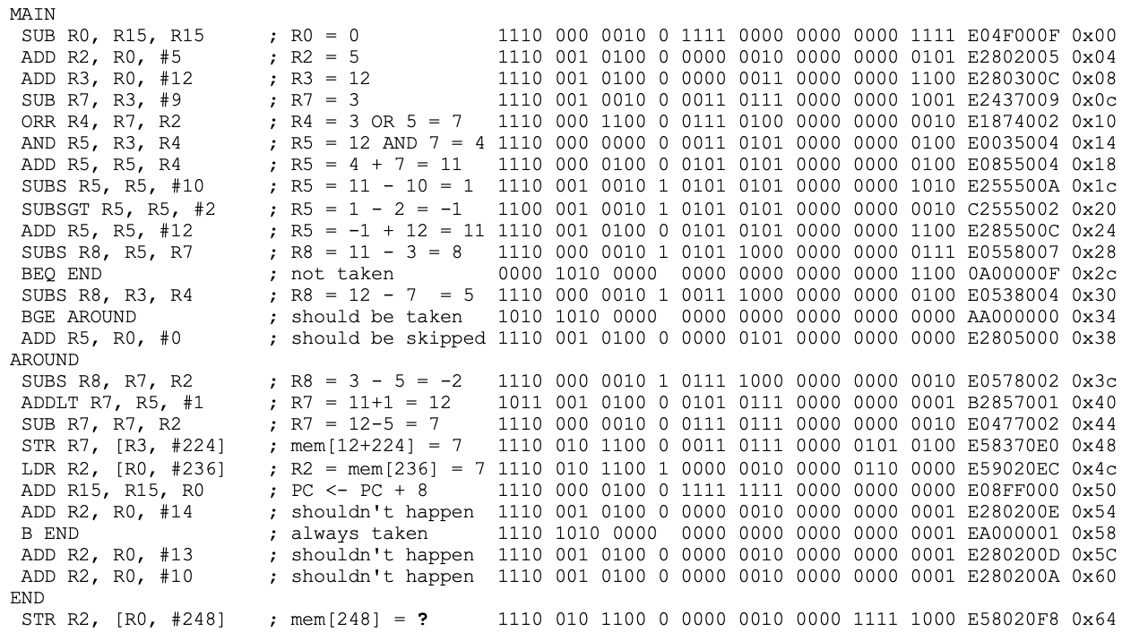
Multicycle Processor Test Program

Slide 27
Multicycle Processor Memory
E04F000F E2802005 E280300C E2437009 E1874002 E0035004 E0855004 E255500A C2555002 E285500C E0558007 0A00000C E0538004 AA000000 E2805000 E0578002 B2857001 E0477002 E58370E0 E59020EC E08FF000 E280200E EA000001 E280200D E280200A E58020F8
initial
$readmemh("memfile.dat",RAM);

