Slide 1
Lecture 17: Function Calls
E85
Digital Electronics & Computer Architecture

Slide 2
Function Calls
Caller: calling function (in this case, main)
Callee: called function (in this case, sum)
C Code
void main()
{
int y;
y = sum(42, 7);
...
}
int sum(int a, int b)
{
return (a + b);
}

Slide 3
Function Conventions
Caller:
passes arguments to callee
jumps to callee
Callee:
performs the function
returns result to caller
returns to point of call
must not overwrite registers or memory needed by caller

Slide 4
RISC-V Function Conventions
Call Function: jump and link (jal)
Return from function: jump register (jr ra)
Arguments: a0 – a7
Return value: a0
Name | Register Number | Usage
zero | x0 | Constant value 0
ra | x1 | Return address
sp | x2 | Stack pointer
gp | x3 | Global pointer
tp | x4 | Thread pointer
t0-2 | x5-7 | Temporaries
s0/fp | x8 | Saved register / Frame pointer
s1 | x9 | Saved register
a0-1 | x10-11 | Function arguments / return values
a2-7 | x12-17 | Function arguments
s2-11 | x18-27 | Saved registers
t3-6 | x28-31 | Temporaries

Slide 5
Function Calls
C Code
int main() {
simple();
a = b + c;
}
void simple() {
return;
}
RISC-V assembly code
0x00000300 main: jal ra, simple # call
0x00000304 add s0, s1, s1
... ...
0x0000051c simple: jr ra # return
void means that simple doesn’t return a value

Slide 6
Function Calls
C Code
int main() {
simple();
a = b + c;
}
void simple() {
return;
}
RISC-V assembly code
0x00000300 main: jal ra, simple # call
0x00000304 add s0, s1, s1
... ...
0x0000051c simple: jr ra # return
jal ra, simple:
ra = PC + 4 (0x00000304)
jumps to simple label (PC = 0x0000051c)
jr ra:
PC = ra (0x00000304)

Slide 7
Function Calls
C Code
int main() {
simple();
a = b + c;
}
void simple() {
return;
}
RISC-V assembly code
0x00000300 main: jal simple # call
0x00000304 add s0, s1, s1
... ...
0x0000051c simple: jr ra # return
Preferred instruction:
jal simple - a pseudoinstruction for jal ra, simple
Pseudoinstructions are not actual RISC-V instructions but they are often simpler for the programmer.
They are converted to real RISC-V instructions by the assembler

Slide 8
Function Conventions
Caller:
passes arguments to callee
jumps to callee
Callee:
performs the function
returns result to caller
returns to point of call
must not overwrite registers or memory needed by caller

Slide 9
RISC-V Function Conventions
Call Function: jump and link (jal)
Return from function: jump and link register (jr ra)
Arguments: a0 – a7
Return value: a0

Slide 10
Input Arguments & Return Value
C Code
int main()
{
int y;
...
y = diffofsums(2, 3, 4, 5); // 4 arguments
...
}
int diffofsums(int f, int g, int h, int i)
{
int result;
result = (f + g) - (h + i);
return result; // return value
}

Slide 11
Input Arguments & Return Value
RISC-V assembly code
# s7 = y
main:
. . .
addi a0, zero, 2 # argument 0 = 2
addi a1, zero, 3 # argument 1 = 3
addi a2, zero, 4 # argument 2 = 4
addi a3, zero, 5 # argument 3 = 5
jal diffofsums # call function
add s7, a0, zero # y = returned value
. . .
# s3 = result
diffofsums:
add t0, a0, a1 # t0 = f + g
add t1, a2, a3 # t1 = h + i
sub s3, t0, t1 # result = (f + g) − (h + i)
add a0, s3, zero # put return value in a0
jr ra # return to caller
jal diffofsums
is pseudocode for
jal ra, diffofsums

Slide 12
Input Arguments & Return Value
RISC-V assembly code
# s3 = result
diffofsums:
add t0, a0, a1 # t0 = f + g
add t1, a2, a3 # t1 = h + i
sub s3, t0, t1 # result = (f + g) − (h + i)
add a0, s3, zero # put return value in a0
jr ra # return to caller
diffofsums overwrote 3 registers: t0, t1, s3
diffofsums can use the stack to temporarily store registers

Slide 13
The Stack
Memory used to temporarily save variables
Like stack of dishes, last-in-first-out (LIFO) queue
Expands: uses more memory when more space needed
Contracts: uses less memory when the space is no longer needed

Slide 14
The Stack
Grows down (from higher to lower memory addresses)
Stack pointer: sp points to top of the stack

Slide 15
How Functions use the Stack
Called functions must have no unintended side effects
But diffofsums overwrites 3 registers: t0, t1, s3
# RISC-V assembly
# s3 = result
diffofsums:
add t0, a0, a1 # t0 = f + g
add t1, a2, a3 # t1 = h + i
sub s3, t0, t1 # result = (f + g) − (h + i)
add a0, s3, zero # put return value in a0
jr ra # return to caller

Slide 16
Storing Register Values on the Stack
# s3 = result
diffofsums:
addi sp, sp, -12 # make space on stack to
# store three registers
sw s3, 8(sp) # save s3 on stack
sw t0, 4(sp) # save t0 on stack
sw t1, 0(sp) # save t1 on stack
add t0, a0, a1 # t0 = f + g
add t1, a2, a3 # t1 = h + i
sub s3, t0, t1 # result = (f + g) − (h + i)
add a0, s3, zero # put return value in a0
lw t1, 0(sp) # restore $t1 from stack
lw t0, 4(sp) # restore $t0 from stack
lw s3, 8(sp) # restore $s3 from stack
addi sp, sp, 12 # deallocate stack space
jr ra # return to caller

Slide 17
The Stack During diffofsums Call

Slide 18
Register Saving Conventions
Preserved Callee-Saved | Nonpreserved Caller-Saved
s0-s11 | t0-t6
sp | ra
stack above sp | a0-a7
 | stack below sp

Slide 19
Storing Saved Registers on the Stack
# s3 = result
diffofsums:
addi sp, sp, -4 # make space on stack to
# store one register
sw s3, 0(sp) # save s3 on stack
add t0, a0, a1 # t0 = f + g
add t1, a2, a3 # t1 = h + i
sub s3, t0, t1 # result = (f + g) − (h + i)
add a0, s3, zero # put return value in a0
lw s3, 0(sp) # restore $s3 from stack
addi sp, sp, 4 # deallocate stack space
jr ra # return to caller

Slide 20
Optimized diffofsums
# a0 = result
diffofsums:
add t0, a0, a1 # t0 = f + g
add t1, a2, a3 # t1 = h + i
sub a0, t0, t1 # result = (f + g) − (h + i)
jr ra # return to caller

Slide 21
Non-Leaf Function Calls
Non-leaf function:
a function that calls another function
func1:
addi sp, sp, -4 # make space on stack
sw ra, 0(sp) # save ra on stack
jal func2
...
lw ra, 0(sp) # restore ra from stack
addi sp, sp, 4 # deallocate stack space
jr ra # return to caller

Slide 22
Function Call Summary
Caller
Put arguments in a0-a7
Save any needed registers (ra, maybe t0-t6)
Call function: jal callee
(Possibly restore registers)
Look for result in a0
Callee
Save registers that might be disturbed (s0-s11)
Perform function
Put result in a0
Restore registers
Return: jr ra

Slide 23
Recursive Functions
int factorial(int n) {
if (n <= 1)
return 1;
else
return (n * factorial(n − 1));
}

Slide 24
Recursive Functions
0x8500 factorial: addi sp, sp, -8 # make room for a0, ra
0x8504 sw a0, 4(sp)
0x8508 sw ra, 0(sp)
0x850C addi t0, zero, 1 # temporary = 1
0x8510 bgt a0, t0, else # if n>1, go to else
0x8514 addi a0, zero, 1 # otherwise, return 1
0x8518 addi sp, sp, 8 # restore sp
0x851C jr ra # return
0x8520 else: addi a0, a0, -1 # n = n − 1
0x8524 jal factorial # recursive call
0x8528 lw ra, 0(sp) # restore ra
0x852C lw t1, 4(sp) # restore n into t1
0x8530 addi sp, sp, 8 # restore sp
0x8534 mul a0, t1, a0 # a0 = n*factorial(n−1)
0x8538 jr ra # return

Slide 25
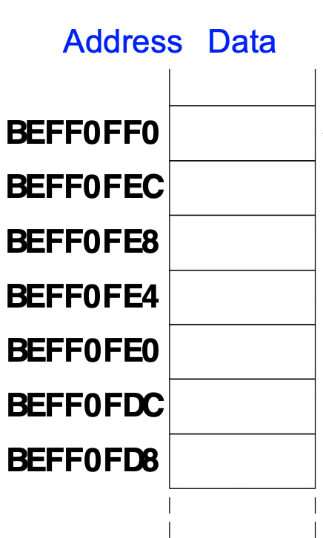
Recursive Functions
What does the stack look like when executing factorial(3)?
0x8500 factorial: addi sp, sp, -8
0x8504 sw a0, 4(sp)
0x8508 sw ra, 0(sp)
0x850C addi t0, zero, 1
0x8510 bgt a0, t0, else
0x8514 addi a0, zero, 1
0x8518 addi sp, sp, 8
0x851C jr ra
0x8520 else: addi a0, a0, -1
0x8524 jal factorial
0x8528 lw ra, 0(sp)
0x852C lw t1, 4(sp)
0x8530 addi sp, sp, 8
0x8534 mul a0, t1, a0
0x8538 jr ra

Slide 26
Recursive Functions
Stack (a) before, (b) during, and (c) after recursive call.

