Slide 1
Lecture 16: RISC-V Assembly Language
E85
Digital Electronics & Computer Architecture

Slide 2
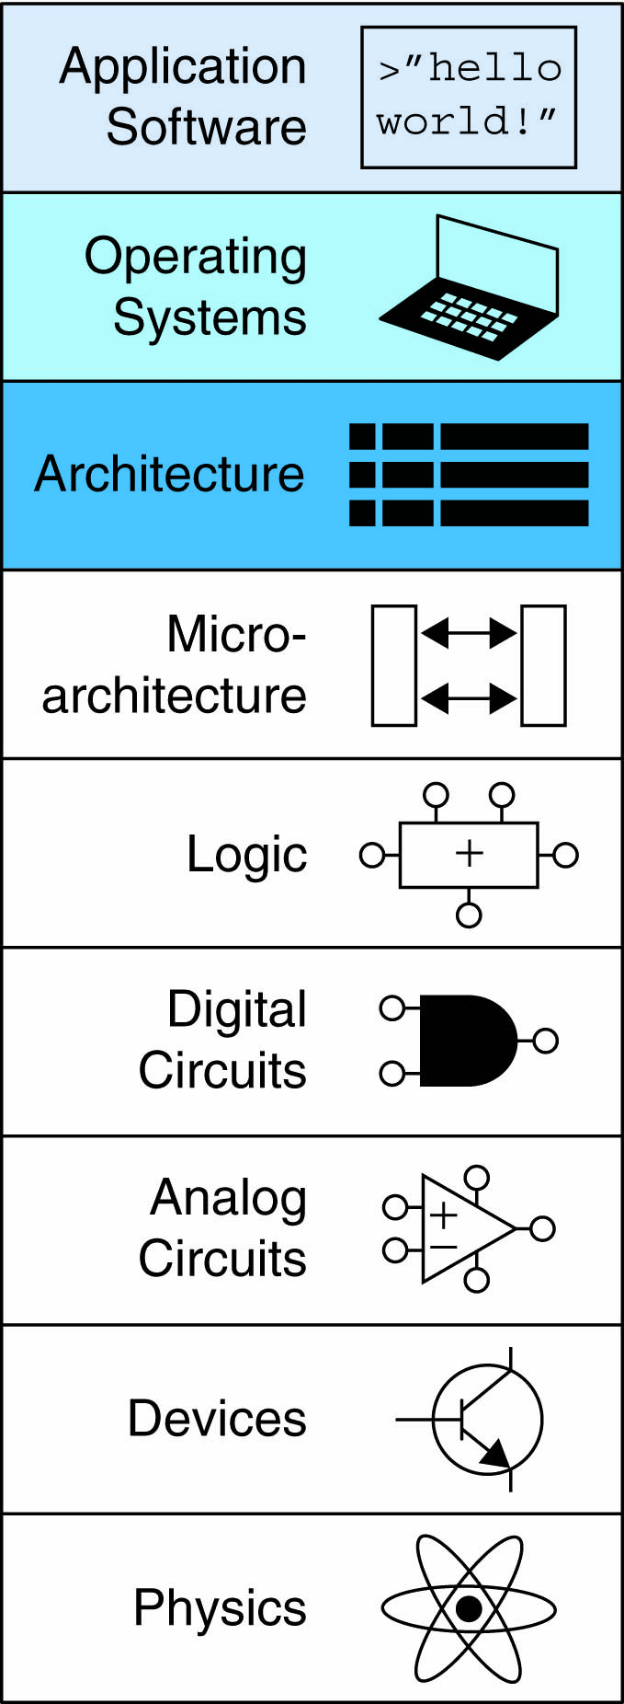
Lecture 16
Introduction
Instruction Set Architecture (ISA)
RISC-V History
RISC-V Assembly Language
Instructions
Register Set
Memory
Programming constructs

Slide 3
Lecture 16
Introduction
Instruction Set Architecture (ISA)
RISC-V History
RISC-V Assembly Language
Instructions
Register Set
Memory
Programming constructs

Slide 4
Introduction
Jumping up a few levels of abstraction
Architecture: programmer’s view of computer
Defined by instructions & operand locations
Microarchitecture: how to implement an architecture in hardware (covered in Chapter 7)

Slide 5
Assembly Language
Instructions: commands in a computer’s language
Assembly language: human-readable format of instructions
Machine language: computer-readable format (1’s and 0’s)
RISC-V architecture:
Developed by Krste Asanovic, David Patterson and their colleagues at UC Berkeley in 2010.
First open-source computer architecture
Once you’ve learned one architecture, it’s easier to learn others

Slide 6
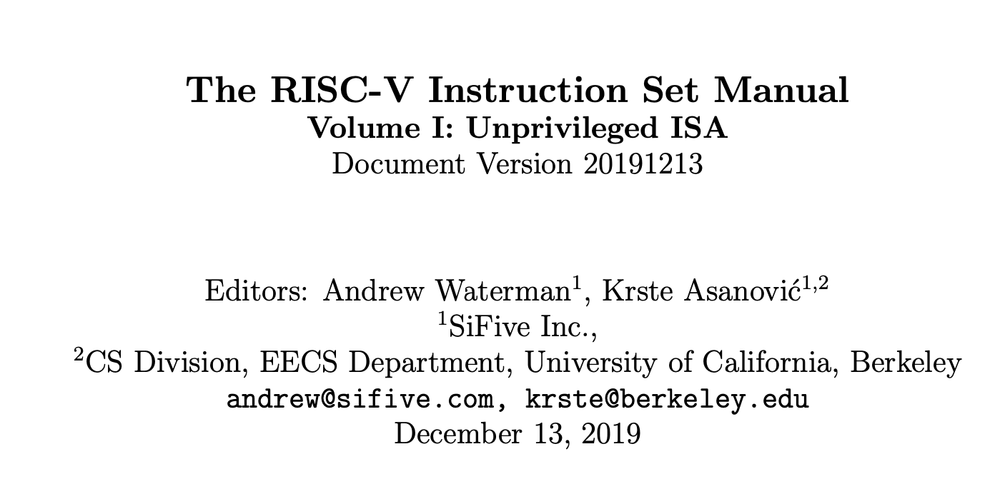
Instruction Set Architecture Manual
RISC-V ISA Manual available at: https://riscv.org/specifications/isa-spec-pdf/
Details base integer ISA along with optional extensions
Gives not only the specs but also some helpful rationale and reasoning behind the decisions

Slide 7
Krste Asanovic
Professor of Computer Science at the University of California, Berkeley
Developed RISC-V during one summer
Chairman of the Board of the RISC-V Foundation
Co-Founder of SiFive, a company that commercializes and develops supporting tools for RISC-V

Slide 8
David Patterson
Professor of Computer Science at the University of California, Berkeley since 1976
Coinvented the Reduced Instruction Set Computer (RISC) with John Hennessy in the 1980’s
Developed the RISC architecture at Berkeley in 1984, which was later commercialized as SPARC architecture

Slide 9
Architecture Design Principles
Underlying design principles, as articulated by Hennessy and Patterson:
Simplicity favors regularity
Make the common case fast
Smaller is faster
Good design demands good compromises

Slide 10
Lecture 16
Introduction
Instruction Set Architecture (ISA)
RISC-V History
RISC-V Assembly Language
Instructions
Register Set
Memory
Programming constructs

Slide 11
Instructions: Addition
add: mnemonic indicates operation to perform
b, c: source operands (on which the operation is performed)
a: destination operand (to which the result is written)
C Code
a = b + c;
RISC-V assembly code
add a, b, c

Slide 12
Instructions: Subtraction
Similar to addition - only mnemonic changes
sub: mnemonic
b, c: source operands
a: destination operand
C Code
a = b - c;
RISC-V assembly code
sub a, b, c

Slide 13
Design Principle 1
Simplicity favors regularity
Consistent instruction format
Same number of operands (two sources and one destination)
Easier to encode and handle in hardware

Slide 14
Multiple Instructions
More complex code is handled by multiple RISC-V instructions.
C Code
a = b + c - d;
RISC-V assembly code
add t, b, c # t = b + c
sub a, t, d # a = t - d

Slide 15
Design Principle 2
Make the common case fast
RISC-V includes only simple, commonly used instructions
Hardware to decode and execute instructions can be simple, small, and fast
More complex instructions (that are less common) performed using multiple simple instructions
RISC-V is a reduced instruction set computer (RISC), with a small number of simple instructions
Other architectures, such as Intel’s x86, are complex instruction set computers (CISC)

Slide 16
Operands
Operand location: physical location in computer
Registers
Memory
Constants (also called immediates)

Slide 17
Operands: Registers
RISC-V has 32 32-bit registers
Registers are faster than memory
RISC-V called “32-bit architecture” because it operates on 32-bit data

Slide 18
Design Principle 3
Smaller is Faster
RISC-V includes only a small number of registers

Slide 19
RISC-V Register Set
Name | Register Number | Usage
zero | x0 | Constant value 0
ra | x1 | Return address
sp | x2 | Stack pointer
gp | x3 | Global pointer
tp | x4 | Thread pointer
t0-2 | x5-7 | Temporaries
s0/fp | x8 | Saved register / Frame pointer
s1 | x9 | Saved register
a0-1 | x10-11 | Function arguments / return values
a2-7 | x12-17 | Function arguments
s2-11 | x18-27 | Saved registers
t3-6 | x28-31 | Temporaries

Slide 20
Operands: Registers
Registers:
Can use either name (i.e., ra, zero) or x0, x1, etc.
Using name is preferred
Registers used for specific purposes:
zero always holds the constant value 0.
the saved registers, s0-s11, used to hold variables
the temporary registers, t0-t6, used to hold intermediate values during a larger computation
Discuss others later

Slide 21
Instructions with Registers
Revisit add instruction
C Code
a = b + c
RISC-V assembly code
# s0 = a, s1 = b, s2 = c
add s0, s1, s2
# indicates a single-line comment

Slide 22
Operands: Memory
Too much data to fit in only 32 registers
Store more data in memory
Memory is large, but slow
Commonly used variables kept in registers

Slide 23
Memory
First, we’ll discuss word-addressable memory
Then we’ll discuss byte-addressable memory
RISC-V is byte-addressable

Slide 24
Word-Addressable Memory
Each 32-bit data word has a unique address
Note: RISC-V uses byte-addressable memory, which we’ll talk about next.

Slide 25
Reading Word-Addressable Memory
Memory read called load
Mnemonic: load word (lw)
Format:
lw <rd>, <offset>(<base register>)
lw t1, 5(s0)
Address calculation:
add offset (5) to the base address (s0)
address = (s0 + 5)
Destination register (rd):
t1 holds the value at address (s0 + 5)
Any register may be used as base address

Slide 26
Reading Word-Addressable Memory
Example: read a word of data at memory address 1 into s3
address = (0 + 1) = 1
s3 = 0xF2F1AC07 after load
Assembly code
lw s3, 1(zero) # read memory word 1 into s3

Slide 27
Writing Word-Addressable Memory
Memory write are called store
Mnemonic: store word (sw)
Format similar to load
sw <src1>, <offset>(<base register>)

Slide 28
Writing Word-Addressable Memory
Example: Write (store) the value in t4 into memory address 7
add the base address (zero) to the offset (0x7)
address: (0 + 0x7) = 7
Offset can be written in decimal (default) or hexadecimal
Assembly code
sw t4, 0x7(zero) # write the value in t4
# to memory word 7

Slide 29
Byte-Addressable Memory
Each data byte has unique address
Load/store words or single bytes: load byte (lb) and store byte (sb)
32-bit word = 4 bytes, so word address increments by 4

Slide 30
Reading Byte-Addressable Memory
The address of a memory word must now be multiplied by 4. For example,
the address of memory word 2 is 2 × 4 = 8
the address of memory word 10 is 10 × 4 = 40 (0x28)
RISC-V is byte-addressed, not word-addressed

Slide 31
Reading Byte-Addressable Memory
Example: Load a word of data at memory address 4 into s3.
s3 holds the value 0xF2F1AC07 after load
RISC-V assembly code
lw s3, 4(zero) # read word at address 4 into s3

Slide 32
Writing Byte-Addressable Memory
Example: stores the value held in t7 into memory address 0x2C (44)
RISC-V assembly code
sw t7, 44(zero) # write t7 into address 44

Slide 33
Big-Endian & Little-Endian Memory
How to number bytes within a word?
Little-endian: byte numbers start at the little (least significant) end
Big-endian: byte numbers start at the big (most significant) end
Word address is the same for big- or little-endian

Slide 34
Big-Endian & Little-Endian Memory
Jonathan Swift’s Gulliver’s Travels: the Little-Endians broke their eggs on the little end of the egg and the Big-Endians broke their eggs on the big end
It doesn’t really matter which addressing type used – except when the two systems need to share data!

Slide 35
Big-Endian & Little-Endian Example
Suppose t0 initially contains 0x23456789
After following code runs on big-endian system, what value is s0?
In a little-endian system?
sw t0, 0(zero)
lb s0, 1(zero)

Slide 36
Big-Endian & Little-Endian Example
Suppose t0 initially contains 0x23456789
After following code runs on big-endian system, what value is s0?
In a little-endian system?
sw t0, 0(zero)
lb s0, 1(zero)
Big-endian: s0 = 0x00000045
Little-endian: s0 = 0x00000067

Slide 37
Programming
High-level languages:
e.g., C, Java, Python
Written at higher level of abstraction
Common high-level software constructs:
if/else statements
for loops
while loops
arrays
function calls

Slide 38
Ada Lovelace, 1815-1852
Wrote the first computer program
Her program calculated the Bernoulli numbers on Charles Babbage’s Analytical Engine
She was the daughter of the poet Lord Byron

Slide 39
Branching
Execute instructions out of sequence
Types of branches:
Conditional
branch if equal (beq)
branch if not equal (bne)
branch if less than (blt/bltu)
branch if greater than or equal to (bge/bgeu)
Unconditional
jump (j)
jump register (jr)
jump and link (jal)
jump and link register (jalr)
Will talk about these when we discuss function calls

Slide 40
Conditional Branching (beq)
# RISC-V assembly
addi s0, zero, 4 # s0 = 0 + 4 = 4
addi s1, zero, 1 # s1 = 0 + 1 = 1
slli s1, s1, 2 # s1 = 1 << 2 = 4
beq s0, s1, target # branch is taken
addi s1, s1, 1 # not executed
sub s1, s1, s0 # not executed
target: # label
add s1, s1, s0 # s1 = 4 + 4 = 8
Labels indicate instruction location. They can’t be reserved words and must be followed by colon (:)

Slide 41
The Branch Not Taken (bne)
# RISC-V assembly
addi s0, zero, 4 # s0 = 0 + 4 = 4
addi s1, zero, 1 # s1 = 0 + 1 = 1
slli s1, s1, 2 # s1 = 1 << 2 = 4
bne s0, s1, target # branch not taken
addi s1, s1, 1 # s1 = 4 + 1 = 5
sub s1, s1, s0 # s1 = 5 – 4 = 1
target:
add s1, s1, s0 # s1 = 1 + 4 = 5

Slide 42
Other Conditional Branches
Branch if less than (blt/bltu)
blt s0, s1, target # branches if s0 < s1 (signed)
bltu s0, s1, target # same as blt but interprets # s0 and s1 as unsigned
Branch if less than (bge/bgeu)
bge s0, s1, target # branches if s0 > s1 (signed)
bgeu s0, s1, target # branches if s0 > s1 (unsigned)

Slide 43
Unconditional Branching (j)
# RISC-V assembly
j target # jump to target
srai s1, s1, 2 # not executed
addi s1, s1, 1 # not executed
sub s1, s1, s0 # not executed
target:
add s1, s1, s0 # s1 = 1 + 4 = 5

Slide 44
Programming
High-level constructs: loops, conditional statements
First, introduce:
Logical operations
Shifty instructions
Generating constants
Multiplication

Slide 45
Logical Instructions
and, or, xor
and: useful for masking bits
Masking all but the least significant byte of a value:
0xF234012F AND 0x000000FF = 0x0000002F
or: useful for combining bit fields
Combine 0xF2340000 with 0x000012BC:
0xF2340000 OR 0x000012BC = 0xF23412BC
xor: useful for inverting bits:
A xor -1 = NOT A (remember that -1 = 0xFFFFFFFF)

Slide 46
Logical Instructions Example 1

Slide 47
Logical Instructions Example 2
-1484 = 0xA34 in 12-bit 2’s complement representation.

Slide 48
Shift Instructions
Shift amount is in (lowest 5 bits of) a register
sll: shift left logical
Example: sll t0, t1, t2 # t0 = t1 << t2
srl: shift right logical
Example: srl t0, t1, t2 # t0 = t1 >> t2
sra: shift right arithmetic
Example: sra t0, t1, t2 # t0 = t1 >>> t2

Slide 49
Immediate Shift Instructions
Shift amount is an immediate between 0 to 31
slli: shift left logical immediate
Example: slli t0, t1, 23 # t0 = t1 << 23
srli: shift right logical immediate
Example: srli t0, t1, 18 # t0 = t1 >> 18
srai: shift right arithmetic imeediate
Example: srai t0, t1, 5 # t0 = t1 >>> 5

Slide 50
Generating Constants
12-bit signed constants using addi:
Any immediate that needs more than 12 bits cannot use this method.
C Code
// int is a 32-bit signed word
int a = -372;
RISC-V assembly code
# s0 = a
addi s0, 0, -372

Slide 51
Generating 32-bit Constants
Use load upper immediate (lui) and addi:
lui: puts an immediate in the upper 20 bits of destination register, 0’s in lower 12 bits
C Code
int a = 0xFEDC8765;
RISC-V assembly code
# s0 = a
lui s0, 0xFEDC8
addi s0, s0, 0x765
Remember that addi sign-extends its 12-bit immediate

Slide 52
Generating 32-bit Constants
If bit 11 of 32-bit constant is 1, increment upper 20 bits by 1 in lui
C Code
int a = 0xFEDC8EAB;
Note: -341 = 0xEAB
RISC-V assembly code
# s0 = a
lui s0, 0xFEDC9 # s0 = 0xFEDC9000
addi s0, s0, -341 # s0 = 0xFEDC9000 + 0xFFFFFEAB
# = 0xFEDC8EAB

Slide 53
Multiplication
32 × 32 multiplication, 64-bit result
mul s0, s1, s2
s0 = lower 32 bits of result
mulh s0, s1, s2
s0 = upper 32 bits of result, treats operands as signed
mulhu s0, s1, s2
s0 = upper 32 bits of result, treats operands as
unsigned
mulhsu s0, s1, s2
s0 = upper 32 bits of result, treats s1 as signed, s3
as unsigned

Slide 54
Multiplication
32 × 32 multiplication, 64-bit result
For full 64-bit result:
mulh s4, s1, s2
mul s3, s1, s2
{s4, s3} = s1 x s2
Could also use mulhu or mulhsu instead of mulh

Slide 55
Division
32-bit division, 32-bit quotient, remainder
div s1, s2, s3 # s1 = s2/s3
divu s1, s2, s3 # unsigned division

Slide 56
High-Level Code Constructs
if statements
if/else statements
while loops
for loops

Slide 57
If Statement
C Code
if (i == j)
f = g + h;
f = f – i;
RISC-V assembly code
# s0 = f, s1 = g, s2 = h
# s3 = i, s4 = j
bne s3, s4, L1
add s0, s1, s2
L1:
sub s0, s0, s3
Assembly tests opposite case (i != j) of high-level code (i == j)

Slide 58
If/Else Statement
C Code
if (i == j)
f = g + h;
else
f = f – i;
RISC-V assembly code
# s0 = f, s1 = g, s2 = h
# s3 = i, s4 = j
bne s3, s4, L1
add s0, s1, s2
j done
L1:
sub s0, s0, s3
done:

Slide 59
While Loops
C Code
// determines the power
// of x such that 2^{x} = 128
int pow = 1;
int x = 0;
while (pow != 128) {
pow = pow * 2;
x = x + 1;
}
RISC-V assembly code
# s0 = pow, s1 = x
addi s0, zero, 1
add s1, zero, zero
addi t0, zero, 128
while:
beq s0, t0, done
slli s0, s0, 1
addi s1, s1, 1
j while
done:
Assembly tests for the opposite case (pow == 128) of the C code (pow != 128).

Slide 60
For Loops
for (initialization; condition; loop operation)
statement
initialization: executes before the loop begins
condition: is tested at the beginning of each iteration
loop operation: executes at the end of each iteration
statement: executes each time the condition is met

Slide 61
For Loops
C Code
// add the numbers from 0 to 9
int sum = 0;
int i;
for (i=0; i!=10; i = i+1) {
sum = sum + i;
}
RISC-V assembly code
# s0 = i, s1 = sum
addi s1, zero, 0
add s0, zero, zero
addi t0, zero, 10
for:
beq s0, t0, done
add s1, s1, s0
addi s0, s0, 1
j for
done:

Slide 62
Less Than Comparison
C Code
// add the powers of 2 from 1
// to 100
int sum = 0;
int i;
for (i=1; i < 101; i = i*2) {
sum = sum + i;
}
RISC-V assembly code
# s0 = i, s1 = sum
addi s1, zero, 0
addi s0, zero, 1
addi t0, zero, 101
loop:
bge s0, t0, done
add s1, s1, s0
slli s0, s0, 1
j loop
done:

Slide 63
Arrays
Access large amounts of similar data
Index: access each element
Size: number of elements

Slide 64
Arrays
5-element array
Base address = 0x12348000 (address of first element, array[0])
First step in accessing an array: load base address into a register

Slide 65
Accessing Arrays
// C Code
int array[5];
array[0] = array[0] * 2;
array[1] = array[1] * 2;
# RISC-V assembly code
# s0 = array base address
lui s0, 0x12348 # 0x12348 in upper 20 bits of s0
lw t1, 0(s0) # t1 = array[0]
slli t1, t1, 1 # t1 = t1 * 2
sw t1, 0(s0) # array[0] = t1
lw t1, 4(s0) # t1 = array[1]
slli t1, t1, 1 # t1 = t1 * 2
sw t1, 4(s0) # array[1] = t1

Slide 66
Arrays Using For Loops
// C Code
int array[1000];
int i;
for (i=0; i < 1000; i = i + 1)
array[i] = array[i] * 8;
# RISC-V assembly code
# s0 = array base address, s1 = i

Slide 67
Arrays Using For Loops
# RISC-V assembly code
# s0 = array base address, s1 = i
# initialization code
lui s0, 0x23B8F # s0 = 0x23B8F000
ori s0, s0, 0x400 # s0 = 0x23B8F400
addi s1, zero, 0 # i = 0
addi t2, zero, 1000 # t2 = 1000
loop:
bge s1, t2, done # if not then done
slli t0, s1, 2 # t0 = i * 4 (byte offset)
add t0, t0, s0 # address of array[i]
lw t1, 0(t0) # t1 = array[i]
slli t1, t1, 3 # t1 = array[i] * 8
sw t1, 0(t0) # array[i] = array[i] * 8
addi s1, s1, 1 # i = i + 1
j loop # repeat
done:

Slide 68
ASCII Code
American Standard Code for Information Interchange
Each text character has unique byte value
For example, S = 0x53, a = 0x61, A = 0x41
Lower-case and upper-case differ by 0x20 (32)

Slide 69
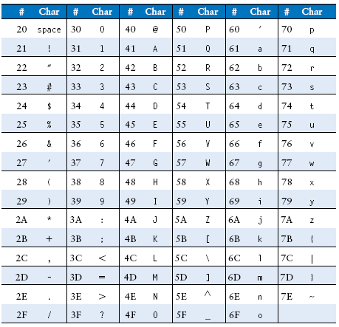
Cast of Characters

Slide 70
Unconditional Branching (jr)
# RISC-V assembly
0x00000200 addi s0, zero, 0x210
0x00000204 jr s0
0x00000208 addi s1, zero, 1 # not executed
0x0000020C sra s1, s1, 2 # not executed
0x00000210 lw s3, 44(s1)

Slide 71
Lecture 16
Introduction
Instruction Set Architecture (ISA)
RISC-V History
RISC-V Assembly Language
Instructions
Register Set
Memory
Programming constructs

