Slide 1

Lecture 13:
More C Programming
E85 Digital Design & Computer Engineering

Slide 2
Lecture 13
Structures
Memory
Pointers
Memory Allocation
Example: Variable Size Matrices

Slide 3
Structures
Store a collection of related information
General format:
  struct name {
  type1 element1;
  type2 element2;
  ...
  };

Slide 4
Structures
struct contact {
char name[30];
int phone;
float height; // in meters
};
struct contact c1;
Strcpy(c1.name, "Ben Bitdiddle”);
c1.phone = 7226993;
c1.height = 1.82;

Slide 5
Memory
Variables are stored in memory
Each data type has a size
  char 1 byte
  short 2 bytes
  long 4 bytes
  int native word size of machine
  (4 bytes on 32-bit computer)
  float 4 bytes
  double 8 bytes
Arrays stored in multiple consecutive locations

Slide 6
Typedef
If you’re using lots of the same structure, you can shorten your typing by using typedef.
typedef type name;
typedef struct contact {
char name[30];
int phone;
float height; // in meters
} contact; // defines contact as shorthand for "struct contact”
contact c1; // now we can declare the variable as type contact

Slide 7
Structure Examples
typedef struct point {
int x;
int y;
} point;
point p1;
p1.x = 42; p1.y = 9;
typedef struct rect {
point ll;
point ur;
int color;
} rect;
rect r1;
r1.color = 1;
r1.ll = p1;
r1.ur.x = r1.ll.x + width;
r1.ur.y = r1.ll.y + height;

Slide 8
Sizeof
Sizeof operator returns size of a datatype
char c;
double d;
point p;
rect r;
int s1 = sizeof c; // s1 = 1
int s2 = sizeof(d); // s2 = 8
int s3 = sizeof(p); // s3 = 4 + 4 = 8
int s4 = sizeof(r); // s4 = 8 + 8 + 4 = 20

Slide 9
Memory Example: Array

Slide 10
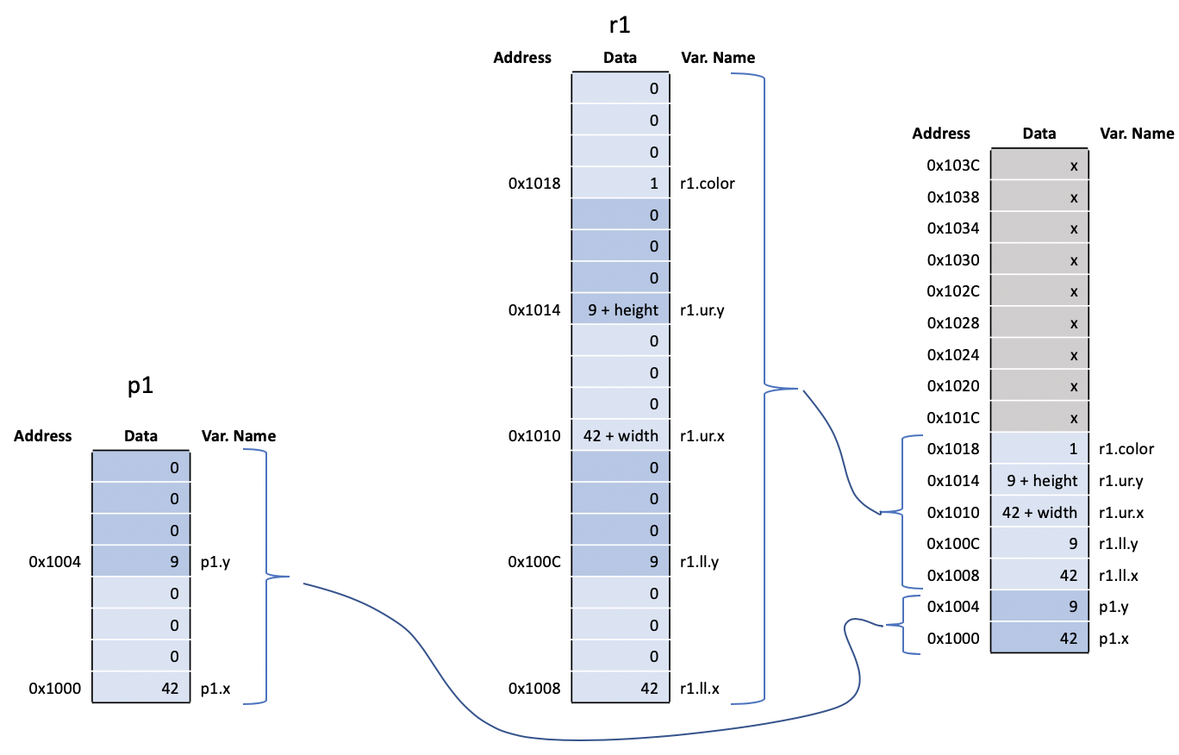
Memory Example: Structure

Slide 11
Pointers
A pointer is an address in memory
Pointer variables are declared with * and a data type to which the pointer points
  int salary1, salary2;
  int *ptr; // a pointer to an integer
& returns address of a variable
  salary1 = 98500; // suppose this is at address 100 in memory
  ptr = &salary1; // ptr contains 100 (the address of salary1)
* dereferences a pointer (finds value it points to)
  salary2 = *ptr + 1000; // salary2 gets 99500

Slide 12
Arrays and Pointers
An array in C is viewed as the address of the zeroth element
Equivalent to a pointer to the beginning of the array

Slide 13
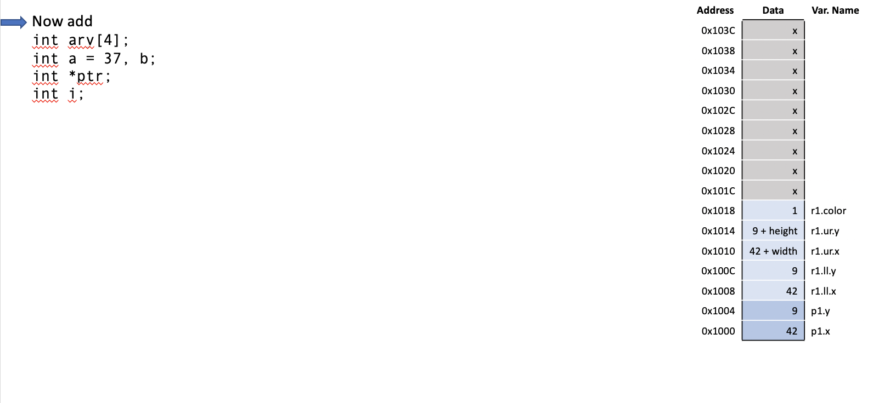
Pointer Example

Slide 14
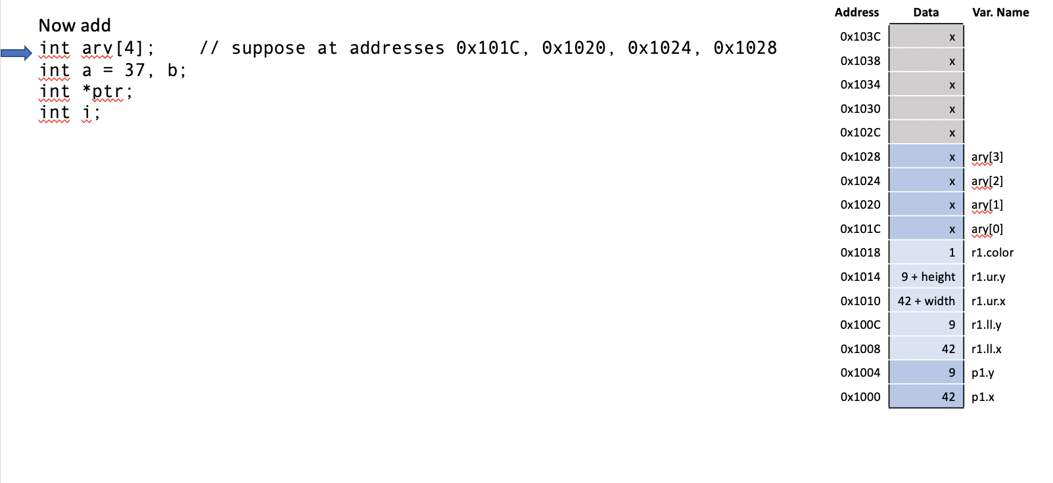
Pointer Example

Slide 15
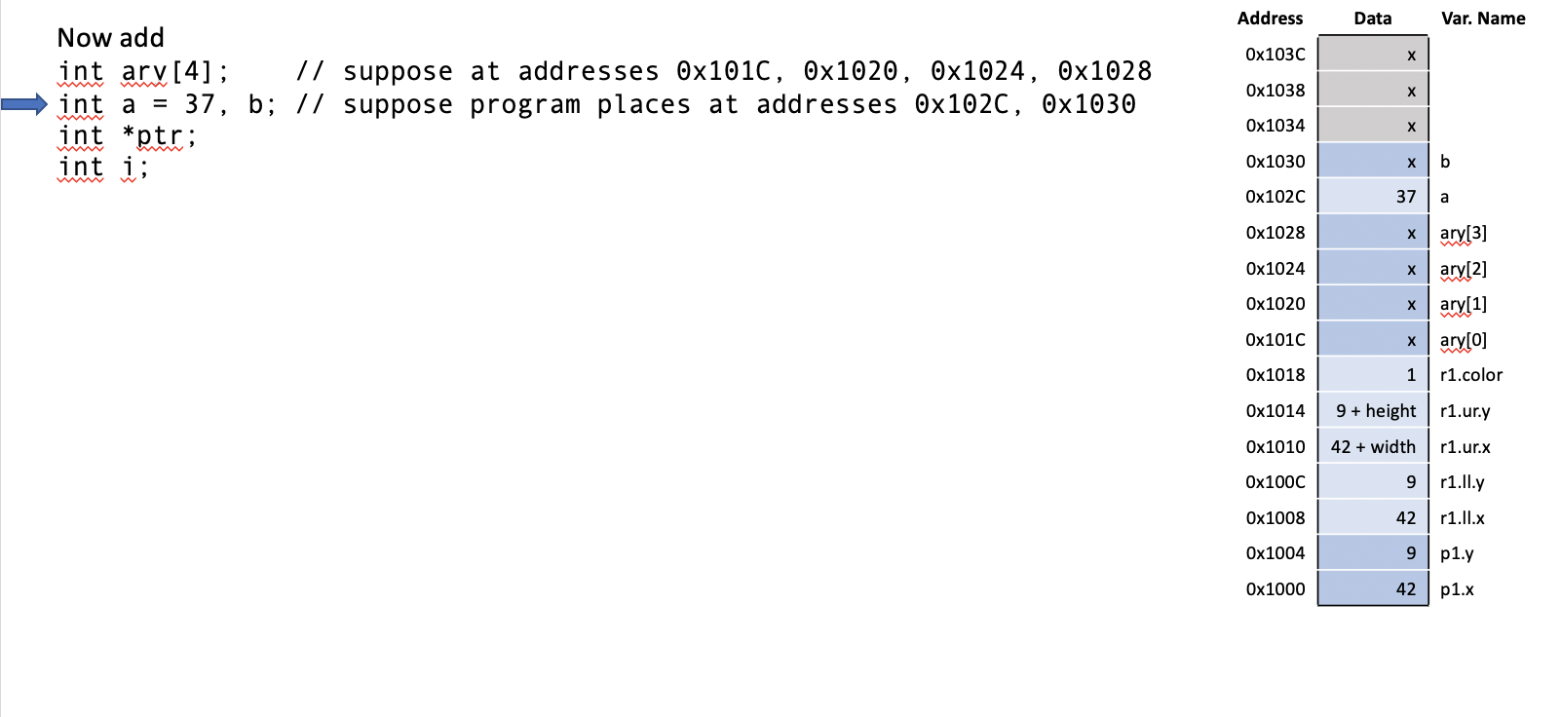
Pointer Example

Slide 16
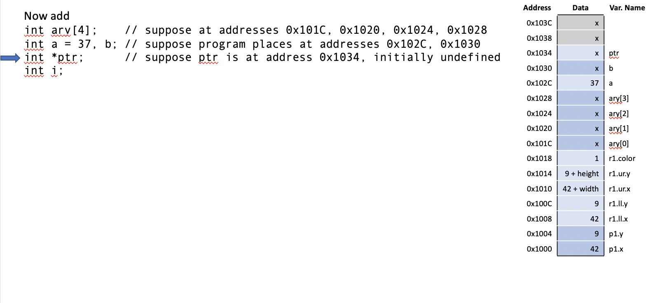
Pointer Example

Slide 17
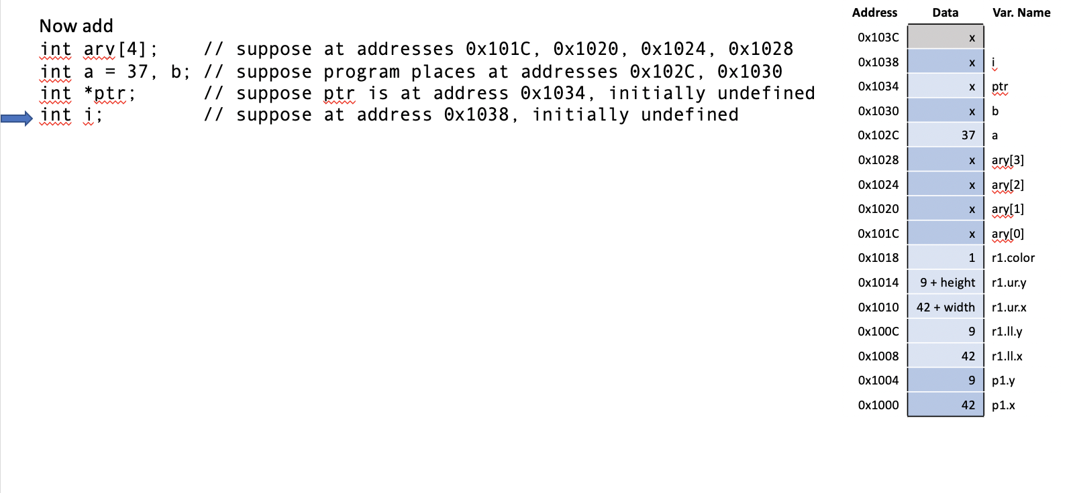
Pointer Example

Slide 18
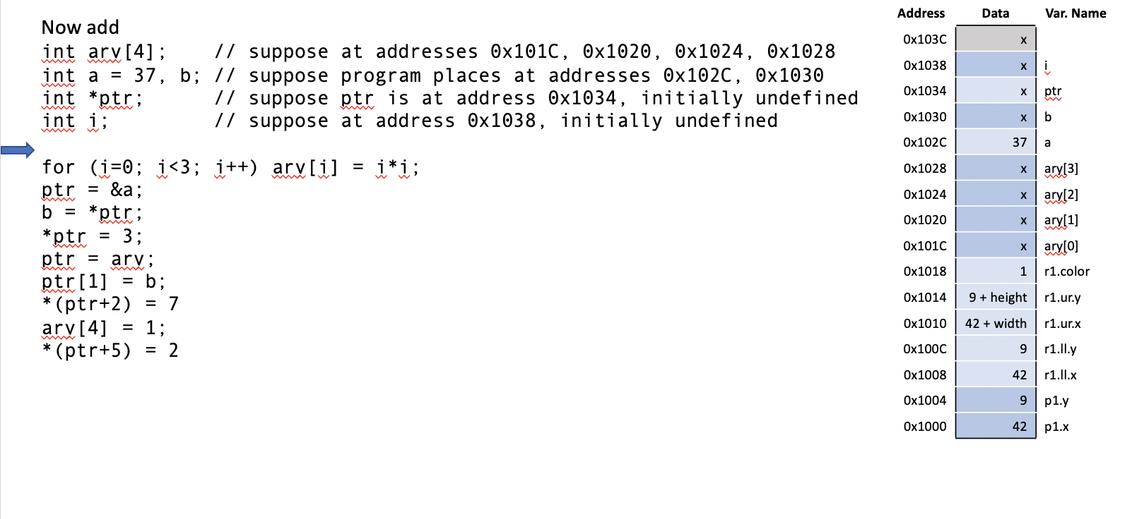
Pointer Example

Slide 19
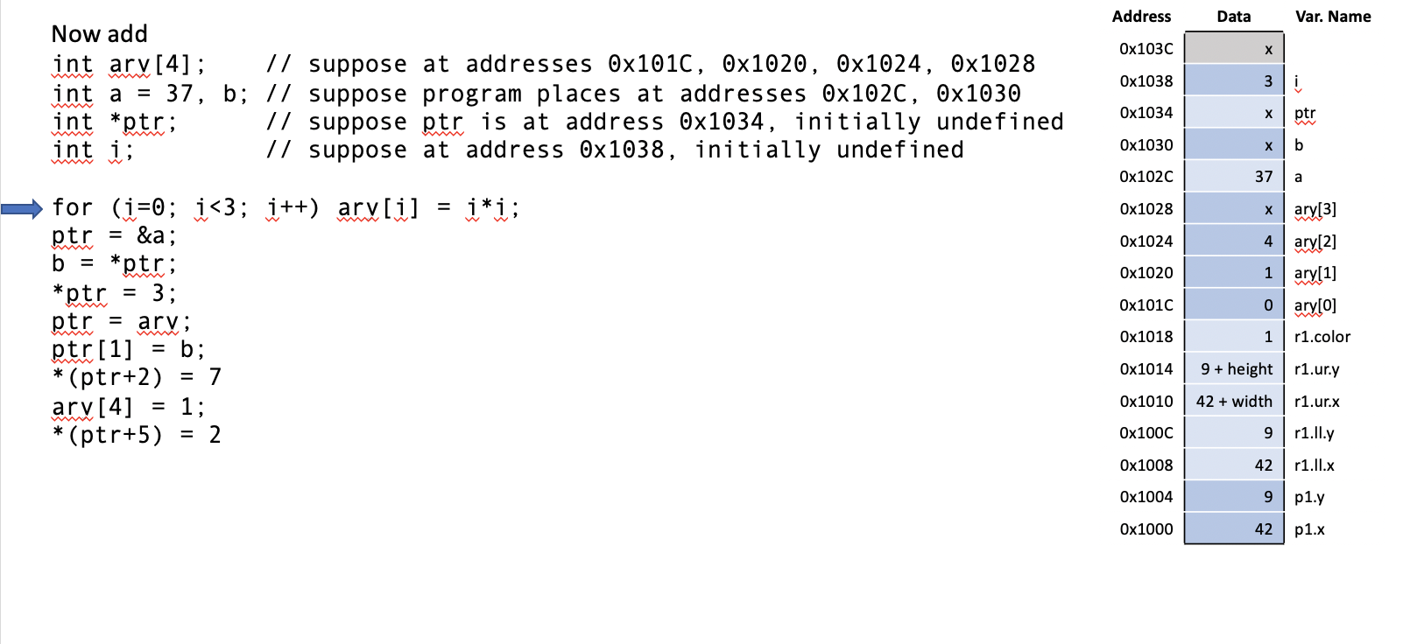
Pointer Example

Slide 20
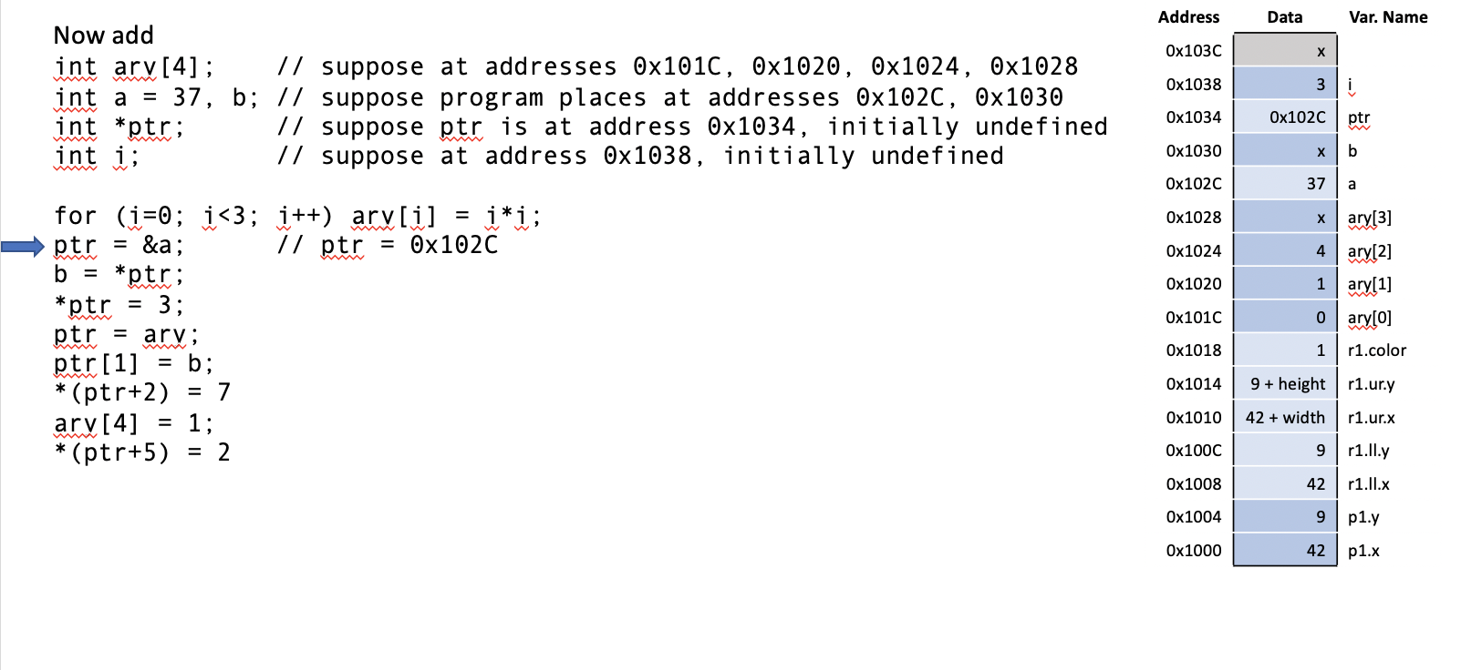
Pointer Example

Slide 21
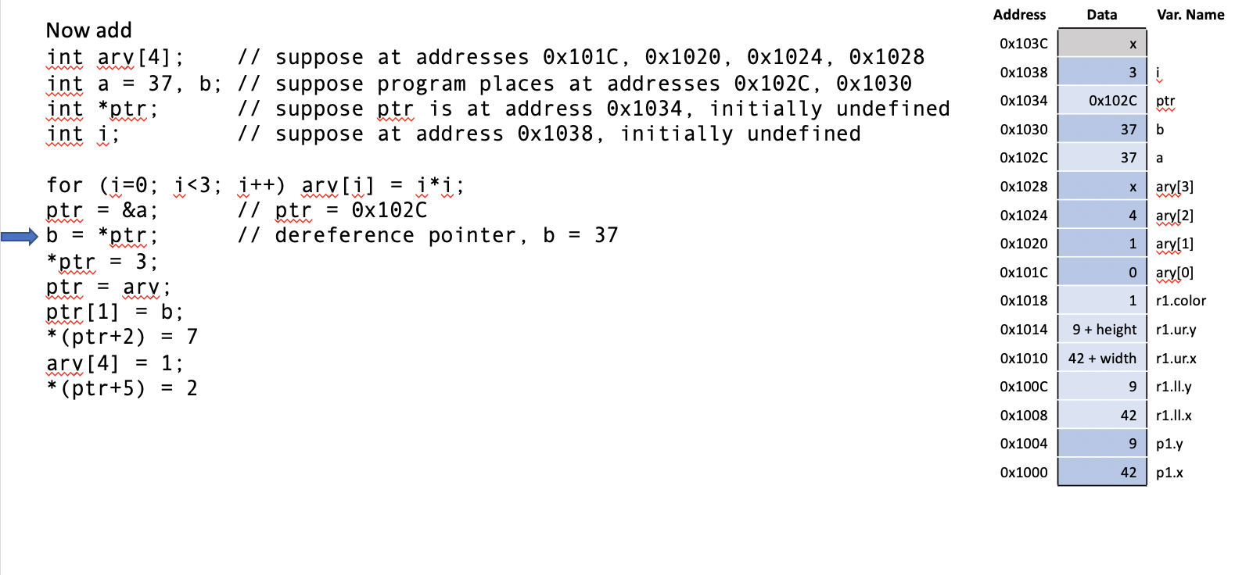
Pointer Example

Slide 22
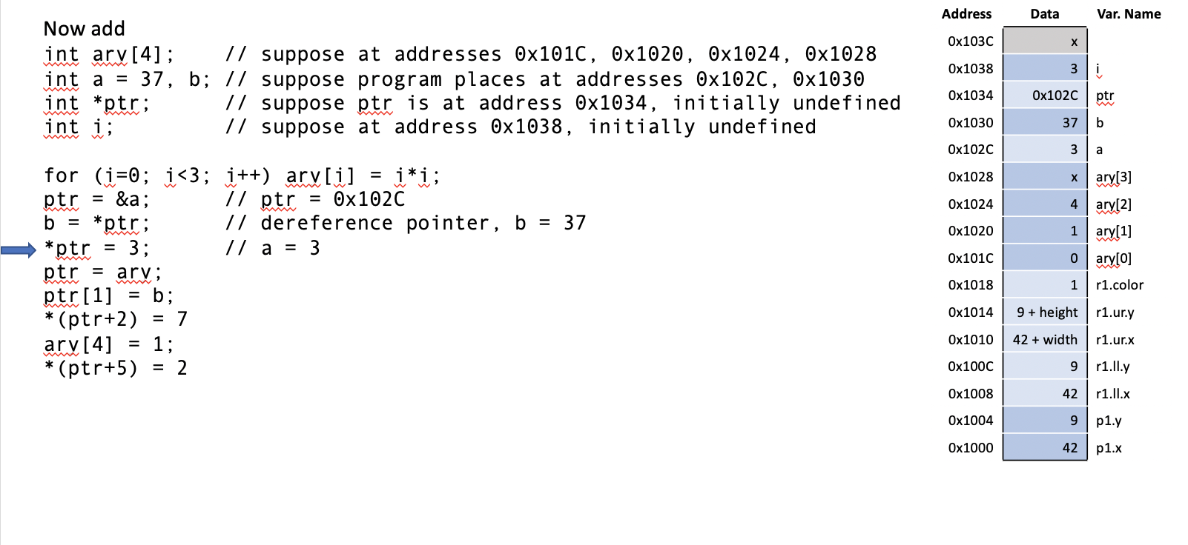
Pointer Example

Slide 23
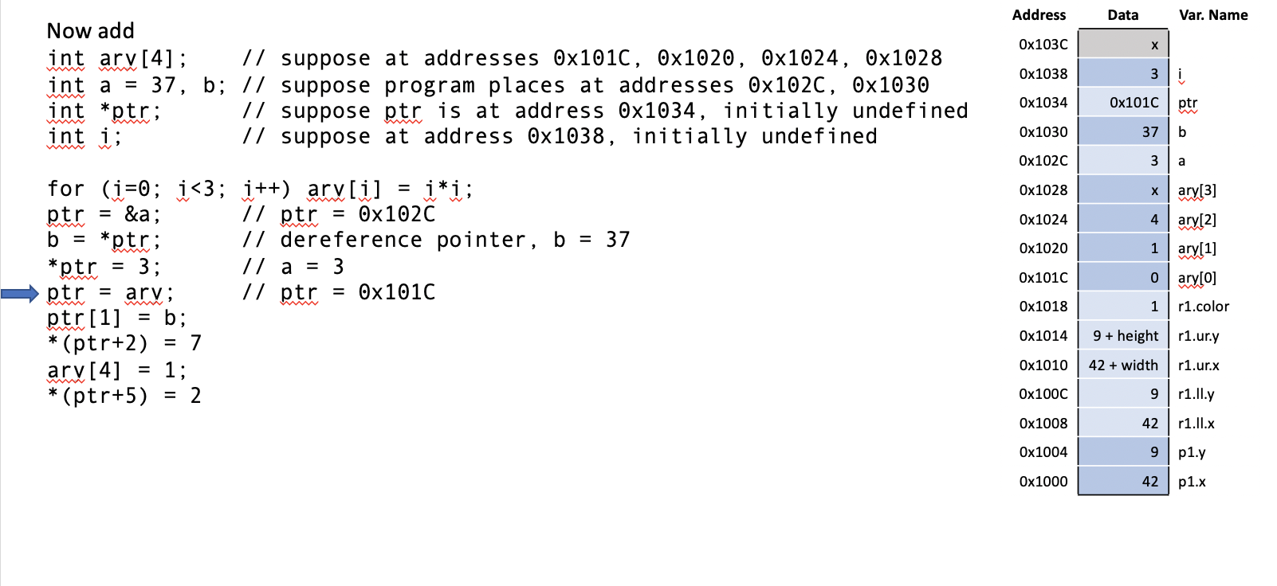
Pointer Example

Slide 24
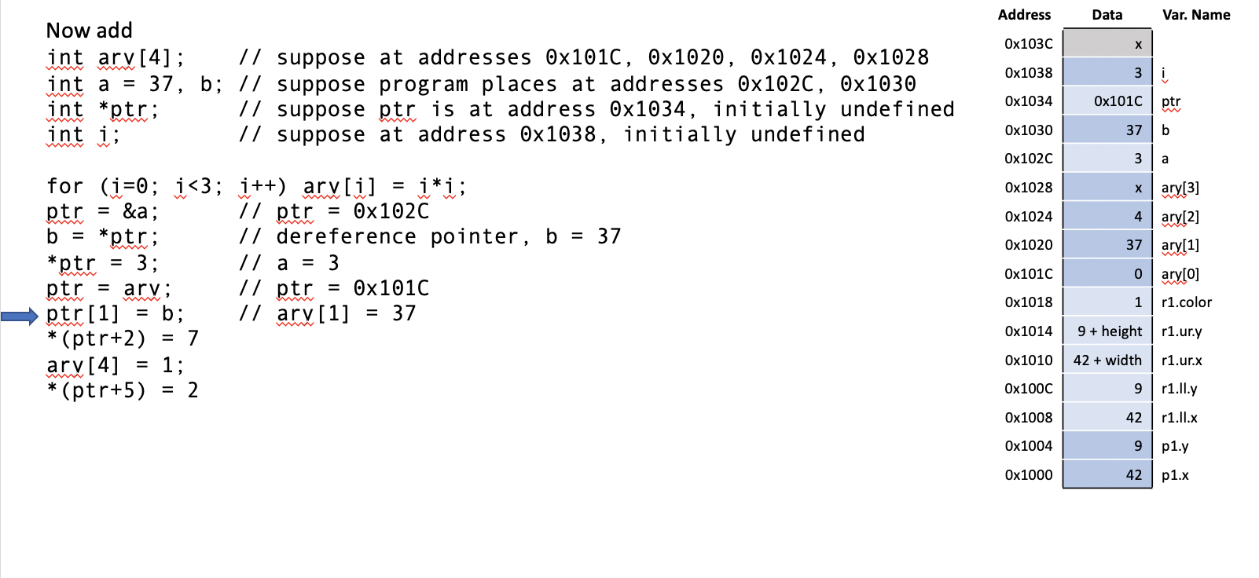
Pointer Example

Slide 25
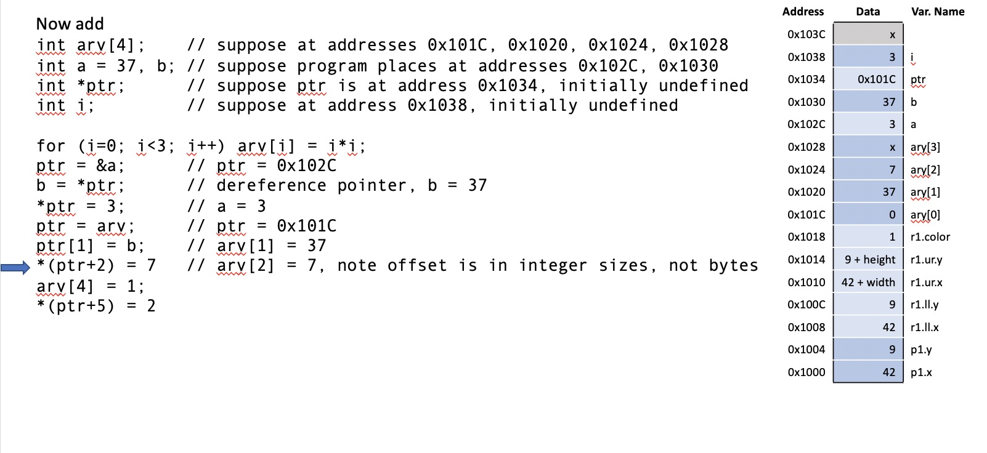
Pointer Example

Slide 26
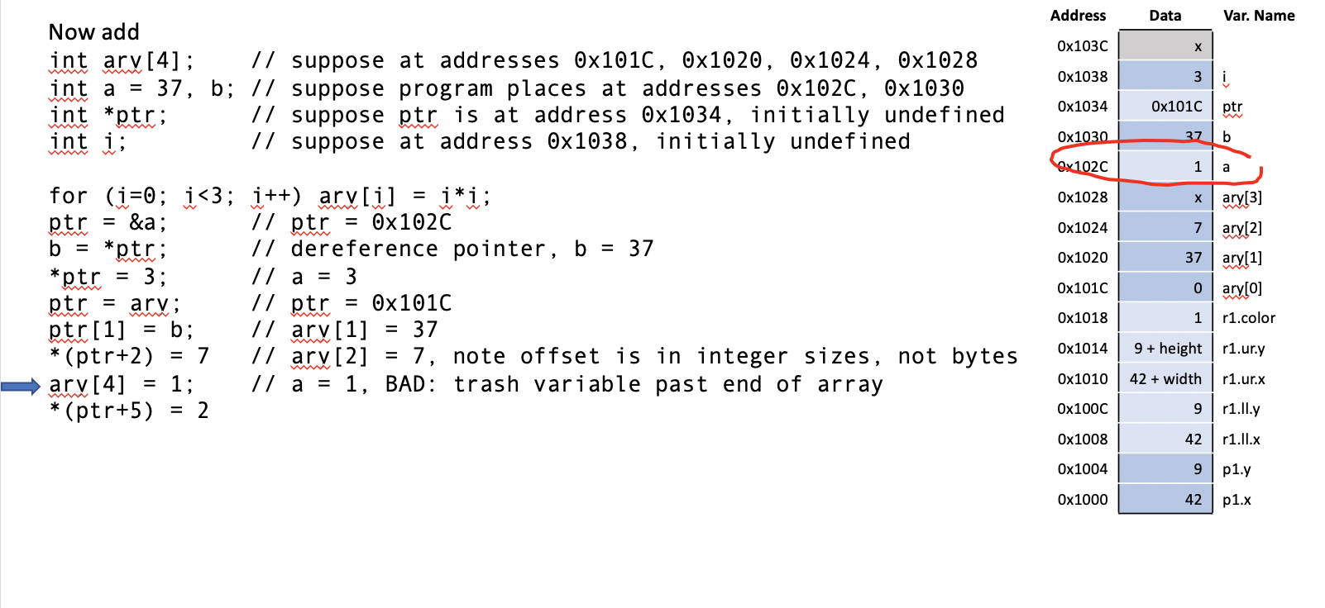
Pointer Example

Slide 27
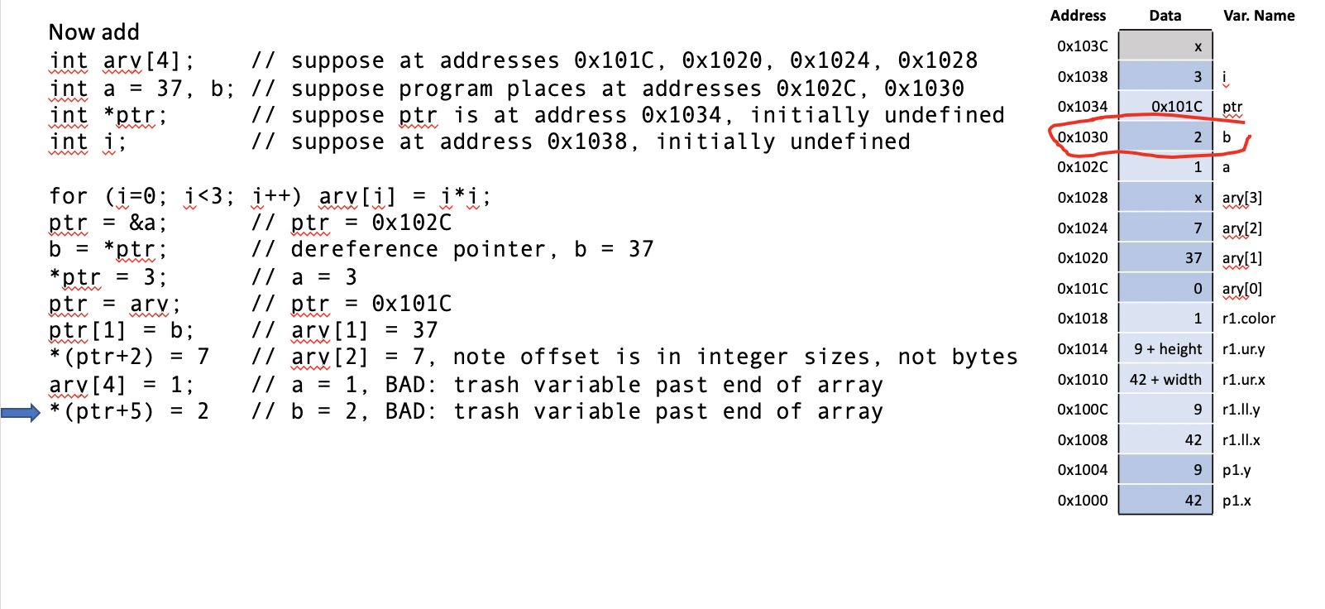
Pointer Example

Slide 28
Pointers and Structures
rect *rptr; // Let rptr know it’s pointing to a rect
rptr = &r1; // Have rptr point at r1
(*rptr).color = 3; // Change r1.color to 3
rptr->color = 4; // Change r1.color to 4
// Use dot “.” when you are using the structure name.
// Arrow “->” is preferred when you are using the pointer.

Slide 29
Passing Structures to Functions
Complex data structures and arrays are normally passed to C programs by address rather than copied; it’s more efficient.
void createRect(int xl, int yl, int width, int height, int color, rect *r) {
r->ll.x = x1; r->ll.y = yl;
r->ur.x = xl + width; r->ur.y = yl + height;
r->color = color;
}
int main(void) {
rect r1;
createRect(3, 5, 10, 20, 1, &r1);
}

Slide 30
Local Variable Hazard
void doubleWidthRect(rect *r1, rect *r2) {
rect s;
s.ll.x = r1->ll.x;
s.ll.y = r1->ll.y;
s.ur.x = (r1->ur.x – r1->ll.x) * 2 + r1->ll.x;
s.ur.y = r1->ll.y;
r2 = &s; // bad; s is a local variable and is lost
}

Slide 31
Solution
Be sure to declare rectangle r2 in calling function. Then:
void doubleWidthRect(rect *r1, rect *r2) {
r2->ll.x = r1->ll.x;
r2->ll.y = r1->ll.y;
r2->ur.x = (r1->ur.x – r1->ll.x) * 2 + r1->ll.x;
r2->ur.y = r1->ll.y;
}

Slide 32
Multidimensional Arrays
Address0 | Entry
0x1068 | field[1][2][2]
0x1060 | field[1][2][1]
0x1068 | field[1][2][0]
0x1060 | field[1][1][2]
0x1068 | field[1][1][1]
0x1060 | field[1][1][0]
0x1068 | field[1][0][2]
0x1060 | field[1][0][1]
0x1068 | field[1][0][0]
0x1060 | field[0][2][2]
0x1068 | field[0][2][1]
0x1060 | field[0][2][0]
0x1068 | field[0][1][2]
0x1060 | field[0][1][1]
0x1058 | field[0][1][0]
0x1050 | field[0][0][2]
0x1048 | field[0][0][1]
0x1040 | field[0][0][0]
Stored in consecutive addresses
  last dimension first
double field[2][3][3];

Slide 33
Complex Structures in Memory
Address | Entry
0x277E | z[9].s[15]
.. | …
0x217E | z[1][s[15]
.. | …
0x20C0 | z[1].d[0][0]
0x20BE | z[0].s[15]
… | …
0x20A2 | z[0].s[1]
0x20A0 | z[0].s[0]
0x2098 | z[0].d[3][4]
… | …
0x2008 | z[0].d[0][1]
0x2000 | z[0].d[0][0]
typedef struct foo {
double d[4][5];
unsigned short s[16];
} foo;
foo z[10];
int s5 = sizeof(z[0]);
// 8*4*5 + 2*16 = 192 = 0xC0
int s5 = sizeof(z);
// 10*192 = 1920 = 0x780

Slide 34
Memory Allocation
malloc returns a pointer to allocated memory of a certain number of bytes.
free frees this memory.
These functions are declared in stdlib

Slide 35
Variable Sized Arrays
In standard C, multidimensional array sizes must be declared at compile time.
Treat variable-sized M row x N column array as 1-dimensional array of M x N entries

Slide 36
Variable Dimension Matrix Example
#include <stdlib.h> // for malloc
double* newMatrix(int m, int n) {
double *mat;
mat = (double*)malloc(m*n*sizeof(double));
return mat;
}
double* newIdentityMatrix(int n) {
double *mat = newMatrix(n, n);
int i, j;
for (i=0; i<n; i++)
for (j=0; j<n; j++)
mat[j+i*n] = (i==j);
return mat;
}

Slide 37
Variable Dimension Matrix Example
void scaleMatrix(double *mat, double *scaled, int m, int n, double c) {
int i, j;
for (i=0; i<m; i++)
for (j=0; j<n; j++)
scaled[j+i*n] = mat[j+i*n]*c;
}
int main(void) {
double *m1, *m2;
m1 = newIdentityMatrix(3);
m2 = newMatrix(3, 3);
scaleMatrix(m1, m2, 3, 3, 10);
free(m1);
}

