Slide 1
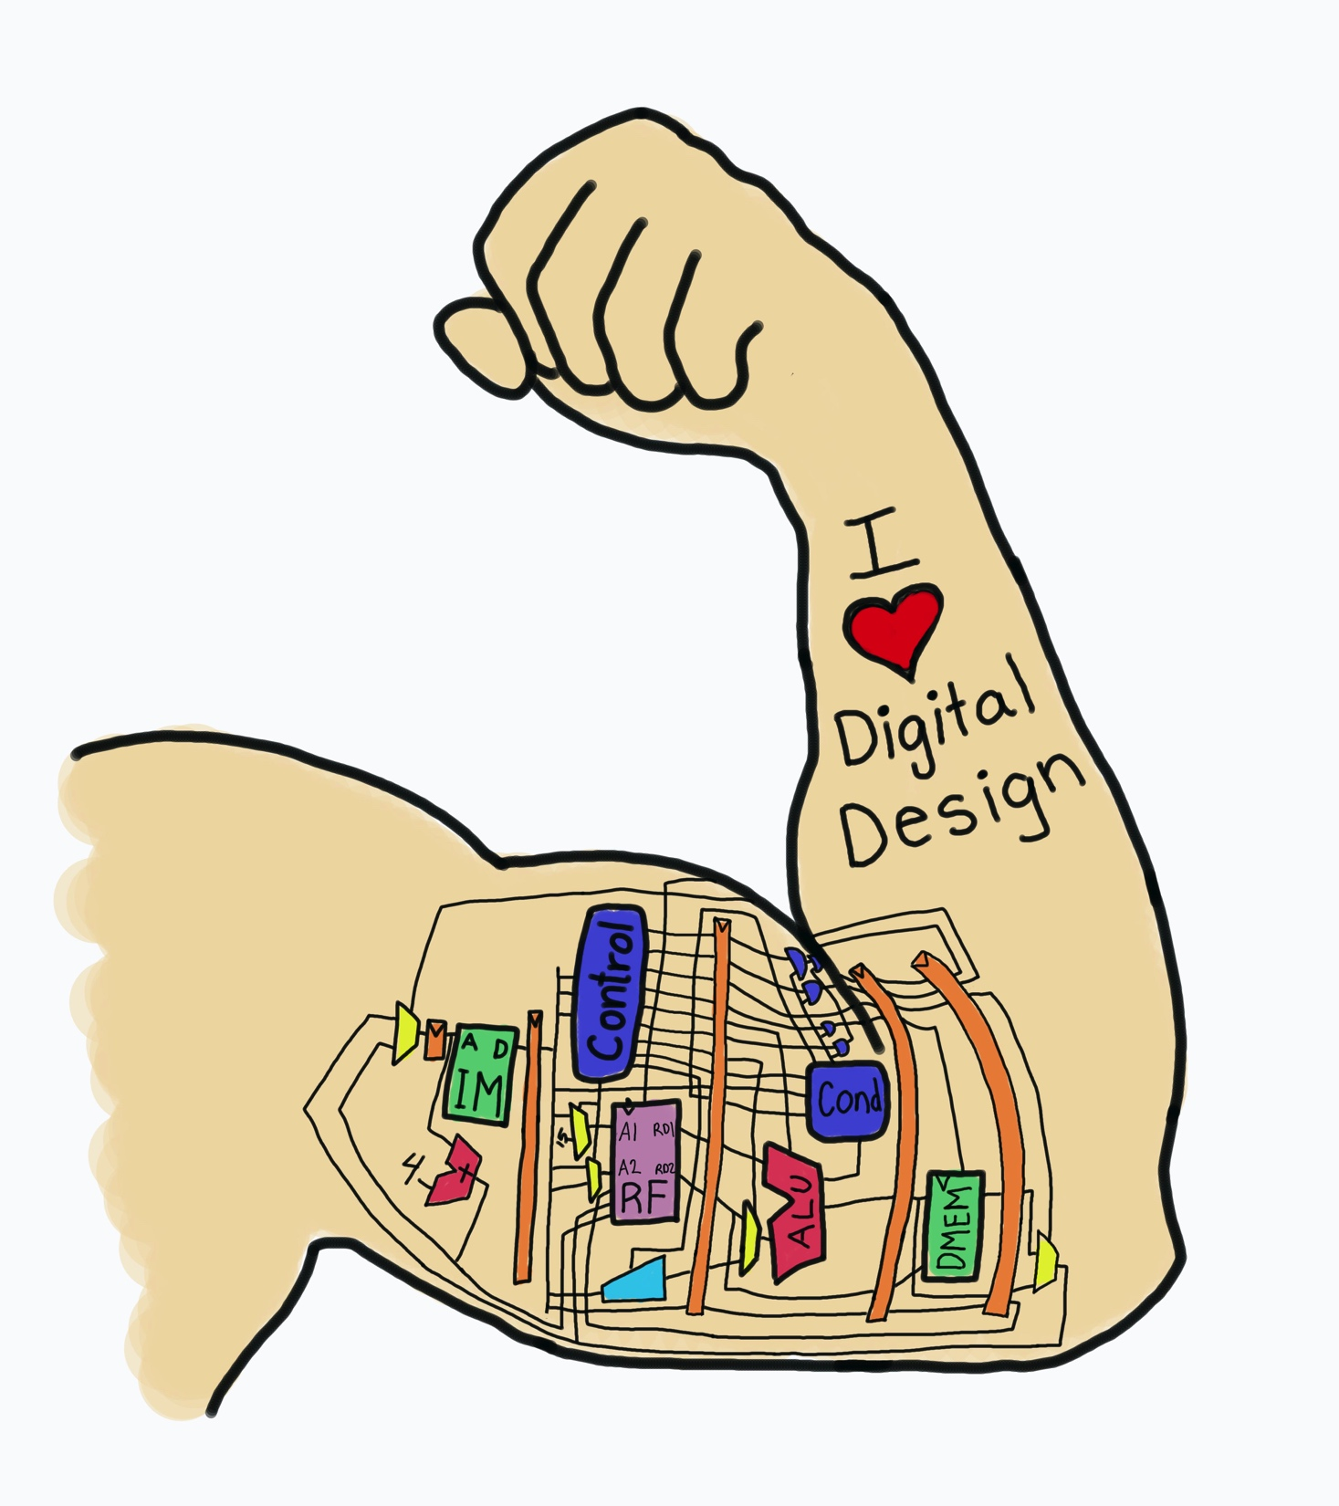
Lecture 1:
Logic Gates &
Analog Behavior of
Digital Systems
E85 Digital Design & Computer Engineering

Slide 2
Lecture 1
Logic Gates
Verilog
Logic Levels
CMOS Transistors
Power Consumption
Datasheets

Slide 3
Logic Gates
Perform logic functions:
  inversion (NOT), AND, OR, NAND, NOR, etc.
Single-input:
  NOT gate, buffer
Two-input:
  AND, OR, XOR, NAND, NOR, XNOR
Multiple-input

Slide 4
Single-Input Logic Gates

Slide 5
Two-Input Logic Gates

Slide 6
More Two-Input Logic Gates

Slide 7
Multiple-Input Logic Gates
Multi-input XOR: Odd parity (true if odd number of inputs are true)

Slide 8
SystemVerilog Description
module gates(input logic a, b, c,
output logic y1, y2, y3, y4, y5);
not g1(y1, a);
and g2(y2, a, b);
or g3(y3, a, b, c);
nand g4(y4, b, c);
xor g5(y5, a, c);
endmodule

Slide 9
Logic Levels
Discrete voltages represent 1 and 0
For example:
  0 = ground (GND) or 0 volts
  1 = V_{DD} or 5 volts
What about 4.99 volts? Is that a 0 or a 1?
What about 3.2 volts?

Slide 10
Logic Levels
Range of voltages for 1 and 0
Different ranges for inputs and outputs to allow for noise

Slide 11
What is Noise?
Anything that degrades the signal
  E.g., resistance, power supply noise, coupling to neighboring wires, etc.
Example: a gate (driver) outputs 5 V but, because of resistance in a long wire, receiver gets 4.5 V

Slide 12
The Static Discipline
With logically valid inputs, every circuit element must produce logically valid outputs
Use limited ranges of voltages to represent discrete values

Slide 13
Noise Margins

Slide 14
Noise Margins
High Noise Margin: NM_{H} = V_{OH} – V_{IH}
Low Noise Margin: NM_{L} = V_{IL} – V_{OL}

Slide 15
DC Transfer Characteristics
Ideal Buffer: Real Buffer:
NM_{H} = NM_{L} = V_{DD}/2
NM_{H}, NM_{L} < V_{DD}/2

Slide 16
DC Transfer Characteristics

Slide 17
V_{DD} Scaling
In 1970’s and 1980’s, V_{DD} = 5 V
V_{DD} has dropped
  Avoid frying tiny transistors
  Save power
3.3 V, 2.5 V, 1.8 V, 1.5 V, 1.2 V, 1.0 V, …
  Be careful connecting chips with different supply voltages

Slide 18
V_{DD} Scaling
In 1970’s and 1980’s, V_{DD} = 5 V
V_{DD} has dropped
  Avoid frying tiny transistors
  Save power
3.3 V, 2.5 V, 1.8 V, 1.5 V, 1.2 V, 1.0 V, …
  Be careful connecting chips with different supply voltages
Chips operate because they contain magic smoke
Proof: if the magic smoke is let out, the chip stops working

Slide 19
Logic Family Examples
Logic Family | V_{DD} | V_{IL} | V_{IH} | V_{OL} | V_{OH}
TTL | 5 (4.75 - 5.25) | 0.8 | 2.0 | 0.4 | 2.4
CMOS | 5 (4.5 - 6) | 1.35 | 3.15 | 0.33 | 3.84
LVTTL | 3.3 (3 - 3.6) | 0.8 | 2.0 | 0.4 | 2.4
LVCMOS | 3.3 (3 - 3.6) | 0.9 | 1.8 | 0.36 | 2.7

Slide 20
Transistors
Logic gates built from transistors
3-ported voltage-controlled switch
  2 ports connected depending on voltage of 3rd
  d and s are connected (ON) when g is 1

Slide 21
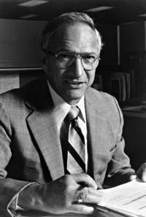
Robert Noyce, 1927-1990
Nicknamed “Mayor of Silicon Valley”
Cofounded Fairchild Semiconductor in 1957
Cofounded Intel in 1968
Co-invented the integrated circuit

Slide 22
Silicon
Transistors built from silicon, a semiconductor
Pure silicon is a poor conductor (no free charges)
Doped silicon is a good conductor (free charges)
  n-type (free negative charges, electrons)
  p-type (free positive charges, holes)

Slide 23
MOS Transistors
Metal oxide silicon (MOS) transistors:
  Polysilicon (used to be metal) gate
  Oxide (silicon dioxide) insulator
  Doped silicon

Slide 24
Transistors: nMOS
Gate = 0
OFF (no connection between source and drain)
Gate = 1
ON (channel between source and drain)

Slide 25
Transistors: pMOS
pMOS transistor is opposite
  ON when Gate = 0
  OFF when Gate = 1

Slide 26
Transistor Function

Slide 27
Transistor Function
nMOS: pass good 0’s, so connect source to GND
pMOS: pass good 1’s, so connect source to V_{DD}

Slide 28
CMOS Gates: NOT Gate
A | P1 | N1 | Y
0 | ON | OFF | 1
1 | OFF | ON | 0

Slide 29
CMOS Gates: NAND Gate
A | B | P1 | P2 | N1 | N2 | Y
0 | 0 | ON | ON | OFF | OFF | 1
0 | 1 | ON | OFF | OFF | ON | 1
1 | 0 | OFF | ON | ON | OFF | 1
1 | 1 | OFF | OFF | ON | ON | 0

Slide 30
CMOS Gate Structure

Slide 31
NOR3 Gate
How do you build a three-input NOR gate?

Slide 32
AND2 Gate
How do you build a two-input AND gate?

Slide 33
Transmission Gates
nMOS pass 1’s poorly
pMOS pass 0’s poorly
Transmission gate is a better switch
  passes both 0 and 1 well
When EN = 1, the switch is ON:
  EN = 0 and A is connected to B
When EN = 0, the switch is OFF:
  A is not connected to B

Slide 34
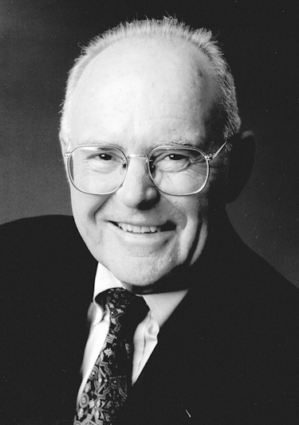
Gordon Moore, 1929-
Cofounded Intel in 1968 with Robert Noyce.
Moore’s Law: number of transistors on a computer chip doubles every year (observed in 1965)
Since 1975, transistor counts have doubled every two years.

Slide 35
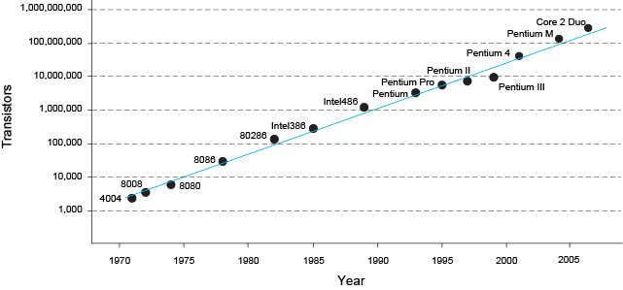
Moore’s Law
“If the automobile had followed the same development cycle as the computer, a Rolls-Royce would today cost $100, get one million miles to the gallon, and explode once a year . . .” (Robert Cringely, Infoworld)
– Robert Cringley

Slide 36
Power Consumption
Power = Energy consumed per unit time
Dynamic power consumption
Static power consumption

Slide 37
Dynamic Power Consumption
Power to charge transistor gate capacitances
  Energy required to charge a capacitance, C, to V_{DD} is CV_{DD}²
  Circuit running at frequency f: transistors switch (from 1 to 0 or vice versa) at that frequency
  Capacitor is charged f/2 times per second (discharging from 1 to 0 is free)
Dynamic power consumption:
P_{dynamic} = ½CV_{DD}²f

Slide 38
Static Power Consumption
Power consumed when no gates are switching
Caused by the quiescent supply current, I_{DD} (also called the leakage current)
Static power consumption:
P_{static} = I_{DD}V_{DD}

Slide 39
Power Consumption Example
Estimate the power consumption of a mobile phone running Angry Birds
  V_{DD} = 0.8 V
  C = 5 nF
  f = 2 GHz
  I_{DD} = 10 mA
P = ½CV_{DD}²f + I_{DD}V_{DD}
= ½(5 nF)(0.8 V)²(2 GHz) + (10 mA)(0.8 V)
= (3.2 + 0.008) W ≈ 3.2 W

Slide 40
Datasheets
Datasheets are a contract between the manufactuer and the user.
74LS04 has six NOT gates
Pinout
  Input A, output Y
  Also hook up VCC and GND
74-series are logic gates
LS: Low power Shottky
HC: High speed CMOS
04: six NOT gates

Slide 41
Datasheets
Chips are available in plastic or ceramic packages with different temperature ratings.
Dual Inline Package (DIP)
Small Outline IC (SOIC)
Small Outline Package (SOP)
Leadless Chip Carrier (LCC)

Slide 42
Datasheets
Six NOT gates
Input A, output Y

Slide 43
Datasheets
Internal structure
  Not too important for you.
  NPN transistor at middle and resistors above and below comprise the inverter
  NPN transistors on right form an output stage for driving more current

Slide 44
Datasheets
Absolute Maximums specify when the chip will catch on fire or suffer permanent damage. It is not guaranteed to function correctly near these levels. Don’t use for design purposes.
Recommended Operating Conditions say how it should be used.
Different vendors have different names for conditions
  Use some common sense to interpret

Slide 45
Datasheets
Note 74LS vs. 74
Supply voltage (V_{CC})
Logic levels (V_{IH}, V_{IL}, V_{OH}, V_{OL})
Currents
  Output (I_{OH}, I_{OL}, I_{OS})
  Input (I_{I}, I_{H}, I_{L})
  Supply (I_{CCH}, I_{CCL})
Propagation Delay (t_{PLH}, t_{PHL})

Slide 46
Datasheets
Mechanical data important when you are designing a printed circuit board.
Make sure the pins fit your board!

Slide 47

Example: Fanout
What is the maximum fanout for a 74LS04 NOT gate?
Solution:
Maximum current into a 74LS04 is I_{IL} = 0.4 mA.
Output voltage V_{OL} is guaranteed at I_{OL} = 8 mA
Hence, maximum fanout is I_{OL} / I_{IL} = 20.

Slide 48
Example: Power Consumption
One 74LS04 NOT gate drives 20 identical gates. V_{CC} = 5V. What is the power consumption of the entire system if the input to the first gate switches at 1 MHz?
Static Power:
  Each gate draws I_{CC} = (I_{CCL} + I_{CCH})/2 = (6.6 + 2.4 mA)/2 = 4.5 mA
  I_{static} = (21 gates)(4.5 mA/gate) = 94.5 mA
  P_{static} = 94.5 mA * 5 V = 472.5 mW
Dynamic Power
  C_{in} is not specified. Assume 15 pF/gate * 20 gates = 300 pF.
  P = CV_{DD}2f = (300x10-12)(52)(1x106) = 7.5 mW
P_{total} = P_{static} + P_{dynamic} = 480 mW
  TTL power is primarily static

