Slide 1
Chapter 6
Digital Design and Computer Architecture: ARM® Edition
Sarah L. Harris and David Money Harris

Slide 2
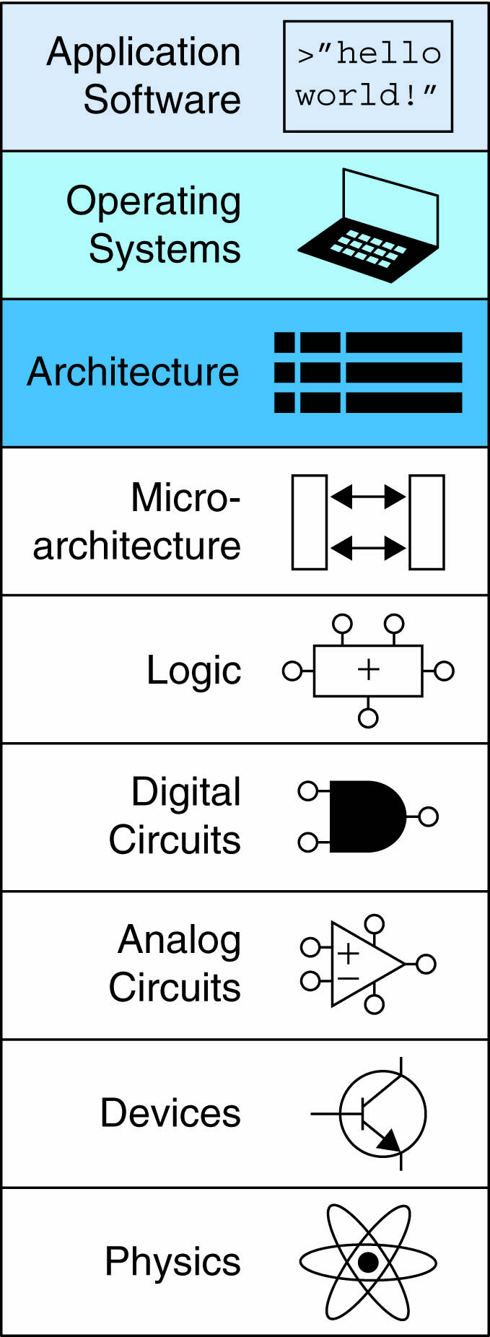
Chapter 6 :: Topics
Introduction
Assembly Language
Machine Language
Programming
Addressing Modes

Slide 3
Introduction
Jumping up a few levels of abstraction
  Architecture: programmer’s view of computer
    Defined by instructions & operand locations
  Microarchitecture: how to implement an architecture in hardware (covered in Chapter 7)

Slide 4
Instructions
Commands in a computer’s language
  Assembly language: human-readable format of instructions
  Machine language: computer-readable format (1’s and 0’s)

Slide 5
ARM Architecture
Developed in the 1980’s by Advanced RISC Machines – now called ARM Holdings
Nearly 10 billion ARM processors sold/year
Almost all cell phones and tablets have multiple ARM processors
Over 75% of humans use products with an ARM processor
Used in servers, cameras, robots, cars, pinball machines, etc.

Slide 6
ARM Architecture
Developed in the 1980’s by Advanced RISC Machines – now called ARM Holdings
Nearly 10 billion ARM processors sold/year
Almost all cell phones and tablets have multiple ARM processors
Over 75% of humans use products with an ARM processor
Used in servers, cameras, robots, cars, pinball machines,, etc.
Once you’ve learned one architecture, it’s easier to learn others

Slide 7
Architecture Design Principles
Underlying design principles, as articulated by Hennessy and Patterson:
    Regularity supports design simplicity
    Make the common case fast
    Smaller is faster
    Good design demands good compromises

Slide 8
Instruction: Addition
ADD: mnemonic – indicates operation to perform
b, c: source operands
a: destination operand
C Code
a = b + c;
ARM Assembly Code
ADD a, b, c

Slide 9
Instruction: Subtraction
Similar to addition - only mnemonic changes
SUB: mnemonic
b, c: source operands
a: destination operand
C Code
a = b - c;
ARM assembly code
SUB a, b, c

Slide 10
Design Principle 1
Regularity supports design simplicity
Consistent instruction format
Same number of operands (two sources and one destination)
Ease of encoding and handling in hardware

Slide 11
Multiple Instructions
More complex code handled by multiple ARM instructions
C Code
a = b + c - d;
ARM assembly code
ADD t, b, c ; t = b + c
SUB a, t, d ; a = t - d

Slide 12
Design Principle 2
Make the common case fast
ARM includes only simple, commonly used instructions
Hardware to decode and execute instructions kept simple, small, and fast
More complex instructions (that are less common) performed using multiple simple instructions

Slide 13
Design Principle 2
Make the common case fast
ARM is a Reduced Instruction Set Computer (RISC), with a small number of simple instructions
Other architectures, such as Intel’s x86, are Complex Instruction Set Computers (CISC)

Slide 14
Operand Location
Physical location in computer
  Registers
  Constants (also called immediates)
  Memory

Slide 15
Operands: Registers
ARM has 16 registers
Registers are faster than memory
Each register is 32 bits
ARM is called a “32-bit architecture” because it operates on 32-bit data

Slide 16
Design Principle 3
Smaller is Faster
ARM includes only a small number of registers

Slide 17
ARM Register Set
Name | Use
R0 | Argument / return value / temporary variable
R1-R3 | Argument / temporary variables
R4-R11 | Saved variables
R12 | Temporary variable
R13 (SP) | Stack Pointer
R14 (LR) | Link Register
R15 (PC) | Program Counter

Slide 18
Operands: Registers
Registers:
  R before number, all capitals
  Example: “R0” or “register zero” or “register R0”

Slide 19
Operands: Registers
Registers used for specific purposes:
  Saved registers: R4-R11 hold variables
  Temporary registers: R0-R3 and R12, hold intermediate values
  Discuss others later

Slide 20
Instructions with Registers
Revisit ADD instruction
C Code
a = b + c;
ARM Assembly Code
; R0 = a, R1 = b, R2 = c
ADD R0, R1, R2

Slide 21
Operands: Constants\Immediates
Many instructions can use constants or immediate operands
For example: ADD and SUB
value is immediately available from instruction
C Code
a = a + 4;
b = a – 12;
ARM Assembly Code
; R0 = a, R1 = b
ADD R0, R0, #4
SUB R1, R0, #12

Slide 22
Generating Constants
Generating small constants using move (MOV):
C Code
//int: 32-bit signed word
int a = 23;
int b = 0x45;
ARM Assembly Code
; R0 = a, R1 = b
MOV R0, #23
MOV R1, #0x45

Slide 23
Generating Constants
Generating small constants using move (MOV):
Constant must have < 8 bits of precision
Note: MOV can also use 2 registers: MOV R7, R9
C Code
//int: 32-bit signed word
int a = 23;
int b = 0x45;
ARM Assembly Code
; R0 = a, R1 = b
MOV R0, #23
MOV R1, #0x45

Slide 24
Generating Constants
Generate larger constants using move (MOV) and or (ORR):
C Code
int a = 0x7EDC8765;
ARM Assembly Code
# R0 = a
MOV R0, #0x7E000000
ORR R0, R0, #0xDC0000
ORR R0, R0, #0x8700
ORR R0, R0, #0x65

Slide 25
Operands: Memory
Too much data to fit in only 16 registers
Store more data in memory
Memory is large, but slow
Commonly used variables still kept in registers

Slide 26
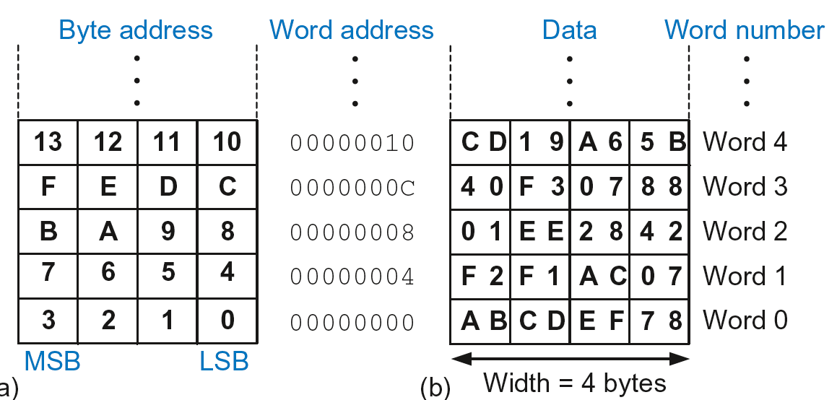
Byte-Addressable Memory
Each data byte has unique address
32-bit word = 4 bytes, so word address increments by 4

Slide 27
Reading Memory
Memory read called load
Mnemonic: load register (LDR)
Format:
LDR R0, [R1, #12]
  Address calculation:
    add base address (R1) to the offset (12)
    address = (R1 + 12)
  Result:
    R0 holds the data at memory address (R1 + 12)
Any register may be used as base address

Slide 28
Reading Memory
Example: Read a word of data at memory address 8 into R3
  Address = (R2 + 8) = 8
  R3 = 0x01EE2842 after load
ARM Assembly Code
MOV R2, #0
LDR R3, [R2, #8]

Slide 29
Writing Memory
Memory write are called stores
Mnemonic: store register (STR)

Slide 30
Writing Memory
Example: Store the value held in R7 into memory word 21.
Memory address = 4 x 21 = 84 = 0x54
ARM assembly code
MOV R5, #0
STR R7, [R5, #0x54]
The offset can be written in decimal or hexadecimal

Slide 31
Recap: Accessing Memory
Address of a memory word must be multiplied by 4
Examples:
  Address of memory word 2 = 2 × 4 = 8
  Address of memory word 10 = 10 × 4 = 40

Slide 32
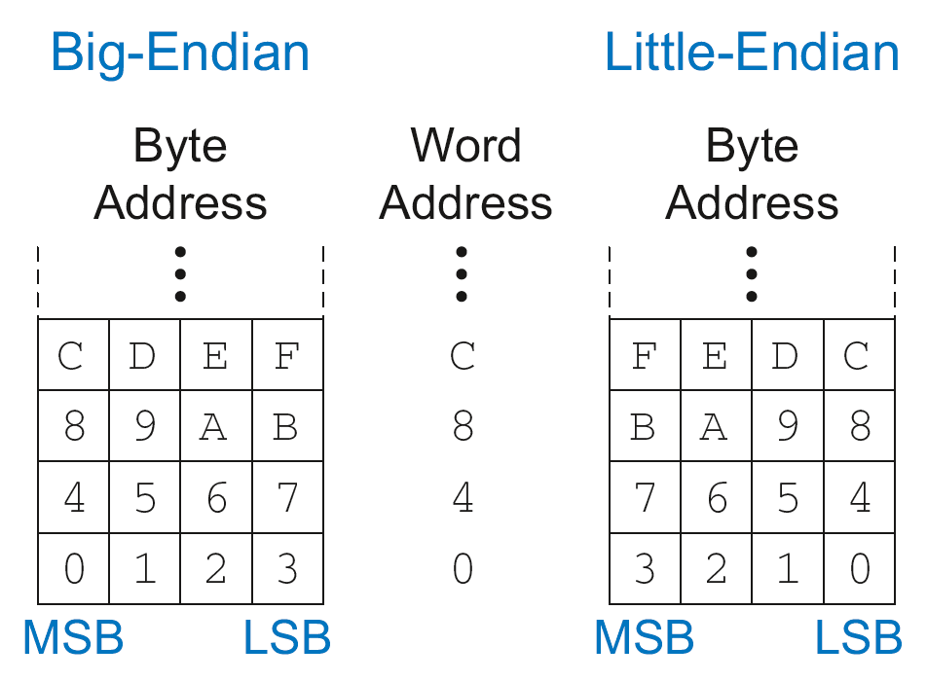
Big-Endian & Little-Endian Memory
How to number bytes within a word?
  Little-endian: byte numbers start at the little (least significant) end
  Big-endian: byte numbers start at the big (most significant) end

Slide 33
Big-Endian & Little-Endian Memory
Jonathan Swift’s Gulliver’s Travels: the Little-Endians broke their eggs on the little end of the egg and the Big-Endians broke their eggs on the big end
It doesn’t really matter which addressing type used – except when two systems share data

Slide 34
Big-Endian & Little-Endian Example
Suppose R2 and R5 hold the values 8 and 0x23456789
After following code runs on big-endian system, what value is in R7?
In a little-endian system?
      STR R5, [R2, #0]
      LDRB R7, [R2, #1]

Slide 35
Big-Endian & Little-Endian Example
Suppose R2 and R5 hold the values 8 and 0x23456789
After following code runs on big-endian system, what value is in R7?
In a little-endian system?
      STR R5, [R2, #0]
      LDRB R7, [R2, #1]
      Big-endian: 0x00000045
      Little-endian: 0x00000067

Slide 36
Programming
High-level languages:
  e.g., C, Java, Python
  Written at higher level of abstraction

Slide 37

Ada Lovelace, 1815-1852
British mathematician
Wrote the first computer program
Her program calculated the Bernoulli numbers on Charles Babbage’s Analytical Engine
She was a child of the poet Lord Byron

Slide 38
Programming Building Blocks
Data-processing Instructions
Conditional Execution
Branches
High-level Constructs:
  if/else statements
  for loops
  while loops
  arrays
  function calls

Slide 39
Data-processing Instructions
Logical operations
Shifts / rotate
Multiplication

Slide 40
Logical Instructions
AND
ORR
EOR (XOR)
BIC (Bit Clear = A & ~B)
MVN (MoVe and NOT)

Slide 41
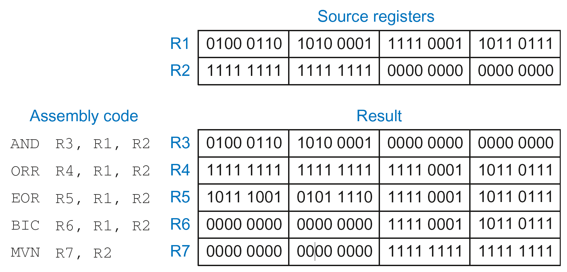
Logical Instructions: Examples

Slide 42
Logical Instructions: Uses
AND or BIC: useful for masking bits
  Example: Masking all but the least significant byte of a value
  0xF234012F AND 0x000000FF = 0x0000002F
  0xF234012F BIC 0xFFFFFF00 = 0x0000002F
ORR: useful for combining bit fields
  Example: Combine 0xF2340000 with 0x000012BC:
  0xF2340000 ORR 0x000012BC = 0xF23412BC

Slide 43
Shift Instructions
LSL: logical shift left
  Example: LSL R0, R7, #5 ; R0 = R7 << 5
LSR: logical shift right
  Example: LSR R3, R2, #31 ; R3 = R2 >> 31
ASR: arithmetic shift right
  Example: ASR R9, R11, R4 ; R9 = R11 >>> R4_{7:0}
ROR: rotate right
  Example: ROR R8, R1, #3 ; R8 = R1 ROR 3

Slide 44
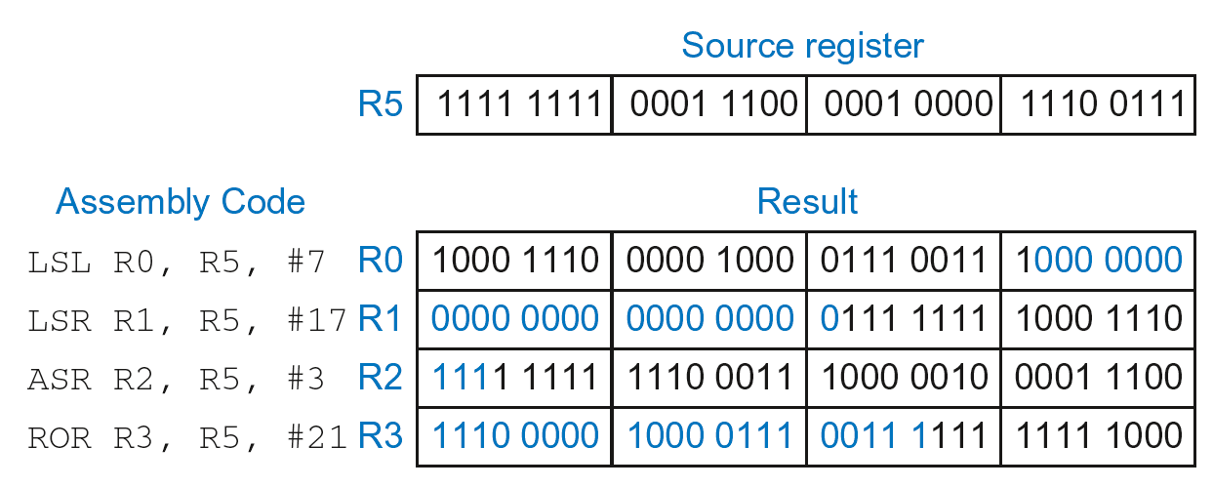
Shift Instructions: Example 1
Immediate shift amount (5-bit immediate)
Shift amount: 0-31

Slide 45
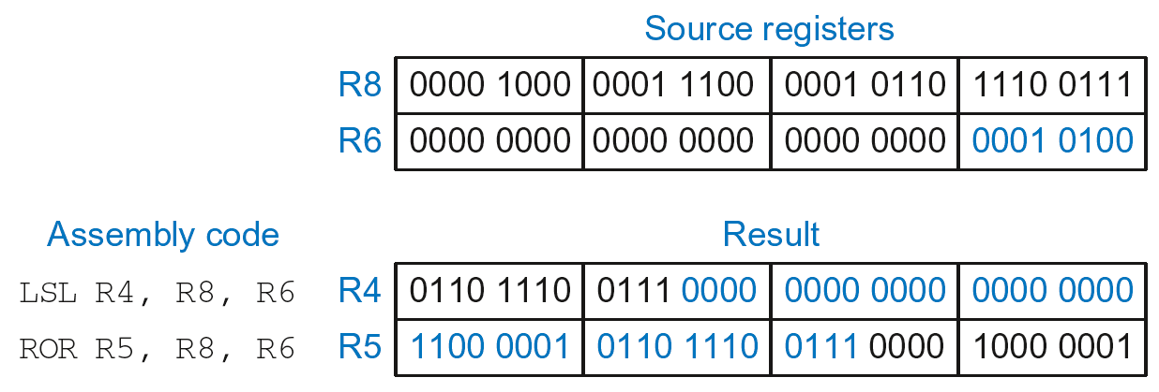
Shift Instructions: Example 2
Register shift amount (uses low 8 bits of register)
Shift amount: 0-255

Slide 46
Multiplication
MUL: 32 × 32 multiplication, 32-bit result
  MUL R1, R2, R3
  Result: R1 = (R2 x R3)_{31:0} (signed doesn’t matter)
UMULL: Unsigned multiply long: 32 × 32 multiplication, 64-bit result
  UMULL R1, R2, R3, R4
  Result: {R1,R4} = R2 x R3 (R2, R3 unsigned)
SMULL: Signed multiply long: 32 × 32 multiplication, 64-bit result
  SMULL R1, R2, R3, R4
  Result: {R1,R4} = R2 x R3 (R2, R3 signed)

Slide 47
Programming Building Blocks
Data-processing Instructions
Conditional Execution
Branches
High-level Constructs:
  if/else statements
  for loops
  while loops
  arrays
  function calls

Slide 48
Conditional Execution
Don’t always want to execute code sequentially
For example:
  if/else statements, while loops, etc.: only want to execute code if a condition is true
  branching: jump to another portion of code if a condition is true

Slide 49
Conditional Execution
Don’t always want to execute code sequentially
For example:
  if/else statements, while loops, etc.: only want to execute code if a condition is true
  branching: jump to another portion of code if a condition is true
ARM includes condition flags that can be:
  set by an instruction
  used to conditionally execute an instruction

Slide 50
ARM Condition Flags
Flag | Name | Description
N | Negative | Instruction result is negative
Z | Zero | Instruction results in zero
C | Carry | Instruction causes an unsigned carry out
V | oVerflow | Instruction causes an overflow
Set by ALU (recall from Chapter 5)
Held in Current Program Status Register (CPSR)

Slide 51
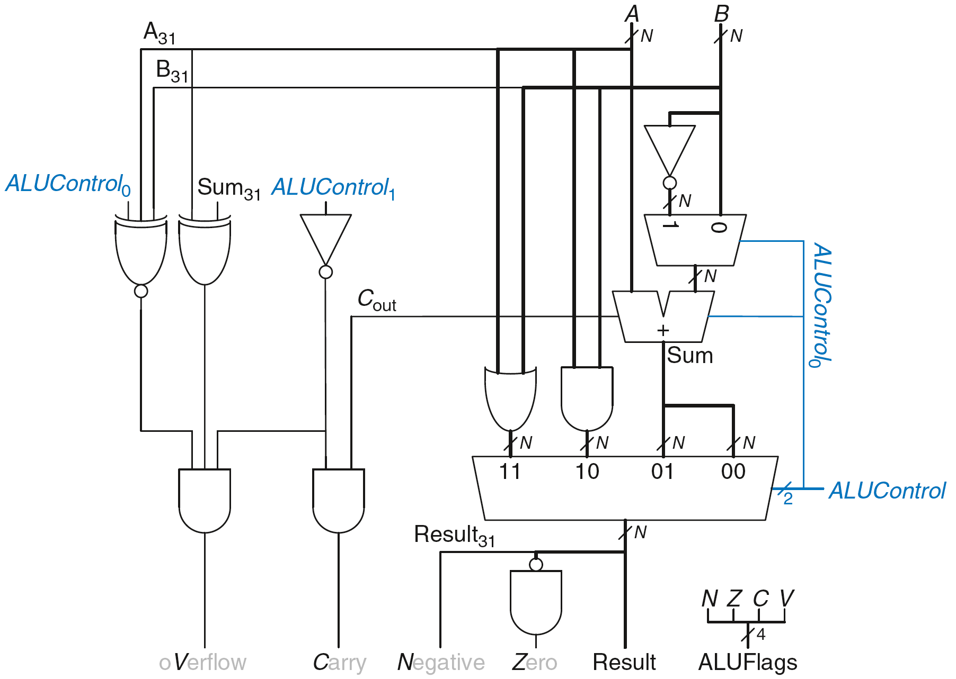
Review: ARM ALU

Slide 52
Setting the Condition Flags: NZCV
Method 1: Compare instruction: CMP
  Example: CMP R5, R6
    Performs: R5-R6
    Does not save result
    Sets flags. If result:
      Is 0, Z=1
      Is negative, N=1
      Causes a carry out, C=1
      Causes a signed overflow, V=1

Slide 53
Setting the Condition Flags: NZCV
Method 1: Compare instruction: CMP
  Example: CMP R5, R6
    Performs: R5-R6
    Sets flags: If result is 0 (Z=1), negative (N=1), etc.
    Does not save result
Method 2: Append instruction mnemonic with S
  Example: ADDS R1, R2, R3
    Performs: R2 + R3
    Sets flags: If result is 0 (Z=1), negative (N=1), etc.
    Saves result in R1

Slide 54
Condition Mnemonics
Instruction may be conditionally executed based on the condition flags
Condition of execution is encoded as a condition mnemonic appended to the instruction mnemonic
  Example: CMP R1, R2
  SUBNE R3, R5, R8
        NE: not equal condition mnemonic
        SUB will only execute if R1 ≠ R2
        (i.e., Z = 0)

Slide 55
Condition Mnemonics

Slide 56
Conditional Execution
Example:
  CMP R5, R9 ; performs R5-R9
  ; sets condition flags
  SUBEQ R1, R2, R3 ; executes if R5==R9 (Z=1)
  ORRMI R4, R0, R9 ; executes if R5-R9 is
  ; negative (N=1)
  Suppose R5 = 17, R9 = 23:
    CMP performs: 17 – 23 = -6 (Sets flags: N=1, Z=0, C=0, V=0)
    SUBEQ doesn’t execute (they aren’t equal: Z=0)
    ORRMI executes because the result was negative (N=1)

Slide 57
Programming Building Blocks
Data-processing Instructions
Conditional Execution
Branches
High-level Constructs:
  if/else statements
  for loops
  while loops
  arrays
  function calls

Slide 58
Branching
Branches enable out of sequence instruction execution
Types of branches:
  Branch (B)
    branches to another instruction
  Branch and link (BL)
    discussed later
Both can be conditional or unconditional

Slide 59
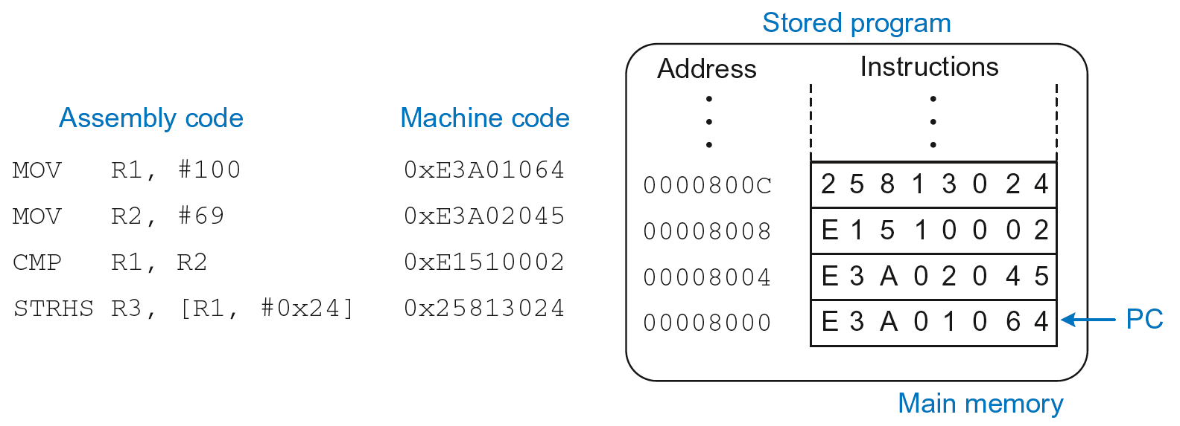
The Stored Program

Slide 60
Unconditional Branching (B)
ARM assembly
MOV R2, #17 ; R2 = 17
B TARGET ; branch to target
ORR R1, R1, #0x4 ; not executed
TARGET
SUB R1, R1, #78 ; R1 = R1 + 78
Labels (like TARGET) indicate instruction location. Labels can’t be reserved words (like ADD, ORR, etc.)

Slide 61
The Branch Not Taken
ARM Assembly
MOV R0, #4 ; R0 = 4
ADD R1, R0, R0 ; R1 = R0+R0 = 8
CMP R0, R1 ; sets flags with R0-R1
BEQ THERE ; branch not taken (Z=0)
ORR R1, R1, #1 ; R1 = R1 OR R1 = 9
THERE
ADD R1, R1, 78 ; R1 = R1 + 78 = 87

Slide 62
Programming Building Blocks
Data-processing Instructions
Conditional Execution
Branches
High-level Constructs:
  if/else statements
  for loops
  while loops
  arrays
  function calls

Slide 63
if Statement
C Code
if (i == j)
f = g + h;
f = f – i;

Slide 64
if Statement
C Code
if (i == j)
f = g + h;
f = f – i;
ARM Assembly Code
;R0=f, R1=g, R2=h, R3=i, R4=j
CMP R3, R4 ; set flags with R3-R4
BNE L1 ; if i!=j, skip if block
ADD R0, R1, R2 ; f = g + h
L1
SUB R0, R0, R2 ; f = f - i

Slide 65
if Statement
C Code
if (i == j)
f = g + h;
f = f – i;
ARM Assembly Code
;R0=f, R1=g, R2=h, R3=i, R4=j
CMP R3, R4 ; set flags with R3-R4
BNE L1 ; if i!=j, skip if block
ADD R0, R1, R2 ; f = g + h
L1
SUB R0, R0, R2 ; f = f - i
Assembly tests opposite case (i != j) of high-level code (i == j)

Slide 66
if Statement: Alternate Code
C Code
if (i == j)
f = g + h;
f = f – i;
ARM Assembly Code
;R0=f, R1=g, R2=h, R3=i, R4=j
CMP R3, R4 ; set flags with R3-R4
ADDEQ R0, R1, R2 ; if (i==j) f = g + h
SUB R0, R0, R2 ; f = f - i

Slide 67
if Statement: Alternate Code
Alternate Assembly Code
;R0=f, R1=g, R2=h, R3=i, R4=j
CMP R3, R4 ; set flags with R3-R4
ADDEQ R0, R1, R2 ; if (i==j) f = g + h
SUB R0, R0, R2 ; f = f - i
Original
CMP R3, R4
BNE L1
ADD R0, R1, R2
L1
SUB R0, R0, R2

Slide 68
if Statement: Alternate Code
Alternate Assembly Code
;R0=f, R1=g, R2=h, R3=i, R4=j
CMP R3, R4 ; set flags with R3-R4
ADDEQ R0, R1, R2 ; if (i==j) f = g + h
SUB R0, R0, R2 ; f = f - i
Original
CMP R3, R4
BNE L1
ADD R0, R1, R2
L1
SUB R0, R0, R2
Useful for short conditional blocks of code

Slide 69
if/else Statement
C Code
if (i == j)
f = g + h;
else
f = f – i;
ARM Assembly Code

Slide 70
if/else Statement
C Code
if (i == j)
f = g + h;
else
f = f – i;
ARM Assembly Code
;R0=f, R1=g, R2=h, R3=i, R4=j
CMP R3, R4 ; set flags with R3-R4
BNE L1 ; if i!=j, skip if block
ADD R0, R1, R2 ; f = g + h
B L2 ; branch past else block
L1
SUB R0, R0, R2 ; f = f – i
L2

Slide 71
if/else Statement: Alternate Code
C Code
if (i == j)
f = g + h;
else
f = f – i;
ARM Assembly Code
;R0=f, R1=g, R2=h, R3=i, R4=j
CMP R3, R4 ; set flags with R3-R4
ADDEQ R0, R1, R2 ; if (i==j) f = g + h
SUBNE R0, R0, R2 ; else f = f - i

Slide 72
if/else Statement: Alternate Code
Original
CMP R3, R4
BNE L1
ADD R0, R1, R2
B L2
L1
SUB R0, R0, R2
L2
Alternate Assembly Code
;R0=f, R1=g, R2=h, R3=i, R4=j
CMP R3, R4 ; set flags with R3-R4
ADDEQ R0, R1, R2 ; if (i==j) f = g + h
SUBNE R0, R0, R2 ; else f = f - i

Slide 73
while Loops
C Code
// determines the power
// of x such that 2^{x} = 128
int pow = 1;
int x = 0;
while (pow != 128) {
pow = pow * 2;
x = x + 1;
}
ARM Assembly Code

Slide 74
while Loops
C Code
// determines the power
// of x such that 2^{x} = 128
int pow = 1;
int x = 0;
while (pow != 128) {
pow = pow * 2;
x = x + 1;
}
ARM Assembly Code
; R0 = pow, R1 = x
MOV R0, #1 ; pow = 1
MOV R1, #0 ; x = 0
WHILE
CMP R0, #128 ; R0-128
BEQ DONE ; if (pow==128) ; exit loop
LSL R0, R0, #1 ; pow=pow*2
ADD R1, R1, #1 ; x=x+1
B WHILE ; repeat loop
DONE

Slide 75
while Loops
C Code
// determines the power
// of x such that 2^{x} = 128
int pow = 1;
int x = 0;
while (pow != 128) {
pow = pow * 2;
x = x + 1;
}
ARM Assembly Code
; R0 = pow, R1 = x
MOV R0, #1 ; pow = 1
MOV R1, #0 ; x = 0
WHILE
CMP R0, #128 ; R0-128
BEQ DONE ; if (pow==128) ; exit loop
LSL R0, R0, #1 ; pow=pow*2
ADD R1, R1, #1 ; x=x+1
B WHILE ; repeat loop
DONE
Assembly tests for the opposite case (pow == 128) of the C code (pow != 128).

Slide 76
for Loops
for (initialization; condition; loop operation)
statement
initialization: executes before the loop begins
condition: is tested at the beginning of each iteration
loop operation: executes at the end of each iteration
statement: executes each time the condition is met

Slide 77
for Loops
C Code
// adds numbers from 1-9
int sum = 0;
int i;
for (i=1; i!=10; i=i+1)
sum = sum + i;
ARM Assembly Code

Slide 78
for Loops
C Code
// adds numbers from 1-9
int sum = 0
for (i=1; i!=10; i=i+1)
sum = sum + i;
ARM Assembly Code
; R0 = i, R1 = sum
MOV R0, #1 ; i = 1
MOV R1, #0 ; sum = 0
FOR
CMP R0, #10 ; R0-10
BEQ DONE ; if (i==10) ; exit loop
ADD R1, R1, R0 ; sum=sum + i
ADD R0, R0, #1 ; i = i + 1
B FOR ; repeat loop
DONE

Slide 79
for Loops: Decremented Loops
In ARM, decremented loop variables are more efficient

Slide 80
for Loops: Decremented Loops
In ARM, decremented loop variables are more efficient
C Code
// adds numbers from 1-9
int sum = 0
for (i=9; i!=0; i=i-1)
sum = sum + i;
ARM Assembly Code
; R0 = i, R1 = sum
MOV R0, #9 ; i = 9
MOV R1, #0 ; sum = 0
FOR
ADD R1, R1, R0 ; sum=sum + i
SUBS R0, R0, #1 ; i = i – 1
; and set flags
BNE FOR ; if (i!=0) ; repeat loop

Slide 81
for Loops: Decremented Loops
In ARM, decremented loop variables are more efficient
C Code
// adds numbers from 1-9
int sum = 0
for (i=9; i!=0; i=i-1)
sum = sum + i;
ARM Assembly Code
; R0 = i, R1 = sum
MOV R0, #9 ; i = 9
MOV R1, #0 ; sum = 0
FOR
ADD R1, R1, R0 ; sum=sum + i
SUBS R0, R0, #1 ; i = i – 1
; and set flags
BNE FOR ; if (i!=0) ; repeat loop
Saves 2 instructions per iteration:
Decrement loop variable & compare: SUBS R0, R0, #1
Only 1 branch – instead of 2

Slide 82
Programming Building Blocks
Data-processing Instructions
Conditional Execution
Branches
High-level Constructs:
  if/else statements
  for loops
  while loops
  arrays
  function calls

Slide 83
Arrays
Access large amounts of similar data
  Index: access to each element
  Size: number of elements

Slide 84
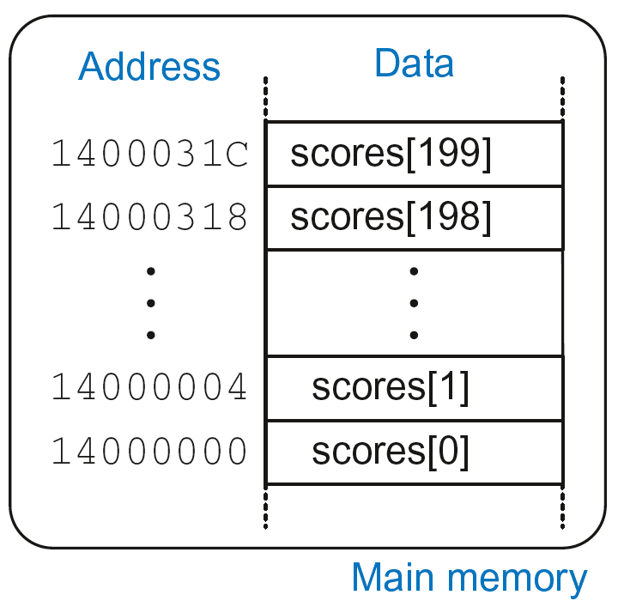
Arrays
200-element array
  Base address = 0x14000000 (address of first element, scores[0])
  Array elements accessed relative to base address

Slide 85
Accessing Arrays
C Code
int array[200];
array[0] = array[0] * 8;
array[1] = array[1] * 8;
ARM Assembly Code
; R0 = array base address

Slide 86
Accessing Arrays
C Code
int array[5];
array[0] = array[0] * 8;
array[1] = array[1] * 8;
ARM Assembly Code
; R0 = array base address
MOV R0, #0x60000000 ; R0 = 0x60000000
LDR R1, [R0] ; R1 = array[0]
LSL R1, R1, 3 ; R1 = R1 << 3 = R1*8
STR R1, [R0] ; array[0] = R1
LDR R1, [R0, #4] ; R1 = array[1]
LSL R1, R1, 3 ; R1 = R1 << 3 = R1*8
STR R1, [R0, #4] ; array[1] = R1

Slide 87
Arrays using for Loops
C Code
int array[200];
int i;
for (i=199; i >= 0; i = i - 1)
array[i] = array[i] * 8;
ARM Assembly Code
; R0 = array base address, R1 = i

Slide 88
Arrays using for Loops
C Code
int array[200];
int i;
for (i=199; i >= 0; i = i - 1)
array[i] = array[i] * 8;
ARM Assembly Code
; R0 = array base address, R1 = i
MOV R0, 0x60000000
MOV R1, #199
FOR
LDR R2, [R0, R1, LSL #2] ; R2 = array(i)
LSL R2, R2, #3 ; R2 = R2<<3 = R3*8
STR R2, [R0, R1, LSL #2] ; array(i) = R2
SUBS R1, R1, #1 ; i = i – 1
; and set flags
BPL FOR ; if (i>=0) repeat loop

Slide 89
ASCII Code
American Standard Code for Information Interchange
Each text character has unique byte value
  For example, S = 0x53, a = 0x61, A = 0x41
  Lower-case and upper-case differ by 0x20 (32)

Slide 90
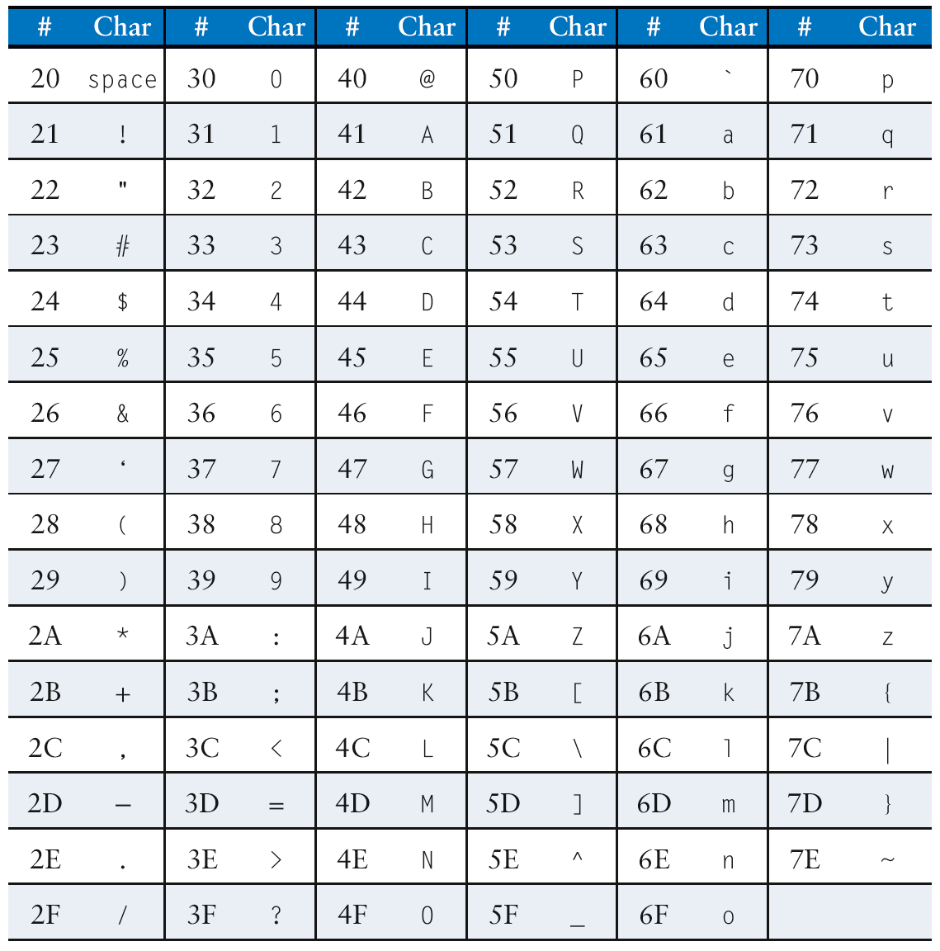
Cast of Characters

Slide 91
Programming Building Blocks
Data-processing Instructions
Conditional Execution
Branches
High-level Constructs:
  if/else statements
  for loops
  while loops
  arrays
  function calls

Slide 92
Function Calls
Caller: calling function (in this case, main)
Callee: called function (in this case, sum)
C Code
void main()
{
int y;
y = sum(42, 7);
...
}
int sum(int a, int b)
{
return (a + b);
}

Slide 93
Function Conventions
Caller:
  passes arguments to callee
  jumps to callee

Slide 94
Function Conventions
Caller:
  passes arguments to callee
  jumps to callee
Callee:
  performs the function
  returns result to caller
  returns to point of call
  must not overwrite registers or memory needed by caller

Slide 95
ARM Function Conventions
Call Function: branch and link
BL
Return from function: move the link register to PC: MOV PC, LR
Arguments: R0-R3
Return value: R0

Slide 96
Function Calls
C Code
int main() {
simple();
a = b + c;
}
void simple() {
return;
}
ARM Assembly Code
0x00000200 MAIN BL SIMPLE
0x00000204 ADD R4, R5, R6
...
0x00401020 SIMPLE MOV PC, LR
void means that simple doesn’t return a value

Slide 97
Function Calls
C Code
int main() {
simple();
a = b + c;
}
void simple() {
return;
}
ARM Assembly Code
0x00000200 MAIN BL SIMPLE
0x00000204 ADD R4, R5, R6
...
0x00401020 SIMPLE MOV PC, LR
BL branches to SIMPLE
LR = PC + 4 = 0x00000204
MOV PC, LR makes PC = LR
(the next instruction executed is at 0x00000200)

Slide 98
Input Arguments and Return Value
ARM conventions:
Argument values: R0 - R3
Return value: R0

Slide 99
Input Arguments and Return Value
C Code
int main()
{
int y;
...
y = diffofsums(2, 3, 4, 5); // 4 arguments
...
}
int diffofsums(int f, int g, int h, int i)
{
int result;
result = (f + g) - (h + i);
return result; // return value
}

Slide 100
Input Arguments and Return Value
ARM Assembly Code
; R4 = y
MAIN
...
MOV R0, #2 ; argument 0 = 2
MOV R1, #3 ; argument 1 = 3
MOV R2, #4 ; argument 2 = 4
MOV R3, #5 ; argument 3 = 5
BL DIFFOFSUMS ; call function
MOV R4, R0 ; y = returned value
...
; R4 = result
DIFFOFSUMS
ADD R8, R0, R1 ; R8 = f + g
ADD R9, R2, R3 ; R9 = h + i
SUB R4, R8, R9 ; result = (f + g) - (h + i)
MOV R0, R4 ; put return value in R0
MOV PC, LR ; return to caller

Slide 101
Input Arguments and Return Value
ARM Assembly Code
; R4 = result
DIFFOFSUMS
ADD R8, R0, R1 ; R8 = f + g
ADD R9, R2, R3 ; R9 = h + i
SUB R4, R8, R9 ; result = (f + g) - (h + i)
MOV R0, R4 ; put return value in R0
MOV PC, LR ; return to caller
diffofsums overwrote 3 registers: R4, R8, R9
diffofsums can use stack to temporarily store registers

Slide 102

The Stack
Memory used to temporarily save variables
Like stack of dishes, last-in-first-out (LIFO) queue
Expands: uses more memory when more space needed
Contracts: uses less memory when the space no longer needed

Slide 103
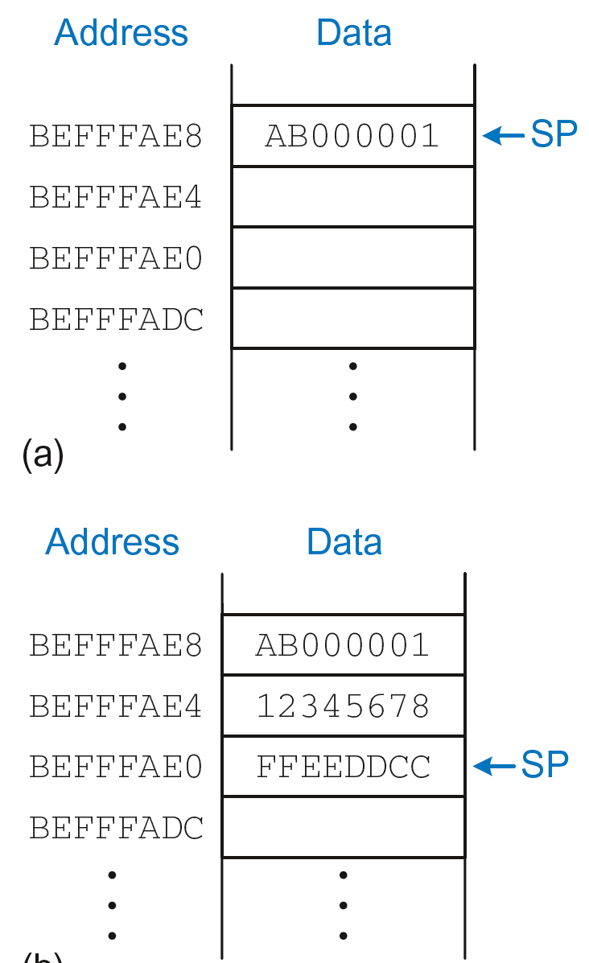
The Stack
Grows down (from higher to lower memory addresses)
Stack pointer: SP points to top of the stack
Stack expands by 2 words

Slide 104
How Functions use the Stack
Called functions must have no unintended side effects
But diffofsums overwrites 3 registers: R4, R8, R9
ARM Assembly Code
; R4 = result
DIFFOFSUMS
ADD R8, R0, R1 ; R8 = f + g
ADD R9, R2, R3 ; R9 = h + i
SUB R4, R8, R9 ; result = (f + g) - (h + i)
MOV R0, R4 ; put return value in R0
MOV PC, LR ; return to caller

Slide 105
Storing Register Values on the Stack
ARM Assembly Code
; R2 = result
DIFFOFSUMS
SUB SP, SP, #12 ; make space on stack for 3 registers
STR R4, [SP, 8] ; save R4 on stack
STR R8, [SP, #4] ; save R8 on stack
STR R9, [SP] ; save R9 on stack
ADD R8, R0, R1 ; R8 = f + g
ADD R9, R2, R3 ; R9 = h + i
SUB R4, R8, R9 ; result = (f + g) - (h + i)
MOV R0, R4 ; put return value in R0
LDR R9, [SP] ; restore R9 from stack
LDR R8, [SP, #4] ; restore R8 from stack
LDR R4, [SP, #8] ; restore R4 from stack
ADD SP, SP, #12 ; deallocate stack space
MOV PC, LR ; return to caller

Slide 106
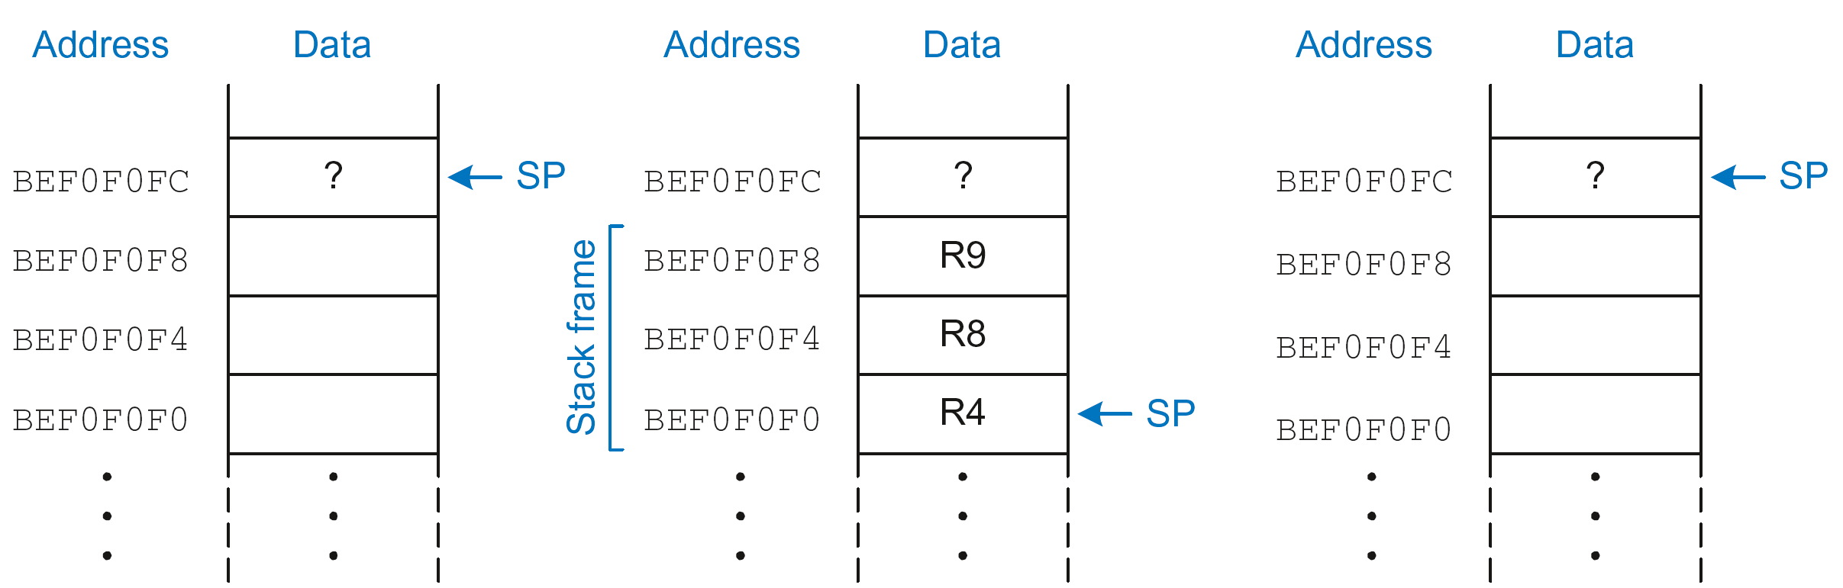
The Stack during diffofsums Call
Before call
During call
After call

Slide 107
Registers
Preserved Callee-Saved | Nonpreserved Caller-Saved
R4-R11 | R12
R14 (LR) | R0-R3
R13 (SP) | CPSR
stack above SP | stack below SP

Slide 108
Storing Saved Registers only on Stack
ARM Assembly Code
; R2 = result
DIFFOFSUMS
STR R4, [SP, #-4]! ; save R4 on stack
ADD R8, R0, R1 ; R8 = f + g
ADD R9, R2, R3 ; R9 = h + i
SUB R4, R8, R9 ; result = (f + g) - (h + i)
MOV R0, R4 ; put return value in R0
LDR R4, [SP], #4 ; restore R4 from stack
MOV PC, LR ; return to caller

Slide 109
Storing Saved Registers only on Stack
ARM Assembly Code
; R2 = result
DIFFOFSUMS
STR R4, [SP, #-4]! ; save R4 on stack
ADD R8, R0, R1 ; R8 = f + g
ADD R9, R2, R3 ; R9 = h + i
SUB R4, R8, R9 ; result = (f + g) - (h + i)
MOV R0, R4 ; put return value in R0
LDR R4, [SP], #4 ; restore R4 from stack
MOV PC, LR ; return to caller
Notice code optimization for expanding/contracting stack

Slide 110
Nonleaf Function
ARM Assembly Code
STR LR, [SP, #-4]! ; store LR on stack
BL PROC2 ; call another function
...
LDR LR, [SP], #4 ; restore LR from stack
MOV PC, LR ; return to caller

Slide 111
Nonleaf Function Example
C Code
int f1(int a, int b) {
int i, x;
x = (a + b)*(a − b);
for (i=0; i<a; i++)
x = x + f2(b+i);
return x;
}
int f2(int p) {
int r;
r = p + 5;
return r + p;
}

Slide 112
Nonleaf Function Example
C Code
int f1(int a, int b) {
int i, x;
x = (a + b)*(a − b);
for (i=0; i<a; i++)
x = x + f2(b+i);
return x;
}
int f2(int p) {
int r;
r = p + 5;
return r + p;
}
ARM Assembly Code
; R0=a, R1=b, R4=i, R5=x
F1
PUSH {R4, R5, LR}
ADD R5, R0, R1
SUB R12, R0, R1
MUL R5, R5, R12
MOV R4, #0
FOR
CMP R4, R0
BGE RETURN
PUSH {R0, R1}
ADD R0, R1, R4
BL F2
ADD R5, R5, R0
POP {R0, R1}
ADD R4, R4, #1
B FOR
RETURN
MOV R0, R5
POP {R4, R5, LR}
MOV PC, LR
; R0=p, R4=r
F2
PUSH {R4}
ADD R4, R0, 5
ADD R0, R4, R0
POP {R4}
MOV PC, LR

Slide 113
Nonleaf Function Example
ARM Assembly Code
; R0=a, R1=b, R4=i, R5=x
F1
PUSH {R4, R5, LR} ; save regs
ADD R5, R0, R1 ; x = (a+b)
SUB R12, R0, R1 ; temp = (a-b)
MUL R5, R5, R12 ; x = x*temp
MOV R4, #0 ; i = 0
FOR
CMP R4, R0 ; i < a?
BGE RETURN ; no: exit loop
PUSH {R0, R1} ; save regs
ADD R0, R1, R4 ; arg is b+i
BL F2 ; call f2(b+i)
ADD R5, R5, R0 ; x = x+f2(b+i)
POP {R0, R1} ; restore regs
ADD R4, R4, #1 ; i++
B FOR ; repeat loop
RETURN
MOV R0, R5 ; return x
POP {R4, R5, LR} ; restore regs
MOV PC, LR ; return
; R0=p, R4=r
F2
PUSH {R4} ; save regs
ADD R4, R0, 5 ; r = p+5
ADD R0, R4, R0 ; return r+p
POP {R4} ; restore regs
MOV PC, LR ; return

Slide 114
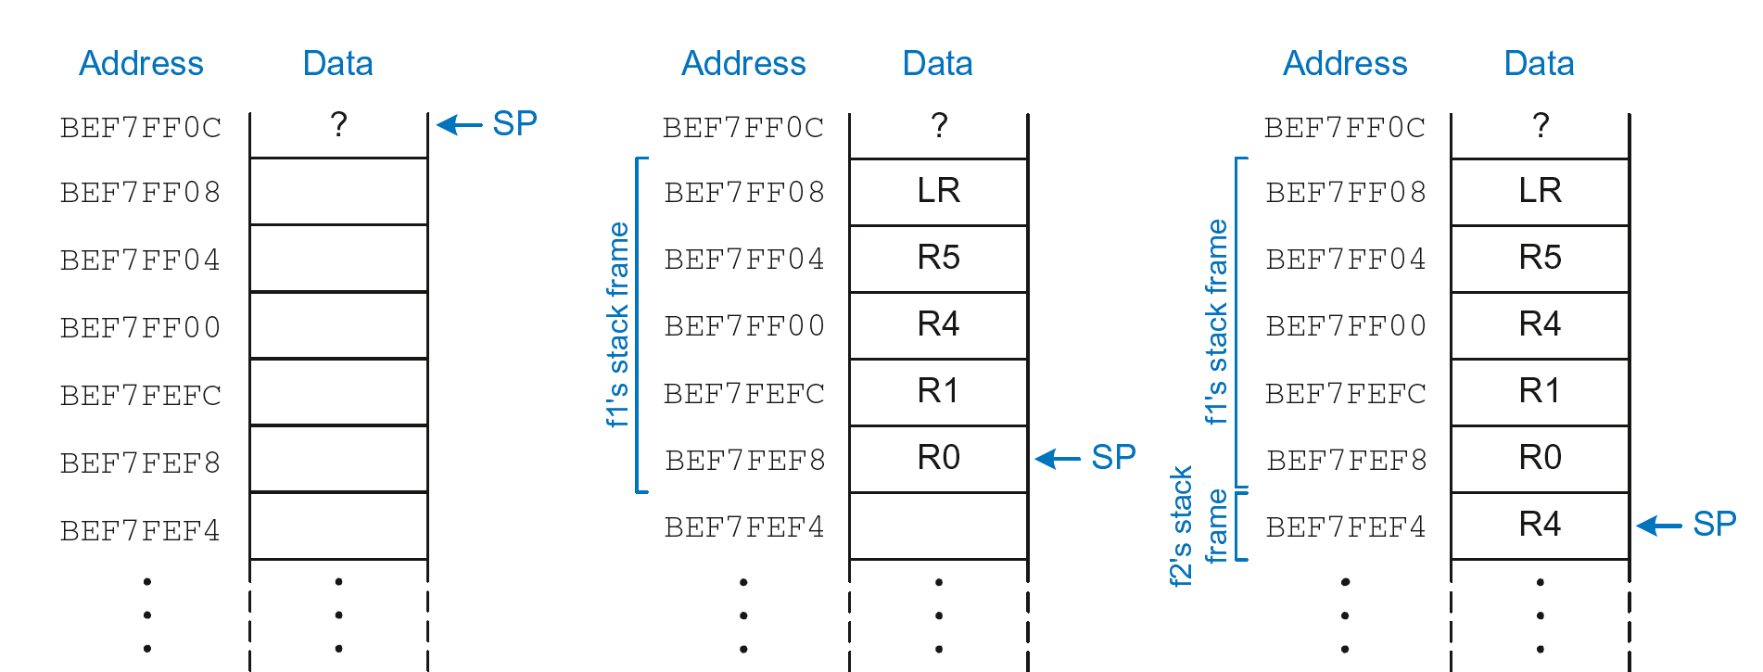
Stack during Nonleaf Function
At beginning of f1
Just before calling f2
After calling f2

Slide 115
Recursive Function Call
C Code
int factorial(int n) {
if (n <= 1)
return 1;
else
return (n * factorial(n-1));
}

Slide 116
Recursive Function Call
ARM Assembly Code
0x94 FACTORIAL STR R0, [SP, #-4]! ;store R0 on stack
0x98 STR LR, [SP, #-4]! ;store LR on stack
0x9C CMP R0, #2 ;set flags with R0-2
0xA0 BHS ELSE ;if (r0>=2) branch to else
0xA4 MOV R0, #1 ; otherwise return 1
0xA8 ADD SP, SP, #8 ; restore SP 1
0xAC MOV PC, LR ; return
0xB0 ELSE SUB R0, R0, #1 ; n = n - 1
0xB4 BL FACTORIAL ; recursive call
0xB8 LDR LR, [SP], #4 ; restore LR
0xBC LDR R1, [SP], #4 ; restore R0 (n) into R1
0xC0 MUL R0, R1, R0 ; R0 = n*factorial(n-1)
0xC4 MOV PC, LR ; return

Slide 117
Recursive Function Call
C Code
int factorial(int n) {
if (n <= 1)
return 1;
else
return (n * factorial(n-1));
}
ARM Assembly Code
0x94 FACTORIAL STR R0, [SP, #-4]!
0x98 STR LR, [SP, #-4]!
0x9C CMP R0, #2
0xA0 BHS ELSE
0xA4 MOV R0, #1
0xA8 ADD SP, SP, #8
0xAC MOV PC, LR
0xB0 ELSE SUB R0, R0, #1
0xB4 BL FACTORIAL
0xB8 LDR LR, [SP], #4
0xBC LDR R1, [SP], #4
0xC0 MUL R0, R1, R0
0xC4 MOV PC, LR

Slide 118
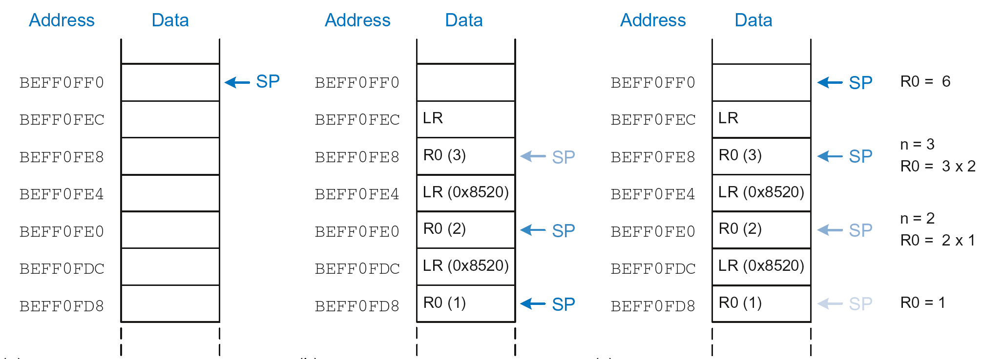
Stack during Recursive Call
Before call
During call
After call

Slide 119
Function Call Summary
Caller
  Puts arguments in R0-R3
  Saves any needed registers (LR, maybe R0-R3, R8-R12)
  Calls function: BL CALLEE
  Restores registers
  Looks for result in R0
Callee
  Saves registers that might be disturbed (R4-R7)
  Performs function
  Puts result in R0
  Restores registers
  Returns: MOV PC, LR

Slide 120
How to Encode Instructions?

Slide 121
How to Encode Instructions?
Design Principle 1: Regularity supports design simplicity
  32-bit data, 32-bit instructions
  For design simplicity, would prefer a single instruction format but…

Slide 122
How to Encode Instructions?
Design Principle 1: Regularity supports design simplicity
  32-bit data, 32-bit instructions
  For design simplicity, would prefer a single instruction format but…
  Instructions have different needs

Slide 123
Design Principle 4
Good design demands good compromises
Multiple instruction formats allow flexibility
  ADD, SUB: use 3 register operands
  LDR, STR: use 2 register operands and a constant
Number of instruction formats kept small
  to adhere to design principles 1 and 3 (regularity supports design simplicity and smaller is faster)

Slide 124
Machine Language
Binary representation of instructions
Computers only understand 1’s and 0’s
32-bit instructions
  Simplicity favors regularity: 32-bit data & instructions
3 instruction formats:
  Data-processing
  Memory
  Branch

Slide 125
Instruction Formats
Data-processing
Memory
Branch

Slide 126
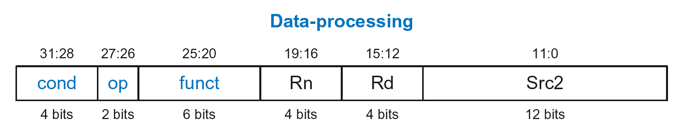
Data-processing Instruction Format
Operands:
  Rn: first source register
  Src2: second source – register or immediate
  Rd: destination register
Control fields:
  cond: specifies conditional execution
  op: the operation code or opcode
  funct: the function/operation to perform

Slide 127
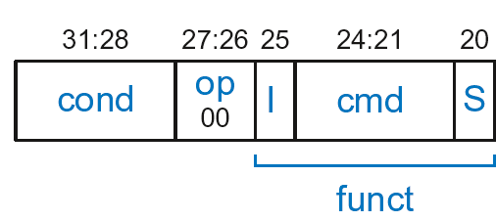
Data-processing Control Fields
op = 00₂ for data-processing (DP) instructions
funct is composed of cmd, I-bit, and S-bit

Slide 128
Data-processing Control Fields
op = 00₂ for data-processing (DP) instructions
funct is composed of cmd, I-bit, and S-bit
  cmd: specifies the specific data-processing instruction. For example,
    cmd = 0100₂ for ADD
    cmd = 0010₂ for SUB
  I-bit
    I = 0: Src2 is a register
    I = 1: Src2 is an immediate
  S-bit: 1 if sets condition flags
    S = 0: SUB R0, R5, R7
    S = 1: ADDS R8, R2, R4 or CMP R3, #10

Slide 129
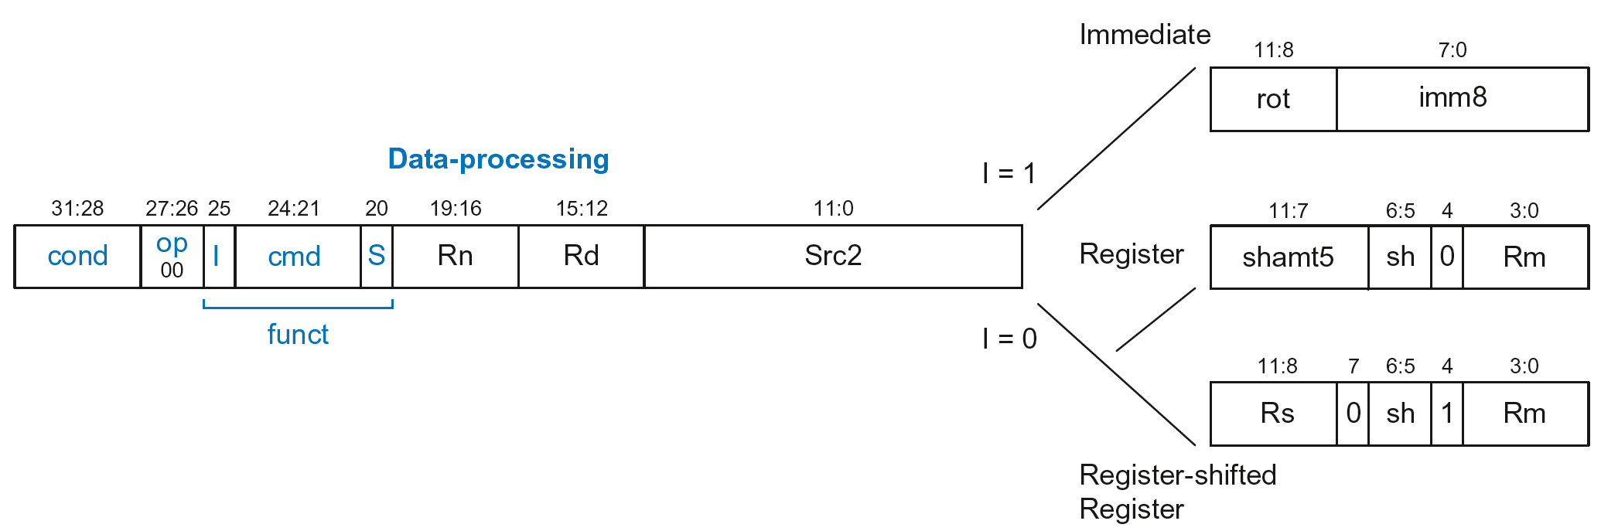
Data-processing Src2 Variations
Src2 can be:
  Immediate
  Register
  Register-shifted register

Slide 130
Data-processing Src2 Variations
Src2 can be:
  Immediate
  Register
  Register-shifted register

Slide 131
Immediate Src2
Immediate encoded as:
  imm8: 8-bit unsigned immediate
  rot: 4-bit rotation value
32-bit constant is: imm8 ROR (rot × 2)

Slide 132
Immediate Src2
Immediate encoded as:
  imm8: 8-bit unsigned immediate
  rot: 4-bit rotation value
32-bit constant is: imm8 ROR (rot × 2)
Example: imm8 = abcdefgh
rot | 32-bit constant
0000 | 0000 0000 0000 0000 0000 0000 abcd efgh
0001 | gh00 0000 0000 0000 0000 0000 00ab cdef
… | …
1111 | 0000 0000 0000 0000 0000 00ab cdef gh00

Slide 133
Immediate Src2
Immediate encoded as:
  imm8: 8-bit unsigned immediate
  rot: 4-bit rotation value
32-bit constant is: imm8 ROR (rot × 2)
Example: imm8 = abcdefgh
ROR by X = ROL by (32-X)
Ex: ROR by 30 = ROL by 2
rot | 32-bit constant
0000 | 0000 0000 0000 0000 0000 0000 abcd efgh
0001 | gh00 0000 0000 0000 0000 0000 00ab cdef
… | …
1111 | 0000 0000 0000 0000 0000 00ab cdef gh00

Slide 134
DP Instruction with Immediate Src2
  ADD R0, R1, #42
        cond = 1110₂ (14) for unconditional execution
        op = 00₂ (0) for data-processing instructions
        cmd = 0100₂ (4) for ADD
        Src2 is an immediate so I = 1
        Rd = 0, Rn = 1
        imm8 = 42, rot = 0

Slide 135
DP Instruction with Immediate Src2
  ADD R0, R1, #42
        cond = 1110₂ (14) for unconditional execution
        op = 00₂ (0) for data-processing instructions
        cmd = 0100₂ (4) for ADD
        Src2 is an immediate so I = 1
        Rd = 0, Rn = 1
        imm8 = 42, rot = 0
0xE281002A

Slide 136
DP Instruction with Immediate Src2
  SUB R2, R3, #0xFF0
  cond = 1110₂ (14) for unconditional execution
  op = 00₂ (0) for data-processing instructions
  cmd = 0010₂ (2) for SUB
  Src2 is an immediate so I=1
  Rd = 2, Rn = 3
  imm8 = 0xFF
  imm8 must be rotated right by 28 to produce 0xFF0, so rot = 14
ROR by 28 =
ROL by (32-28) = 4
0xE2432EFF

Slide 137
DP Instruction with Register Src2
Src2 can be:
  Immediate
  Register
  Register-shifted register

Slide 138
DP Instruction with Register Src2
Rm: the second source operand
shamt5: the amount Rm is shifted
sh: the type of shift (i.e., >>, <<, >>>, ROR)

Slide 139
DP Instruction with Register Src2
Rm: the second source operand
shamt5: the amount Rm is shifted
sh: the type of shift (i.e., >>, <<, >>>, ROR)
  First, consider unshifted versions of Rm (shamt5=0, sh=0)

Slide 140
DP Instruction with Register Src2
  ADD R5, R6, R7
  cond = 1110₂ (14) for unconditional execution
  op = 00₂ (0) for data-processing instructions
  cmd = 0100₂ (4) for ADD
  Src2 is a register so I=0
  Rd = 5, Rn = 6, Rm = 7
  shamt = 0, sh = 0
0xE0865007

Slide 141
DP Instruction with Register Src2
Rm: the second source operand
shamt5: the amount Rm is shifted
sh: the type of shift
Shift Type | sh
LSL | 00₂
LSR | 01₂
ASR | 10₂
ROR | 11₂
  Now, consider shifted versions.

Slide 142
DP Instruction with Register Src2
  ORR R9, R5, R3, LSR #2
  Operation: R9 = R5 OR (R3 >> 2)
  cond = 1110₂ (14) for unconditional execution
  op = 00₂ (0) for data-processing instructions
  cmd = 1100₂ (12) for ORR
  Src2 is a register so I=0
  Rd = 9, Rn = 5, Rm = 3
  shamt5 = 2, sh = 01₂ (LSR)
  1110 00 0 1100 0 0101 1001 00010 01 0 0011
  0xE1859123

Slide 143
DP with Register-shifted Reg. Src2
Src2 can be:
  Immediate
  Register
  Register-shifted register

Slide 144
DP with Register-shifted Reg. Src2
  EOR R8, R9, R10, ROR R12
  Operation: R8 = R9 XOR (R10 ROR R12)
  cond = 1110₂ (14) for unconditional execution
  op = 00₂ (0) for data-processing instructions
  cmd = 0001₂ (1) for EOR
  Src2 is a register so I=0
  Rd = 8, Rn = 9, Rm = 10, Rs = 12
  sh = 11₂ (ROR)
  1110 00 0 0001 0 1001 1000 1100 0 11 1 1010
  0xE0298C7A

Slide 145
Shift Instructions Encoding
Shift Type | sh
LSL | 00₂
LSR | 01₂
ASR | 10₂
ROR | 11₂

Slide 146
Shift Instructions: Immediate shamt
  ROR R1, R2, #23
  Operation: R1 = R2 ROR 23
  cond = 1110₂ (14) for unconditional execution
  op = 00₂ (0) for data-processing instructions
  cmd = 1101₂ (13) for all shifts (LSL, LSR, ASR, and ROR)
  Src2 is an immediate-shifted register so I=0
  Rd = 1, Rn = 0, Rm = 2
  shamt5 = 23, sh = 11₂ (ROR)
  1110 00 0 1101 0 0000 0001 10111 11 0 0010
  0xE1A01BE2

Slide 147
Shift Instructions: Immediate shamt
  ROR R1, R2, #23
  Operation: R1 = R2 ROR 23
  cond = 1110₂ (14) for unconditional execution
  op = 00₂ (0) for data-processing instructions
  cmd = 1101₂ (13) for all shifts (LSL, LSR, ASR, and ROR)
  Src2 is an immediate-shifted register so I=0
  Rd = 1, Rn = 0, Rm = 2
  shamt5 = 23, sh = 11₂ (ROR)
Uses (immediate-shifted) register Src2 encoding
  1110 00 0 1101 0 0000 0001 10111 11 0 0010
  0xE1A01BE2

Slide 148
Shift Instructions: Register shamt
  ASR R5, R6, R10
  Operation: R5 = R6 >>> R10_{7:0}
  cond = 1110₂ (14) for unconditional execution
  op = 00₂ (0) for data-processing instructions
  cmd = 1101₂ (13) for all shifts (LSL, LSR, ASR, and ROR)
  Src2 is a register so I=0
  Rd = 5, Rn = 0, Rm = 6, Rs = 10
  sh = 10₂ (ASR)
  1110 00 0 1101 0 0000 0101 1010 0 10 1 0110
  0xE1A05A56

Slide 149
Shift Instructions: Register shamt
  ASR R5, R6, R10
  Operation: R5 = R6 >>> R10_{7:0}
  cond = 1110₂ (14) for unconditional execution
  op = 00₂ (0) for data-processing instructions
  cmd = 1101₂ (13) for all shifts (LSL, LSR, ASR, and ROR)
  Src2 is a register so I=0
  Rd = 5, Rn = 0, Rm = 6, Rs = 10
  sh = 10₂ (ASR)
Uses register-shifted register Src2 encoding
  1110 00 0 1101 0 0000 0101 1010 0 10 1 0110
  0xE1A05A56

Slide 150
Review: Data-processing Format
Src2 can be:
  Immediate
  Register
  Register-shifted register

Slide 151
Instruction Formats
Data-processing
Memory
Branch

Slide 152
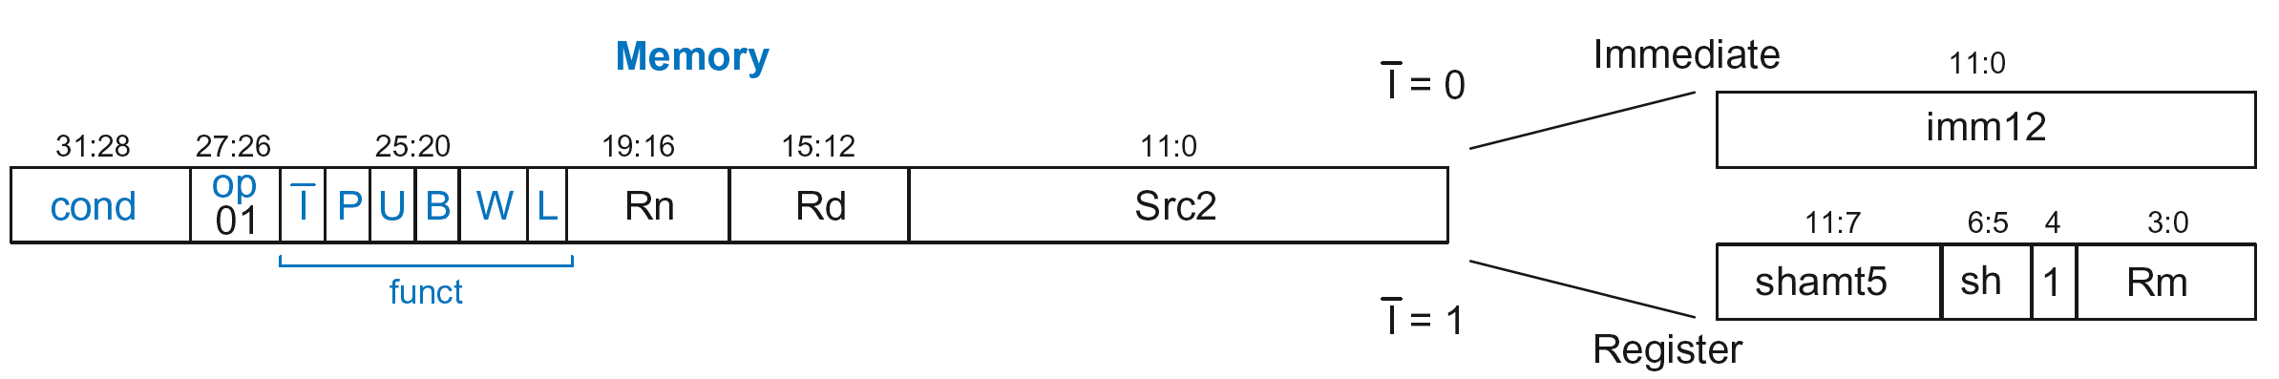
Memory Instruction Format
Encodes: LDR, STR, LDRB, STRB
op = 01₂
Rn = base register
Rd = destination (load), source (store)
Src2 = offset
funct = 6 control bits

Slide 153
Offset Options
Recall: Address = Base Address + Offset
  Example: LDR R1, [R2, #4]
  Base Address = R2, Offset = 4
  Address = (R2 + 4)
Base address always in a register
The offset can be:
  an immediate
  a register
  or a scaled (shifted) register

Slide 154
Offset Examples
ARM Assembly | Memory Address
LDR R0, [R3, #4] | R3 + 4
LDR R0, [R5, #-16] | R5 – 16
LDR R1, [R6, R7] | R6 + R7
LDR R2, [R8, -R9] | R8 – R9
LDR R3, [R10, R11, LSL #2] | R10 + (R11 << 2)
LDR R4, [R1, -R12, ASR #4] | R1 – (R12 >>> 4)
LDR R0, [R9] | R9

Slide 155
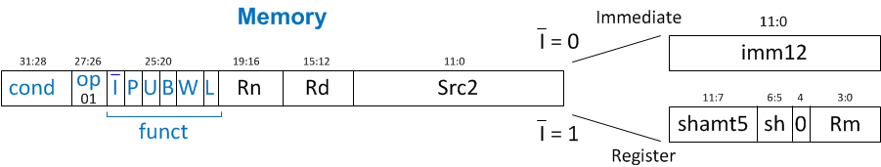
Memory Instruction Format
Encodes: LDR, STR, LDRB, STRB
op = 01₂
Rn = base register
Rd = destination (load), source (store)
Src2 = offset: register (optionally shifted) or immediate
funct = 6 control bits

Slide 156
Indexing Modes
Mode | Address | Base Reg. Update
Offset | Base register ± Offset | No change
Preindex | Base register ± Offset | Base register ± Offset
Postindex | Base register | Base register ± Offset
Examples
Offset: LDR R1, [R2, #4] ; R1 = mem[R2+4]
Preindex: LDR R3, [R5, #16]! ; R3 = mem[R5+16]
; R5 = R5 + 16
Postindex: LDR R8, [R1], #8 ; R8 = mem[R1]
    ; R1 = R1 + 8

Slide 157
Memory Instruction Format
funct:
  I: Immediate bar
  P: Preindex
  U: Add
  B: Byte
  W: Writeback
  L: Load

Slide 158
Memory Format funct Encodings
Type of Operation
L | B | Instruction
0 | 0 | STR
0 | 1 | STRB
1 | 0 | LDR
1 | 1 | LDRB

Slide 159
Memory Format funct Encodings
Type of Operation
Indexing Mode
L | B | Instruction
0 | 0 | STR
0 | 1 | STRB
1 | 0 | LDR
1 | 1 | LDRB
P | W | Indexing Mode
0 | 1 | Not supported
0 | 0 | Postindex
1 | 0 | Offset
1 | 1 | Preindex

Slide 160
Memory Format funct Encodings
Type of Operation
Indexing Mode
L | B | Instruction
0 | 0 | STR
0 | 1 | STRB
1 | 0 | LDR
1 | 1 | LDRB
P | W | Indexing Mode
0 | 1 | Not supported
0 | 0 | Postindex
1 | 0 | Offset
1 | 1 | Preindex
Add/Subtract Immediate/Register Offset
Value | I | U
0 | Immediate offset in Src2 | Subtract offset from base
1 | Register offset in Src2 | Add offset to base

Slide 161
Memory Instruction Format
Encodes: LDR, STR, LDRB, STRB
op = 01₂
Rn = base register
Rd = destination (load), source (store)
Src2 = offset: immediate or register (optionally shifted)
funct = I (immediate bar), P (preindex), U (add),
B (byte), W (writeback), L (load)

Slide 162
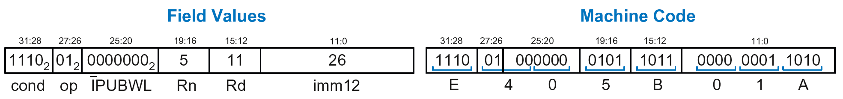
Memory Instr. with Immediate Src2
  STR R11, [R5], #-26
  Operation: mem[R5] <= R11; R5 = R5 - 26
  cond = 1110₂ (14) for unconditional execution
  op = 01₂ (1) for memory instruction
  funct = 0000000₂ (0)
  I = 0 (immediate offset), P = 0 (postindex),
  U = 0 (subtract), B = 0 (store word), W = 0 (postindex),
  L = 0 (store)
  Rd = 11, Rn = 5, imm12 = 26

Slide 163
Memory Instr. with Register Src2
  LDR R3, [R4, R5]
  Operation: R3 <= mem[R4 + R5]
  cond = 1110₂ (14) for unconditional execution
  op = 01₂ (1) for memory instruction
  funct = 111001₂ (57)
  I = 1 (register offset), P = 1 (offset indexing),
  U = 1 (add), B = 0 (load word), W = 0 (offset indexing),
  L = 1 (load)
  Rd = 3, Rn = 4, Rm = 5 (shamt5 = 0, sh = 0)
  1110 01 111001 0100 0011 00000 00 0 0101 = 0xE7943005

Slide 164
Memory Instr. with Scaled Reg. Src2
  STR R9, [R1, R3, LSL #2]
  Operation: mem[R1 + (R3 << 2)] <= R9
  cond = 1110₂ (14) for unconditional execution
  op = 01₂ (1) for memory instruction
  funct = 111000₂ (0)
  I = 1 (register offset), P = 1 (offset indexing),
  U = 1 (add), B = 0 (store word), W = 0 (offset indexing),
  L = 0 (store)
  Rd = 9, Rn = 1, Rm = 3, shamt = 2, sh = 00₂ (LSL)
  1110 01 111000 0001 1001 00010 00 0 0011 = 0xE7819103

Slide 165
Review: Memory Instruction Format
Encodes: LDR, STR, LDRB, STRB
op = 01₂
Rn = base register
Rd = destination (load), source (store)
Src2 = offset: register (optionally shifted) or immediate
funct = I (immediate bar), P (preindex), U (add),
B (byte), W (writeback), L (load)

Slide 166
Instruction Formats
Data-processing
Memory
Branch

Slide 167
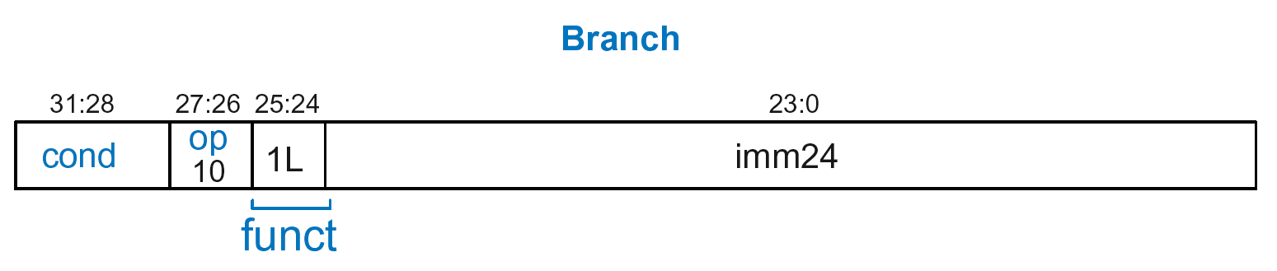
Branch Instruction Format
Encodes B and BL
op = 10₂
imm24: 24-bit immediate
funct = 1L₂: L = 1 for BL, L = 0 for B

Slide 168
Encoding Branch Target Address
Branch Target Address (BTA): Next PC when branch taken
BTA is relative to current PC + 8
imm24 encodes BTA
imm24 = # of words BTA is away from PC+8

Slide 169
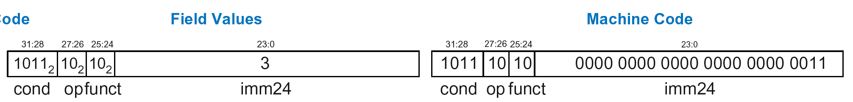
Branch Instruction: Example 1
ARM assembly code
0xA0 BLT THERE
0xA4 ADD R0, R1, R2
0xA8 SUB R0, R0, R9
0xAC ADD SP, SP, #8
0xB0 MOV PC, LR
0xB4 THERE SUB R0, R0, #1
0xB8 BL TEST
PC
PC = 0xA0
PC + 8 = 0xA8
THERE label is 3 instructions past PC+8
So, imm24 = 3
PC+8
BTA
0xBA000003

Slide 170
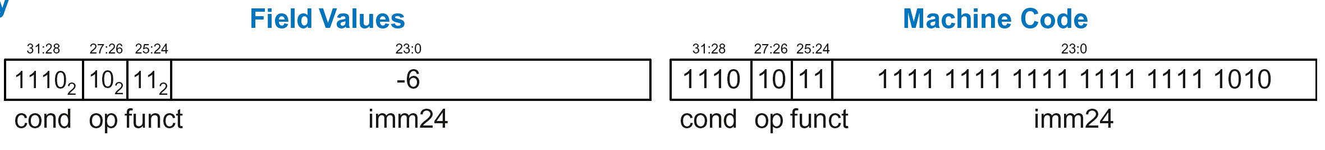
Branch Instruction: Example 2
ARM assembly code
0x8040 TEST LDRB R5, [R0, R3]
0x8044 STRB R5, [R1, R3]
0x8048 ADD R3, R3, #1
0x8044 MOV PC, LR
0x8050 BL TEST
0x8054 LDR R3, [R1], #4
0x8058 SUB R4, R3, #9
BTA
PC = 0x8050
PC + 8 = 0x8058
TEST label is 6 instructions before PC+8
So, imm24 = -6
PC
PC+8
0xEBFFFFFA

Slide 171
Review: Instruction Formats

Slide 172
Conditional Execution
Encode in cond bits of machine instruction
  For example,
  ANDEQ R1, R2, R3 (cond = 0000)
  ORRMI R4, R5, #0xF (cond = 0100)
  SUBLT R9, R3, R8 (cond = 1011)

Slide 173
Review: Condition Mnemonics

Slide 174
Conditional Execution: Machine Code

Slide 175
Interpreting Machine Code
Start with op: tells how to parse rest
    op = 00 (Data-processing)
    op = 01 (Memory)
    op = 10 (Branch)
I-bit: tells how to parse Src2
Data-processing instructions:
    If I-bit is 0, bit 4 determines if Src2 is a register (bit 4 = 0) or a register-shifted register (bit 4 = 1)
Memory instructions:
    Examine funct bits for indexing mode, instruction, and add or subtract offset

Slide 176
Interpreting Machine Code: Example 1
0xE0475001

Slide 177
Interpreting Machine Code: Example 1
0xE0475001
  Start with op: 00₂, so data-processing instruction

Slide 178
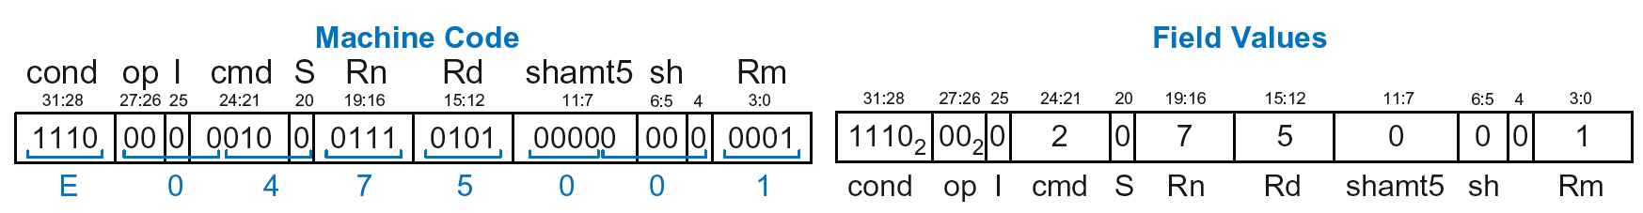
Interpreting Machine Code: Example 1
0xE0475001
  Start with op: 00₂, so data-processing instruction
  I-bit: 0, so Src2 is a register
  bit 4: 0, so Src2 is a register (optionally shifted by shamt5)

Slide 179
Interpreting Machine Code: Example 1
0xE0475001
  Start with op: 00₂, so data-processing instruction
  I-bit: 0, so Src2 is a register
  bit 4: 0, so Src2 is a register (optionally shifted by shamt5)
  cmd: 0010₂ (2), so SUB
  Rn=7, Rd=5, Rm=1, shamt5 = 0, sh = 0
  So, instruction is: SUB R5,R7,R1

Slide 180
Interpreting Machine Code: Example 2
0xE5949010

Slide 181
Interpreting Machine Code: Example 2
0xE5949010
  Start with op: 01₂, so memory instruction
  funct: B=0, L=1, so LDR; P=1, W=0, so offset indexing;
  I=0, so immediate offset, U=1, so add offset
  Rn=4, Rd=9, imm12 = 16
  So, instruction is: LDR R9,[R4,#16]

Slide 182
Addressing Modes
How do we address operands?
Register
Immediate
Base
PC-Relative

Slide 183
Addressing Modes
How do we address operands?
Register Only
Immediate
Base
PC-Relative

Slide 184
Register Addressing
Source and destination operands found in registers
Used by data-processing instructions
Three submodes:
  Register-only
  Immediate-shifted register
  Register-shifted register

Slide 185
Register Addressing Examples
Register-only
  Example: ADD R0, R2, R7
Immediate-shifted register
  Example: ORR R5, R1, R3, LSL #1
Register-shifted register
  Example: SUB R12, R9, R0, ASR R1

Slide 186
Addressing Modes
How do we address operands?
Register Only
Immediate
Base
PC-Relative

Slide 187
Immediate Addressing
Operands found in registers and immediates
  Example: ADD R9, R1, #14
Uses data-processing format with I=1
  Immediate is encoded as
    8-bit immediate (imm8)
    4-bit rotation (rot)
  32-bit immediate = imm8 ROR (rot x 2)

Slide 188
Addressing Modes
How do we address operands?
Register Only
Immediate
Base
PC-Relative

Slide 189
Base Addressing
Address of operand is:
base register + offset
Offset can be a:
  12-bit Immediate
  Register
  Immediate-shifted Register

Slide 190
Base Addressing Examples
Immediate offset
  Example: LDR R0, [R8, #-11]
  (R0 = mem[R8 - 11] )
Register offset
  Example: LDR R1, [R7, R9]
  (R1 = mem[R7 + R9] )
Immediate-shifted register offset
  Example: STR R5, [R3, R2, LSL #4]
  (R5 = mem[R3 + (R2 << 4)] )

Slide 191
Addressing Modes
How do we address operands?
Register Only
Immediate
Base
PC-Relative

Slide 192
PC-Relative Addressing
Used for branches
Branch instruction format:
  Operands are PC and a signed 24-bit immediate (imm24)
  Changes the PC
  New PC is relative to the old PC
  imm24 indicates the number of words away from PC+8
PC = (PC+8) + (SignExtended(imm24) x 4)

Slide 193
Power of the Stored Program
32-bit instructions & data stored in memory
Sequence of instructions: only difference between two applications
To run a new program:
  No rewiring required
  Simply store new program in memory
Program Execution:
  Processor fetches (reads) instructions from memory in sequence
  Processor performs the specified operation

Slide 194
The Stored Program
Program Counter (PC): keeps track of current instruction

Slide 195
Up Next
How to implement the ARM Instruction Set
Architecture in Hardware
  Microarchitecture

