Slide 1

Lecture 9:
Shift, Mult, Div
Fixed & Floating Point
E85 Digital Design & Computer Engineering

Slide 2
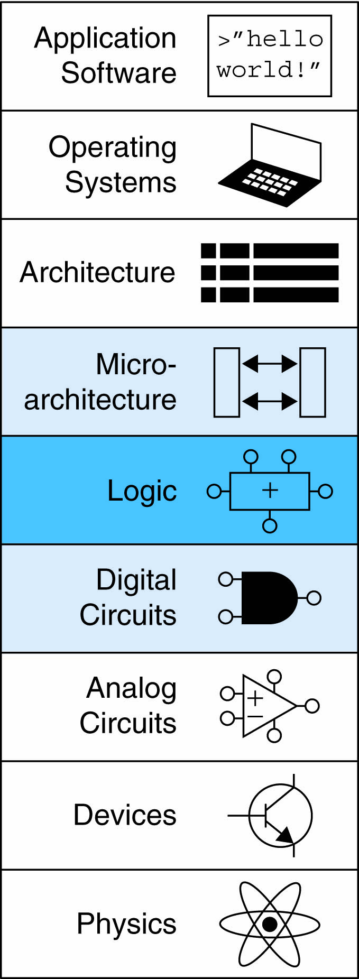
Lecture 9
Shifters
Multipliers
Dividers
Fixed Point Numbers
Floating Point Numbers

Slide 3
Shifters
Logical shifter: shifts value to left or right and fills empty spaces with 0’s
  Ex: 11001 >> 2 = 00110
  Ex: 11001 << 2 = 00100
Arithmetic shifter: same as logical shifter, but on right shift, fills empty spaces with the old most significant bit (msb)
  Ex: 11001 >>> 2 = 11110
  Ex: 11001 <<< 2 = 00100
Rotator: rotates bits in a circle, such that bits shifted off one end are shifted into the other end
  Ex: 11001 ROR 2 = 01110
  Ex: 11001 ROL 2 = 00111

Slide 4
Shifter Design

Slide 5
Shifters as Multipliers, Dividers
A << N = A × 2^{N}
  Example: 00001 << 2 = 00100 (1 × 2² = 4)
  Example: 11101 << 2 = 10100 (-3 × 2² = -12)
A >>> N = A ÷ 2^{N}
  Example: 01000 >>> 2 = 00010 (8 ÷ 2² = 2)
  Example: 10000 >>> 2 = 11100 (-16 ÷ 2² = -4)

Slide 6
Multipliers
Partial products formed by multiplying a single digit of the multiplier with multiplicand
Shifted partial products summed to form result

Slide 7
4 x 4 Multiplier

Slide 8
Dividers
A/B = Q + R/B
Decimal Example: 2584/15 = 172 R4

Slide 9
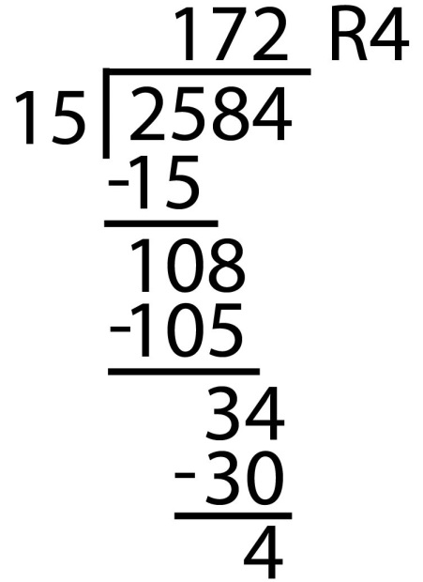
Dividers
A/B = Q + R/B
Decimal Example: 2584/15 = 172 R4
Long-Hand:

Slide 10
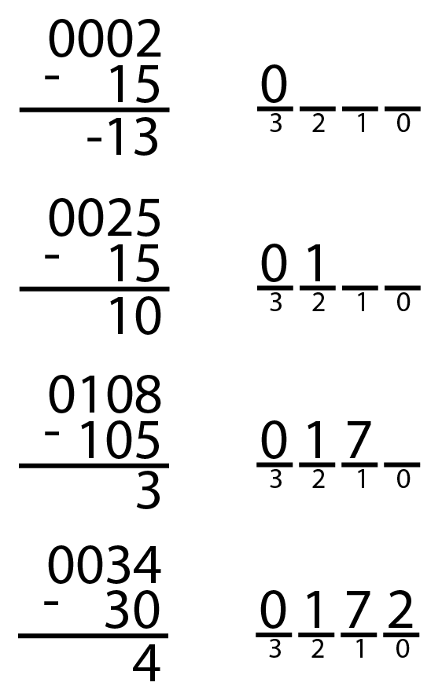
Dividers
A/B = Q + R/B
Decimal Example: 2584/15 = 172 R4
Long-Hand:
Long-Hand Revisited:

Slide 11
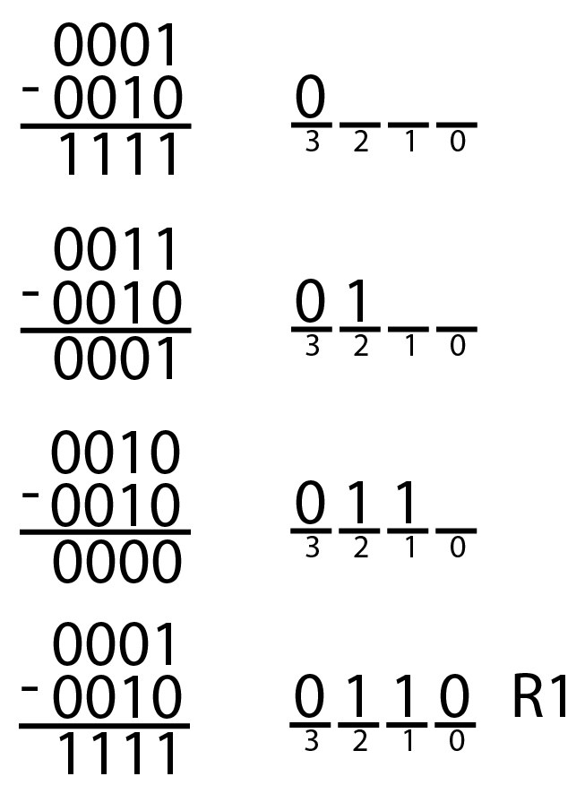
Dividers
A/B = Q + R/B
Decimal: 2584/15 = 172 R4
Binary: 1101/0010 = 0110 R1

Slide 12
Divider Algorithm
A/B = Q + R/B
R’ = 0
for i = N-1 to 0
R = {R’ << 1, A_{i}}
D = R - B
if D < 0, Q_{i}= 0; R’= R
else Q_{i}= 1; R’= D
R=R’
Binary: 1101/10 = 0110 R1

Slide 13
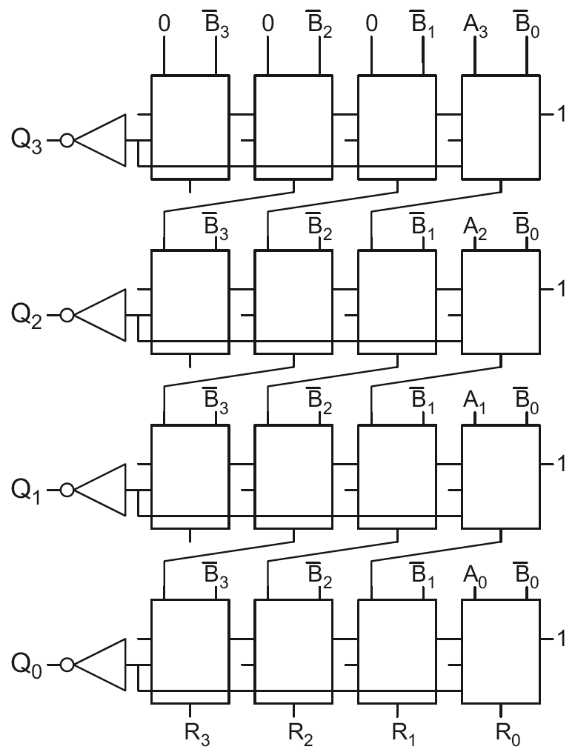
4 x 4 Divider
Division: A/B = Q + R/B
R’ = 0
for i = N-1 to 0
R = {R’ << 1, A_{i}}
D = R - B
if D < 0, Q_{i}=0, R’=R
else Q_{i}=1, R’=D
R=R’
Each row computes one iteration of the division algorithm.

Slide 14
4 x 4 Divider
Each row computes one iteration of the division algorithm.

Slide 15
Number Systems
Numbers we can represent using binary representations
  Positive numbers
    Unsigned binary
  Negative numbers
    Two’s complement
    Sign/magnitude numbers
What about fractions?

Slide 16
Numbers with Fractions
Two common notations:
Fixed-point: binary point fixed
Floating-point: binary point floats to the right of the most significant 1

Slide 17
Fixed-Point Numbers
6.75 using 4 integer bits and 4 fraction bits:
  Binary point is implied
  The number of integer and fraction bits must be agreed upon beforehand

Slide 18
Fixed-Point Number Example
Represent 7.5₁₀ using 4 integer bits and 4 fraction bits.
  01111000

Slide 19
Signed Fixed-Point Numbers
Representations:
  Sign/magnitude
  Two’s complement
Example: Represent -7.5₁₀ using 4 integer and 4 fraction bits
  Sign/magnitude:
  11111000
  Two’s complement:
  1. +7.5: 01111000
  2. Invert bits: 10000111
  3. Add 1 to lsb: + 1
  10001000

Slide 20
Floating-Point Numbers
Binary point floats to the right of the most significant 1
Similar to decimal scientific notation
For example, write 273₁₀ in scientific notation:
  273 = 2.73 × 10²
In general, a number is written in scientific notation as:
± M × B^{E}
  M = mantissa
  B = base
  E = exponent
  In the example, M = 2.73, B = 10, and E = 2

Slide 21
Floating-Point Numbers
Example: represent the value 228₁₀ using a 32-bit floating point representation
We show three versions – final version is called the IEEE 754 floating-point standard

Slide 22
Floating-Point Representation 1
Convert decimal to binary
  228₁₀ = 11100100₂
Write the number in “binary scientific notation”:
  11100100₂ = 1.11001₂ × 2⁷
Fill in each field of the 32-bit floating point number:
  The sign bit is positive (0)
  The 8 exponent bits represent the value 7
  The remaining 23 bits are the mantissa

Slide 23
Floating-Point Representation 2
First bit of the mantissa is always 1:
  228₁₀ = 11100100₂ = 1.11001 × 2⁷
So, no need to store it: implicit leading 1
Store just fraction bits in 23-bit field

Slide 24
Floating-Point Representation 3
Biased exponent: bias = 127 (01111111₂)
  Biased exponent = bias + exponent
  Exponent of 7 is stored as:
  127 + 7 = 134 = 0x10000110₂
The IEEE 754 32-bit floating-point representation of 228₁₀
in hexadecimal: 0x43640000

Slide 25
Floating-Point Example
Write -58.25₁₀ in floating point (IEEE 754)

Slide 26
Floating-Point Example
Write -58.25₁₀ in floating point (IEEE 754)
Convert decimal to binary:
  58.25₁₀ = 111010.01₂
Write in binary scientific notation:
1.1101001 × 2⁵
Fill in fields:
  Sign bit: 1 (negative)
  8 exponent bits: (127 + 5) = 132 = 10000100₂
  23 fraction bits: 110 1001 0000 0000 0000 0000
in hexadecimal: 0xC2690000

Slide 27
Floating-Point: Special Cases
Number | Sign | Exponent | Fraction
0 | X | 00000000 | 00000000000000000000000
∞ | 0 | 11111111 | 00000000000000000000000
- ∞ | 1 | 11111111 | 00000000000000000000000
NaN | X | 11111111 | non-zero

Slide 28
Floating-Point Precision
Single-Precision:
  32-bit
  1 sign bit, 8 exponent bits, 23 fraction bits
  bias = 127
Double-Precision:
  64-bit
  1 sign bit, 11 exponent bits, 52 fraction bits
  bias = 1023

Slide 29
Floating-Point: Rounding
Overflow: number too large to be represented
Underflow: number too small to be represented
Rounding modes:
  Down
  Up
  Toward zero
  To nearest
Example: round 1.100101 (1.578125) to only 3 fraction bits
  Down: 1.100
  Up: 1.101
  Toward zero: 1.100
  To nearest: 1.101 (1.625 is closer to 1.578125 than 1.5 is)

Slide 30
Floating-Point Addition
Extract exponent and fraction bits
Prepend leading 1 to form mantissa
Compare exponents
Shift smaller mantissa if necessary
Add mantissas
Normalize mantissa and adjust exponent if necessary
Round result
Assemble exponent and fraction back into floating-point format

Slide 31
Floating-Point Addition Example
Add the following floating-point numbers:
0x3FC00000
0x40500000

Slide 32
Floating-Point Addition Example
1. Extract exponent and fraction bits
For first number (N1): S = 0, E = 127, F = .1
For second number (N2): S = 0, E = 128, F = .101
2. Prepend leading 1 to form mantissa
N1: 1.1
N2: 1.101

Slide 33
Floating-Point Addition Example
3. Compare exponents
127 – 128 = -1, so shift N1 right by 1 bit
4. Shift smaller mantissa if necessary
shift N1’s mantissa: 1.1 >> 1 = 0.11 (× 2¹)
5. Add mantissas
0.11 × 2¹
+ 1.101 × 2¹
10.011 × 2¹

Slide 34
Floating Point Addition Example
6. Normalize mantissa and adjust exponent if necessary
10.011 × 2¹ = 1.0011 × 2²
7. Round result
No need (fits in 23 bits)
8. Assemble exponent and fraction back into floating-point format
S = 0, E = 2 + 127 = 129 = 10000001₂, F = 001100..
in hexadecimal: 0x40980000

