Slide 1
Lecture 8: Arithmetic Circuits
E85 Digital Design & Computer Engineering

Slide 2
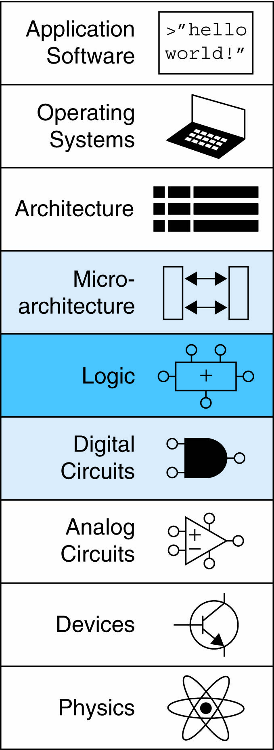
Lecture 8
Chapter 5 Introduction
Arithmetic Circuits
1-bit Adders
N-bit Adders
Ripple Adders
Carry Lookahead Adders
Prefix Adders
Subtractors
Arithmetic/Logic Units

Slide 3
Chapter 5 Introduction
Digital building blocks:
Gates, multiplexers, decoders, registers, arithmetic circuits, counters, memory arrays, logic arrays
Building blocks demonstrate hierarchy, modularity, and regularity:
Hierarchy of simpler components
Well-defined interfaces and functions
Regular structure easily extends to different sizes
Will use these building blocks in Chapter 7 to build microprocessor

Slide 4
1-Bit Adders

Slide 5
Multibit Adders (CPAs)
Types of carry propagate adders (CPAs):
Ripple-carry (slow)
Carry-lookahead (fast)
Prefix (faster)
Carry-lookahead and prefix adders faster for large adders but require more hardware
Symbol

Slide 6
Ripple-Carry Adder
Chain 1-bit adders together
Carry ripples through entire chain
Disadvantage: slow

Slide 7
Ripple-Carry Adder Delay
t_{ripple} = Nt_{FA}
where t_{FA} is the delay of a 1-bit full adder

Slide 8
Carry-Lookahead Adder
Compute C_{out} for k-bit blocks using generate and propagate signals
Some definitions:
Column i produces a carry out by either generating a carry out or propagating a carry in to the carry out
Generate (G_{i}) and propagate (P_{i}) signals for each column:
Generate: Column i will generate a carry out if A_{i} and B_{i} are both 1.
G_{i} = A_{i} B_{i}
Propagate: Column i will propagate a carry in to the carry out if A_{i} or B_{i} is 1.
P_{i} = A_{i} + B_{i}
Carry out: The carry out of column i (C_{i}) is:
C_{i} = A_{i} B_{i} + (A_{i} + B_{i} )C_{i-1} = G_{i} + P_{i} C_{i-1}

Slide 9
Block Propagate and Generate
Now use column Propagate and Generate signals to compute Block Propagate and Generate signals for k-bit blocks, i.e.:
Compute if a k-bit group will propagate a carry in (to the block) to the carry out (of the block)
Compute if a k-bit group will generate a carry out (of the block)

Slide 10
Block Propagate and Generate Signals
Example: Block propagate and generate signals for 4-bit blocks (P_{3:0} and G_{3:0}):
P_{3:0} = P₃P₂ P₁P₀
G_{3:0} = G₃ + G₂P₃ + G₁P₂P₃ + G₀P₁P₂P₃
= G₃ + P₃ (G₂ + P₂ (G₁ + P₁G₀ )

Slide 11
Block Propagate and Generate Signals
In general for a block spanning bits i through j,
P_{i:j} = P_{i}P_{i-1} P_{i-2 …} P_{j}
G_{i:j} = G_{i} + P_{i} (G_{i-1} + P_{i-1} (G_{i-2} + P_{i-2 …} G_{j} )
C_{i} = G_{i:j} + P_{i:j} C_{j-1}

Slide 12
32-bit CLA with 4-bit Blocks

Slide 13
Carry-Lookahead Addition
Step 1: Compute G_{i} and P_{i} for all columns
Step 2: Compute G and P for k-bit blocks
Step 3: C_{in} propagates through each k-bit propagate/generate logic (meanwhile computing sums)
Step 4: Compute sum for most significant k-bit block

Slide 14
Carry-Lookahead Addition
Step 1: Compute G_{i} and P_{i} for all columns
G_{i} = A_{i} B_{i}
P_{i} = A_{i} + B_{i}

Slide 15
Carry-Lookahead Addition
Step 1: Compute G_{i} and P_{i} for all columns
Step 2: Compute G and P for k-bit blocks
P_{3:0} = P₃P₂ P₁P₀
G_{3:0} = G₃ + P₃ (G₂ + P₂ (G₁ + P₁G₀ )

Slide 16
Carry-Lookahead Addition
Step 1: Compute G_{i} and P_{i} for all columns
Step 2: Compute G and P for k-bit blocks
Step 3: C_{in} propagates through each k-bit propagate/generate logic (meanwhile computing sums)
B
31:28
A
31:28
B
27:24
A
27:24
B
7:4
A
7:4
B
3:0
A
3:0
C
4-bit CLA
C
27
4-bit CLA
C
23
C
7
4-bit CLA
C
3
4-bit CLA
C
out
Block
Block
Block
Block
in
S
31:28
S
27:24
S
7:4
S
3:0
B
3
+
A
3
C
2
B
2
+
A
2
C
1
B
1
+
A
1
C
0
B
0
+
A
0
C
in
G
S
3
S
2
S
1
S
0
G
B
3
A
3
C
2
B
2
A
2
C
1
B
1
A
1
C
0
B
0
A
0
C
3:0
P
3
+
+
+
+
in
B
A
B
A
B
A
B
A
G
3
S
S
S
S
3
3
2
2
1
1
0
0
P
2
3
2
1
0
C
2
C
1
C
0
C
G
2
G
+
+
+
+
in
P
1
3:0
G
3
G
1
P
3
S
3
S
2
S
1
S
0
B
A
B
A
B
A
B
A
0
G
2
3
3
2
2
1
1
0
0
P
2
G
3:0
G
C
2
C
1
C
0
P
P
3
G
1
P
3
+
+
+
+
C
in
C
out
3:0
P
2
P
1
G
3
C
P
1
G
0
P
2
S
3
S
2
S
1
S
0
in
P
0
G
2
P
P
1
G
G
C
P
3:0
P
3
G
1
3:0
P
3
out
C
P
2
0
G
3
in
P
1
P
2
0
C
P
P
3
G
2
out
3:0
P
2
P
1
C
P
1
G
1
in
P
0
P
0
C
out
P
3:0
P
3
C
P
2
in
P
1
0

Slide 17
Carry-Lookahead Addition
Step 1: Compute G_{i} and P_{i} for all columns
Step 2: Compute G and P for k-bit blocks
Step 3: C_{in} propagates through each k-bit propagate/generate logic (meanwhile computing sums)
Step 4: Compute sum for most significant k-bit block
B
3
+
A
3
C
2
B
2
+
A
2
C
1
B
1
+
A
1
C
0
B
0
+
A
0
C
in
G
S
3
S
2
S
1
S
0
G
B
3
A
3
C
2
B
2
A
2
C
1
B
1
A
1
C
0
B
0
A
0
C
3:0
P
3
+
+
+
+
in
B
A
B
A
B
A
B
A
G
3
S
S
S
S
3
3
2
2
1
1
0
0
P
2
3
2
1
0
C
2
C
1
C
0
C
G
2
G
+
+
+
+
in
P
1
3:0
G
3
G
1
P
3
S
3
S
2
S
1
S
0
B
A
B
A
B
A
B
A
0
G
2
3
3
2
2
1
1
0
0
P
2
G
3:0
G
C
2
C
1
C
0
P
P
3
G
1
P
3
+
+
+
+
C
in
C
out
3:0
P
2
P
1
G
3
C
P
1
G
0
P
2
S
3
S
2
S
1
S
0
in
P
0
G
2
P
P
1
G
G
C
P
3:0
P
3
G
1
3:0
P
3
out
C
P
2
0
G
3
in
P
1
P
2
0
C
P
P
3
G
2
out
3:0
P
2
P
1
C
P
1
G
1
in
P
0
P
0
C
out
P
3:0
P
3
C
P
2
in
P
1
0

Slide 18
Carry-Lookahead Adder Delay
For N-bit CLA with k-bit blocks:
t_{CLA} = t_{pg} + t_{pg_block} + (N/k – 1)t_{AND_OR} + kt_{FA}
t_{pg} : delay to generate all P_{i}, G_{i}
t_{pg_block} : delay to generate all P_{i:j}, G_{i:j}
t_{AND_OR} : delay from C_{in} to C_{out} of final AND/OR gate in k-bit CLA block
An N-bit carry-lookahead adder is generally much faster than a ripple-carry adder for N > 16

Slide 19
Prefix Adder
Computes carry in (C_{i-1}) for each column, then computes sum:
S_{i} = (A_{i} ^ B_{i}) ⊥ C_{i-1}
Computes G and P for 1-, 2-, 4-, 8-bit blocks, etc. until all G_{i} (carry in) known
log₂N stages

Slide 20
Prefix Adder
Carry in either generated in a column or propagated from a previous column.
Column -1 holds C_{in}, so
G₋₁ = C_{in}
Carry in to column i = carry out of column i-1:
C_{i-1} = G_{i-1:-1}
G_{i-1:-1}: generate signal spanning columns i-1 to -1
Sum equation:
S_{i} = (A_{i} ⊥ B_{i}) ⊥ G_{i-1:-1}
Goal: Quickly compute G_{0:-1}, G_{1:-1}, G_{2:-1}, G_{3:-1}, G_{4:-1}, G_{5:-1}, … (called prefixes) (= C₀, C₁, C₂, C₃, C₄, C₅, …)

Slide 21
Prefix Adder
Generate and propagate signals for a block spanning bits i:j
G_{i:j} = G_{i:k} + P_{i:k} G_{k-1:j}
P_{i:j} = P_{i:k}P_{k-1:j}
In words:
Generate: block i:j will generate a carry if:
upper part (i:k) generates a carry or
upper part (i:k) propagates a carry generated in lower part (k-1:j)
Propagate: block i:j will propagate a carry if both the upper and lower parts propagate the carry

Slide 22
16-Bit Prefix Adder Schematic
A
i
B
i
15
14
13
12
11
10
9
8
7
6
5
4
3
2
1
0
-1
i
P
i:i
G
i:i
14:13
12:11
10:9
8:7
6:5
4:3
2:1
0:-1
P
i:k
P
k-1:j
G
i:k
G
k-1:j
14:11
13:11
10:7
9:7
6:3
5:3
2:-1
1:-1
i:j
14:7
13:7
12:7
11:7
6:-1
5:-1
4:-1
3:-1
P
G
i:j
i:j
14:-1
13:-1
12:-1
11:-1
10:-1
9:-1
8:-1
7:-1
G
i-1:-1
A
i
B
i
15
14
13
12
11
10
9
8
7
6
5
4
3
2
1
0
i
S
i

Slide 23
Prefix Adder Delay
t_{PA} = t_{pg} + log₂N(t_{pg_prefix} ) + t_{XOR}
t_{pg}: delay to produce P_{i}, G_{i} (AND or OR gate)
t_{pg_prefix}: delay of black prefix cell (AND-OR gate)

Slide 24
Adder Delay Comparisons
Compare delay of: 32-bit ripple-carry, CLA, and prefix adders
CLA has 4-bit blocks
2-input gate delay = 10 ps; full adder delay = 30 ps
t_{ripple} = Nt_{FA} = 32(30 ps)
= 960 ps
t_{CLA} = t_{pg} + t_{pg_block} + (N/k – 1)t_{AND_OR} + kt_{FA}
= [10 + 60 + (7)20 + 4(30)] ps
= 330 ps
t_{PA} = t_{pg} + log₂N(t_{pg_prefix} ) + t_{XOR}
= [10 + log₂32(20) + 10] ps
= 120 ps

Slide 25
Subtracter

Slide 26
Comparator: Equality

Slide 27
Comparator: Less Than

Slide 28
ALU: Arithmetic Logic Unit
ALU should perform:
Addition
Subtraction
AND
OR

Slide 29
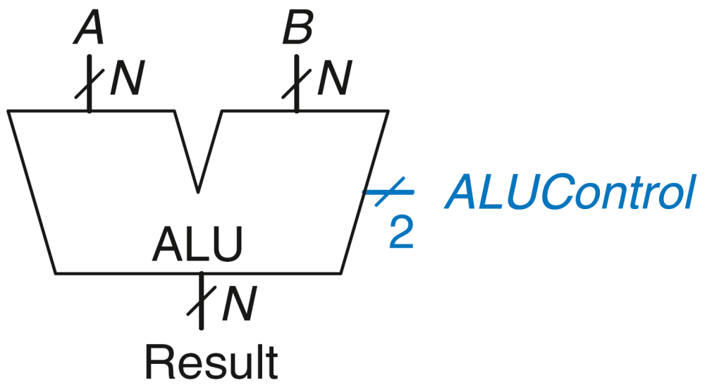
ALU: Arithmetic Logic Unit
ALUControl_{1:0} | Function
00 | Add
01 | Subtract
10 | AND
11 | OR
Example: Perform A + B
ALUControl = 00
Result = A + B

Slide 30
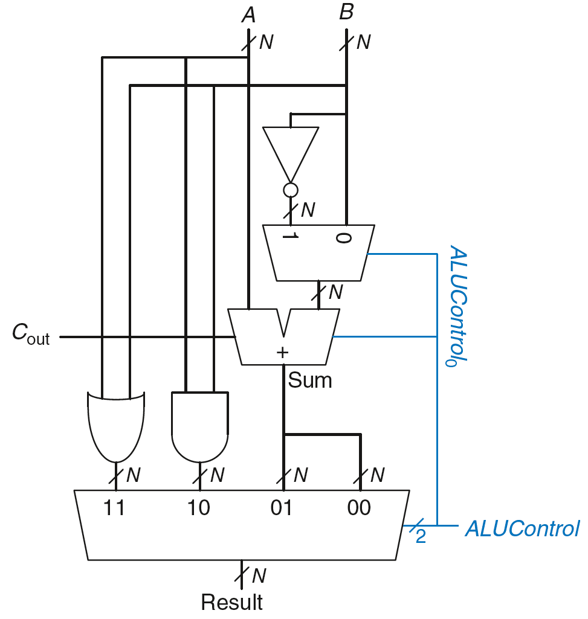
ALU: Arithmetic Logic Unit
ALUControl_{1:0} | Function
00 | Add
01 | Subtract
10 | AND
11 | OR
Example: Perform A OR B

Slide 31
ALU: Arithmetic Logic Unit
ALUControl_{1:0} | Function
00 | Add
01 | Subtract
10 | AND
11 | OR
Example: Perform A OR B
ALUControl_{1:0} = 11
Mux selects output of OR gate as Result, so
Result = A OR B

Slide 32
ALU: Arithmetic Logic Unit
ALUControl_{1:0} | Function
00 | Add
01 | Subtract
10 | AND
11 | OR
Example: Perform A + B

Slide 33
ALU: Arithmetic Logic Unit
ALUControl_{1:0} | Function
00 | Add
01 | Subtract
10 | AND
11 | OR
Example: Perform A + B
ALUControl_{1:0} = 00
ALUControl₀ = 0, so:
C_{in} to adder = 0
2nd input to adder is B
Mux selects Sum as Result, so
Result = A + B

Slide 34
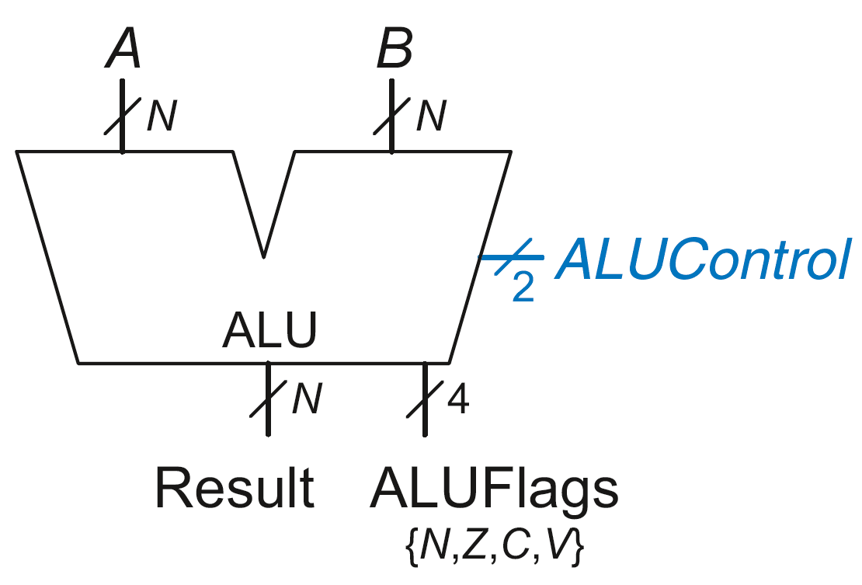
ALU with Status Flags
Flag | Description
N | Result is Negative
Z | Result is Zero
C | Adder produces Carry out
V | Adder oVerflowed

Slide 35
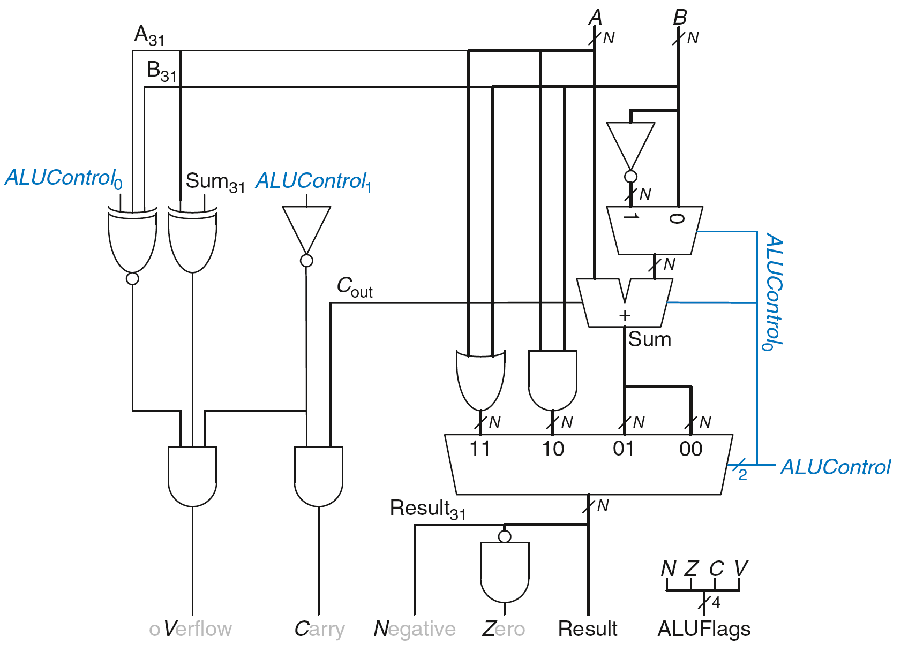
ALU with Status Flags

Slide 36
ALU with Status Flags: Negative
N = 1 if:
Result is negative
So, N is connected to most significant bit of Result

Slide 37
ALU with Status Flags: Zero
Z = 1 if:
all of the bits of Result are 0

Slide 38
ALU with Status Flags: Carry
C = 1 if:
C_{out} of Adder is 1
AND
ALU is adding or subtracting (ALUControl is 00 or 01)

Slide 39
ALU with Status Flags: oVerflow
V = 1 if:
The addition of 2 same-signed numbers produces a result with the opposite sign

Slide 40
ALU with Status Flags: oVerflow
V = 1 if:
ALU is performing addition or subtraction
(ALUControl₁ = 0)

Slide 41
ALU with Status Flags: oVerflow
V = 1 if:
ALU is performing addition or subtraction
(ALUControl₁ = 0)
AND
A and Sum have opposite signs

Slide 42
ALU with Status Flags: oVerflow
V = 1 if:
ALU is performing addition or subtraction
(ALUControl₁ = 0)
AND
A and Sum have opposite signs
AND
A and B have same signs upon addition OR
A and B have different signs upon subtraction

Slide 43
ALU with Status Flags: oVerflow
V = 1 if:
ALU is performing addition or subtraction
(ALUControl₁ = 0)
AND
A and Sum have opposite signs
AND
A and B have same signs upon addition (ALUControl₀ = 0) OR
A and B have different signs upon subtraction
(ALUControl₀ = 1)

