Slide 1
Lecture 3: Timing & Sequential Circuits
E85 Digital Design & Computer Engineering

Slide 2
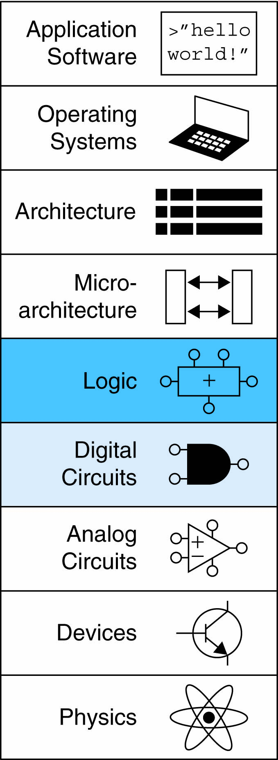
Lecture 3
Timing
Sequential Circuits
Latches and Flip-Flops
Synchronous Logic Design

Slide 3
Introduction
A logic circuit is composed of:
Inputs
Outputs
Functional specification
Timing specification

Slide 4
Timing
Delay: time between input change and output changing
How to build fast circuits?

Slide 5
Propagation & Contamination Delay
Propagation delay: t_{pd} = max delay from input to output
Contamination delay: t_{cd} = min delay from input to output

Slide 6
Propagation & Contamination Delay
Delay is caused by
Capacitance and resistance in a circuit
Speed of light limitation
Reasons why t_{pd} and t_{cd} may be different:
Different rising and falling delays
Multiple inputs and outputs, some of which are faster than others
Circuits slow down when hot and speed up when cold

Slide 7
Critical (Long) & Short Paths
Critical (Long) Path: t_{pd} = 2t_{pd_AND} + t_{pd_OR}
Short Path: t_{cd} = t_{cd_AND}

Slide 8
Example: 8-input OR Delay
Find the minimum and maximum delay of this 8-input OR
Cell | Propagation Delay (ps) | Contamination Delay (ps)
OR2 | 20 | 15
OR3 | 25 | 19
OR4 | 35 | 28

Slide 9
Solution: 8-input OR Delay
Find the minimum and maximum delay of this 8-input OR
Annotate each node with earliest and latest arrivals
Min = 15 ps from A₇ to Y.
Max = 140 ps from A₀ to Y.
Cell | Propagation Delay (ps) | Contamination Delay (ps)
OR2 | 20 | 15
OR3 | 25 | 19
OR4 | 35 | 28

Slide 10
Example: Optimized 8-input OR
Redesign the 8-input OR to be as fast as possible.
Cell | Propagation Delay (ps) | Contamination Delay (ps)
OR2 | 20 | 15
OR3 | 25 | 19
OR4 | 35 | 28

Slide 11
Example: Optimized 8-input OR
Redesign the 8-input OR to be as fast as possible.
Try various possibilities:
Cell | Propagation Delay (ps) | Contamination Delay (ps)
OR2 | 20 | 15
OR3 | 25 | 19
OR4 | 35 | 28

Slide 12
Solution: Optimized 8-input OR
Redesign the 8-input OR to be as fast as possible.
Annotate delays. OR3+OR3 is fastest (50 ps).
Cell | Propagation Delay (ps) | Contamination Delay (ps)
OR2 | 20 | 15
OR3 | 25 | 19
OR4 | 35 | 28

Slide 13
Sequential Logic Introduction
Outputs of sequential logic depend on current and prior input values – it has memory.
Some definitions:
State: all the information about past inputs necessary to explain its future behavior
Latches and flip-flops: state elements that store one bit of state
Synchronous sequential circuits: combinational logic followed by a bank of flip-flops

Slide 14
Sequential Circuits
Give sequence to events
Have memory (short-term)
Use feedback from output to input to store information

Slide 15
State Elements
The state of a circuit influences its future behavior
State elements store state
Bistable circuit
SR Latch
D Latch
D Flip-flop

Slide 16
Bistable Circuit
Fundamental building block of other state elements
Two outputs: Q, Q
No inputs

Slide 17
Bistable Circuit Analysis
Consider the two possible cases:
Q = 0:
then Q = 0, Q = 1 (consistent)
Q = 1:
then Q = 1, Q = 0 (consistent)
Stores 1 bit of state in the state variable, Q (or Q)
But there are no inputs to control the state

Slide 18
SR (Set/Reset) Latch
SR Latch
Consider the four possible cases:
S = 1, R = 0
S = 0, R = 1
S = 0, R = 0
S = 1, R = 1

Slide 19
SR Latch Analysis
S = 1, R = 0:
then Q = 1 and Q = 0
Set the output
S = 0, R = 1:
then Q = 0 and Q = 1
Reset the output
1
1

Slide 20
SR Latch Analysis
S = 0, R = 0:
then Q = Q_{prev}
Memory!
S = 1, R = 1:
then Q = 0, Q = 0
Invalid State
Q ≠ NOT Q
1

Slide 21
SR Latch Symbol
SR stands for Set/Reset Latch
Stores one bit of state (Q)
Control what value is being stored with S, R inputs
Set: Make the output 1
(S = 1, R = 0, Q = 1)
Reset: Make the output 0
(S = 0, R = 1, Q = 0)
Avoid invalid state
(when S = R = 1)

Slide 22
D Latch
Two inputs: CLK, D
CLK: controls when the output changes
D (the data input): controls what the output changes to
Function
When CLK = 1,
D passes through to Q (transparent)
When CLK = 0,
Q holds its previous value (opaque)
Avoids invalid case when
Q ≠ NOT Q

Slide 23
D Latch Internal Circuit

Slide 24
D Flip-Flop
Inputs: CLK, D
Function
Samples D on rising edge of CLK
When CLK rises from 0 to 1, D passes through to Q
Otherwise, Q holds its previous value
Q changes only on rising edge of CLK
Called edge-triggered
Activated on the clock edge

Slide 25
D Flip-Flop Internal Circuit
Two back-to-back latches (L1 and L2) controlled by complementary clocks
When CLK = 0
L1 is transparent
L2 is opaque
D passes through to N1
When CLK = 1
L2 is transparent
L1 is opaque
N1 passes through to Q
Thus, on the edge of the clock (when CLK rises from 0 1)
D passes through to Q

Slide 26
D Latch vs. D Flip-Flop

Slide 27
Registers: Multi-bit Flip-Flop

Slide 28
Enabled Flip-Flops
Inputs: CLK, D, EN
The enable input (EN) controls when new data (D) is stored
Function
EN = 1: D passes through to Q on the clock edge
EN = 0: the flip-flop retains its previous state

Slide 29
Resettable Flip-Flops
Inputs: CLK, D, Reset
Function:
Reset = 1: Q is forced to 0
Reset = 0: flip-flop behaves as ordinary D flip-flop

Slide 30
Resettable Flip-Flops
Two types:
Synchronous: resets at the clock edge only
Asynchronous: resets immediately when Reset = 1
Asynchronously resettable flip-flop requires changing the internal circuitry of the flip-flop
Synchronously resettable flip-flop?

Slide 31
Resettable Flip-Flops
Two types:
Synchronous: resets at the clock edge only
Asynchronous: resets immediately when Reset = 1
Asynchronously resettable flip-flop requires changing the internal circuitry of the flip-flop
Synchronously resettable flip-flop

Slide 32
Settable Flip-Flops
Inputs: CLK, D, Set
Function:
Set = 1: Q is set to 1
Set = 0: the flip-flop behaves as ordinary D flip-flop

Slide 33
Sequential Logic
Sequential circuits: all circuits that aren’t combinational
A problematic circuit:
No inputs and 1-3 outputs
Astable circuit, oscillates
Period depends on inverter delay
It has a cyclic path: output fed back to input

Slide 34
SystemVerilog Description
module flop(input logic clk, d,
output logic q);
always_ff @(posedge clk)
q <= d;
endmodule
Multi-input XOR: Odd parity

Slide 35
SystemVerilog Description
module flopenr(input logic clk, en, reset, d,
output logic q);
always_ff @(posedge clk, posedge reset)
if (reset) q <= 0;
else if (en) q <= d;
endmodule
Multi-input XOR: Odd parity

Slide 36
SystemVerilog Description
module flopenr #(parameter WIDTH = 4)
(input logic clk, reset, en,
input logic [WIDTH-1:0] d,
output logic [WIDTH-1:0] q);
always_ff @(posedge clk, posedge reset)
if (reset) q <= 0;
else if (en) q <= d;
endmodule
Multi-input XOR: Odd parity

Slide 37
Synchronous Sequential Logic Design
Breaks cyclic paths by inserting registers
Registers contain state of the system
State changes at clock edge: system synchronized to the clock
Rules of synchronous sequential circuit composition:
Every circuit element is either a register or a combinational circuit
At least one circuit element is a register
All registers receive the same clock signal
Every cyclic path contains at least one register
Two common synchronous sequential circuits
Finite State Machines (FSMs)
Pipelines

