Slide 1
Lecture 22: Pipelined Processor
E85 Digital Design & Computer Engineering

Slide 2
Lecture 22
Pipelined Processor

Slide 3
Review: Single-Cycle ARM Processor

Slide 4
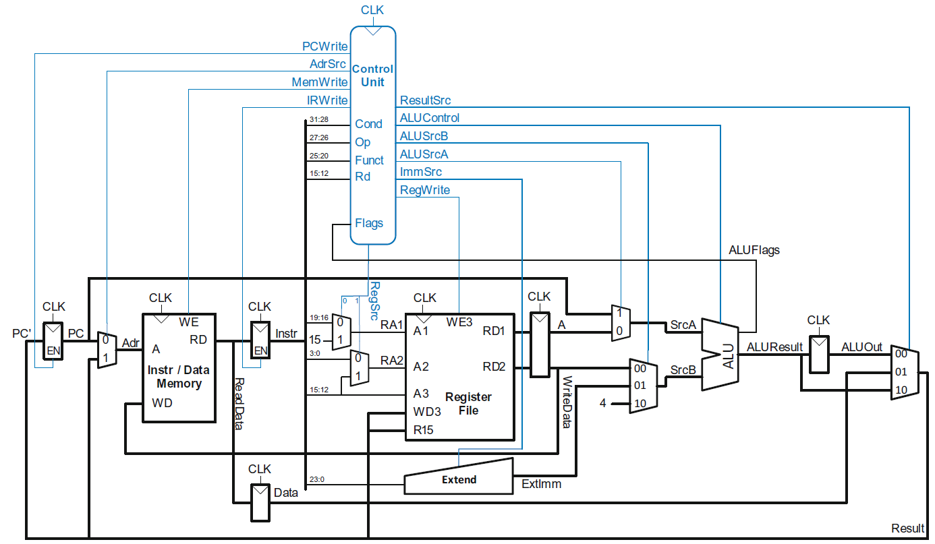
Review: Multicycle ARM Processor

Slide 5
Pipelined ARM Processor
Aim to really improve performance
Use temporal parallelism
Divide single-cycle processor into 5 stages:
Fetch
Decode
Execute
Memory
Writeback
Add pipeline registers between stages

Slide 6
Single-Cycle vs. Pipelined

Slide 7
Pipelined Processor Abstraction

Slide 8
Single-Cycle & Pipelined Datapath

Slide 9
Corrected Pipelined Datapath
WA3 must arrive at same time as Result
Register file written on falling edge of CLK

Slide 10
Optimized Pipelined Datapath
Remove adder by using PCPlus4F after PC has been updated to PC+4

Slide 11
Pipelined Processor Control
Same control unit as single-cycle processor
Control delayed to proper pipeline stage

Slide 12
Pipeline Hazards
When an instruction depends on result from instruction that hasn’t completed
Types:
Data hazard: register value not yet written back to register file
Control hazard: next instruction not decided yet (caused by branch)

Slide 13
Data Hazard

Slide 14
Handling Data Hazards
Insert NOPs in code at compile time
Rearrange code at compile time
Forward data at run time
Stall the processor at run time

Slide 15
Compile-Time Hazard Elimination
Insert enough NOPs for result to be ready
Or move independent useful instructions forward

Slide 16
Data Forwarding

Slide 17
Data Forwarding
Check if register read in Execute stage matches register written in Memory or Writeback stage
If so, forward result

Slide 18
Data Forwarding

Slide 19
Data Forwarding
Execute stage register matches Memory stage register?
Match_1E_M = (RA1E == WA3M)
Match_2E_M = (RA2E == WA3M)
Execute stage register matches Writeback stage register?
Match_1E_W = (RA1E == WA3W)
Match_2E_W = (RA2E == WA3W)
If it matches, forward result:
if (Match_1E_M • RegWriteM) ForwardAE = 10;
else if (Match_1E_W • RegWriteW) ForwardAE = 01;
else ForwardAE = 00;

Slide 20
Data Forwarding
Execute stage register matches Memory stage register?
Match_1E_M = (RA1E == WA3M)
Match_2E_M = (RA2E == WA3M)
Execute stage register matches Writeback stage register?
Match_1E_W = (RA1E == WA3W)
Match_2E_W = (RA2E == WA3W)
If it matches, forward result:
if (Match_1E_M • RegWriteM) ForwardAE = 10;
else if (Match_1E_W • RegWriteW) ForwardAE = 01;
else ForwardAE = 00;
ForwardBE same but with Match2E

Slide 21
Stalling

Slide 22
Stalling

Slide 23
Stalling Hardware

Slide 24
Stalling Logic
Is either source register in the Decode stage the same as the one being written in the Execute stage?
Match_12D_E = (RA1D == WA3E) + (RA2D == WA3E)
Is a LDR in the Execute stage AND Match_12D_E?
ldrstall = Match_12D_E • MemtoRegE
StallF = StallD = FlushE = ldrstall

Slide 25
Control Hazards
B:
branch not determined until the Writeback stage of pipeline
Instructions after branch fetched before branch occurs
These 4 instructions must be flushed if branch happens
Writes to PC (R15) similar

Slide 26
Control Hazards
Branch misprediction penalty
number of instruction flushed when branch is taken (4)
May be reduced by determining BTA earlier

Slide 27
Early Branch Resolution
Determine BTA in Execute stage
Branch misprediction penalty = 2 cycles
Hardware changes
Add a branch multiplexer before PC register to select BTA from ALUResultE
Add BranchTakenE select signal for this multiplexer (only asserted if branch condition satisfied)
PCSrcW now only asserted for writes to PC

Slide 28
Pipelined processor with Early BTA

Slide 29
Control Hazards with Early BTA

Slide 30
Control Stalling Logic
PCWrPendingF = 1 if write to PC in Decode, Execute or Memory
PCWrPendingF = PCSrcD + PCSrcE + PCSrcM
Stall Fetch if PCWrPendingF
StallF = ldrStallD + PCWrPendingF
Flush Decode if PCWrPendingF OR PC is written in Writeback OR branch is taken
FlushD = PCWrPendingF + PCSrcW + BranchTakenE
Flush Execute if branch is taken
FlushE = ldrStallD + BranchTakenE
Stall Decode if ldrStallD (as before)
StallD = ldrStallD

Slide 31
ARM Pipelined Processor with Hazard Unit

Slide 32
Pipelined Performance Example
SPECINT2000 benchmark:
25% loads
10% stores
13% branches
52% data processing
Suppose:
40% of loads used by next instruction
50% of branches mispredicted
What is the average CPI?

Slide 33
Pipelined Performance Example
SPECINT2000 benchmark:
25% loads
10% stores
13% branches
52% data processing
Suppose:
40% of loads used by next instruction
50% of branches mispredicted
What is the average CPI?
Load CPI = 1 when not stalling, 2 when stalling
So, CPI_{lw} = 1(0.6) + 2(0.4) = 1.4
Branch CPI = 1 when not stalling, 3 when stalling
So, CPI_{beq} = 1(0.5) + 3(0.5) = 2
Average CPI = (0.25)(1.4) + (0.1)(1) + (0.13)(2) + (0.52)(1) = 1.23

Slide 34
Pipelined Performance
Pipelined processor critical path:
T_{c3} = max [
t_{pcq} + t_{mem} + t_{setup} Fetch
2(t_{RFread} + t_{setup} ) Decode
t_{pcq} + 2t_{mux} + t_{ALU} + t_{setup} Execute
t_{pcq} + t_{mem} + t_{setup} Memory
2(t_{pcq} + t_{mux} + t_{RFwrite}) ] Writeback

Slide 35
Pipelined Performance Example
Element | Parameter | Delay (ps)
Register clock-to-Q | t_{pcq_PC} | 40
Register setup | t_{setup} | 50
Multiplexer | t_{mux} | 25
ALU | t_{ALU} | 120
Memory read | t_{mem} | 200
Register file read | t_{RFread} | 100
Register file setup | t_{RFsetup} | 60
Register file write | t_{RFwrite} | 70
Cycle time: T_{c3} = ?

Slide 36
Pipelined Performance Example
Element | Parameter | Delay (ps)
Register clock-to-Q | t_{pcq_PC} | 40
Register setup | t_{setup} | 50
Multiplexer | t_{mux} | 25
ALU | t_{ALU} | 120
Memory read | t_{mem} | 200
Register file read | t_{RFread} | 100
Register file setup | t_{RFsetup} | 60
Register file write | t_{RFwrite} | 70
Cycle time: T_{c3} = 2(t_{RFread} + t_{setup} )
= 2[100 + 50] ps = 300 ps

Slide 37
Pipelined Performance Example
Program with 100 billion instructions
Execution Time = (# instructions) × CPI × T_{c}
= (100 × 10⁹)(1.23)(300 × 10⁻¹²)
= 36.9 seconds

Slide 38
Processor Performance Comparison
Processor | Execution Time (seconds) | Speedup (single-cycle as baseline)
Single-cycle | 84 | 1
Multicycle | 140 | 0.6
Pipelined | 36.9 | 2.28

