Slide 1

Lecture 21:
Multicycle Processor
E85 Digital Design & Computer Engineering

Slide 2
Lecture 21
Multicycle Processor

Slide 3
Multicycle ARM Processor
Single-cycle:
  + simple
  cycle time limited by longest instruction (LDR)
  separate memories for instruction and data
  3 adders/ALUs
Multicycle processor addresses these issues by breaking instruction into shorter steps
  shorter instructions take fewer steps
  can re-use hardware
  cycle time is faster

Slide 4
Multicycle ARM Processor
Single-cycle:
  + simple
  cycle time limited by longest instruction (LDR)
  separate memories for instruction and data
  3 adders/ALUs
Multicycle:
  + higher clock speed
  + simpler instructions run faster
  + reuse expensive hardware on multiple cycles
  - sequencing overhead paid many times

Slide 5
Multicycle ARM Processor
Single-cycle:
  + simple
  cycle time limited by longest instruction (LDR)
  separate memories for instruction and data
  3 adders/ALUs
Multicycle:
  + higher clock speed
  + simpler instructions run faster
  + reuse expensive hardware on multiple cycles
  - sequencing overhead paid many times
Same design steps as single-cycle:
first datapath
then control

Slide 6
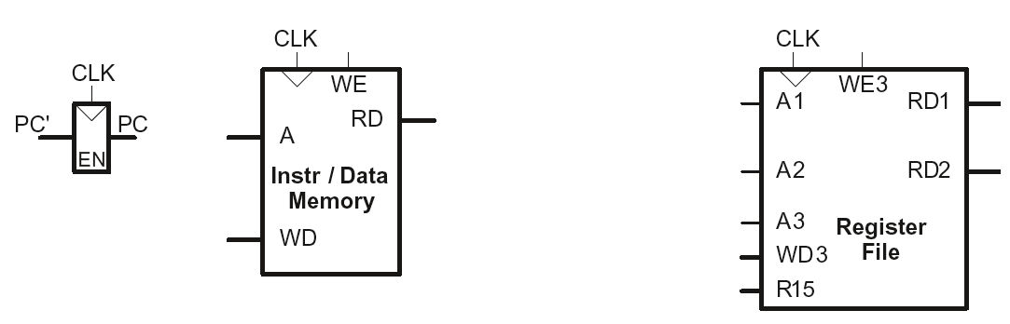
Multicycle State Elements
Replace Instruction and Data memories with a single unified memory – more realistic

Slide 7
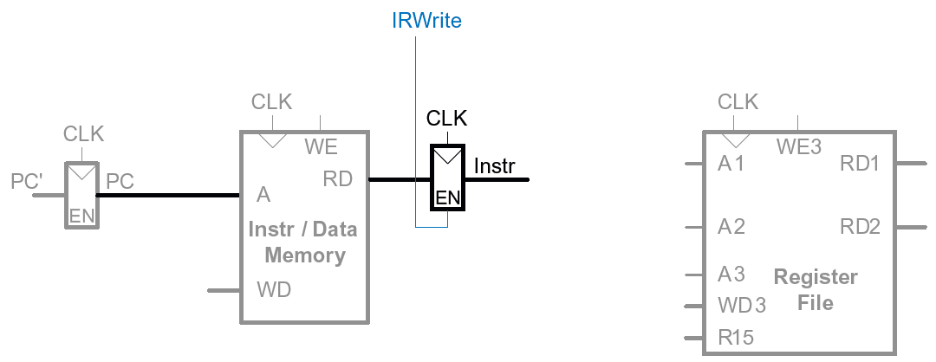
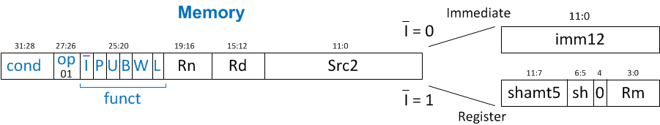
Multicycle Datapath: Instruction Fetch
STEP 1: Fetch instruction
LDR Rd, [Rn, imm12]

Slide 8
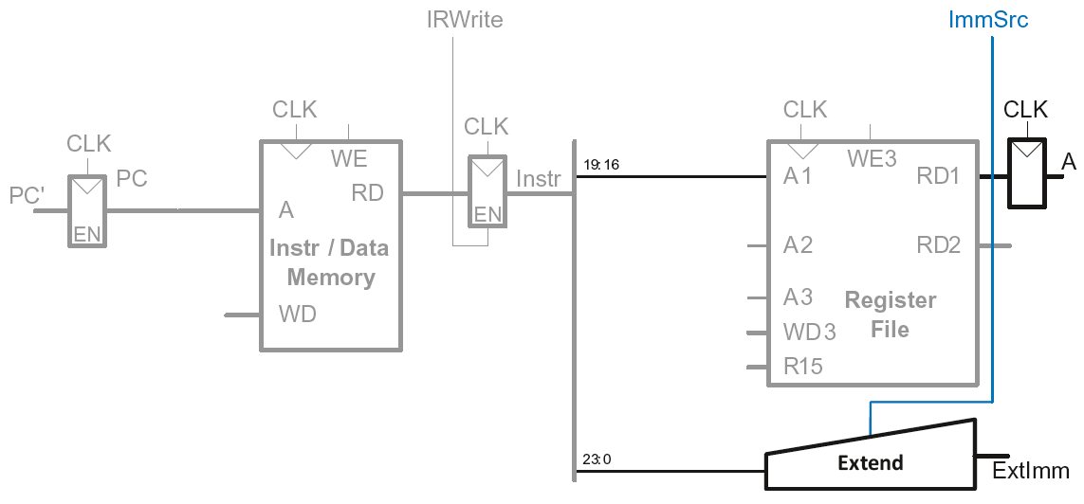
Multicycle Datapath: LDR Register Read
STEP 2: Read source operands from RF
LDR Rd, [Rn, imm12]

Slide 9
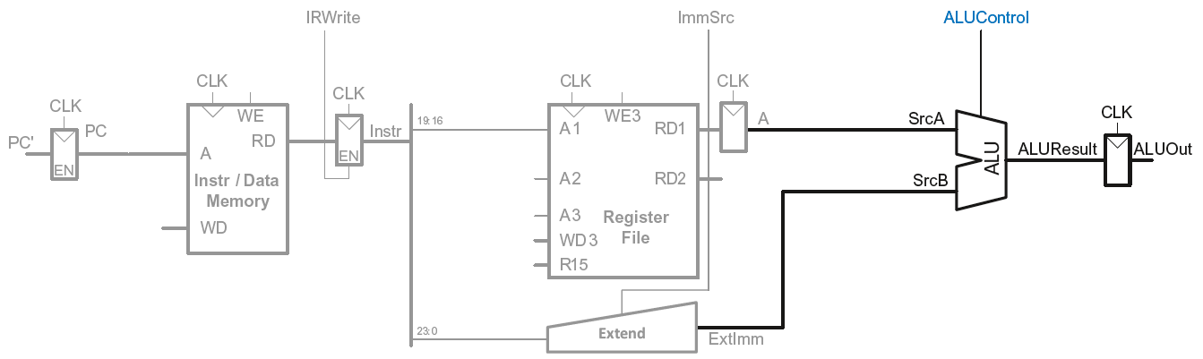
Multicycle Datapath: LDR Address
STEP 3: Compute the memory address
LDR Rd, [Rn, imm12]

Slide 10
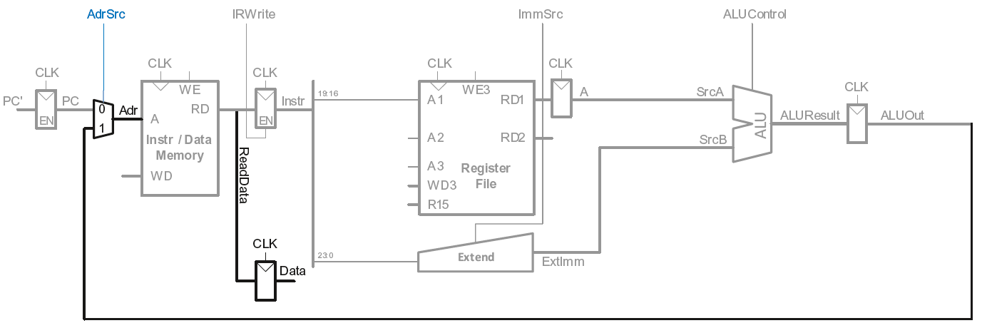
Multicycle Datapath: LDR Memory Read
STEP 4: Read data from memory
LDR Rd, [Rn, imm12]

Slide 11
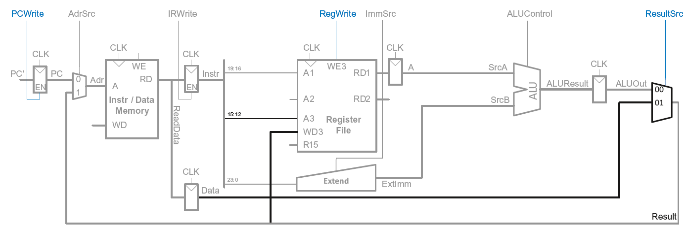
Multicycle Datapath: LDR Write Register
STEP 5: Write data back to register file
LDR Rd, [Rn, imm12]

Slide 12
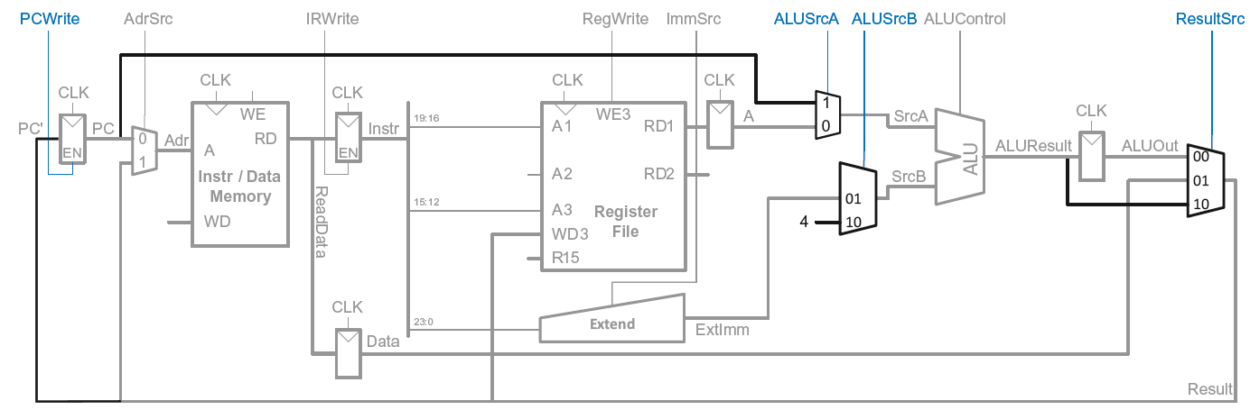
Multicycle Datapath: Increment PC
Meanwhile: Increment PC
Concurrent with fetching instruction

Slide 13
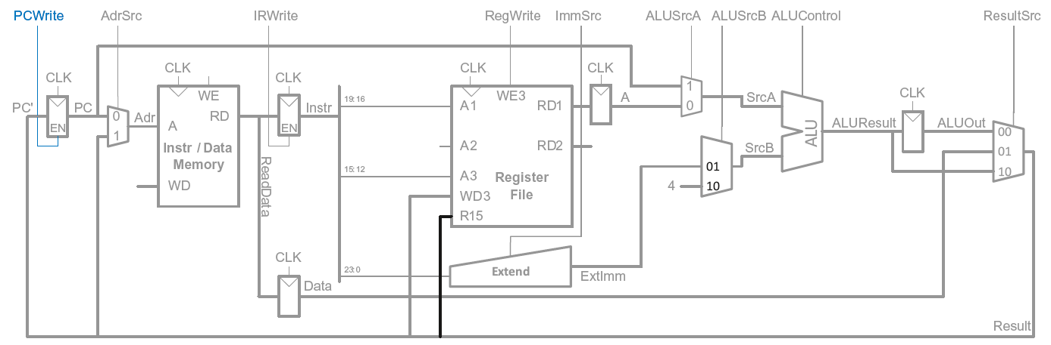
Multicycle Datapath: Access to PC
PC can be read/written by instruction

Slide 14
Multicycle Datapath: Access to PC
PC can be read/written by instruction
Read: R15 (PC+8) available in Register File

Slide 15
Multicycle Datapath: Read to PC (R15)
Example: ADD R1, R15, R2

Slide 16
Multicycle Datapath: Read to PC (R15)
Example: ADD R1, R15, R2
R15 needs to be read as PC+8 from Register File (RF) in 2nd step
PC+4 was computed in 1st step
So (also in 2nd step) ALU computes (PC+4) + 4 for R15 input

Slide 17
Multicycle Datapath: Read to PC (R15)
Example: ADD R1, R15, R2
R15 needs to be read as PC+8 from Register File (RF) in 2nd step
PC+4 was computed in 1st step
So (also in 2nd step) ALU computes (PC+4) + 4 for R15 input
  SrcA = PC (which was already updated in step 1 to PC+4)
  SrcB = 4
  ALUResult = PC + 8
ALUResult is fed to R15 input port of RF in 2nd step (which is then routed to RD1 output of RF)

Slide 18
Multicycle Datapath: Access to PC
PC can be read/written by instruction
Read: R15 (PC+8) available in Register File
Write: Be able to write result of instruction to PC

Slide 19
Multicycle Datapath: Write to PC (R15)
Example: SUB R15, R8, R3

Slide 20
Multicycle Datapath: Write to PC (R15)
Example: SUB R15, R8, R3
Result of instruction needs to be written to the PC register
ALUResult already routed to the PC register, just assert PCWrite

Slide 21
Multicycle Datapath: Write to PC (R15)
Example: SUB R15, R8, R3
Result of instruction needs to be written to the PC register
ALUResult already routed to the PC register, just assert PCWrite

Slide 22
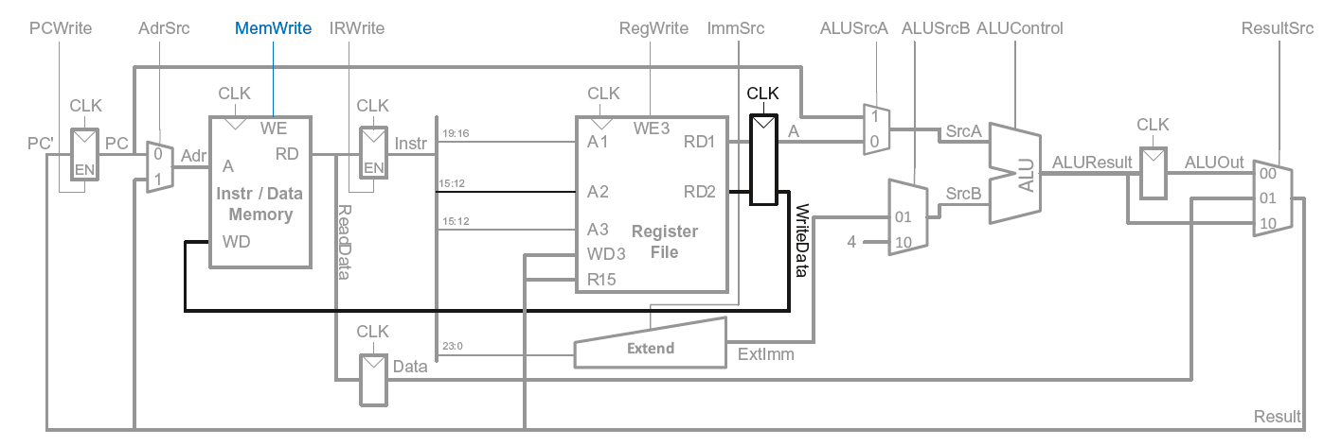
Multicycle Datapath: STR
Write data in Rn to memory

Slide 23
Multicycle Datapath: Data-processing
With immediate addressing (i.e., an immediate Src2), no additional changes needed for datapath

Slide 24
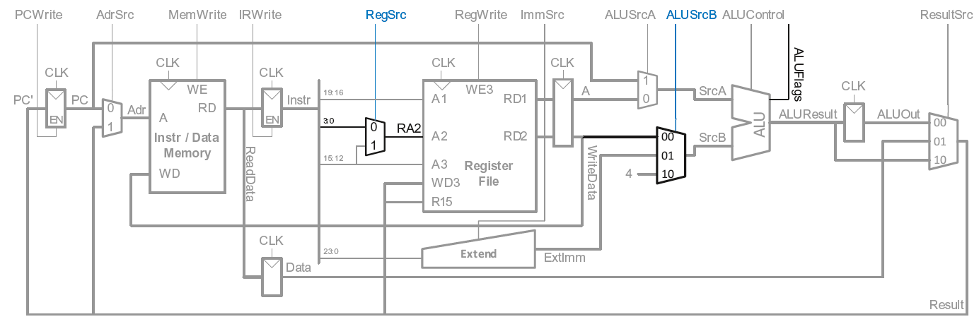
Multicycle Datapath: Data-processing
With register addressing (register Src2):
Read from Rn and Rm

Slide 25
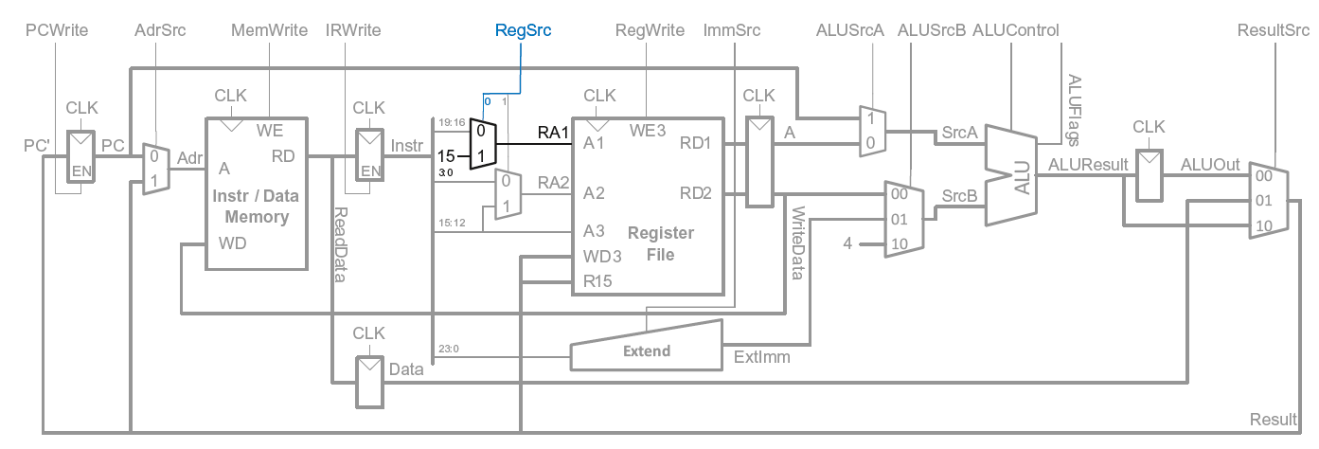
Multicycle Datapath: B
Calculate branch target address:
BTA = (ExtImm) + (PC+8)
ExtImm = Imm24 << 2 and sign-extended

Slide 26
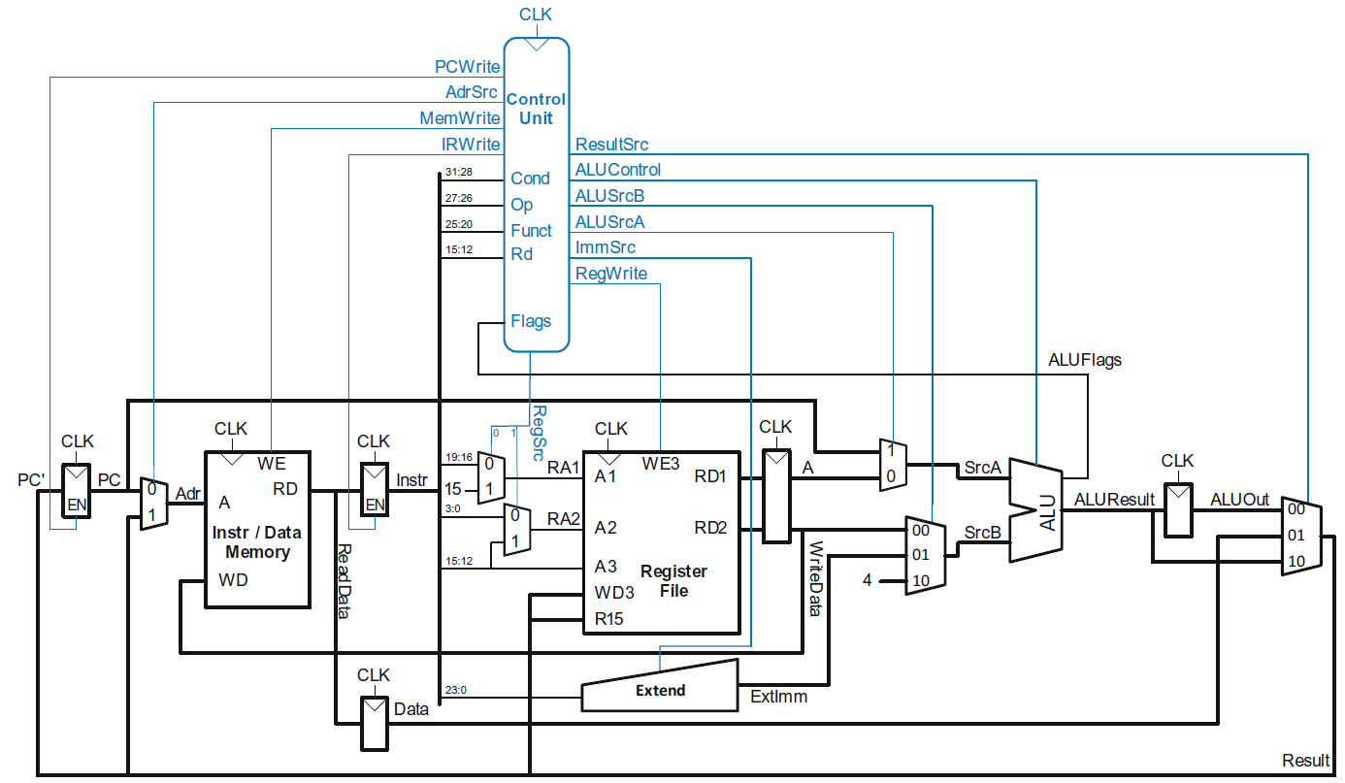
Multicycle ARM Processor

Slide 27
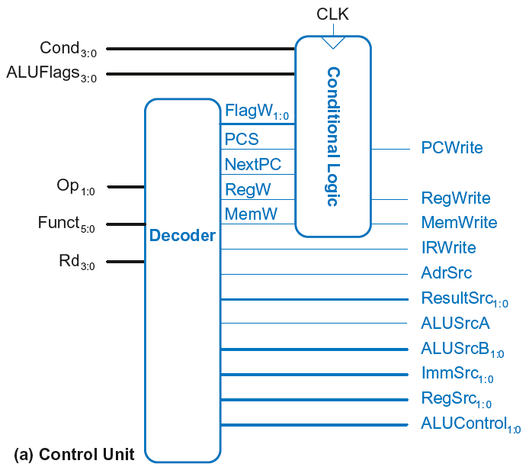
Multicycle Control
First, discuss Decoder
Then, Conditional Logic

Slide 28
Multicycle Control: Decoder

Slide 29
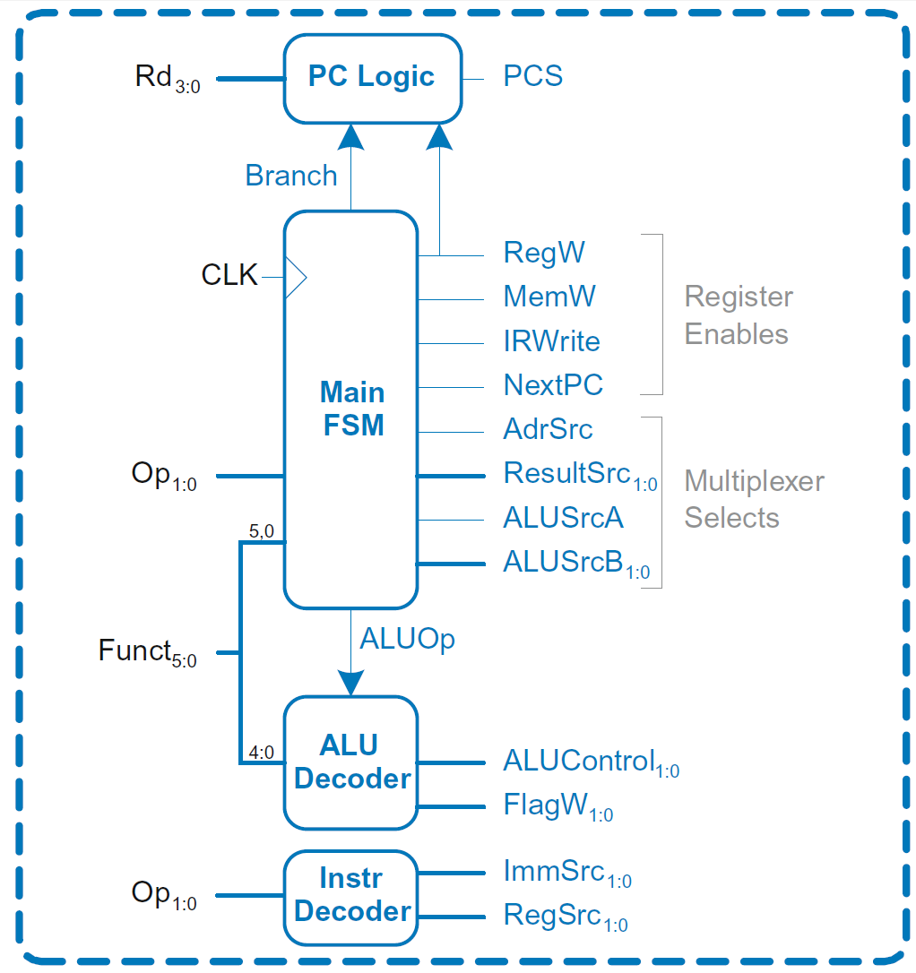
Multicycle Control: Decoder
Decoder

Slide 30
Multicycle Control: Decoder
ALU Decoder and PC Logic same as single-cycle

Slide 31
Multicycle Control: Instr Decoder
RegSrc₀ = (Op == 10₂)
RegSrc₁ = (Op == 01₂)
ImmSrc_{1:0} = Op
Instruction | Op | Funct₅ | Funct₀ | RegSrc₀ | RegSrc₁ | ImmSrc_{1:0}
LDR | 01 | X | 1 | 0 | X | 01
STR | 01 | X | 0 | 0 | 1 | 01
DP immediate | 00 | 1 | X | 0 | X | 00
DP register | 00 | 0 | X | 0 | 0 | 00
B | 10 | X | X | 1 | X | 10

Slide 32
Multicycle ARM Processor

Slide 33
Multicycle Control: Main FSM
Decoder

Slide 34
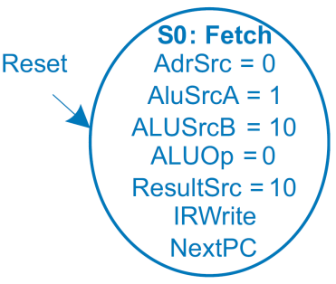

Main Controller FSM: Fetch

Slide 35
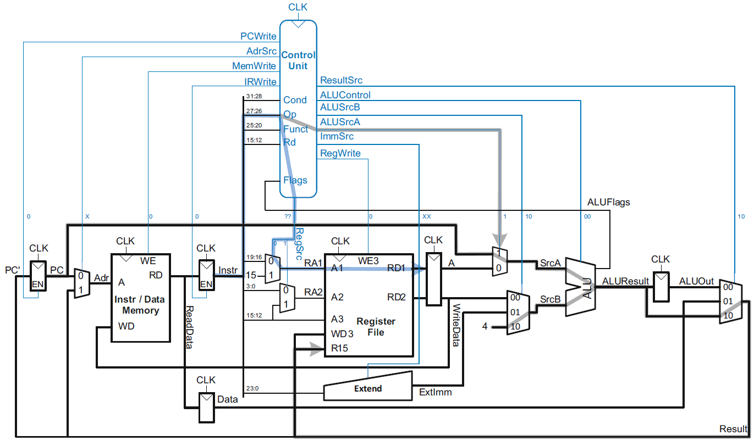
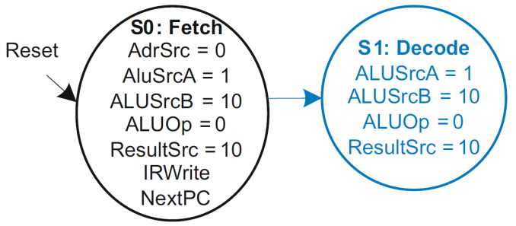
Main Controller FSM: Decode

Slide 36
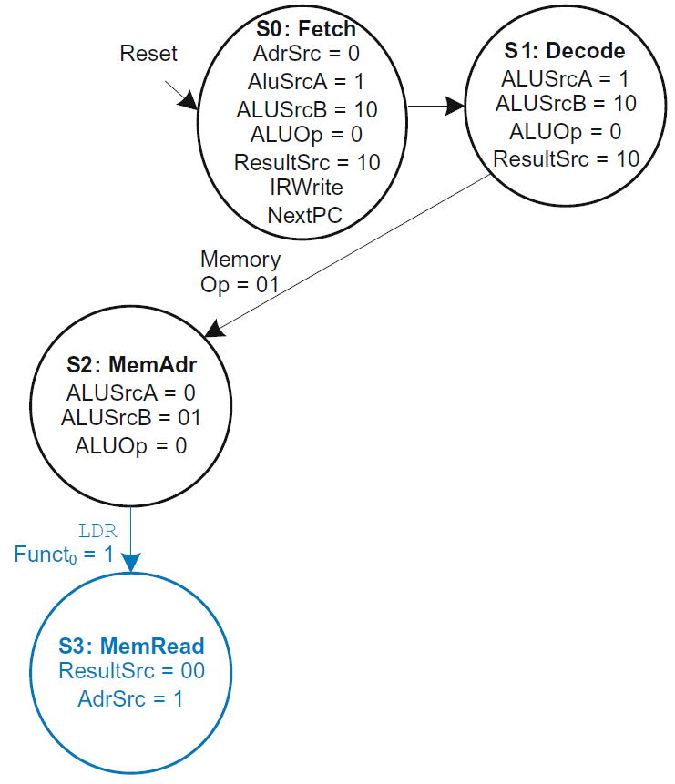
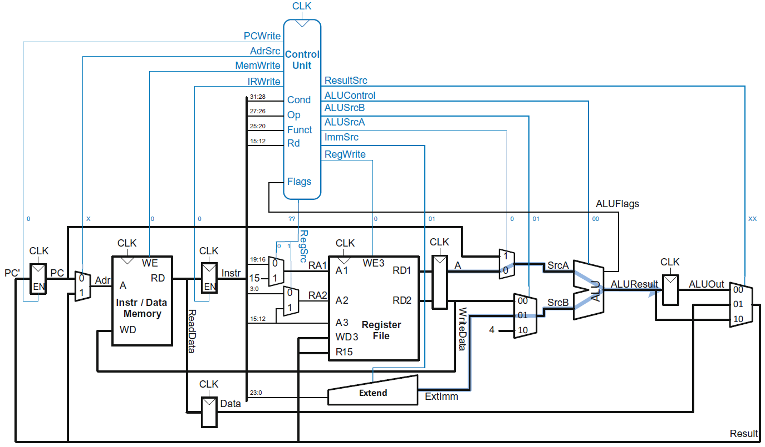
Main Controller FSM: Address

Slide 37
Main Controller FSM: Read Memory

Slide 38
Multicycle ARM Processor

Slide 39
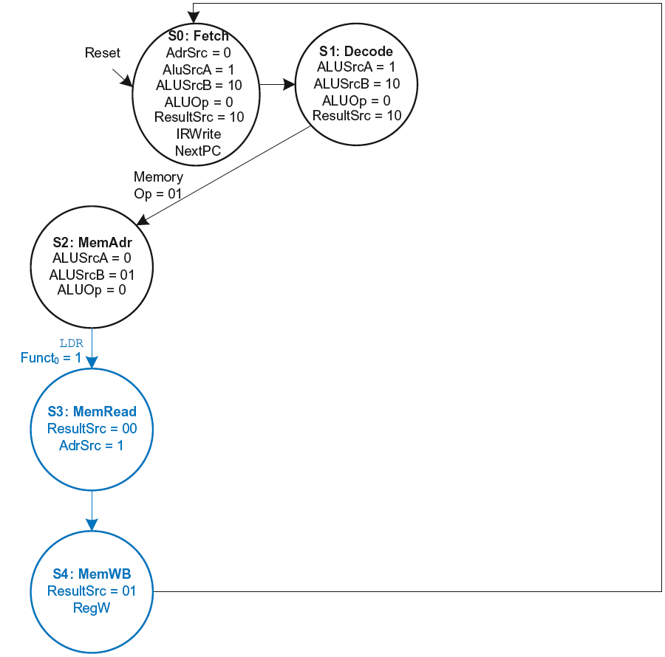
Main Controller FSM: LDR

Slide 40
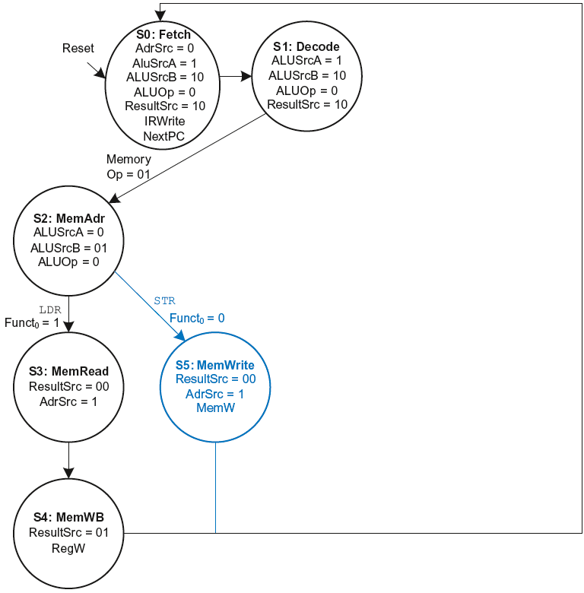
Main Controller FSM: STR

Slide 41
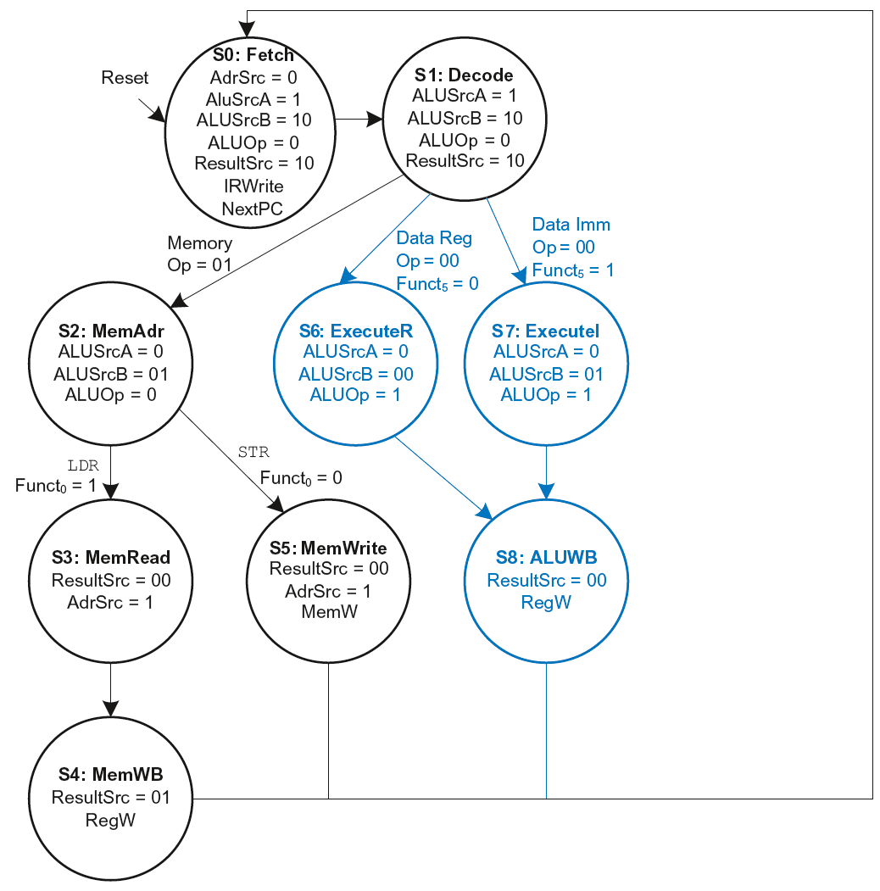
Main Controller FSM: Data-processing

Slide 42
Main Controller FSM: Data-processing

Slide 43
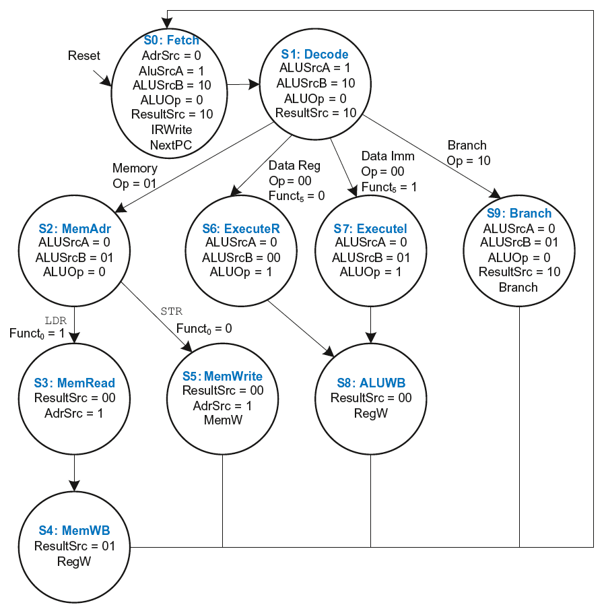
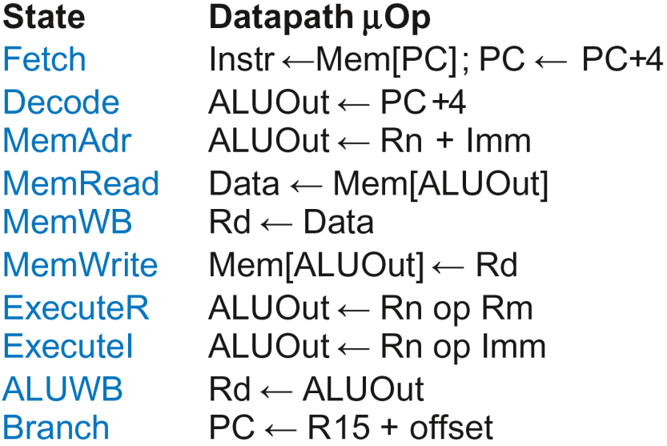
Multicycle Controller FSM

Slide 44
Multicycle Control
First, discuss Decoder
Then, Conditional Logic

Slide 45
Multicycle Control: Cond. Logic

Slide 46
Single-Cycle Conditional Logic

Slide 47
Multicycle Conditional Logic
PCWrite asserted in Fetch state
ExecuteI/ExecuteR state:
CondEx asserts
ALUFlags generated
ALUWB state:
Flags updated
CondEx changes
PCWrite, RegWrite, and
MemWrite don’t see
change till new
instruction (Fetch state)

Slide 48
Multicycle Processor Performance
Instructions take different number of cycles.

Slide 49
Multicycle Controller FSM

Slide 50
Multicycle Processor Performance
Instructions take different number of cycles:
  3 cycles:
  4 cycles:
  5 cycles:

Slide 51
Multicycle Processor Performance
Instructions take different number of cycles:
  3 cycles: B
  4 cycles: DP, STR
  5 cycles: LDR

Slide 52
Multicycle Processor Performance
Instructions take different number of cycles:
  3 cycles: B
  4 cycles: DP, STR
  5 cycles: LDR
CPI is weighted average
SPECINT2000 benchmark:
  25% loads
  10% stores
  13% branches
  52% data processing

Slide 53
Multicycle Processor Performance
Instructions take different number of cycles:
  3 cycles: B
  4 cycles: DP, STR
  5 cycles: LDR
CPI is weighted average
SPECINT2000 benchmark:
  25% loads
  10% stores
  13% branches
  52% data processing
Average CPI = (0.13)(3) + (0.52 + 0.10)(4) + (0.25)(5) = 4.12

Slide 54
Multicycle Processor Performance
Multicycle critical path:
Assumptions:
  RF is faster than memory
  writing memory is faster than reading memory
T_{c2} = t_{pcq} + 2t_{mux} + max(t_{ALU} + t_{mux}, t_{mem}) + t_{setup}

Slide 55
Multicycle Performance Example
Element | Parameter | Delay (ps)
Register clock-to-Q | t_{pcq_PC} | 40
Register setup | t_{setup} | 50
Multiplexer | t_{mux} | 25
ALU | t_{ALU} | 120
Decoder | t_{dec} | 70
Memory read | t_{mem} | 200
Register file read | t_{RFread} | 100
Register file setup | t_{RFsetup} | 60
T_{c2} = ?

Slide 56
Multicycle Performance Example
Element | Parameter | Delay (ps)
Register clock-to-Q | t_{pcq_PC} | 40
Register setup | t_{setup} | 50
Multiplexer | t_{mux} | 25
ALU | t_{ALU} | 120
Decoder | t_{dec} | 70
Memory read | t_{mem} | 200
Register file read | t_{RFread} | 100
Register file setup | t_{RFsetup} | 60
T_{c2} = t_{pcq} + 2t_{mux} + max[t_{ALU} + t_{mux}, t_{mem}] + t_{setup}
= [40 + 2(25) + 200 + 50] ps = 340 ps

Slide 57
Multicycle Performance Example
For a program with 100 billion instructions executing on a multicycle ARM processor
  CPI = 4.12 cycles/instruction
  Clock cycle time: T_{c2} = 340 ps
Execution Time = ?

Slide 58
Multicycle Performance Example
For a program with 100 billion instructions executing on a multicycle ARM processor
  CPI = 4.12 cycles/instruction
  Clock cycle time: T_{c2} = 340 ps
Execution Time = (# instructions) × CPI × T_{c}
= (100 × 10⁹)(4.12)(340 × 10⁻¹²)
= 140 seconds

Slide 59
Multicycle Performance Example
For a program with 100 billion instructions executing on a multicycle ARM processor
  CPI = 4.12 cycles/instruction
  Clock cycle time: T_{c2} = 340 ps
Execution Time = (# instructions) × CPI × T_{c}
= (100 × 10⁹)(4.12)(340 × 10⁻¹²)
= 140 seconds
This is slower than the single-cycle processor (84 sec.)

Slide 60
Processor Comparisons
Single Cycle Multicycle
One cycle/instruction 3-5 cycles/instruction
Long clock period Shorter clock period
Separate I and D Mem Unified Memory
Combinational controller FSM controller
Architectural State Only Extra state

