Slide 1

Lecture 20:
Single Cycle
Processor Controller
E85 Digital Design & Computer Engineering

Slide 2
Lecture 20
Single Cycle Processor Controller

Slide 3
Single-Cycle ARM Processor

Slide 4
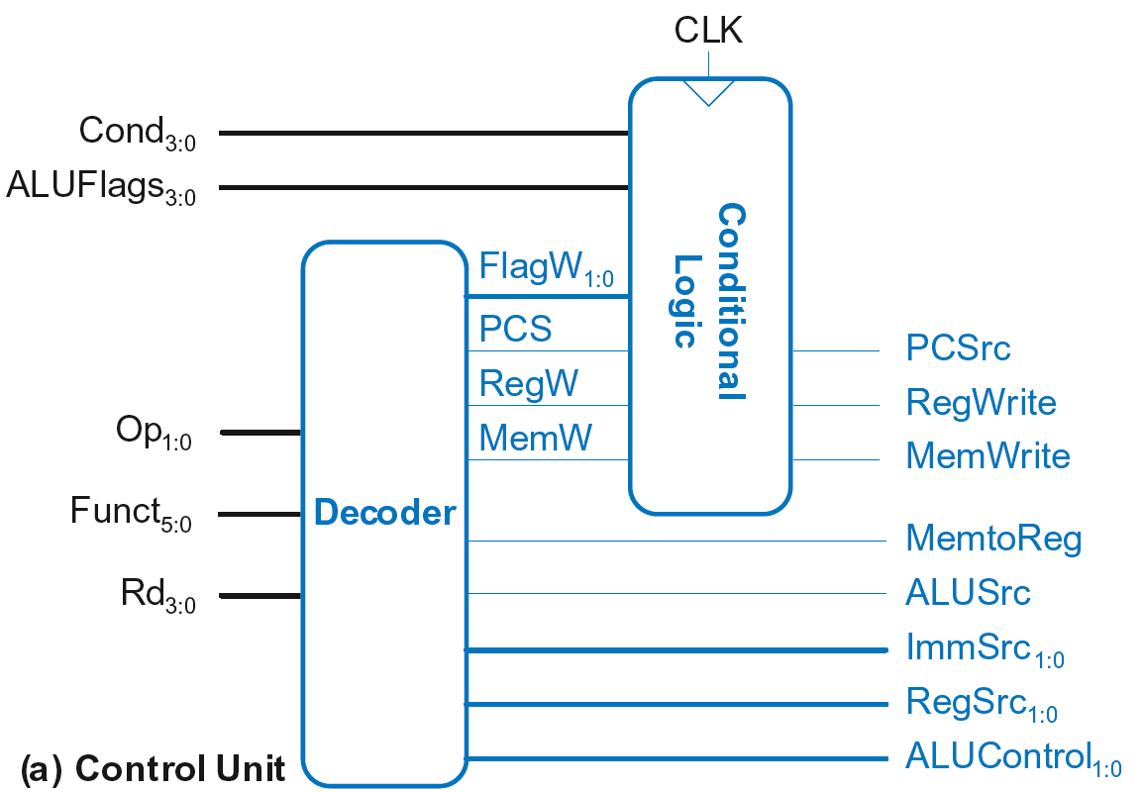
Single-Cycle Control

Slide 5
Single-Cycle Control
Sent directly
to datapath

Slide 6
Single-Cycle Control
Sent through
Conditional Logic
first, then to
datapath
Sent directly
to datapath

Slide 7
Single-Cycle Control
These signals change the state (PC, RF, Memory)
If instruction shouldn’t execute, forced to 0
Sent through
Conditional Logic
first, then to
datapath
Sent directly
to datapath

Slide 8
Single-Cycle Control
FlagW_{1:0}: Flag Write signal, asserted when ALUFlags should be saved (i.e., on instruction with S=1)

Slide 9
Single-Cycle Control
FlagW_{1:0}: Flag Write signal, asserted when ALUFlags should be saved (i.e., on instruction with S=1)
ADD, SUB update all flags (NZCV)
AND, ORR only update NZ flags

Slide 10
Single-Cycle Control
FlagW_{1:0}: Flag Write signal, asserted when ALUFlags should be saved (i.e., on instruction with S=1)
ADD, SUB update all flags (NZCV)
AND, ORR only update NZ flags
So, two bits needed:
  FlagW₁ = 1: NZ saved (ALUFlags_{3:2} saved)
  FlagW₀ = 1: CV saved (ALUFlags_{1:0} saved)

Slide 11
Single-Cycle Control

Slide 12
Single-Cycle Control: Decoder

Slide 13
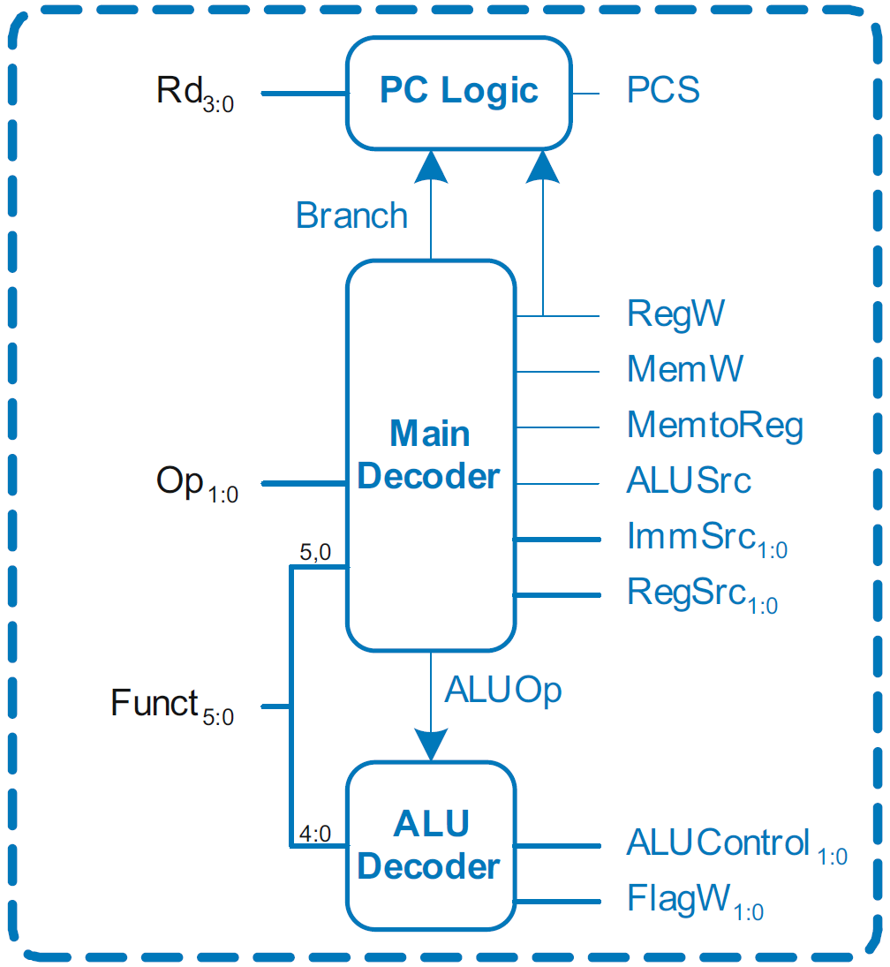
Single-Cycle Control: Decoder
Submodules:
Main Decoder
ALU Decoder
PC Logic

Slide 14
Single-Cycle Control: Decoder
Submodules:
Main Decoder
ALU Decoder
PC Logic

Slide 15
Control Unit: Main Decoder
Op | Funct₅ | Funct₀ | Type | Branch | MemtoReg | MemW | ALUSrc | ImmSrc | RegW | RegSrc | ALUOp
00 | 0 | X | DP Reg | 0 | 0 | 0 | 0 | XX | 1 | 00 | 1
00 | 1 | X | DP Imm | 0 | 0 | 0 | 1 | 00 | 1 | X0 | 1
01 | X | 0 | STR | 0 | X | 1 | 1 | 01 | 0 | 10 | 0
01 | X | 1 | LDR | 0 | 1 | 0 | 1 | 01 | 1 | X0 | 0
10 | X | X | B | 1 | 0 | 0 | 1 | 10 | 0 | X1 | 0

Slide 16
Single-Cycle Control: Decoder
Submodules:
Main Decoder
ALU Decoder
PC Logic

Slide 17
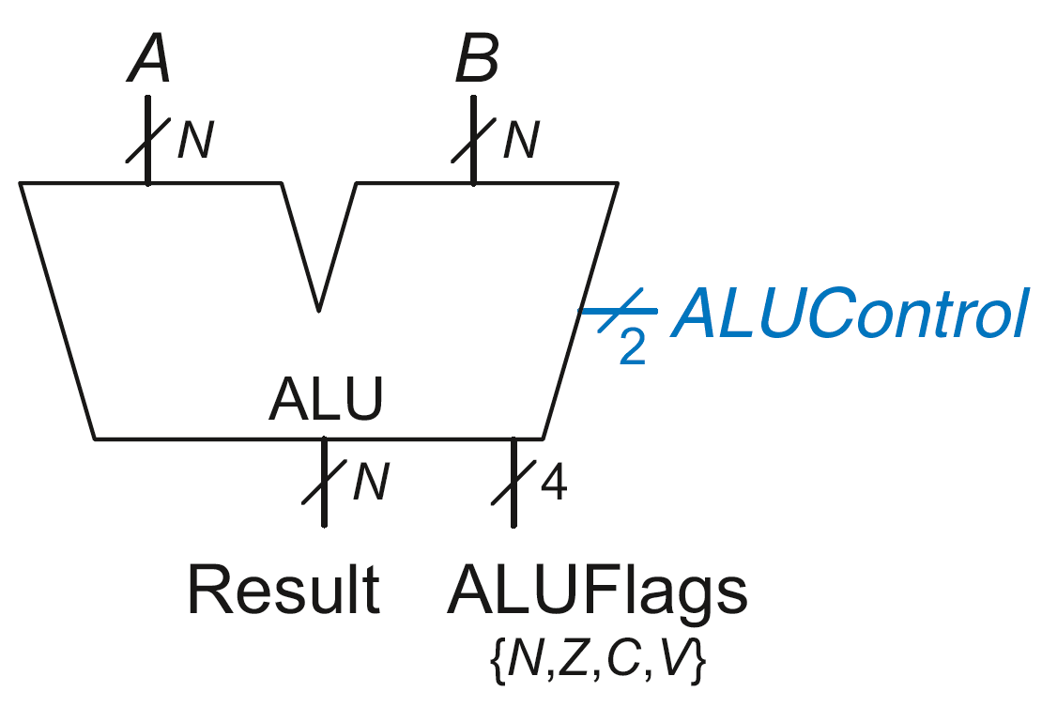
Review: ALU
ALUControl_{1:0} | Function
00 | Add
01 | Subtract
10 | AND
11 | OR

Slide 18
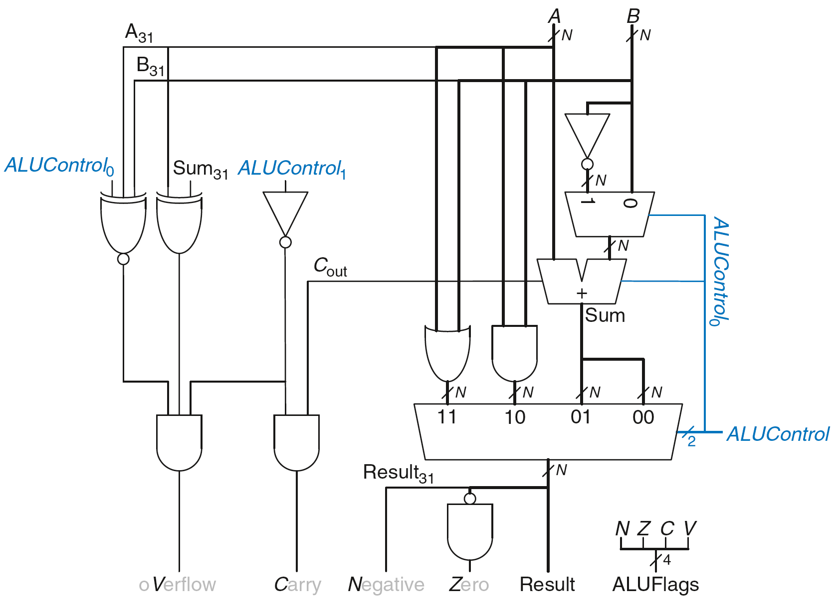
Review: ALU

Slide 19
Single-Cycle Control: Decoder
Submodules:
Main Decoder
ALU Decoder
PC Logic

Slide 20
Control Unit: ALU Decoder
ALUOp | Funct_{4:1} (cmd) | Funct₀ (S) | Type | ALUControl_{1:0} | FlagW_{1:0}
0 | X | X | Not DP | 00 | 00
1 | 0100 | 0 | ADD | 00 | 00
 |  | 1 |  |  | 11
 | 0010 | 0 | SUB | 01 | 00
 |  | 1 |  |  | 11
 | 0000 | 0 | AND | 10 | 00
 |  | 1 |  |  | 10
 | 1100 | 0 | ORR | 11 | 00
 |  | 1 |  |  | 10
  FlagW₁ = 1: NZ (Flags_{3:2}) should be saved
  FlagW₀ = 1: CV (Flags_{1:0}) should be saved

Slide 21
Single-Cycle Control: Decoder
Submodules:
Main Decoder
ALU Decoder
PC Logic

Slide 22
Single-Cycle Control: PC Logic
PCS = 1 if PC is written by an instruction or branch (B):
PCS = ((Rd == 15) & RegW) | Branch
If instruction is executed: PCSrc = PCS
Else PCSrc = 0 (i.e., PC = PC + 4)

Slide 23
Single-Cycle Control

Slide 24
Single-Cycle Control: Cond. Logic

Slide 25
Conditional Logic
Function:
Check if instruction should execute (if not, force PCSrc, RegWrite, and MemWrite to 0)
Possibly update Status Register (Flags_{3:0})

Slide 26
Conditional Logic
Function:
Check if instruction should execute (if not, force PCSrc, RegWrite, and MemWrite to 0)
Possibly update Status Register (Flags_{3:0})

Slide 27
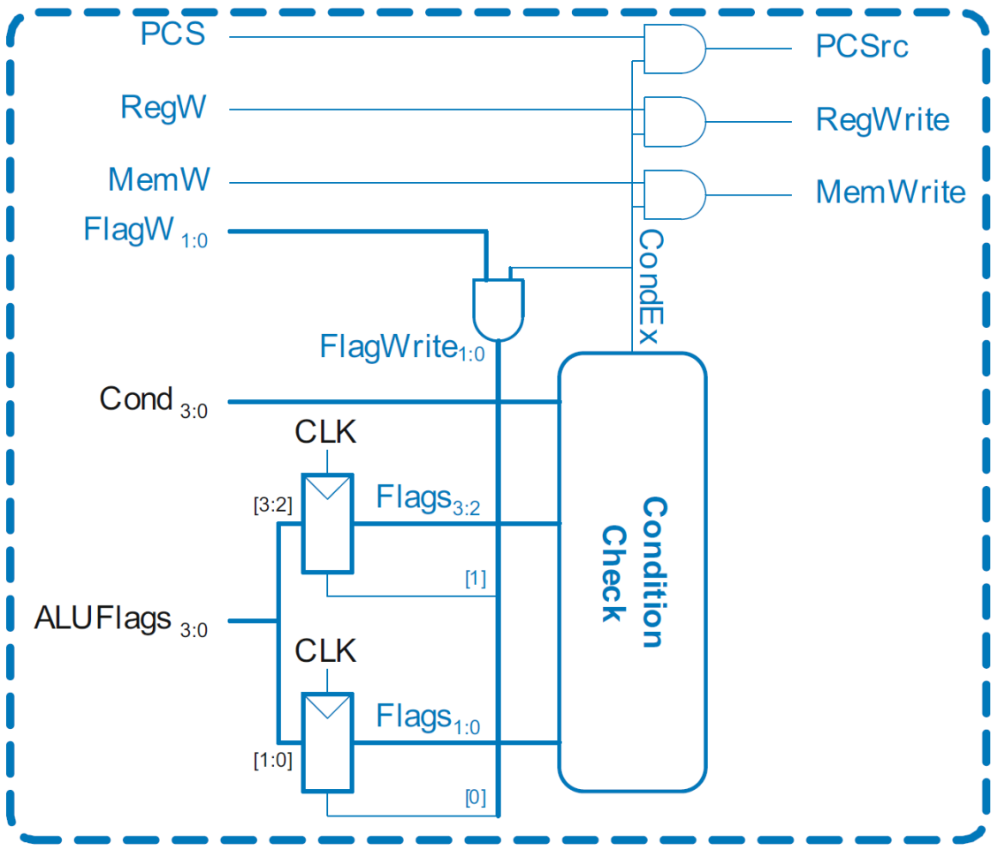
Single-Cycle Control: Conditional Logic

Slide 28
Conditional Logic: Conditional Execution
Depending on condition mnemonic (Cond_{3:0}) and condition flags (Flags_{3:0}) the instruction is executed (CondEx = 1)

Slide 29
Conditional Logic: Conditional Execution
Flags_{3:0} is the status register
Depending on condition mnemonic (Cond_{3:0}) and condition flags (Flags_{3:0}) the instruction is executed (CondEx = 1)

Slide 30
Review: Condition Mnemonics

Slide 31
Conditional Logic: Conditional Execution
Flags_{3:0} = NZCV
Example: AND R1, R2, R3
Cond_{3:0}=1110 (unconditional) => CondEx = 1

Slide 32
Conditional Logic: Conditional Execution
Flags_{3:0} = NZCV
Example: EOREQ R5, R6, R7
Cond_{3:0}=0000 (EQ): if Flags = x1xx => CondEx = 1

Slide 33
Conditional Logic
Function:
Check if instruction should execute (if not, force PCSrc, RegWrite, and MemWrite to 0)
Possibly update Status Register (Flags_{3:0})

Slide 34
Conditional Logic: Update (Set) Flags
Flags_{3:0} = NZCV
Flags_{3:0} updated (with ALUFlags_{3:0}) if:
FlagW is 1 (i.e., the instruction’s S-bit is 1) AND
CondEx is 1 (the instruction should be executed)

Slide 35

Conditional Logic: Update (Set) Flags
Recall:
ADD, SUB update all Flags
AND, OR update NZ only
So Flags status register has two write enables: FlagW_{1:0}

Slide 36
Review: ALU Decoder
ALUOp | Funct_{4:1} (cmd) | Funct₀ (S) | Type | ALUControl_{1:0} | FlagW_{1:0}
0 | X | X | Not DP | 00 | 00
1 | 0100 | 0 | ADD | 00 | 00
 |  | 1 |  |  | 11
 | 0010 | 0 | SUB | 01 | 00
 |  | 1 |  |  | 11
 | 0000 | 0 | AND | 10 | 00
 |  | 1 |  |  | 10
 | 1100 | 0 | ORR | 11 | 00
 |  | 1 |  |  | 10
  FlagW₁ = 1: NZ (Flags_{3:2}) should be saved
  FlagW₀ = 1: CV (Flags_{1:0}) should be saved

Slide 37
Conditional Logic: Update (Set) Flags
All Flags updated
Example: SUBS R5, R6, R7
FlagW_{1:0} = 11 AND CondEx = 1 (unconditional) => FlagWrite_{1:0} = 11

Slide 38
Conditional Logic: Update (Set) Flags
Flags_{3:0} = NZCV
Only Flags_{3:2} updated
i.e., only NZ Flags updated
Example: ANDS R7, R1, R3
FlagW_{1:0} = 10 AND CondEx = 1 (unconditional) => FlagWrite_{1:0} = 10

Slide 39
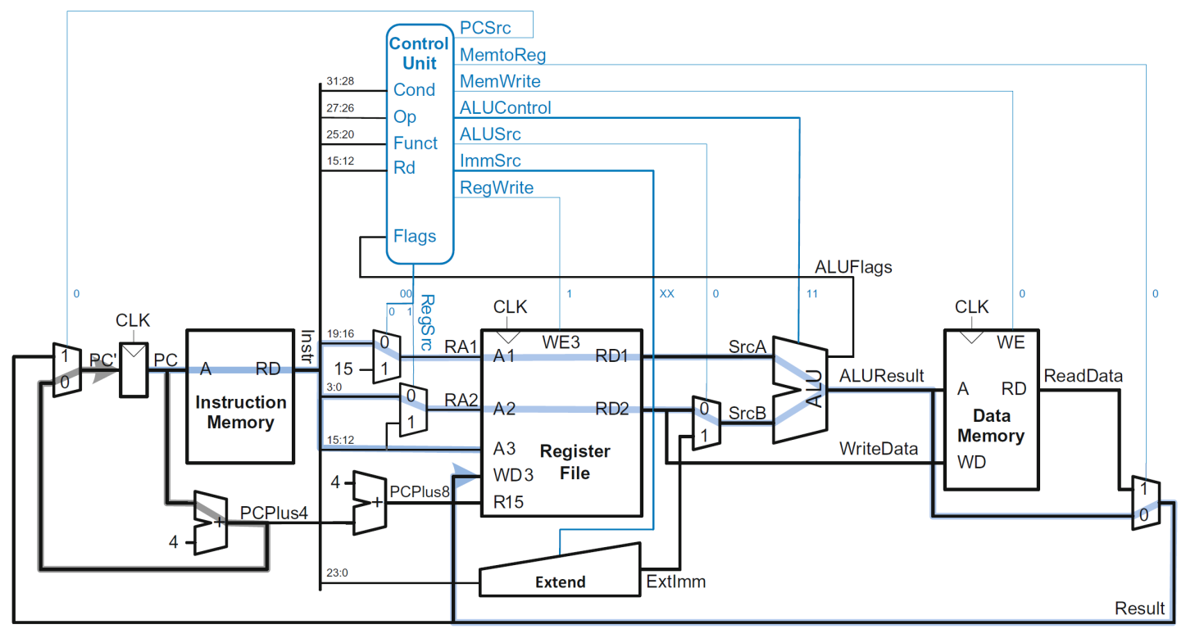
Example: ORR
Op | Funct₅ | Funct₀ | Type | Branch | MemtoReg | MemW | ALUSrc | ImmSrc | RegW | RegSrc | ALUOp
00 | 0 | X | DP Reg | 0 | 0 | 0 | 0 | XX | 1 | 00 | 1

Slide 40
Example: ORR

Slide 41
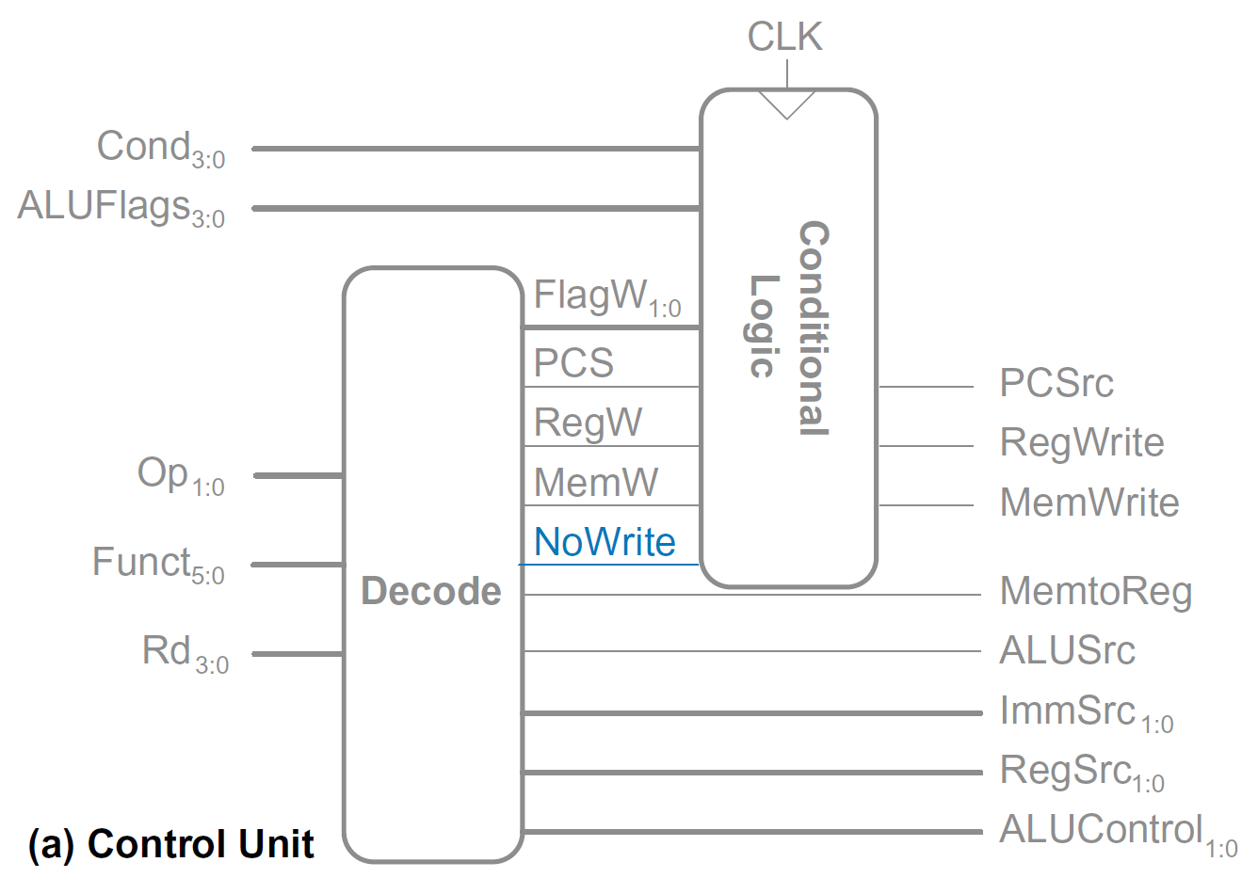
Extended Functionality: CMP

Slide 42
Extended Functionality: CMP
No change to datapath

Slide 43
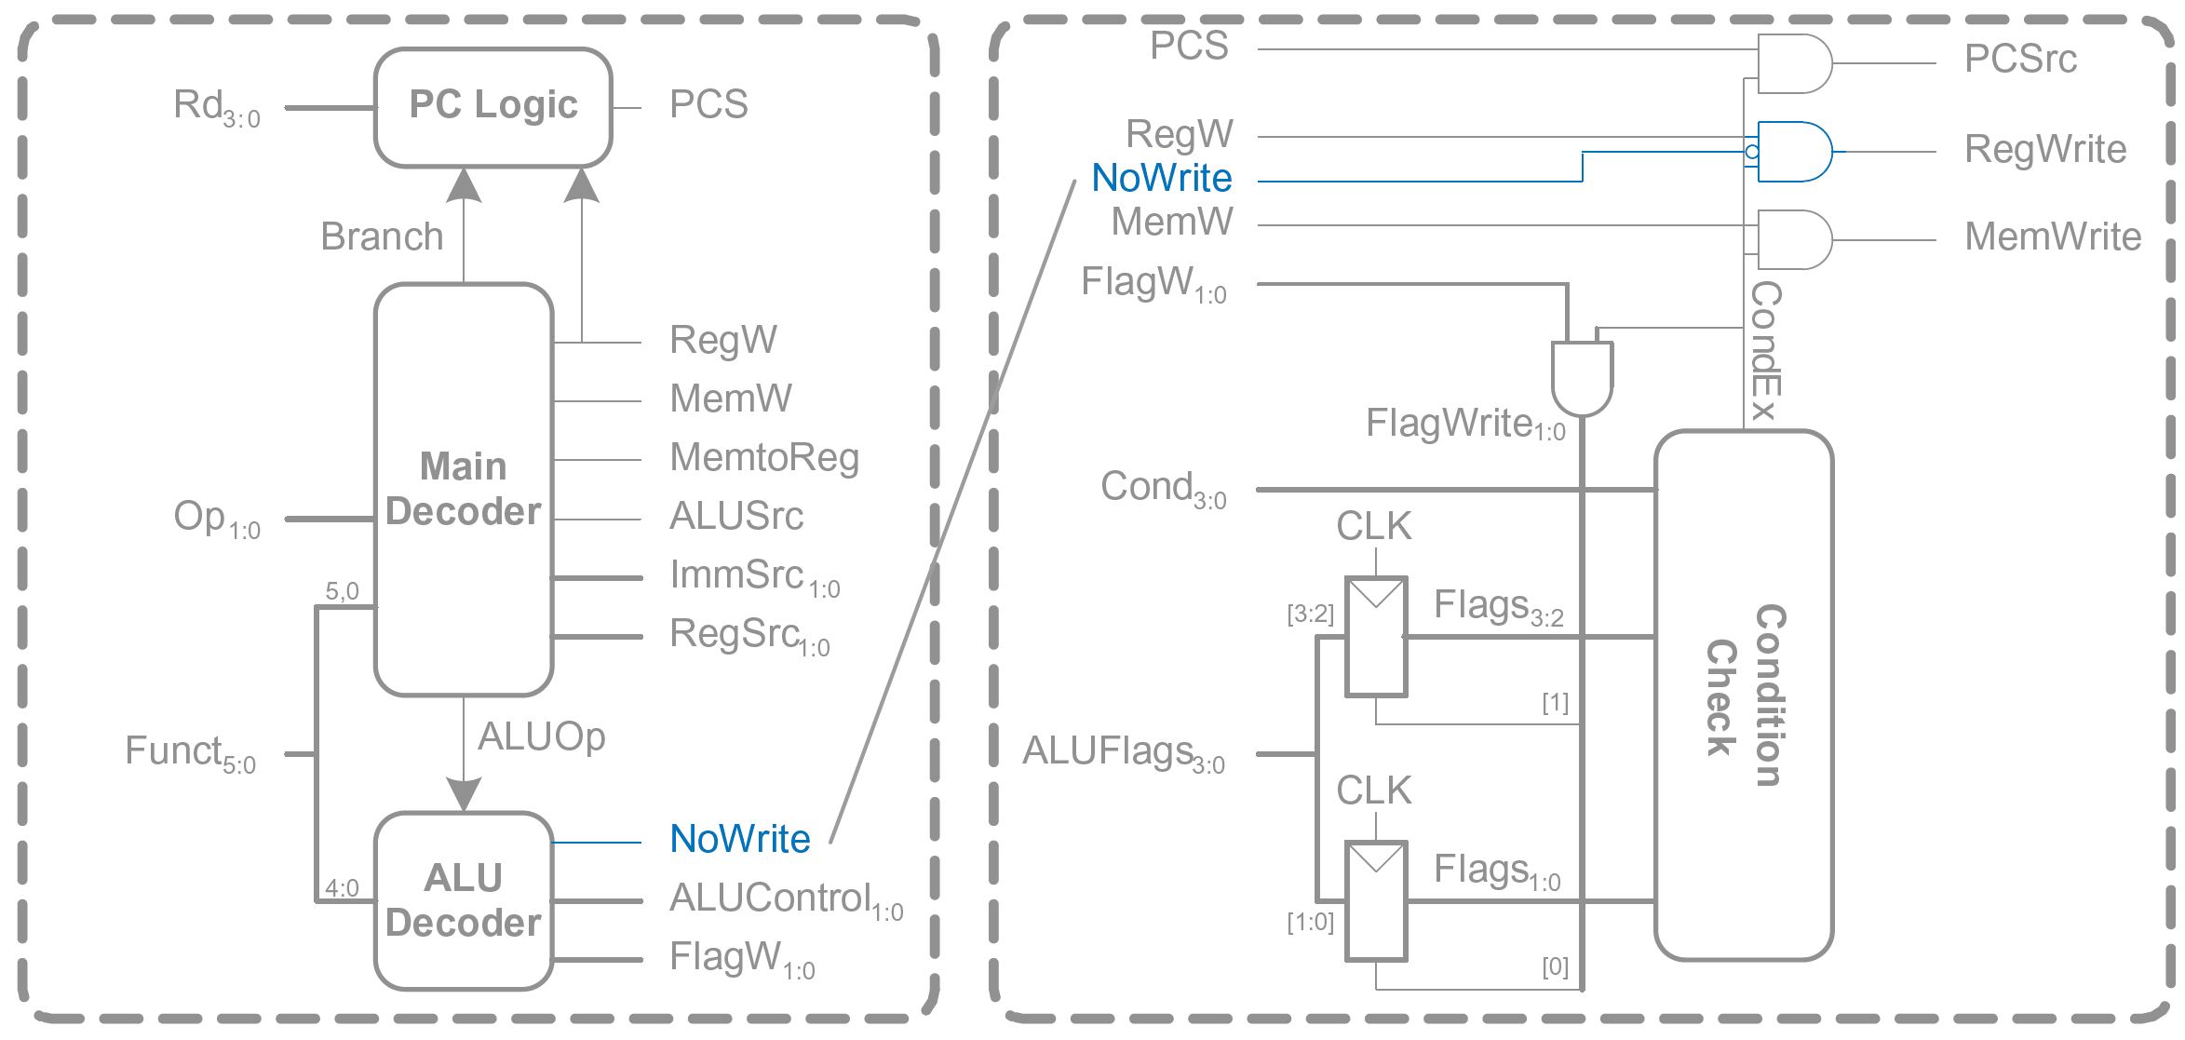
Extended Functionality: CMP

Slide 44
Extended Functionality: CMP
ALUOp | Funct_{4:1} (cmd) | Funct₀ (S) | Type | ALUControl_{1:0} | FlagW_{1:0} | NoWrite
0 | X | X | Not DP | 00 | 00 | 0
1 | 0100 | 0 | ADD | 00 | 00 | 0
 |  | 1 |  |  | 11 | 0
 | 0010 | 0 | SUB | 01 | 00 | 0
 |  | 1 |  |  | 11 | 0
 | 0000 | 0 | AND | 10 | 00 | 0
 |  | 1 |  |  | 10 | 0
 | 1100 | 0 | ORR | 11 | 00 | 0
 |  | 1 |  |  | 10 | 0
 | 1010 | 1 | CMP | 01 | 11 | 1

Slide 45
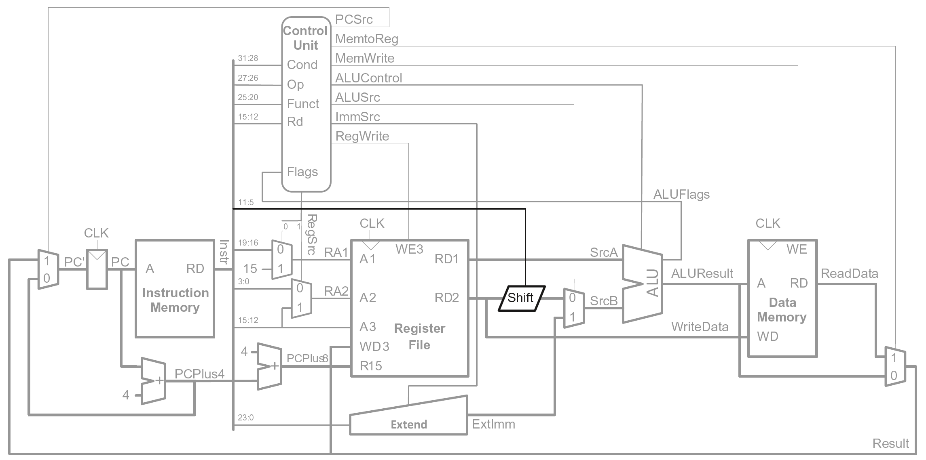
Extended Functionality: Shifted Register

Slide 46
Extended Functionality: Shifted Register
No change to controller

Slide 47
Review: Processor Performance
Program Execution Time
= (#instructions)(cycles/instruction)(seconds/cycle)
= # instructions x CPI x T_{C}

Slide 48
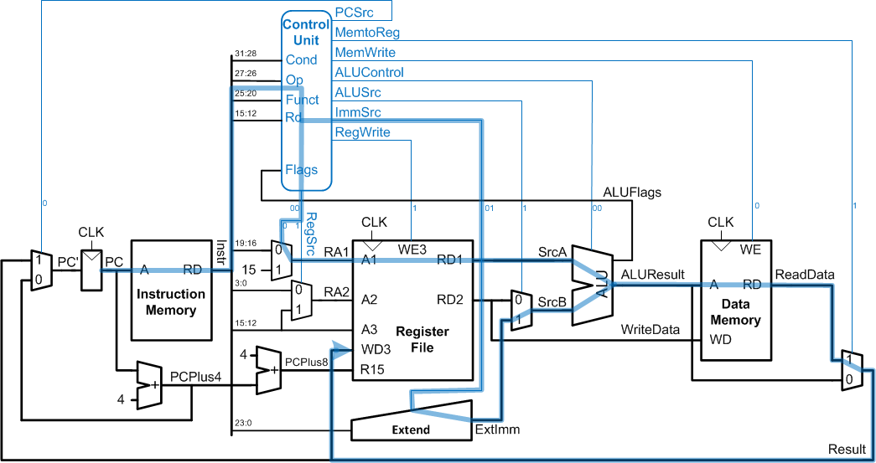
Single-Cycle Performance
T_{C} limited by critical path (LDR)

Slide 49
Single-Cycle Performance
Single-cycle critical path:
T_{c1} = t_{pcq_PC} + t_{mem} + t_{dec} +
max[t_{mux} + t_{RFread}, t_{sext} + t_{mux}] +
t_{ALU} + t_{mem} + t_{mux} + t_{RFsetup}
Typically, limiting paths are:
  memory, ALU, register file
  T_{c1} = t_{pcq_PC} + 2t_{mem} + t_{dec} + t_{RFread} + t_{ALU} + 2t_{mux} + t_{RFsetup}

Slide 50
Single-Cycle Performance Example
Element | Parameter | Delay (ps)
Register clock-to-Q | t_{pcq_PC} | 40
Register setup | t_{setup} | 50
Multiplexer | t_{mux} | 25
ALU | t_{ALU} | 120
Decoder | t_{dec} | 70
Memory read | t_{mem} | 200
Register file read | t_{RFread} | 100
Register file setup | t_{RFsetup} | 60
  T_{c1} = ?

Slide 51
Single-Cycle Performance Example
Element | Parameter | Delay (ps)
Register clock-to-Q | t_{pcq_PC} | 40
Register setup | t_{setup} | 50
Multiplexer | t_{mux} | 25
ALU | t_{ALU} | 120
Decoder | t_{dec} | 70
Memory read | t_{mem} | 200
Register file read | t_{RFread} | 100
Register file setup | t_{RFsetup} | 60
  T_{c1} = t_{pcq_PC} + 2t_{mem} + t_{dec} + t_{RFread} + t_{ALU} + 2t_{mux} + t_{RFsetup}
= [40 + 2(200) + 70 + 100 + 120 + 2(25) + 60] ps
= 840 ps

Slide 52
Single-Cycle Performance Example
Program with 100 billion instructions:
Execution Time = # instructions x CPI x T_{C}
= (100 × 10⁹)(1)(840 × 10⁻¹² s)
= 84 seconds

