Slide 1
Lecture 19: Single Cycle Processor Datapath
E85 Digital Design & Computer Engineering

Slide 2
Lecture 19
Single Cycle Processor Datapath

Slide 3
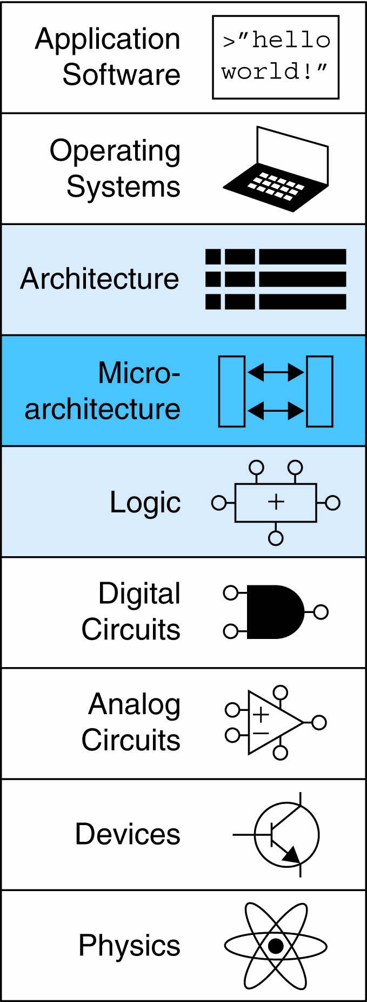
Introduction
Microarchitecture: how to implement an architecture in hardware
Processor:
Datapath: functional blocks
Control: control signals

Slide 4
Microarchitecture
Multiple implementations for a single architecture:
Single-cycle: Each instruction executes in a single cycle
Multicycle: Each instruction is broken up into series of shorter steps
Pipelined: Each instruction broken up into series of steps & multiple instructions execute at once

Slide 5
Processor Performance
Program execution time
Execution Time = (#instructions)(cycles/instruction)(seconds/cycle)
Definitions:
CPI: Cycles/instruction
clock period: seconds/cycle
IPC: instructions/cycle = IPC
Challenge is to satisfy constraints of:
Cost
Power
Performance

Slide 6
ARM Processor
Consider subset of ARM instructions:
Data-processing instructions:
ADD, SUB, AND, ORR
with register and immediate Src2, but no shifts
Memory instructions:
LDR, STR
with positive immediate offset
Branch instructions:
B

Slide 7
Architectural State Elements
Determines everything about a processor:
Architectural state:
16 registers (including PC)
Status register
Memory

Slide 8
ARM Architectural State Elements

Slide 9
Single-Cycle ARM Processor
Datapath
Control

Slide 10
Single-Cycle ARM Processor
Datapath
Control

Slide 11
Single-Cycle ARM Processor
Datapath: start with LDR instruction
Example: LDR R1, [R2, #5]
LDR Rd, [Rn, imm12]

Slide 12
Single-Cycle Datapath: LDR fetch
STEP 1: Fetch instruction

Slide 13
Single-Cycle Datapath: LDR Reg Read
STEP 2: Read source operands from RF
LDR Rd, [Rn, imm12]

Slide 14
Single-Cycle Datapath: LDR Immed.
STEP 3: Extend the immediate
LDR Rd, [Rn, imm12]

Slide 15
Single-Cycle Datapath: LDR Address
STEP 4: Compute the memory address
LDR Rd, [Rn, imm12]

Slide 16
Single-Cycle Datapath: LDR Mem Read
STEP 5: Read data from memory and write it back to register file
LDR Rd, [Rn, imm12]

Slide 17
Single-Cycle Datapath: PC Increment
STEP 6: Determine address of next instruction

Slide 18
Single-Cycle Datapath: Access to PC
PC can be source/destination of instruction

Slide 19
Single-Cycle Datapath: Access to PC
PC can be source/destination of instruction
Source: R15 must be available in Register File
PC is read as the current PC plus 8

Slide 20
Single-Cycle Datapath: Access to PC
PC can be source/destination of instruction
Source: R15 must be available in Register File
PC is read as the current PC plus 8
Destination: Be able to write result to PC

Slide 21
Single-Cycle Datapath: STR
Expand datapath to handle STR:
Write data in Rd to memory
STR Rd, [Rn, imm12]

Slide 22
Single-Cycle Datapath: Data-processing
With immediate Src2:
Read from Rn and Imm8 (ImmSrc chooses the zero-extended Imm8 instead of Imm12)
Write ALUResult to register file
Write to Rd
ADD Rd, Rn, imm8

Slide 23
Single-Cycle Datapath: Data-processing
With immediate Src2:
Read from Rn and Imm8 (ImmSrc chooses the zero-extended Imm8 instead of Imm12)
Write ALUResult to register file
Write to Rd
ADD Rd, Rn, imm8

Slide 24
Single-Cycle Datapath: Data-processing
With register Src2:
Read from Rn and Rm (instead of Imm8)
Write ALUResult to register file
Write to Rd
ADD Rd, Rn, Rm

Slide 25
Single-Cycle Datapath: Data-processing
With register Src2:
Read from Rn and Rm (instead of Imm8)
Write ALUResult to register file
Write to Rd
ADD Rd, Rn, Rm

Slide 26
Single-Cycle Datapath: B
Calculate branch target address:
BTA = (ExtImm) + (PC + 8)
ExtImm = Imm24 << 2 and sign-extended
B Label

Slide 27
Single-Cycle Datapath: ExtImm
ImmSrc_{1:0} | ExtImm | Description
00 | {24’b0, Instr_{7:0}} | Zero-extended imm8
01 | {20’b0, Instr_{11:0}} | Zero-extended imm12
10 | {6{Instr₂₃}, Instr_{23:0}} | Sign-extended imm24

Slide 28
Single-Cycle ARM Processor

