Slide 1

Lecture 17:
ARM Assembly
Language
E85 Digital Design & Computer Engineering

Slide 2
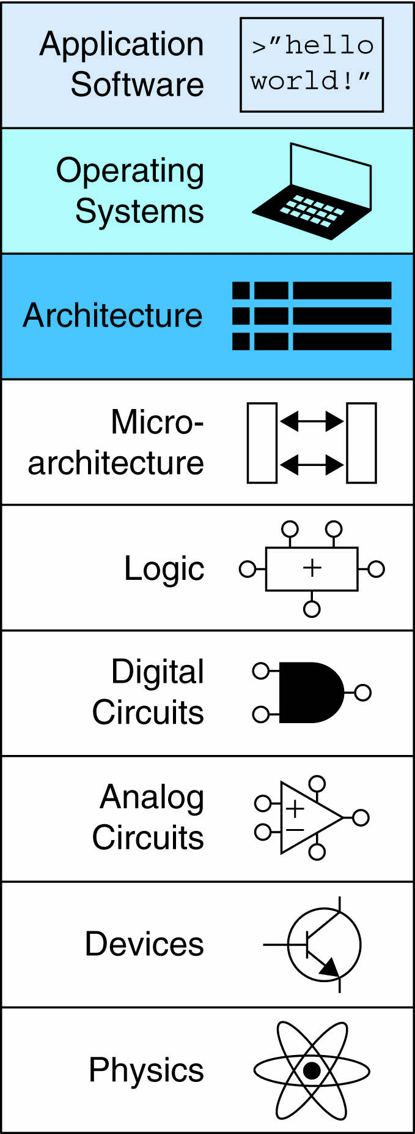
Lecture 17
Introduction
Assembly Language
Machine Language
Programming
Addressing Modes

Slide 3
Introduction
Jumping up a few levels of abstraction
  Architecture: programmer’s view of computer
    Defined by instructions & operand locations
  Microarchitecture: how to implement an architecture in hardware (covered in Chapter 7)

Slide 4
Instructions
Commands in a computer’s language
  Assembly language: human-readable format of instructions
  Machine language: computer-readable format (1’s and 0’s)

Slide 5
ARM Architecture
Developed in the 1980’s by Advanced RISC Machines – now called ARM Holdings
Nearly 10 billion ARM processors sold/year
Almost all cell phones and tablets have multiple ARM processors
Over 75% of humans use products with an ARM processor
Used in servers, cameras, robots, cars, pinball machines, etc.

Slide 6
ARM Architecture
Developed in the 1980’s by Advanced RISC Machines – now called ARM Holdings
Nearly 10 billion ARM processors sold/year
Almost all cell phones and tablets have multiple ARM processors
Over 75% of humans use products with an ARM processor
Used in servers, cameras, robots, cars, pinball machines,, etc.
Once you’ve learned one architecture, it’s easier to learn others

Slide 7
Architecture Design Principles
Underlying design principles, as articulated by Hennessy and Patterson:
    Regularity supports design simplicity
    Make the common case fast
    Smaller is faster
    Good design demands good compromises

Slide 8
Instruction: Addition
ADD: mnemonic – indicates operation to perform
b, c: source operands
a: destination operand
C Code
a = b + c;
ARM Assembly Code
ADD a, b, c

Slide 9
Instruction: Subtraction
Similar to addition - only mnemonic changes
SUB: mnemonic
b, c: source operands
a: destination operand
C Code
a = b - c;
ARM assembly code
SUB a, b, c

Slide 10
Design Principle 1
Regularity supports design simplicity
Consistent instruction format
Same number of operands (two sources and one destination)
Ease of encoding and handling in hardware

Slide 11
Multiple Instructions
More complex code handled by multiple ARM instructions
C Code
a = b + c - d;
ARM assembly code
ADD t, b, c ; t = b + c
SUB a, t, d ; a = t - d

Slide 12
Design Principle 2
Make the common case fast
ARM includes only simple, commonly used instructions
Hardware to decode and execute instructions kept simple, small, and fast
More complex instructions (that are less common) performed using multiple simple instructions

Slide 13
Design Principle 2
Make the common case fast
ARM is a Reduced Instruction Set Computer (RISC), with a small number of simple instructions
Other architectures, such as Intel’s x86, are Complex Instruction Set Computers (CISC)

Slide 14
Operand Location
Physical location in computer
  Registers
  Constants (also called immediates)
  Memory

Slide 15
Operands: Registers
ARM has 16 registers
Registers are faster than memory
Each register is 32 bits
ARM is called a “32-bit architecture” because it operates on 32-bit data

Slide 16
Design Principle 3
Smaller is Faster
ARM includes only a small number of registers

Slide 17
ARM Register Set
Name | Use
R0 | Argument / return value / temporary variable
R1-R3 | Argument / temporary variables
R4-R11 | Saved variables
R12 | Temporary variable
R13 (SP) | Stack Pointer
R14 (LR) | Link Register
R15 (PC) | Program Counter

Slide 18
Operands: Registers
Registers:
  R before number, all capitals
  Example: “R0” or “register zero” or “register R0”

Slide 19
Operands: Registers
Registers used for specific purposes:
  Saved registers: R4-R11 hold variables
  Temporary registers: R0-R3 and R12, hold intermediate values
  Discuss others later

Slide 20
Instructions with Registers
Revisit ADD instruction
C Code
a = b + c;
ARM Assembly Code
; R0 = a, R1 = b, R2 = c
ADD R0, R1, R2

Slide 21
Operands: Constants\Immediates
Many instructions can use constants or immediate operands
For example: ADD and SUB
value is immediately available from instruction
C Code
a = a + 4;
b = a – 12;
ARM Assembly Code
; R0 = a, R1 = b
ADD R0, R0, #4
SUB R1, R0, #12

Slide 22
Generating Constants
Generating small constants using move (MOV):
C Code
//int: 32-bit signed word
int a = 23;
int b = 0x45;
ARM Assembly Code
; R0 = a, R1 = b
MOV R0, #23
MOV R1, #0x45

Slide 23
Generating Constants
Generating small constants using move (MOV):
Constant must have < 8 bits of precision
Note: MOV can also use 2 registers: MOV R7, R9
C Code
//int: 32-bit signed word
int a = 23;
int b = 0x45;
ARM Assembly Code
; R0 = a, R1 = b
MOV R0, #23
MOV R1, #0x45

Slide 24
Generating Constants
Generate larger constants using move (MOV) and or (ORR):
C Code
int a = 0x7EDC8765;
ARM Assembly Code
# R0 = a
MOV R0, #0x7E000000
ORR R0, R0, #0xDC0000
ORR R0, R0, #0x8700
ORR R0, R0, #0x65

Slide 25
Operands: Memory
Too much data to fit in only 16 registers
Store more data in memory
Memory is large, but slow
Commonly used variables still kept in registers

Slide 26
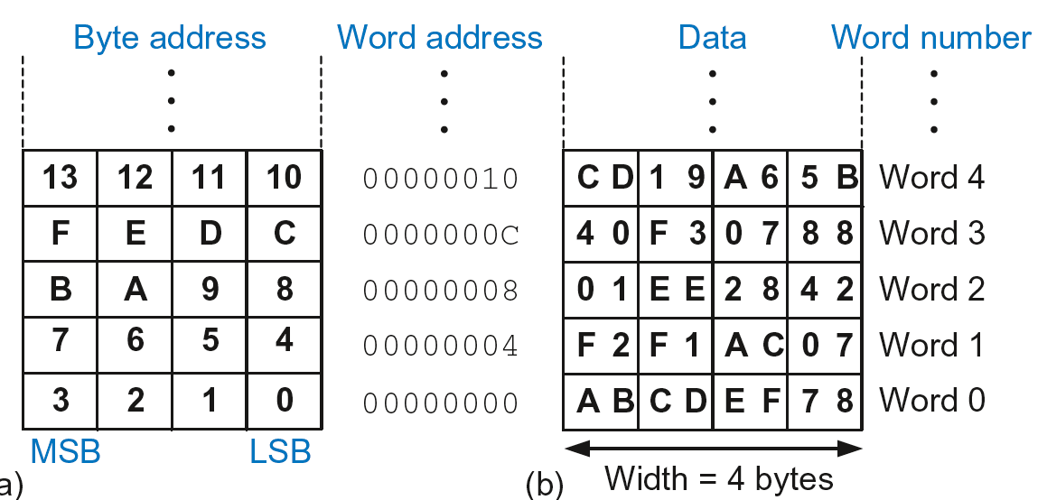
Byte-Addressable Memory
Each data byte has unique address
32-bit word = 4 bytes, so word address increments by 4

Slide 27
Reading Memory
Memory read called load
Mnemonic: load register (LDR)
Format:
LDR R0, [R1, #12]
  Address calculation:
    add base address (R1) to the offset (12)
    address = (R1 + 12)
  Result:
    R0 holds the data at memory address (R1 + 12)
Any register may be used as base address

Slide 28
Reading Memory
Example: Read a word of data at memory address 8 into R3
  Address = (R2 + 8) = 8
  R3 = 0x01EE2842 after load
ARM Assembly Code
MOV R2, #0
LDR R3, [R2, #8]

Slide 29
Writing Memory
Memory write are called stores
Mnemonic: store register (STR)

Slide 30
Writing Memory
Example: Store the value held in R7 into memory word 21.
Memory address = 4 x 21 = 84 = 0x54
ARM assembly code
MOV R5, #0
STR R7, [R5, #0x54]
The offset can be written in decimal or hexadecimal

Slide 31
Recap: Accessing Memory
Address of a memory word must be multiplied by 4
Examples:
  Address of memory word 2 = 2 × 4 = 8
  Address of memory word 10 = 10 × 4 = 40

Slide 32
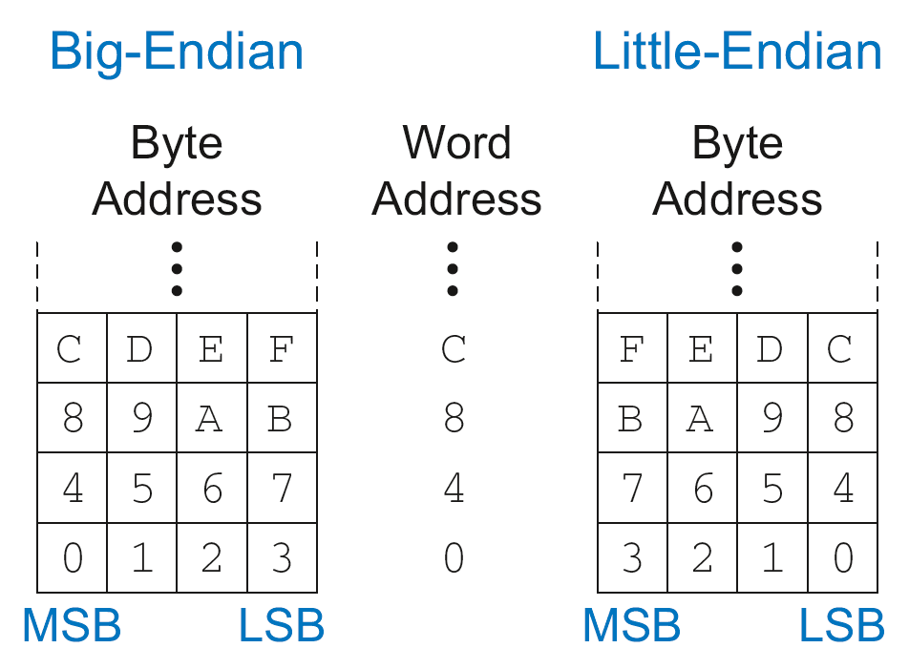
Big-Endian & Little-Endian Memory
How to number bytes within a word?
  Little-endian: byte numbers start at the little (least significant) end
  Big-endian: byte numbers start at the big (most significant) end

Slide 33
Big-Endian & Little-Endian Memory
Jonathan Swift’s Gulliver’s Travels: the Little-Endians broke their eggs on the little end of the egg and the Big-Endians broke their eggs on the big end
It doesn’t really matter which addressing type used – except when two systems share data

Slide 34
Big-Endian & Little-Endian Example
Suppose R2 and R5 hold the values 8 and 0x23456789
After following code runs on big-endian system, what value is in R7?
In a little-endian system?
      STR R5, [R2, #0]
      LDRB R7, [R2, #1]

Slide 35
Big-Endian & Little-Endian Example
Suppose R2 and R5 hold the values 8 and 0x23456789
After following code runs on big-endian system, what value is in R7?
In a little-endian system?
      STR R5, [R2, #0]
      LDRB R7, [R2, #1]
      Big-endian: 0x00000045
      Little-endian: 0x00000067

Slide 36
Programming
High-level languages:
  e.g., C, Java, Python
  Written at higher level of abstraction

Slide 37

Ada Lovelace, 1815-1852
British mathematician
Wrote the first computer program
Her program calculated the Bernoulli numbers on Charles Babbage’s Analytical Engine
She was a child of the poet Lord Byron

Slide 38
Programming Building Blocks
Data-processing Instructions
Conditional Execution
Branches
High-level Constructs:
  if/else statements
  for loops
  while loops
  arrays
  function calls

Slide 39
Data-processing Instructions
Logical operations
Shifts / rotate
Multiplication

Slide 40
Logical Instructions
AND
ORR
EOR (XOR)
BIC (Bit Clear = A & ~B)
MVN (MoVe and NOT)

Slide 41
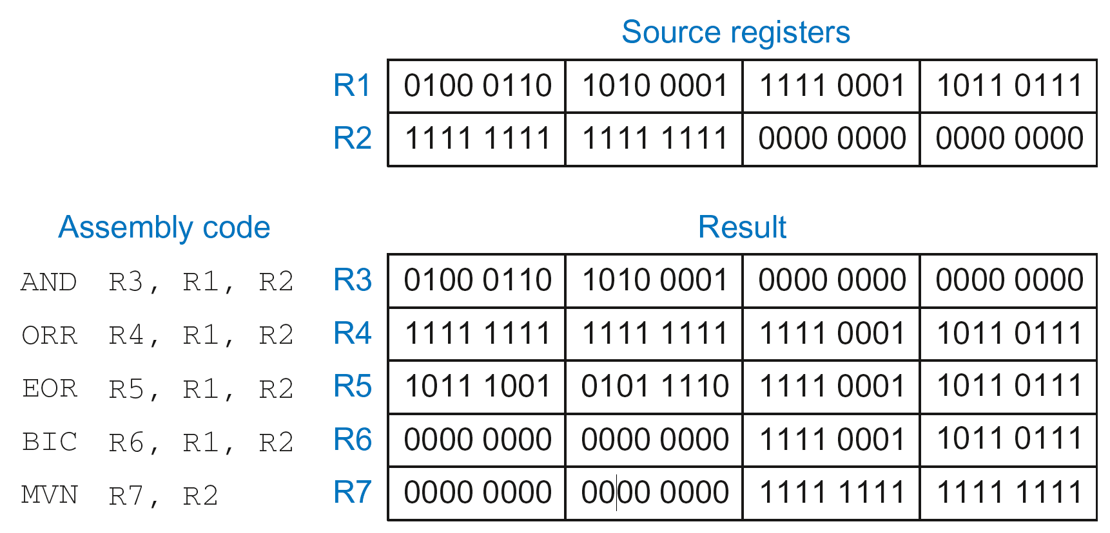
Logical Instructions: Examples

Slide 42
Logical Instructions: Uses
AND or BIC: useful for masking bits
  Example: Masking all but the least significant byte of a value
  0xF234012F AND 0x000000FF = 0x0000002F
  0xF234012F BIC 0xFFFFFF00 = 0x0000002F
ORR: useful for combining bit fields
  Example: Combine 0xF2340000 with 0x000012BC:
  0xF2340000 ORR 0x000012BC = 0xF23412BC

Slide 43
Shift Instructions
LSL: logical shift left
  Example: LSL R0, R7, #5 ; R0 = R7 << 5
LSR: logical shift right
  Example: LSR R3, R2, #31 ; R3 = R2 >> 31
ASR: arithmetic shift right
  Example: ASR R9, R11, R4 ; R9 = R11 >>> R4_{7:0}
ROR: rotate right
  Example: ROR R8, R1, #3 ; R8 = R1 ROR 3

Slide 44
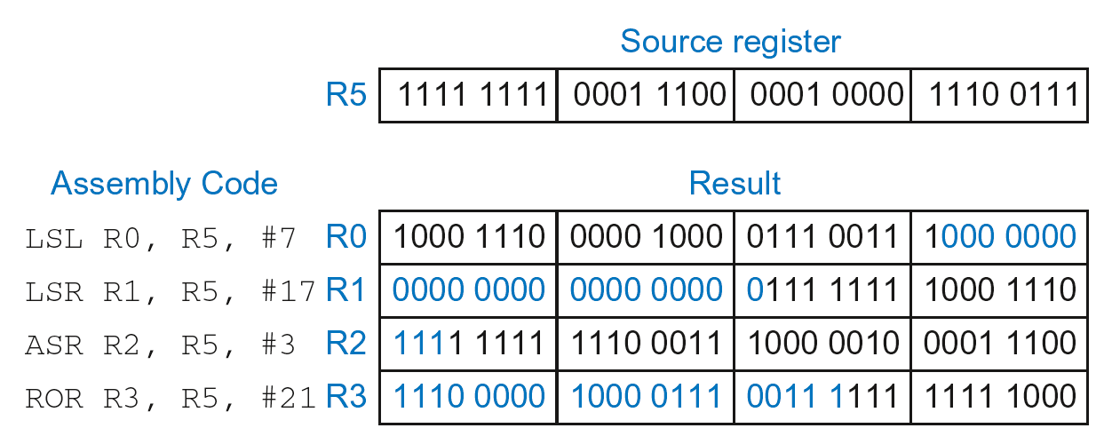
Shift Instructions: Example 1
Immediate shift amount (5-bit immediate)
Shift amount: 0-31

Slide 45
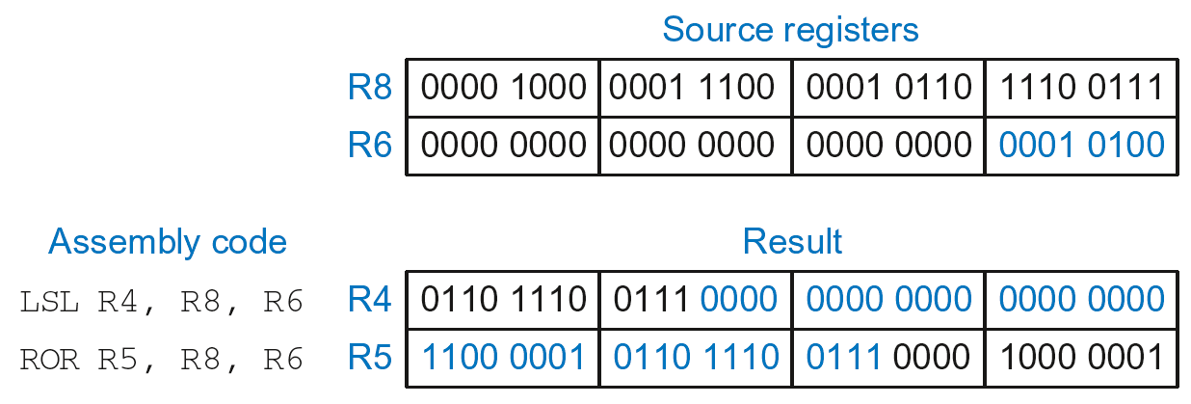
Shift Instructions: Example 2
Register shift amount (uses low 8 bits of register)
Shift amount: 0-255

Slide 46
Multiplication
MUL: 32 × 32 multiplication, 32-bit result
  MUL R1, R2, R3
  Result: R1 = (R2 x R3)_{31:0} (signed doesn’t matter)
UMULL: Unsigned multiply long: 32 × 32 multiplication, 64-bit result
  UMULL R1, R2, R3, R4
  Result: {R1,R4} = R2 x R3 (R2, R3 unsigned)
SMULL: Signed multiply long: 32 × 32 multiplication, 64-bit result
  SMULL R1, R2, R3, R4
  Result: {R1,R4} = R2 x R3 (R2, R3 signed)

Slide 47
Programming Building Blocks
Data-processing Instructions
Conditional Execution
Branches
High-level Constructs:
  if/else statements
  for loops
  while loops
  arrays
  function calls

Slide 48
Conditional Execution
Don’t always want to execute code sequentially
For example:
  if/else statements, while loops, etc.: only want to execute code if a condition is true
  branching: jump to another portion of code if a condition is true

Slide 49
Conditional Execution
Don’t always want to execute code sequentially
For example:
  if/else statements, while loops, etc.: only want to execute code if a condition is true
  branching: jump to another portion of code if a condition is true
ARM includes condition flags that can be:
  set by an instruction
  used to conditionally execute an instruction

Slide 50
ARM Condition Flags
Flag | Name | Description
N | Negative | Instruction result is negative
Z | Zero | Instruction results in zero
C | Carry | Instruction causes an unsigned carry out
V | oVerflow | Instruction causes an overflow
Set by ALU (recall from Chapter 5)
Held in Current Program Status Register (CPSR)

Slide 51
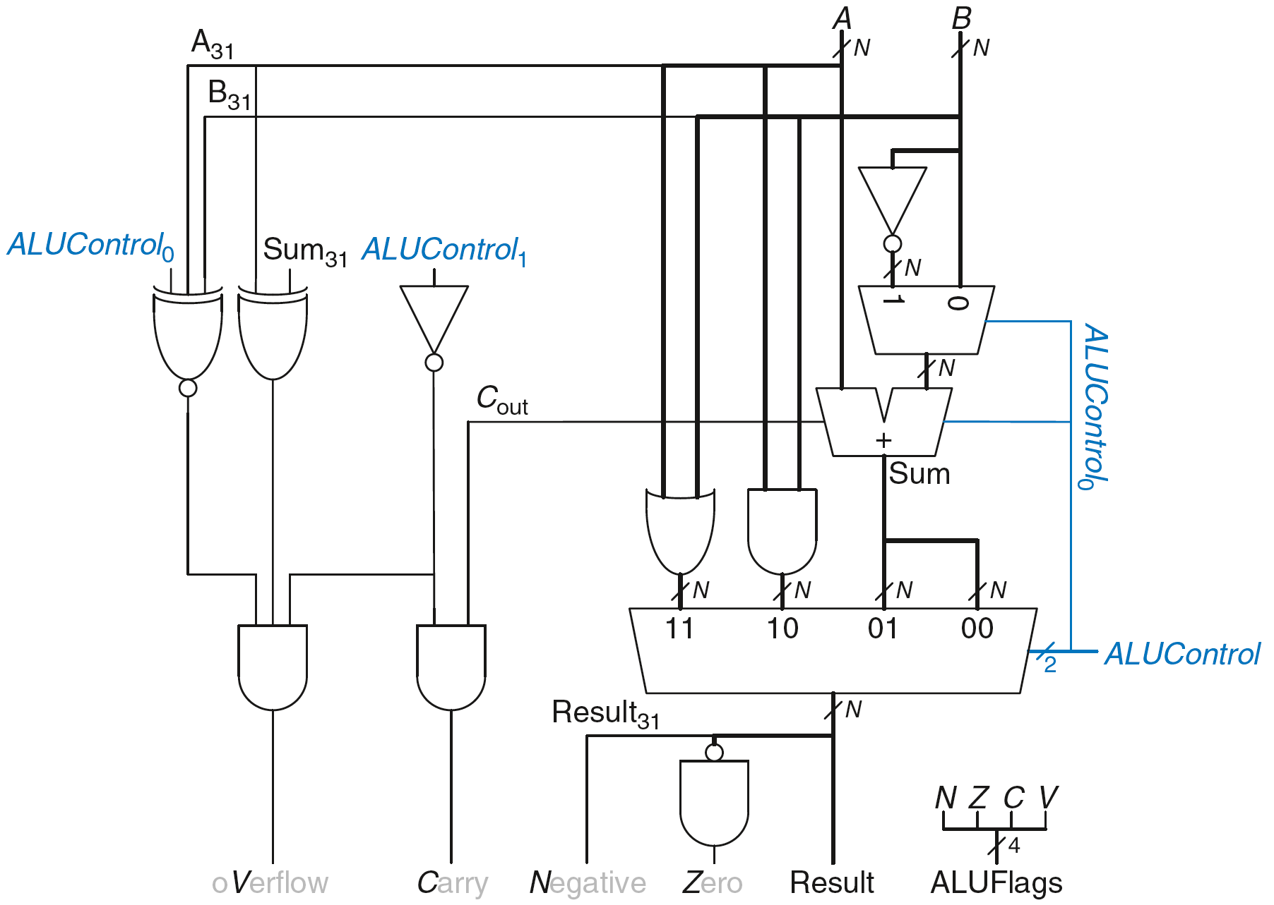
Review: ARM ALU

Slide 52
Setting the Condition Flags: NZCV
Method 1: Compare instruction: CMP
  Example: CMP R5, R6
    Performs: R5-R6
    Does not save result
    Sets flags. If result:
      Is 0, Z=1
      Is negative, N=1
      Causes a carry out, C=1
      Causes a signed overflow, V=1

Slide 53
Setting the Condition Flags: NZCV
Method 1: Compare instruction: CMP
  Example: CMP R5, R6
    Performs: R5-R6
    Sets flags: If result is 0 (Z=1), negative (N=1), etc.
    Does not save result
Method 2: Append instruction mnemonic with S
  Example: ADDS R1, R2, R3
    Performs: R2 + R3
    Sets flags: If result is 0 (Z=1), negative (N=1), etc.
    Saves result in R1

Slide 54
Condition Mnemonics
Instruction may be conditionally executed based on the condition flags
Condition of execution is encoded as a condition mnemonic appended to the instruction mnemonic
  Example: CMP R1, R2
  SUBNE R3, R5, R8
        NE: not equal condition mnemonic
        SUB will only execute if R1 ≠ R2
        (i.e., Z = 0)

Slide 55
Condition Mnemonics

Slide 56
Conditional Execution
Example:
  CMP R5, R9 ; performs R5-R9
  ; sets condition flags
  SUBEQ R1, R2, R3 ; executes if R5==R9 (Z=1)
  ORRMI R4, R0, R9 ; executes if R5-R9 is
  ; negative (N=1)
  Suppose R5 = 17, R9 = 23:
    CMP performs: 17 – 23 = -6 (Sets flags: N=1, Z=0, C=0, V=0)
    SUBEQ doesn’t execute (they aren’t equal: Z=0)
    ORRMI executes because the result was negative (N=1)

Slide 57
Programming Building Blocks
Data-processing Instructions
Conditional Execution
Branches
High-level Constructs:
  if/else statements
  for loops
  while loops
  arrays
  function calls

Slide 58
Branching
Branches enable out of sequence instruction execution
Types of branches:
  Branch (B)
    branches to another instruction
  Branch and link (BL)
    discussed later
Both can be conditional or unconditional

Slide 59
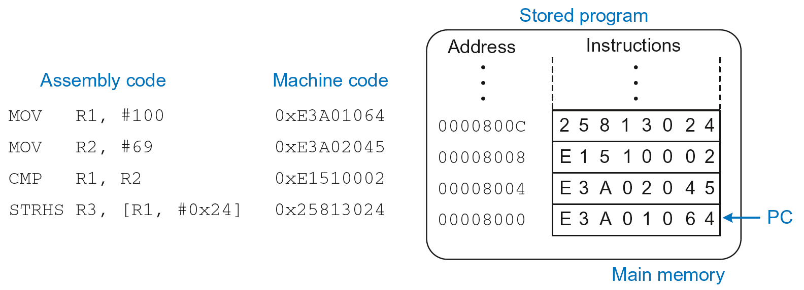
The Stored Program

Slide 60
Unconditional Branching (B)
ARM assembly
MOV R2, #17 ; R2 = 17
B TARGET ; branch to target
ORR R1, R1, #0x4 ; not executed
TARGET
SUB R1, R1, #78 ; R1 = R1 + 78
Labels (like TARGET) indicate instruction location. Labels can’t be reserved words (like ADD, ORR, etc.)

Slide 61
The Branch Not Taken
ARM Assembly
MOV R0, #4 ; R0 = 4
ADD R1, R0, R0 ; R1 = R0+R0 = 8
CMP R0, R1 ; sets flags with R0-R1
BEQ THERE ; branch not taken (Z=0)
ORR R1, R1, #1 ; R1 = R1 OR R1 = 9
THERE
ADD R1, R1, 78 ; R1 = R1 + 78 = 87

Slide 62
Programming Building Blocks
Data-processing Instructions
Conditional Execution
Branches
High-level Constructs:
  if/else statements
  for loops
  while loops
  arrays
  function calls

Slide 63
if Statement
C Code
if (i == j)
f = g + h;
f = f – i;

Slide 64
if Statement
C Code
if (i == j)
f = g + h;
f = f – i;
ARM Assembly Code
;R0=f, R1=g, R2=h, R3=i, R4=j
CMP R3, R4 ; set flags with R3-R4
BNE L1 ; if i!=j, skip if block
ADD R0, R1, R2 ; f = g + h
L1
SUB R0, R0, R2 ; f = f - i

Slide 65
if Statement
C Code
if (i == j)
f = g + h;
f = f – i;
ARM Assembly Code
;R0=f, R1=g, R2=h, R3=i, R4=j
CMP R3, R4 ; set flags with R3-R4
BNE L1 ; if i!=j, skip if block
ADD R0, R1, R2 ; f = g + h
L1
SUB R0, R0, R2 ; f = f - i
Assembly tests opposite case (i != j) of high-level code (i == j)

Slide 66
if Statement: Alternate Code
C Code
if (i == j)
f = g + h;
f = f – i;
ARM Assembly Code
;R0=f, R1=g, R2=h, R3=i, R4=j
CMP R3, R4 ; set flags with R3-R4
ADDEQ R0, R1, R2 ; if (i==j) f = g + h
SUB R0, R0, R2 ; f = f - i

Slide 67
if Statement: Alternate Code
Alternate Assembly Code
;R0=f, R1=g, R2=h, R3=i, R4=j
CMP R3, R4 ; set flags with R3-R4
ADDEQ R0, R1, R2 ; if (i==j) f = g + h
SUB R0, R0, R2 ; f = f - i
Original
CMP R3, R4
BNE L1
ADD R0, R1, R2
L1
SUB R0, R0, R2

Slide 68
if Statement: Alternate Code
Alternate Assembly Code
;R0=f, R1=g, R2=h, R3=i, R4=j
CMP R3, R4 ; set flags with R3-R4
ADDEQ R0, R1, R2 ; if (i==j) f = g + h
SUB R0, R0, R2 ; f = f - i
Original
CMP R3, R4
BNE L1
ADD R0, R1, R2
L1
SUB R0, R0, R2
Useful for short conditional blocks of code

Slide 69
if/else Statement
C Code
if (i == j)
f = g + h;
else
f = f – i;
ARM Assembly Code

Slide 70
if/else Statement
C Code
if (i == j)
f = g + h;
else
f = f – i;
ARM Assembly Code
;R0=f, R1=g, R2=h, R3=i, R4=j
CMP R3, R4 ; set flags with R3-R4
BNE L1 ; if i!=j, skip if block
ADD R0, R1, R2 ; f = g + h
B L2 ; branch past else block
L1
SUB R0, R0, R2 ; f = f – i
L2

Slide 71
if/else Statement: Alternate Code
C Code
if (i == j)
f = g + h;
else
f = f – i;
ARM Assembly Code
;R0=f, R1=g, R2=h, R3=i, R4=j
CMP R3, R4 ; set flags with R3-R4
ADDEQ R0, R1, R2 ; if (i==j) f = g + h
SUBNE R0, R0, R2 ; else f = f - i

Slide 72
if/else Statement: Alternate Code
Original
CMP R3, R4
BNE L1
ADD R0, R1, R2
B L2
L1
SUB R0, R0, R2
L2
Alternate Assembly Code
;R0=f, R1=g, R2=h, R3=i, R4=j
CMP R3, R4 ; set flags with R3-R4
ADDEQ R0, R1, R2 ; if (i==j) f = g + h
SUBNE R0, R0, R2 ; else f = f - i

Slide 73
while Loops
C Code
// determines the power
// of x such that 2^{x} = 128
int pow = 1;
int x = 0;
while (pow != 128) {
pow = pow * 2;
x = x + 1;
}
ARM Assembly Code

Slide 74
while Loops
C Code
// determines the power
// of x such that 2^{x} = 128
int pow = 1;
int x = 0;
while (pow != 128) {
pow = pow * 2;
x = x + 1;
}
ARM Assembly Code
; R0 = pow, R1 = x
MOV R0, #1 ; pow = 1
MOV R1, #0 ; x = 0
WHILE
CMP R0, #128 ; R0-128
BEQ DONE ; if (pow==128) ; exit loop
LSL R0, R0, #1 ; pow=pow*2
ADD R1, R1, #1 ; x=x+1
B WHILE ; repeat loop
DONE

Slide 75
while Loops
C Code
// determines the power
// of x such that 2^{x} = 128
int pow = 1;
int x = 0;
while (pow != 128) {
pow = pow * 2;
x = x + 1;
}
ARM Assembly Code
; R0 = pow, R1 = x
MOV R0, #1 ; pow = 1
MOV R1, #0 ; x = 0
WHILE
CMP R0, #128 ; R0-128
BEQ DONE ; if (pow==128) ; exit loop
LSL R0, R0, #1 ; pow=pow*2
ADD R1, R1, #1 ; x=x+1
B WHILE ; repeat loop
DONE
Assembly tests for the opposite case (pow == 128) of the C code (pow != 128).

Slide 76
for Loops
for (initialization; condition; loop operation)
statement
initialization: executes before the loop begins
condition: is tested at the beginning of each iteration
loop operation: executes at the end of each iteration
statement: executes each time the condition is met

Slide 77
for Loops
C Code
// adds numbers from 1-9
int sum = 0;
int i;
for (i=1; i!=10; i=i+1)
sum = sum + i;
ARM Assembly Code

Slide 78
for Loops
C Code
// adds numbers from 1-9
int sum = 0
for (i=1; i!=10; i=i+1)
sum = sum + i;
ARM Assembly Code
; R0 = i, R1 = sum
MOV R0, #1 ; i = 1
MOV R1, #0 ; sum = 0
FOR
CMP R0, #10 ; R0-10
BEQ DONE ; if (i==10) ; exit loop
ADD R1, R1, R0 ; sum=sum + i
ADD R0, R0, #1 ; i = i + 1
B FOR ; repeat loop
DONE

Slide 79
for Loops: Decremented Loops
In ARM, decremented loop variables are more efficient

Slide 80
for Loops: Decremented Loops
In ARM, decremented loop variables are more efficient
C Code
// adds numbers from 1-9
int sum = 0
for (i=9; i!=0; i=i-1)
sum = sum + i;
ARM Assembly Code
; R0 = i, R1 = sum
MOV R0, #9 ; i = 9
MOV R1, #0 ; sum = 0
FOR
ADD R1, R1, R0 ; sum=sum + i
SUBS R0, R0, #1 ; i = i – 1
; and set flags
BNE FOR ; if (i!=0) ; repeat loop

Slide 81
for Loops: Decremented Loops
In ARM, decremented loop variables are more efficient
C Code
// adds numbers from 1-9
int sum = 0
for (i=9; i!=0; i=i-1)
sum = sum + i;
ARM Assembly Code
; R0 = i, R1 = sum
MOV R0, #9 ; i = 9
MOV R1, #0 ; sum = 0
FOR
ADD R1, R1, R0 ; sum=sum + i
SUBS R0, R0, #1 ; i = i – 1
; and set flags
BNE FOR ; if (i!=0) ; repeat loop
Saves 2 instructions per iteration:
Decrement loop variable & compare: SUBS R0, R0, #1
Only 1 branch – instead of 2

Slide 82
Programming Building Blocks
Data-processing Instructions
Conditional Execution
Branches
High-level Constructs:
  if/else statements
  for loops
  while loops
  arrays
  function calls

Slide 83
Arrays
Access large amounts of similar data
  Index: access to each element
  Size: number of elements

Slide 84
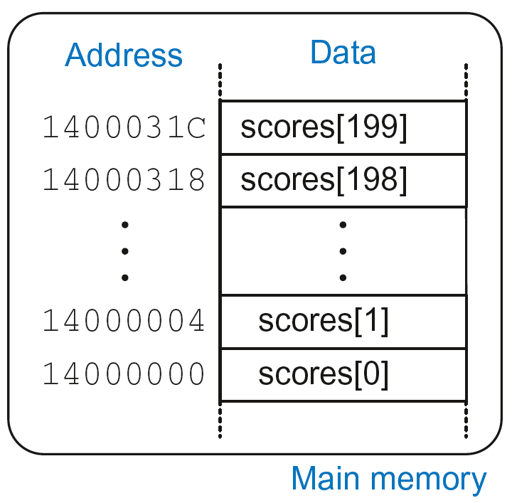
Arrays
200-element array
  Base address = 0x14000000 (address of first element, scores[0])
  Array elements accessed relative to base address

Slide 85
Accessing Arrays
C Code
int array[200];
array[0] = array[0] * 8;
array[1] = array[1] * 8;
ARM Assembly Code
; R0 = array base address

Slide 86
Accessing Arrays
C Code
int array[5];
array[0] = array[0] * 8;
array[1] = array[1] * 8;
ARM Assembly Code
; R0 = array base address
MOV R0, #0x60000000 ; R0 = 0x60000000
LDR R1, [R0] ; R1 = array[0]
LSL R1, R1, 3 ; R1 = R1 << 3 = R1*8
STR R1, [R0] ; array[0] = R1
LDR R1, [R0, #4] ; R1 = array[1]
LSL R1, R1, 3 ; R1 = R1 << 3 = R1*8
STR R1, [R0, #4] ; array[1] = R1

Slide 87
Arrays using for Loops
C Code
int array[200];
int i;
for (i=199; i >= 0; i = i - 1)
array[i] = array[i] * 8;
ARM Assembly Code
; R0 = array base address, R1 = i

Slide 88
Arrays using for Loops
C Code
int array[200];
int i;
for (i=199; i >= 0; i = i - 1)
array[i] = array[i] * 8;
ARM Assembly Code
; R0 = array base address, R1 = i
MOV R0, 0x60000000
MOV R1, #199
FOR
LDR R2, [R0, R1, LSL #2] ; R2 = array(i)
LSL R2, R2, #3 ; R2 = R2<<3 = R3*8
STR R2, [R0, R1, LSL #2] ; array(i) = R2
SUBS R1, R1, #1 ; i = i – 1
; and set flags
BPL FOR ; if (i>=0) repeat loop

Slide 89
ASCII Code
American Standard Code for Information Interchange
Each text character has unique byte value
  For example, S = 0x53, a = 0x61, A = 0x41
  Lower-case and upper-case differ by 0x20 (32)

Slide 90
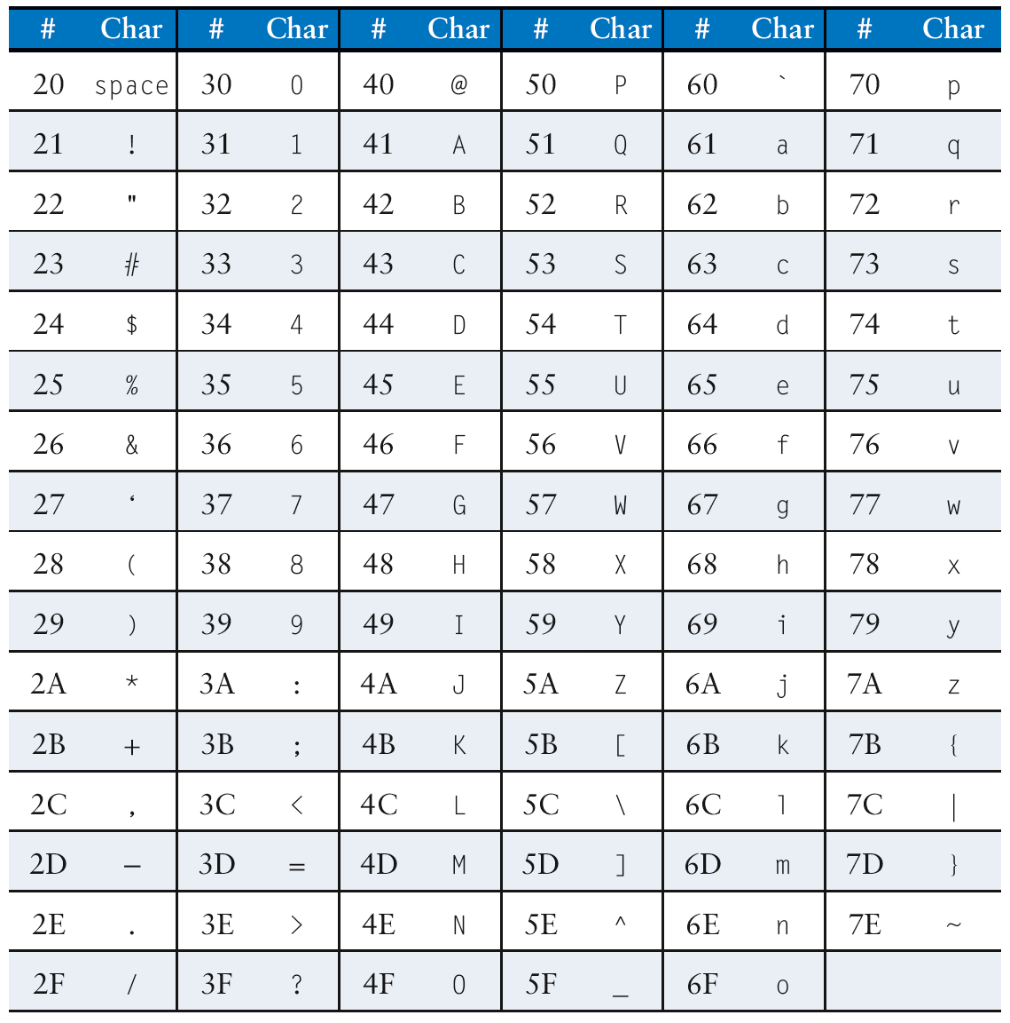
Cast of Characters

