Slide 1

Lecture 16:
Microcontrollers Libraries & Examples
E85 Digital Design & Computer Engineering

Slide 2
Lecture 16
Cortex Microcontroller Software Interface Standard (CMSIS)
EasyNucleoIO Library
Morse Code GPIO Example
Accelerometer SPI Example

Slide 3
CMSIS
Gives names to all the I/O registers
  Organized as structures
  So you don’t have to look up and type in addresses
Please don’t use this in Lab 7
  I want you to get comfortable looking up addresses once
But take advantage of it for Lab 8

Slide 4
Without and With CMSIS
Turn on Nucleo Board LED (PB3)
Without CMSIS
volatile unsigned long *RCC_AHBENR = (unsigned long*)0x40021014;
volatile unsigned long *GPIOB_MODER = (unsigned long*)0x48000400;
volatile unsigned long *GPIOB_ODR = (unsigned long*)0x48000414;
*RCC_AHBENR |= (1 << 18);
*GPIOB_MODER |= (1 << 6); // set PB3 mode to output
*GPIOB_ODR |= (1 << 3); // turn on PB3
With CMSIS
#include <stm32f042x6.h>
RCC->AHBENR |= RCC_AHBENR_GPIOBEN;
GPIOB->MODER |= 1 << 6;
GPIOB->ODR |= 1 << 3;

Slide 5
Peeking Inside CMSIS: Structures
typedef struct
{
__IO uint32_t MODER; /*!< GPIO port mode register, Address offset: 0x00 */
__IO uint32_t OTYPER; /*!< GPIO port output type register, Address offset: 0x04 */
__IO uint32_t OSPEEDR; /*!< GPIO port output speed register, Address offset: 0x08 */
__IO uint32_t PUPDR; /*!< GPIO port pull-up/pull-down register, Address offset: 0x0C */
__IO uint32_t IDR; /*!< GPIO port input data register, Address offset: 0x10 */
__IO uint32_t ODR; /*!< GPIO port output data register, Address offset: 0x14 */
__IO uint32_t BSRR; /*!< GPIO port bit set/reset register, Address offset: 0x1A */
__IO uint32_t LCKR; /*!< GPIO port configuration lock register, Address offset: 0x1C */
__IO uint32_t AFR[2]; /*!< GPIO alternate function low register, Address offset: 0x20-0x24 */
__IO uint32_t BRR; /*!< GPIO bit reset register, Address offset: 0x28 */
}GPIO_TypeDef;
Notes:
Uint32_t is a 32-bit unsigned integer data type (equivalent to unsigned long)
__IO is equivalent to volatile
Each element of the struct is 4 bytes past the previous

Slide 6
Peeking Inside CMSIS: Addresses
#define PERIPH_BASE ((uint32_t)0x40000000)
#define AHB2PERIPH_BASE (PERIPH_BASE + 0x08000000)
#define GPIOA_BASE (AHB2PERIPH_BASE + 0x00000000)
#define GPIOB_BASE (AHB2PERIPH_BASE + 0x00000400)
#define GPIOF_BASE (AHB2PERIPH_BASE + 0x00001400)
#define GPIOA ((GPIO_TypeDef *) GPIOA_BASE)
#define GPIOB ((GPIO_TypeDef *) GPIOB_BASE)
#define GPIOF ((GPIO_TypeDef *) GPIOF_BASE)
#define RCC_AHBENR_GPIOAEN ((uint32_t)0x00020000) /*!< GPIOA clock enable */
#define RCC_AHBENR_GPIOBEN ((uint32_t)0x00040000) /*!< GPIOB clock enable */
#define RCC_AHBENR_GPIOFEN ((uint32_t)0x00400000) /*!< GPIOF clock enable */
Notes:
RCC_AHBENR_GPIOBEN = 0x00040000 = (1 << 18)
GPIOB_BASE is 0x40000000+0x08000000+0x00000400 = 0x48000400
GPIOA->ODR is at GPIOB_BASE + 0x14 = 0x48000414

Slide 7
EasyNucleoIO Library
We have developed a library giving Arduino-style access to the Nucleo I/O.
  Built on top of CMSIS
  Tricky part is pin numbering
Library Functions
  void EasyNucleoIOInit(void); // call before others
  void pinMode(int pin, int function); // 0 = input, 1 = output, 2 = ALT
  void digitalWrite(int pin, int val); // Set pin to val
  int digitalRead(int pin); // return value of pin
  void delayLoop(int ms); // delay for given number of ms
Please do not use in Lab 7 but use in Lab 8

Slide 8
EasyNucleoIO Pin Numbering
  // Arduino Pin STM32 Pin
  // D0 PA10
  // D1 PA9
  // D2 PA12 DO NOT USE
  // D3 PB0
  // D4 PB7 DO NOT USE
  // D5 PB6 DO NOT USE
  // D6 PB1
  // D7 PF0
  // D8 PF1
  // D9 PA8
  // D10 PA11
  // D11 PB5
  // D12 PB4
  // D13 PB3 (on-board green LED)
  // A0 (D14) PA0
  // A1 (D15) PA1
  // A2 (D16) PA3
  // A3 (D17) PA4
  // A4 (D18) PA5
  // A5 (D19) PA6
  // A6 (D20) PA7
  // A7 (D21) PA2

Slide 9
Internal Pin Numbering
Let us create a code for pins
  Easily identify port and pin within the port
  Not all codes are used (16 for Port A, 8 for Port B, 2 for Port F)
16 codes for each port
  Port A: 0-15 (all used for PA15:0)
  Port B: 16-31 (only 23-16 for PB7:0)
  Port F: 32-47 (only 33-32 for PF1:0)
  PF0 = 32
  PF1 = 33
Find port based on code / 16
Find pin based on code % 16

Slide 10
EasyNucleoIO Pin Numbering
  // Arduino Pin STM32 Pin Code
  // D0 PA10 10
  // D1 PA9 9
  // D2 PA12 DO NOT USE 12
  // D3 PB0 16
  // D4 PB7 DO NOT USE 23
  // D5 PB6 DO NOT USE 22
  // D6 PB1 17
  // D7 PF0 32
  // D8 PF1 33
  // D9 PA8 8
  // D10 PA11 11
  // D11 PB5 21
  // D12 PB4 20
  // D13 PB3 (on-board green LED) 19
  // A0 (D14) PA0 0
  // A1 (D15) PA1 1
  // A2 (D16) PA3 3
  // A3 (D17) PA4 4
  // A4 (D18) PA5 5
  // A5 (D19) PA6 6
  // A6 (D20) PA7 7
  // A7 (D21) PA2 2

Slide 11
EasyNucleoIOInit
void EasyNucleoIOInit(void) {
//Clocks:
//enable clock for GPIOA, B, F
RCC->AHBENR |= RCC_AHBENR_GPIOAEN |
RCC_AHBENR_GPIOBEN |
RCC_AHBENR_GPIOFEN;
//enable clock to SPI1
RCC->APB2ENR |= RCC_APB2ENR_SPI1EN;
}

Slide 12
Pin Mapping Helper Functions
int digitalPinMapping[22] = {10, 9, 12, 16, 23, 22, 17,
32, 33, 8, 11, 21, 20, 19,
0, 1, 3, 4, 5, 6, 7, 2};
GPIO_TypeDef* pinToReg(int pin) {
int p = digitalPinMapping[pin];
if (p < 16) return GPIOA;
else if (p < 32) return GPIOB;
else return GPIOF;
}
int pinToOffset(int pin) {
int p = digitalPinMapping[pin];
return p % 16;
}

Slide 13
digitalRead
int digitalRead(int pin) {
GPIO_TypeDef *gpio = pinToReg(pin);
int offset = pinToOffset(pin);
return (gpio->IDR >> offset) & 0x1;
}

Slide 14
digitalWrite
void digitalWrite(int pin, int val) {
GPIO_TypeDef *gpio = pinToReg(pin);
int offset = pinToOffset(pin);
if (val) gpio->ODR |= (1 << offset);
else gpio->ODR &= ~(1 << offset);
}

Slide 15
pinMode
void pinMode(int pin, int function) {
GPIO_TypeDef *gpio = pinToReg(pin);
int offset = pinToOffset(pin)*2;
gpio->MODER &= ~((3 & ~function) << offset);
gpio->MODER |= ((3 & function) << offset);
}

Slide 16
Morse Code Example
Play a message in Morse code by blinking LEDs.
Demonstrate EasyNucleoIO
Similarities to Lab 7

Slide 17
Morse Code Example
// morse.c
// David_Harris@hmc.edu
// Arduino-like library for IO functions
#include "EasyNucleoIO.h"
#define DUR 100

Slide 18
Morse Code Example
// Define Morse code for letters
char codes[26][5] = {
".-", // A
"-...", // B
"-.-.", // C
"-..", // D
".", // E
"..-.", // F
"--.", // G
"....", // H
"..", // I
".---", // J
"-.-", // K
".-..", // L
"--", // M
"-.", // N
"---", // O
".--.", // P
"--.-", // Q
".-.", // R
"...", // S
"-", // T
"..-", // U
"...-", // V
".--", // W
"-..-", // X
"-.--", // Y
"--.." // Z
};

Slide 19
Morse Code Example
void playChar(char c) {
int i=0;
while (codes[c-'A'][i]) {
digitalWrite(13, 1); // turn on LED
if (codes[c-'A'][i] == '.') delayLoop(DUR); // dot
else delayLoop(3*DUR); // dash
digitalWrite(13, 0); // turn off LED
delayLoop(DUR); // pause between elements
i++;
}
delayLoop(DUR*2); // extra pause between characters
}

Slide 20
Morse Code Example
void playStr(char msg[]) {
int i=0;
while(msg[i]) playChar(msg[i++]);
}

Slide 21
Morse Code Example
int main(void) {
EasyNucleoIOInit();
pinMode(13, OUTPUT); // Green LED
while (1) {
playStr("SOS");
// pause between words
delayLoop(DUR*4);
}
}

Slide 22
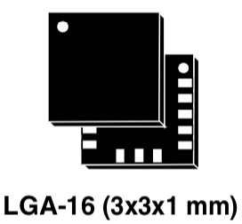
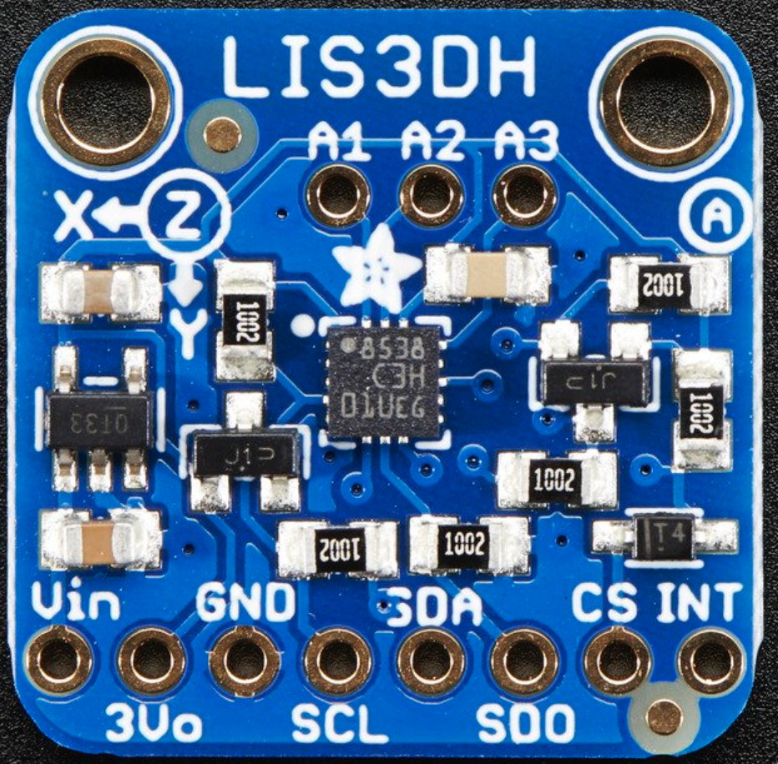
Example: SPI Interface to Accelerometer
LIS3DH 3-axis accelerometer
  Measures X, Y, Z acceleration
  2-8 G Full scale (configurable)
  SPI interface with 16-bit transfers
  ~1 mg sensitivity
  3x3 mm land grid array package
    Hard to assemble without tooling
  Available on a breakout board
    $4.95 from Adafruit

Slide 23
LIS3DH Internal Operation
MEMS cantilevers move based on acceleration
Changes capacitance, sensed by ADC
Temperature compensation for good accuracy

Slide 24
Microcontroller -> Accel Interface
3.3V, GND
SPI interface
Optional Interrupt
  Indicates new sample ready

Slide 25
SPI Data Packets
Communicate with SPI through internal registers
Each register has 6 bit address, 8 bits of data
Use a 16-bit SPI transaction
  RWbar = 1 to read, 0 to write. MSbar = 0 for single register accesses

Slide 26
SPI Write
RWbar = 0. MSbar = 0
Send 6-bit address of register to write
Send 8 bit data value to write to register
Receive 8 bits of dummy data back (discard)

Slide 27
SPI Read
RWbar = 1. MSbar = 0
Send 6-bit address of register to read
Send 8 bit dummy data
Receive 8 bits of read data

Slide 28
LISD3H Registers
Read WHO_AM_I to check
SPI interface working
Write CTRL_REG to
configure accel
Read OUT_X/Y/Z registers
to measure acceleration
  16-bit 2’s complement values
  Stored in 8-bit high and low regs

Slide 29
LISD3H WHO_AM_I
WHO_AM_I register (0x0F) always reads 33
  Easy way to check your SPI wiring is correct

Slide 30
LISD3H Control Registers
CTRL_REG1 (0x20)
  Write 0x77
  Enable X, Y, Z axis measurements
  Normal mode 400 Hz sampling

Slide 31
LISD3H Control Registers
CTRL_REG4 (0x23)
  Write 0x88
  Update output after each reading
  High resolution (16-bit) mode

Slide 32
LISD3H Output Registers
Read X, Y, Z acceleration as 2 bytes each
Combine into 16-bit 2’s complement numbers
Accel = (Reading – Offset) * Scale
  Must calibrate offset and scale
  Measure reading at level, rotated +/- 90 degrees on each axis
  Different offset and scale for each axis

Slide 33
Accelerometer Starter Code
// E85 Lab 8: Digital Level
// Cherie Ho and David Money Harris
// Based on Bryce's SPI + GPIO STM32F0 CMSIS example
#include "stm32f0xx.h"
#include "EasyNucleoIO.h"
/////////////////////////////////////////////////////////////////////
// SPI Functions
/////////////////////////////////////////////////////////////////////
#define ALT 2

Slide 34
Accelerometer Starter Code
void spiInit() {
//set ALT function for SPI pins
pinMode(17, ALT); // PA4/SPI1_NSS (A3)
pinMode(18, ALT); // PA5/SPI1_SCK (A4)
pinMode(19, ALT); // PA6/SPI1_MISO (A5)
pinMode(20, ALT); // PA7/SPI1_MOSI (A6)
//configure SPI:
//BR = fclk/8, master mode
SPI1->CR1 |= SPI_CR1_BR_1 | SPI_CR1_MSTR;
// Enable NSS select signal,
//pulse NSS between transfers, 16-bit data
SPI1->CR2 |= SPI_CR2_SSOE | SPI_CR2_NSSP | (0xF) << 8;
//enable SPI
SPI1->CR1 |= SPI_CR1_SPE;
}

Slide 35
Accelerometer Starter Code
//send a 16-bits (short) on SPI1
unsigned short SPI1SendReceive16(unsigned short outDat) {
SPI1->DR = outDat;
while(!(SPI1->SR & SPI_SR_RXNE)); // wait for response
return SPI1->DR;
}
void spiWrite(unsigned char address, unsigned char value) {
SPI1SendReceive16(address << 8 | value);
}
unsigned char spiRead(unsigned char address) {
return SPI1SendReceive16(address << 8 | (1 << 15));
}

Slide 36
Accelerometer Starter Code
int main(void) {
volatile unsigned char debug;
volatile short x,y;
//setup clocks and hardware
EasyNucleoIOInit();
spiInit(); // Initialize SPI pins and clocks
//Setup the LIS3DH for use
spiWrite(0x20, 0x77); // highest conversion rate, all axis on
spiWrite(0x23, 0x88); // block update, and high resolution
// Check WHO_AM_I register. should return 0x33
debug = spiRead(0x0F);
while(1) {
// Collect the X and Y values from the LIS3DH
x = spiRead(0x28) | (spiRead(0x29) << 8);
y = spiRead(0x2A) | (spiRead(0x2B) << 8);
// Small delay to reduce flicker
delayLoop(100);
}
}

Slide 37
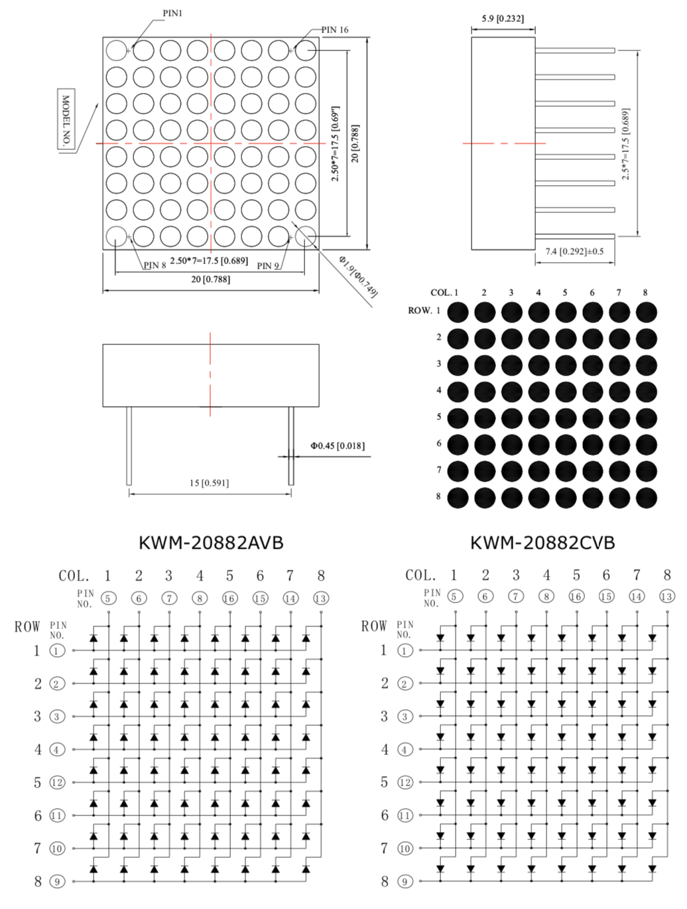
Lab 8
Goal of Lab 8 is to build a digital level
Accelerometer code on previous pages is provided
You move a dot around on
an LED matrix to indicate tilt
Use digitalWrite from
EasyNucleoIO

