Slide 1

Lecture 15:
Microcontrollers Interfacing
E85 Digital Design & Computer Engineering

Slide 2
Lecture 15
Interfacing
Parallel
Serial
  SPI
Analog

Slide 3
Interfacing
Interfacing: connecting external devices to a microcontroller
  Sensors
  Actuators
  Other Processors
Interacing Methods
  Parallel
  Serial
    SPI: Serial Peripheral Interface
      1 clock, 1 data out, 1 data in pin
    UART: Universal Asynchronous Receiver/Transmitter
      no clock, 1 data out, 1 data in pin, agree in software about intended data rate
    I2C: Inter-Integrated Circuit
      1 clock, 1 bidirectional data pin
  Analog

Slide 4
Parallel Interfacing
Connect 1 wire / bit of information
  Ex: 8-bit parallel interface to send a byte at a time
Also send clock or REQ/ACK to indicate when data is ready
Parallel busses are expensive and cumbersome because of the high number of wires
Mostly used for high-performance applications such as DRAM interfaces

Slide 5
Parallel Interfacing
*** show example

Slide 6
Serial Interfacing
Serial interface sends one bit at a time
Use many clock cycles to send a large block of information
Also send timing information about when the bits are valid

Slide 7
Serial Peripheral Interface (SPI)
SPI is an easy way to connect devices
Master device communicates with one or more slave devices
  Slave select signals indicate which slave is chosen
  Master sends clock and data out. Slave sends back data in.
Signals
  SCLK: Generated by master; one pulse per bit
  MOSI: Master Out Slave In serial data from master to slave
  MISO: Master In Slave Out serial data from slave to master
  SS: Slave select (optional, one or more, may be active low)

Slide 8
SPI Waveforms
*** show waveforms
Show 8 clocks and 8 bits of data, value transmitted
Another slide about using a shift register to receive.
  Step by step

Slide 9
SPI Connection
en.wikipedia.org/wiki/Serial_Peripheral_Interface_Bus#/media/File:SPI_three_slaves.svg

Slide 10
STM32 SPI Pinout
Table 13 on Page 33 of STM32F042×4 Datasheet
NSS: PA4 (A3 on Nucleo board)
SCK: PA5 (A4 on Nucleo board)
MISO: PA6 (A5 on Nucleo board)
MOSI: PA7 (A6 on Nucleo board)

Slide 11
SPI Communication
Configure
  Enable SPI Clock Tree
  Set SPI SCK, MISO, MOSI pins to ALT mode
  Set Baud Rate (1 MHz or less prudent on a breadboard)
  Clock Polarity
    CPOL = 0 (default): clock idles at 0
    CPOL = 1: clock idles at 1
  Clock Phase
    CPHA = 0: sample MOSI on the first clock transition
    CPHA = 1: sample MOSI on the second clock transition

Slide 12
SPI Communication Continued
Write byte to SPI data register to transmit
  Data shifted out one bit at a time
Wait for Receive Not Empty (SPI1_SR_RXNE bit)
Read byte from SPI data register

Slide 13
SPI Slave Select
Slave select is usually active low (labeled NSS or SS)
  Turns on device when 0, off when 1
Turning off the slave device may save power
Options
  1 slave devices: tie slave select active
  1 or more slave devices: use GPIO pins to turn desired device ON before SPI transaction, turn device back OFF afterward
  1 slave device: use SPI controller to automatically pulse the SS pin during a transaction

Slide 14
SPI Timing Diagram
CPOL and CPHA flexible
Easy to talk to devices

Slide 15
SPI Communication on STM32F0xx
Enable SPI Clock with RCC APB2ENR bit 12: SPI1EN
  This clock enables the peripheral, isn’t the SCLK
Assume slave select signal for device is tied active
Set PA4, PA5, PA6 to ALT mode (10)
Let CPOL and CPHA default to 0 with SPI1_CR1 bits 1:0
Enable Master mode with SPI_CR1 bit 2
Set baud rate with SPI1_CR1 bits 5:3 e.g. 010 for fclk/8
Enable SPI port with SPI1_CR1 bit 6

Slide 16
Register Base Addresses
Base Addresses
RCC: 0x40021000
GPIOA: 0x48000000
SPI1: 0x40013000

Slide 17
Enable SPI Clock in RCC
RCC_APB2ENR adr = 0x40021000 base + 0x18 offset
SPI1EN is bit 12

Slide 18
Set PA4, 5, 6 to ALT Mode
GPIOA_MODER adr = 0x48000000 base + 0x00 offset
PA6, 5, 4 MODE bits are 13:12, 11:10, and 9:8

Slide 19
SPI Baud Rate, Polarity, Phase, Master
SPI1_CR1 adr = 0x40013000 base + 0x00 offset
SPI1_CR2 adr = 0x40013000 base + 0x04 offset
SPI1_SR adr = 0x40013000 base + 0x08 offset
SPI1_DR adr = 0x40013000 base + 0x0C offset
Leave CR2 with default DS for 8-bit transfer, NSSP and SSOE for no automatic SS pulses

Slide 20
SPI Sample Code
void spiInit() {
// 2.2.2 lists memory map for IO registers
volatile unsigned long *GPIOA_MODER = (unsigned long*)0x48021000; // 8.4.1
volatile unsigned long *SPI1_CR1 = (unsigned long*)0x40013000; // 28.9.1
volatile unsigned long *RCC_APB2ENR = (unsigned long*)0x40021018 // 6.4.7
*RCC_APB2ENR |= (1<<12); // set SPI1EN bit to activate SPI1
*GPIOA_MODER |= (1<<9 | 1 << 11 | 1<<13); // ALT for PA4, 5, 6
*SPI1_CR1 |= (1 << 4 | 1 << 2); // Baud Rate = fclk/8; master mode
*SPI1_CR1 |= 1 << 6; // turn on SPI
}
unsigned char SPI1SendReceive8(unsigned char outDat) {
volatile unsigned long *SPI1_DR = (unsigned long*)0x4001300C; // 28.9.4
volatile unsigned long *SPI1_SR = (unsigned long*)0x40013008; // 28.9.3
*SPI1_DR = outDat; // Send a byte to the slave device
while (!(*SPI1_SR & (1<<0))); // wait for RXNE flag to clear
return *SPI1_DR; // Get the byte back from slave device
}

Slide 21
Analog/Digital Converter
12-bit A/D Converter
  Reads analog input on scale of 0 – 3.3 V
  Converts to digital value between 0 and 2¹²-1
  Hence the resolution is 3.3/2¹² = 0.81 mV per step
16 Input channels
  Can read from any of the 16 PA inputs
  Also can read internal temperature and voltage sensors

Slide 22
ADC Example
12-bit A/D Converter
  Reads analog input on scale of 0 – 3.3 V
  Converts to digital value between 0 and 2¹²-1
  Hence the resolution is 3.3/2¹² = 0.81 mV per step
16 Input channels
  Can read from any of the 16 PA inputs
  Also can read internal temperature and voltage sensors

Slide 23
Using the ADC
Initialize ADC
  Enable ADC clock using the Reset/Clock Control register
  Turn on ADC by setting the ADEN bit
  Wait for ADRDY flag to set to indicate ADC ready to go
  Write 111 to the SMP bits to run the sampling clock slowly
To Convert Voltage on Channel n
  Write a 1 to the CHSELn bit and 0s to the other CHSLE bits to choose channel n for conversion
  Start conversion by setting the ADSTART bit
  Wait for ADSTART bit to go low to indicate conversion complete
  Read answer from the ADC_DR data register

Slide 24
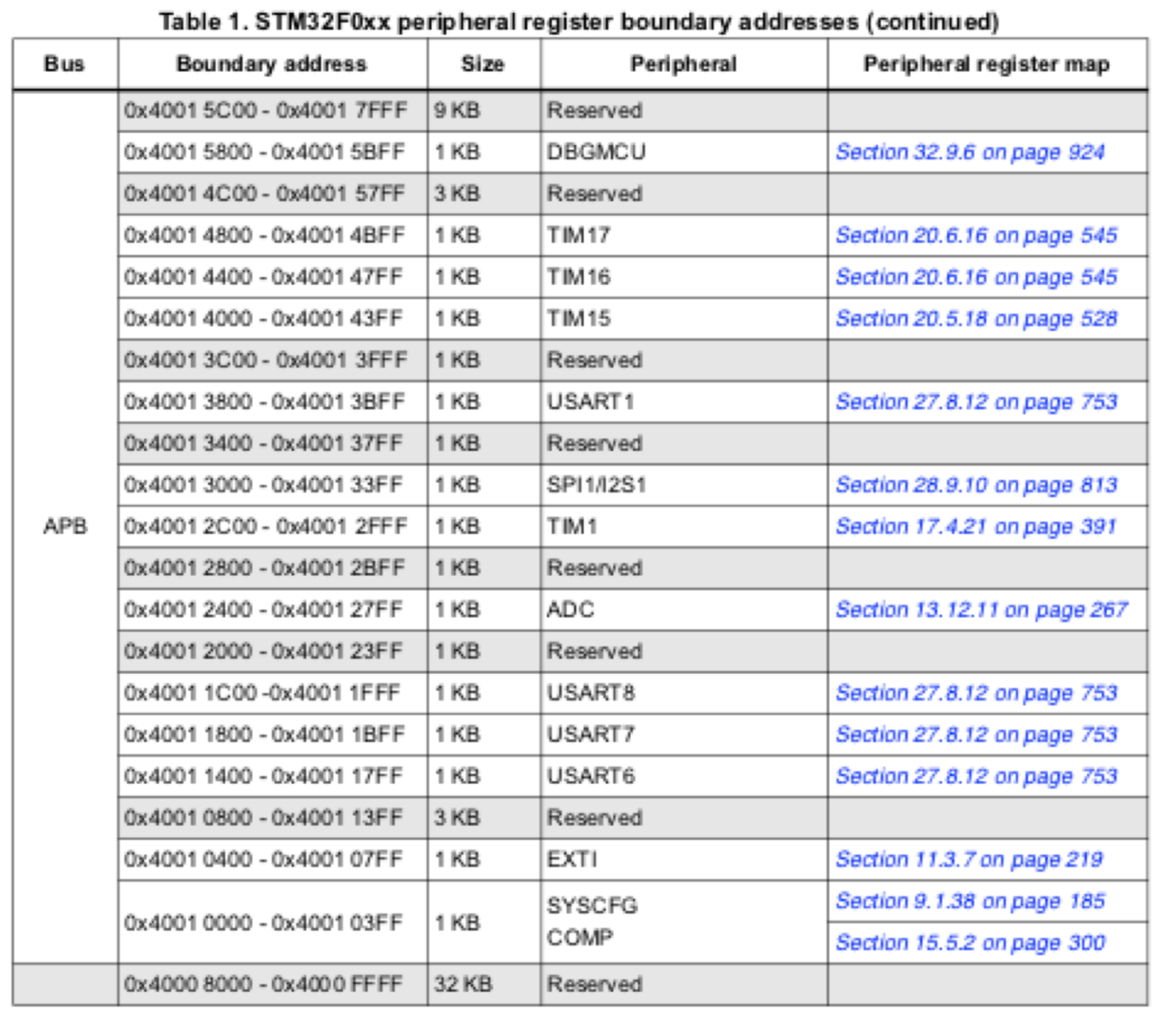
Register Base Addresses

Slide 25
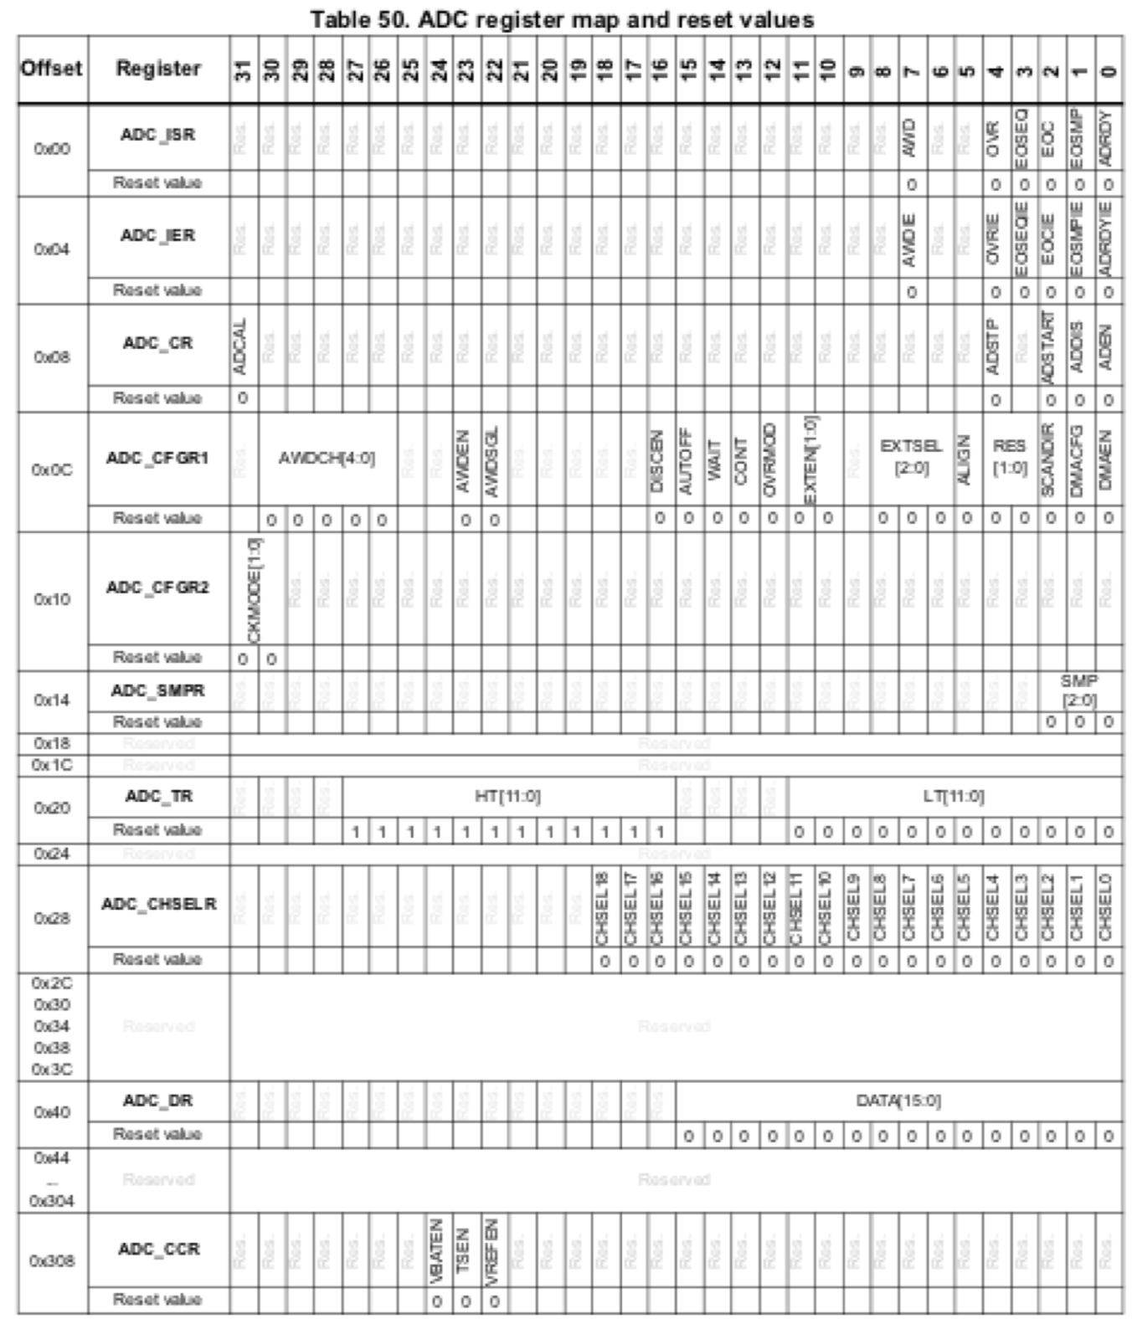
ADC Register Map

Slide 26
Using the ADC
Initialize ADC
  Enable ADC clock using the Reset/Clock Control register
  Turn on ADC by setting the ADEN bit
  Wait for ADRDY flag to set to indicate ADC ready to go
  Write 111 to the SMP bits to run the sampling clock slowly
To Convert Voltage on Channel n
  Write a 1 to the CHSELn bit and 0s to the other CHSLE bits to choose channel n for conversion
  Start conversion by setting the ADSTART bit
  Wait for ADSTART bit to go low to indicate conversion complete
  Read answer from the ADC_DR data register

Slide 27
Initialize ADC
void adcInit(void) {
// declare registers
volatile unsigned long *RCC_APB2ENR = (unsigned long*)0x40021018;
// turn on ADC clock by writing 1 to ADCEN bit 9 of RCC_APB2ENR
*RCC_APB2ENR |= 1 << 9;
// your code here
// turn on ADC with ADEN bit
// wait for ADRDY bit for ADC ready
// Write 111 to SMP bits to set speed
}

Slide 28
Initialize ADC: Solution
void adcInit(void) {
volatile unsigned long *RCC_APB2ENR = (unsigned long*)0x40021018;
volatile unsigned long *ADC_CR = (unsigned long*)0x40012408;
volatile unsigned long *ADC_ISR = (unsigned long*)0x40012400;
volatile unsigned long *ADC_SMPR = (unsigned long*)0x40012414;
// Enable ADC clock by writing 1 to ADCEN bit of RCC_APB2ENR
*RCC_APB2ENR |= 1<<9;
*ADC_CR |= 1<<0; // enable ADC with ADEN bit
while (!(ADC_ISR & 1)); // wait for ADRDY saying ADC is ready
*ADC_SMPR |= 0b111; // set slow samping rate
}

Slide 29
Read ADC
int analogRead(int channel) {
// Define register addresses
// Select which channel to convert
// Start conversion with ADSTART bit
// Wait for ADSTART to become 0 to indicate conversion complete
// Read answer from ADC_DR
}

Slide 30
Read ADC: Solution
int analogRead(int channel) {
volatile unsigned long *ADC_CHSELR = (unsigned long*)0x40012428;
volatile unsigned long *ADC_CR = (unsigned long*)0x40012408;
volatile unsigned long *ADC_DR = (unsigned long*)0x40012440;
*ADC_CHSELR = 1<<channel; // write appropriate channel select bit
*ADC_CR |= 1<<2; // write ADSTART bit to begin conversion
while((*ADC_CR & (1<<2)); // wait until ADSTART bit falls
return *ADC_DR;
}

