Slide 1

Lecture 14:
Microcontrollers &
Memory-Mapped I/O
E85 Digital Design & Computer Engineering

Slide 2
Lecture 14
Microcontrollers
Memory-Mapped I/O
General-Purpose I/O
STM32
Nucleo32 Board
STM32 Memory-Mapped IO
STM32 Clock Tree
Delay Generation

Slide 3
Microcontrollers
Microprocessors are computers on a chip
Microcontrollers are microprocessors with flexible input/output (I/O) peripherals
Peripheral examples
  General-purpose I/O (GPIO): turn pins ON and OFF
  Serial ports
  Analog/Digital and Digital/Analog Converters (ADC/DAC)
  Timers
  Universal Serial Bus
  Ethernet

Slide 4
Embedded Systems
Microcontrollers are commonly used in embedded systems
An embedded system is a system whose user may be unaware there is a computer inside
  Microwave oven
  Clock/radio
  Electronic fuel injection
  Annoying toys with batteries for toddlers
  Implantable glucose monitor

Slide 5
Microcontroller Market
Global Microcontroller market $18.6B in 2018
Forecast to grow at 9%/year

Slide 6
Microcontroller Economics
Highly cost-sensitive market
  Often < $0.40; pennies matter
  Cheaper than using a cable or a pushrod in a system
  A microcontroller integrated on a larger chip can have a manufacturing cost of < $0.01
Memory tends to dominate the cost
  Select one with no more memory than necessary
Classified as 8, 16, 32-bit based on internal bus
  1970s vintage 8-bit processors can still be adequate
  32-bit processors are faster and more flexible but use more code memory

Slide 7
Microprocessor Architectures
The architecture is the native machine language a microprocessor understands.
Commercial Examples
  ARM
  PIC
  Intel x86
  MIPS
  PowerPC
  RISC-V
  8051
  Z80

Slide 8
Microcontroller Suppliers

Slide 9
Cortex M-Series Microcontrollers
ARM Cortex M-Series microcontrollers are a market leader
  Over 90B ARM processors have shipped
  Over 75% of humans on Earth use a product with an ARM processor
32-bit performance with code density approaching 16-bit
Robust ecosystem of chips, boards, compilers, libraries
Inexpensive
  Many competing suppliers

Slide 10
Memory-Mapped I/O
Control peripherals by reading or writing memory locations called registers
  Not really the same as a bank of flip-flops
Just like accessing any other variable, but these registers cause physical things to happen.
Portion of the address space is reserved for I/O registers rather than program or data.
In C, use pointers to specify addresses to read or write.

Slide 11
General-Purpose I/O (GPIO)
GPIOs can be driven to 0/1 or read.
Examples: LEDs, switches, connect to other digital logic.
In general:
  Look up how many pins your microcontroller has, how they are named.
  Each pin needs to be configured as an input, output, or special function.
  Then read or write the pin.

Slide 12
STM32F042K6 Microcontroller
Popular ARM Cortex-M0 microcontroller
Used in labs for this class
Manufactured by ST Microelectronics
Available on an $10 Nucleo32 dev board
  Unit cost of $1.14 in quantity of 10,000
Many handy peripherals
Good development environment

Slide 13
STM32F042K6
STM32: ST Microelectronics family of 32-bit ARM Cortex microcontrollers
F0: General Purpose Cortex-M0 Core
All devices in the STM32F0 family have the same processor and general set of peripherals and share a datasheet
42: Sub-family
K: 32 pins (LQFP32 surface mount package)
6: 32 KB Code memory

Slide 14
STM32F042K6 Pinout & Package
26 GPIO Pins
  PA15:0, BP7:0, PF1:0
3 power, 2 GND, 1 reset
STM32F042x6 Datasheet

Slide 15
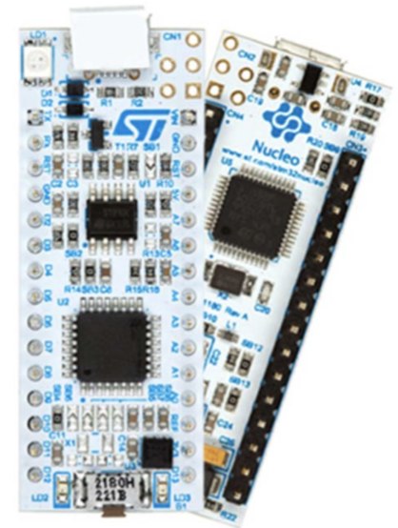
Nucleo32-F042K6 Development Board
$10 Development Board
  STM32F042K6 Microcontroller
  3.3V power supply (regulated from USB or external)
    Use 3.3V output to power external circuitry
    Turns off external circuits when Nucleo powers off, avoid damage
    5V inputs could damage the STM32
  ST-Link Programmer/Debugger
    Allows you to step through your code line by line
    and watch variables
  30 pins, suitable for breadboarding
    Arduino Nano form factor and pin names
  User LED
  Reset button

Slide 16
Nucleo Board Pin-Out
Not all STM32 pins are tapped out to Nucleo board for lack of space
  PA12:0
  PB7:0 except PB2
  PF1:0
Weird Nucleo naming (Arduino-based)
  D0-D13, A0-A7
Rather random mapping of STM32 names to Nucleo names
Some pins have special purposes
  PB3 (D13) is connected to green on-board LED
  PA12 (D2) is jumpered to ground for self-test. Don’t use.
  PB6 and PB7 (D4 and D5) are bridged to other pins and cannot be used reliably.
  If you try to use D2, D4, or D5 in the lab, you will have a bad day

Slide 17
Nucleo Pin Numbering
Nucleo32 Datasheet

Slide 18
STM Datasheets
Information is spread across three datasheets
  Learn to find the appropriate one for the task
STM32F0xx Reference Manual
  Information common to all STM32F0 microcontrollers
  Memory maps, I/O Peripheral Operation
STM32F042x6 Reference Manual
  Information specific to STM32F042x6
  Package pinouts
NUCLEO32 User Manual
  Pinouts and features of Nucleo32 board

Slide 19
STM GPIO Registers
MODE: 2 bits for each pin on a port (reset to all 0s except a few upper bits of A)
  00 = input, 01 = output, 10 = alternate, 11 = reserved
ODR, IDR: 1 bit for each pin on a port (only 16 bits used per port)
GPIOA, GPIOB, GPIOF
0x4800 0000 – 0x4800 03FF GPIOA (p. 46)
0x4800 0400 – 0x4800 07ff GPIOB (p. 46)
ModeR: offset 0 (Table 24 on p. 163)
IDR: offset 10 (Table 24 on p. 163)
ODR: offset 14 (Table 24 on p. 163)

Slide 20
LED GPIO Example
To turn on LED3 (PB3, Pin 3 of bank B of the GPIO)
Find location of GPIO bank B register (Table 1 on page 46)

Slide 21
Nucleo Pin Numbering
To turn on LED3 (PB3, Pin 3 of bank B of the GPIO)
  Find Offset to MODE register (Table 24 on page 163)
  Set MODER3 (Pin 3’s mode) of GPIOB to 01
    00 = input, 01 = output, 10 = alternate, 11 = reserved

Slide 22
Nucleo Pin Numbering
To turn on LED3 (PB3, Pin 3 of bank B of the GPIO)
  Find Offset to MODE register (Table 24 on page 163)
  Set MODER3 (Pin 3’s mode) of GPIOB to 01
    00 = input, 01 = output, 10 = alternate, 11 = reserved

Slide 23
Nucleo Pin Numbering
To turn on LED3 (PB3)
volatile unsigned long *GPIOB_MODER = (unsigned long*)0x48000400;
volatile unsigned long *GPIOB_ODR = (unsigned long*)0x48000414;
volatile means access memory / peripherals directly each time
*GPIOB_MODER |= (1 << 6); // set PB3 mode to output
*GPIOB_ODR |= (1 << 3); // turn on PB3

Slide 24
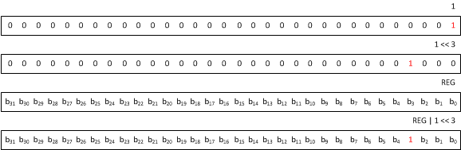
C Idioms: Write Bit to 1
*REG |= (1 << 3); // turn on bit 3

Slide 25
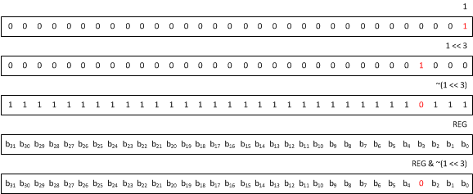
C Idioms: Write Bit to 0
*REG &= ~(1 << 3); // turn off bit 3

Slide 26
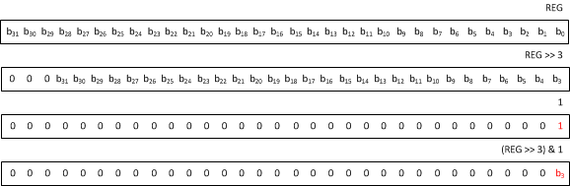
C Idioms: Read value of bit
int bit = (*REG >> 3) & 1; // get value of bit 3

Slide 27
C Idioms: Wait for a bit
Wait for bit 3 to become 1
while (!((*REG >> 3) & 1)); // wait for bit 3
Wait for bit 3 to become 0
while (((*REG >> 3) & 1)); // wait for bit 3

Slide 28
Clock Tree Configuration
STM processors have many options for clock sources
Simplest is the HSI clock
Comes from ~8 MHz on-chip RC oscillator
Speed will vary ~1% from chip to chip at 25°C, and more across temperature

Slide 29
Peripheral Clocks
All clocks to peripherals default to OFF to save power
You will need to turn them on
The RCC AHBENR register enables clocks (see ref manual page 120)
  RCC addresses 0x40021000 (p. 46)
  AHBENR offset is 0x14
  So RCC_AHBENR is at 0x40021014
  Bit 18 enables port B clock
volatile unsigned long *RCC_AHBENR = (unsigned long*)0x40021014;
*RCC_AHBENR |= (1 << 18);
needed to turn on LED on PB3

Slide 30
Generating Delays
// Delay constant
#define COUNTSPERMS 898 //Counts Per millisecond
void delayLoop(int ms) {
// declare loop counter volatile so it isn't optimized away
// countsperms empirically determined such that
// delayLoop(100) waits 100 ms
volatile int i = COUNTSPERMS * ms;
while (i--); // count down time
}

