Slide 1

Lecture 12:
C Programming
E85 Digital Design & Computer Engineering

Slide 2
Lecture 12
Overview
Programming Constructs
  Comments
  Constants
  Variables
  Primitive Data Types
  Function Calls
  Operators
  Control Flow
  Loops
  Arrays and Strings

Slide 3
Overview
C programming language developed at Bell Labs around 1973
Capable of controlling a computer to do nearly anything, including directly interacting with the hardware
Suitable for generating high performance code
Relatively easy to use
Available from supercomputers to microcontrollers
Closely related to other important languages including C++, C#, Objective C, Java, Arduino

Slide 4
C is Libertarian
Lets you do just about anything
Interacts directly with the hardware
Does NOT protect you from your own stupidity
Assumes YOU know the size of arrays and variables
Unless sandboxed will write ANYWHERE in memory

Slide 5
Example
// factorial.c
// David_Harris@hmc.edu 22 October 2019
int fact(int n) {
if (n <= 1) return 1;
else return n*fact(n-1);
}
void main(void) {
int result;
result = fact(4);
}

Slide 6
Steps to C Programming
Write code
Compile code
Execute code
Debug code

Slide 7
Comments
Single-line comments begin with “//” and continue to the end of the line.
  x += 2; //This is a single-line comment.
Multi-line comments begin with “/*” end with “*/”.
  /* You can hide or disable a section of code such as this block with a multi-line comment
  x = bob ? x : y;
  y -= 5;
  */

Slide 8
Constants, Defines, or Macros
Constants are named using the #define directive
  #define MAXGUESSES 5
  #define PI 3.14159
The # indicates that this line in the program will be handled by the preprocessor.
Before compilation, the preprocessor replaces each occurrence of the identifier MAXGUESSES in the program with 5.
By convention, #define lines are located at the top of the file and identifiers are written in all capital letters.

Slide 9
Global and Local Variables
Global variables often lead to hard-to-debug code and should be avoided
Global variables are declared outside of any function
Local variables are declared inside a function
Local variables should be your go-to type

Slide 10
Primitive Data Types

Slide 11
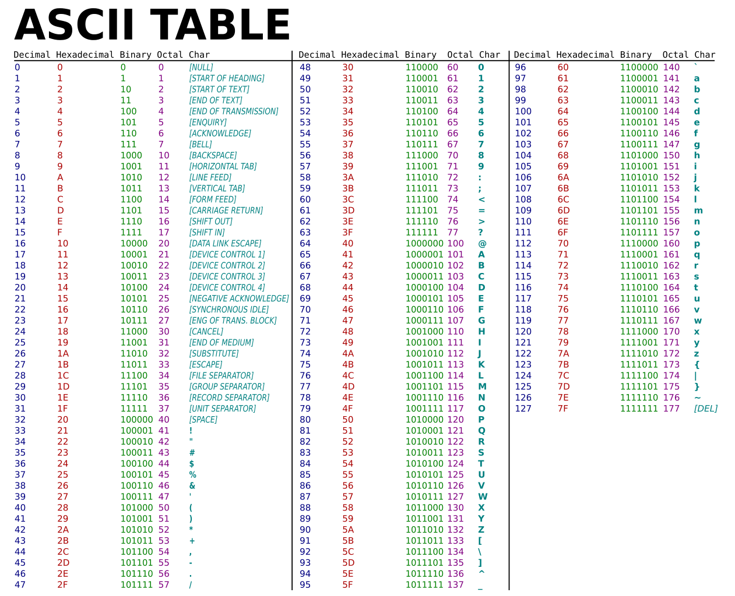
ASCII Table
https://commons.wikimedia.org/wiki/File:ASCII-Table.svg

Slide 12
Functions
Curly braces {} enclose the body of the function, which may contain zero or more statements
A function can return (or output) at most one value
The type of returned value is declared in the function declaration
The return statement indicates the value that the function should return to its caller
A function can receive inputs
The type of the inputs is declared in the function declaration
Functions pass variables by value not reference
A function must be either declared BEFORE it is used or a function prototype declared BEFORE it is used

Slide 13
Function Example
// Return the sum of the three input variables
int sum3(int a, int b, int c) {
int result = a + b + c;
return result;
}

Slide 14
Function Prototypes
// sum3example.c
// David_Harris@hmc.edu 22 October 2019
////////////////////////////////
// Prototypes
////////////////////////////////
int sum3(int, int, int); // needed because sum3 is called before declared
////////////////////////////////
// main
////////////////////////////////
void main(void) {
int answer;
answer = sum3(6, 7, 8);
}
////////////////////////////////
// other functions
// prototype not needed if thsse were moved before main
////////////////////////////////
int sum3(int a, int b, int c) {
int result = a + b + c;
return result;
}

Slide 15
Prototypes are Sometimes Unavoidable
// Prototypes needed for f1 and/or f2 because they
// can’t both be declared before each other
int f1(int);
int f2(int);
int f1(int n) {
return f2(n-1) + 1;
}
int f2(int n) {
return f1(n-1)*2;
}
void main(void) {
int answer;
answer = f1(5);
}

Slide 16
Includes
The function prototypes for the standard libraries are included at the top of a file with the #include directive:
  e.g., #include <stdio.h> or #include <math.h>
Your own function prototypes (or anything else you want to include) is done with quotes instead of brackets for relative or absolute path:
  e.g., #include "other/myFuncs.h"

Slide 17
Boolean (True/False) in C
A variable or expression is considered FALSE if its value is 0
A variable is considered TRUE if it has any other value
  1, 42, and -1 are all TRUE for C
Logical operators assign FALSE as 0 and TRUE as 1

Slide 18
Operators and Precedence

Slide 19
Operators Continued

Slide 20
Operators Continued

Slide 21
Operators Continued

Slide 22
Control Flow Statements
if
  if (expression)
  statement;
if/else
  if (expression)
  statement1;
  else
  statement2;
switch/case
  switch (variable) {
  case (expression1): statement1; break;
  case (expression2): statement2; break;
  case (expression3): statement3; break;
  default: statement4;
  }
Don’t forget “break” or “default”

Slide 23
If example
if (n <= 1) return 1;

Slide 24
Compound Statements
When a statement has more than one line, enclose it in {}
if (answer == 42) {
ultimateQuesiton = 1;
hitchhikersGuide = 1;
}

Slide 25
If/else example
if (n <= 1) return 1;
else return fact(n-1);

Slide 26
Case example
  switch (state) {
  case (0): if (ta) state = 0; else state = 1; break;
  case (1): state = 2; break;
  case (2): if (tb) state = 2; else state = 3; break;
  case (3): state = 0; break;
  default: state = 0;
  }

Slide 27
Loops
while
  while (condition)
  statement;
do/while
  do {
  statement;
  } while (condition);
for
  for (initialization; condition; loop operation)
  statement;

Slide 28
While example
int fact(int n) {
int result = 1;
while (n > 1) {
result = result * n; // or write result *= n;
n = n – 1; // or write n—
}
return result;
}
// Alternative code is shorter but less clear
while (n > 1) result *= n--;

Slide 29
Do/while example
int fact(int n) {
int result = 1;
do {
result *= n;
} while (n-- > 1);
return result;
}
Do always executes the statement at least once.
Longer and not preferred for this example

Slide 30
For example
int fact(int n) {
int result = 1;
int i;
for (i=1; i <= n; i++)
result *= I;
return result;
}
First do initialization (I = 1)
Then check condition (i<=n)
  If satisfied, do body (result *= i)
  Then do loop operation (i++)
Then repeat from checking condition

Slide 31
Data Types: Arrays
Array contains multiple elements
float accel[3];
The elements are numbered from 0 to N−1, where N is the length of the array
Initialize your arrays.
  An uninitialized array can contain anything
Arrays can be multidimensional
  #define NUMSTUDENTS 120
  #define NUMLABS 11
int grades[NUMSTUDENTS][NUMLABS];

Slide 32
Array Example
#include <math.h>
double mag(double v[3]) {
return sqrt(v[0]*v[0] + v[1]*v[1] + v[2]*v[2]);
}

Slide 33
Data Types: Strings
A string is an array of characters
Last entry is zero to indicate end (”NULL terminated”)
  char name[20] = "BOB";
Stored as:
name[0] = 66; // ASCII value for B
name[1] = 79; // ASCII value for O
name[2] = 66; // ASCII value for B
name[3] = 0; // NULL termination
other entries are junk, ignored

Slide 34
Examples: String Handling
#define MAXLEN 80
int strlen(char str[]) {
int len=0;
while (str[len] && len < MAXLEN) len++;
return len;
}
void strcpy(char dest[], char src[]) {
int i = 0;
do {
dest[i] = src[i];
} while (src[i++] && i < MAXLEN);
}

Slide 35
Examples: Using Strings
#include <string.h>
#define MAXLEN 80
void main(void) {
char name[80];
int len;
char c;
strcpy(name, "BOB"); // copy BOB into name
len = strlen(name); // len = 3
c = name[1]; // c = 'O' (79)
}

