Slide 1

Lecture 11:
Midterm Review
E85 Digital Design & Computer Engineering

Slide 2
Lecture 11
Logic Levels
Number Systems
CMOS Transistors
Power Consumption
Combinational Logic Design
Finite State Machines
Timing
Verilog
Arithmetic Circuits

Slide 3
Logic Levels
Assign V_{IH}, V_{IL}, V_{OH}, V_{OL} to maximize noise margins |V_{OH} – V_{IH}|, |V_{OL} – V_{IL}|
Normally at the unity gain points
If the curve has many bends, pick the ones to maximize noise margins

Slide 4
Logic Levels: Example
What is the logic function?
  OR
What are the logic levels?
V_{IL} = 2 V_{IH} = 2.7
V_{OL} = 0.2 V_{OH} = 2.8
What are the noise margins?
  NM_{L} = 1.8 NM_{H} = 0.1

Slide 5
Logic Levels: Compatibility
Consider two logic families
A: V_{IL} = 1, V_{IH} = 2.3, V_{OL} = 0.4, V_{OH} = 2.9
B: V_{IL} = 2, V_{IH} = 3, V_{OL} = 1.1, V_{OH} = 3.2
Can A drive itself? YES
Can B drive itself? YES
Can A drive B? NO: V_{OH} of 2.9 < V_{IH} of 3
Can B drive A? NO: V_{OL} of 1.1 > V_{IL} of 1

Slide 6
Number Systems: Signed and Unsigned
Find decimal value of 101₂ interpreted as:
Unsigned: 1x4 + 0x2 + 1x1 = 5
Sign/Magnitude: (-1)¹ x (0x2+1x1) = -1
Two’s Complement: 1x-4 + 0x2 + 1x1 = -3

Slide 7
Number Systems: Negative Numbers
Write 19 as a 6-bit binary number:
19 = 010011₂
Write -19 as a 6-bit binary number
Two’s complement
Invert the bits and add 1
101100+1 = 101101₂
Sign/Magnitude
110011₂

Slide 8
Number Systems: Bases
Write 37₁₀ in other bases
Hexadecimal: 25₁₆
Binary: 100101₂

Slide 9
CMOS Transistors
Design nMOS pull-down network
  Series for AND, parallel for OR
pMOS pull-up network is complement
CMOS gates are inherently inverting
Add another stage to get non-inverting

Slide 10
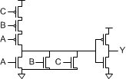
CMOS Transistors: OR3
Sketch a 3-input OR gate
  Use NOR3 + inverter
  NOR3: nMOS in parallel, hence pMOS in series

Slide 11

CMOS Transistors: AOI
Sketch an AND-OR-INVERT gate Y = ~(AB+C)
  nMOS network
    A and B in series. This stack in parallel with C
  pMOS network is complement
    A and B in parallel. This stack in series with C

Slide 12


Switches and LEDs
Switch:
  Choose R big enough to limit power, small enough to keep a good logic level if I_{load} is leakage current.
  P = V_{DD}²/R
  V_{out} = I_{load} * R < V_{IL}
Light Emitting Diode
  Choose R small enough to make the LED bright, large enough to not overstress I_{OH} of the gate driving V_{in}.
  I_{D} ~ (V_{in}-2) / R
  5 mA is visible in room lighting and near max I_{OH} of many gates

Slide 13
Power Consumption
P = P_{dynamic} + P_{static} = αCV_{DD}²f + I_{static}V_{DD}
  α = activity factor:
    1 for clocks rising and falling each cycle
    0.5 for data signal switching once per cycle
    0.5p for data signal switching with probability p
Know your units
  K = 10³, M = 10⁶, G = 10⁹, T=10¹²
  m = 10⁻³, μ = 10⁻⁶, n = 10⁻⁹, p = 10⁻¹², f=10⁻¹⁵

Slide 14
Power Consumption: Example
V_{DD} = 0.707 V
1000 flip-flops clocked at 1 GHz. For each:
  100 nA leakage
  5 fF of clock capacitance
  20 fF capacitance on Q
  10% of inputs change on any given cycle
Idle power = P_{static} =
  100 nA/flop * 1000 flops * 0.707 = 70.7 μW
Running power = P_{static} + P_{dynamic} = 70.7 uW +
1000 * (5 + 0.1 * 20 * 0.5) fF * (0.707)2 * 1 GHz = 3.07 mW

Slide 15
Combinational Logic Design
Output depends on current inputs
Write truth table
Circle 1’s to find sum of products
Simplify with Boolean algebra or inspection

Slide 16


Combinational Logic: Example
Write a truth table & eqn for
$Y=A\overline{B}+A\overline{C}+\overline{A}B\overline{C}$
A | B | C | Y
0 | 0 | 0 | 0
0 | 0 | 1 | 0
0 | 1 | 0 | 1
0 | 1 | 1 | 0
1 | 0 | 0 | 1
1 | 0 | 1 | 1
1 | 1 | 0 | 1
1 | 1 | 1 | 0

Slide 17
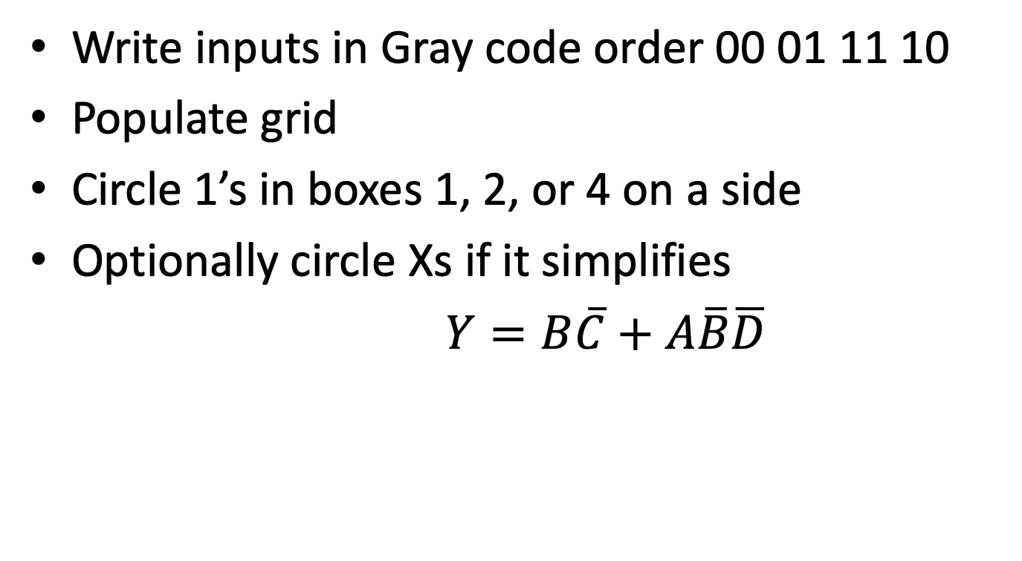
Combinational Logic: K-Map
Write inputs in Gray code order 00 01 11 10
Populate grid
Circle 1’s in boxes 1, 2, or 4 on a side
Optionally circle Xs if it simplifies
$Y=B\overline{C}+A\overline{B}\overline{D}$
 |  | AB
 |  | 00 | 01 | 11 | 10
CD | 00 | 0 | 1 | X | 1
 | 01 | 0 | 1 | 1 | 0
 | 11 | 0 | 0 | 0 | 0
 | 10 | X | 0 | 0 | 1

Slide 18
Sequential Circuits
Sequential circuits: output depends on previous as well as current inputs
Flip-flops
  On the rising edge of CLK, Q gets D.
  Enables
  Reset: synchronous or asynchronous
Synchronous sequential design: every element is combinational or a flip-flop, and all flops share the same clock. Easy to analyze.

Slide 19
Finite State Machines
State transition diagram
State encodings
Next state and output tables
Derive and simplify Boolean equations
Sketch circuit
Inverse problems: derive diagram from circuit

Slide 20
Timing
T_{c} ≥ t_{pcq} + t_{pd} + t_{setup} + t_{skew}
t_{ccq} + t_{cd} > t_{hold} + t_{ske}

Slide 21
Verilog
Think of the logic you want first
Use Verilog as shorthand for logic
Pick the appropriate idiom for each element

Slide 22
Verilog Idioms: Combinational Logic
Combinational Logic with Boolean Eqns.
assign y = (a & b) ^ (c | ~d);
Multipliexers
assign y = s ? d1 : d0;
Comb logic with truth tables
always_comb
casez(in)
3’b1xx: y <= 2’b11;
3’b01x: y <= 2’b10;
3’b001: y <= 2’b01;
default: y <= 2’b00;
endcase

Slide 23
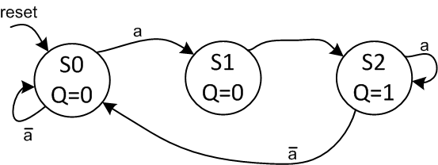
Verilog Idioms: FSMs
module fsmWithInputs(input logic clk,
input logic reset,
input logic a,
output logic q);
typedef enum logic [1:0] {S0, S1, S2} statetype;
statetype state, nextstate;
// state register
always_ff @(posedge clk, posedge reset)
if (reset) state <= S0;
else state <= nextstate;
// next state logic
always_comb
case (state)
S0: if (a) nextstate = S1;
else nextstate = S0;
S1: nextstate = S2;
S2: if (a) nextstate = S2;
else nextstate = S0;
default: nextstate = S0;
endcase
// output logic
assign q = (state == S2);
endmodule

Slide 24
Verilog Idioms: Structural
module mux2(input logic [3:0] d0, d1,
input logic s,
output logic [3:0] y);
assign y = s ? d1 : d0;
endmodule
module mux2_8(input logic [7:0] d0, d1,
input logic s,
output logic [7:0] y);
mux2 lsbmux(d0[3:0], d1[3:0], s, y[3:0]);
mux2 msbmux(d0[7:4], d1[7:4], s, y[7:4]);
endmodule

Slide 25
Adders
Ripple Carry
Carry Lookahead Parallel Prefix
15
14
13
12
11
10
9
8
7
6
5
4
3
2
1
0
-1
14:13
12:11
10:9
8:7
6:5
4:3
2:1
0:-1
14:11
13:11
10:7
9:7
6:3
5:3
2:-1
1:-1
14:7
13:7
12:7
11:7
6:-1
5:-1
4:-1
3:-1
14:-1
13:-1
12:-1
11:-1
10:-1
9:-1
8:-1
7:-1
15
14
13
12
11
10
9
8
7
6
5
4
3
2
1
0

Slide 26
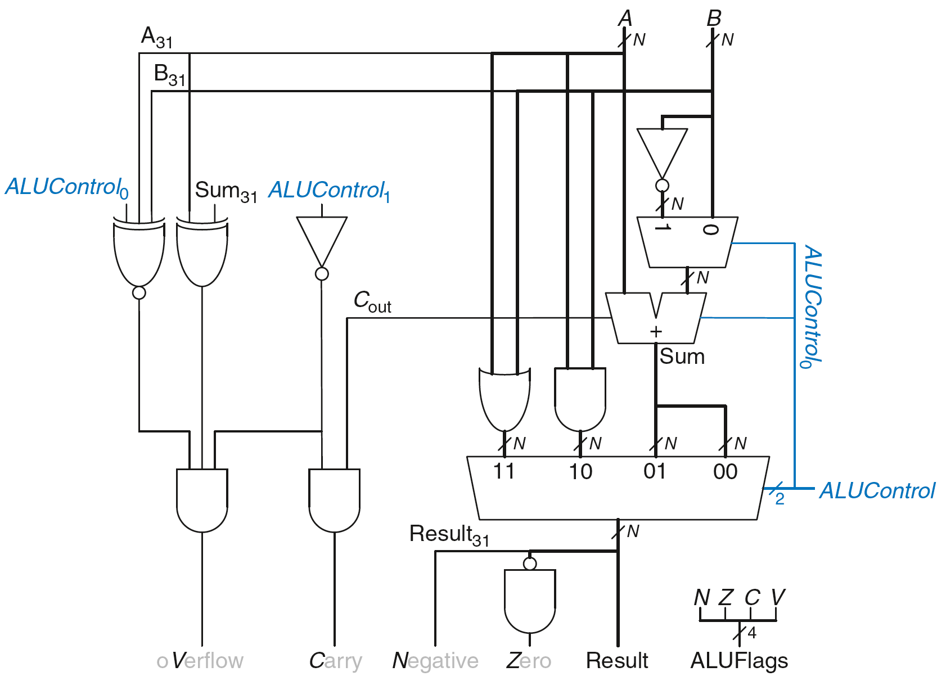
ALU
Flag | Description
N | Result is Negative
Z | Result is Zero
C | Adder produces Carry out
V | Adder oVerflowed
ALUControl_{1:0} | Function
00 | Add
01 | Subtract
10 | AND
11 | OR

