Slide 1

Lecture 10:
Sequential Blocks
Arrays
E85 Digital Design & Computer Engineering

Slide 2
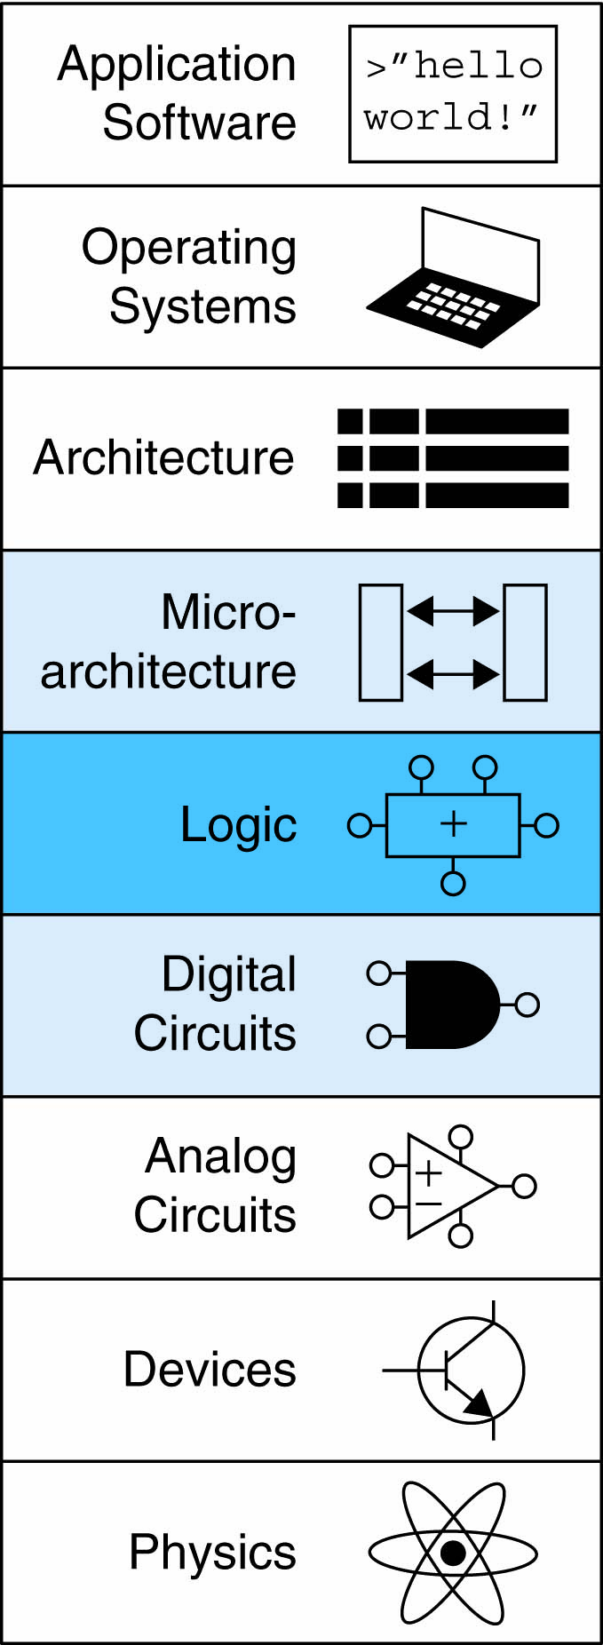
Lecture 8
Counters
Shift Registers
Memory Arrays
  RAM
  ROM
Logic Arrays
  PLAs
  FPGAs

Slide 3
Counters
Increments on each clock edge
Used to cycle through numbers. For example,
  000, 001, 010, 011, 100, 101, 110, 111, 000, 001…
Example uses:
  Digital clock displays
  Program counter: keeps track of current instruction executing

Slide 4
Counter Verilog (FSM style)
module counter (input logic clk, reset,
output logic [N-1:0] q);
logic [N-1:0] nextq;
// register
always_ff @(posedge clk, posedge reset)
if (reset) q <= 0;
else q <= nextq;
// next state
assign nextq = q + 1;
endmodule

Slide 5
Counter Verilog (better idiom)
module counter (input logic clk, reset,
output logic [N-1:0] q);
always_ff @(posedge clk, posedge reset)
if (reset) q <= 0;
else q <= q+1;
endmodule

Slide 6
Divide-by-2^{N} Counter
Most significant bit of an N-bit counter toggles every 2^{N} cycles.
Useful for slowing a clock. Ex: blink an LED
Example: 50 MHz clock, 24-bit counter
  2.98 Hz

Slide 7
Digitally Controlled Oscillator
N-bit counter
Add p on each cycle, instead of 1
Most significant bit toggles at f_{out} = f_{clk} * p / 2^{N}
Example: f_{clk} = 50 MHz clock
  How to generate a f_{out} = 200 Hz signal?
  p/2^{N} = 200 / 50 MHz
Try N = 24, p = 67 ➔ f_{out} = 199.676 Hz
Or N = 32, p = 17179 ➔ f_{out} = 199.990 Hz

Slide 8
Shift Registers
Shift a new bit in on each clock edge
Shift a bit out on each clock edge
Serial-to-parallel converter: converts serial input (S_{in}) to parallel output (Q_{0:N-1})
Symbol:
Implementation:

Slide 9
Shift Register with Parallel Load
When Load = 1, acts as a normal N-bit register
When Load = 0, acts as a shift register
Now can act as a serial-to-parallel converter (S_{in} to Q_{0:N-1}) or a parallel-to-serial converter (D_{0:N-1} to S_{out})

Slide 10
Shift Register Verilog Idiom
module shiftreg(input logic clk,
input logic load, sin,
input logic [N-1:0] d,
output logic [N-1:0] q,
output logic sout);
always_ff @(posedge clk)
if (load) q <= d;
else q <= {q[N-2:0], sin};
assign sout = q[N-1];
endmodule

Slide 11
Memory Arrays
Efficiently store large amounts of data
3 common types:
  Dynamic random access memory (DRAM)
  Static random access memory (SRAM)
  Read only memory (ROM)
M-bit data value read/ written at each unique N-bit address

Slide 12
Memory Arrays
2-dimensional array of bit cells
Each bit cell stores one bit
N address bits and M data bits:
  2^{N} rows and M columns
  Depth: number of rows (number of words)
  Width: number of columns (size of word)
  Array size: depth × width = 2^{N} × M

Slide 13
Memory Array Example
2² × 3-bit array
Number of words: 4
Word size: 3-bits
For example, the 3-bit word stored at address 10 is 100

Slide 14
Memory Arrays

Slide 15
Memory Array Bit Cells

Slide 16
Memory Array Bit Cells
0
Z
1
Z

Slide 17
Memory Array
Wordline:
  like an enable
  single row in memory array read/written
  corresponds to unique address
  only one wordline HIGH at once

Slide 18
Types of Memory
Random access memory (RAM): volatile
Read only memory (ROM): nonvolatile

Slide 19
RAM: Random Access Memory
Volatile: loses its data when power off
Read and written quickly
Main memory in your computer is RAM (DRAM)
Historically called random access memory because any data word accessed as easily as any other (in contrast to sequential access memories such as a tape recorder)

Slide 20
ROM: Read Only Memory
Nonvolatile: retains data when power off
Read quickly, but writing is impossible or slow
Flash memory in cameras, thumb drives, and digital cameras are all ROMs
  Historically called read only memory because ROMs were written at manufacturing time or by burning fuses. Once ROM was configured, it could not be written again. This is no longer the case for Flash memory and other types of ROMs.

Slide 21
Types of RAM
DRAM (Dynamic random access memory)
SRAM (Static random access memory)
Differ in how they store data:
  DRAM uses a capacitor
  SRAM uses cross-coupled inverters

Slide 22
Robert Dennard, 1932 -
Invented DRAM in 1966 at IBM
Others were skeptical that the idea would work
By the mid-1970’s DRAM in virtually all computers

Slide 23
DRAM
Data bits stored on capacitor
Dynamic because the value needs to be refreshed (rewritten) periodically and after read:
  Charge leakage from the capacitor degrades the value
  Reading destroys the stored value

Slide 24
DRAM

Slide 25
SRAM

Slide 26
Memory Arrays Review
DRAM bit cell:
SRAM bit cell:

Slide 27
ROM: Dot Notation

Slide 28
Types of ROMs
Type | Name | Description
ROM | Read Only Memory | Chip is hardwired with presence or absence of transistors. Changing requires building a new chip.
PROM | Programmable ROM | Fuses in series with each transistor are blown to program bits. Can’t be changed after programming.
EPROM | Electrically Programmable ROM | Charge is stored on a floating gate to activate or deactivate transistor. Erasing requires exposure to UV light.
EEPROM | Electrically Erasable Programmable ROM | Like EPROM, but erasing can be done electrically.
Flash | Flash Memory | Like EEPROM, but erasing is done on large blocks to amortize cost of erase circuit. Low cost per bit, dominates nonvolatile storage today.

Slide 29

Fujio Masuoka, 1944 -
Developed memories and high speed circuits at Toshiba, 1971-1994
Invented Flash memory as an unauthorized project pursued during nights and weekends in the late 1970’s
The process of erasing the memory reminded him of the flash of a camera
Toshiba slow to commercialize the idea; Intel was first to market in 1988
Flash has grown into a $25 billion per year market

Slide 30
ROM Storage

Slide 31
ROM Logic
Data₂ = A₁ ⊥ A₀
Data₁ = A₁ + A₀
Data₀ = A₁A₀

Slide 32
Example: Logic with ROMs
Implement the following logic functions using a 2² × 3-bit ROM:
  X = AB
  Y = A + B
  Z = A B

Slide 33
Example: Logic with ROMs
Implement the following logic functions using a 2² × 3-bit ROM:
  X = AB
  Y = A + B
  Z = A B

Slide 34
Logic with Any Memory Array
Data₂ = A₁ ⊕ A₀
Data₁ = A₁ + A₀
Data₀ = A₁A₀

Slide 35
Logic with Memory Arrays
Implement the following logic functions using a 2² × 3-bit memory array:
  X = AB
  Y = A + B
  Z = A B

Slide 36
Logic with Memory Arrays
Implement the following logic functions using a 2² × 3-bit memory array:
  X = AB
  Y = A + B
  Z = A B

Slide 37
Logic with Memory Arrays
Called lookup tables (LUTs): look up output at each input combination (address)

Slide 38
Multi-ported Memories
Port: address/data pair
3-ported memory
  2 read ports (A1/RD1, A2/RD2)
  1 write port (A3/WD3, WE3 enables writing)
Register file: small multi-ported memory

Slide 39
SystemVerilog Memory Arrays
// 256 x 64 memory module with one read/write port
module dmem(input logic clk, we,
input logic [7:0] a,
input logic [63:0] wd,
output logic [63:0] rd);
logic [63:0] RAM[255:0];
always @(posedge clk)
begin
rd <= RAM[a]; // synchronous read
if (we)
RAM[a] <= wd; // synchronous write
end
endmodule

Slide 40
SystemVerilog Register File
// 16 x 32 register file with two read, 1 write port
module rf(input logic clk, we3,
input logic [3:0] a1, a2, a3,
input logic [31:0] wd3,
output logic [31:0] rd1, rd2);
logic [31:0] RAM[15:0];
always @(posedge clk) // synchronous write
if (we3)
RAM[a3] <= wd3;
assign rd1 = RAM[a1]; // asynchronous read
assign rd2 = RAM[a2];
endmodule

Slide 41
Logic Arrays
PLAs (Programmable logic arrays)
  AND array followed by OR array
  Combinational logic only
  Fixed internal connections
FPGAs (Field programmable gate arrays)
  Array of Logic Elements (LEs)
  Combinational and sequential logic
  Programmable internal connections

Slide 42
PLAs
X = ABC + ABC
Y = AB

Slide 43
PLAs: Dot Notation

Slide 44
FPGA: Field Programmable Gate Array
Composed of:
  LEs (Logic elements): perform logic
  IOEs (Input/output elements): interface with outside world
  Programmable interconnection: connect LEs and IOEs
  Some FPGAs include other building blocks such as multipliers and RAMs

Slide 45
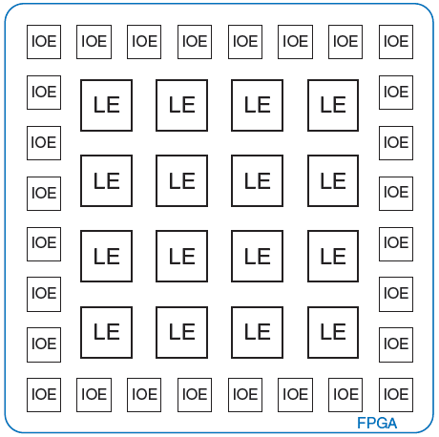
General FPGA Layout

Slide 46
LE: Logic Element
Composed of:
  LUTs (lookup tables): perform combinational logic
  Flip-flops: perform sequential logic
  Multiplexers: connect LUTs and flip-flops

Slide 47
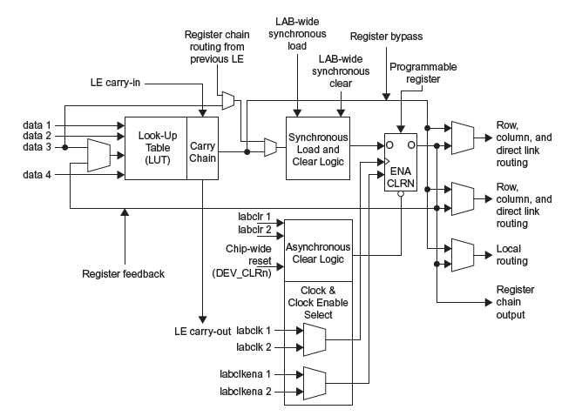
Altera Cyclone IV LE

Slide 48
Altera Cyclone IV LE
The Altera Cyclone IV LE has:
  1 four-input LUT
  1 registered output
  1 combinational output

Slide 49
LE Configuration Example
Show how to configure a Cyclone IV LE to perform the following functions:
  X = ABC + ABC
  Y = AB

Slide 50
LE Configuration Example
Show how to configure a Cyclone IV LE to perform the following functions:
  X = ABC + ABC
  Y = AB

Slide 51
LE Example: AND5
How many LEs are required to build a 5-input AND gate?
Solution: 2. First performs AND4 (function of 4 variables). Second performs AND2 of the first result and the 5th input.

Slide 52
LE Example: 8-bit shift register
How many LEs are required to build an 8-bit shift register?
Solution: 8. The shift register has 8 flip-flops, so it requires at least 8 LEs. There is no logic between flops, so 8 LEs is sufficient.

Slide 53
LE Example: 3-bit counter
How many LEs are required to build a 3-bit counter?
Solution: 3. The counter has 3 flip-flops, so it requires at least 3 LEs. The add logic for each bit is a function of less than 4 variables, so it can fit in the LUT before the flop. Hence, 3 LEs is sufficient.

Slide 54
FPGA Design Flow
Using a CAD tool (such as Altera’s Quartus II)
  Enter the design with a HDL
  Simulate the design
  Synthesize design and map it onto FPGA
  Download the configuration onto the FPGA
  Test the design
This is an iterative process!

