Slide 1
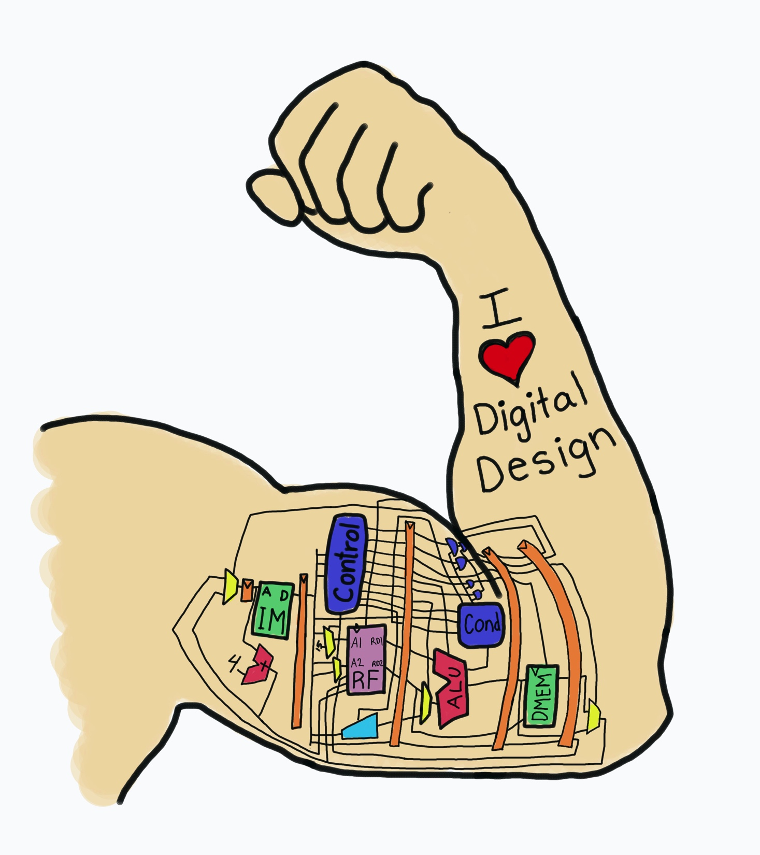
Lecture 0:
Introduction
E85 Digital Design & Computer Engineering

Slide 2
Lecture 0
Course Overview
  Learning Objectives
  Schedule
  Assignments
The Game Plan
The Art of Managing Complexity
The Digital Abstraction
Number Systems

Slide 3
Learning Objectives
Build digital systems at all levels of abstraction from transistors through circuits, logic, microarchitecture, architecture, and C culminating with implementing and programming a microprocessor soft core on a field programable gate array.
Manage complexity using the digital abstraction, data types, static and dynamic disciplines, and hierarchical design.
Design and implement combinational and sequential digital circuits using schematics and hardware description languages.

Slide 4
Learning Objectives Cont.
Program a commercial microcontroller in C and assembly language and use it in a physical system.
Begin the practice of implementing and debugging digital systems with appropriate lab techniques including breadboarding, interpreting datasheets, and using field-programmable gate arrays and microcontroller boards, simulators, debuggers, and test-and-measurement equipment.

Slide 5
Big Picture
Start from the fundamentals so you understand why, not just how.
  What makes the system tick on the inside?
Some of you will become computer engineers.
  This material is the foundation of your career.
Most of you will pursue other paths.
  Digital systems are a tremendously valuable tool in your toolbox.
  This course will get you to the point you can be dangerous!
  Skills about managing complexity, designing nontrivial systems, debugging carry over to other fields.
  Programmable microprocessors are one of humanities great ideas.
  Computing has fundamentally changed the world we live in.
If you like this course, take E155 next Fall.

Slide 6
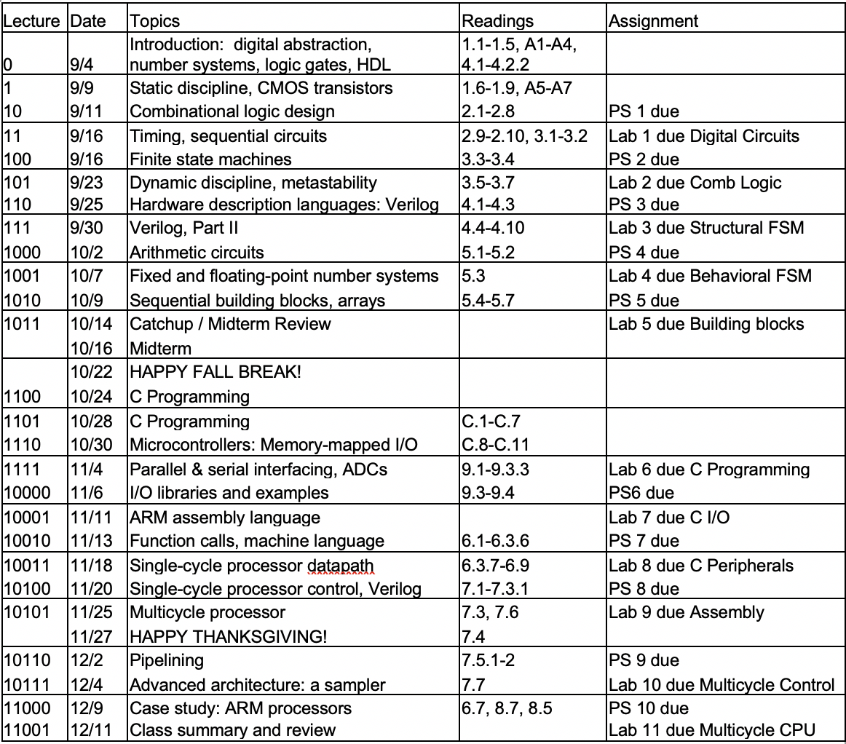
Schedule

Slide 7
Assignments
Mondays: Labs (30%)
  Must complete Lab 11 to pass the class
  Digital Lab Tutoring Sat 12-2, Sun 12-6
Wednesdays: Problem Sets (20%)
  TBP Tutoring Sunday 8-9, Monday 7-9 Platt
Midterm & Final (50%)
You can have a 1-week extension on one assignment
  Just turn it in with your assignment next week
Your lowest lab and problem set score will be dropped

Slide 8
Collaboration Policy
Speak with other students, instructor, tutors AFTER you have made an effort by yourself.
  Ask about tool issues in the lab!
Turn in your own work. Not identical to others.
  Don’t sit at adjacent computers and work in lockstep.
  Pair programming prohibited.
Credit classmates with whom you discussed ideas.
Don’t refer to old solutions!

Slide 9
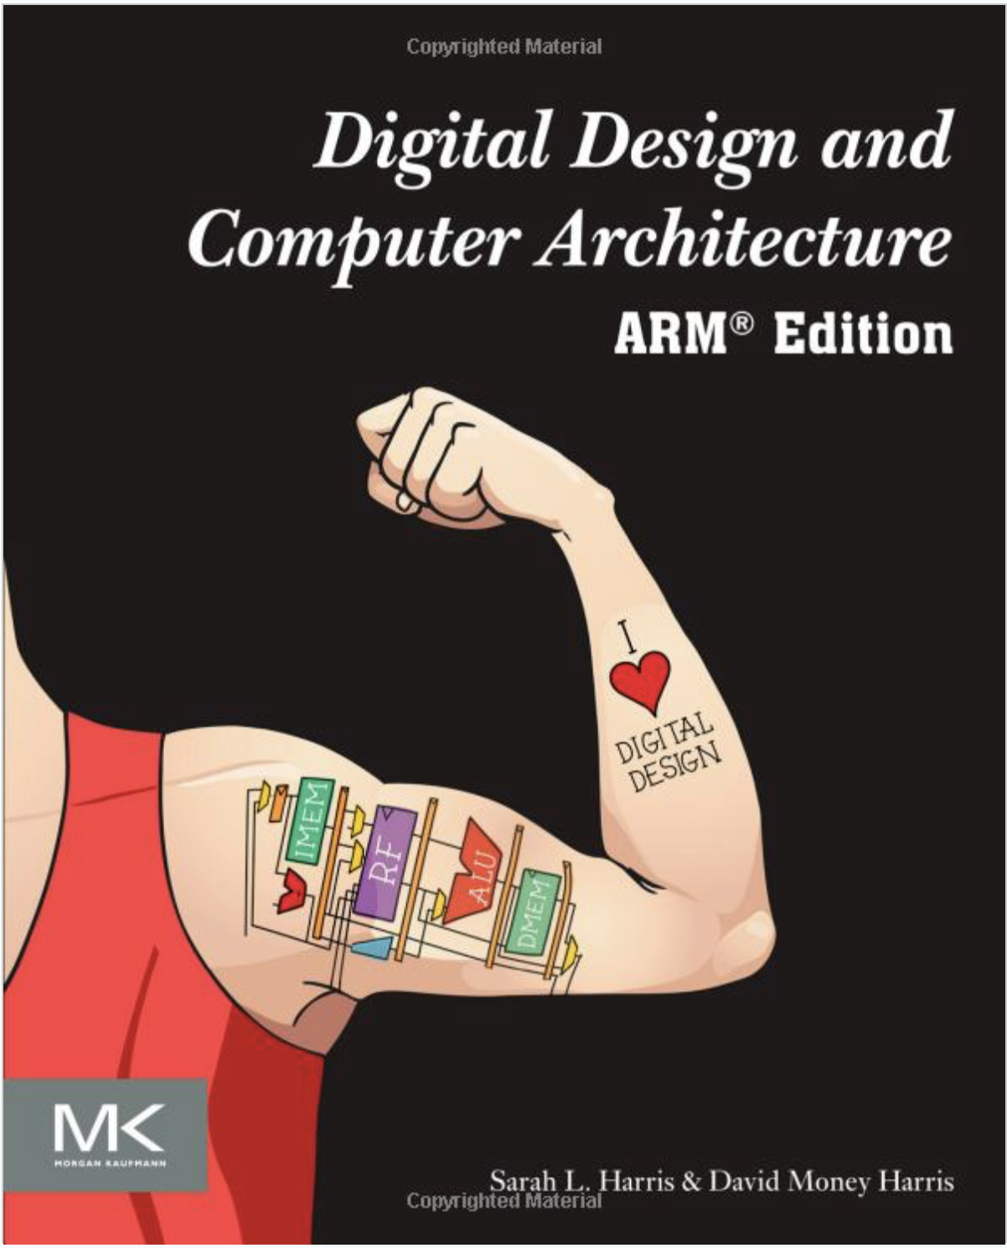
Textbook
Many students have found it enjoyable and useful
  Suggest reading before class, come with questions
  Reread key parts as you are doing the assignments
Not everything in the assignments is covered in lecture.
Copies available in the Eng. Lounge and Digital Lab.

Slide 10
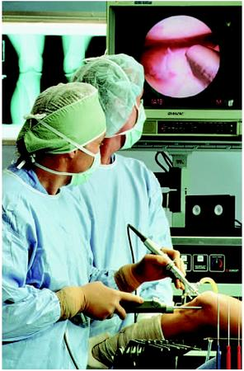

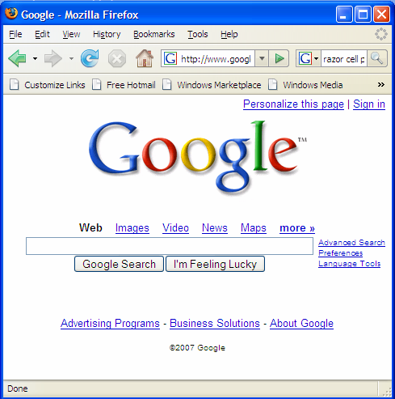
Background
Microprocessors have revolutionized our world
  Cell phones, Internet, rapid advances in medicine, etc.
The semiconductor industry has grown from $21 billion in 1985 to $412 billion in 2017

Slide 11
The Art of Managing Complexity
Abstraction
Discipline
The Three –y’s
  Hierarchy
  Modularity
  Regularity

Slide 12
Abstraction
Hiding details when they aren’t important

Slide 13
Discipline
Intentionally restrict design choices
Example: Digital discipline
  Discrete voltages instead of continuous
  Simpler to design than analog circuits – can build more sophisticated systems
  Digital systems replacing analog predecessors: i.e., digital cameras, digital television, cell phones, CDs

Slide 14
The Three -y’s
Hierarchy
  A system divided into modules and submodules
Modularity
  Having well-defined functions and interfaces
Regularity
  Encouraging uniformity, so modules can be easily reused

Slide 15
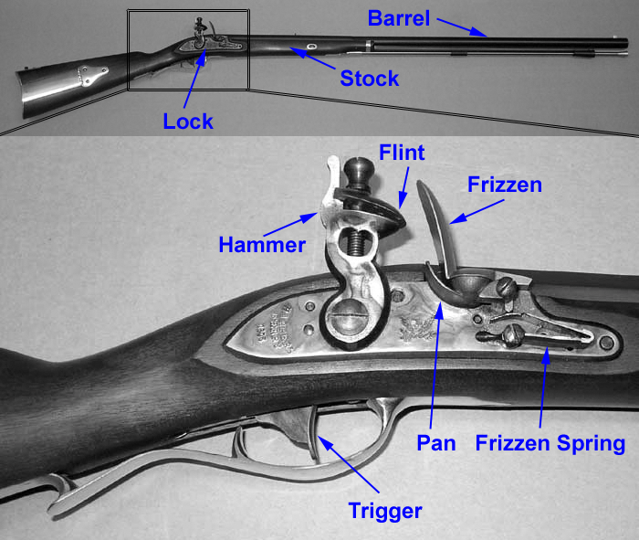
Example: The Flintlock Rifle
Hierarchy
  Three main modules: lock, stock, and barrel
  Submodules of lock: hammer, flint, frizzen, etc.

Slide 16
Example: The Flintlock Rifle
Modularity
  Function of stock: mount barrel and lock
  Interface of stock: length and location of mounting pins
Regularity
  Interchangeable parts

Slide 17
The Digital Abstraction
Most physical variables are continuous
  Voltage on a wire
  Frequency of an oscillation
  Position of a mass
Digital abstraction considers discrete subset of values

Slide 18
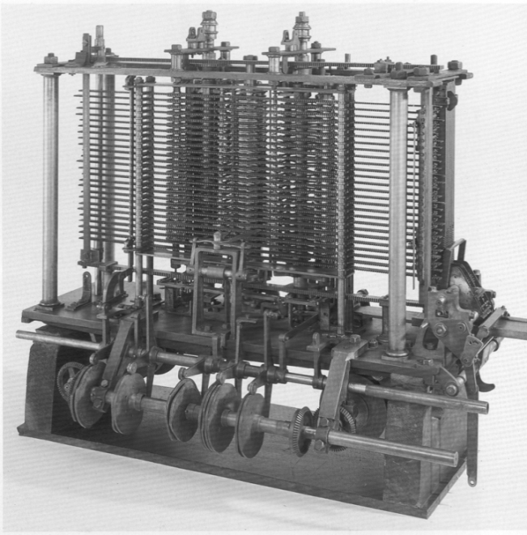
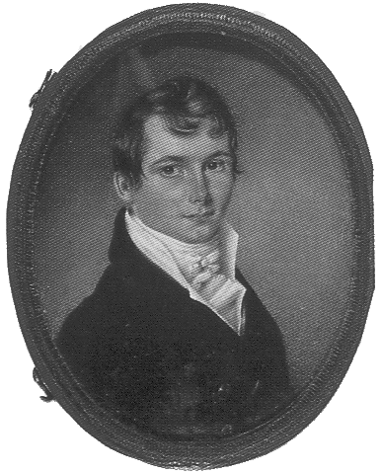
The Analytical Engine
Designed by Charles Babbage from 1834 – 1871
Considered to be the first digital computer
Built from mechanical gears, where each gear represented a discrete value (0-9)
Babbage died before it was finished

Slide 19
Digital Discipline: Binary Values
Two discrete values:
  1’s and 0’s
  1, TRUE, HIGH
  0, FALSE, LOW
1 and 0: voltage levels, rotating gears, fluid levels, etc.
Digital circuits use voltage levels to represent 1 and 0
Bit: Binary digit

Slide 20
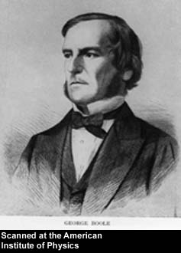
George Boole, 1815-1864
Born to working class parents
Taught himself mathematics and joined the faculty of Queen’s College in Ireland
Wrote An Investigation of the Laws of Thought (1854)
Introduced binary variables
Introduced the three fundamental logic operations: AND, OR, and NOT

Slide 21
Number Systems
Decimal numbers
Binary numbers

Slide 22
Powers of Two
2⁰ = 1
2¹ = 2
2² = 4
2³ = 8
2⁴ = 16
2⁵ = 32
2⁶ = 64
2⁷ = 128
2⁸ = 256
2⁹ = 512
2¹⁰ = 1024
2¹¹ = 2048
2¹² = 4096
2¹³ = 8192
2¹⁴ = 16384
2¹⁵ = 32768
Handy to memorize

Slide 23
Number Conversion
Binary to decimal conversion:
  Convert 10011₂ to decimal
  16×1 + 8×0 + 4×0 + 2×1 + 1×1 = 19₁₀
Decimal to binary conversion:
  Convert 47₁₀ to binary
  32×1 + 16×0 + 8×1 + 4×1 + 2×1 + 1×1 = 101111₂

Slide 24
Decimal to Binary Conversion
Two methods:
  Method 1: Find the largest power of 2 that fits, subtract and repeat
  Method 2: Repeatedly divide by 2, remainder goes in next most significant bit

Slide 25
Decimal to Binary Conversion
  53₁₀
  Method 1: Find the largest power of 2 that fits, subtract and repeat
  53₁₀ 32×1
  53-32 = 21 16×1
  21-16 = 5 4×1
  5-4 = 1 1×1 = 110101₂
Method 2: Repeatedly divide by 2, remainder goes in next most significant bit
  53₁₀ = 53/2 = 26 R1
  26/2 = 13 R0
  13/2 = 6 R1
  6/2 = 3 R0
  3/2 = 1 R1
  1/2 = 0 R1 = 110101₂

Slide 26
Decimal to Binary Conversion
  Another example: Convert 75₁₀ to binary.
  75₁₀= 64 + 8 + 2 + 1 = 1001011₂
or
75/2 = 37 R1
37/2 = 18 R1
18/2 = 9 R0
9/2 = 4 R1
4/2 = 2 R0
2/2 = 1 R0
1/2 = 0 R1

Slide 27
Binary Values and Range
N-digit decimal number
  How many values? 10^{N}
  Range? [0, 10^{N} - 1]
  Example: 3-digit decimal number:
    10³ = 1000 possible values
    Range: [0, 999]
N-bit binary number
  How many values? 2^{N}
  Range: [0, 2^{N} - 1]
  Example: 3-digit binary number:
    2³ = 8 possible values
    Range: [0, 7] = [000₂ to 111₂]

Slide 28
Hexadecimal Numbers
Hex Digit | Decimal Equivalent | Binary Equivalent
0 | 0 | 0000
1 | 1 | 0001
2 | 2 | 0010
3 | 3 | 0011
4 | 4 | 0100
5 | 5 | 0101
6 | 6 | 0110
7 | 7 | 0111
8 | 8 | 1000
9 | 9 | 1001
A | 10 | 1010
B | 11 | 1011
C | 12 | 1100
D | 13 | 1101
E | 14 | 1110
F | 15 | 1111

Slide 29
Hexadecimal Numbers
Base 16
Shorthand for binary

Slide 30
Hexadecimal to Binary Conversion
Hexadecimal to binary conversion:
  Convert 4AF₁₆ (also written 0x4AF) to binary
  0100 1010 1111₂
Hexadecimal to decimal conversion:
  Convert 4AF₁₆ to decimal
  16²×4 + 16¹×10 + 16⁰×15 = 1199₁₀

Slide 31
Bits, Bytes, Nibbles…
Bits
Bytes & Nibbles
Bytes

Slide 32
Large Powers of Two
2¹⁰ = 1 kilo ≈ 1000 (1024)
2²⁰ = 1 mega ≈ 1 million (1,048,576)
2³⁰ = 1 giga ≈ 1 billion (1,073,741,824)
2⁴⁰ = 1 tera ≈ 1 trillion
2⁵⁰ = 1 peta ≈ 1 quadrillion
2⁶⁰ = 1 exa ≈ 1 quintillion

Slide 33
Estimating Powers of Two
What is the value of 2²⁴?
2⁴ × 2²⁰ ≈ 16 million
How many values can a 32-bit variable represent?
2² × 2³⁰ ≈ 4 billion

Slide 34
Addition
Decimal
Binary

Slide 35
Binary Addition Examples
Add the following 4-bit binary numbers
Add the following 4-bit binary numbers

Slide 36
Overflow
Digital systems operate on a fixed number of bits
Overflow: when result is too big to fit in the available number of bits
See previous example of 11 + 6

Slide 37
Signed Binary Numbers
Sign/Magnitude Numbers
Two’s Complement Numbers

Slide 38
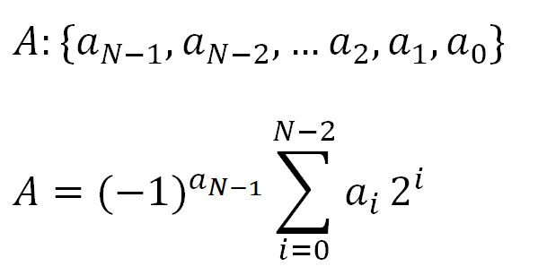
Sign/Magnitude Numbers
1 sign bit, N-1 magnitude bits
Sign bit is the most significant (left-most) bit
  Positive number: sign bit = 0
  Negative number: sign bit = 1
Example, 4-bit sign/mag representations of ± 6:
+6 = 0110
- 6 = 1110
Range of an N-bit sign/magnitude number:
[-(2^{N-1}-1), 2^{N-1}-1]

Slide 39
Sign/Magnitude Numbers
Problems:
Addition doesn’t work, for example -6 + 6:
1110
+ 0110
10100 (wrong!)
Two representations of 0 (± 0):
1000
0000

Slide 40
Two’s Complement Numbers
Don’t have same problems as sign/magnitude numbers:
  Addition works
  Single representation for 0

Slide 41
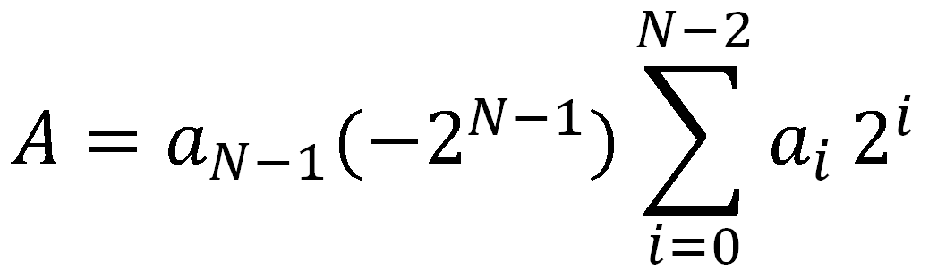
Two’s Complement Numbers
msb has value of -2^{N-1}
Most positive 4-bit number: 0111
Most negative 4-bit number: 1000
The most significant bit still indicates the sign (1 = negative, 0 = positive)
  Range of an N-bit two’s complement number:
  [-(2^{N-1}), 2^{N-1}-1]
+

Slide 42
“Taking the Two’s Complement”
“Taking the Two’s complement” flips the sign of a two’s complement number
Method:
    Invert the bits
    Add 1
Example: Flip the sign of 3₁₀ = 0011₂
    1100
    + 1
    1101 = -3₁₀

Slide 43
Two’s Complement Examples
Take the two’s complement of 6₁₀ = 0110₂
    1001
    + 1
    1010₂ = -6₁₀
What is the decimal value of the two’s complement number 1001₂?
    0110
    + 1
    0111₂ = 7₁₀, so 1001₂ = -7₁₀

Slide 44
Two’s Complement Addition
Add 6 + (-6) using two’s complement numbers
Add -2 + 3 using two’s complement numbers

Slide 45
Two’s Complement Addition
Add 6 + (-6) using two’s complement numbers
Add -2 + 3 using two’s complement numbers

Slide 46
Increasing Bit Width
Extend number from N to M bits (M > N) :
  Sign-extension
  Zero-extension

Slide 47
Sign-Extension
Sign bit copied to msb’s
Number value is same
Example 1:
  4-bit representation of 3 = 0011
  8-bit sign-extended value: 00000011
Example 2:
  4-bit representation of -5 = 1011
  8-bit sign-extended value: 11111011

Slide 48
Zero-Extension
Zeros copied to msb’s
Value changes for negative numbers
Example 1:
  4-bit value = 0011 = 3₁₀
  8-bit zero-extended value: 00000011 = 3₁₀
Example 2:
  4-bit value = 1011 = -5₁₀
  8-bit zero-extended value: 00001011 = 11₁₀

Slide 49
Number System Comparison
Number System | Range
Unsigned | [0, 2^{N}-1]
Sign/Magnitude | [-(2^{N-1}-1), 2^{N-1}-1]
Two’s Complement | [-2^{N-1}, 2^{N-1}-1]
For example, 4-bit representation:

