Slide 1
Introduction to the Machine Shop
Harvey Mudd College
Johnson and Vincent
HMC Head Shop Proctors

Slide 2
Outline
Logistics
Shop Safety
Advice
Preview of the Tours

Slide 3
Logistics
Safety training – 4 parts
This presentation
In-Shop tours
Shop videos
Safety quiz (due by Feb 15th)
Some machines require additional training
Table saw
Miter saw
and others
Contact Paul or either of us to arrange training

Slide 4
More on Logistics
Buddy System
A shop proctor must be present for anyone to work in the shop.
In extreme cases, Paul can substitute for a proctor.
ID-card checkout system
All equipment in the main shop must be checked out
Check in with the proctor on duty if you are working in one of the other shops
Leave time to clean up before you leave
You can ask the shop proctor about anything
Notes:
Stress cleaning up

Slide 5
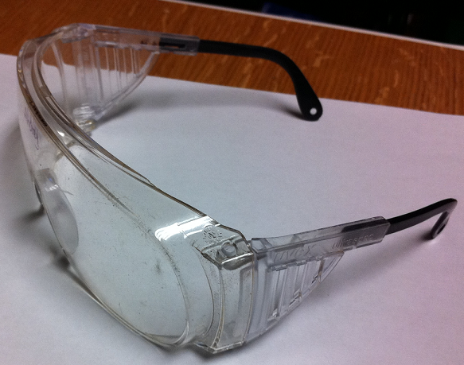
Shop Safety
Safety goggles
Must be worn at all times when in the shop.
Must have side guards.
Must have safety rating of Z87.1-1989

Slide 6
Proper Shop Attire
Roll up long sleeves
Remove loose jewelry, such as rings & watches
No dangling earphones
Don’t wear gloves when working with moving parts
Protective shoes
Long pants are preferable
Notes:
Shoes that give protection, not just cloth keds/toe shoes

Slide 7
Yale Incident
Tie back long hair
NEVER work alone (there should always be at least 1 other person there)

Slide 8
More Shop Safety
Never:
Get close to a moving part
Reach where you can’t see
Leave your machine unattended
Distract someone who’s working on a machine
Always:
Mind the point of operation
Think ahead
Pay attention to a machine when it’s turned on
Work with a proctor on duty

Slide 9
Working on a Machine is like Driving
You must be focused on the task at hand
The shop is full of powerful machines that can kill you if misused
Only machine when you are alert and focused
Set your phone to silent (do not call or text anyone while machining)
Do not come to the shop if you are under the influence
Shop proctors have the power to kick you out of the shop if you don’t follow the appropriate safety guidelines!

Slide 10
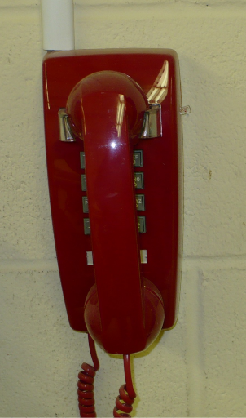
How to Deal with Injuries
Report all injuries to the shop proctor on duty
There are first aid kits in each shop, above the sink
In case of an emergency, dial campus safety
The red phone in the shop is a direct line
72000 on a school phone
909-607-2000 on any phone
Notes:
Red phone > bad shop signal

Slide 11
Advice
Start early
Plan shop visits into your regular schedule
Come prepared to start machining
Watch the videos and read your process router!
http://www.eng.hmc.edu/E8/Videos.htm
You can always cut it smaller, but you can never cut it bigger!
Always clean up: pay it forward

Slide 12
In-Shop Tours
Specific safety information and tips for each machine
Mill
Sheet Metal Shop
Hole puncher
Bender
Band Saw
Wood Shop
Band Saw
Belt Sander
Drill Press

Slide 13
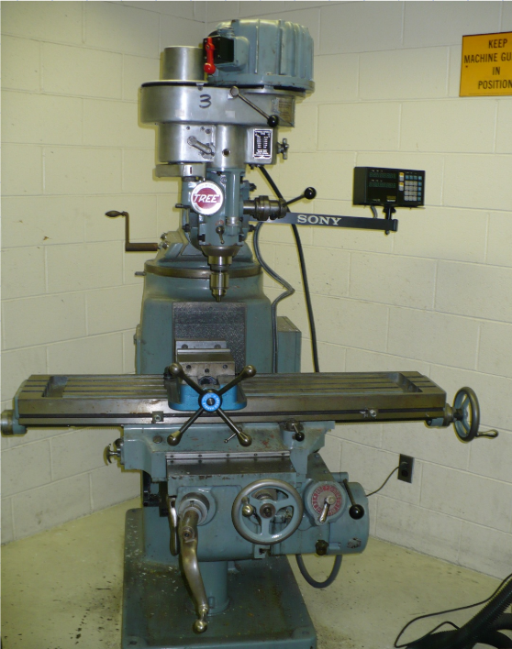
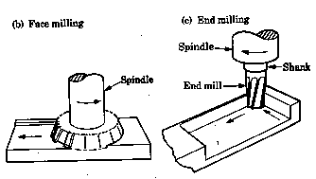
Mill

Slide 14
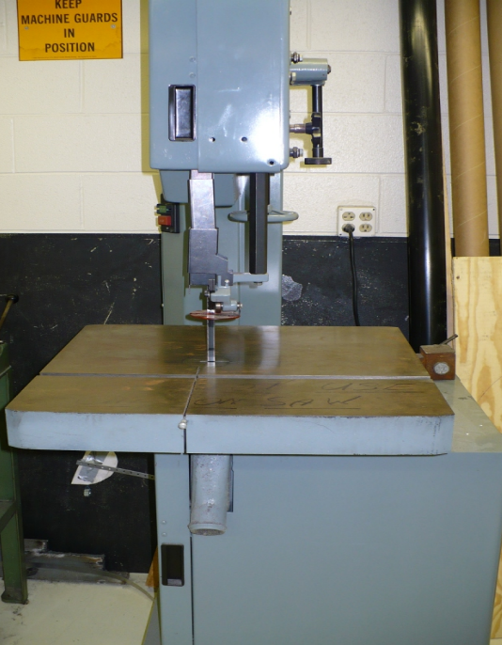
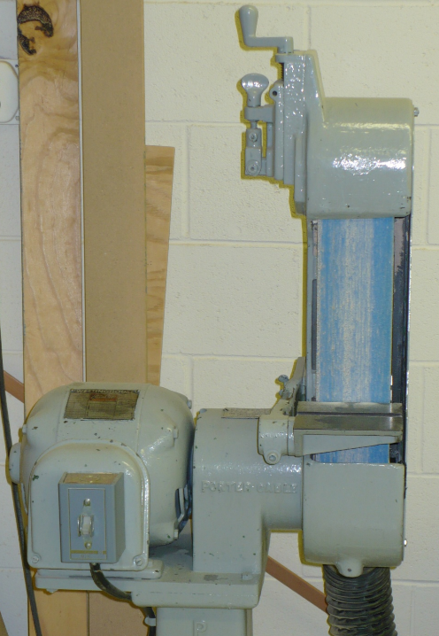
Band Saw & Belt Sander

Slide 15
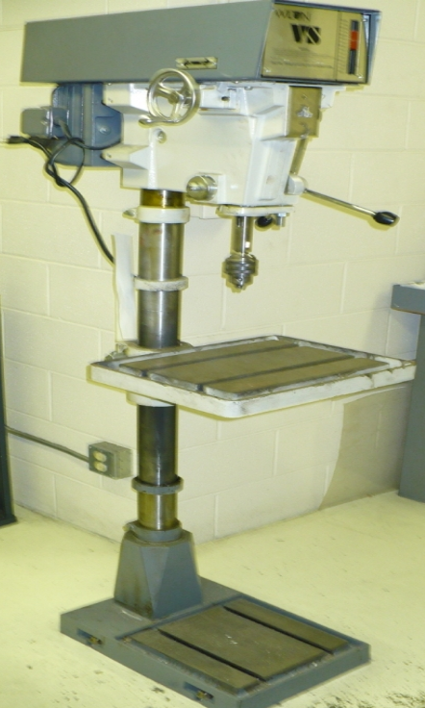
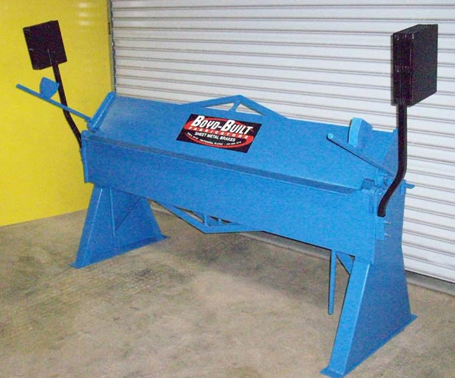
Bender & Drill Press

Slide 16
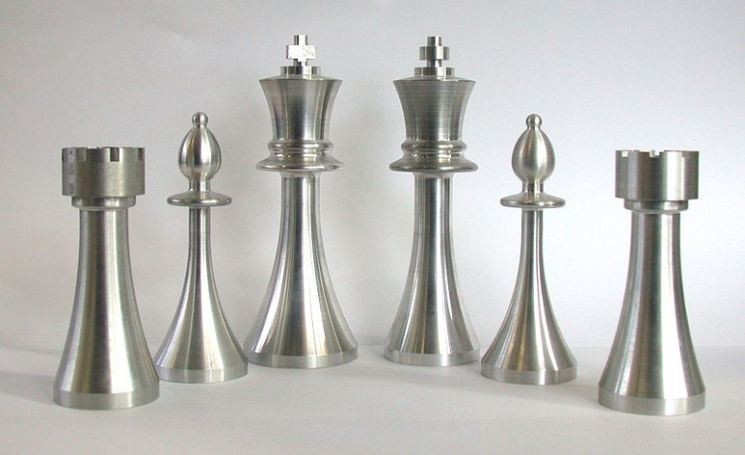
Questions?

